Slide 1
12_2_ThreeJS_3
Computer Graphics

Slide 2
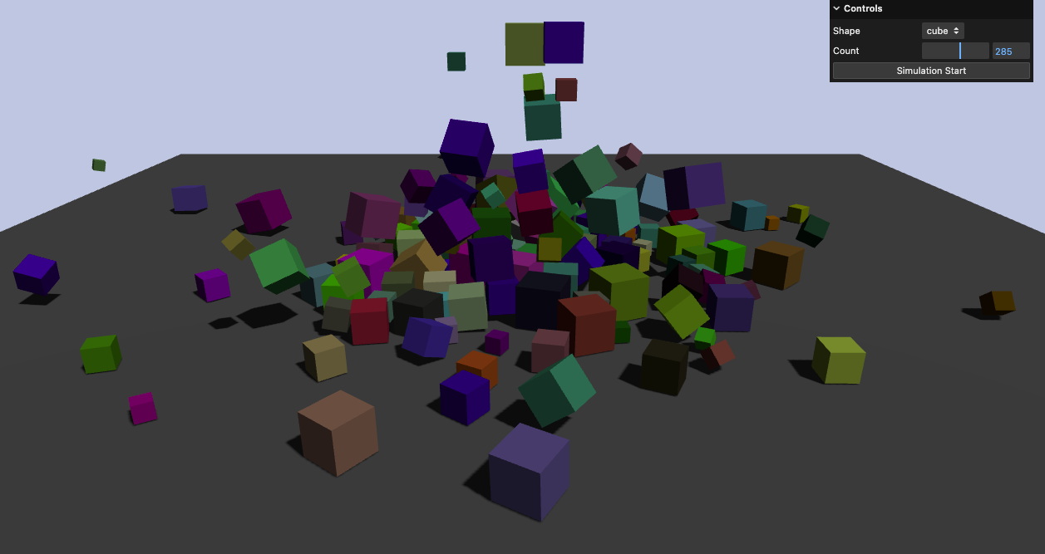
13-rapier-physics

Slide 3
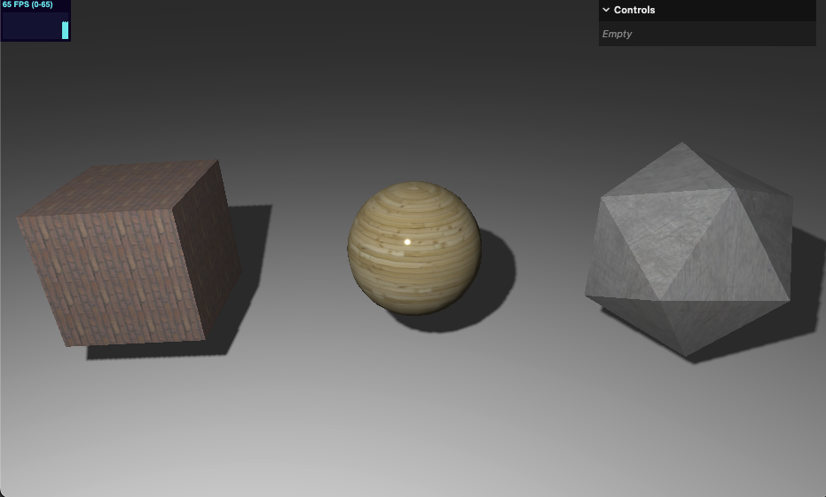
14-basic-texture

Slide 4
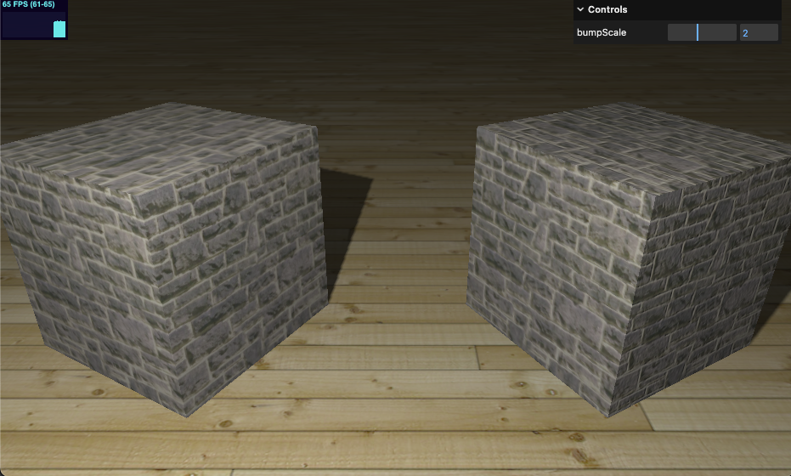
15-bump-map

Slide 5
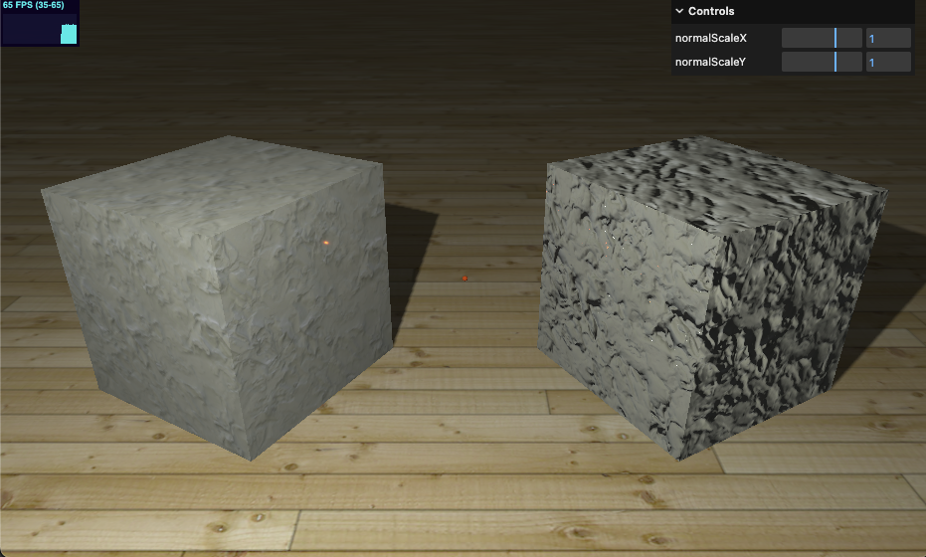
16-normal-map

Slide 6
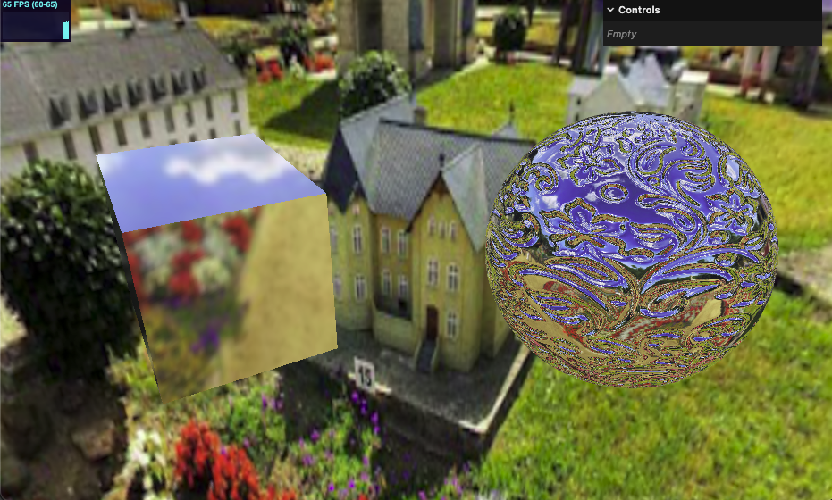
17-env-map-static

