Slide 1
13_2_ThreeJS_4
Computer Graphics

Slide 2
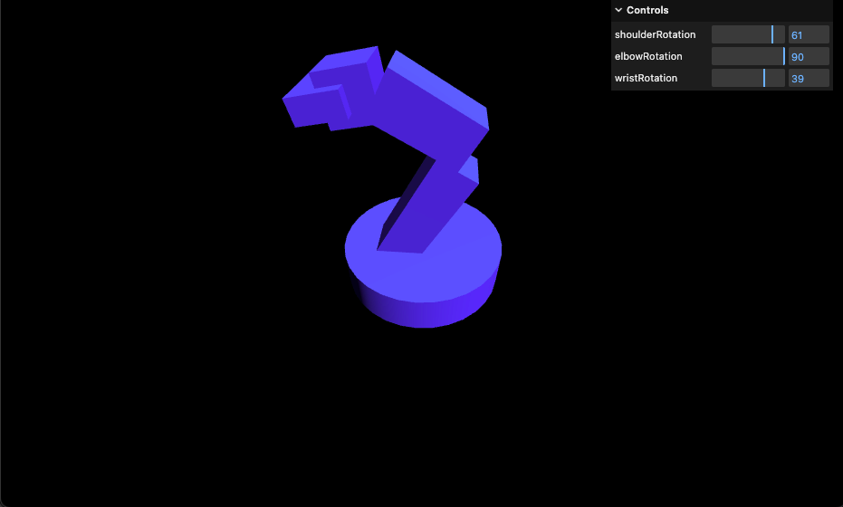
18-scene-graph

Slide 3
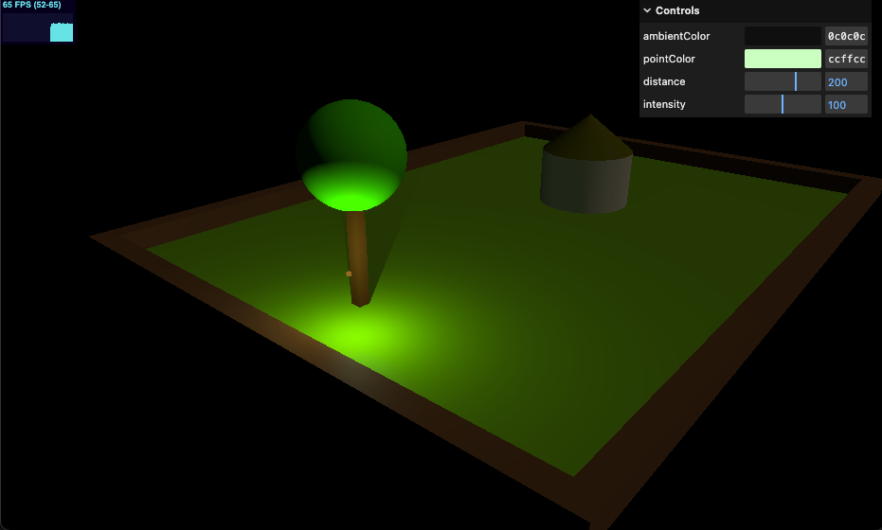
19-point-light

Slide 4
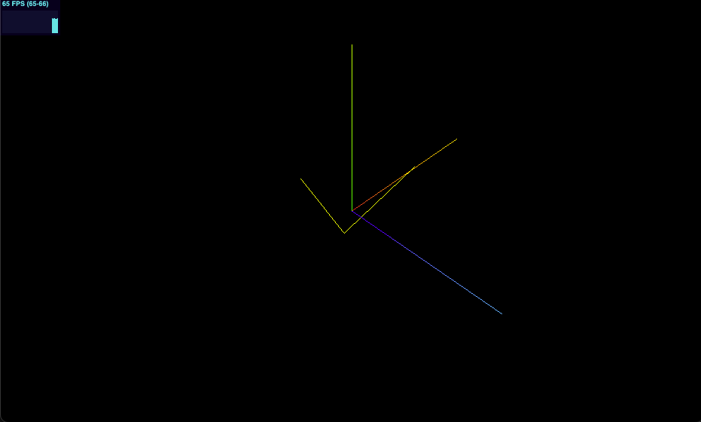
20-line-material

Slide 5
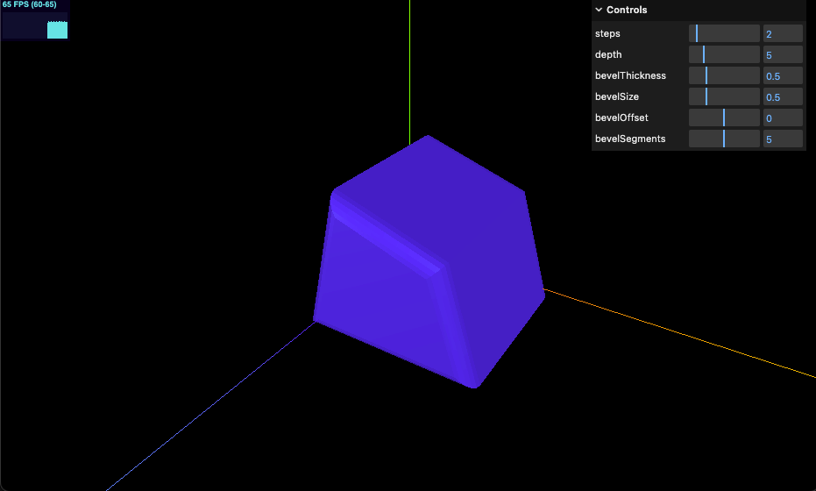
21-extrude-geometry

Slide 6
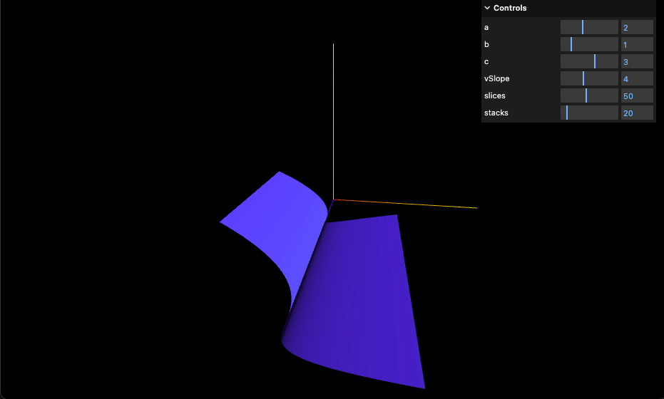
22-parametric-geometry

Slide 7
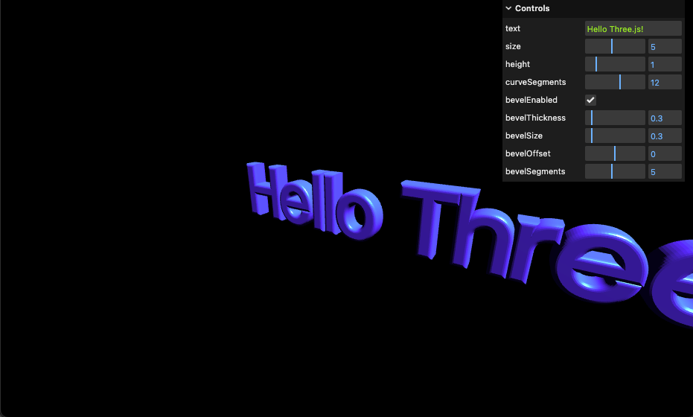
23-text-geometry

Slide 8
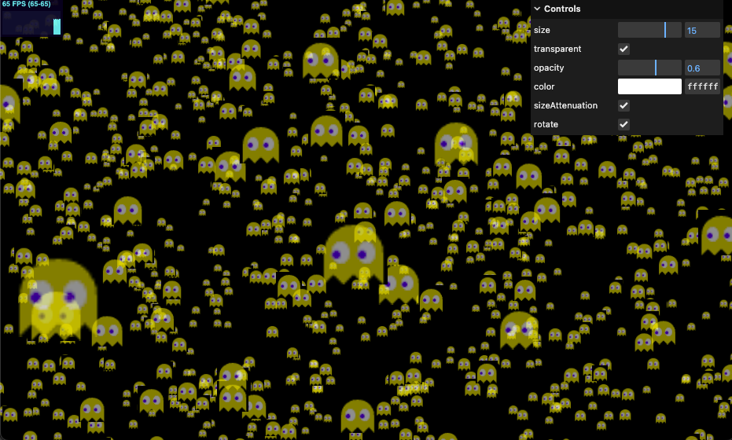
24-program-based-points

Slide 9
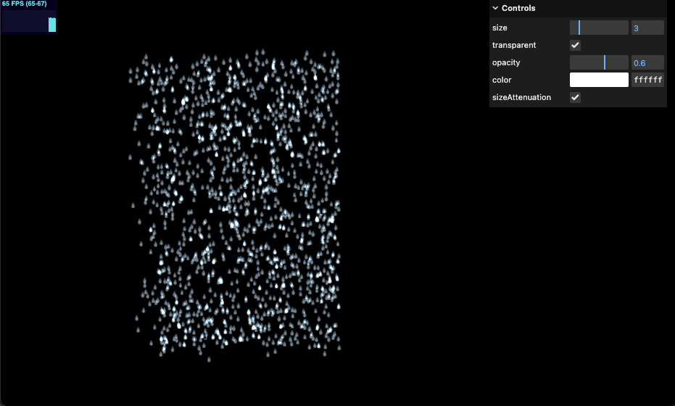
25-rainy-scene

Slide 10
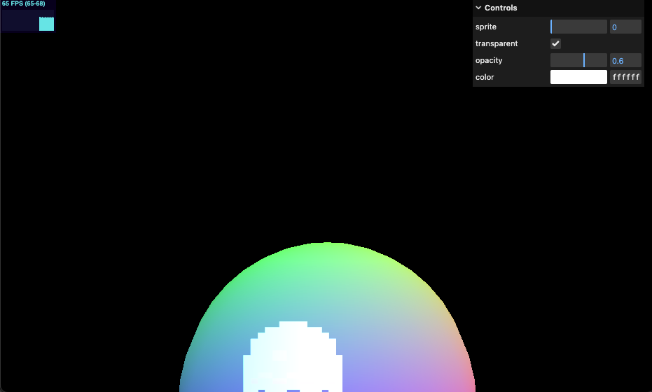
26-sprites

