Slide 1
Web Architecture, Standards and Protocols

Slide 2
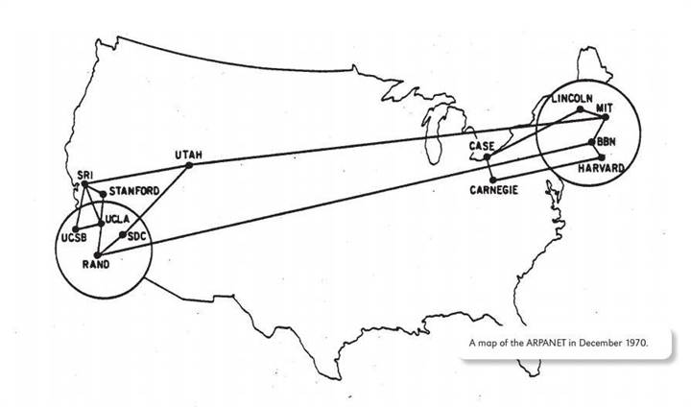
Internet versus WWW
Internet : network of networks
Notes:
In 1958, DoD founded the Advanced Research Projects Agency (ARPA), which in turn created the ARPANET in 1969, a network of mainframe computers at major universities.
Question 1: Is Internet same as WWW?

Slide 3
Internet
It is the infrastructure that connects networks across the world, including both the hardware (computers, servers, cables and more) and the software.
When you use an app on your phone, send an instant message, transfer a file directly from one computer to another via file transfer protocol (FTP) or simply send an email, you are using the Internet – but not necessarily the Web.

Slide 4
WWW
WWW is just another avenue for transmitting data over the Internet
In this case, by entering a string of characters called a uniform resource locator (URL) into a browser
This URL describes the location of a document written in HyperText Markup Language (HTML)

Slide 5
TCP/IP Protocols
TCP/IP is a family of protocols for communication between computers
TCP - Transmission Control Protocol is responsible for breaking data down into small packets before they can be sent over a network, and for assembling the packets again when they arrive
IP - Internet Protocol: takes care of the communication between computers. It is responsible for addressing, sending and receiving the data packets over the Internet

Slide 6
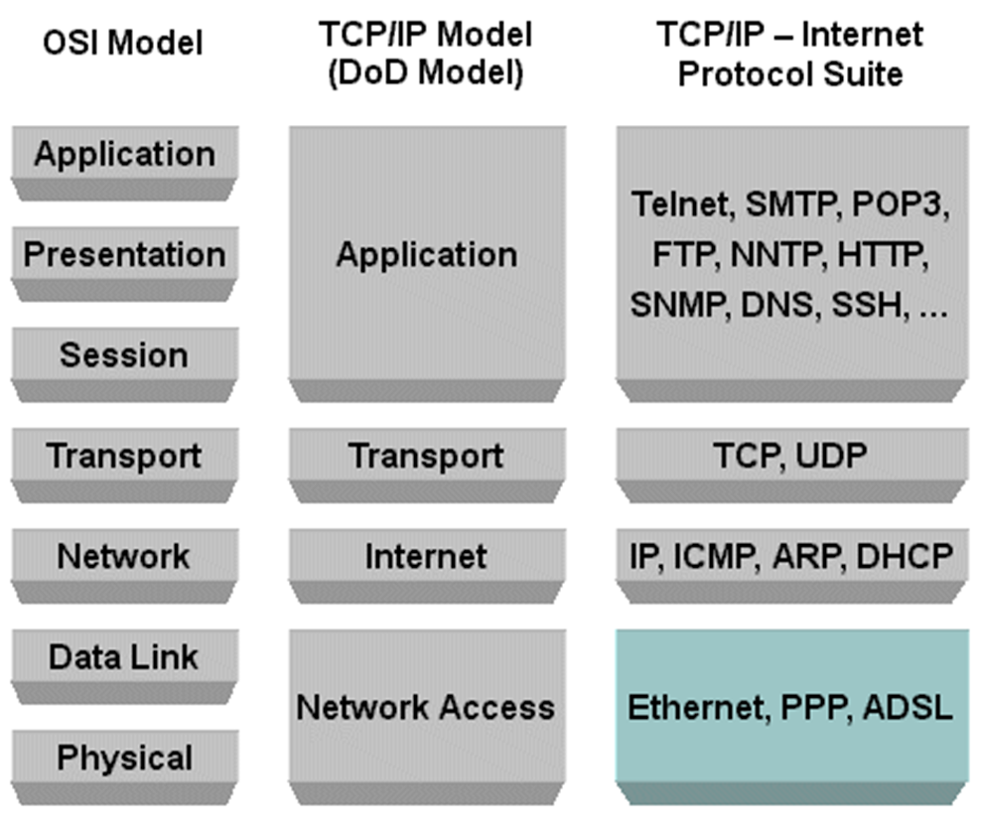
TCP/IP Protocols
Notes:
The Open Systems Interconnection model (OSI) is a conceptual model that characterizes and standardizes the internal functions of a communication system by partitioning it into abstraction layers.

Slide 7
TCP/IP Protocols for the Web
Common TCP/IP protocols for the Web:
HTTP – Hypertext Transfer Protocol
HTTPS – Secure HTTP
takes care of secure communication between a web server and a web browser. HTTPS typically handles credit card transactions and other sensitive data
FTP – File Transfer Protocol
takes care of transmission of files between computers.

Slide 8
HTTP
The communication between client and server takes place using the Hypertext Transfer Protocol (HTTP)
The Hypertext Transfer Protocol (HTTP) is an application layer protocol
HTTP is the foundation of data communication for the World Wide Web

Slide 9
HTTP
HTTP is used for sending requests from a web client (a browser) to a web server, returning web content (web pages) from the server back to the client.
It’s a request-response protocol in a client-server computing model
The client (e.g. browser) submits an HTTP request message to the server (e.g. web site)
The server provides resources such as HTML files and other content, or performs other functions as per the client’s request, returns a response message to the client

Slide 10
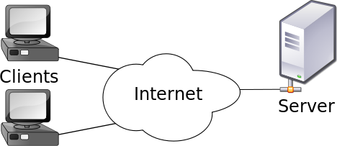
Web Architecture
Client-server model
The client–server model of computing is a distributed application structure that partitions tasks or workloads between the providers of a resource or service, called servers, and service requesters, called clients

Slide 11
Web Architecture
Often clients and servers communicate over a computer network on separate hardware.
A server host runs one or more server programs which share their resources with clients. A client does not share any of its resources, but requests a server's content or service function.
Examples of computer applications that use the client–server model are Email, network printing, and the World Wide Web.
Notes:
Clients therefore initiate communication sessions with servers which await incoming requests.

Slide 12
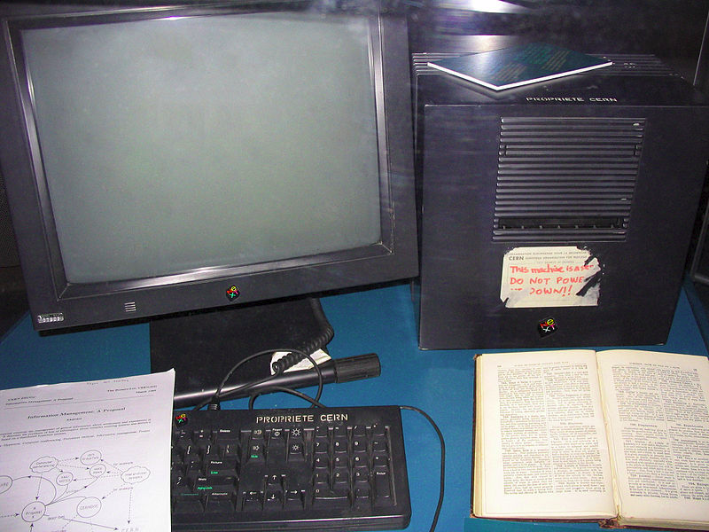
Web Architecture
The worlds’ first web server
Notes:
This NeXT Computer used by Tim Berners-Lee at CERN became the world's first web server
CERN: European Council for Nuclear Research

Slide 13
Tools and Technologies
History
Tim Berners-Lee proposed a new project in 1989
Goal: easing the exchange of information between scientists by using a hypertext system.
The project resulted in Berners-Lee writing two programs in 1990:
1. A browser called WorldWideWeb.
2. The world's first web server, later known as CERN httpd, which ran on NeXTSTEP
Notes:
CERN: European Council for Nuclear Research
Question 2: What is hypertext?

Slide 14
Tools and Technologies
Web Browsers
The web's usefulness and growth depends on its universality
We should be able to access and publish information regardless of the software, hardware, language, whether we are wired or wireless
We should be able to access the web from any kind of hardware that can connect to the Internet – stationary or mobile, small or large
Web browsers allow all of us to explore a universal space of web content

Slide 15
Tools and Technologies
Web Servers
helps to deliver web content that can be accessed through the Internet
hardware/software that accepts HTTP requests and return HTTP responses with optional data content
may respond with a static HTML page or image, send a redirect, or delegate the dynamic response generation to some other program such as CGI scripts, ASPs, PHPs
generate a response, most often in HTML, for viewing in a browser

Slide 16
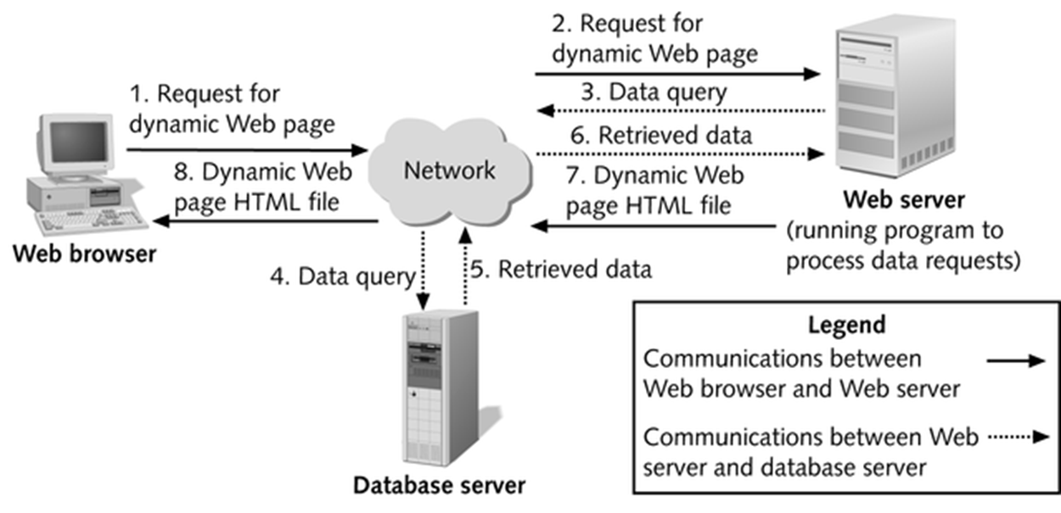
Web Servers
3-tier client-server architecture

Slide 17
Web Servers
Apache, Apache
IIS, Microsoft
Nginx, NGINX, Inc.
GWS, Google

Slide 18
Tools and Technologies
Application Servers
exposes business logic to client applications through various protocols, possibly including HTTP
while a Web Server mainly deals with sending HTML for display in a Web browser, an application server provides access to business logic for use by client application programs
the application program can use this logic just as it would call a method on an object (or a function in the procedural world)

Slide 19
Application Servers
information traveling back and forth between an application server and its client is not restricted to simple display markup but the information is program logic
logic takes the form of data and method calls and not static HTML, the client can employ the exposed business logic however it wants
WebSphere (IBM), WebLogic (Oracle), Tomcat (Apache), Jboss (Jboss/RedHat) are some popular App Servers

Slide 20
Tools and Technologies
Client-side
HTML/CSS
Bootstrap
JavaScript
Jquery
AngularJS
Angular
React
Server-side
ASP
ASP.NET
Perl
PHP, e.g. CakePHP
Python, e.g. Django
Ruby, e.g. Ruby on Rails
Node.js

Slide 21
Web Standards
W3C publishes documents that define Web technologies
These documents follow a process designed to promote consensus, fairness, public accountability, and quality
At the end of this process, W3C publishes Recommendations, which are considered Web standards

Slide 22
Web Standards
List of Web standards:
http://www.w3.org/TR/tr-date-stds.html
Some interesting standards:
HTML, XHTML, CSS
XML related: XPath, XSLT, DOM
Semantic Web related: RDF, RDFS, OWL, SPARQL
Web Services related: Core, SOAP
Notes:
SOAP: Simple Object Access protocol, is a protocol specification for exchanging structured information in the implementation of web services in computer networks.
As an example of what SOAP procedures can do, an application can send a SOAP message to a server that has web services enabled—such as a real-estate price database—with the parameters for a search. The server then returns an XML-formatted document with the resulting data, e.g., prices, location, features. With the data returned in a standardized machine-parsable format, it can then be integrated directly into the requesting application.

