Slide 1
PHP

Slide 2
PHP Introduction
PHP is a recursive acronym (or backronym) for “PHP: Hypertext Preprocessor”
PHP is a widely-used open source general-purpose scripting language that is especially suited for web development and can be embedded into HTML
As of December 2017, PHP makes up over 83% of server side languages used on the internet. Much of that is made up of PHP-based content management systems such as WordPress, but even if you remove pre-built CMS from the equation, PHP still makes up over 54% of the web.
PHP runs on different platforms (Windows, Linux/Unix, etc.)‏
PHP is compatible with almost all servers used today (Apache, IIS, etc.)‏
PHP is FREE to download from the official PHP resource: www.php.net
PHP is easy to learn and runs efficiently on the server side
Notes:
As of December 2017, PHP makes up over 83% of server side languages used on the internet. Much of that is made up of PHP-based content management systems such as WordPress, but even if you remove pre-built CMS from the equation, PHP still makes up over 54% of the web.

Slide 3
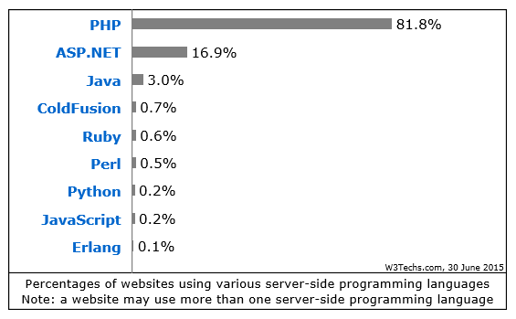
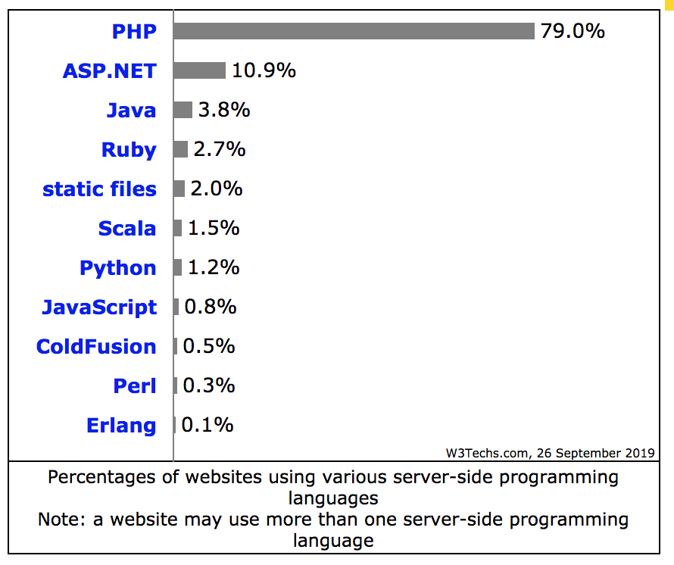
Market Share
This diagram shows the percentages of websites using various server-side programming languages. The reports are updated daily. PHP is used by 81.8% of all the websites whose server-side programming language we know. (Survey on June 29, 2015)
Notes:
http://w3techs.com/technologies/overview/programming_language/all
Server-side JavaScript (Node.js) is currently the fastest growing server-side technology.

Slide 4
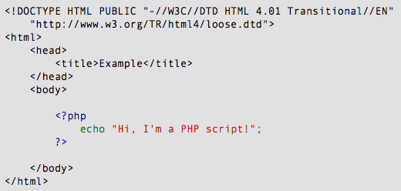
PHP Introduction
Instead of lots of commands to output HTML (as seen in C or Perl), PHP pages contain HTML with embedded code that does "something"
The PHP code is enclosed in special start and end processing instructions <?php and ?> that allow you to jump into and out of "PHP mode."

Slide 5
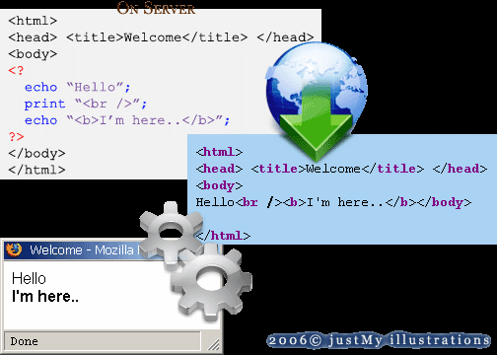
PHP Introduction
PHP code is executed on the server, generating HTML which is then sent to the client. The client would receive the results of running that script, but would not know what the underlying code was.

Slide 6
PHP Introduction
PHP files:
contain text, HTML, CSS, JavaScript, and PHP code
are executed on the server, and the result is returned to the browser as plain HTML
have extension ".php“
PHP can:
generate dynamic page content
create, open, read, write, delete, and close files on the server
collect form data
send and receive cookies
add, delete, modify data in your database
restrict users to access some pages on your website
encrypt data
also output images, PDF files, and even Flash movies
also output any text, such as XHTML and XML

Slide 7
PHP Getting Started
For both Windows and Mac, you can download and install MAMP
http://www.mamp.info/en/index.html
Note: you might have to install additional support for PHP:
MySQL/PostgreSQL
XML
SOAP

Slide 8
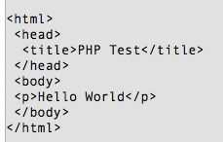
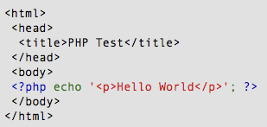
PHP Hello World
Sample program to display “Hello World” using the PHP echo() statement.
HTML returned to client (e.g. web browser)
from HelloWorld.php on Server
HelloWorld.php on Server

Slide 9
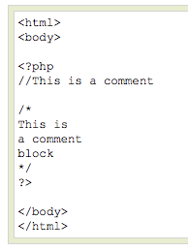
PHP Comments
Use // to make a single-line comment or /* and */ to make a large comment block

Slide 10
PHP Variables
All variables in PHP start with a $ sign symbol
Variables are used for:
storing values, like text strings, numbers or arrays (e.g. $y=5)
hold expressions ($z=$x+$y)
A variable name:
must start with a letter or the underscore character
cannot start with a number
can only contain alpha-numeric characters and underscores (A-z, 0-9, and _ )
is case sensitive i.e. $lower and $LOWER are two different variables
should not contain spaces
a variable name that is more than one word, should be separated with an underscore ($my_string) or with capitalization ($myString)‏
A variable is created when a value is assigned to it

Slide 11
PHP Variables
In PHP, a variable does not need to be declared before adding a value to it
PHP automatically converts the variable to the correct data type, depending on its value.
Examples:
$txt=“Hello World!”;
$x=16;
$y=10.5;

Slide 12
PHP Variables
Variables can be declared anywhere in the PHP script
The scope of a variable is the part of the script where the variable can be referenced/used
PHP has three different variable scopes:
Local
Global
Static
http://php.net/manual/en/language.variables.scope.php

Slide 13
PHP Variables
Local
variable declared within a function has a LOCAL SCOPE and can only be accessed within that function
Global
variable declared outside a function has a GLOBAL SCOPE and can only be accessed outside a function
<?php
$x=5; // global scope
function myTest() { $y=10; // local scope echo "<p>Test variables inside the function:<p>"; echo "Variable x is: $x"; echo "<br>"; echo "Variable y is: $y"; }
myTest(); echo "<p>Test variables outside the function:<p>"; echo "Variable x is: $x"; echo "<br>"; echo "Variable y is: $y"; ?>

Slide 14
PHP Variables
Global (continued)
Exception:
global keyword is used to access a global variable from within a function
use the global keyword before the variables (inside the function)
PHP also stores all global variables in an array called $GLOBALS[index]. The index holds the name of the variable. This array is also accessible from within functions and can be used to update global variables directly.
<?php $x=5; $y=10; function myTest() { global $x,$y; $y=$x+$y; } myTest(); echo $y; // outputs 15 ?>
<?php $x=5; $y=10; function myTest() { $GLOBALS['y']=$GLOBALS['x']+$GLOBALS['y']; } myTest(); echo $y; // outputs 15 ?>

Slide 15
PHP Variables
Static
a variable that has been allocated statically—whose lifetime or "extent" extends across the entire run of the program
<?php function myTest() { static $x=0; echo $x; $x++; } myTest(); myTest(); myTest(); ?>
Notes:
A static variable exists only in a local function scope, but it does not lose its value when program execution leaves this scope.

Slide 16
PHP Output Statements
The two PHP output statements are:
echo
output one or more strings
<?php
$txt1=“Echo this text"; $cars=array("Volvo","BMW","Toyota");
echo "<h2>PHP is fun!</h2>";
echo "<br>"; echo "This", " string", " was", " made", " with multiple strings.";
echo $txt1; echo “Again $txt2"; echo "My car is a {$cars[0]}"; ?>

Slide 17
PHP Output Statements
print
can only output one string, and returns always 1
<?php
$txt1=“Print this text"; $cars=array("Volvo","BMW","Toyota");
print "<h2>PHP is fun!</h2>";
print "<br>"; print $txt1; print “Again $txt2"; print "My car is a {$cars[0]}"; ?>
Note: output strings for both echo() and print() can contain HTML markup

Slide 18
PHP Data Types
String
a sequence of characters inside single or double quotes
$x = "Hello world!";
$x = 'Hello world!';
Integer
three formats:
Decimal
$x = 5985;
$x = -345;
Hexadecimal (prefixed with 0x)
$x = 0x8C;
octal (prefixed with 0)
$x = 047;

Slide 19
PHP Data Types
Floating Point Number
number with a decimal point or in exponential form
$x = 10.365;
$x = 2.4e3;
$x = 8E-5;
Boolean
True or false
$x=true;
$y=false;
Array
stores multiple values in one single variable
$cars=array("Volvo","BMW","Toyota");

Slide 20
PHP Data Types
Object
stores data and information on how to process that data
use class keyword to declare a structure that can contain properties and methods
create instances/objects of that class
<?php class Car { var $color; function Car($color="green") { $this->color = $color; } function what_color() { return $this->color; } } ?>

Slide 21
PHP Data Types
NULL value
NULL is the only possible value of data type NULL
NULL value represents that a variable has no value.
Variables can be emptied by setting the value to NULL
Example: $x=null;
The PHP var_dump() function returns the data type and value of variables:
<?php $a = array(1, 2, array("a", "b", "c")); var_dump($a); ?>
The above example will output:
array(3) {
[0]=>
int(1)
[1]=>
int(2)
[2]=>
array(3) {
[0]=>
string(1) "a"
[1]=>
string(1) "b"
[2]=>
string(1) "c"
}
}

Slide 22
PHP Arrays
In PHP, there are three kind of arrays:
Numeric array - An array with a numeric index
Associative array - An array where each ID key is associated with a value
Multidimensional array - An array containing one or more arrays

Slide 23

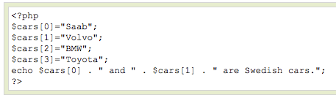
PHP Numeric Arrays
A numeric array stores each array element with a numeric index
There are two methods to create a numeric array
In the following example the index is automatically assigned (the index starts at 0):
In the following example we assign the index manually:

Slide 24

PHP Associative Arrays
With an associative array, each ID key is associated with a value
When storing data about specific named values, a numerical array is not always the best way to do it
With associative arrays we can use the values as keys and assign values to them
In this example we use an array to assign ages to the different persons:
This example is the same as the one above, but shows a different way of creating the array:

Slide 25
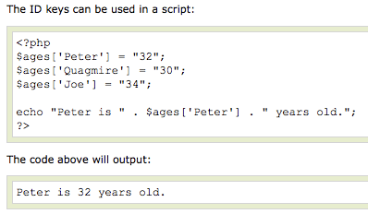
PHP Associative Arrays

Slide 26
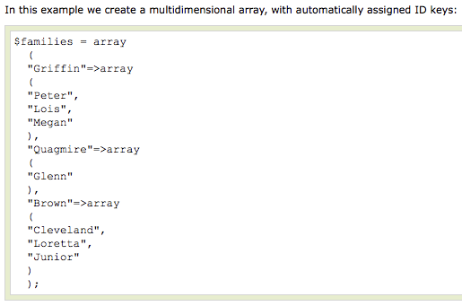
PHP Multidimensional Arrays
In a multidimensional array, each element in the main array can also be an array
And each element in the sub-array can be an array, and so on

Slide 27
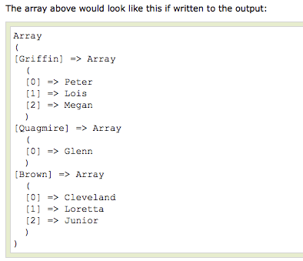
PHP Multidimensional Arrays

Slide 28
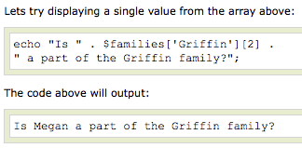
PHP Multidimensional Arrays

Slide 29
PHP Multidimensional Arrays
<?php
$cars = array ( array("Volvo",22,18), array("BMW",15,13), array("Saab",5,2), array("Land Rover",17,15) );
echo $cars[0][0].": In stock: ".$cars[0][1].", sold: ".$cars[0][2].".<br>"; echo $cars[1][0].": In stock: ".$cars[1][1].", sold: ".$cars[1][2].".<br>"; echo $cars[2][0].": In stock: ".$cars[2][1].", sold: ".$cars[2][2].".<br>"; echo $cars[3][0].": In stock: ".$cars[3][1].", sold: ".$cars[3][2].".<br>";
?>

Slide 30
PHP Concatenation
The concatenation operator (.) is used to put two string values together
To concatenate two string variables together, use the concatenation operator:
<?php
$first_name=“John"; $last_name=“Smith”;
$full_name=$first_name . $last_name; ?>

Slide 31
PHP Operators
Operators are used to operate on values. There are four classifications of operators:
Arithmetic
Assignment
Comparison
Logical

Slide 32
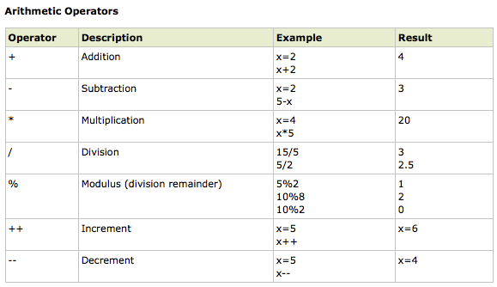
PHP Operators

Slide 33
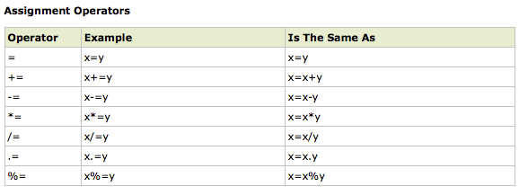
PHP Operators

Slide 34
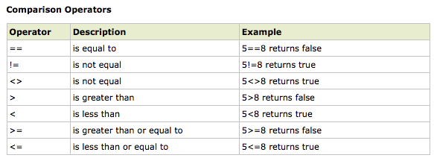
PHP Operators

Slide 35
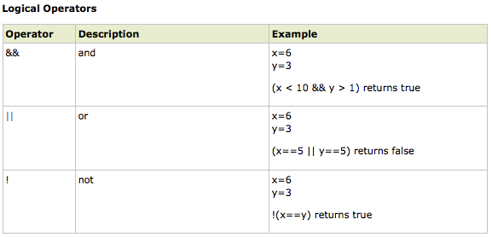
PHP Operators

Slide 36
PHP Conditional Statements
Very often when you write code, you want to perform different actions for different decisions.
PHP has the following conditional statements:
if statement - use this statement to execute some code only if a specified condition is true
if...else statement - use this statement to execute some code if a condition is true and another code if the condition is false
if...elseif....else statement - use this statement to select one of several blocks of code to be executed
switch statement - use this statement to select one of many blocks of code to be executed

Slide 37
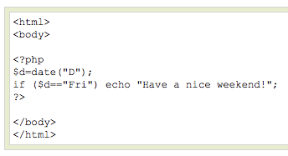
PHP Conditional Statements
The following example will output "Have a nice weekend!" if the current day is Friday:

Slide 38
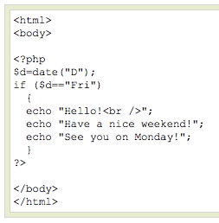
PHP Conditional Statements
If more than one line should be executed if a condition is true/false, the lines should be enclosed within curly braces { }

Slide 39
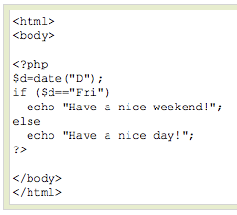
PHP Conditional Statements
Use the if....else statement to execute some code if a condition is true and another code if a condition is false.

Slide 40
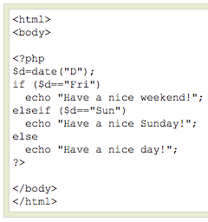
PHP Conditional Statements
The following example will output "Have a nice weekend!" if the current day is Friday, and "Have a nice Sunday!" if the current day is Sunday. Otherwise it will output "Have a nice day!":

Slide 41
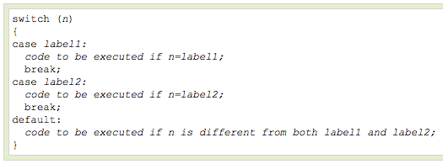
PHP Conditional Statements
Use the switch statement to select one of many blocks of code to be executed.
For switches, first we have a single expression n (most often a variable), that is evaluated once.
The value of the expression is then compared with the values for each case in the structure. If there is a match, the block of code associated with that case is executed.
Use break to prevent the code from running into the next case automatically. The default statement is used if no match is found.

Slide 42
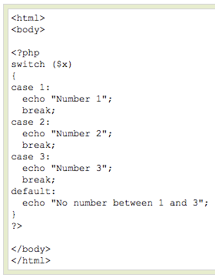
PHP Conditional Statements

Slide 43
PHP Loops
In PHP, we have the following looping statements:
while - loops through a block of code while a specified condition is true
do...while - loops through a block of code once, and then repeats the loop as long as a specified condition is true
for - loops through a block of code a specified number of times
foreach - loops through a block of code for each element in an array

Slide 44
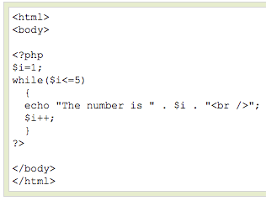
PHP Loops - While
The while loop executes a block of code while a condition is true
The example below defines a loop that starts with i=1. The loop will continue to run as long as i is less than, or equal to 5. i will increase by 1 each time the loop runs:

Slide 45
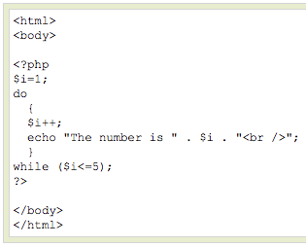
PHP Loops – Do ... While
The do...while statement will always execute the block of code once, it will then check the condition, and repeat the loop while the condition is true
The example below defines a loop that starts with i=1. It will then increment i with 1, and write some output. Then the condition is checked, and the loop will continue to run as long as i is less than, or equal to 5:

Slide 46
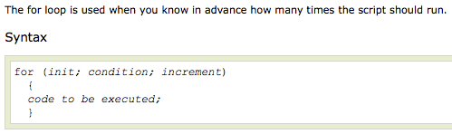
PHP Loops - For
init: Mostly used to set a counter (but can be any code to be executed once at the beginning of the loop)‏
condition: Evaluated for each loop iteration. If it evaluates to TRUE, the loop continues. If it evaluates to FALSE, the loop ends.
increment: Mostly used to increment a counter (but can be any code to be executed at the end of the loop)‏

Slide 47
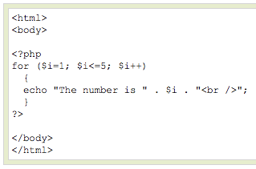
PHP Loops - For
The example below defines a loop that starts with i=1. The loop will continue to run as long as i is less than, or equal to 5. i will increase by 1 each time the loop runs:

Slide 48

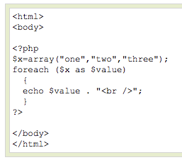
PHP Loops - Foreach
For every loop iteration, the value of the current array element is assigned to $value (and the array pointer is moved by one) - so on the next loop iteration, you'll be looking at the next array value.
The following example demonstrates a loop that will print the values of the given array:

Slide 49

PHP Functions
To prevent a script from being executed when the page loads, you can put it into a function
Give the function a name that reflects what the function does
The function name can start with a letter or underscore (not a number)‏
A function will be executed by a call to the function
You may call a function from anywhere within a page

Slide 50
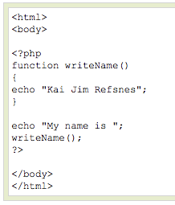
PHP Functions
A function will be executed by a call to the function
You may call a function from anywhere within a page

Slide 51
PHP Functions - Parameters
Adding parameters:
Parameters are specified after the function name, inside the parentheses
<?php function familyName($fname,$year) { echo "$fname Refsnes. Born in $year <br>"; } familyName("Hege","1975"); familyName("Stale","1978"); familyName("Kai Jim","1983"); ?>

Slide 52
PHP Functions - Parameters
Parameter with default value:
<?php function setHeight($minheight=50) { echo "The height is : $minheight <br>"; } setHeight(350); setHeight(); // will use the default value of 50 setHeight(135); setHeight(80); ?>

Slide 53
PHP Functions - Parameters
Return a value:
<?php function sum($x,$y) { $z=$x+$y; return $z; } echo "5 + 10 = " . sum(5,10) . "<br>"; echo "7 + 13 = " . sum(7,13) . "<br>"; echo "2 + 4 = " . sum(2,4); ?>

Slide 54
PHP Predefined Global Variables
Several predefined variables in PHP are "superglobals", which means that they are always accessible, regardless of scope
Accessible from any function, class or file without having to do anything special
The PHP predefined global variables are:
$GLOBALS: which is used to access user defined global variables from anywhere in the PHP script
$_SERVER: holds information about headers, paths, and script locations
$_REQUEST: used to collect data after submitting an HTML form
$_POST: used to collect form data after submitting an HTML form with method="post"
$_GET: used to collect form data after submitting an HTML form with method="get"
$_FILES: used to access the files uploaded from a client computer to the remote server
$_ENV: used to access the environment variables
$_COOKIE: used to retrieve a cookie value
$_SESSION: used to store and retrieve session variables

Slide 55
PHP Forms - $_GET Function
The built-in $_GET function is used to collect values from a form sent with the method=“get”
Information sent from a form with the GET method is visible to everyone (it will be displayed in the browser's address bar) and has limits on the amount of information to send (max. 2000 characters on most browsers)

Slide 56
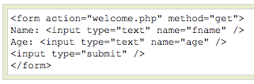

PHP Forms - $_GET Function
http://www.example.com/welcome.php?fname=Peter&age=37
Notice how the URL carries the information after the file name.

Slide 57
PHP Forms - $_GET Function
When using method="get" in HTML forms, all variable names and values are displayed in the URL
This method should not be used when sending passwords or other sensitive information!
However, because the variables are displayed in the URL, it is possible to bookmark the page. This can be useful in some cases.
The get method is not suitable for large variable values; the value cannot exceed 2000 chars on most browsers.

Slide 58
PHP Forms - $_POST Function
The built-in $_POST function is used to collect values from a form sent with method="post“
Appends form-data inside the body of the HTTP request
Information sent from a form with the POST method is invisible to others and has no limits on the amount of information to send
Note: However, there is an 8 Mb max size for the POST method, by default (can be changed by setting the post_max_size in the php.ini file).
Notes:
Appends form-data inside the body of the HTTP request

Slide 59


PHP Forms - $_POST Function
And here is what the code of action.php might look like:

Slide 60
PHP Forms - $_POST Function
Apart from htmlspecialchars() and (int), it should be obvious what this does. htmlspecialchars() makes sure any characters that are special in html are properly encoded so people can't inject HTML tags or Javascript into your page
For the age field, since we know it is a number, we can just convert it to an integer which will automatically get rid of any stray characters. The $_POST['name'] and $_POST['age'] variables are automatically set for you by PHP.

Slide 61
PHP – Form Validation
<?php
// define variables and set to empty values $name = $email = $gender = $comment = $website = ""; if ($_SERVER["REQUEST_METHOD"] == "POST") { $name = test_input($_POST["name"]); $email = test_input($_POST["email"]); $website = test_input($_POST["website"]); $comment = test_input($_POST["comment"]); $gender = test_input($_POST["gender"]); } function test_input($data) { $data = trim($data); $data = stripslashes($data); $data = htmlspecialchars($data); return $data; }
?>

Slide 62
PHP – Form Validation
<?php
// define variables and set to empty values $nameErr = $emailErr = ""; $name = $email = ""; if ($_SERVER["REQUEST_METHOD"] == "POST") { if (empty($_POST["name"])) {$nameErr = "Name is required";} else {
$name = test_input($_POST["name"]);
if (!preg_match("/^[a-zA-Z ]*$/",$name)) { $nameErr = "Only letters and white space allowed"; }
} if (empty($_POST["email"])) {$emailErr = "Email is required";} else {
$email = test_input($_POST["email"]);}
if (!preg_match("/([\w\-]+\@[\w\-]+\.[\w\-]+)/",$email)) { $emailErr = "Invalid email format"; }
}
?>
Notes:
Discussion: Which type of validations is better or best? Server-side validation or client-side validation?
http://stackoverflow.com/questions/162159/javascript-client-side-vs-server-side-validation

Slide 63
PHP - Cookie
A cookie is often used to identify a user
A cookie is a small file that is stored on the user's computer
Each time the same computer requests a page with a browser, it will send the cookie too
With PHP, you can both create and retrieve cookie values
Create:
setcookie(name, value, expire, path, domain);
The setcookie() function must appear BEFORE the <html> tag
<?php setcookie("user", "Alex Porter", time()+3600); ?> <html> .....

Slide 64
PHP - Cookie
Read/Retrieve:
The PHP $_COOKIE variable is used to retrieve a cookie value
<html> <body> <?php if (isset($_COOKIE["user"])) echo "Welcome " . $_COOKIE["user"] . "!<br>"; else echo "Welcome guest!<br>"; ?> </body> </html>.

Slide 65
PHP - Session
A PHP session variable is used to store information about, or change settings for a user session on the server
Session variables hold information about one single user, and are available to all pages in one application
A unique session id is associated with a user’s session
Session id returned to the client inside a cookie
Example use case: session based user authentication/authorization
Starting/Resuming PHP Session:
Before storing user information in PHP session:
first start up the session
Storing/Retrieve Session Variable:
PHP $_SESSION variable used to store and retrieve session variables
Delete Session Data:
Use unset() function to delete some session data
Destroy Session:
session_destroy() function to destroy session
Notes:
https://www.tutorialspoint.com/php/php_sessions.htm
PHPSESSID

Slide 66
PHP - Simple Login using Session
<?php
//Start session
session_start();
//Check whether the session variable SESS_MEMBER_ID is present or not
if(!isset($_SESSION['sess_user_id']) || (trim($_SESSION['sess_user_id']) == '')) {
header("location: login.html");
exit();
}
?>
<!DOCTYPE html PUBLIC "-//W3C//DTD XHTML 1.0 Transitional//EN" "http://www.w3.org/TR/xhtml1/DTD/xhtml1-transitional.dtd">
<html xmlns="http://www.w3.org/1999/xhtml">
<head>
<meta http-equiv="Content-Type" content="text/html; charset=utf-8" />
<title>Home Page</title>
</head>
<body>
<h1>Welcome, <?php echo $_SESSION["sess_username"] ?></h1>
</body>
</html>

Slide 67
PHP - Simple Login using Session
<?php
session_start();
$username = $_POST['username'];
$password = $_POST['password'];
$con=mysqli_connect("example.com","peter","abc123","my_db");
$username = mysql_real_escape_string($username);
$query = "SELECT id, username, password, salt FROM member WHERE username = '$username';";
$result = mysqli_query ($con,$query);
if($result->num_rows == 0) // User not found. So, redirect to login_form again.
{
header('Location: login.html');
exit();
}
$userData = mysqli_fetch_array($result, MYSQL_ASSOC);
$hash = hash('sha256', $userData['salt'] . hash('sha256', $password) );
mysqli_close($con);
if($hash != $userData['password']) // Incorrect password. So, redirect to login_form again.
{
header('Location: login.html');
exit();
}else{ // Redirect to home page after successful login.
session_regenerate_id(); //recommended since the user session is now authenticated
$_SESSION['sess_user_id'] = $userData['id'];
$_SESSION['sess_username'] = $userData['username'];
session_write_close();
header('Location: home.php');
}
?>
Notes:
The SHA (Secure Hash Algorithm) is a cryptographic hash function. SHA-256 algorithm generates an almost-unique, fixed size 256-bit (32-byte) hash. Hash is a one way function – it cannot be decrypted back. This makes it suitable for password validation and digital signatures.
Hashing is using an cryptographic algorithm to convert data like a password into a fixed length string of characters called a fingerprint. Salting is a way to randomize hashes by adding a random string (which is called a salt) before a password is hashed, which makes it much more difficult to crack the password hash.

Slide 68
PHP - MySQL
<?php
$servername = "localhost";
$username = "username";
$password = "password";
// Create connection
$conn = mysqli_connect($servername, $username, $password);
// Check connection
if (!$conn) {
die("Connection failed: " . mysqli_connect_error());
}
echo "Connected successfully";
?>

Slide 69
PHP - MySQL
<?php
$servername = "localhost";
$username = "username";
$password = "password";
// Create connection
$conn = new mysqli($servername, $username, $password);
// Check connection
if ($conn->connect_error) {
die("Connection failed: " . $conn->connect_error);
}
echo "Connected successfully";
?>

Slide 70
PHP - MySQL
<?php
$servername = "localhost";
$username = "username";
$password = "password";
try {
$conn = new PDO("mysql:host=$servername;dbname=myDB", $username, $password);
// set the PDO error mode to exception
$conn->setAttribute(PDO::ATTR_ERRMODE, PDO::ERRMODE_EXCEPTION);
echo "Connected successfully";
}
catch(PDOException $e)
{
echo "Connection failed: " . $e->getMessage();
}
?>

Slide 71
PHP – MySQL
MySQLi - Procedural
mysqli_close($conn);
MySQLi - Object oriented
$conn->close();
PDO
$conn = null;

Slide 72
PHP – MySQL
Insert data into tables:
INSERT INTO table_name VALUES (value1, value2, value3,...)
INSERT INTO table_name (column1, column2, column3,...) VALUES (value1, value2, value3,...)
MySQL:
<?php $con=mysqli_connect("example.com","peter","abc123","my_db"); // Check connection if (mysqli_connect_errno()) { echo "Failed to connect to MySQL: " . mysqli_connect_error(); } // escape variables for security $firstname = mysqli_real_escape_string($_POST['firstname']); $lastname = mysqli_real_escape_string($_POST['lastname']); $age = mysqli_real_escape_string($_POST['age']); $sql="INSERT INTO Persons (FirstName, LastName, Age) VALUES ($firstname, $lastname, $age)"; if (!mysqli_query($con,$sql)) { die('Error: ' . mysqli_error($con)); } echo "1 record added"; mysqli_close($con); ?>

Slide 73
PHP – MySQL/PostGreSQL
Select data from tables:
SELECT statement is used to select data from a database
SELECT column_name(s) FROM table_name WHERE column_name operator value
<?php $con=mysqli_connect("example.com","peter","abc123","my_db"); // Check connection if (mysqli_connect_errno()) { echo "Failed to connect to MySQL: " . mysqli_connect_error(); } $result = mysqli_query($con,"SELECT * FROM Persons WHERE FirstName='Peter'"); while($row = mysqli_fetch_array($result)) { echo $row['FirstName'] . " " . $row['LastName']; echo "<br>"; } ?>

Slide 74
PHP – Prepared Statements
$stmt = $conn->prepare("INSERT INTO MyGuests (firstname, lastname, email) VALUES (?, ?, ?)");
$stmt->bind_param("sss", $firstname, $lastname, $email);
// set parameters and execute
$firstname = "John";
$lastname = "Doe";
$email = "john@example.com";
$stmt->execute();
$firstname = "Mary";
$lastname = "Moe";
$email = "mary@example.com";
$stmt->execute();
echo "New records created successfully";
$stmt->close();
$conn->close();
?>

Slide 75
PHP – AJAX
<html><head>
<script> function showUser(str) { if (str=="") { document.getElementById("txtHint").innerHTML=""; return; } if (window.XMLHttpRequest) {// code for IE7+, Firefox, Chrome, Opera, Safari xmlhttp=new XMLHttpRequest(); } else {// code for IE6, IE5 xmlhttp=new ActiveXObject("Microsoft.XMLHTTP"); } xmlhttp.onreadystatechange=function() { if (xmlhttp.readyState==4 && xmlhttp.status==200) { document.getElementById("txtHint").innerHTML=xmlhttp.responseText; } } xmlhttp.open("GET","getuser.php?q="+str,true); xmlhttp.send(); } </script> </head> <body> <form> <select name="users" onchange="showUser(this.value)"> <option value="">Select a person:</option> <option value="1">Peter Griffin</option> <option value="2">Lois Griffin</option> </select> </form><br> <div id="txtHint"><b>Person info will be listed here.</b></div> </body></html>

Slide 76
PHP – AJAX
<?php $q = intval($_GET['q']); $con = mysqli_connect('localhost','peter','abc123','my_db'); if (!$con) { die('Could not connect: ' . mysqli_error($con)); } mysqli_select_db($con,"ajax_demo"); $sql="SELECT * FROM user WHERE id = '".$q."'"; $result = mysqli_query($con,$sql); echo "<table border='1'> <tr> <th>Firstname</th> <th>Lastname</th> <th>Age</th> <th>Hometown</th> <th>Job</th> </tr>"; while($row = mysqli_fetch_array($result)) { echo "<tr>"; echo "<td>" . $row['FirstName'] . "</td>"; echo "<td>" . $row['LastName'] . "</td>"; echo "<td>" . $row['Age'] . "</td>"; echo "<td>" . $row['Hometown'] . "</td>"; echo "<td>" . $row['Job'] . "</td>"; echo "</tr>"; } echo "</table>"; mysqli_close($con); ?>

