Slide 1
HR Metrics Automation Dashboard
Generated Feb 15, 2026
Executive Summary
As of Jan 2026, total headcount is 339 (+1.5% MoM), with 7 hires and 4 terminations. Average turnover is 1.40% (+0.12
pts MoM), offer acceptance is 81.6%, and time-to-fill averages 30.5 days. Highest turnover is in Sales (2.18%), while
fastest hiring cycle is in Customer Success (18.0 days).

Slide 2
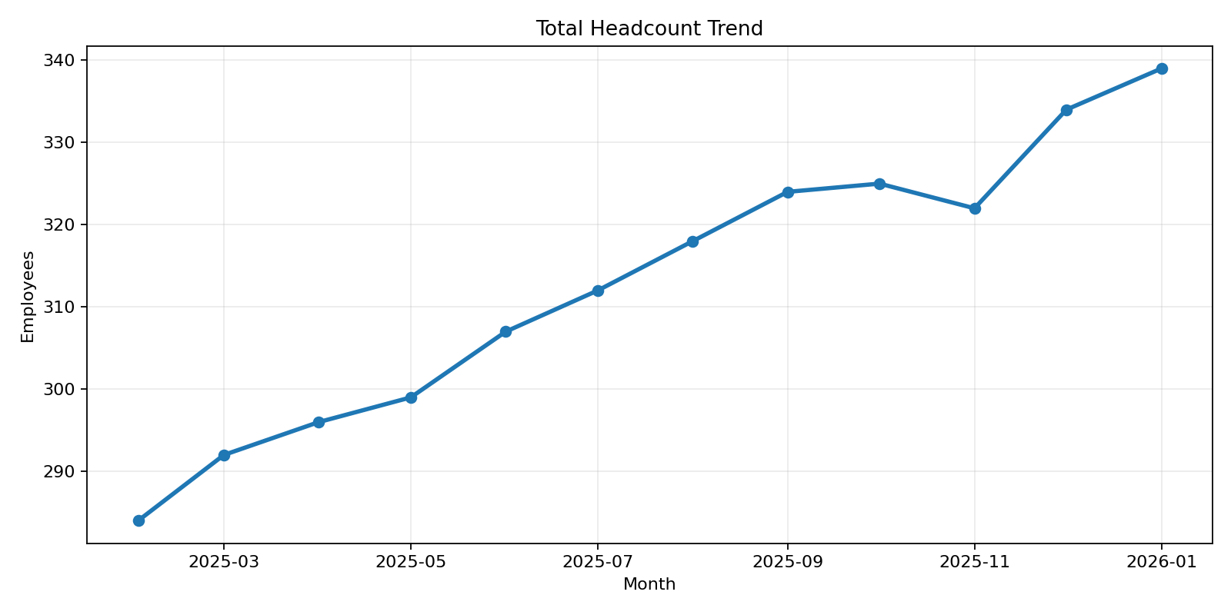
Headcount Trends
Monthly total headcount across all departments

Slide 3
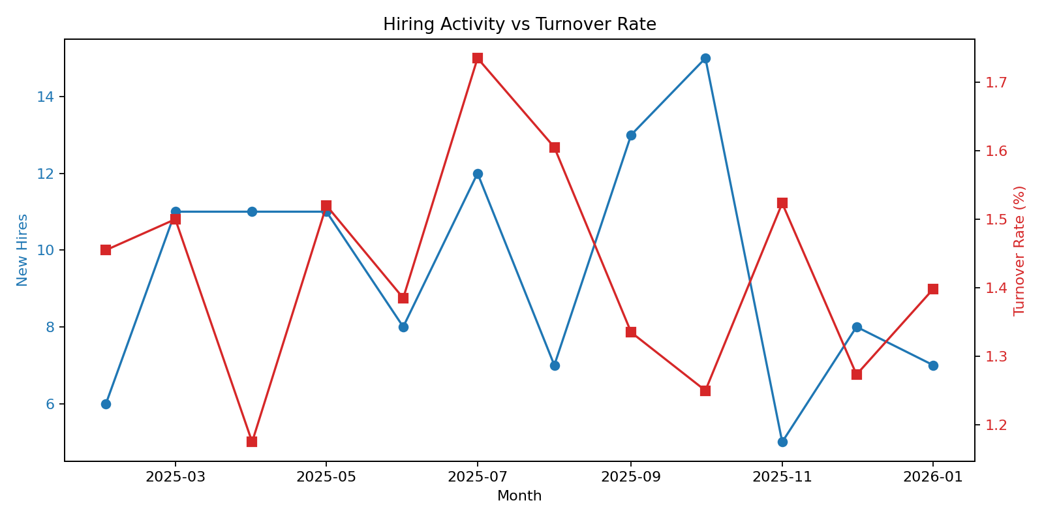
Hiring Metrics
New hires and turnover rate by month

Slide 4
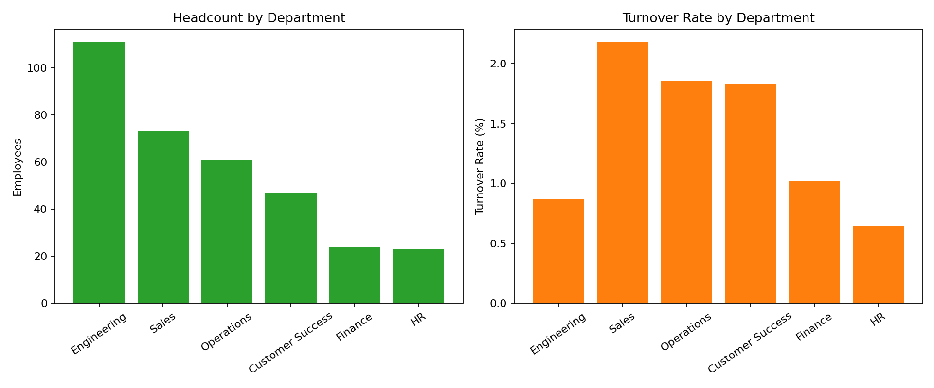
Departmental Breakdown
Latest month headcount and turnover comparison

Slide 5
Key Insights & Recommendations
Total headcount reached 339, with momentum of +1.5% month-over-month.
Average turnover is 1.40%; highest risk area is Sales (2.18%).
Average time-to-fill is 30.5 days; focus pipeline acceleration for teams above 40 days.
Open positions currently total 13; prioritize hiring plans for HR to avoid service bottlenecks.
Recommendation: Launch targeted retention interventions for high-turnover departments and monitor offer acceptance weekly to reduce backfill lag.

