Slide 1
Lambda authorizer blueprint
Enrique Bassallo
Advanced Cloud Engineering (ACE)
May 11, 2021
Notes:
1

Slide 2
Agenda
What is a Lambda Authorizer?
Why do we need it?
OAuth2 and JWT
Azure AD App Roles Map
How Lambda Authorizer works?
Blueprint Deployment Model

Slide 3
What is a Lambda Authorizer?
API Gateway feature known as Custom Authorizer.
Uses an AWS Lambda function to control access to API endpoints.
Invoked by API Gateway for every request to an API endpoint.
Validates the caller’s identity as input.
Returns an IAM policy as output.

Slide 4
Why do we need it?
Modern web apps separate Frontend (UI) and Backend (API).
Centralized AuthN & AuthZ processes in Azure AD for TMNA employees.
AuthN process is normally performed in the Frontend (Login / SSO).
AuthZ process needs to be performed in the Backend for each request.
Lambda Authorizer avoids reaching Backend resources directly.
Backend resources are protected and scale only for valid requests.

Slide 5
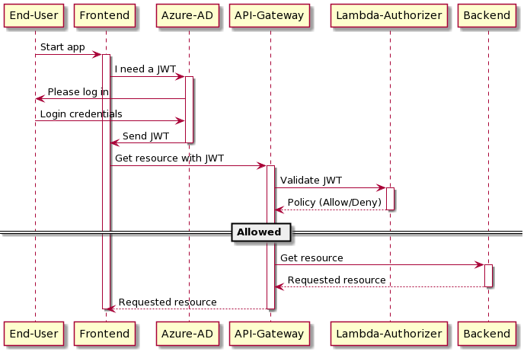
OAuth2 and JWT

Slide 6
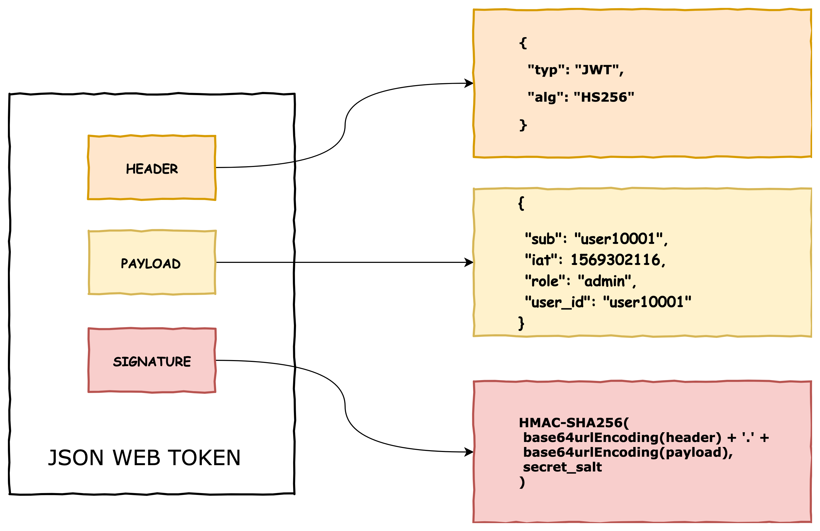
Azure AD App Roles Map
JWT FROM AZURE AD
IAM Roles & Policies
ADMIN = [{
effect = "Allow"
http_method = ["*"] # All HTTP methods
resource_path = ["*"] # All resources
}]
READ-ONLY = [{
effect = "Deny"
http_method = ["*"] # All HTTP methods
resource_path = ["admin", "admin/*"]
},{
effect = "Allow"
http_method = ["GET"]
resource_path = ["res1/*", "res2/*"]
}]

Slide 7
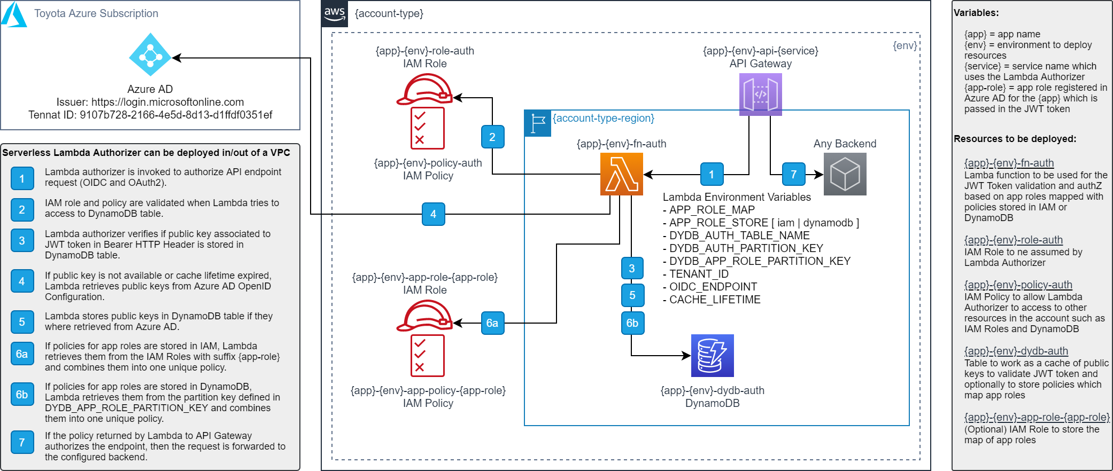
How Lambda Authorizer works?

Slide 8
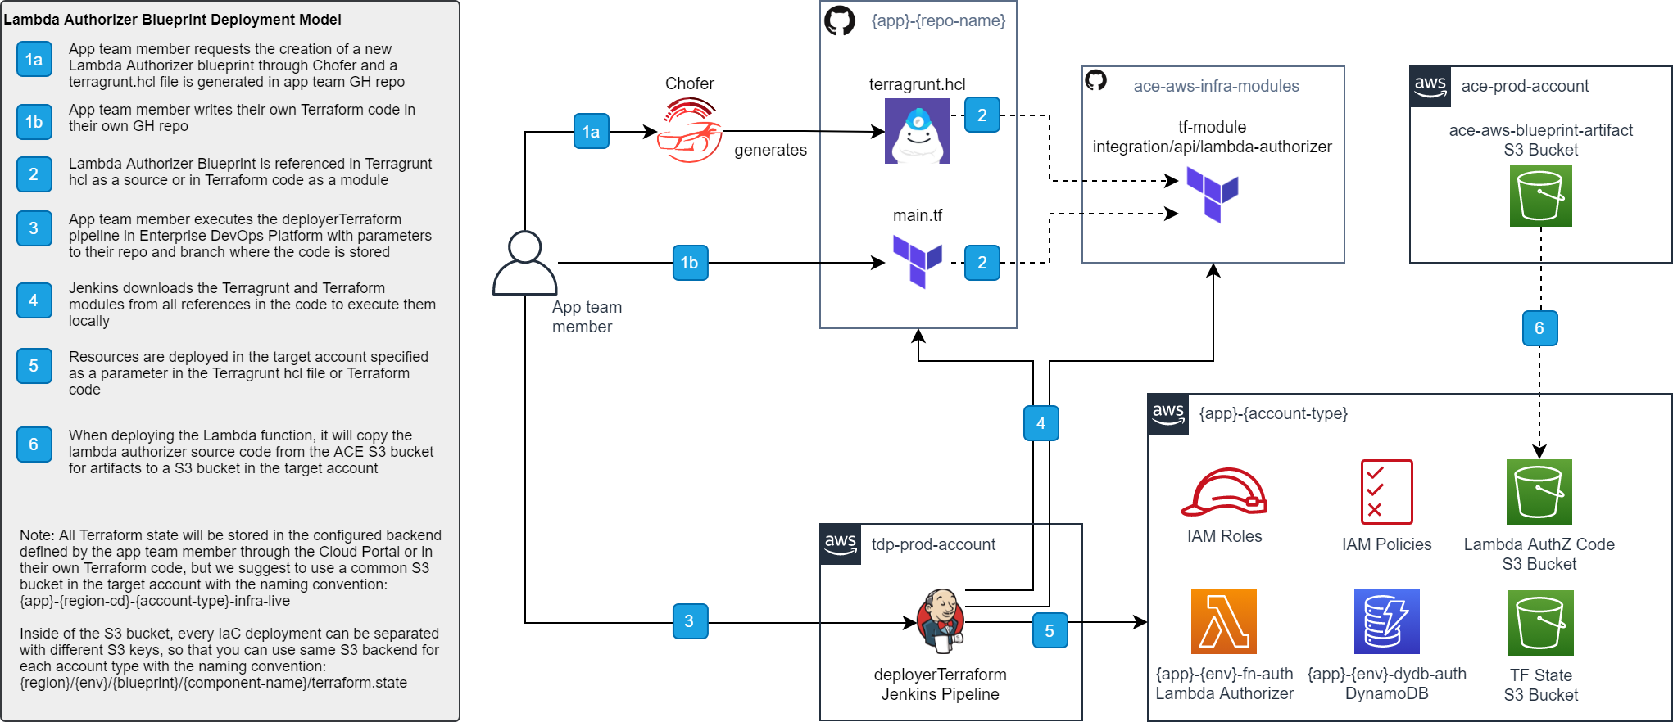
Blueprint Deployment Model

Slide 9
Blueprint Deployment Models
Activity | Self-managed | ACE-managed
Script generation | By app teams using blueprint reference in TG/TF By Chofer requested by app teams | By Chofer requested by app teams
GitHub Repository | Belongs to app teams | Belongs to ACE team
Platform execution | TDP – Jenkins | TDP – Jenkins
Script execution | By app team | By ACE team
Blueprint Support | By ACE team | By ACE team

Slide 10
Lambda authorizer blueprint
Enrique Bassallo
Advanced Cloud Engineering (ACE)
May 11, 2021
Notes:
10

