Slide 1
Applying UML and Patterns
An Introduction to
Object-oriented Analysis
and Design
and Iterative Development
Part III Elaboration Iteration I – Basic¹
Notes:
Inception阶段的主要技术是对构想的系统设立量化的目标，写故事。
细化阶段？

Slide 2
Chapters
Iteration 1 – basics
Domain models
System sequence diagrams
Operation contracts
Requirements to design – iteratively
Logical architecture and UML package diagrams
On to object design
UML interaction diagrams
UML class diagrams
GRASP: design objects with responsibilities
Object design examples with GRASP
Design for visibility
Mapping design to code
Test-driven development and refactoring
Notes:
细化阶段，包含了除了测试与部署之外的所有技术。因此分析与设计工作主要在细化阶段。
本课程只讲述如何做第一个迭代和建立领域模型

Slide 3
Chap 8
Iteration 1
Basics

Slide 4
Iteration 1
Iteration 1 of the elaboration phase
  Requirements and Emphasis: Core OOA/D Skills
  Architecture-centric and risk-driven.
In Iterative Development, Don't Implement All the Requirements at Once
Incremental Development for the Same Use Case Across Iterations
Notes:
Up过程模型的三个重要特性：Use-case driven(用户驱动的)；以架构为中心的；迭代的。
第一个开发迭代，将充分展示这些特性，也包含了OOAD的核心技巧。（请大家在看书，听课时能尽可能与我们Lab1对应，Lab1是到第一个迭代结束）

Slide 5
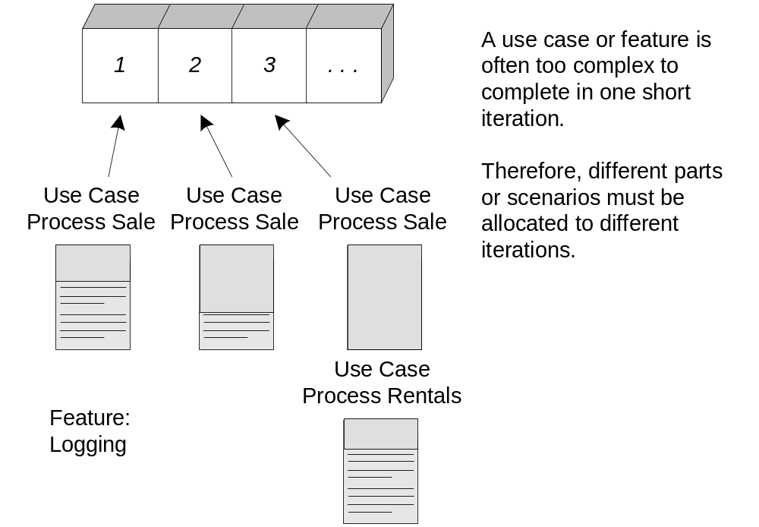
Iteration 1
Use case implementation may be spread across iterations
Notes:
在细化阶段，需求按几个维度在变化：
1、用例的细化的数量，10％ －－ 90％；
2、关键用例，5－10％会实现，这些用例通常会从主成功场景－－整体实现；
3、业务与技术主要风险将在Iter1-2被揭示，可能导致项目需求变化。程序的基本结构被建立。

Slide 6
POS Iteration 1
Requirements for iteration 1 of the POS application
  Implement a basic, key scenario of the Process Sale use case: entering items and receiving a cash payment.
  Implement a Start Up use case as necessary to support the initialization needs of the iteration.
  Nothing fancy or complex is handled, just a simple happy path scenario, and the design and implementation to support it.
  There is no collaboration with external services, such as a tax calculator or product database.
  No complex pricing rules are applied.
  The design and implementation of the supporting UI, database, and so forth, would also be done
Notes:
书P8.1,POS机第一个迭代的目标与需求。部分主场景，包含什么，不包含什么。

Slide 7
Elaboration 1
Elaboration: Build the core architecture, resolve the high-risk elements, define most requirements, and estimate the overall schedule and resources.
Elaboration is the initial series of iterations during project
  the core, risky software architecture is programmed and tested
  the majority of requirements are discovered and stabilized
  the major risks are mitigated or retired
Elaboration often consists of two or more iterations;
  each iteration is recommended to be 2~6 weeks
Elaboration is not a design phase or a phase when the models are fully developed in preparation for implementation.
Notes:
P128. on to elaboration.

Slide 8
Elaboration 2
Executable architecture/Architectural baseline/ Architectural prototype
  to describe the partial system.
  a production subset of the final system.
Some key ideas and best practices will manifest in elaboration:
  do short time boxed risk-driven iterations
  start programming early
  adaptively design, implement, and test the core and risky parts of the architecture
  test early, often, realistically
  adapt based on feedback from tests, users, developers
  write most of the use cases and other requirements in detail, through a series of workshops, once per elaboration iteration
Notes:
关键实践，中英文都需要

Slide 9
Elaboration 3
Artifact
Comment
Domain Model
This is a visualization of the domain concepts; it is similar to a static information model of the domain entities.
Design Model
This is the set of diagrams that describes the logical design. This includes software class diagrams, object interaction diagrams, package diagrams, and so forth.
Software Architecture Document
A learning aid that summarizes the key architectural issues and their resolution in the design. It is a summary of the outstanding design ideas and their motivation in the system.
Data Model
This includes the database schemas, and the mapping strategies between object and non-object representations.
Use-Case Storyboards, UI Prototypes
A description of the user interface, paths of navigation, usability models, and so forth.

Slide 10
Planning the Next Iteration
Organize requirements and iterations by risk, coverage, and criticality.
  Risk includes both technical complexity and other factors, such as uncertainty of effort or usability.
  Coverage implies that all major parts of the system are at least touched on in early iterations perhaps a "wide and shallow" implementation across many components.
  Criticality refers to functions the client considers of high business value.
Notes:
需求的实现排序方法：
高风险：对开发者或客户，对程序可能的结果有较大不确定性。
高价值：游戏智能效果评估；体现程序架构设计。
覆盖：

Slide 11
POS Rank List
Rank
Requirement (Use Case or Feature)
Comment
High
Process Sale
Logging
…
Scores high on all rankings.
Pervasive. Hard to add late.
…
Medium
Maintain Users
…
Affects security subdomain.
…
Low
…
…

Slide 12
Chap 9
Domain Models

Slide 13
★
Introduction
A domain model
  the most important and classic model in OO analysis.
  be a visual representation of conceptual classes or real situation objects in a domain.
  Also called conceptual models, domain object models, and analysis object models.
  "focusing on explaining 'things' and products important to a business domain“, such as POS related things.
Guideline
  Avoid a waterfall-mindset big-modeling effort to make a thorough or "correct" domain model
  it won‘t ever be either, and such over-modeling efforts lead to analysis paralysis（瘫痪）, with little or no return on the investment.
Notes:
p9 的介绍部分：关键词 noteworthy concepts in a domain
最重要，为什么？
1）在编写Use Case文档时，存在不一致的术语；模糊的事物关系；
2）读者难以可视化了解类及其之间的关系与约束；
3）是数据库设计的基础

Slide 14
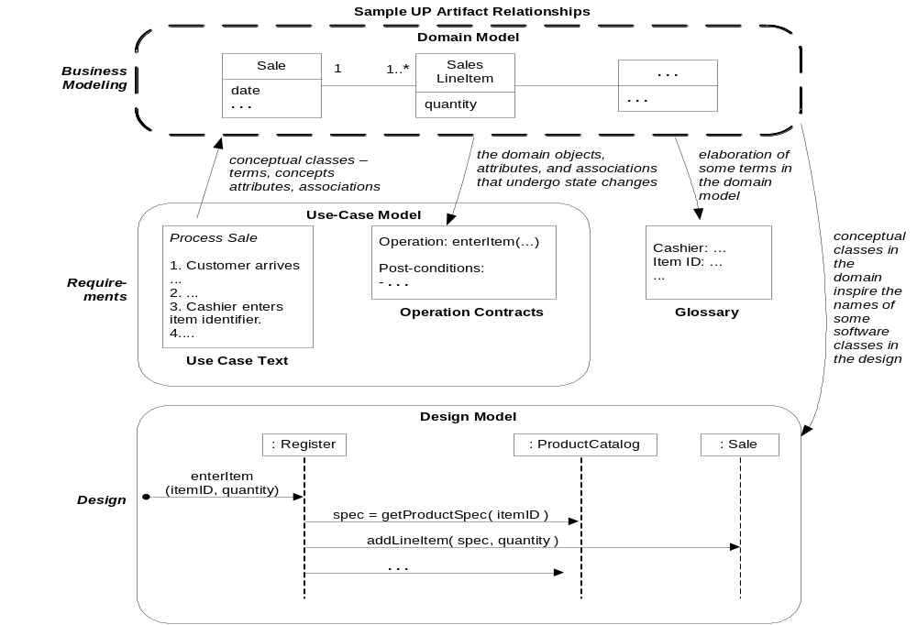
Sample UP artifact influence
Notes:
图9.1,领域模型与当前迭代开发的应用场景相关，不断的进化并完善。

Slide 15
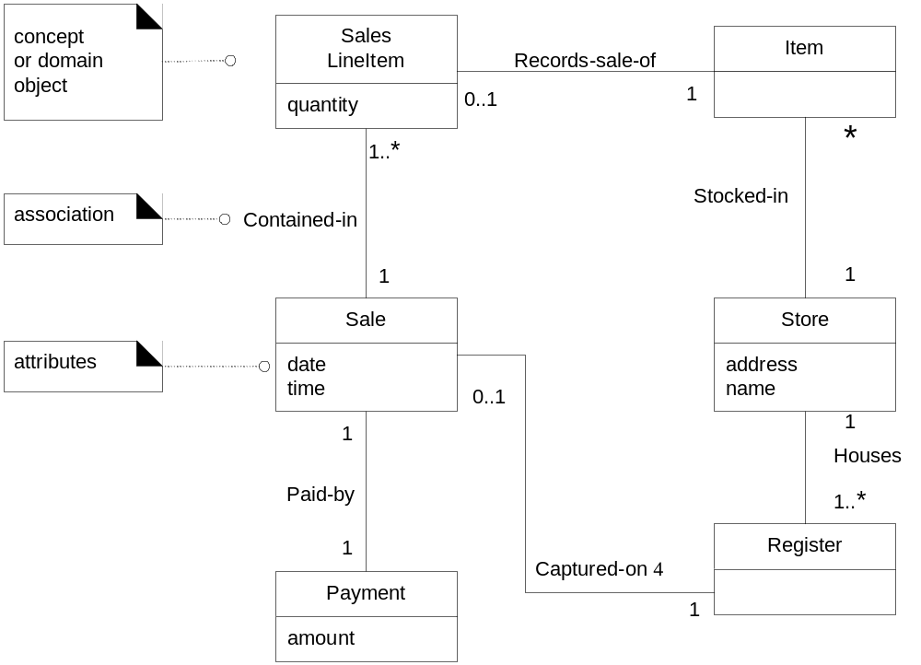
POS Domain Model
Notes:
p9.1的例子。如果我们开发POS的迭代1任务（扫描商品，现金付款），
解释该图：1）将涉及这些概念，其中，最重要的概念在视线的中央。2）它们之间的关系，类似数据库实体关系。3）相关重要属性
领域模型重要性：
1）可视化重要的概念，属性，以及概念之间的关系。 2）可以规范用例文档的术语及描述
难点：不是所有的名词都是核心领域概念
设计最难的是正确的使用”奥卡姆剃刀”,把重要的东西凸显出来。无论你拍照片，还是写项目建议书，你要学会问一个问题：“这个类［功能／用例／故事］不用行吗？”
例如：在第一次开发场景中，商店、柜台都是可以不考虑的

Slide 16
★
Domain Model 1
It provides a conceptual perspective.
  domain objects or conceptual classes
  associations between conceptual classes
  attributes of conceptual classes
Following elements are not suitable in a domain model
  Software artifacts, such as a window or a database, unless the domain being modeled is of software concepts, such as a model of graphical user interfaces.
  Responsibilities or methods.
Notes:
p9.2 记住领域类图（对象、关系、属性）
并记住哪些不是领域对象。

Slide 17
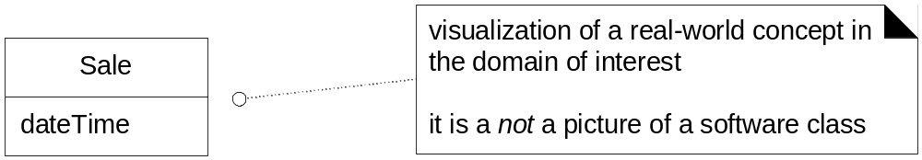
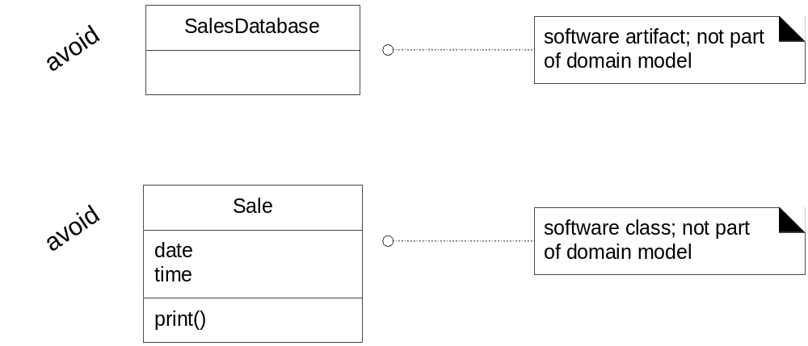
Domain Model 2
A domain model shows real-situation conceptual classes, not software classes
A domain model does not show software artifacts or classes
Notes:
报表，计算的结果通常也不是的。

Slide 18
★ ★
Domain Model 3
A conceptual class is an idea, thing, or object.
  Symbol words or images representing a conceptual class.
  Intension the definition of a conceptual class.
  Extension the set of examples to which the conceptual class applies
Notes:
类的定义

Slide 19
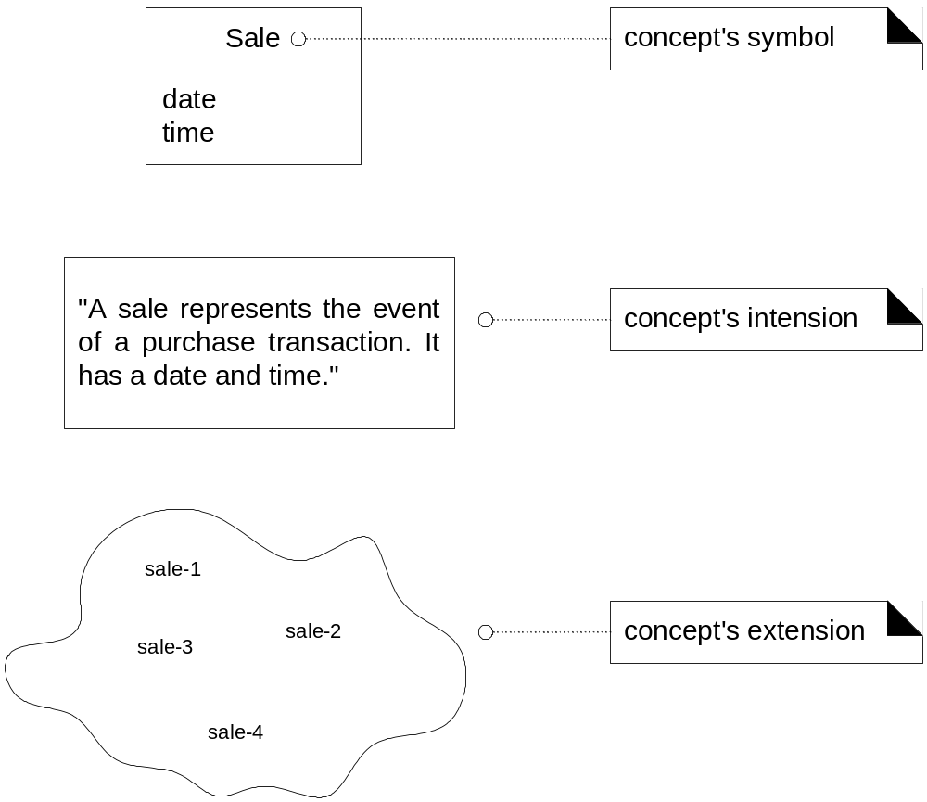
Domain Model 4

Slide 20
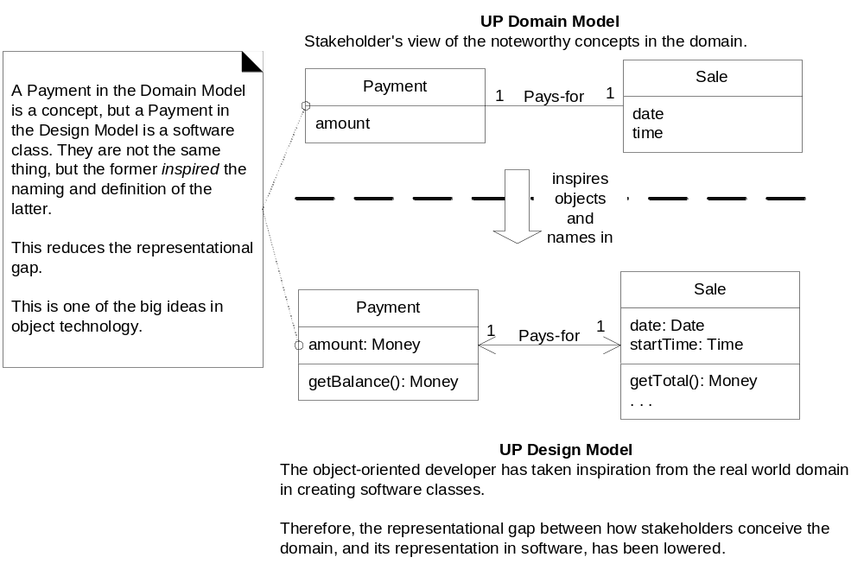
Domain Model 5
Lower representational gap with OO modeling.
Notes:
这个图p9.3说明领域模型的重要性。面向对象的建模方法，在从问题领域概念－－》软件设计对象，表示差异较小。

Slide 21
Guideline: Create a Domain Model
Bounded by the current iteration requirements under design
  Find the conceptual classes (see a following guideline).
  Draw them as classes in a UML class diagram.
  Add the association necessary to record relationships for which there is a need to preserve some memory.
  Add the attributes necessary to fulfill the information requirements.
Notes:
－－如何见领域模型？

Slide 22
★ ★
Guideline: Find Conceptual Classes 1
Reuse or modify existing models.
Use a category list.
Identify noun phrases from the case text
Conceptual Class Category
Examples
business transactions
Guideline: These are critical (they involve money), so start with transactions.
Sale, Payment
Reservation
transaction line items
Guideline: Transactions often come with related line items, so consider these next.
SalesLineItem
product or service related to a transaction or transaction line item
Guideline: Transactions are for something (a product or service). Consider these next.
Item
Flight, Seat, Meal
where is the transaction recorded?
Guideline: Important.
Register, Ledger
FlightManifest
Notes:
我们教材提供了3种方法
（1）抄（山寨）法－－不一定有现成设计资料。不是当我们设计一个系统时，为什么常期望获取别人设计的数据库，因为这其中蕴涵了大量领域概念及关系；企业内长期从事类似项目开发，这是最有用的方法；
（2）分类法－－需要专业知识，企业内这样的大牛不少；
（3）名词抽取法－－新手的方法，错误概率也是最高的方法。

Slide 23
Guideline: Find Conceptual Classes 2
Conceptual Class Category
Examples
place of transaction; place of service
Store
Airport, Plane, Seat
noteworthy events, often with a time or place we need to remember
Sale, Payment, Flight
physical objects
Guideline: This is especially relevant when creating device-control software, or simulations.
Item, Register Board, Piece, Die Airplane
descriptions of things
Guideline: See p. 147 for discussion.
Product Description
Flight Description
catalogs
Guideline: Descriptions are often in a catalog.
Product Catalog
Flight Catalog
containers of things (physical or information)
Store, Bin Board Airplane

Slide 24
Guideline: Find Conceptual Classes 3
Conceptual Class Category
Examples
things in a container
Item Square (in a Board) Passenger
other collaborating systems
Credit Authorization System
Air Traffic Control
records of finance, work, contracts, legal matters
Receipt, Ledger
MaintenanceLog
financial instruments
Cash, Check, LineOfCredit
TicketCredit
schedules, manuals, documents that are regularly referred to in order to perform work
DailyPriceChangeList
RepairSchedule

Slide 25
Guideline: Find Conceptual Classes 4
Conceptual Class Category
Examples
Physical or tangible object
POST, Airplane
Roles of people
Cashier, Pilot
Abstract noun concepts
Hunger, Acrophobia
Organizations
Sales Department
Events
Sale, Meeting, Flight
Process
SellingAProduct, Booking
Rules and policies
RefundPolicy
Notes:
软件工程书籍推荐的分类表。

Slide 26
Find Conceptual Classes: POS
A concept is an idea or notion that we apply to the things.
  Intension: the definition of concept, e.g. the Customer may be a person or organization that purchases goods or services
  Extension: the set of all objects to which the concept applies, e.g. the Customer may be “ John”, Tom”
<<tangible object>>
POSTerminal
<<thing in container>>
Item
<<place>>
Store
<<event or transactions>>
Sale
<<transaction line items>>
SalesLineItem
<<role of people>>
Cashier
<<roles of people>>
Customer
<<transaction>>
Payment
<<catalog>>
ProductCatalog
<<descritpions of things>>
ProductSpec

Slide 27
Guideline: Find Conceptual Classes 5
Identify noun phrases.
  Identify the nouns and noun phrases in textual descriptions of a domain, and consider them as candidate conceptual classes or attributes
  Some of these noun phrases may refer to conceptual classes that are ignored in this iteration (e.g., "Accounting" and "commissions"), and some may be simply attributes of conceptual classes.
  A weakness of this approach is the imprecision of natural language; different noun phrases may represent the same conceptual class or attribute, among other ambiguities.
Notes:
名词法：似乎很简单，但有多少人能够讲故事时能兼顾领域模型？
实战中，不是如图9.1从用例－》领域模型。实际是用领域模型不断规范用例。两者是蛋与鸡的关系。

Slide 28
Find Conceptual Classes: POS 1
Main Success Scenario (or Basic Flow):
  1.Customer arrives at a POS checkout with goods and/or services to purchase.
  2.Cashier starts a new sale.
  3.Cashier enters item identifier.
  4.System records sale line item and presents item description, price, and running total. Price calculated from a set of price rules.
  Cashier repeats steps 2-3 until indicates done.
  5.System presents total with taxes calculated.
  6.Cashier tells Customer the total, and asks for payment.
  7.Customer pays and System handles payment.
  8.System logs the completed sale and sends sale and payment information to the external Accounting (for accounting and commissions) and Inventory systems (to update inventory).

Slide 29
Find Conceptual Classes: POS 2
  9.System presents receipt.
  10.Customer leaves with receipt and goods (if any).
Extensions (or Alternative Flows):
  . . .
  7a. Paying by cash:
    1.Cashier enters the cash amount tendered.
    2.System presents the balance due, and releases the cash drawer.
    3.Cashier deposits cash tendered and returns balance in cash to Customer.
    4.System records the cash payment.

Slide 30
Find Conceptual Classes: POS 3
For iteration-1, the basic cash-only scenario of Process Sale.
  Sale, Cashier, Cash, Payment,
  Customer, Sales Line Item,
  Store, Item, Product Description,
  Register, Product Catalog, Ledger.
Notes:
找到概念：，作领域模型的第一步完成。
找到的概念是否对呢？

Slide 31
Guideline:
Agile Modeling Maintain the Model in a Tool
Perfection is not the goal of Agile, and agile models are usually discarded shortly after creation.
  From this viewpoint, there is no motivation to maintain or update the model.
If someone wants the model maintained and updated with new discoveries
  do the drawing with a UML tool.

Slide 32
Guideline:
Report Objects Include 'Receipt' in the Model
Receipt is a noteworthy term in the POS domain. But perhaps it's only a report of a sale and payment, and duplicate information. Two factors to consider
  Exclude it: Showing a report of other information in a domain model is not useful since all its information is derived or duplicated from other sources.
  Include it: it has a special role in terms of the business rules: It confers the right to the bearer of the receipt to return bought items.
Since item returns are not being considered in this iteration, Receipt will be excluded.
  During the iteration that tackles the Handle Returns use case, we would be justified to include it.
Notes:
报表（计算的结果）
例如：超市自助存包机打印的存包条码在存包用例中不是对象；在取包用例中是对象（钥匙）。

Slide 33
Guideline:
Think Like a Mapmaker; Use Domain Terms
Make a domain model in the spirit of how a cartographer or mapmaker works:
  Use the existing names in the territory. For example, if developing a model for a library, name the customer a "Borrower" the terms used by the library staff.
  Exclude irrelevant or out-of-scope features.
  Do not add things that are not there.
Notes:
制图人不认识所有地名，他是怎么标出地名？听用户的
千万不要用计算机术语。

Slide 34
Guideline:
How to Model the Unreal World
It requires a high degree of abstraction, and listening carefully to the core vocabulary and concepts that domain experts use.

Slide 35
Guideline:
A Common Mistake with Attributes vs. Classes
If we do not think of some conceptual class X as a number or text in the real world, X is probably a conceptual class, not an attribute.
  In the real world, a store is not considered a number or text, the term suggests a legal entity, an organization, and something that occupies space. Therefore, Store should be a conceptual class.
Sale
Store
Sale
Store
phoneNumber
Notes:
区别类与属性。属性：用数或文本表达。XXID，XX一定是类：例如：商品编码，商品是类，编码是重要属性
区别类与集合：XX列表，不是类，但XX是类。如用户列表，用户是类，用户列表一般不是类。

Slide 36
Guideline:
When to Model with 'Description' Classes
A description class contains information that describes something else. For example, a ProductDescription that records the price, picture, and text description of an Item.
  Problems: if implemented in software similar to the domain model, it has duplicate data (space-inefficient, and error-prone). Because the description, price, and itemID are duplicated for every Item instance of the same product
  A particular Item may have a serial number; it represents a physical instance. A ProductDescription wouldn't have a serial number
Item
description
price
serialNumber
itemID
productDescription
description
price
itemID
1 *
Item
serialNumber
Notes:
商品 vs. 商品描述。p9.13说明了哪些条件下需要描述类（对象实例拥有相同的信息，这些信息与实例是否存在无关）。例如，价格，即使库存没有，产品价格也存在。

Slide 37
Association 1
Association
  a relationship between classes (instances of those classes) that indicates some meaningful and interesting connection.
Guideline: When to Show an Association?
  Associations imply knowledge of a relationship that needs to be preserved for some duration.
Guideline: Avoid Adding Many Associations
  Many lines on the diagram will obscure it with "visual noise."
Perspectives: Will the Associations Be Implemented In Software?
  During domain modeling, an association is not data flows, database foreign key relationships, instance variables, or object connections in software solution.
  it is meaningful in a purely conceptual perspective in the real domain.
Notes:
要点：meaningful主观的

Slide 38
Association 2
Guideline
  Name an association based on a ClassName-VerbPhrase-ClassName format where the verb phrase creates a sequence that is readable and meaningful.
  Association names should start with a capital letter, since an association represents a classifier of links between instances;
    e.g. Sale Paid-by CashPayment: bad example (doesn't enhance meaning): Sale Uses CashPayment
    e.g. Player Is-on Square: bad example (doesn't enhance meaning): Player Has Square
Applying UML: Roles
  Each end of an association is called a role. Roles may optionally have multiplicity expression, name, navigability.
Notes:
关系的命名准则：has，use

Slide 39
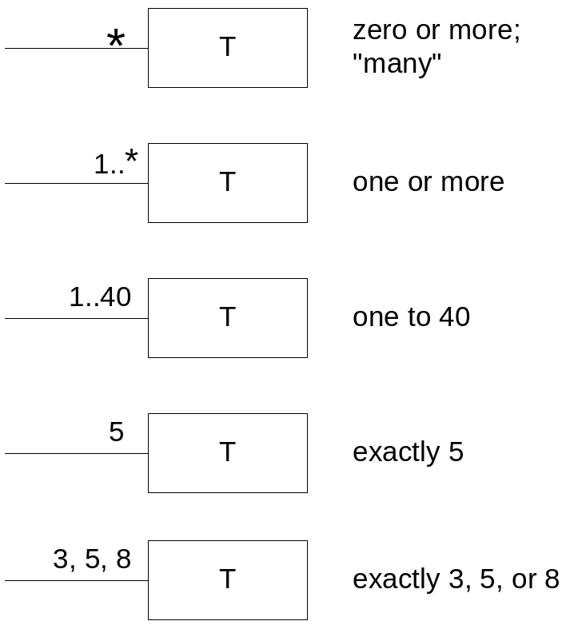
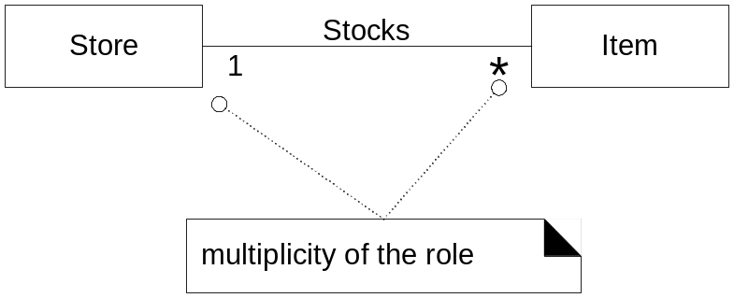
Association 3
Applying UML: Multiplicity
  Multiplicity defines how many instances of a class A can be associated with one instance of a class B
Notes:
角色在哪里？有什么用？

Slide 40
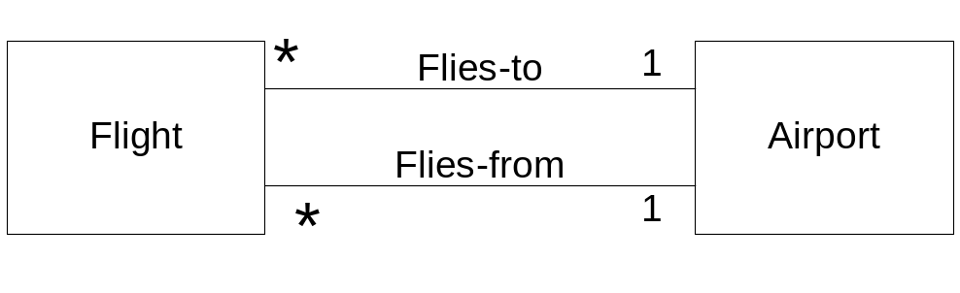
Association 4
Applying UML: Multiple Associations Between Two Classes
Guideline: Find Associations with a Common Associations List
Category
Examples
A is a transaction related to another transaction B
CashPaymentSale
CancellationReservation
A is a line item of a transaction B
SalesLineItemSale
A is a product or service for a transaction (or line item) B
ItemSalesLineItem (or Sale), FlightReservation
A is a role related to a transaction B
CustomerPayment
PassengerTicket

Slide 41
Association 5
Category
Examples
A is a physical or logical part of B
DrawerRegister, SquareBoard, SeatAirplane
A is physically or logically contained in/on B
RegisterStore, ItemShelf, SquareBoard, PassengerAirplane
A is a description for B
ProductDescriptionItem, FlightDescriptionFlight
A is known/logged/recorded/ reported/captured in B
SaleRegister, PieceSquare, ReservationFlightManifest
A is a member of B
CashierStore, PlayerMonopolyGame, PilotAirline
A is an organizational subunit of B
DepartmentStore, MaintenanceAirline
A uses or manages or owns B
CashierRegister, PlayerPiece, PilotAirplane
A is next to B
SalesLineItemSalesLineItem, SquareSquare, CityCity
Notes:
一些常见的关联。

Slide 42
Relate with Association
Cashier
Not a simple attribute
Name
CurrentPOST
Uses
Cashier
POST
1
1
Name
CurrentPOST
Number
Notes:
正确的写法：在右边写currentPOST作为Role。大多数情况下，role是大家都知道的。

Slide 43
Modeling Quantities
Payment
Useable, but not flexible or robust
amount:Number
Payment
Has-amount
Quantity
Is-in
Unit
*
1
*
1
amount:Number
Payment
Quantity are pure data value, so suitable be show in attribute section
amount:Quantity
Notes:
数量什么时候是类？
潜规则：Money，Quntity一但作为类，只代表设计者思考处理多币种，不同度量单位的问题。

Slide 44
★ ★ ★
POS Partial Domain Model
1
Records-
sale-of
Described-by
Product Catalog
Product
Description
Contains
Ledger
1 1..*
Used-by
1
0..1
*
1
1
1
*
Stocks
*
Describes
Sales LineItem
Store
1
Item
1
*
quantity
address
name
1
1..*
Logs-
completed
Contained-in
1
1
1..*
Houses
*
Manager
Sale
Captured-on
POST
1
1
date
time
0..1
1
Started-by
1
Paid-by
1
1
1
Records-sale-on
Initiated-by
1
1
Is-for
Cashier
1
Customer
1
Payment
amount
Notes:
领域图的第二步完成了。画上了关联
这是一个用例多次迭代后的产物。

Slide 45
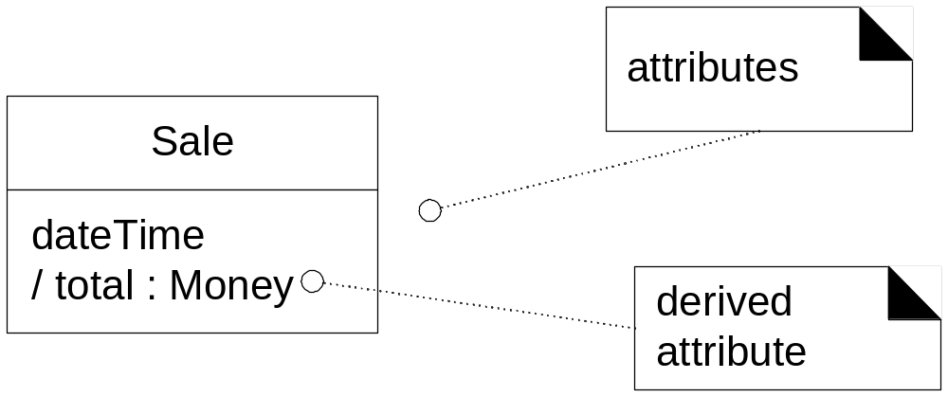
Attributes 1
An attribute is a logical data value of an object.
Guideline: When to Show Attributes?
  Include attributes that the requirements (e.g., use cases) suggest or imply a need to remember information.
  e.g., a receipt (which reports the information of a sale) in the Process Sale use case normally includes a date and time, the store name and address, and the cashier ID,
Notes:
可推导的／计算属性

Slide 46
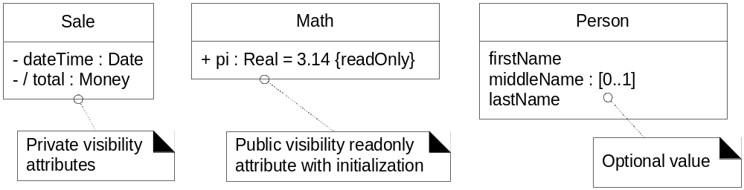
Attributes 2
Guideline: Where to Record Attribute Requirements?
  to use a tool that integrates UML models with a data dictionary; then all attributes will automatically show up as dictionary elements.
Derived Attributes
  The total attribute in the Sale can be calculated or derived from the information in the SalesLineItems.
Notes:
可见性，常数

Slide 47
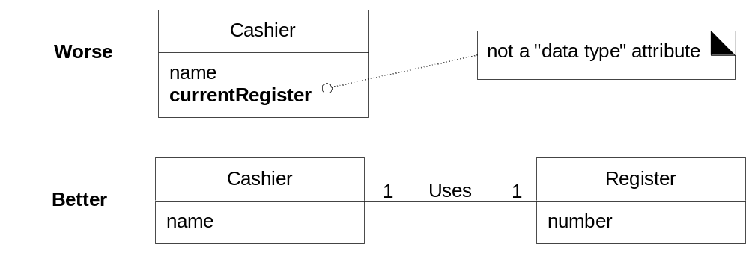
Attributes 3
Guideline: Focus on Data Type Attributes in the Domain Model.
  most attribute types should be primitive data types, such as numbers and booleans.

Slide 48
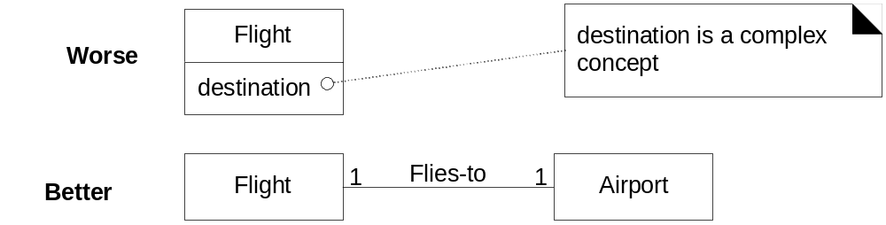
Attributes 4
Guideline: Don't show complex concepts as attributes; use associations

Slide 49
Attributes 5
Guideline: Represent what may initially be considered a number or string as a new data type class in the domain model if:
  It is composed of separate sections: phone number, name of person
  There are operations associated with it, such as parsing or validation.
    social security number
  It has other attributes.
    promotional price could have a start (effective) date and end date
  It is a quantity with a unit.
    payment amount has a unit of currency
  It is an abstraction of one or more types with some of these qualities.
    item identifier in the sales domain is a generalization of types such as Universal Product Code (UPC) and European Article Number (EAN)

Slide 50
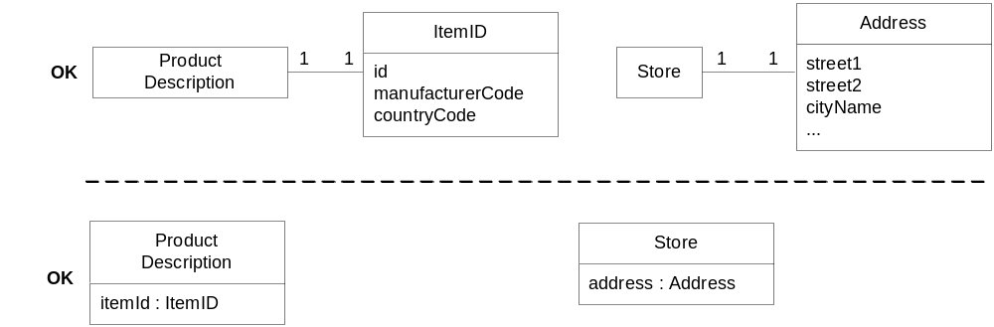
Attributes 6
Applying UML: Two ways to indicate a data type property of an object.

Slide 51
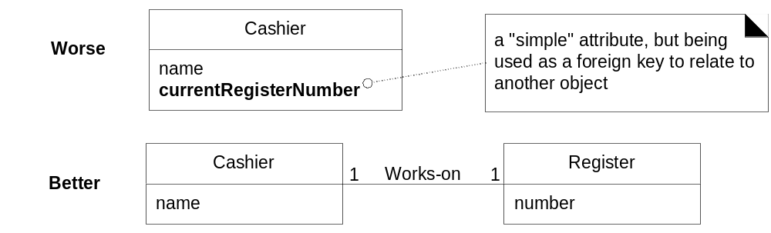
Attributes 7
Guideline: No Attributes Representing Foreign Keys.

Slide 52
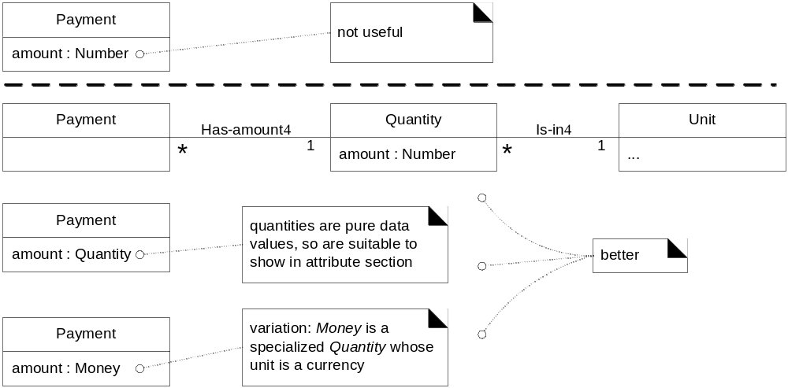
Attributes 8
Guideline: Modeling Quantities and Units.
  Most numeric quantities should not be represented as plain numbers.
  To represent Quantity as a distinct class, with an associated Unit.
  To show Quantity specializations. Money is a kind of quantity whose units are currencies. Weight is a quantity with units such as kilograms or pounds.

Slide 53
常见模型：树
树是常见的模型
例如：文件与目录
{abstract}
AbstractFile
size
*
Directory
File
container
Notes:
Container是什么元素：Role。
树的叶子节点是什么？File； 非叶子节点？容器

Slide 54
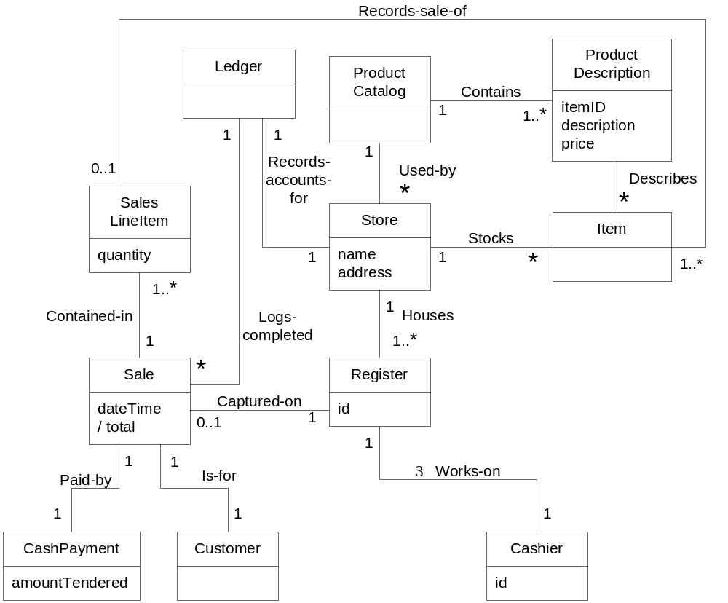
POS Partial Domain Model
Notes:
任务完成。
总结：
1）发现概念（名词）
2）去除界面，数据库，报表（计算结果），属性
3）建立关联
4）重要属性
干活，Lab2.Task2

Slide 55
Iterative and Evolutionary Domain Modeling
Discipline
Artifact
Incep.
Elab.
Const.
Trans.
Iteration
I1
E1..En
C1..Cn
T1..T2
Business Modeling
Domain Model
s
Requirements
Use-Case Model (SSDs)
s
r
Vision
s
r
Supplementary Specification
s
r
Glossary
s
r
Design
Design Model
s
r
SW Architecture Document
s
Data Model
s
r

