Slide 1
Applying UML and Patterns
An Introduction to
Object-oriented Analysis
and Design
and Iterative Development
Part III Elaboration Iteration I – Basic¹

Slide 2
Chapters
Iteration 1 – basics
Domain models
System sequence diagrams
Operation contracts
Requirements to design – iteratively
Logical architecture and UML package diagrams
On to object design
UML interaction diagrams
UML class diagrams
GRASP: design objects with responsibilities
Object design examples with GRASP
Design for visibility
Mapping design to code
Test-driven development and refactoring
Notes:
－－需求建模，输入就是用户故事。
通过用户故事，我们使用UML用例图，描述系统概况；使用UML领域模型描述问题领域中的概念及其之间的关系。
一方面统一需求文档中的术语，另一方面让设计人员更好理解对象之间的关系。
－－系统需求的一个重要任务，就是要识别系统有哪些功能，定义这些功能，并用这些功能给出典型业务实现的操作序列，以帮助使用者更好的理解系统。
例如：我们要理解cocos2d这样的系统，阅读一些游戏行为的实现序列，包括访问各种输入设备，管理游戏场景。
怎样获得系统的功能，并复用这些功能，组成一些有价值的业务实现序列。［为菜单、操作界面提供设计基础］

Slide 3
Chap 10
System Sequence Diagrams
Notes:
这个工具就是系统顺序图。

Slide 4
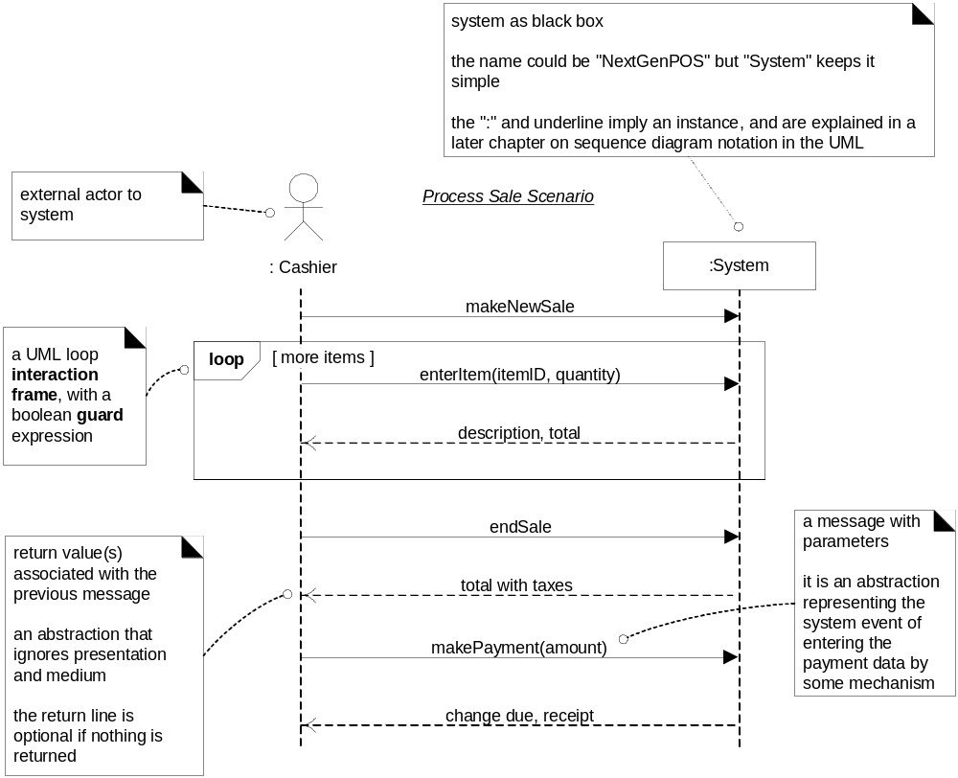
POS SSD: a Process Sale Scenario
Notes:
让我们看案例：
1、名字：XXX场景
2、参与者／系统：注意类前面的“：”的含义
3、操作顺序，注意箭头。实线箭头方向指向哪个对象，则表示它拥有相应的响应事件的职责。箭头上的文字表示A对象给B对象的消息或事件。虚线箭头表示系统响应信息。（很像用例的场景）
例如：
4、UML2.0 Fragment元素。

Slide 5
★
System Sequence Diagram 1
System sequence diagram
  a picture that shows, for one particular scenario of a use case, the events that external actors generate, their order, and inter-system events.
  All systems are treated as a black box; the emphasis of the diagram is events that cross the system boundary from actors to systems.
  During interaction between system and actor, an actor generates system events to a system, usually requesting some system operation to handle the event.
  UML includes sequence diagrams as a notation that can illustrate actor interactions and the operations initiated by them.
Guideline: Draw an SSD for a main success scenario of each use case, and frequent or complex alternative scenarios.
Notes:
p10.2 系统顺序图的概念与作用；系统事件、系统操作概念的区别；系统顺序图的使用准则；
注意：SSD图使用的对象和场景，外部actor一般包括主要参与者与外部系统

Slide 6
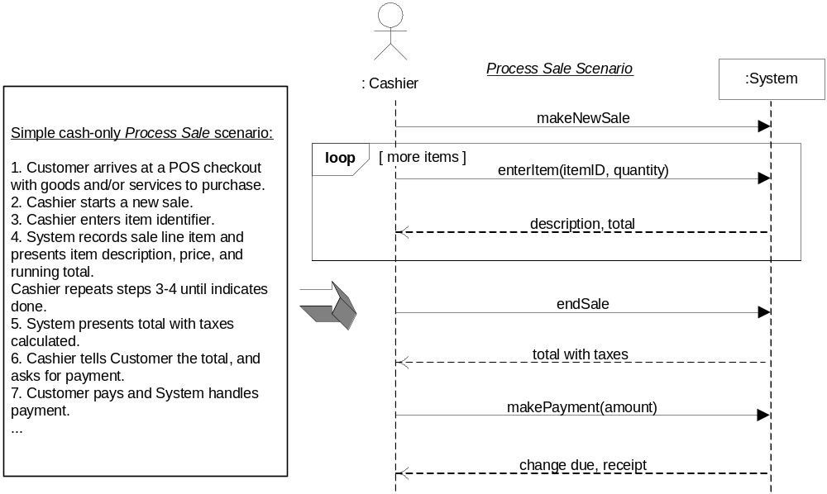
★ ★ ★
System Sequence Diagram 2
SSDs are derived from use cases; they show one scenario.
Notes:
p10.5 系统顺序图与Use case场景的关系。
让我们看第一句话，没有涉及与系统的交互；
第二句，营业员启动一个新的sales。为什么要写成makeNewSale(……)呢？
UML2.0？如果绘图系统不支持UML2.0怎么办？用注释符号表示循环、分支等元素

Slide 7
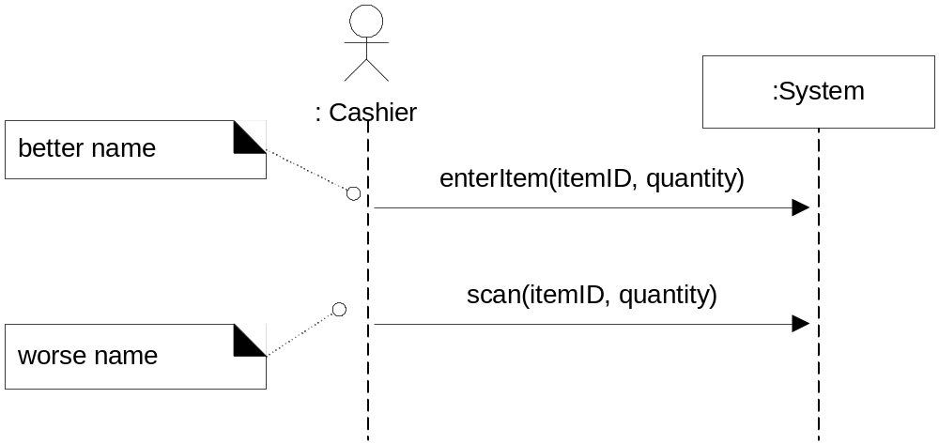
System Sequence Diagram 3
System events should be expressed at the abstract level of intention rather than in terms of the physical input device.
  "enterItem" is better than "scan" (laser scan) because it captures the abstract intent of the operation.
  design choices about what interface is used to capture the system event (laser scanner, keyboard, voice input ..)
Notes:
1）正确反映外部参与者发起事件的意图
2）注意图符号与对象之间的关系。营业员发送一个消息 makeNewItem（事件）给系统。箭头指向系统，则系统会响应这个事件。
3）操作抽象，展现操作的目的，而不是具体的实现。

Slide 8
System Sequence Diagram 4
Guideline
  show details of SSD in the Glossary.
  The elements shown in SSDs (operation name, parameters, return data) are terse.
Iterative and Evolutionary SSDs - UP Phases
  Inception phase: SSDs are not usually motivated in inception, unless you are doing rough estimating (don't expect inception estimating to be reliable) - function points or COCOMO II.
  Elaboration phase: Most SSDs are created during elaboration, when it is useful to identify the details of the system events to clarify what major operations, write system operation contracts, and possibly to support estimation.
Notes:
---Details 指代什么？。。。
---为什么不用它表示Use Case？
是否还记得Use Case文本的格式？ 每个场景语法都是 Actions-Responses序列，如果有可选场景，语法是Condition: Actions-Responses
顺序图关注操作之间的顺序。如果分支过多，请使用伪代码或UML活动图等手段。
---SSD的使用
在项目初始阶段不使用SSD，我们有一个粗燥的Use Case图就够了。大家如果使用EA的话，菜单里面有一个用例点估算工作量的功能。（误差50％不算多）
在项目细化阶段使用SSD，便于有效分析出系统需要提供哪些功能，以便实现功能级别的复用（用例是更高级别的复用），这时就可以用功能点更精确的估算工作量。
－－不要过度使用SSD，记住，20％的场景，往往包含80％的操作。

Slide 9
System Sequence Diagram - Buy-Item
Buy-Item-version 1
Actor
System as block box
:System
:Cashier
Enteritem(UPC, quantity)
Repeat until
no more items
endSale()
makePayment(amount)
Text which clarifies control, logic, iteration, etc.
May be taken from the use case
System event
It triggers a system operation
Notes:
---系统顺序图小结：
1、选择本次迭代要实现的主要场景（或子用例）。
2、建立抽象层次的外部触发事件（主参与者，时钟，系统异常），识别系统操作后的响应（结果）
2.1 按以下顺序组织参与者对象 ［主参与者］－［设计系统］；右边是支持系统或服务，次要参与者。例如：
2.2 尽可能建立一个无分支的操作顺序，最多两重UML2.0的Fragment。把焦点放在业务成功、失败的常见操作序列。
2.3 系统顺序图存放在对应的用例下层
2.4 事件的命名需要一定的抽象，箭头指向的对象表示该对象需要响应事件，实现操作（方法）
2.5、如果一个事件可能引发一个或多种子操作序列，请用注释在该事件说明。例如：makePayment的实现是makePaymentByCash(), 如果有必要，在该图的下一层，建立payByCash的主场景顺序图。
3、细化并完善词汇表、领域模型；
4、通过序列图，我们得到一组系统需要实现的操作。这时可以用功能点、COCOMOII模型，进一步细化估算系统开发工作量。

Slide 10
Chap 11
Operation Contracts
Notes:
操作协议，先看一个例子

Slide 11
POS Operation Contract
Contract CO2: enterItem
  Operation: enterItem(itemID: ItemID, quantity: integer)
  Cross References: Use Cases: Process Sale
  Preconditions: There is a sale underway.
  Postconditions:
    A SalesLineItem instance sli was created (instance creation).
    sli was associated with the current Sale (association formed).
    sli.quantity became quantity (attribute modification).
    sli was associated with a ProductDescription, based on itemID match (association formed).
Notes:
操作协议定义系统如何处理 enterItem 这个事件／消息

Slide 12
★
Sections of a Contract
Operation: Name of operation, and parameters
Cross References: Use cases this operation can occur within
Preconditions: Noteworthy assumptions about the state of the system or objects in the Domain Model before execution of the operation.
Postconditions: The state of objects in the Domain Model after completion of the operation.
Notes:
1、操作包含名字（动词，或动名词），以及一组参数。－－类似函数
2、操作可以在多用用例中被复用
3、前置条件、后置条件：注意核心词（state of objects in the domain）。 操作协议关注系统事件发生后，领域模型发生的变化。即研究操作对领域模型（数据）的影响。

Slide 13
System Operations 1
System operations
  Define as Operation contracts
  the system as a black box component offers in its public interface.
  can be identified while sketching SSDs
  SSDs show system events or I/O messages relative to the system.
Notes:
p11.3系统操作的定义（注意与事件／消息的区别），操作是系统对外的公共接口属性。
事件、消息是有方向的，它指向你研究的系统（实例）。

Slide 14
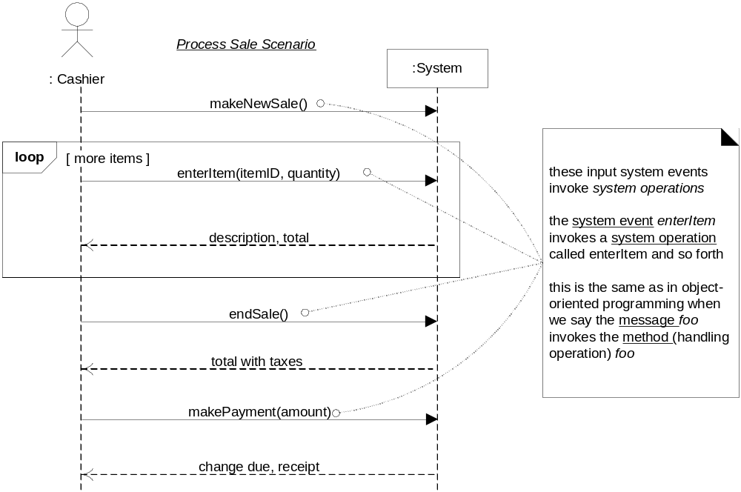
System Operations 2
SSD. System operations handle input system events
Notes:
系统操作处理事件

Slide 15
Postconditions 1
Postconditions
  describe changes in the state of objects in the domain model.
  Domain model state changes include instances created, associations formed or broken, and attributes changed.
  Postconditions are not actions to be performed.
Postconditions fall into these categories:
  Instance creation and deletion.
  Attribute change of value.
  Associations (UML links) formed and broken.
Postconditions Related to the Domain Model
  What instances can be created; What associations can be formed in the Domain Model.
Motivation: Why Postconditions?
  Postconditions support fine-grained detail and precision in declaring what the outcome of the operation must be.
Notes:
注意：后置条件描述的是数据变化的结果，不是响应的过程。（计算过程，是设计）
后置条件包括三类（对象的产生与消亡／属性的变化／关联的形成或取消）／ 采用固定的语法结构。

Slide 16
Postconditions 2
Guideline: To Write a Postcondition
  to emphasize state changes that arose from an operation, not an action to happen.
  (better) A SalesLineItem was created.
  (worse) Create a SalesLineItem, or, A SalesLineItem is created.
Analogy: The Spirit of Postconditions: The Stage and Curtain
  The system and its objects are presented on a theatre stage.
    1.Before the operation, take a picture of the stage.
    2.Close the curtains on the stage, and apply the system operation
    3.Open the curtains and take a second picture.
    4.Compare the before and after pictures, and express as postconditions the changes in the state of the stage
Guideline: How Complete Should Postconditions Be?
  generating a complete and detailed set of postconditions for all system operations is not likely or necessary.
Notes:
这个结构一般采用被动语态和过去时。
书上有一段类比（自己看）
注意：系统是复杂的，如果domian对象操作前可能有10种状态，操作后可能有10种状态，我如何描述这种变化？那就描述最典型一种应用。
例如：飞行棋，有一个操作roll骰子，它有6个可能结果，如果你得到一个6的运气，它的结果是在大本营和在路上的棋都处于可以选择的状态，其他则在路上的处于可以选择的状态。
然后是select&move操作。这时操作的结果，需要根据不同位置规则来决定。几乎无法写出后置条件。只能简单写，结果见规则A,B,D。

Slide 17
★ ★ ★
Example: enterItem Postconditions
Postconditions of the enterItem system operation.
  Instance Creation and Deletion
    After the itemID and quantity of an item have been entered, what new object should have been created? A SalesLineItem. Thus:
    A SalesLineItem instance sli was created (instance creation).
  Attribute Modification
    After the itemID and quantity of an item have been entered by the cashier, what attributes of new or existing objects should have been modified? The quantity of the SalesLineItem should have become equal to the quantity parameter. Thus:
    sli.quantity became quantity (attribute modification).
  Associations Formed and Broken
    After the itemID and quantity of an item have been entered by the cashier, what associations between new or existing objects should have been formed or broken?
    The new SalesLineItem should have been related to its Sale, and related to its ProductDescription. Thus:
    sli was associated with the current Sale (association formed).
    sli was associated with a ProductDescription, based on itemID match (association formed).
Notes:
后置条件的一些写法：p11.5

Slide 18
Guideline: Update the Domain Model
It's common during the creation of the contracts to discover the need to record new conceptual classes, attributes, or associations in the domain model.
Enhance it as you make new discoveries while thinking through operation contracts.
Notes:
细化领域模型。

Slide 19
Guideline: When Are Contracts Useful
Consider an airline reservation system
  the system operation addNewReservation: the complexity is very high regarding all the domain objects that must be changed, created, and associated.
  These fine-grained details can be written up in the use case, but it will make it extremely detailed (e.g., noting each attribute in all the objects that must change).
  the postcondition offers and encourages a very precise, analytical language.
If developers can comfortably understand what to do without them, then avoid writing contracts.
Notes:
用于表达复杂数据操作的要求，给出了系统功能明晰的定义；
以开发者知识为准。或者该内容在分析师做业务培训时，有分析师和开发者按需要决定是否编写。

Slide 20
Guideline: Create and Write Contracts
Identify system operations from the SSDs.
For system operations that are complex and perhaps subtle in their results, or which are not clear in the use case, construct a contract.
To describe the postconditions, use the following categories:
  instance creation and deletion
  attribute modification
  associations formed and broken
Writing Contracts
  write the postconditions in a declarative, passive past form (was ..) to emphasize the observation of a change rather than how it is going to be achieved.
  (better) A SalesLineItem was created.
  (worse) Create a SalesLineItem.
To establish an association between existing objects or those newly created.
  After the enterItem operation is complete, the newly created instance was associated with Sale; thus:
  The SalesLineItem was associated with the Sale.
The most common problem is forgetting to include the forming of associations. Particularly when new instances are created.
Notes:
创建和编写操作协议小结：

Slide 21
Example: NextGen POS Contracts 1
System Operations of the Process Sale Use Case
  Contract CO1: makeNewSale
  Operation:makeNewSale()
  Cross References: Use Cases: Process Sale
  Preconditions: none
  Postconditions:
    A Sale instance s was created (instance creation).
    s was associated with a Register (association formed).
    Attributes of s were initialized.
Keep it as light as possible, and avoid all artifacts unless they really add value.
Contract CO2: enterItem
  Operation: enterItem(itemID: ItemID, quantity: integer)
  Cross References: Use Cases: Process Sale
  Preconditions: There is a sale underway.
  Postconditions:
    A SalesLineItem instance sli was created (instance creation).
    sli was associated with the current Sale (association formed).
    sli.quantity became quantity (attribute modification).
    sli was associated with a ProductDescription, based on itemID match (association formed).

Slide 22
Example: NextGen POS Contracts 2
Contract CO3: endSale
  Operation: endSale()
  Cross References: Use Cases: Process Sale
  Preconditions: There is a sale underway.
  Postconditions:
    Sale.isComplete became true (attribute modification).
Contract CO4: makePayment
  Operation: makePayment( amount: Money )
  Cross References: Use Cases: Process Sale
  Preconditions:There is a sale underway.
  Postconditions:
    A Payment instance p was created (instance creation).
    p.amountTendered became amount (attribute modification).
    p was associated with the current Sale (association formed).
    The current Sale was associated with the Store (association formed); (to add it to the historical log of completed sales)

Slide 23
Process: Operation Contracts Within the UP
In the UML, operations exists at many levels, from System down to fine-grained classes, such as Sale.
  Operation contracts for the System level are part of the Use-Case Model.
Inception phase
  Contracts are not motivated during inception, they are too detailed.
Elaboration phase
  If used at all, most contracts will be written during elaboration, when most use cases are written. Only write contracts for the most complex and subtle system operations.
Notes:
绝大多数操作都是不写的，除非用户需要理解系统功能。
记住：
1）操作协议是帮助开发者理解业务行为结果的最有效工具。但通常是不需要的编写的。
2）操作协议是100％实现的。为了提高开发质量和效率，分析与设计人员会尽可能定义准确的系统API文档，并由系统开发工具doclet自动生成合格的操作协议。
后面我们可以看到，相关的类和方法coding的描述，就是操作协议。

Slide 24
Chap 6X
用例可视化－UML活动图
Notes:
UML活动图，先看一个例子

Slide 25
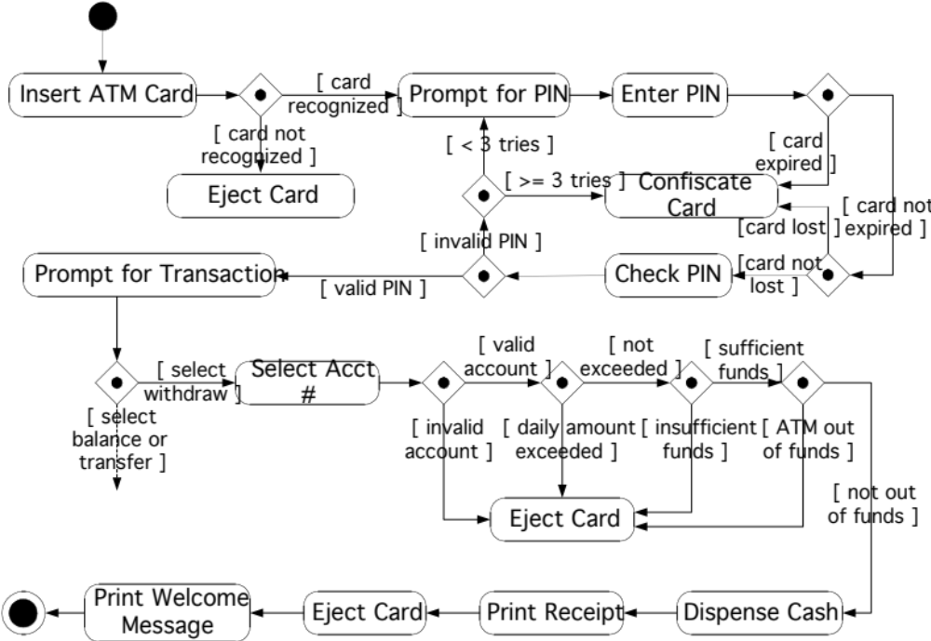
ATM Withdraw Activities Diagram
Notes:
这就是活动图。简单直观的描述了ATM 取款这个用例。
这个图用于客户、开发者沟通，很大程度上是足够的。

Slide 26
使用UML活动图
UML活动图的应用场合
  描述用户和您的系统之间的业务流程或工作流。
  描述某一用例中执行的步骤，使复杂的多场景用例以及与Include或extend用例的关系可视化。
  描述软件中的方法、函数或操作。（描述算法）
UML活动图的必要性
  编写Use Case文本太耗费时间
  复杂场景或包含很多子用例的用例文档，他们之间的过程关系用户难以理解
  在需求调查中，现场与用户高效沟通

Slide 27
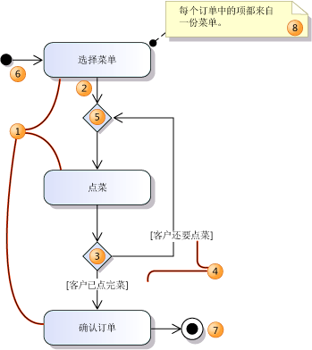
UML活动图基本符号
 | 符号解释
1 | 操作／子用例
2 | 控制流
3 | 决策节点
4 | 限定条件：［条件］
5 | 归并节点
6 | 起始节点：必须，唯一
7 | 中止节点：必须
8 | 注释：前置／后置条件；支持系统；用户感兴趣的各种需求；问题
更多细节：
UML软件设计图绘制准则（微软）

Slide 28
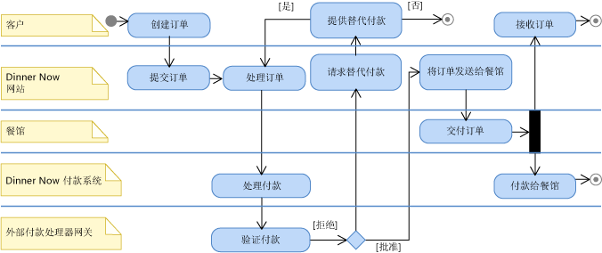
UML活动图用于业务建模
① 参与者／设计的系统
② 责职／用例／子用例 注意：业务建模一般不要细到操作级别。
①
②
④
③
③ 并行，Fork操作
④ 泳道，表示该泳道上的活动都是其上参与者的责职

Slide 29
Chap 4－12
系统需求建模小结

Slide 30
系统需求建模小结
目标：建立一致、无歧义的软件需求描述文档，用于用户与开发者之间高效沟通
输入：产品愿景、用例文档
UML用例图：
  展示系统外部环境，包含外部实体（三类参与者）
  给读者完整的系统概念，系统能为参与者做什么
UML领域模型：
  统一问题领域的业务概念
  概念之间基本业务规则（关联，角色，多重性）
UML活动图：
  展示用例操作或用例之间的活动过程
  多泳道活动图，业务流程建模
UML系统顺序图与操作契约
  识别系统提供的功能，建立基于功能点的工作量评估
  细化用例描述与领域模型
更多细节：
开发过程中使用模型：需求建模（微软）
Notes:
让我们回顾软件工程的定义：系统化、规范化、可度量的方法。
OOAD提供了目标清晰的开发过程，并给出了每一步的工作规范，并可用于评估项目的规模。

Slide 31
系统需求建模案例研究
微软 dinner Now+
Notes:
软件工程是实践科学，多做才能理解教材内容。

