Slide 1
Applying UML and Patterns
An Introduction to
Object-oriented Analysis
and Design
and Iterative Development
Part III Elaboration Iteration I – Basic²

Slide 2
Chapters
Iteration 1 – basics
Domain models
System sequence diagrams
Operation contracts
Requirements to design – iteratively
Logical architecture and UML package diagrams
On to object design
UML interaction diagrams
UML class diagrams
GRASP: design objects with responsibilities
Object design examples with GRASP
Design for visibility
Mapping design to code
Test-driven development and refactoring

Slide 3
Chap 14
On to Object Design

Slide 4
Three Ways to Develop Programs ₁
How do developers design objects? Here are three ways
  Code. Design-while-coding (Java, C#, …), ideally with power tools such as refactoring.
  Draw, then code. Drawing some UML on a whiteboard or UML CASE tool, then switching to #1 with a text-strong IDE (e.g., Eclipse or Visual Studio).
  Only draw. Somehow, the tool generates everything from diagrams.
  "Only draw" is a misnomer, as this still involves a text programming language attached to UML graphic elements.
This chapter introduces object design and lightweight drawing before coding, suggesting ways to make it pay off.
Notes:
p14开始简单介绍了应用UML图的三种方法。先code，然后借助强大的工具，逆工程，重构（数据访问层在JAVA中就是这样干的）；草图法，先画一些重要的UML，用于讨论沟通，然后编码（本课程要求这样干的）；将UML图作为编程工具，目前在探索阶段，只能做一些小程序。
我们的lab2会涉及前两种方法。

Slide 5
Three Ways to Develop Programs ₂
Some aims of agile modeling are to reduce drawing overhead and model to understand and communicate, rather than to document though documenting is easy with digital photos
Three ways to apply UML [Fowler03].
  using lots of whiteboards (ten in a room, not two) or special white plastic static cling sheets (that work like whiteboards) covering large wall areas, using markers, digital cameras, and printers to capture "UML as sketch"
  Modeling with others
  Creating several models in parallel. For example, five minutes on a wall of interaction diagrams, then five minutes on a wall of related class diagrams
Notes:
敏捷开发的做法与工作场景

Slide 6
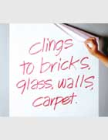
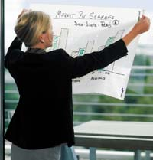

Tips
More tips of using Agile modeling
It's easy to upload digital photos of wall drawings to an internal wiki (see www.twiki.org) that captures your project information.
Popular brands of white plastic static cling sheets:
  Write On Cling Sheets
  Magic-Chart
Write On Cling Sheets
Magic-Chart
Notes:
异地协同的基本方法。
运用wiki共同设计并积累需求设计文档

Slide 7
UML Tools
Guidelines
  Choose a UML CASE tool that integrates with popular text-strong IDEs, such as Eclipse or Visual Studio.
  Choose a UML tool that can reverse-engineer (generate diagrams from code) not only class diagrams (common), but also interaction diagrams (more rare, but very useful to learn call-flow structure of a program).
Agile modeling on the walls and using a UML CASE tool integrated into a text-strong IDE can be complementary. Try both during different phases of activity.
Notes:
一定要会使用UML工具，否则会被人笑话的！

Slide 8
How Much Time Spent Drawing
UML Before Coding
For a three-week timeboxed iteration,
  spend a few hours or at most one day (with partners) near the start of the iteration "at the walls" (or with a UML CASE tool)
  Then stop - and if sketching - perhaps take digital photos, print the pictures, and transition to coding for the remainder of the iteration
  Using the UML drawings for inspiration as a starting point, but recognizing that the final design in code will diverge and improve.
  Shorter drawing/sketching sessions may occur throughout the iteration.

Slide 9
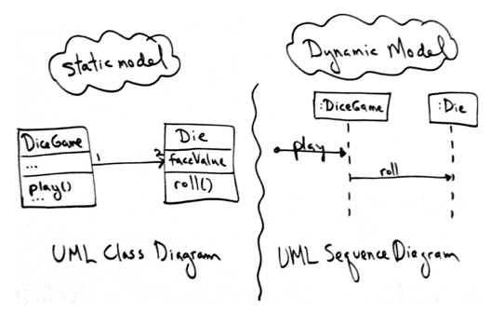
Designing Objects
There are two kinds of object models: dynamic and static.
Spend a short period of time on interaction diagrams (dynamics), then switch to a wall of related class diagrams (statics).
Notes:
当我们设计好系统的架构，将Use case相关的一些候选的类放置到对应的包中后，就需要使用这两个图（静态、动态），细化我们的设计。

Slide 10
Dynamic Object Modeling
Most of the challenging, interesting, useful design work happens while drawing the UML dynamic-view interaction diagrams
Spend significant time doing interaction diagrams (sequence or communication diagrams), not just class diagrams.
Ignoring this guideline is a very common worst-practice with UML.
Notes:
把自己的精力主要花在交互图上，才是最佳实践。这才能帮助你真正理解实现系统需要什么，以及解决问题的过程，为未来优化设计提供直观的体验。
尽管，通过 lab1 你可能发现 类图 在提高程序开发质量方面的作用，但这个理解是相当不充分的。
理论分析讨论开发方法的优劣，毫无意义，请用Lab2,3的开发，去验证，并给出最终答案。

Slide 11
★
Static Object Modeling
After first covering dynamic modeling with interaction diagrams, we then do the static object modeling
If the developers are applying the agile modeling practice of Create several models in parallel, they will be drawing both interaction and class diagrams concurrently.
Notes:
不要讨论先画什么图，两个图是一致的，使用工具后，你会发现：静态对象图在你画动态图时同时完成了。☺

Slide 12
Object Design Skill
The importance of object design skill is over UML notation skill
  What's important is knowing how to think and design in objects, and apply object design best-practice patterns, which is much more valuable skill than knowing UML notation
  Drawing UML is a reflection of making decisions about the design
While drawing a UML object diagram, we need to answer key questions:
  What are the responsibilities of the object?
  Who does it collaborate with?
  What design patterns should be applied?
  Far more important than knowing the difference between UML 1.4 and 2.0 notation! Therefore, the emphasis of the following chapters is on these principles and patterns in object design.
Notes:
画UML对象图需要关注的三个问题。职责、协作与模式。
例如：你在使用层次架构的MVC模式实现用例时，你必须关注三种类的定义和职责，以及他们之间的协作关系。

Slide 13
Fundamental object design
The object design skills are what matter, not knowing how to draw UML. Fundamental object design requires knowledge of:
  principles of responsibility assignment
  design patterns
Notes:
注意，UML只是交流、设计工具。你学习的核心是为什么这些类。
例如：在Lab1中不少团队将world作为程序设计的中心，它承担了游戏模型的update，控制器，视图的更新。显然这是直观的，但太重了。它有太多的方法，与其他类太多的关联，遇到任何变化几乎都能导致全局的变化。请仔细体会我给大家的运用黑板模式的设计方案。

Slide 14
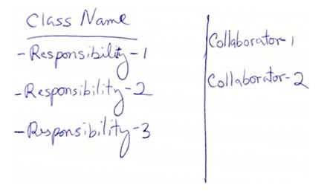
Class Responsibility Card
A CRC modeling session involves a group sitting around a table, discussing and writing on the cards as they play "what if" scenarios with the objects, considering what they must do and what other objects they must collaborate with.
Each card represents one class
Notes:
书上介绍了CRC方法，请大家自己阅读。这是OO早期方法，UML方法使用后，基本就不用了。

Slide 15
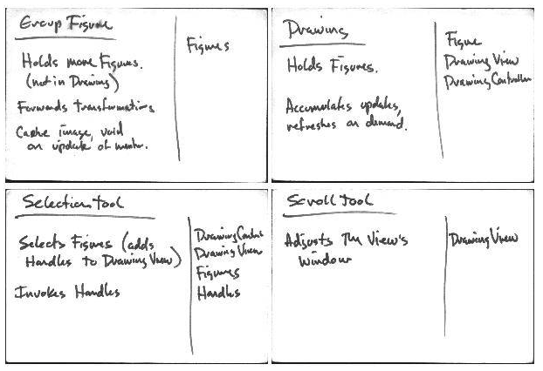
CRC Examples
More detailed: http://c2.com/doc/crc/draw.html
Notes:
本章要点：
（1）OO设计在一个迭代中仅需要 a few hours or days
（2）在敏捷开发中，UML图是作为快速设计沟通的工具。要使用UML提高工作效率
（3）把主要精力放在对象交互图上。类图和交互图是同时完成的
（3）OO设计的核心不是绘制UML图，是关注对象职责的分类原则、交互过程和设计模式。

