Slide 1
Applying UML and Patterns
An Introduction to
Object-oriented Analysis
and Design
and Iterative Development
Part III Elaboration Iteration I – Basic²

Slide 2
Chapter 15
UML Interaction Diagrams
Notes:
首先，我们了解一些绘制UML交互图的基础知识，保证我们画出正确、易于程序员理解、编程的图
然后，我们描述用例的实现过程。即通过绘制UML交互图，研究参与者、边界类、控制器、实体之间的关系，并给出高阶的程序实现。
当然，采用UML状态图，也是方法之一。
最后，运用高阶的程序，和类图，我们将按一定的设计准则，将程序映射到一个现实的系统平台上。（这需要大家按课程要求，准备一种web程序开发技术）

Slide 3
★
Introduction
The UML includes interaction diagrams to illustrate how objects interact via messages.
  sequence and communication interaction diagrams.
This chapter introduces the notation - view it as a reference to skim through - while subsequent chapters focus on a more important question: What are key principles in OO design?
Notes:
UML交互图的符号系统（考试重点，要求顺序图、通讯图、代码之间之间转换）

Slide 4
Sequence and Communication Diagrams
The term interaction diagram is a generalization of two more specialized UML diagram types:
  sequence diagrams
  communication diagrams
Both can express similar interactions
A related diagram is the interaction overview diagram;
  provides a big-picture overview of how a set of interaction diagrams are related in terms of logic and process-flow.
  It's new to UML 2, and so it's too early to tell if it will be practically useful.
Notes:
它有两种UML图，顺序图和通讯图。这两个图是等价的，仅应用场景不一样。
提到顺序图，这在需求里已使用过（系统顺序图）
交互图设计－－描述一个场景的软件对象（不是参与者与系统）之间交互的方法。它具有顺序、分支、循环表达能力，即一种高阶的编程技术

Slide 5
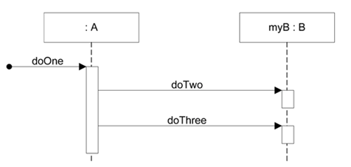
Sequence Diagram
Sequence diagrams illustrate interactions in a kind of fence format, in which each new object is added to the right,
public class A {
private B myB = new B();
public void doOne() {
myB.doTwo();
myB.doThree();
}
// …
}
Notes:
－－顺序图，符号体系：
1）对象：最上面是一组参与交互的对象，“：”表示是对象或实例，不是类。（不能是你设计的系统，那是需求）
2）时间轴线：每个对象下有一条虚线，表示对象存活的生命周期的时间轴线。
3）消息（message）：使用箭头表示，箭头上有消息的名字。名字代表箭头指向对象的职责，或者是对象将实现的方法。例如：A类实现doOne方法，B类实现doTwo，doThree方法。命名方法，也是抽象的意图。
－－符号与系统顺序图是一致的。区别：系统内软件对象／系统外部参与者与系统；消息／事件；类的方法／系统操作。
4）对象A，在处理消息doOne时，有一个执行体，表示doOne工作域。即类方法的作用域。
－－应用要点：
1）通过这个基本符号体系，我们绘制的UML交互图它一定对应一个高阶的，可以用伪代码描述的程序，如右边所示。
2）程序中要注意：类A一定要有方法获得类B实例的过程。主要手段包括：直接new; 利用singlton等模式构造；通过参数传递。
3）多用工具绘图，避免不必要的绘图错误。
3）
要点：不能画超过一页纸。

Slide 6
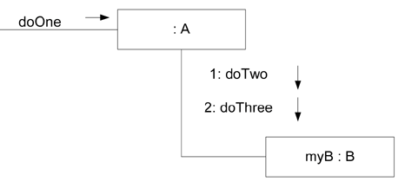
Communication Diagram
Communication diagrams illustrate object interactions in a graph or network format, in which objects can be placed anywhere on the diagram
Notes:
通讯图和顺序图是等价的。符号体系：
1）对象：可以放在任何地方，注意“：”
2）联系：对象之间的连线，没有箭头。表示，两个对象之间可能存在的通讯关系，即调用或被调用
3）消息与标号：在通讯关系上的小箭头。例如：A接收消息doOne, 然后，按顺序向myB发送 doTwo 与 doThree.
使用要点：
1）应能翻译成如前面顺序图一样的伪代码；
2）使用EA这样的UML设计工具，你可以自动生成对应的顺序图。

Slide 7
Strengths and Weaknesses ₁
Sequence diagrams have some advantages over communication diagrams
  UML specification is more sequence diagram centric - more thought and effort has been put into the notation and semantics.
    Thus, tool support is better and more notation options are available
  it is easier to see the call-flow sequence with sequence diagrams simply read top to bottom.
    With communication diagrams we must read the sequence numbers, such as "1:" and "2:"
Notes:
两种图的区别与联系（以前考试考过的，简答题，或者 给你一种图画另一种图）
1）联系：都能表达一个的程序
2）区别：对象摆放的位置，生命线与联系，消息的顺序的表达方式

Slide 8
Strengths and Weaknesses ₂
Advantages of communication diagrams
  communication diagrams have advantages when applying "UML as sketch" to draw on walls (an Agile Modeling practice) because they are much more space-efficient.
  boxes can be easily placed or erased anywhere horizontal or vertical.
  In contrast, new objects in a sequence diagrams must always be added to the right edge, which is limiting as it quickly consumes and exhausts right-edge space on a page (or wall)
Notes:
3）应用场景不一样。通讯图更合适画草图；顺序图更易于阅读，作为正式文档的表达；
－－你可能已发现，我们前面用MVC模式绘制的用例实现的图，就差标上消息就可以得到程序的伪代码了。
太对了！！！

Slide 9
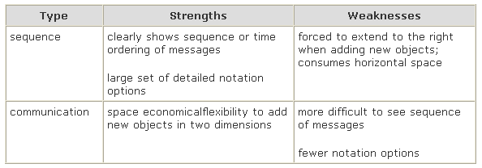
★ ★
Strengths and Weaknesses ₃

Slide 10
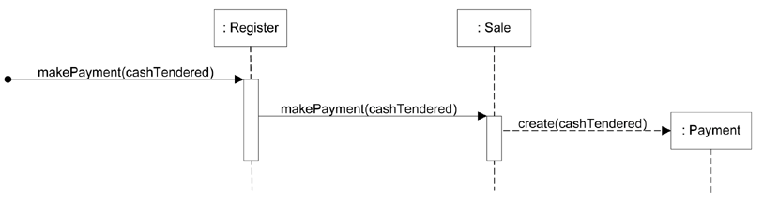
★ ★ ★
Example Sequence Diagram
The message makePayment is sent to an instance of a Register. The sender is not identified.
The Register instance sends the makePayment message to a Sale instance.
The Sale instance creates an instance of a Payment.
What might be some related
code for the Sale class
and its makePayment method?
Notes:
看到这个图，联想到需求中的系统顺序图和操作契约（协议），可以导出程序是怎么实现makePayment操作协议的吗？
1）UI收到系统事件 makePayment
2）UI将 makePayment消息 交给控制器 ：Register
3）Register 将 makePayment消息 交给 ：Sale
4）Sale 创建 Payment对象， 然后修改 Payment 与 Sale 的关联；修改 Payment的属性；……
－－这里，你应该明操作契约（协议）为什么要那样写：created … modified … related …
－－Sale 的部门代码是什么？

Slide 11
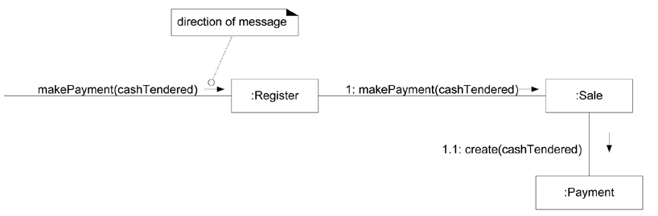
★ ★ ★
Example Communication Diagram
public class Sale {
private Payment payment;
public void makePayment
( Money cashTendered ) {
payment = new Payment
( cashTendered );
//…
}
// …
}
Notes:
Money类型的隐含需求是什么？…… 国际化

Slide 12
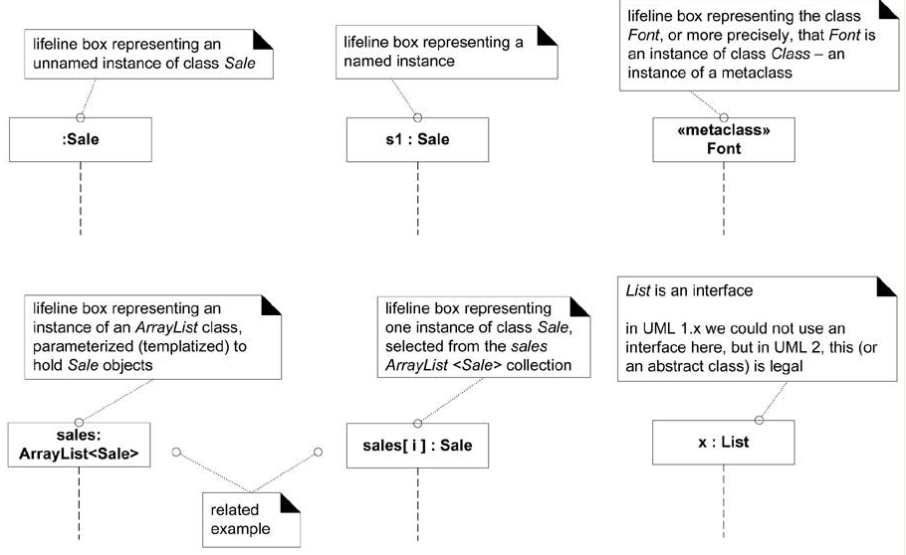
Common UML Interaction Diagram Notation
Lifeline boxes to show participants in interactions
Notes:
常见对象的的描述符号：
匿名对象；有名对象；静态对象
数组，数组中的元素，接口（抽象类）

Slide 13
Basic Message Expression Syntax
UML has a standard syntax for these message expressions
  return = message(parameter : parameterType) : returnType
Parentheses are usually excluded if there are no parameters, though still legal.
Type information may be excluded if obvious or unimportant.
For example:
  initialize(code)
  initialize
  d = getProductDescription(id)
  d = getProductDescription(id:ItemID)
  d = getProductDescription (id:ItemID) : ProductDescription
Notes:
消息的描述。
消息有多种描述方式，是因为按迭代需要（早期设计，草稿，一般不写返回和数据类型）

Slide 14
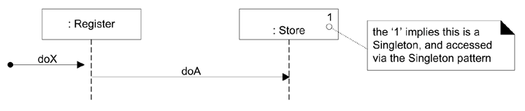
Singleton（单实例） Objects
In the world of OO design patterns, there is one that is especially common, called the Singleton pattern
  There is only one instance of a class instantiated - never two
Notes:
单实例的表达。如果你不知道什么是单实例，请百度

Slide 15
Basic Sequence Diagram Notation
Lifeline Boxes and Lifelines
  In sequence diagrams the lifeline boxes include a vertical line extending below them - these are the actual lifelines.
  Although virtually all UML examples show the lifeline as dashed (because of UML 1 influence), in fact the UML 2 specification says it may be solid or dashed.
Messages
  Each (typical synchronous) message between objects is represented with a message expression on a filled-arrowed solid line between the vertical lifelines
  The time ordering is organized from top to bottom of lifelines.
Notes:
生命线，执行体
消息

Slide 16
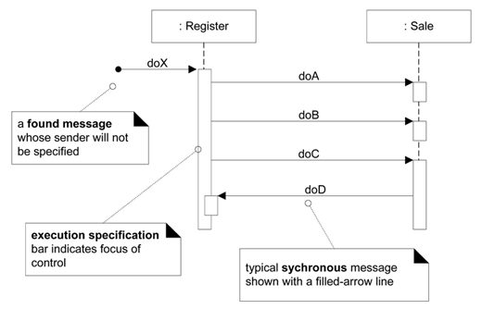
Message and Focus of Control ₁
found message:
  the sender will not be specified, is not known, or that the message is coming from a random source
Notes:
不指定源的消息，执行体，同步消息
－－Register有那些方法? Sale有哪些方法? Sale如何知道Regster对象的？… Sale::doC(reg Regsiter)这是最简单的办法

Slide 17
Message and Focus of Control ₂
Sequence diagrams may also show the focus of control using an execution specification bar (previously called an activation bar or simply an activation in UML 1).
  The bar is optional.
  Guideline: Drawing the bar is more common (and often automatic) when using a UML CASE tool, and less common when wall sketching.

Slide 18
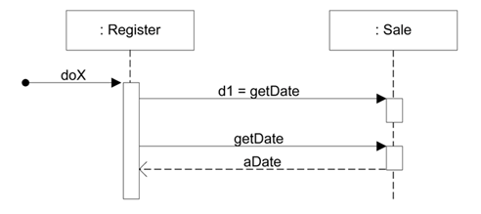
Illustrating Reply or Returns
There are two ways to show the return result from a message:
  Using the message syntax
    returnVar = message(parameter).
  Using a reply (or return) message line at the end of an activation bar.
Notes:
显示响应的方法。

Slide 19
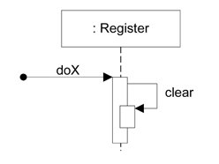
Messages to "self" or "this"
You can show a message being sent from an object to itself by using a nested activation bar
Notes:
内部方法

Slide 20
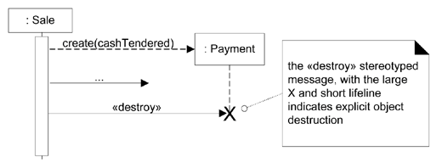
Creation of Instances
The arrow is filled if it's a regular synchronous message (such as implying invoking a Java constructor), or open (stick arrow) if an asynchronous call.
  The message name create is not required - anything is legal - but it's a UML idiom.
Object Lifelines and Object Destruction
Notes:
创建和释放对象

Slide 21
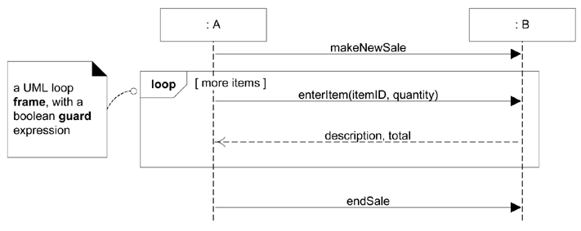
Diagram Frames in UML Sequence Diagrams ₁
To support conditional and looping constructs (among many other things), the UML uses frames.
  Frames are regions or fragments of the diagrams;
  they have an operator or label (such as loop) and a guard (conditional clause).
Notes:
表示分支、循环结构

Slide 22
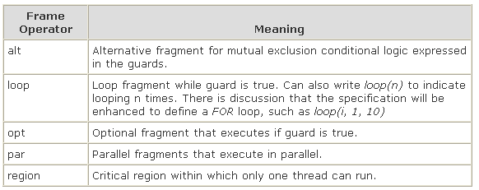
★ ★
Diagram Frames in UML Sequence Diagrams ₂
Notes:
Case 结构（不同于 C ）／ If then else
循环
if 程序块
并行
临界区

Slide 23
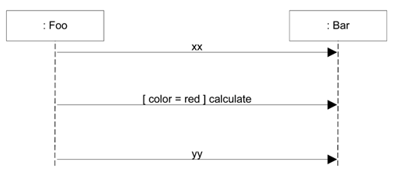
Condition message
Use UML 1 style only for simple single messages when sketching
Notes:
简单的单语句if结构

Slide 24
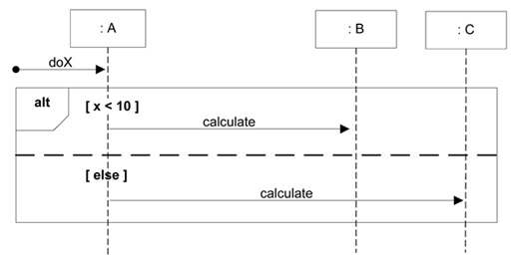
Mutually Exclusive Conditional Messages
An ALT frame is placed around the mutually exclusive alternatives

Slide 25
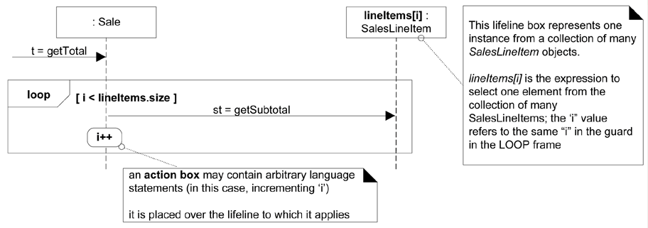
★ ★ ★
Iteration Over a Collection ₁
A common algorithm is to iterate over all members of a collection (such as a list or map), sending the same message to each.
Often, some kind of iterator object is ultimately used, such as an implementation of java.util.Iterator or a C++ standard library iterator, although in the sequence diagram that low-level "mechanism" need not be shown in the interest of brevity or abstraction.
Notes:
迭代

Slide 26
Iteration Over a Collection ₂
The selector expression is used to select one object from a group. Lifeline participants should represent one object, not a collection.
public class Sale {
private List<SalesLineItem> lineItems = new ArrayList<SalesLineItem>();
public Money getTotal() {
Money total = new Money();
Money subtotal = null;
for ( SalesLineItem lineItem : lineItems ) {
subtotal = lineItem.getSubtotal();
total.add( subtotal );
}
return total;
}
// …
}
Notes:
对应的伪代码（以前考试出过该题，给你图写代码）

Slide 27
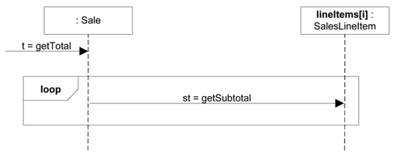
Iteration Over a Collection ₃
Another variation is shown below
  The intent is the same, but details are excluded.
  A team or tool could agree on this simple style by convention to imply iteration over all the collection elements
Notes:
画成这样也不错

Slide 28
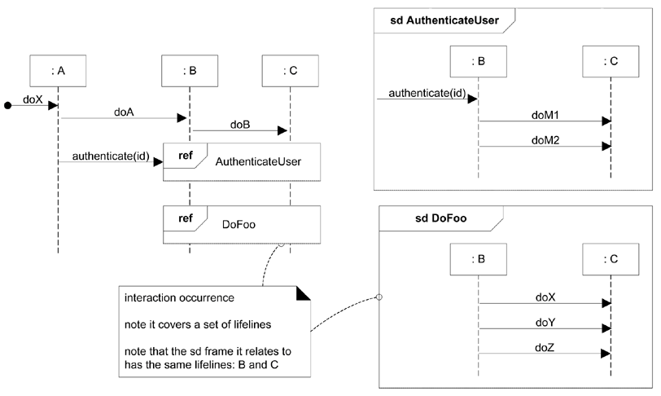
Relating Interaction Diagrams ₁
Notes:
子程序

Slide 29
Relating Interaction Diagrams ₂
An interaction occurrence (also called an interaction use) is a reference to an interaction within another interaction.
  for example, when you want to simplify a diagram and factor out a portion into another diagram, or there is a reusable interaction occurrence.
  UML tools take advantage of them, because of their usefulness in relating and linking diagrams.

Slide 30
Metaclass ₁
You can show class or static method calls by using a lifeline box label that indicates the receiving object is a class, or more precisely, an instance of a metaclass
in Java and Smalltalk, all classes are conceptually or literally instances of class Class;
in .NET classes are instances of class Type. The classes Class and Type are metaclasses, which means their instances are themselves classes.
A specific class, such as class Calendar, is itself an instance of class Class. Thus, class Calendar is an instance of a metaclass! It may help to drink some beer before trying to understand this.
Notes:
静态类

Slide 31
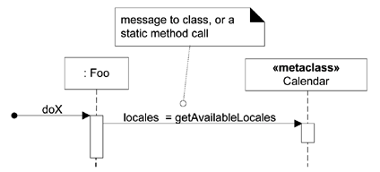
Metaclass ₂
public class Foo {
public void doX() {
// static method call on class
Calendar Locale[] locales = Calendar.getAvailableLocales();
// …
}
// …
}

Slide 32
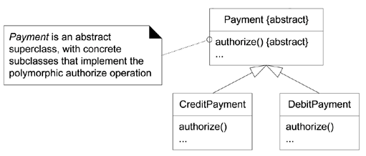
Polymorphic Messages and Cases
How to show it in a sequence diagram? That's a common UML question.
  To use multiple sequence diagrams - one that shows the polymorphic message to the abstract superclass or interface object, and then separate sequence diagrams detailing each polymorphic case, each starting with a found polymorphic message
Notes:
多态

Slide 33
Asynchronous and Synchronous Calls
An asynchronous message call does not wait for a response; it doesn't block.
They are used in multi-threaded environments such as .NET and Java so that new threads of execution can be created and initiated.
In Java, for example, you may think of the Thread.start or Runnable.run (called by Thread.start) message as the asynchronous starting point to initiate execution on a new thread

Slide 34
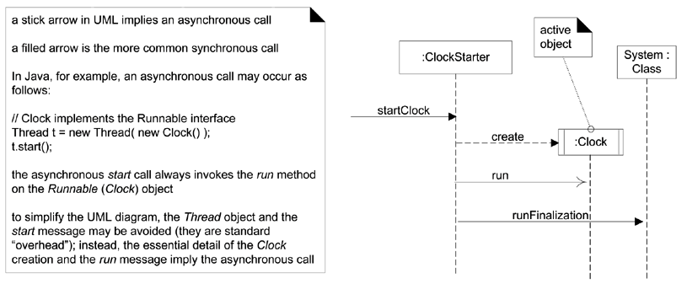
Conti.
Notes:
一部调用

Slide 35
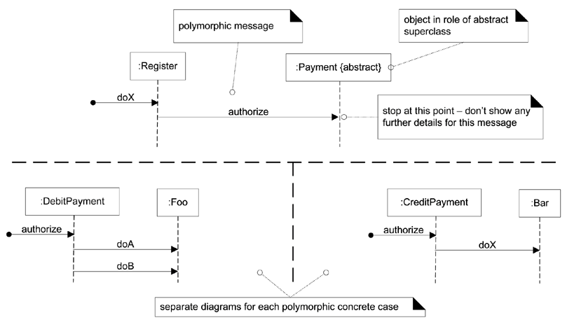
Conti.
Notes:
不需要

Slide 36
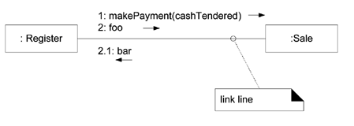
Basic Communication Diagram Notation
A link is a connection path between two objects;
  it indicates some form of navigation and visibility between the objects is possible
  More formally, a link is an instance of an association.
Notes:
通讯图符号

Slide 37
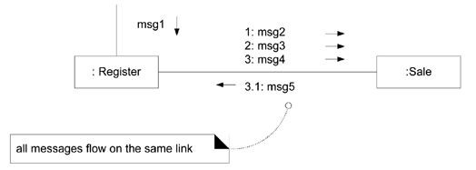
Message
Messages
  Each message between objects is represented with a message expression and small arrow indicating the direction of the message.
  Many messages may flow along this link.
  A sequence number is added to show the sequential order of messages in the current thread of control.
Notes:
消息的顺序

Slide 38
Creation of Instances ₁
Any message can be used to create an instance, but the convention in the UML is to use a message named create for this purpose (some use new).
If another (less obvious) message name is used, the message may be annotated with a UML stereotype, like so: «create».
The create message may include parameters, indicating the passing of initial values. This indicates, for example, a constructor call with parameters in Java.
Furthermore, the UML tagged value {new} may optionally be added to the lifeline box to highlight the creation.
Tagged values are a flexible extension mechanism in the UML to add semantically meaningful information to a UML element.

Slide 39
Creation of Instances ₂
Three ways to show creation in a
communication diagram
create message
,
with optional initializing parameters
.
This will
normally be interpreted as a constructor call
.
1
:
create
(
cashier
)
:
Register
:
Sale
1
:
create
(
cashier
)
:
Register
:
Sale
{
new
}
«create»
1
:
make
(
cashier
)
:
Register
:
Sale
if an unobvious creation message name is used
,
the
message may be stereotyped for clarity

Slide 40
Message Number Sequencing ₁
The order of messages is illustrated with sequence numbers, The numbering scheme is:
  The first message is not numbered. Thus, msg1 is unnumbered
  Actually, a starting number is legal, but it makes all subsequent numbering more awkward, creating another level of number-nesting deeper than otherwise necessary.
  The order and nesting of subsequent messages is shown with a legal numbering scheme in which nested messages have a number appended to them.
  You denote nesting by pre-pending the incoming message number to the outgoing message number

Slide 41
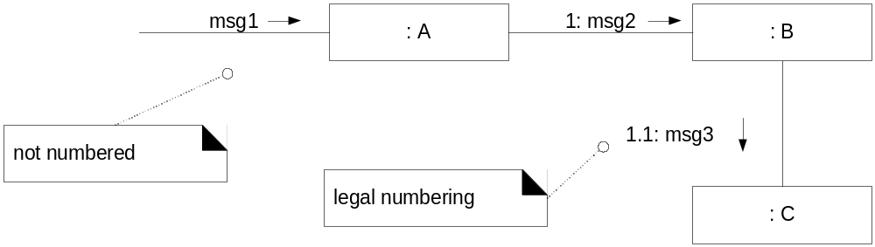
Message Number Sequencing ₂

Slide 42
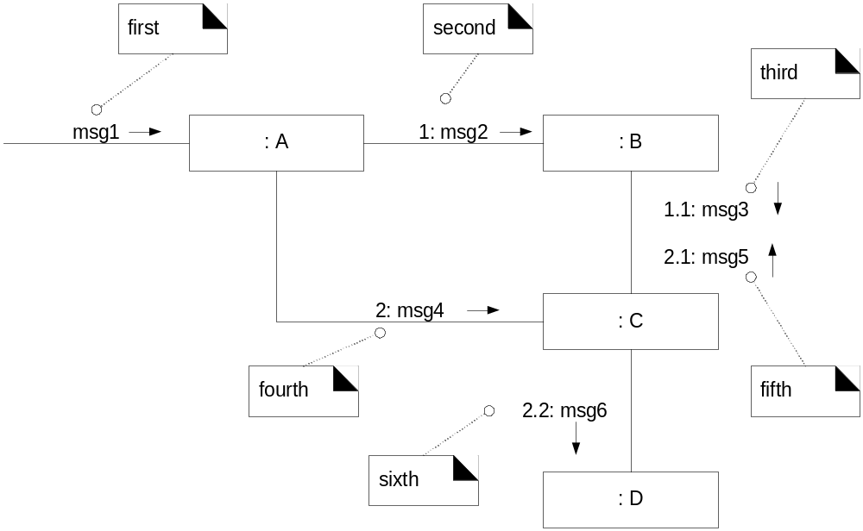
Message Number Sequencing ₃

Slide 43
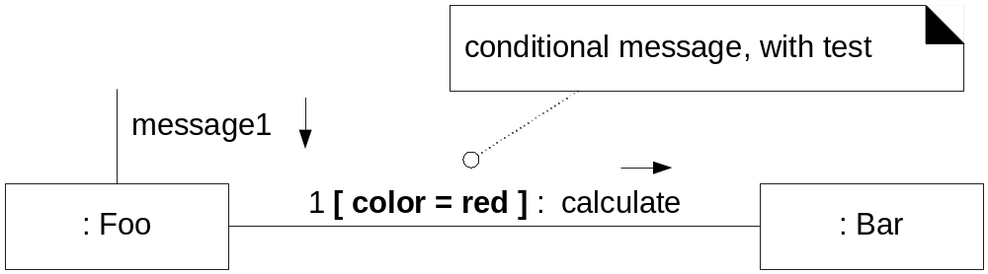
Conditional Messages
A conditional message is shown by following a sequence number with a conditional clause in square brackets, similar to an iteration clause.
The message is only sent if the clause evaluates to true.

Slide 44
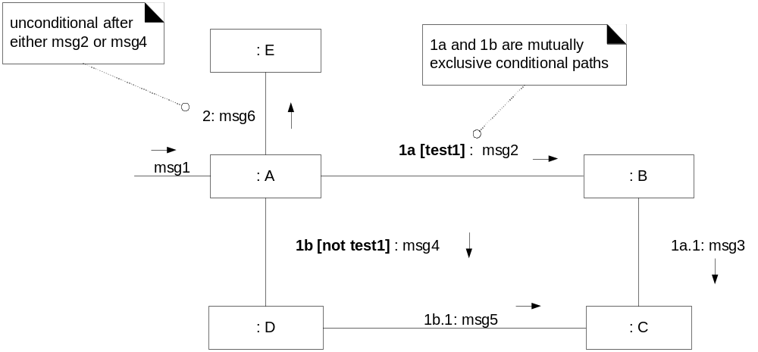
Mutually Exclusive Conditional Paths ₁

Slide 45
Mutually Exclusive Conditional Paths ₂
The example illustrates the sequence numbers with mutually exclusive conditional paths
In this case we must modify the sequence expressions with a conditional path letter. The first letter used is a by convention. Either 1a or 1b could execute after msg1.
Both are sequence number 1 since either could be the first internal message.
Note that subsequent nested messages are still consistently prepended with their outer message sequence. Thus 1b.1 is nested message within 1b.

Slide 46
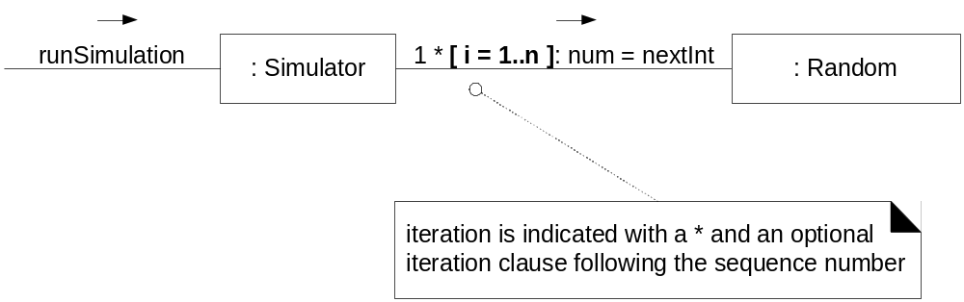
Iteration or Looping
If the details of the iteration clause are not important to the modeler, a simple * can be used.

Slide 47
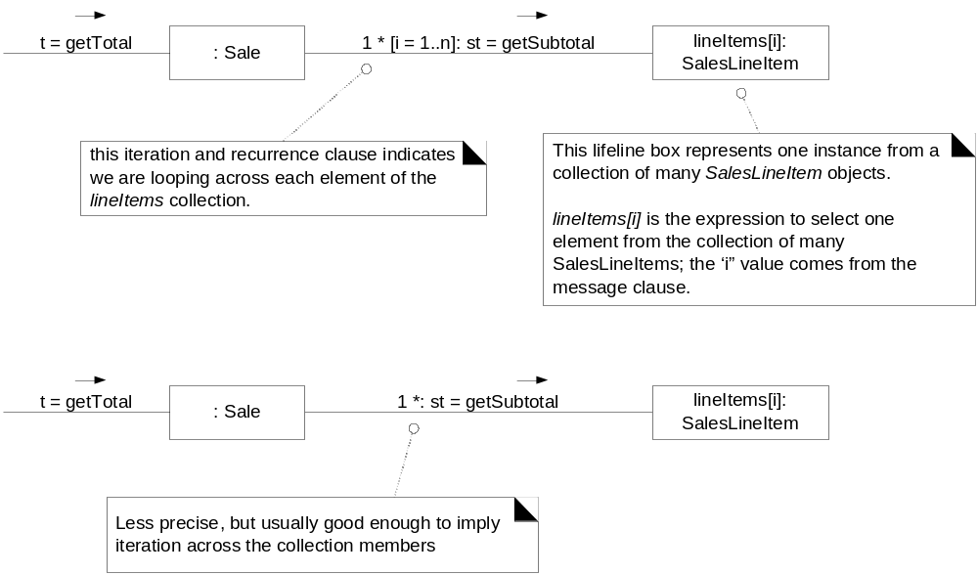
Iteration Over a Collection

Slide 48
Messages to a Classes to Invoke
Static Methods
message to class
,
or a
static method call
doX
1
:
locs
=
getAvailableLocales
«metaclass»
:
Foo
Calendar

Slide 49
Polymorphic Messages and Cases
stop at this point
–
don’t show any
polymorphic message
further details for this message
doX
:
Register
authorize
:
Payment
{
abstract
}
object in role of abstract
superclass
authorize
authorize
doA
doX
:
DebitPayment
doB
:
Foo
:
CreditPayment
:
Bar
separate diagrams for each polymorphic concrete case
Notes:
不要

Slide 50
Asynchronous and Synchronous Calls
startClock
3
:
runFinalization
:
ClockStarter
System
:
Class
1
:
create
asynchronous message
2
:
run
active object
:
Clock

Slide 51
用例的实现-通讯图
1.2 findCityByName(mSearchIno.city)
[find]1.3b1 getHotelByCity(info)
HotelHomePage.jsp
1.1 set mSearchInfo to form
form
1. searchHotel(form)
Hotel
SearchHotelForm
SearchHotelAction
City
[not find]1.3a5 forward/render
[find]1.3b2 forward/render
FindLocation.jsp
FindByLocationAction
Country
Choose Hotel
Region
[not find]
1.3a1 findCapitalCities (user.Country)
1.3a2 findRegionsByCountry (user.Country)
…
Notes:
－－设计与需求的关系：一组软件类是如何通过协作完成操作契约的，即用户改变领域模型的过程。
－－交互图与伪代码的关系。交互图强调对象间的交互（目标是确定类有哪些方法），不表达严格的计算的过程。如果需要展示一个方法内部的计算，请用伪代码。
1）写成顺序图
2）编程注意事项：Action中不能有实例变量，要知道action是会多线程重入的。

Slide 52
用例的实现-顺序图
… …
SearchHotelForm
SearchHotelAction
City
Hotel
Region
submit
searchHotel(form)
set mSearchInfo to form
findCityByName(mSearchIno.city)
Alt [find]
getHotelByCity(mSearchIno)
<<create>>
forward/render
[not find]
findCapitalCities (user.Country)
ChooseHotel
findRegionsByCountry (user.Country)
…
<<create>>
forward/render
FindLocation
Notes:
顺序图，能清晰展示 submit SearchHotel表单是如何导致领域对象如何变化的！（操作契约的实现过程）
通过通讯图，很容易发现可能潜在的bug。如：findcitybyname（）与gethotelbycity哪个在条件的外边。
2）通讯图，阅读标号很困难，但可以很方便建立草图
－－下面，我们将继续演示find location的的几个操作。 searchHotelByCity, searchHotelByRegoin, …… 的交互图

