Slide 1
Applying UML and Patterns
An Introduction to
Object-oriented Analysis
and Design
and Iterative Development
Part III Elaboration Iteration I – Basic²

Slide 2
Chap 16
UML Class Diagrams
Notes:
软件类图（设计类图）
－－在概念建模过程中，使用类图（领域模型）描述［业务概念类、主要属性、主要关系］。类使用一格、二格表示，不需要方法，关系采用无向线段。这是因为在需求阶段，领域模型帮助用户和开发者识别问题领域中设计的名词概念极其关系。用计算机的术语：具有功能性的事物（业务实体）中，用户观察到的数据（属性）与数据之间的约束关系。
－－注意：根据习题发现，关系是表示数据之间的约束，即数据表之间的关联。不是A对象操作B对象。例如：食物 1－locationON－1 地图。表示用户能看到的合法数据状态。不是动作！！！
－－在设计过程中，我们研究的对象是软件类，而不是业务概念或实体。所以它们之间的区别一定要把握。

Slide 3
Introduction
Objective of this chapter
  Provide a reference for frequently used UML class diagram notation
The UML includes class diagrams to illustrate classes, interfaces, and their associations. They are used for static object modeling
Notes:
本课的任务是用UML图描述软件的静态结构。或者画类图。

Slide 4
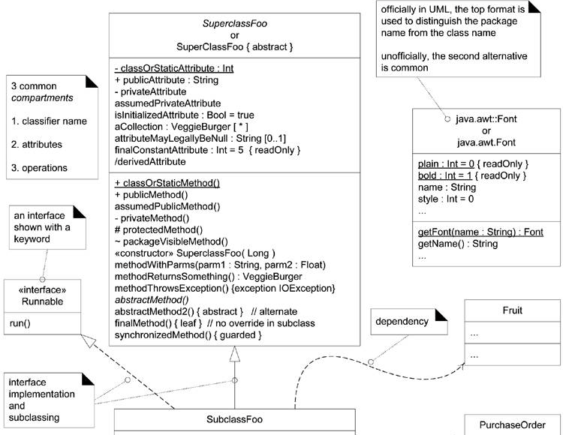
Common UML class diagram notation ₁
Notes:
（一）常见基本符号：
类 ＝（名称，属性集合，方法集合）；使用两线三栏框表示；
完整格式的类名 ＝ 包名::类名。 注意，包名是全小写的风格
接口 ＝ （名称，方法名称集合）
接口和类在符号上的区别是:关键字／构造行 <<interface>> 且具有2个分栏
关系 ＝ ［实现｜继承｜拥有｜依赖］

Slide 5
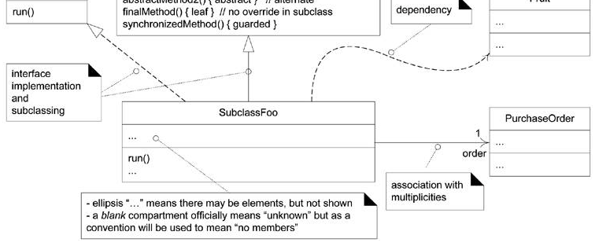
Common UML class diagram notation ₂

Slide 6
★
Design Class Diagram (DCD)
The same UML diagram can be used in multiple perspectives
  In a conceptual perspective the class diagram can be used to visualize a domain model（DM）.
  Class diagram is used in a software or design perspective, called design class diagram (DCD)
Domain Model
Sale
Register
1
Captures
1
conceptual
time
...
isComplete
perspective
:
Boolean
total
/
Register
Sale
Design Model
...
1
time
isComplete
DCD
;
:
Boolean
software
endSale
()
currentSale
total
perspective
/
enterItem
(...)
makePayment
(...)
makeLineItem
(...)
Notes:
类图的多种用途。符号相同，但用法和含义有比较大的区别。
概念：领域模型（DM）， 设计类图（DCD）；考试时会出现这些概念或缩略词
最大的区别就是用途：概念；软件类

Slide 7
★
Classifier
A UML classifier is "a model element that describes behavioral and structure features".
Classifiers can also be specialized.
  They are a generalization of many of the elements of the UML, including classes, interfaces, use cases, and actors.
  In class diagrams, the two most common classifiers are regular classes and interfaces.
Notes:
（二）类元描述
类元：描述行为和结构的元素。
所以，类图中出现用例、接口也很正常。例如：一个外部系统，设计人员总希望它有一个标准的接口。例如：SMTP协议，有了它我们就可以与任何实现SMTP协议的服务器发邮件。
但为了读者，在需求分析时，我们使用Email System表示该对象；设计时，则倾向使用SMTP接口替换Email System这个概念

Slide 8
Ways to Show UML Attributes
Ways to Show UML Attributes:
  Attribute Text and Association Lines
Attributes of a classifier are shown several ways:
  attribute text notation, such as currentSale : Sale.
  association line notation
  both together
The full format of the attribute text notation is:
  visibility name : type multiplicity = default {property-string}
Guideline: Attributes are usually assumed private if no visibility is given
Notes:
属性表示法： (p16.4)
1）三种形式：文本描述方法；关连线符号；同时使用
2）属性表示语法： ⋯⋯ 。 其中：属性字符串，就是用于限定该属性的方法，如 readOnly, 取值范围 等等
3）在设计类图中，属性的public属性必须用“＋”表示，否则就是私有的。在领域模型中，只有public的属性。

Slide 9
Ways to Show UML Attributes ₁
using the attribute
Register
Sale
text notation to
currentSale
...
indicate Register has
:
Sale
a reference to one
...
...
Sale instance
OBSERVE
this style
Register
Sale
:
visually
emphasizes
...
1
...
the connection
currentSale
between these classes
...
...
using the association notation to indicate
Register has a reference to one Sale instance
thorough and
Register
Sale
unambiguous
1
,
but some
currentSale
people dislike the
:
Sale
...
possible redundancy
currentSale
...
...
Notes:
（p16.4）
导航性箭头
多重性／角色名，放在箭头指向的一端

Slide 10
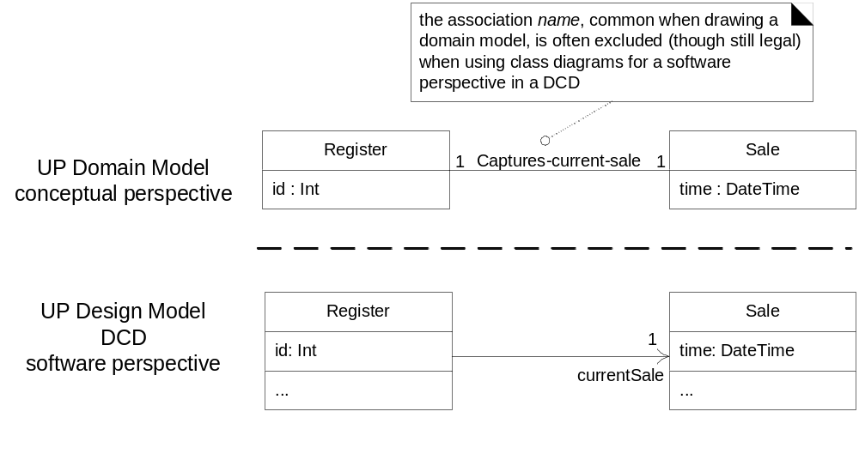
Ways to Show UML Attributes ₂
4.包含界面、系统、接口等
1.没有关联名称
3.通常有方法
2.有箭头
Attribute text versus association line notation for a UML attribute
Notes:
让我们总结属性的表示，与领域模型的不同。

Slide 11
Ways to Show UML Attributes ₃
Guideline: When showing attributes-as-associations, follow the style in DCDs, which is suggested by the UML specification. (Fig 16.4 upper)
Guideline: when using class diagrams for a domain model do show association names but avoid navigation arrows, as a domain model is not a software perspective.

Slide 12
Ways to Show UML Attributes ₄
Guideline: When to Use Attribute Text versus Association Lines for Attributes
  Use the attribute text notation for data type objects and the association line notation for others.
  Both are semantically equal, but showing an association line to another class box in the diagram (as in Figure 16.3) gives visual emphasis - it catches the eye, emphasizing the connection between the class of objects on the diagram.
Notes:
1）如果属性是Money, Unit, Address等，强调数据类型的，请用文本符号。
2）关连线法：强调类！！！
如同我们在领域建模中，总是把关键的概念放在中心。

Slide 13
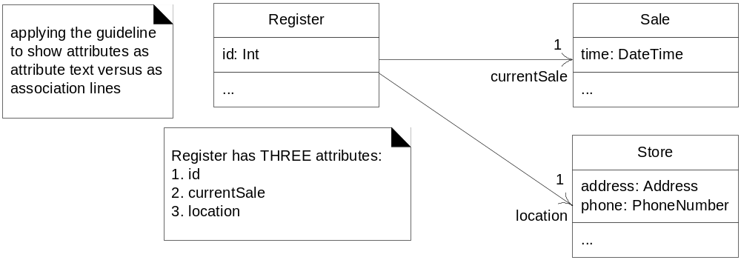
Ways to Show UML Attributes ₅
public class Register {
private int id;
private Sale currentSale;
private Store location;
// …
}
Notes:
图与代码。
需求与实现的区别。例如：需求中游戏的world与snake的关系是2 snake locate-on 1 world。它表示了游戏过程中必须满足的数据状态。
显现中有三个选择：snake has a world; world have two snake; both; 哪个是最佳的选择？
表明snake知道world的存在，可以根据world的状态决定自己的行为；并修改word的状态
world知道snake的存在？它必须曾担update模型的控制行为，让snake->move（）。而snake->move必须回调获取world的状态。这导致的对象的双向拥有。
从图上看，这是高耦合的设计。因此，a)是一个better的设计。
回顾你大二实训的技术框架，1 world has grid[*,*] 的cells（如何UML表达？）. 没有设计要求的扩展world的功能，所有生物都是根据world上的状态决定行为。因此，这是一种在离散仿真模型中通用的设计方法，也是大多数游戏设计的基本思路。
所以：设计b)违背了单职责的设计理念，它承担了控制器、模型、界面控制等太多的任务。UML图可以帮组你正确的描述设计理念，分析设计结果。

Slide 14
Ways to Show UML Attributes ₆
How to Show Collection Attributes with Attribute Text and Association Lines ?
public class Sale {
private List<SalesLineItem> lineItems =
new ArrayList<SalesLineItem>();
// …
}
}
Notes:
用关连线方法，表述数组。

Slide 15
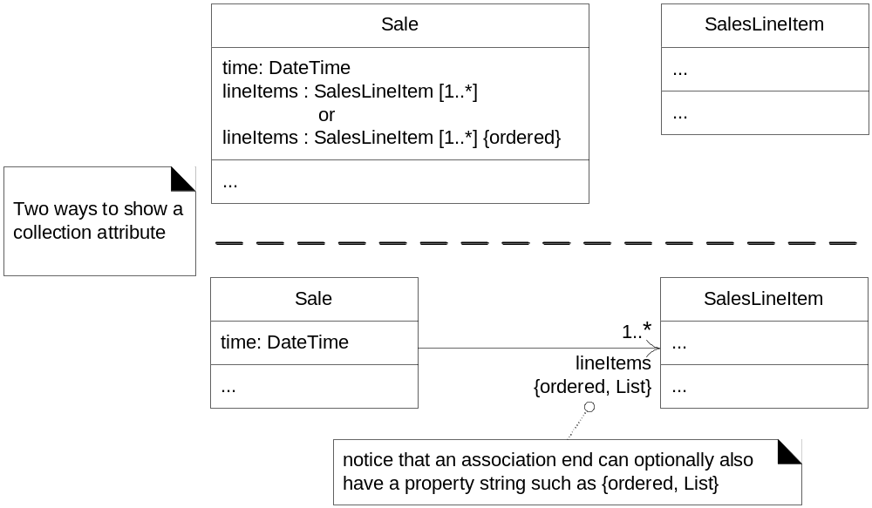
★ ★ ★
Ways to Show UML Attributes ₇
Notes:
（1）多重性
（2）使用约束符号 ｛List，ordered｝.如何表达按用户名降序 {ordered dec by name}

Slide 16
Operations and Methods ₁
Operations
visibility name (parameter-list) : return-type {property-string}
Guideline: Assume the version that includes a return type.
Guideline: Operations are usually assumed public if no visibility is shown.
Example
  + getPlayer( name : String ) : Player {exception IOException}
  public Player getPlayer( String name ) throws IOException
An operation is not a method.
  A UML operation is a declaration, with a name, parameters, return type, exceptions list, and possibly a set of constraints of pre-and post-conditions.
  But, it isn't an implementation - rather, methods are implementation
Notes:
方法不加申明，默认是public的。
操作与方法的区别
不要暴露私有方法。让我们观察snake有哪些方法需要暴露：⋯⋯ 可以看我的设计⋯⋯
好的OO设计的基本准则就是尽可能少的暴露方法，提高对象的包装、隐藏的效果。

Slide 17
Operations and Methods ₂
How to Show Methods in Class Diagrams?
  in interaction diagrams, by the details and sequence of messages
  in class diagrams, with a UML note symbol stereotyped with «method»
Register
«method»
//
pseudo
code or a specific language is OK
-
...
public void enterItem
(
id
,
qty
)
endSale
{
()
enterItem
(
id
,
qty
ProductDescription desc
)
=
catalog
getProductDescription
.
(
id
)
;
sale
makeNewSale
()
.
makeLineItem
(
desc
,
qty
)
;
makePayment
(
cashTendered
}
)

Slide 18
Keywords ₁
A UML keyword is a textual adornment to categorize a model element.
  For example, the keyword to categorize that a classifier box is an interface is «interface».
  The «actor» keyword was used on p. 91 to replace the human stick-figure actor icon with a class box to model computer-system or robotic actors.
Guideline: When sketching UML - when we want speed, ease, and creative flow - modelers often simplify keywords to something like '<interface>' or '<I>'.

Slide 19
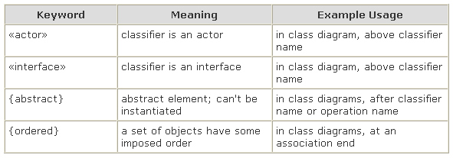
★
Keywords ₂
Most keywords are shown in guillemet (« ») but some are shown in curly braces, such as {abstract}, which is a constraint containing the abstract keyword.
In general, when a UML element says it can have a "property string“ - such as a UML operation and UML association end have - some of the property string terms will be keywords used in the curly brace format.
Notes:
什么时候使用<<>>或｛｝呢？

Slide 20
Stereotypes, Profiles, and Tags
Stereotypes
  are shown with guillemets symbols
  represents a refinement of an existing modeling concept and is defined within a UML profile
  The UML predefines many stereotypes, such as «destroy» (used on sequence diagrams), and also allows user-defined ones.
  Thus, stereotypes provide an extension mechanism in the UML
Profiles
  a collection of related stereotypes, tags, and constraints to specialize the use of the UML for a specific domain or platform
  For example, UML profile for project management or for data modeling.
Notes:
本科生知道使用就可以了。扩展UML就算了。

Slide 21
Stereotypes
declaring the stereotype
using the stereotype
a tool will probably allow a popup to fill in the tag values
UML
extension
,
relationship to a basic
once an element has been stereotyped with «authorship»
UML metamodel term
–
Element
«metaclass»
«stereotype»
«authorship»
«authorship»
author
=
Element
Authorship
Square
“craig”
status
=
“tested”
author
:
...
String
...
status
:
String
Stereotype declaration and use

Slide 22
Property and Property String
In the UML, a property is "a named value denoting a characteristic of an element. A property has semantic impact."
  Some properties are predefined in the UML, such as visibility - a property of an operation.
  Others can be user-defined.
Textual presentation approach
  UML property string {name1=value1, name2=value2}
  such as {abstract, visibility=public}.
  Some properties are shown without a value, such as {abstract};

Slide 23
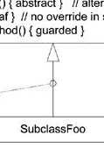
Generalization
Generalization in the UML is shown with a solid line and fat triangular arrow from the subclass to superclass
  A taxonomic relationship between a more general classifier and a more specific classifier.
  Each instance of the specific classifier is also an indirect instance of the general classifier.
  Thus, the specific classifier indirectly has features of the more general classifier.
Generalization ➔ inheritance?
  It depends. In a domain model conceptual-perspective class diagram, the answer is no.
  In a DCD software-perspective class diagram, it implies OOPL inheritance from the superclass to subclass.
Notes:
几乎所有的类元都有泛化能力：
Actor: user， registered user， anonymous user, VIP user（用集合表示，软件实现通常不用继承，而是分配角色对象给不同用户）
Use case： Roll－in， Abroad student Roll－in（尽可能避免泛化用例，使用include or extend替代。）
Concepts： 农夫，动物，东西，蛇，米，狐狸（用集合表示，如何软件实现不一定继承）
软件类：继承

Slide 24

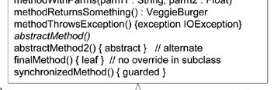
Abstract Classes and Abstract Operations
Abstract classes and operations can be shown either with an {abstract} tag (useful when sketching UML) or by italicizing the name (easy to support in a UML tool).
The opposite case, final classes and operations that can't be overridden in subclasses, are shown with the {leaf} tag.

Slide 25
Dependency ₁
Dependency lines may be used on any diagram, but are especially common on class and package diagrams.
The UML includes a general dependency relationship that indicates that a client element (of any kind, including classes, packages, use cases, and so on) has knowledge of another supplier element and that a change in the supplier could affect the client.
Dependency is illustrated with a dashed arrow line from the client to supplier.
Dependency can be viewed as another version of coupling
There are many kinds of dependency
  having an attribute of the supplier type
  sending a message to a supplier; the visibility to the supplier could be:
    an attribute, a parameter variable, a local variable, a global variable, or class visibility (invoking static or class methods)
  receiving a parameter of the supplier type
  the supplier is a superclass or interface
Notes:
分析程序依赖关系，对软件开发、测试有重要意义。

Slide 26
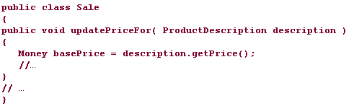
Dependency ₂
All of these could be shown with a dependency line in the UML, but some of these types already have special lines that suggest the dependency
When to show a dependency?
  Guideline: In class diagrams use the dependency line to depict global, parameter variable, local variable, and static-method (when a call is made to a static method of another class) dependency between objects.

Slide 27
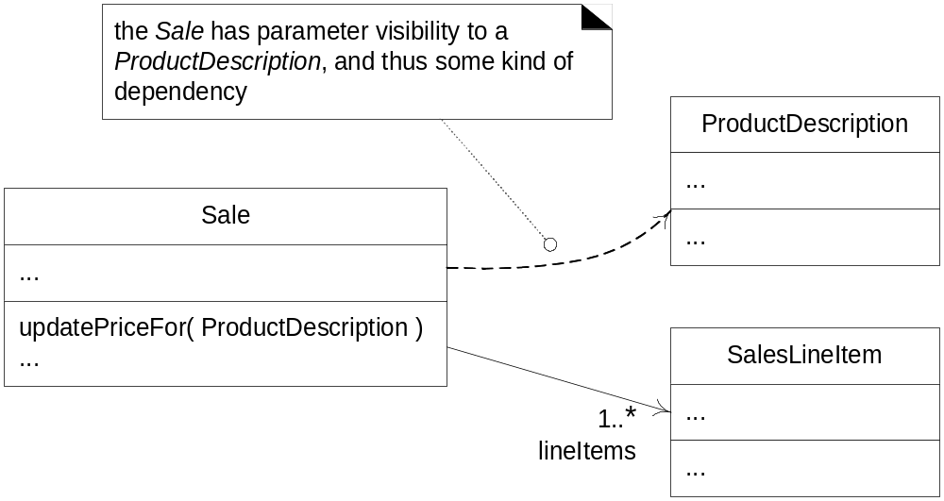
Dependency ₂
Showing dependency

Slide 28
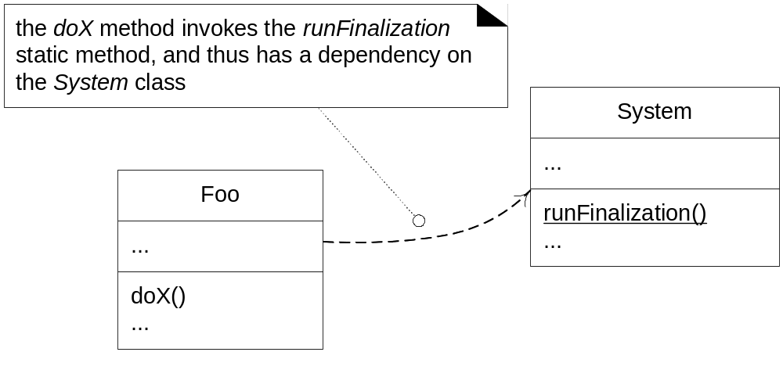
Dependency ₃
Showing dependency
Window
Clock
B
«call»
A
«create»
getTime
()
...
...
a dependency on calling on operations of
a dependency that A objects create B objects
the operations of a
Clock
Optional dependency labels in the UML

Slide 29
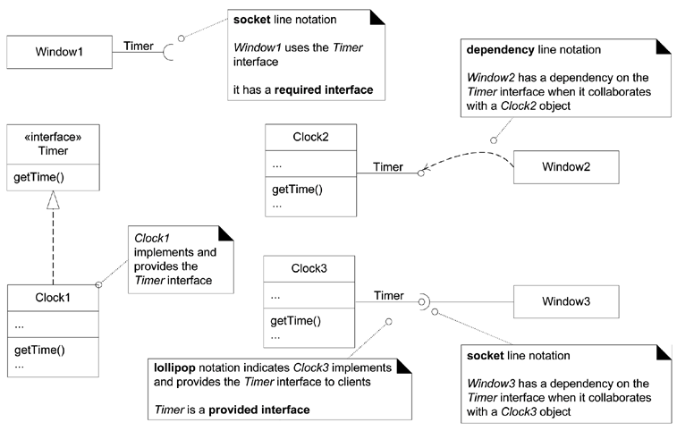
Interface
Notes:
在设计图，图元之间仅四种关系：
Generalization，has／have，implementation，dependency 四种关系
面向接口编程：

Slide 30
Composition Over Aggregation ₁
Aggregation is a vague kind of association in the UML that loosely suggests whole-part relationships
  It has no meaningful distinct semantics in the UML versus a plain association,
  but the term is defined in the UML. Why?
  In spite of the few semantics attached to aggregation, everybody thinks it is necessary (for different reasons). Think of it as a modeling placebo. [RJB04]
Guideline: Therefore, following the advice of UML creators, don't bother to use aggregation in the UML; rather, use composition when appropriate
Notes:
1）聚合和组合都是 whole-part 关系；

Slide 31
Composition Over Aggregation ₂
Composition
  also known as composite aggregation, is a strong kind of whole-part aggregation and is useful to show in some models.
  A composition relationship implies that
    1) an instance of the part (such as a Square) belongs to only one composite instance (such as one Board) at a time,
    2) the part must always belong to a composite (no free-floating Fingers), and
    3) the composite is responsible for the creation and deletion of its parts - either by itself creating/deleting the parts, or by collaborating with other objects.
Guideline: The association name in composition is always implicitly some variation of "Has-part," therefore don't bother to explicitly name the association
Notes:
组合与聚合的最大差异是，生命周期。
聚合：组合体与个体生命周期是自由的。例如：汽车与轮子
组合：当组合体不存在时，个体也不存在。这在程序设计中非常重要。
例如：我们在访问数据库时，期望的行为是，当connect对象关闭后，所有statement,query,cursor对象都自动关闭，并回收内存。否则，就很容易出现bug。

Slide 32
Composition Over Aggregation ₃
1
0
..
Hand
7
Finger
composition means
a part instance
-
(
Square
can only be part of one
)
composite
(
Board
at a time
)
composition
the composite has sole responsibility for management of
-
its parts
especially creation and deletion
,
1
1
1
*
Board
40
Square
Sale
..
SalesLineItem
Notes:
所以，实战中，当我们难以区分组合与聚合时，努力做成聚合关系。这有标准的解决方案，见教材后面的组合模式、工厂模式。

Slide 33
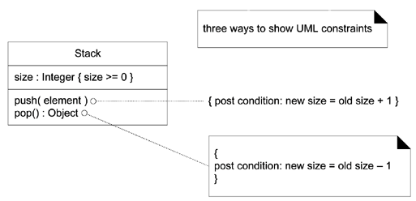
Constraint
Constraints
  Constraints may be used on most UML diagrams, but are especially common on class diagrams.
  A UML constraint is a restriction or condition on a UML element.
  It is visualized in text between braces;
    for example: { size >= 0 }.
  The text may be natural language or anything else, such as Object Constraint Language (OCL)

Slide 34
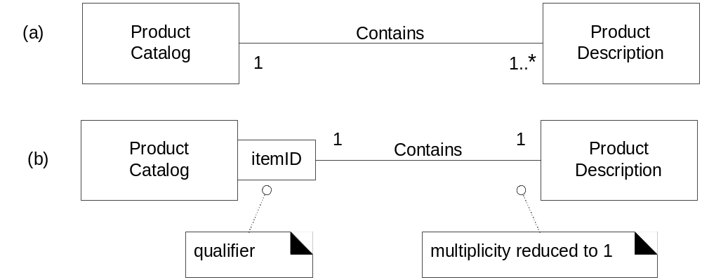
Qualified Association ₁

Slide 35
Qualified Association ₂
A qualified association has a qualifier that is used to select an object (or objects) from a larger set of related objects, based upon the qualifier key.
Informally, in a software perspective, it suggests looking things up by a key, such as objects in a HashMap. For example, if a ProductCatalog contains many ProductDescriptions, and each one can be selected by an itemID
Notes:
数据库：（主键）

Slide 36
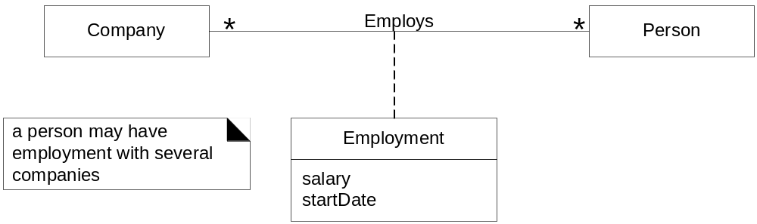
Association Class
An association class allows you treat an association itself as a class, and model it with attributes, operations, and other features.
For example, if a Company employs many Persons, modeled with an Employs association, you can model the association itself as the Employment class, with attributes such as startDate

Slide 37
Singleton Classes
1
ServicesFactory
UML notation
:
this
'
1
'
instance
:
can optionally be used
UML notation
:
ServicesFactory
in a
to indicate that only one
class box
,
an
instance will be created
accountingAdapter
:
underlined
attribute or
IAccountingAdapter
a singleton
inventoryAdapter
IInventoryAdapter
(
)
method indicates a
:
taxCalculatorAdapter
ITaxCalculatorAdapter
static
class level
:
(
)
member
rather than
,
getInstance
() :
ServicesFactory
an instance member
getAccountingAdapter
() :
IAccountingAdapter
getInventoryAdapter
() :
IInventoryAdapter
getTaxCalculatorAdapter
() :
ITaxCalculatorAdapter
...
Notes:
单实例：通常使用静态方法与静态变量构造。

Slide 38
Template Classes and Interfaces ₁
Many languages (Java, C++, …) support templatized types, also known (with shades of variant meanings) as templates, parameterized types, and generics.
They are most commonly used for the element type of collection classes, such as the elements of lists and maps. For example, in Java, suppose that a Board software object holds a List (an interface for a kind of collection) of many Squares. And, the concrete class that implements the List interface is an ArrayList:
  public class Board {
  private List<Square> squares = new ArrayList<Square>();
  // …
  }

Slide 39
Template Classes and Interfaces ₂
the attribute type may be expressed in
official UML
with the template binding
parameterized or template
«interface»
K
,
interfaces and classes
List
syntax requiring an arrow
or
in another language
,
K is a
template parameter
clear
()
such as Java
...
Board
squares
:
List
<
K Square
>
anonymous class with
or
template binding
complete
T
squares
:
List
<
Square
>
ArrayList
...
elements
:
T
ArrayList
T Square
[*]
<
>
...
clear
()
clear
()
for example
,
...
...
the
elements
attribute is an
array of type T
parameterized and bound
,
before actual use
.
there is a chance the UML
“arrow” symbol will
2
eventually be replaced with something else e
.
g
.
,
‘
=
’

Slide 40
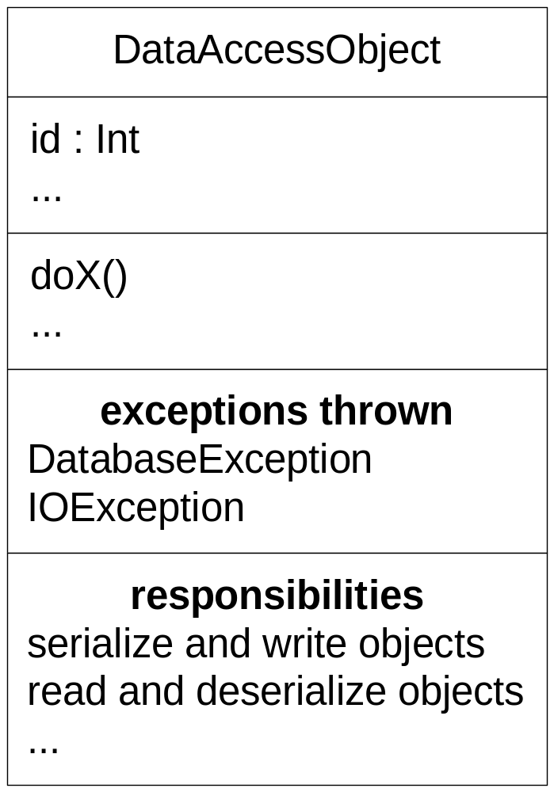
User-Defined Compartments

Slide 41
Active Class
An active object runs on and controls its own thread of execution.
The class of an active object is an active class
active class
Clock
«interface»
Runnable
...
run
()
run
()
...

Slide 42
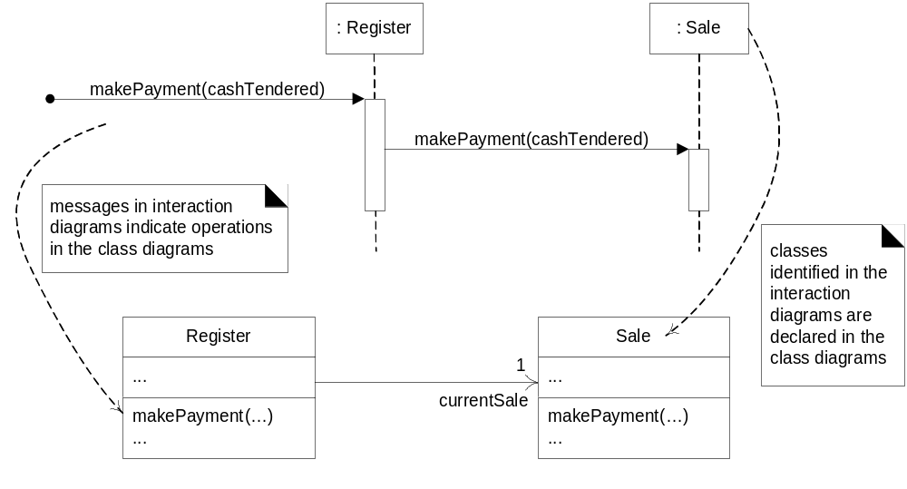
Relationship Between Interaction and
Class Diagrams

Slide 43
用例的实现-顺序图
… …
SearchHotelForm
SearchHotelAction
City
Hotel
Region
submit
searchHotel(form)
set mSearchInfo to form
findCityByName(mSearchIno.city)
Alt [find]
getHotelByCity(mSearchIno)
<<create>>
forward/render
[not find]
findCapitalCities (user.Country)
ChooseHotel
findRegionsByCountry (user.Country)
…
<<create>>
forward/render
FindLocation

Slide 44
建立包图
/hotel/
SearchHotelForm
FindLocation
hotel.controllers
SearchHotelAction
FindByLocationAction
hotel.media
Hotel.models
MSearchInfo
Hotel
City
Region

Slide 45
给类添加方法
City
+findCityByName(name:string):City
+findCapitalCityByCountry(country:string):List<City>{ordered}
Notes:
尽可能使用有业务含义的方法名。企业都是分层开发的，设计师就是定义接口方法的，程序由什么人开发不重要。

