Slide 1
Applying UML and Patterns
An Introduction to
Object-oriented Analysis
and Design
and Iterative Development
Part III Elaboration Iteration I – Basic³

Slide 2
Chap 18
Object Design Examples with GRASP

Slide 3
Introduction
This chapter applies OO design principles and the UML to the case studies, to show larger examples of reasonably designed objects with responsibilities and collaborations.
Objective
  Design use case realizations.
  Apply GRASP to assign responsibilities to classes.
  Apply UML to illustrate and think through the design of objects
No "magic" is needed in object design

Slide 4
Use-case realization
A use-case realization describes how a particular use case is realized within the Design Model, in terms of collaborating objects" [RUP].
  A designer can describe the design of one or more scenarios of a use case; each of these is called a use case realization
  Use case realization is a UP term used to remind us of the connection between the requirements the object design
Some relevant artifact-influence points include the following:
  The use case suggests the system operations that are shown in SSDs.
  The system operations become the starting messages entering the Controllers for domain layer interaction diagrams.
  Domain layer interaction diagrams illustrate how objects interact to fulfill the required tasks - the use case realization.

Slide 5
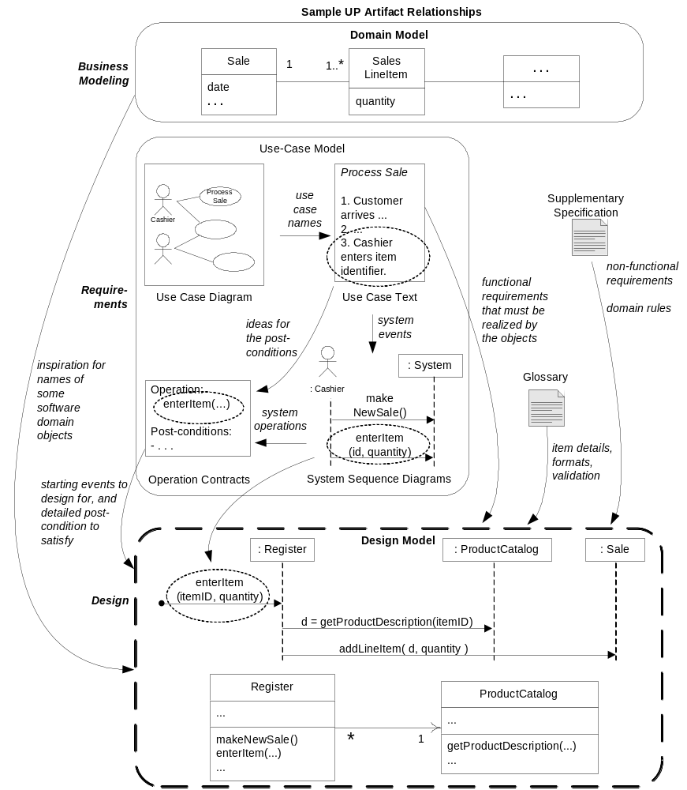

Slide 6
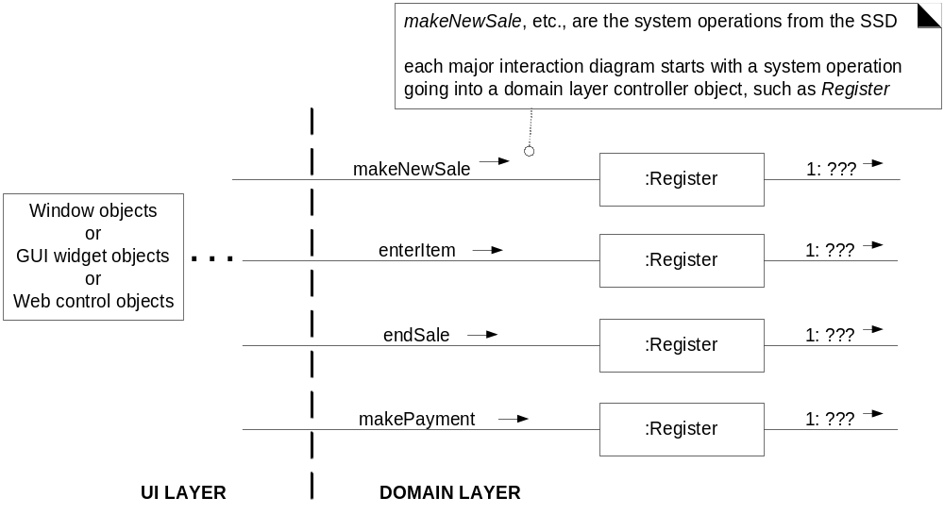
Communication diagrams and
system operation handling

Slide 7
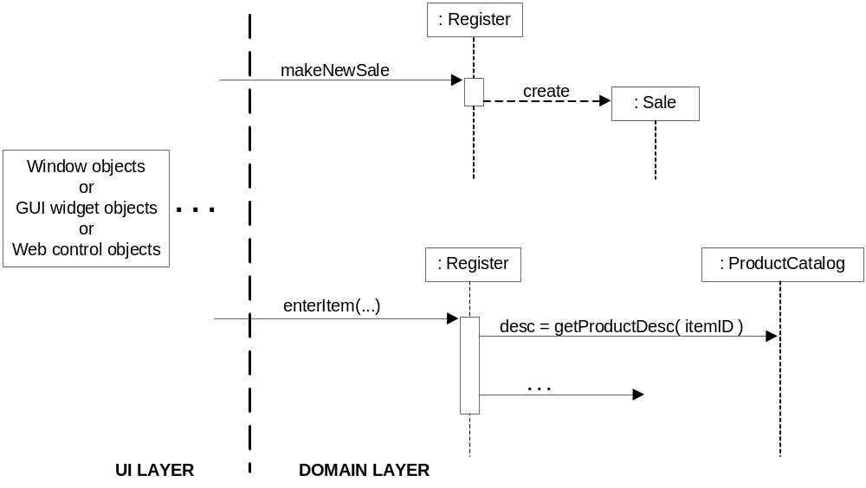
Sequence diagrams and
system operation handling

Slide 8
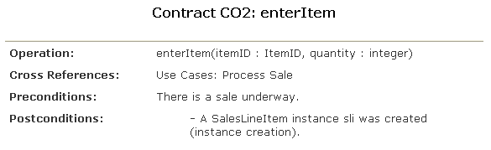
Operation Contract ₁
Use case realizations could be designed directly from the use case text or from one's domain knowledge.
For some complex system operations, contracts may have been written that add more analysis detail. For example:

Slide 9
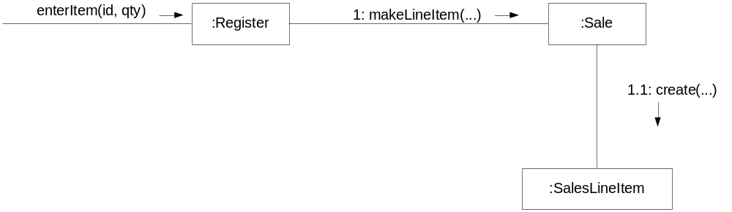
Operation Contract ₂
In conjunction with contemplating the use case text, for each contract, we work through the postcondition state changes and design message interactions to satisfy the requirements

Slide 10
Use case realization with GRASP patterns.
'Start Up' Use Case
Step
  Design makeNewSale
  Design enterItem
  Design endSale
  Design makePayment
  Connect the UI Layer to the Domain Layer
  Create the Initialization Design
  Applications Start Up

Slide 11
'Start Up' Use Case
The Start Up use case realization is the design context in which to consider creating most of the 'root' or long-lived objects.
Guideline
  When coding, program at least some Start Up initialization first.
  But during OO design modeling, consider the Start Up initialization design last, after you have discovered what really needs to be created and initialized.
  Then, design the initialization to support the needs of other use case realizations

Slide 12
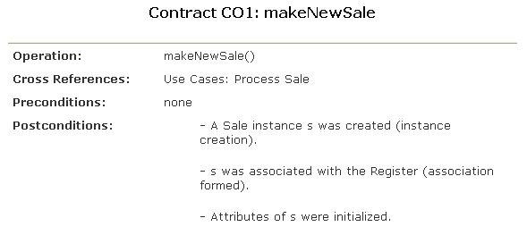
Design makeNewSale ₁

Slide 13
Design makeNewSale ₂
Choosing the Controller Class
  Our first design choice involves choosing the controller for the system operation message enterItem. By the Controller pattern, here are some choices:
Represents the overall "system," "root object," a specialized device, or a major subsystem. | Store a kind of root object because we think of most of the other domain objects as "within" the Store. Register a specialized device that the software runs on; also called a POSTerminal. POSSystem a name suggesting the overall system
Represents a receiver or handler of all system events of a use case scenario. | ProcessSaleHandler constructed from the pattern <use-case-name> "Handler" or "Session" ProcessSaleSession

Slide 14
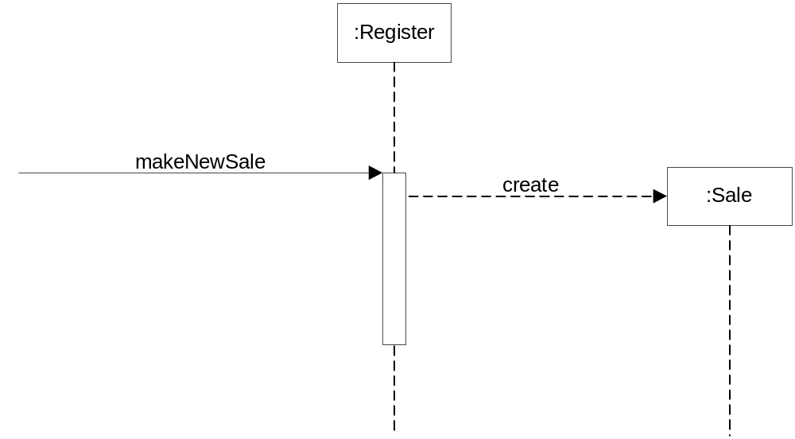
Design makeNewSale ₃

Slide 15
Design makeNewSale ₄
Creating a New Sale
  We must create a software Sale object,
  GRASP Creator pattern suggests assigning the responsibility for creation to a class that aggregates, contains, or records the object to be created.
  Register may be thought of as recording a Sale, Thus, Register is a reasonable candidate for creating a Sale.
  By having the Register create the Sale, we can easily associate the Register with it over time so that during future operations within the session, the Register will have a reference to the current Sale instance.
  When the Sale is created, it must create an empty collection (such as a Java List) to record all the future SalesLineItem instances that will be added.

Slide 16
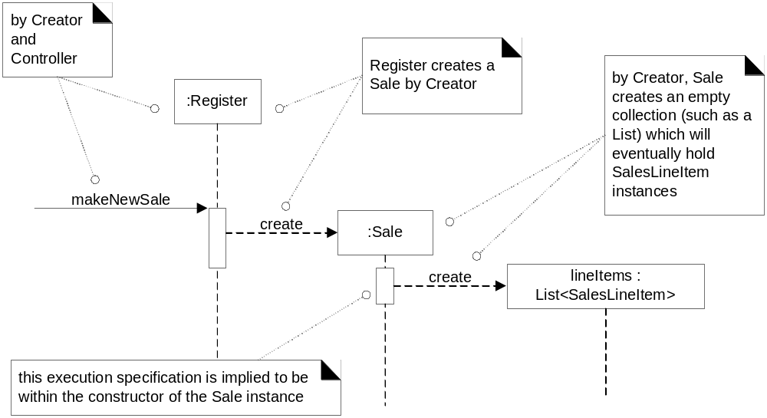
Design makeNewSale ₅

Slide 17
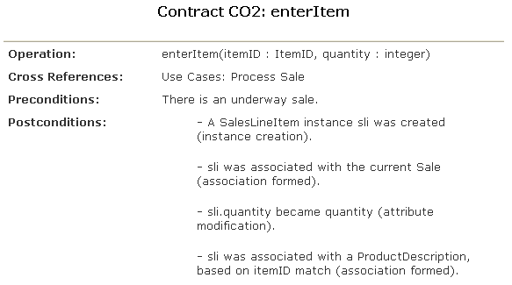
Design enterItem ₁

Slide 18
Design enterItem ₂
Choosing the Controller Class
  Who can handle the responsibility for the system operation message enterItem.
  Based on the Controller pattern, as for makeNewSale, we will continue to use Register as a controller.
Display Item Description and Price?
  Because of a principle of Model-View Separation, it is not the responsibility of non-GUI objects (such as a Register or Sale) to get involved in output tasks.
  Therefore, although the use case states that the description and price are displayed after this operation, we ignore the design at this time.
  All that is required with respect to responsibilities for the display of information is that the information is known, which it is in this case.

Slide 19
Design enterItem ₃
Creating a New SalesLineItem
  The enterItem contract postconditions indicate the creation, initialization, and association of a SalesLineItem.
  Who create? Based on
    Analysis of the Domain Model reveals that a Sale contains SalesLineItem objects.
    Taking inspiration from the domain, we determine that a software Sale may similarly contain software SalesLineItem.
  The postconditions indicate that the new SalesLineItem needs a quantity when created;
    therefore, the Register must pass it along to the Sale, which must pass it along as a parameter in the create message.
    In Java, that would be implemented as a constructor call with a parameter.
  Therefore, by Creator, a makeLineItem message is sent to a Sale for it to create a SalesLineItem. The Sale creates a SalesLineItem, and then stores the new instance in its permanent collection.
  The parameters to the makeLineItem message include the quantity, so that the SalesLineItem can record it, and the ProductDescription that matches the itemID.

Slide 20
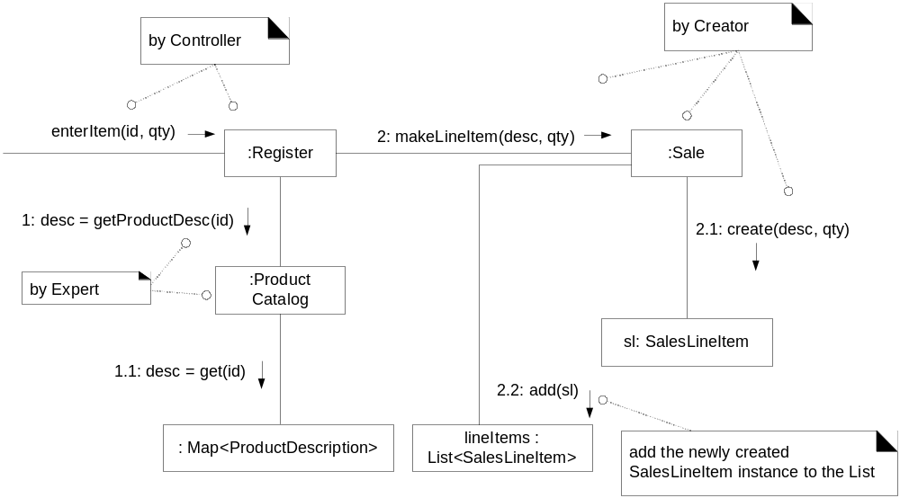
Design enterItem ₄

Slide 21
Design enterItem ₅
Other design issues
  Who should be responsible for knowing a ProductDescription, based on an itemID match?
    Start assigning responsibilities by clearly stating the responsibility
  Who should send the getProductDescription message to the ProductCatalog to ask for a ProductDescription
    For an object to send a message to another object, it must have visibility to it.

Slide 22
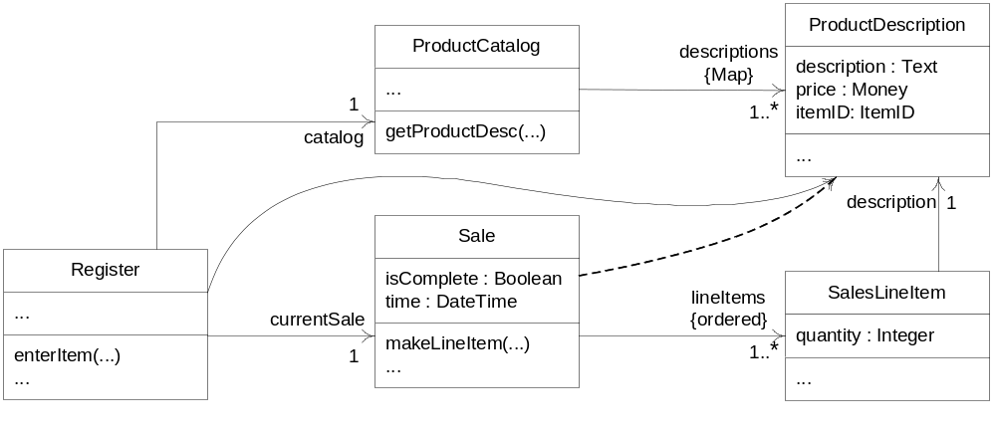
Design enterItem ₆
Partial DCD related to the enterItem design. Static view

Slide 23
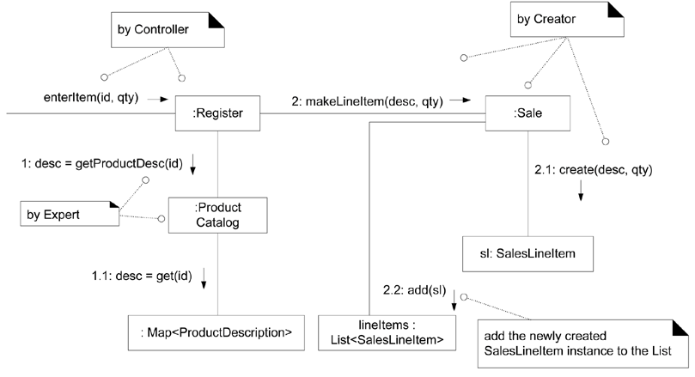
Design enterItem ₇
The enterItem interaction diagram. Dynamic view

Slide 24
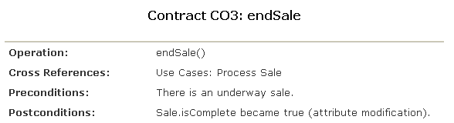
Design endSale ₁
Step
  Choose the controller class
  Setting the Sale.isComplete Attribute
  Calculating the Sale Total
  Designing Sale.getTotal

Slide 25
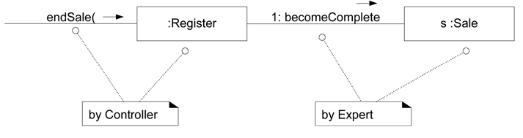
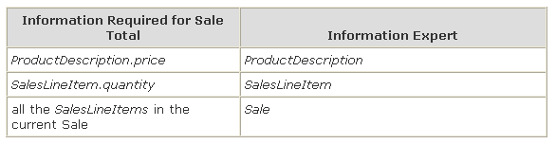
Design endSale ₂
Figure 18.9. Completion of item entry

Slide 26
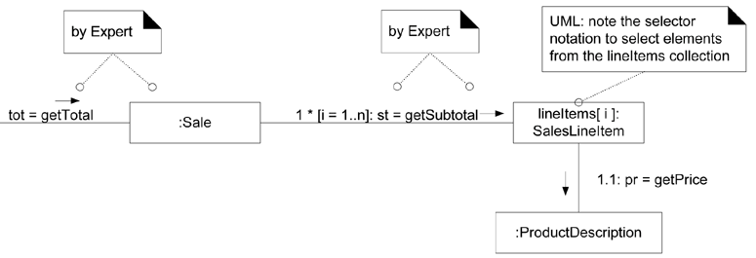
Design endSale ₃
Figure 18.10. Sale.getTotal interaction diagram

Slide 27
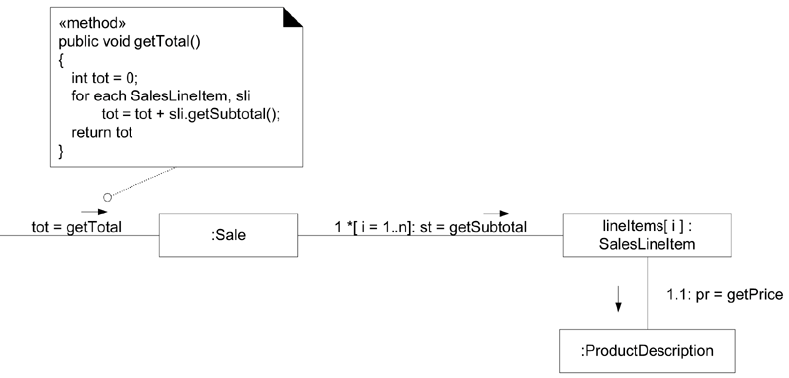
Design endSale ₄
Figure 18.12. Showing a method in a note symbol

Slide 28
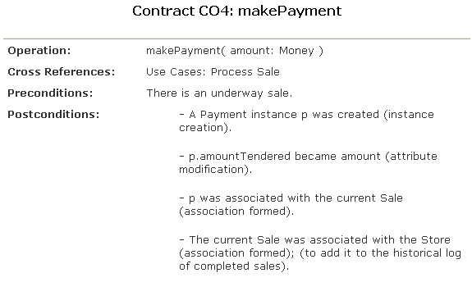
Design makePayment ₁

Slide 29
Design makePayment ₂
Creating the Payment
Guideline
  When there are alternative design choices, take a closer look at the cohesion and coupling implications of the alternatives, and possibly at the future evolution pressures on the alternatives. Choose an alternative with good cohesion, coupling, and stability in the presence of likely future changes
Logging a Sale
Calculating the Balance

Slide 30
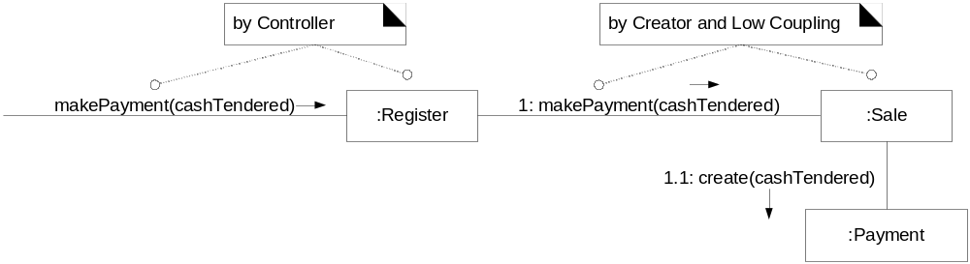
Design makePayment ₃
Figure 18.13. Register.makePayment interaction diagram

Slide 31
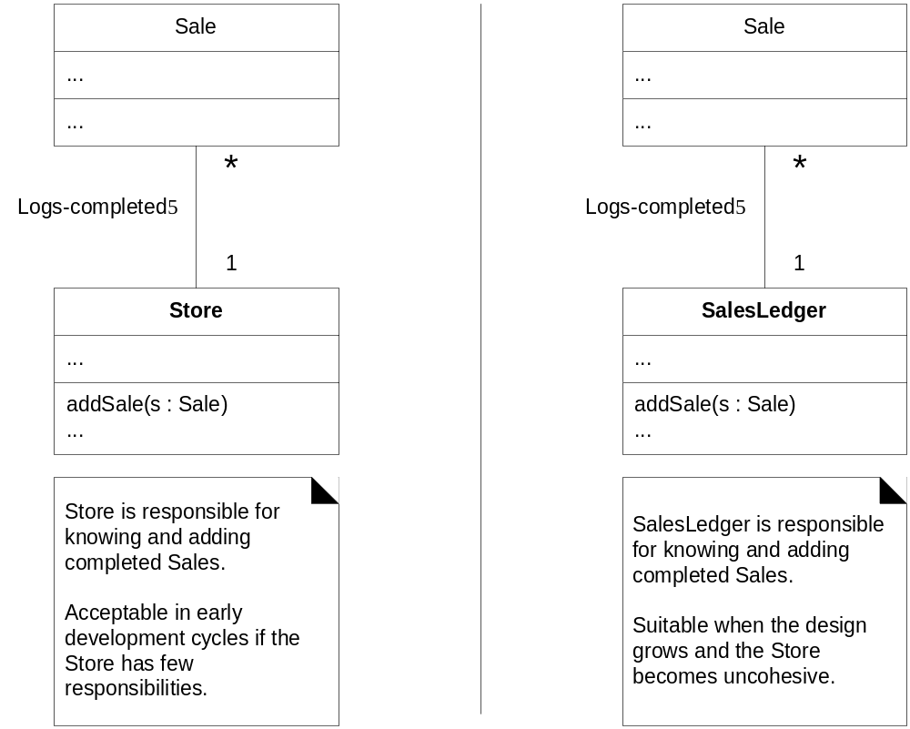
Design makePayment ₄
Figure 18.14. Who should be responsible for knowing the completed sales?

Slide 32
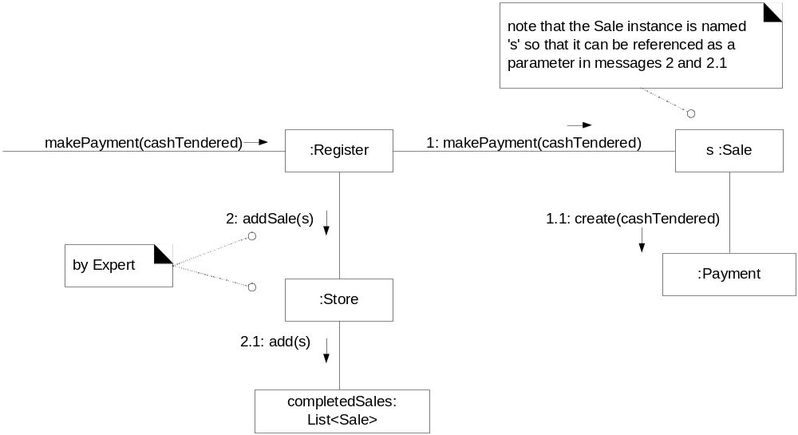
Design makePayment ₅
Figure 18.15. Logging a completed sale

Slide 33
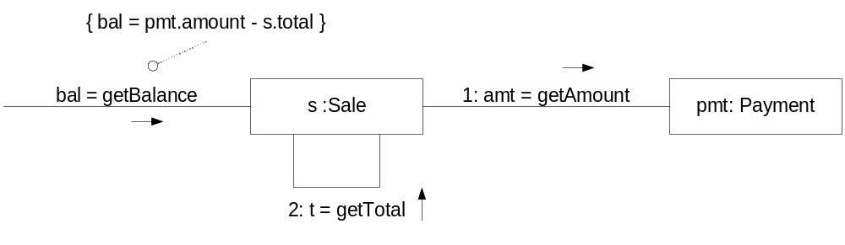
Design makePayment ₆
Figure 18.16. Sale.getBalance interaction diagram

Slide 34
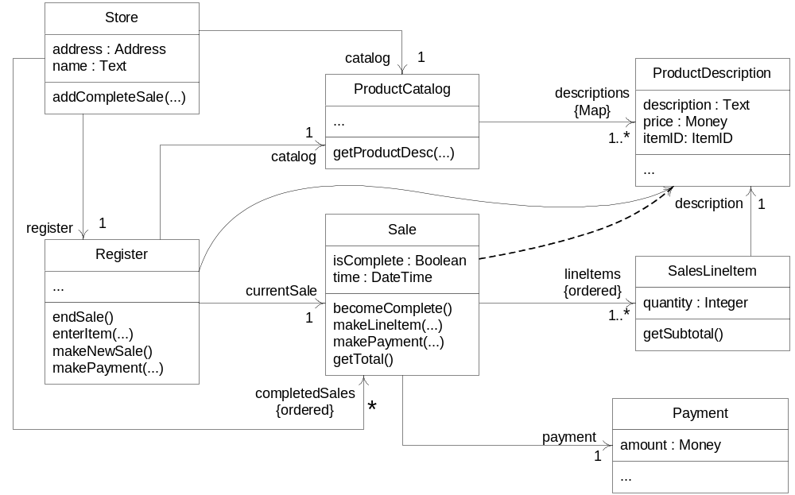
Design makePayment ₇
Figure 18.17. A more complete DCD reflecting most design decisions

Slide 35
Connect the UI Layer to the Domain Layer ₁
Common designs by which objects in the UI layer obtain visibility to objects in the domain layer include the following:
  An initializer object (for example, a Factory object) called from the application starting method (e.g., the Java main method) creates both a UI and a domain object and passes the domain object to the UI.
  A UI object retrieves the domain object from a well-known source, such as a factory object that is responsible for creating domain objects.
Once the UI object has a connection to the Register instance (the facade controller in this design), it can forward system event messages, such as the enterItem and endSale message, to it

Slide 36
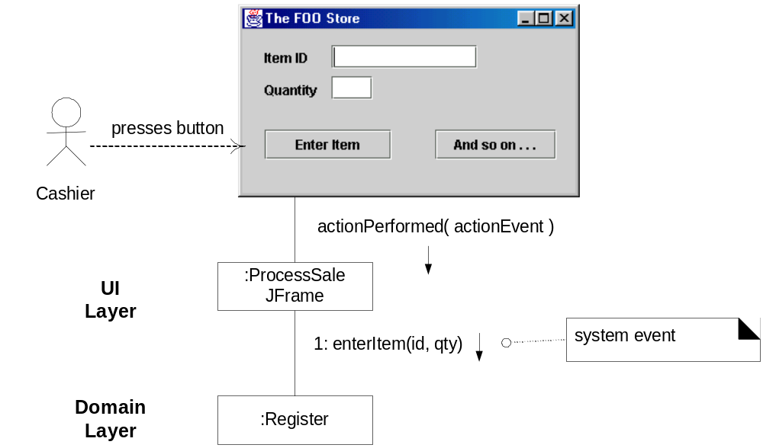
Connect the UI Layer to the Domain Layer ₂
Figure 18.18. Connecting the UI and domain layers.

Slide 37
Initialization and the 'Start Up' Use Case
When to Create the Initialization Design?
  Guideline: Do the initialization design last.
How do Applications Start Up?
  public class Main {
  public static void main( String[] args ) {
  // Store is the initial domain object.
  // The Store creates some other domain objects.
  Store store = new Store();
  Register register = store.getRegister();
  ProcessSaleJFrame frame = new ProcessSaleJFrame( register ); ... } }

Slide 38
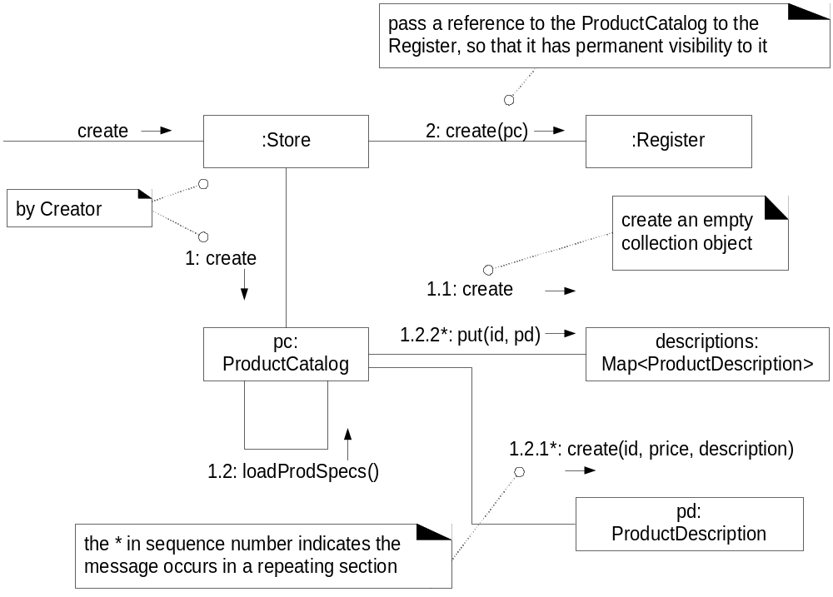

Slide 39
Use Case Realizations for the Monopoly Iteration ₁
Choosing the Controller Class
  Choosing a root-object facade controller like MonopolyGame is satisfactory if there are only a few system operations (there are only two in this use case) and if the facade controller is not taking on too many responsibilities (in other words, if it is not becoming incohesive).
Who is Responsible for Controlling the Game Loop
  By Expert, MonopolyGame is a justifiable choice to control the game loop and coordinate the playing of each round.

Slide 40
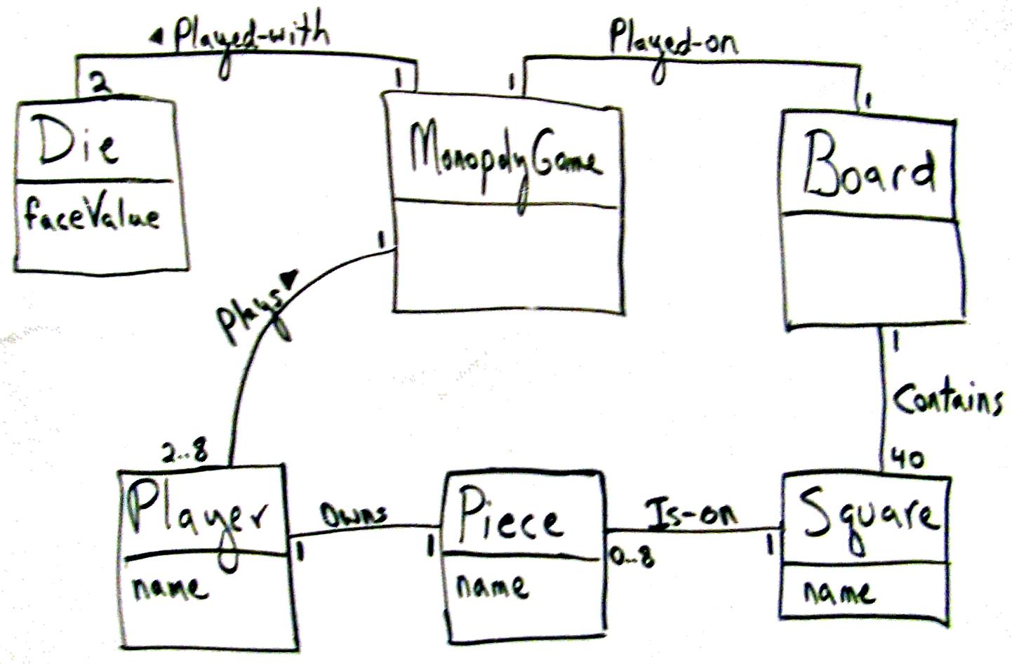
Figure 18.21. Iteration-1 Domain Model for Monopoly

Slide 41
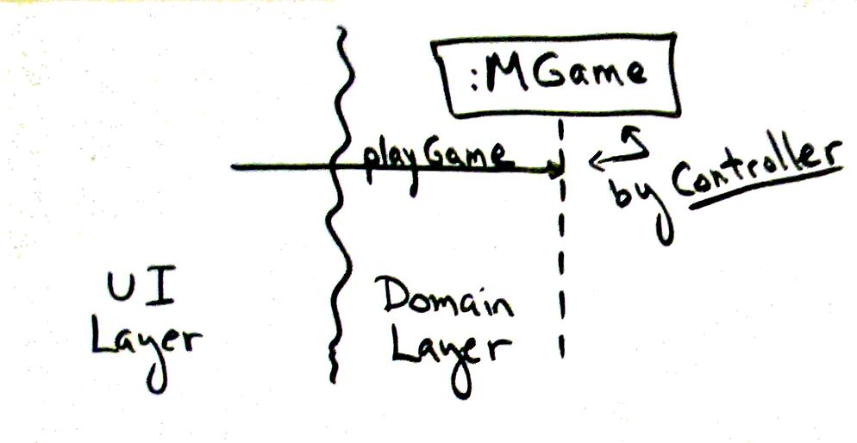
Figure 18.22. Applying Controller to the playGame system operation.

Slide 42
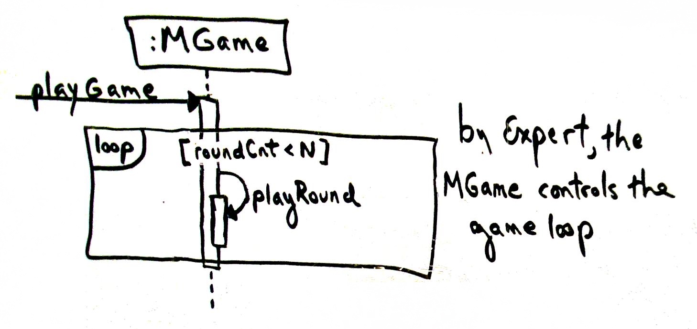
Figure 18.23. Game loop

Slide 43
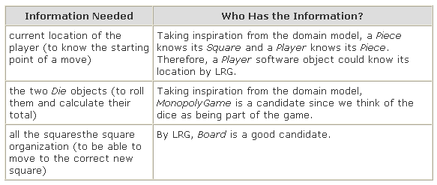
Use Case Realizations for the Monopoly Iteration ₂
Who Takes a Turn
  Again, Expert applies
  Naive reaction might be to say "a Player object should take the turn" because in the real world a human player takes a turn.
  This is an interesting problem! There are three partial information experts for the "take a turn" responsibility: Player, MonopolyGame, and Board.

Slide 44
Use Case Realizations for the Monopoly Iteration ₃
Who Takes a Turn (conti.)
  Guideline: When there are multiple partial information experts to choose from, place the responsibility in the dominant information expert - the object with the majority of the information. This tends to best support Low Coupling.
  Guideline: When there are alternative design choices, consider the coupling and cohesion impact of each, and choose the best.
  Guideline: When there is no clear winner from the alternatives other guidelines, consider probable future evolution of the software objects and the impact in terms of Information Expert, cohesion, and coupling.
  In the end, by these guidelines Player turns out to be a good candidate, justified by Expert when we consider the full game rules.

Slide 45
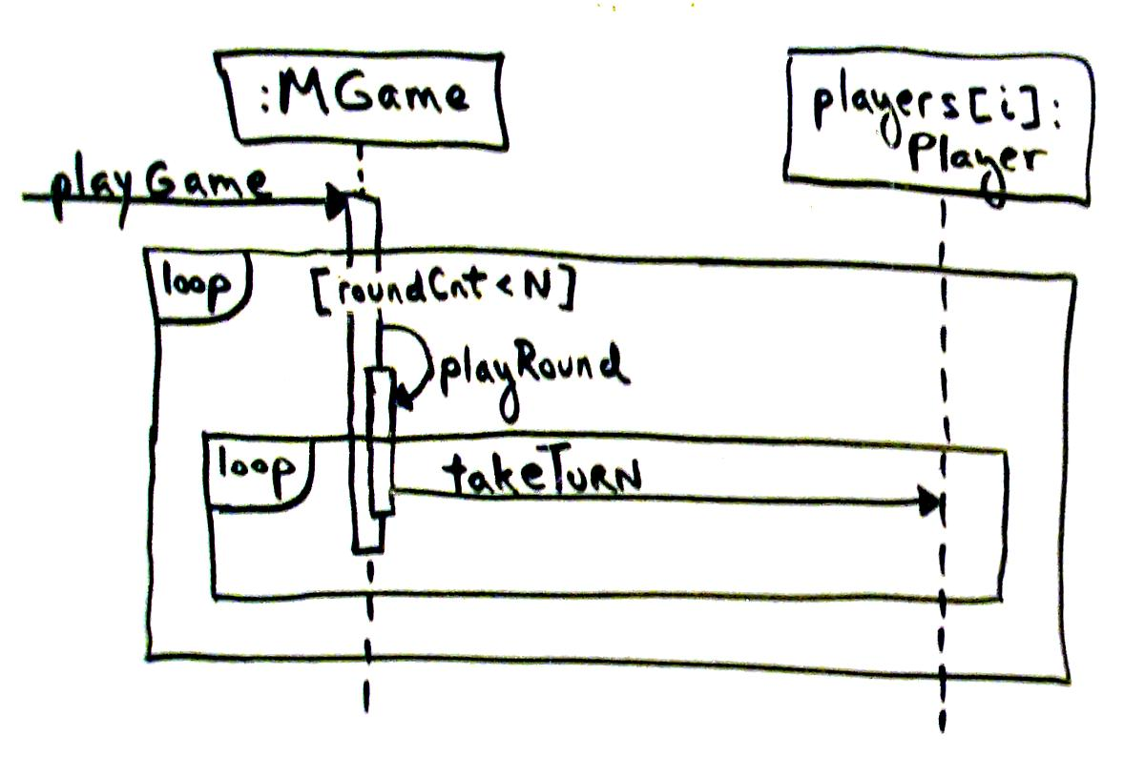
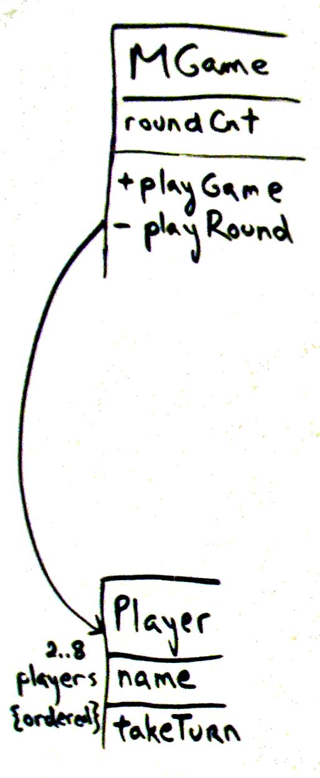
Use Case Realizations for the Monopoly Iteration ₃
Figure 18.24. Player takes a turn by Expert

Slide 46
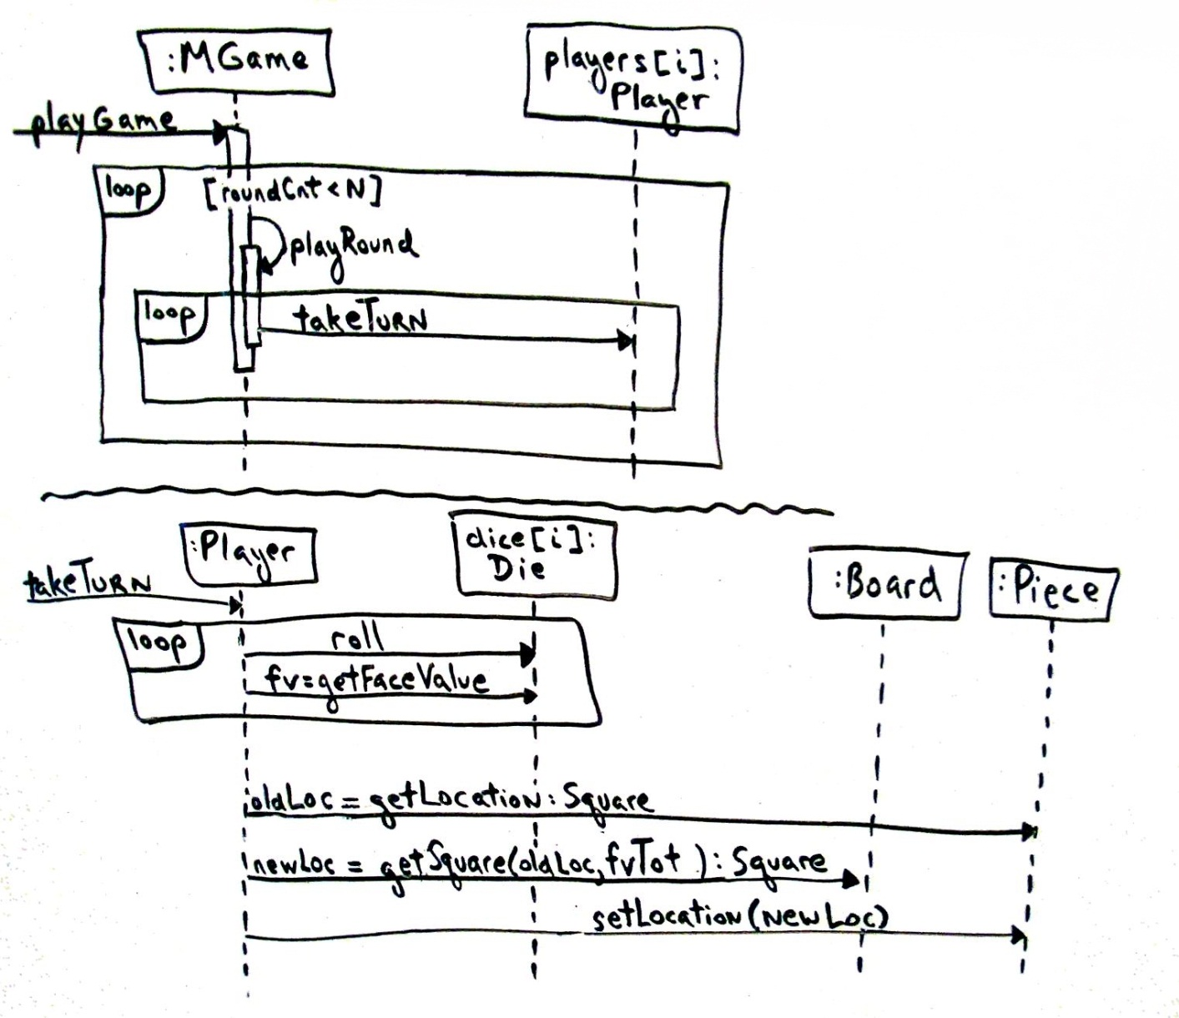
Use Case Realizations for the Monopoly Iteration ₄
Figure 18.25. Dynamic design for playGame

Slide 47
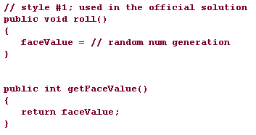
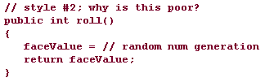
The Command-Query Separation Principle
This principle states that every method should either be:
  a command method that performs an action (updating, coordinating, …), often has side effects such as changing the state of objects, and is void (no return value); or
  a query that returns data to the caller and has no side effects - it should not permanently change the state of any objects

Slide 48
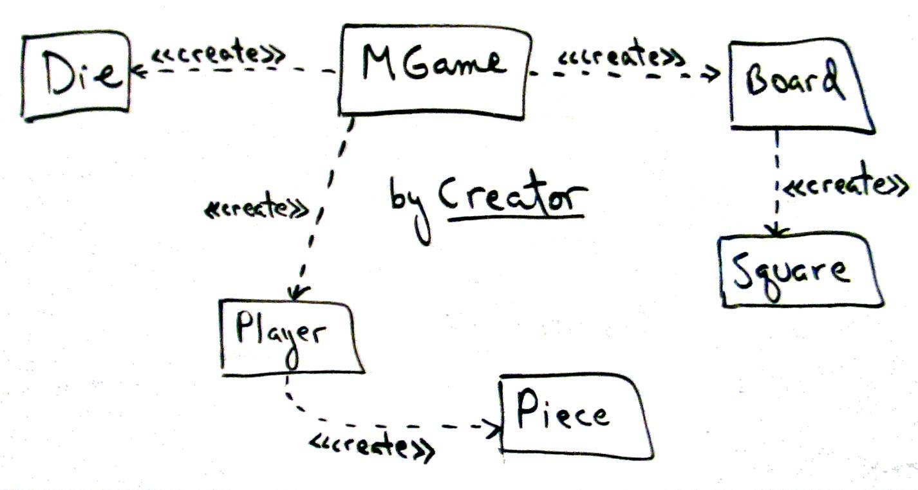
Initialization and the 'Start Up' Use Case
Figure 18.27. Creation dependencies

Slide 49
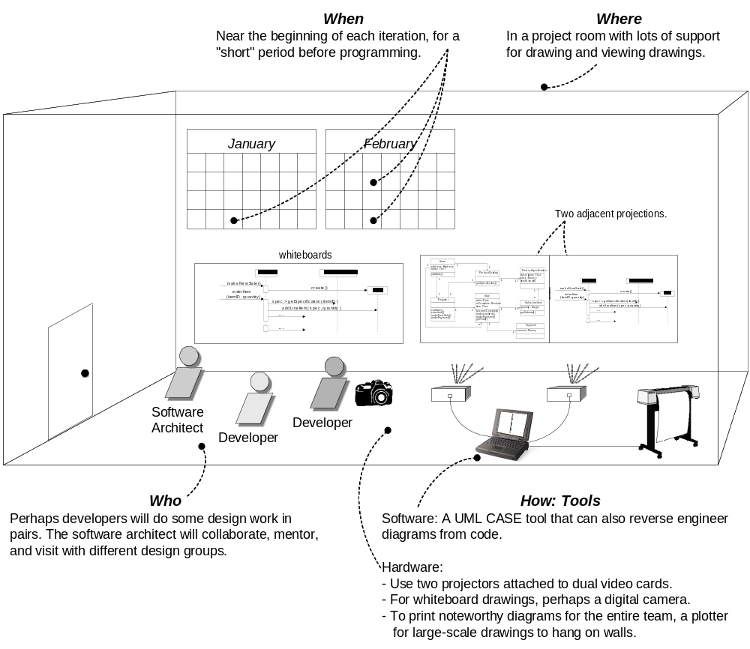
Sample process and setting context

