Slide 1
Digital Signal Processing
(DSP)

Slide 2
About me
Zhiming Dai (戴智明)
Phone: 135-6043-4859
Email: daizhim@mail.sysu.edu.cn
Office: Room 618 E

Slide 3
Textbook
Mitra S K, Digital Signal Processing: A Computer-Based Approach (Fourth Edition). McGraw-Hill, 2011.
Teaching materials download: dsp_dzm@163.com
password: 123456dsp

Slide 4
References
Smith S W, Digital Signal Processing: A Practical Guide for Engineers and Scientists. Newnes, 2002.
Vegte J V, Fundamentals of Digital Signal Processing. Prentice Hall, 2001.
Proakis J G and Manolakis D G, Digital Signal Processing: Principles, Algorithms, and Applications (Third Edition). Prentice Hall, 1995.
程佩青,数字信号处理教程(第三版).清华大学出版社, 2007.
张德丰,详解MATLAB数字信号处理.电子工业出版社, 2010.

Slide 5
The Goals of this course
Understanding of basic concepts of DSP
Mastery of the key terminologies
Ability of simulating digital signals and systems
Matlab software, downloaded from: https://software.sysu.edu.cn/matlabhome

Slide 6
Grade
Attendance 10%
Exercise 30%
Project 60%

Slide 7
Introduction

Slide 8
Why signals should be processed?
Signals are carriers of information
  Useful and unwanted
  Extracting, enhancing, storing and transmitting the useful information
How signals are being processed?---
  Analog Signal Processing vs.
  Digital Signal Processing

Slide 9
Digital Signal Processing
Theory, method, algorithm
Digital Signal Processor
A kind of microprocessor used to implement digital signal processing algorithm

Slide 10
The foundation of information technology is digitalization.
The kernel of digitalization is digital signal processing
Most of digital signal processing, especially real-time processing are implemented by DSP processor or ASIC based on DSP core
DSP technology becomes hot front edge and is growing up rapidly.

Slide 11
About DSP

Slide 12
History of DSP
The roots of DSP are in the 1960s and 1970s when digital computers first became available
DSP was limited to only a few critical applications at first
The personal computer revolution of the 1980s and 1990s caused DSP to explode with new applications

Slide 13
History of DSP (cont.)
In the early 1980s, DSP was taught as a graduate level course in electrical engineering
A decade later, DSP had become a standard part of the undergraduate curriculum
Today, DSP is a basic skill needed by scientists and engineers in many fields

Slide 14
Applications
of DSP

Slide 15
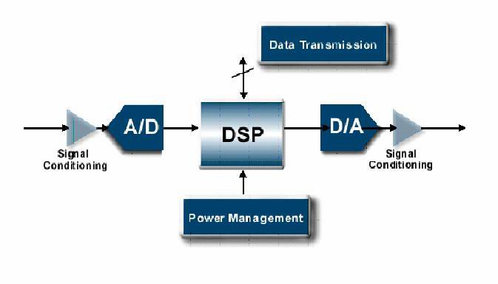
DSP Solution

Slide 16
Communication

Slide 17
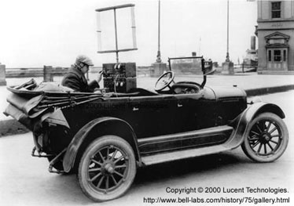
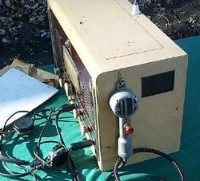
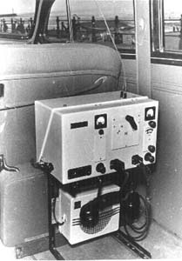
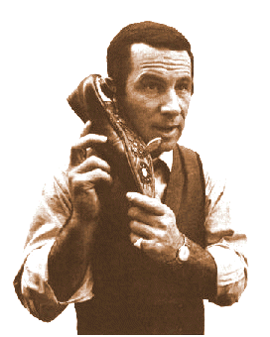
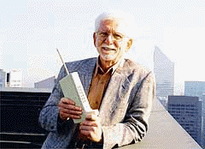
Analog Mobile Phones

Slide 18

Mobile phone

Slide 19
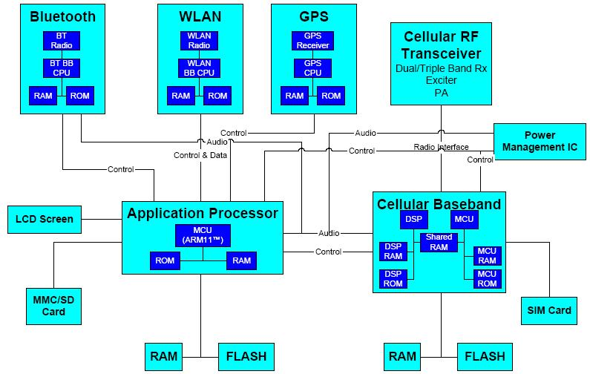
Current-Generation Smartphone Using Baseband IC with Application Processors

Slide 20
Medical

Slide 21
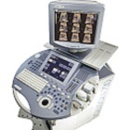
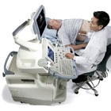
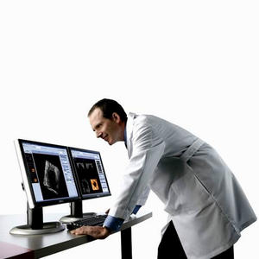
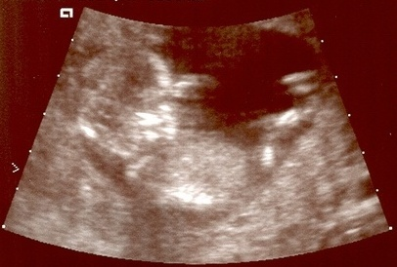
Ultrasound

Slide 22
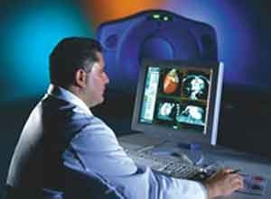
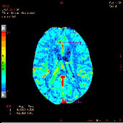
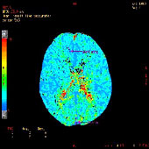
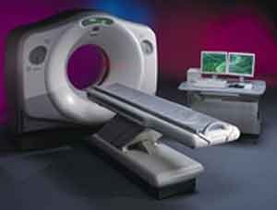
CT
(Computed Tomography)

Slide 23
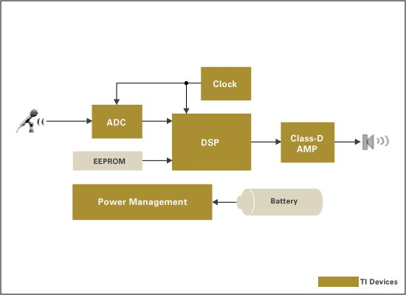
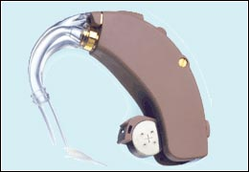
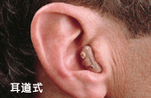
Hearing Aid

Slide 24
Why digital?
（1）Programmability
Analog system：Modify hardware design.
Digital system：Modify software.
Example：Analog filter, digital filter, adaptive filter

Slide 25
Why digital?
（2）Precision
Analog system：component specification: resistors have a tolerance 5%; capacitors 20% or worse
Digital system：ADC bits, CPU word width and algorithm

Slide 26
Why digital?
（3）Stability
Analog system：the characteristics of analog system components, resistors, capacitors and operational amplifiers will change along with temperature, humidity
Digital system：will show no variation with temperature throughout their guaranteed operation range.

Slide 27
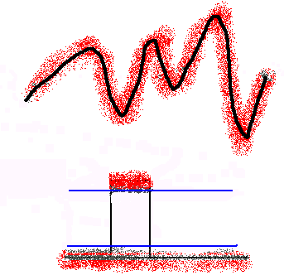
Why digital?
(4) Anti-noise

Slide 28
Why digital?
(5) Repeatability
computer A
Amplify A
Signal generator
computer B
Amplify B

Slide 29

Why digital?
（6）VLSI (Very Large Scale
Integrated circuit)

Slide 30
Why digital?
(7) Error Correcting Codes
Data retrieval and transmission systems suffer from a number of potential forms of error.
With information in a digital or binary form, we may easily build into the data stream additional “redundant” bits that are used to detect when an error has occurred.

Slide 31
Why digital?
(8) Data Transmission and Storage
The Internet, Compact Disc (CD) and Digital Video Disc (DVD) brought information based on trouble-free high-quality text, audio and video into the office and home.
The fidelity of the digital medium is greater than that of the analog one.

Slide 32
Why digital?
(9) Data Compression
The information channels cost and transmission bottlenecks make compression necessary for real-time processing.
With analog compression some information is lost. A typical example is the bandwidth limiting applied to analog telephone lines in order to multiples calls, which limits the frequency response to 3kHz.

Slide 33
We still need analog processing
（1）Real-Time Processing
Analog system：Besides the delay introduced by the circuit, the processing is in real-time.
Digital system：Decided by the processor speed.

Slide 34
We still need analog processing
（2）Processing very high frequency signals
Analog system：may process microwave, mini-meter-wave, even light wave signals.
Digital system：By the Nyquist Rule，the processing speed is limited by the S/H, A/D and processor speed.

Slide 35
We still need analog processing
(3)The most signals in real would are analog.
If we want to process these analog signals with digital signal processing system, must change them into digital form first by mixed signal processing.

Slide 36
Thank you!

