Slide 1

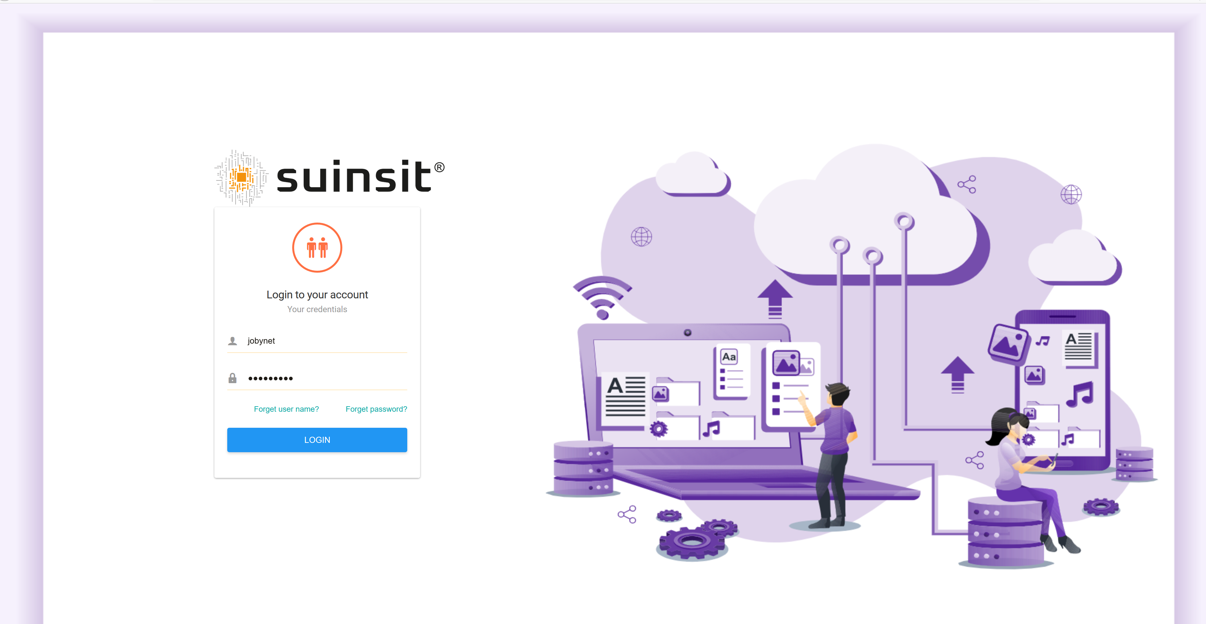
FAST DEVELOPMENT WITHOUT CODE

Slide 2


Shrink the costs and times of development in more than 80% increasing it profitability of their projects .
Suinsit is the first deck wha and the will allow create its projects using language natural and without need of use staff highly qualified
You can create and use applications in minutes that traditionally take weeks to develop.

Slide 3
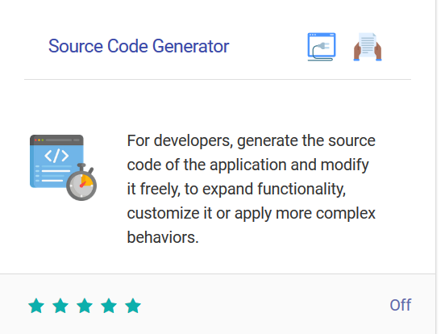
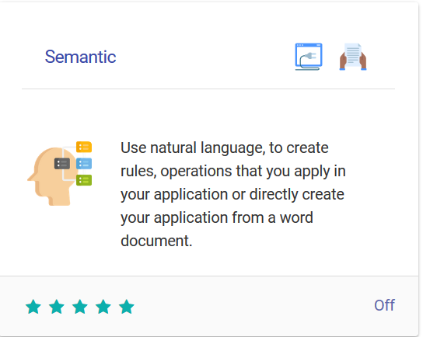
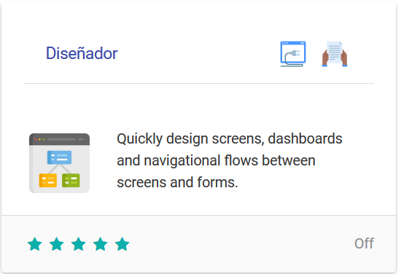
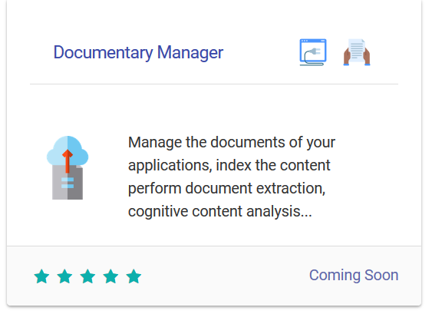
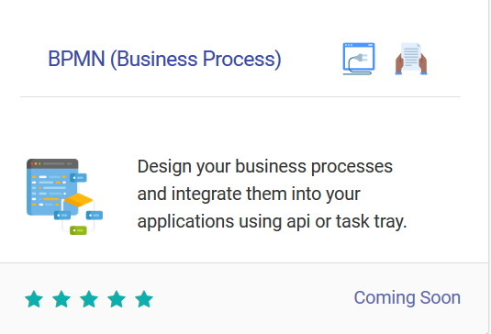

SUINSIT STUDIO
Modules
Spread out its deck at measure that your projects grow and develop from simple applications to complex projects with BPM, IA, Business Intelligence ...,
For IT companies and development teams, there is the "Suinsit Open Low Code" version that can generate the application code in different open source technologies and allow full access to the source code, modify it and integrate it with other platforms.

Slide 4
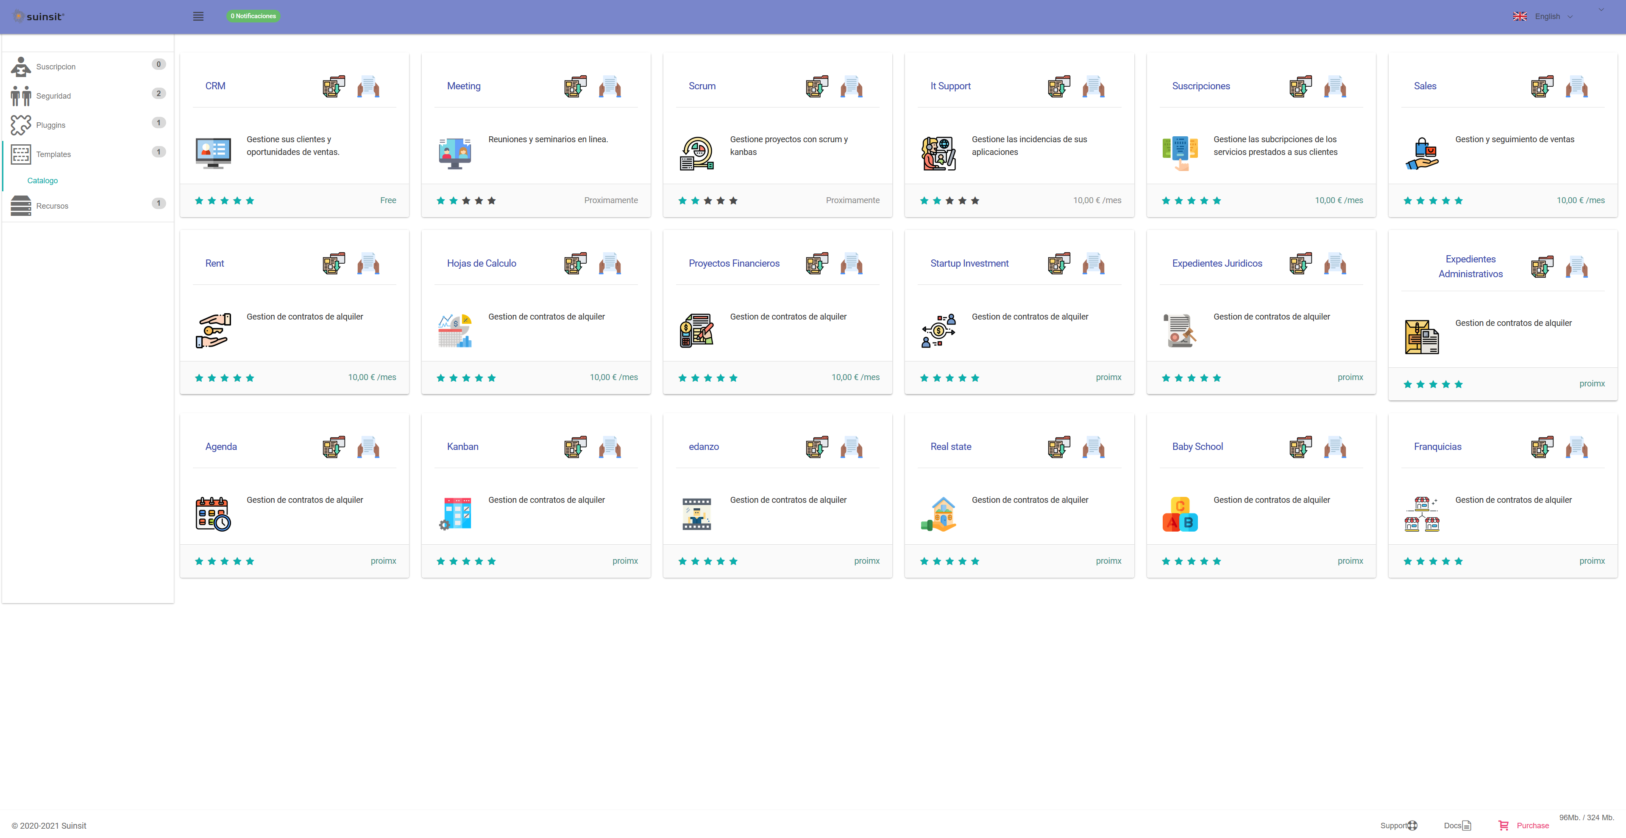
SUINSIT STUDIO
Templates
Suinsit provides sample applications adapted to each type of subscription that the user can use and customize using it always in our cloud.

Slide 5
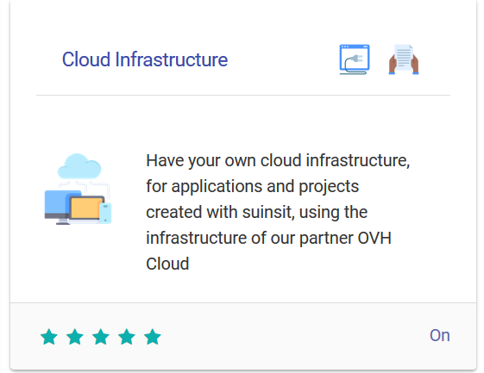
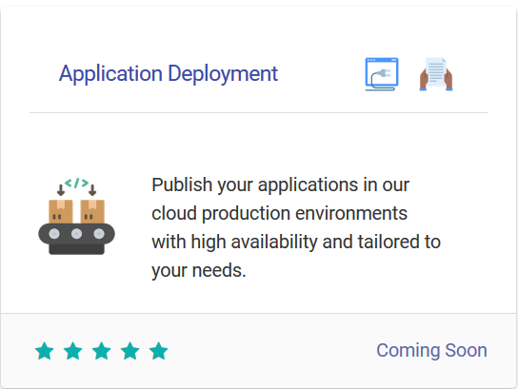

SUINSIT Cloud
Suinsit Cloud is fully integrated with the infrastructure of our sponsor OVH Cloud with its own data centers on 5 continents.
Applications are deployed on the kubernetes infrastructure integrated with openshift.
But we can also offer dedicated infrastructure, including communications and hybrid cloud solutions.

Slide 6

SUNSIT pilot FREE and started EDITIONS
At the end of October 2021 we plan to launch a pilot of the free version and started it before our sponsors and its users.
Users who are interested in the started version during the pilot will have a free month in addition to a 35% discount for the first year and subsequent years.

