Slide 1


Faculty of Artificial Intelligence Engineering
Department of AI & Data Science
An AI-Based Early Warning System for Sepsis in the ICU
Prepared by : Enas AL-Saleh
Supervised by : Dr.Nisreen Sulayman
    Eng.Zainab Baghdadi

Slide 2

01
Introduction
02
Problem Statement
03
Objectives
04
Literature Review
contents
05
Implementations
06
Limitations
07
Future Work
08
Refreneces

Slide 3
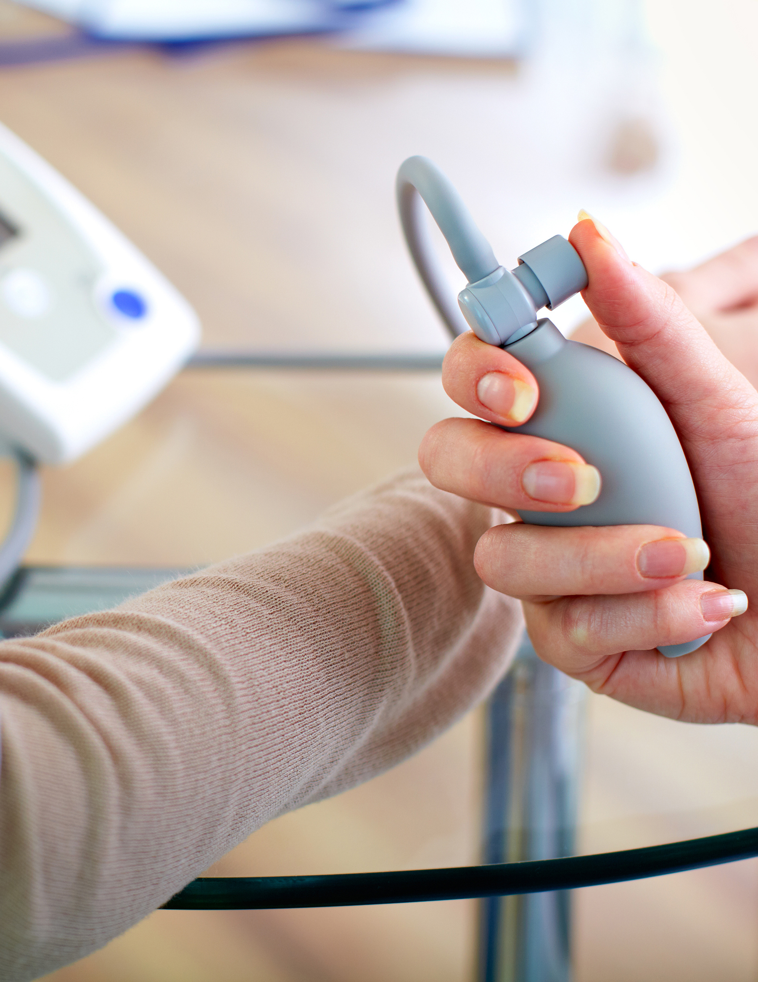
01 · INTRODUCTION
Why sepsis needs early warning
It is common in the ICU, its early signs are subtle, and outcomes worsen the longer treatment is delayed. An early warning system flags at-risk patients hours before they would otherwise be recognised.

Slide 4



02 · PROBLEM STATEMENT
Sepsis is easy to miss and hard to predict
Research question: can machine learning on routine hourly ICU data predict sepsis 6 hours before clinical onset, better than the scores used today?
Early changes are small and spread across dozens of vitals and lab results measured at different times.
SIRS and qSOFA describe sepsis once it is present. On our data they reach an AUROC of only 0.64 and 0.57.
Clinicians monitor many patients at once, so alerts must come early and must not be too frequent.

Slide 5
Sepsis prediction as a learning task
Element | Definition
Task | Binary classification, repeated every hour of the ICU stay
Input | All vital signs, lab results and demographics recorded up to the current hour
Output | Probability that sepsis onset (Sepsis-3) occurs within the next 6 hours
Users | ICU physicians and nurses, as a bedside alert
Data | PhysioNet 2019: 40,336 ICU patients from 2 hospitals
Constraints | No look-ahead; alarms must be early and not too frequent

Slide 6
03.Objectives
01
02
03
Build a reproducible data pipeline for 40,336 ICU patients
Engineer time-aware, clinically meaningful features
Train machine-learning models and compare them with SIRS and qSOFA
04
05
Evaluate like a clinical tool: AUROC, AUPRC, alarm rate, lead time
Explain every prediction with SHAP

Slide 7
04 · LITERATURE REVIEW
Related work and the gap we address

Slide 8
Reference No. | Dataset | Preprocessing and Feature Engineering | AI/ML Models | Training and Validation | Evaluation Metrics and Results | Limitations | Year
[1] | MIMIC-IV v3.0 (2008–2019) and eICU-CRD v2.0 (2014–2015); sample sizes not reported. | Admission-available features only (demographics, history, vital signs, laboratory values); future variables excluded to prevent leakage; MICE imputation; outliers removed using clinical reference ranges and manual review. | RF (final model), SVM, XGBoost, LR, DT, NB. | Hyperparameter tuning and class balancing; stratified 10-fold CV repeated 10 times; bidirectional external validation (MIMIC-IV ↔ eICU-CRD); bootstrap CIs (n = 1,000). | RF AUROC 0.870 (MIMIC-IV) and 0.883 (eICU-CRD) internally; 0.841 and 0.852 externally. SVM had a higher baseline AUROC (0.934), but RF was selected. Mortality rose from 0.8% (very low risk) to 84.2% (very high risk). Calibration and decision curve analysis also reported. | Retrospective design with possible temporal and inter-institutional bias; susceptible to coding errors, missing data, and selection bias that imputation may not fully address. Only structured EHR data were used, excluding nursing assessments and clinical judgment, and data were limited to North America; prospective and broader external validation are needed. | 2026
[2] | MIMIC-IV (development; n = 5,561; 2,259 septic shock) and eICU-CRD (external; n = 5,822; 1,212 septic shock); adults aged 18–89 years. | First vital signs, laboratory values, and severity scores within 24 h of ICU admission; exclusion of high-missingness patients (>40%) and variables (>10%); median imputation; standardization; LASSO feature selection; SHAP interpretation. | RF (best), XGBoost, SVM, LightGBM, LR, NB. | Trained on MIMIC-IV and externally validated on eICU-CRD; 10-fold CV used to tune LASSO. | RF AUC 0.785 (95% CI 0.770–0.800), sensitivity 0.736, specificity 0.699, Brier score 0.189; other models AUC 0.742–0.782. RF showed the best calibration and net benefit. Top SHAP predictors: SOFA, heart rate, creatinine, SAPS II, OASIS. | Retrospective data are subject to documentation bias, missingness, and inter-institutional variation, and recalibration may be required in other settings. Only routinely available variables were used, excluding lactate trends, inflammatory markers, and imaging. The study compared existing algorithms rather than proposing a novel method; hybrid approaches (e.g., fuzzy logic, genetic algorithms) are suggested for future work. | 2026
[3] | MIMIC-IV (n = 5,125; 766 septic shock; 60/20/20 split) and eICU-CRD (external; n = 2,180; 480 septic shock). | 6-h look-back window to predict septic shock in the next 6 h; hourly aggregation with forward-fill; SHAP-guided selection of 8 ABG and 7 vital-sign features; WOE/IV binning. | SORP: WOE-based LR scorecard, compared with complex ML/DL models (XGBoost used for SHAP). | 60/20/20 train/validation/test split of MIMIC-IV; external validation on eICU-CRD. | Test AUC 0.946 vs 0.965 for the best complex model. Septic shock incidence ranged from 88.6% (high risk) to 0.3% (ultralow risk); risk distribution was stable (PSI < 0.01); median warning time 13 h. In eICU-CRD, results were similar under an alternative septic shock definition. | Data sources were geographically limited, restricting analysis of regional differences; validation in other regions is needed, along with regular monitoring and adjustment of forewarning performance as new data become available. In eICU-CRD, septic shock could not be defined by Sepsis-3 criteria, so metrics such as AUC were not directly comparable with MIMIC-IV. | 2025

Slide 9
Reference No. | Dataset | Preprocessing and Feature Engineering | AI/ML Models | Training and Validation | Evaluation Metrics and Results | Limitations | Year
[4] | Adult ward admissions from three U.S. health systems: development n = 901,491; retrospective validation n = 1,769,461; prospective validation n = 205,946; external validation in 21 hospitals. | 97 features (demographics, vital signs, laboratory values, documentation, temporal trends); implausible values set to missing; carry-forward imputation (blood gas and lactate up to 24 h); 8-h intervals; downsampling. | Gradient-boosted trees with discrete-time survival analysis (eCARTv5); compared with eCARTv2, NEWS, and MEWS. | 5-fold CV for hyperparameter tuning; retrospective external and prospective real-time validation (2023–2024); subgroup analyses. | AUROC 0.834 (retrospective) and 0.828 (prospective), outperforming all comparators; subgroup AUROC 0.810–0.909. Calibration and lead time also assessed. | GBM models are difficult to interpret and require explainability methods. Other ML approaches and comparator scores were not evaluated, and it could not be determined whether ICU transfers were expected or unanticipated. High discrimination may not improve outcomes; prospective implementation is needed to assess impact on patient care. | 2025
[5] | MIMIC-IV (development; n = 23,909; 452 IHCA), eICU-CRD (external; n = 10,049; 85 IHCA), and NTUH (clinical validation; 1,935 IHCA, 3,692 controls); adults with ICU stay ≥24 h. | Baseline features plus six hourly vital signs from the preceding 24 h; last observation carried forward; SMOTE; RF importance and SHAP for interpretation. | Stacked ensemble: RF (baseline features) and LSTM (vital-sign series) combined by SVM; compared with LR, KNN, and XGBoost. | 5-fold CV with grid search on MIMIC-IV; external validation on eICU-CRD; clinical validation on NTUH. | At 1 h before IHCA: AUROC 0.91 (MIMIC-IV), 0.89 (eICU-CRD), and ≈0.945 (NTUH). Identified >70% of at-risk patients 12 h before arrest, outperforming CART. | Data were drawn from a single medical center, and reasons for irregular EHR sampling could not be determined. Interventions, temperature, and mental status were omitted owing to complexity and missingness. IHCA labels relied on procedure codes and epinephrine dosing, which may be affected by delayed or inconsistent documentation; manual review of vital signs was used to reduce this bias. | 2024
[6] | 9 studies (2001–2019); 879,224 adult inpatients; sample sizes 702–374,605. | 4–33 predictors per study (vital signs, consciousness, demographics, laboratory data); missing-data handling identified as a methodological concern. | ANN, LSTM, MLP, RNN, RF, SVM, GBM, KNN, decision and bagged trees; compared with MEWS. | PRISMA, CHARMS, and PROBAST; 2 prospective and 7 retrospective cohorts; no meta-analysis owing to heterogeneity. | ML AUROC 0.736–0.936 vs MEWS 0.603–0.886; ML outperformed MEWS in six studies. Best model: hybrid MLP–LSTM (AUROC 0.936). | Possible selection bias despite a rigorous search (final search December 2020) and possible publication bias; the funnel plot suggested the latter, but the small number of studies precluded a firm conclusion. | 2022

Slide 10
Theoritical background
MODELS
Logistic Regression
A linear, interpretable baseline: each feature adds or subtracts risk.
LightGBM
Gradient-boosted decision trees: each tree corrects the errors of the previous ones. Handles missing values natively.
SHAP
Explains a single prediction by showing how much each feature pushed the risk up or down.
METRICS
AUROC
Chance that a pre-sepsis hour is ranked above a normal hour. 0.5 is random, 1.0 is perfect.
AUPRC
How precise the alarms are across all sensitivities. Random baseline equals the prevalence, about 0.018 here.
Why not accuracy?
Always predicting “no sepsis” scores 98% accuracy while catching no one.

Slide 11
PhysioNet / CinC Challenge 2019
06.Dataset
40,336
1,552,210
40
ICU patients, one file per patient
hourly records
variables: 8 vital signs, 26 lab tests, 6 demographic
2
37 h
7.3%
hospitals (A and B)
median ICU stay
of patients develop sepsis

Slide 12
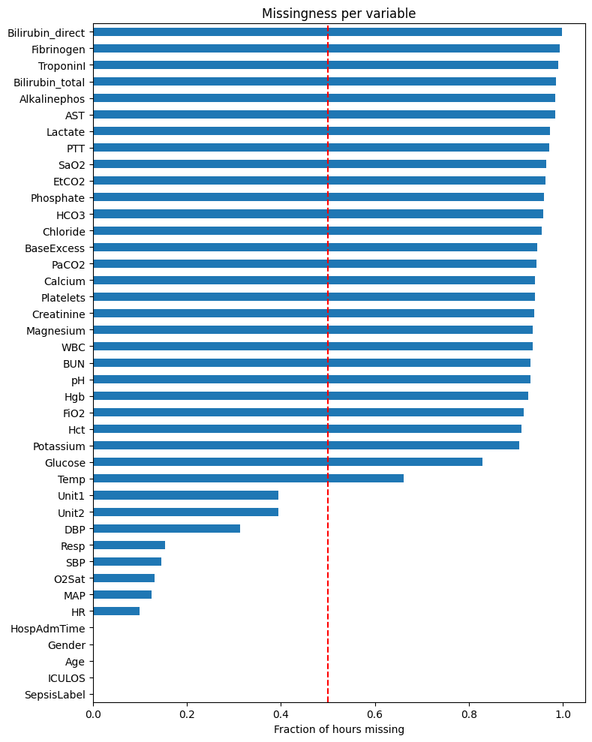
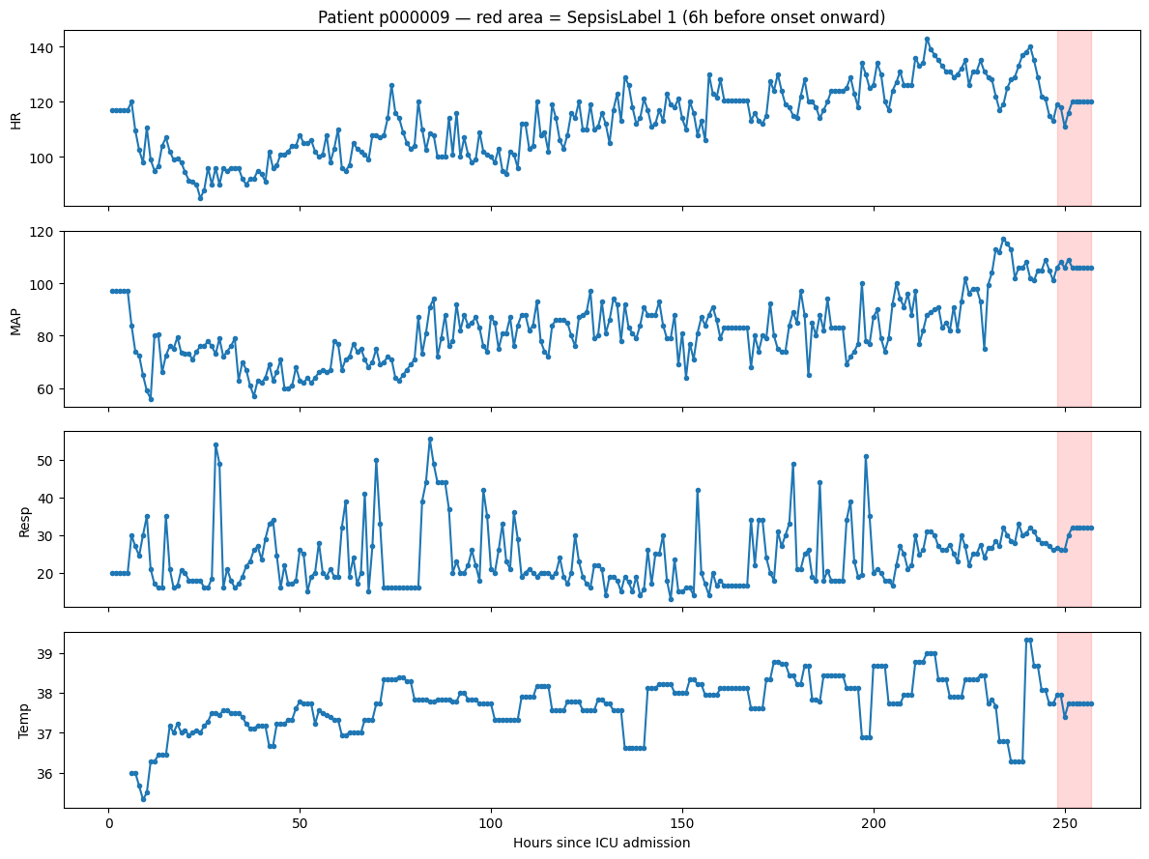

Slide 13
05 · Implemenation
Patient-level split and data cleaning

Slide 14
Split by patient (stratified)
Impossible values removed
Set | Patients | Sepsis rate
Train | 28,235 | 7.27%
Validation | 6,050 | 7.27%
Test | 6,051 | 7.27%
Variable | Valid range | Removed
Heart rate | 20–250 | 4
SpO2 | 50–100 | 272
Temperature | 30–43 °C | 18
Systolic BP | 40–250 | 192
Mean BP | 20–200 | 444
Diastolic BP | 10–180 | 151
Resp. rate | 4–60 | 1,906
No patient appears in two sets, so test results reflect truly unseen patients. The test set stays locked until final evaluation.
2,987 values in total, under 0.2% of hours

Slide 15
Missing data
Carry the last known value forward within each patient, and record how many hours have passed since it was measured. Ordering a test is itself a signal.
Still missing after filling | Hours
Vital signs | 2–7%
Common labs (glucose, potassium, BUN) | 15–21%
Specialised labs (lactate, troponin, bilirubin) | 70–95%

Slide 16
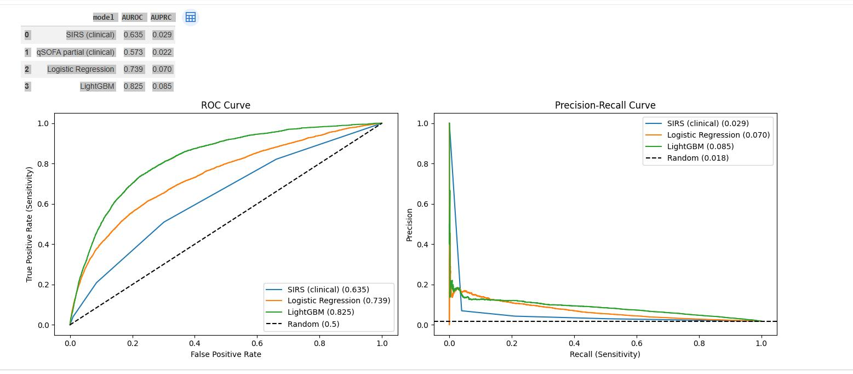
AUROC rises from 0.635 (SIRS) to 0.825, and AUPRC is 4.7× the random baseline.

Slide 17
06 · Limitations
What this work cannot yet show

Slide 18
Limitations
Retrospective data
Two hospitals, historical records; no prospective or real-time testing.
Missing information
No level of consciousness, medications or clinical notes;
qSOFA is incomplete.
Automatic labels
Sepsis onset is derived from EHR criteria and may contain noise.
Limited tuning so far
One LightGBM configuration; hyperparameter search is in progress.
Conclusion:Routine hourly ICU data, turned into time-aware features, lets a LightGBM model flag sepsis risk 6 hours ahead far better than SIRS or qSOFA.

Slide 19
07.Future Work
MIMIC-IV
Patient-level detection rate (sensitivity)
Validate on a larger dataset after PhysioNet credentialing.
Model tuning
Sequence models
GRU, LSTM or Transformer models on raw hourly data.

Slide 20
08 .References
[1] Gao, S., Zhang, Y., Deng, M., Liu, H., Xu, W., Luo, M., Tian, Y., & Zhang, B. (2026). Machine learning-based early warning system for hemodynamic deterioration in cardiovascular ICU patients: A bidirectional cross-validation study. Frontiers in Cardiovascular Medicine, 12, Article 1694001. https://doi.org/10.3389/fcvm.2025.1694001
[2] Zhou, H., Li, F., & Liu, X. (2026). Early prediction of septic shock in ICU patients using machine learning: Development, external validation, and explainability with SHAP. International Journal of Medical Informatics, 206, Article 106169. https://doi.org/10.1016/j.ijmedinf.2025.106169
[3] Liu, G., Zheng, S., He, J., Zhang, Z.-M., Wu, R., Yu, Y., Fu, H., Han, L., Zhu, H., Xu, Y., Shao, H., Yan, H., Chen, T., & Shen, X. (2025). An easy and quick risk-stratified early forewarning model for septic shock in the intensive care unit: Development, validation, and interpretation study. Journal of Medical Internet Research, 27, Article e58779. https://doi.org/10.2196/58779
[4] Churpek, M. M., Carey, K. A., Snyder, A., Winslow, C. J., Gilbert, E., Shah, N. S., Patterson, B. W., Afshar, M., Weiss, A., Amin, D. N., Rhodes, D. J., & Edelson, D. P. (2025). Multicenter development and prospective validation of eCARTv5: A gradient-boosted machine-learning early warning score. Critical Care Explorations, 7(4), Article e1232. https://doi.org/10.1097/CCE.0000000000001232
[5] Lee, H.-Y., Kuo, P.-C., Qian, F., Li, C.-H., Hu, J.-R., Hsu, W.-T., Jhou, H.-J., Chen, P.-H., Lee, C.-H., Su, C.-H., Liao, P.-C., Wu, I.-J., & Lee, C.-C. (2024). Prediction of in-hospital cardiac arrest in the intensive care unit: Machine learning–based multimodal approach. JMIR Medical Informatics, 12, Article e49142. https://doi.org/10.2196/49142
[6] Moffat, L. M., & Xu, D. (2022). Accuracy of machine learning models to predict in-hospital cardiac arrest: A systematic review. Clinical Nurse Specialist, 36(1), 29–44. https://doi.org/10.1097/NUR.0000000000000644
[7] Reyna, M., Josef, C., Jeter, R., Shashikumar, S., Moody, B., Westover, M. B., Sharma, A., Nemati, S., & Clifford, G. D. (2019). Early Prediction of Sepsis from Clinical Data: The PhysioNet/Computing in Cardiology Challenge 2019 (version 1.0.0). PhysioNet. https://doi.org/10.13026/v64v-d857

Slide 21
THANK YOU！
Any Questions?

