Slide 1
Calculus Behind Neural Networks
Deriving Backpropagation Using Partial Derivatives and the Chain Rule
Essential Math for Data science- Project Presentation
Enas Elhaj

Slide 2
Objectives
This project demonstrates how calculus enables learning in neural networks by:
  Deriving backpropagation for a small neural network step-by-step
  Applying partial derivatives and the chain rule to compute gradients
  Optionally, implement and test the weights and biases updates in Python

Slide 3
Hypothesis
If we apply partial derivatives and the chain rule correctly through backpropagation, then we can compute accurate gradients that allow a neural network to reduce its error through gradient descent.

Slide 4
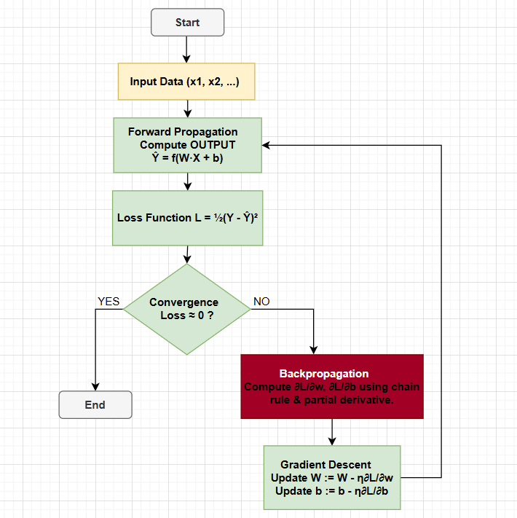
learning in neural networks
The flowchart shows the complete learning cycle of a neural network.
This project focuses on the Backpropagation step, where chain rule and partial derivatives drives the learning process.
Figure 1: learning in neural networks

Slide 5
Methods Explored
Method Overview
  Define a small neural network (2 inputs → 2 hidden neurons → 1 output)
  Compute forward pass and loss function
  Derive gradients using partial derivatives + chain rule
  Implement one step of gradient descent updates in Python

Slide 6
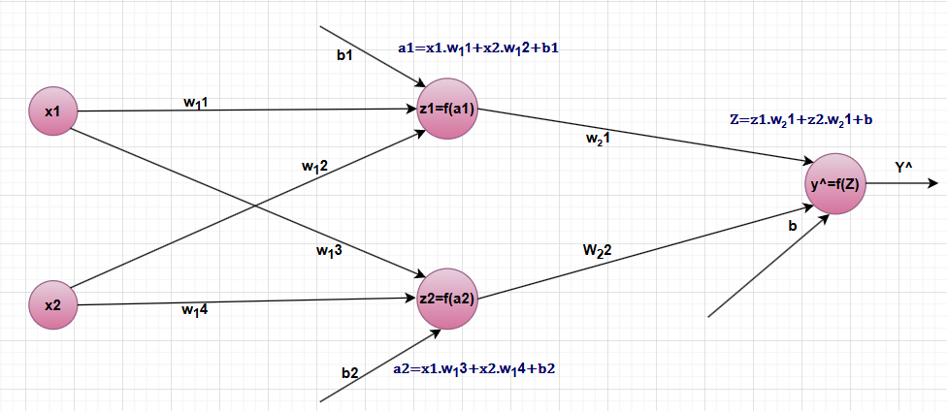
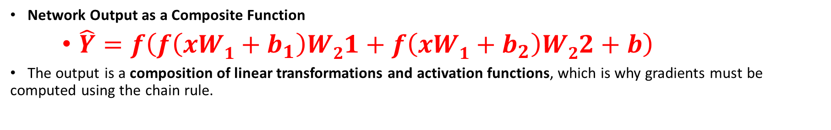
Composite Output
Figure 2: Forward Propagation
Network Output as a Composite Function
    $\hat{Y}=f\left(f\left(xW1+b_{1}\right)W21+f\left(xW1+b_{2}\right)W22+b\right)$
The output is a composition of linear transformations and activation functions, which is why gradients must be computed using the chain rule.

Slide 7

Loss Function
Loss function (Prediction Error):
  $$L=\frac{1}{2}\left(Y−\hat{Y}{\left.)\right.}^{2}\right.$$
Purpose:
The network learns by adjusting weights and biases to reduce the loss.

Slide 8

Why the Chain Rule is Needed
Why Chain Rule is Needed?
Because each parameter affects the loss indirectly through multiple layers.
$$\frac{∂L}{∂w}, \frac{∂L}{∂b}$$
$\frac{∂L}{∂b1}=\frac{∂L}{∂\hat{y}}⋅\frac{∂\hat{y}}{∂z}⋅\frac{∂z}{∂z_{1}}⋅\frac{∂z_{1}}{∂a_{1}}⋅\frac{∂a_{1}}{∂b1}$​​
$\frac{∂L}{∂w_{11}}=\frac{∂L}{∂\hat{y}}⋅\frac{∂\hat{y}}{∂z}⋅\frac{∂z}{∂z_{1}}⋅\frac{∂z_{1}}{∂a_{1}}⋅\frac{∂a_{1}}{∂w_{11}}$
To compute these, we apply the chain rule backwards through the network, this is backpropagation.

Slide 9
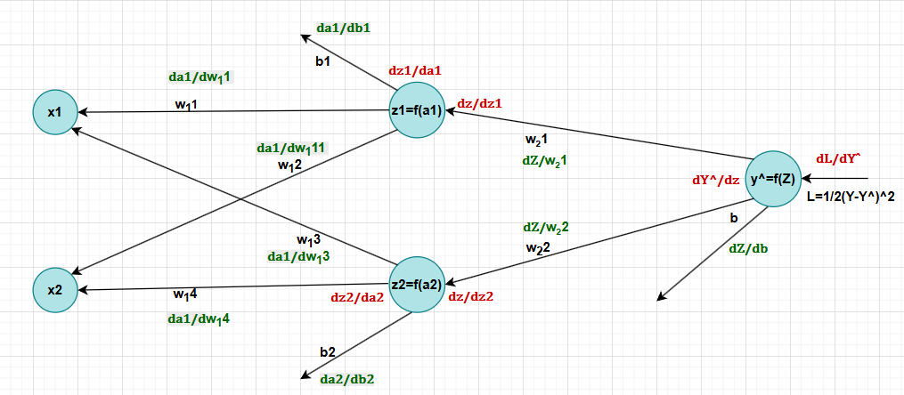
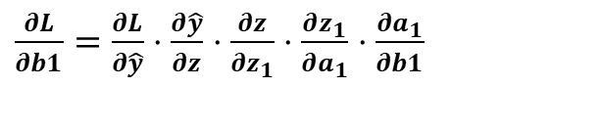
Backpropagation in Neural Networks
$\frac{∂L}{∂b1}=\frac{∂L}{∂\hat{y}}⋅\frac{∂\hat{y}}{∂z}⋅\frac{∂z}{∂z_{1}}⋅\frac{∂z_{1}}{∂a_{1}}⋅\frac{∂a_{1}}{∂b1}$​​
Figure 3: Backpropagation in Neural Networks

Slide 10
Use Case
Why a Small Network Here
  Makes every derivative and update step fully visible
  Shows how calculus enables learning, especially the chain rule
  Improves conceptual understanding before scaling to complex architectures.
Neural Networks at Scale
Real applications contain thousands to millions of neurons
Examples:
  Image recognition (e.g., face detection)
  Speech and language processing (e.g., voice assistants)
  Medical diagnosis (e.g., tumor classification)

Slide 11
Manual Implementation (NumPy)
Forward pass and loss calculation
Gradients computed with chain rule
One gradient-descent update applied
  w2 -= lr * dL_dw2
  b2 -= lr * dL_db2
  w1 -= lr * dL_dw1
  b1 -= lr * dL_db1

Slide 12
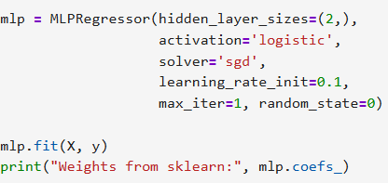
Framework Implementation (sklearn)
Same architecture
Same activation
One update step
Framework performs backprop internally

Slide 13
Results & Conclusion
Results
  Successfully computed all gradients for a real network example
  Performed one full weight-update step using gradient descent
  Confirmed that parameter updates follow gradient direction
Conclusion
  Chain rule enables backpropagation.
  Partial derivatives show how each parameter affects loss.
  Without calculus, neural networks cannot learn, calculus is the learning engine.

Slide 14
Future Work
Extend to deeper or wider networks and other activations
Visualize loss curves and weight updates over time
Compare manual implementation with PyTorch/TensorFlow
Experiment with hyperparameters (learning rate, batch size)

Slide 15
References
[1] Wikipedia contributors, Neural network (machine learning), 2025.
[2] D. Maiolo, Understanding the Role of Calculus in Neural Networks for AI Advancement, 2024.
[3] ApX Machine Learning, Introduction to Neural Networks as Composite Functions, 2025.
[4] ApX Machine Learning, Backpropagation Algorithm and the Chain Rule, 2025.

Slide 16
Thank You

