Slide 1
High Speed Energy-Efficient Convolutional Neural Network with Approximate Computing
Keertana Settaluri, Emily Naviasky

Slide 2
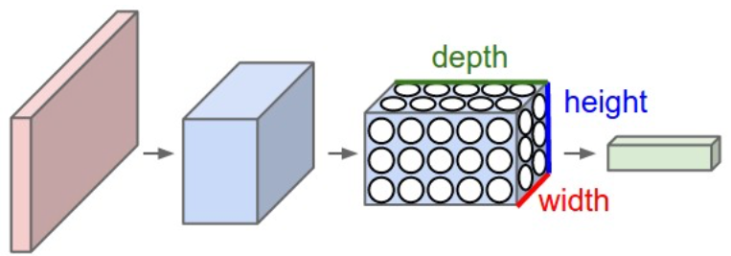
Background: ConvNet
Neurons arranged in layers with 3 dimensions
Every layer transforms 3D input to 3D output
Layer types: Convolutional, pooling, fully-connected
Computationally intensive
- AlexNet: 666 million MACs per 227x227 pixel image

Slide 3
Problem Statement: Approximate Computing in ConvNet
Propose to use hardware approximate computing on ConvNet
ConvNets innately resilient to imperfections in precision due to nature of noisy data which it they are used to interpret

Slide 4
Table of Contents
Adder
Multiplier
Verilog Implementation
Caffe/Evaluation
Results

Slide 5
Adder Implementation
Lower Part Or (LPO) Adder
Carry (A[n-1]*B[n-1])
m, Upper Accurate Bits
n, lower OR-ed bits
Approximated bit width
Saves power and area by reducing number of adder blocks
Performance increase
- Critical path is through carry
- OR-ing lower bits reduces propagation delay greatly

Slide 6
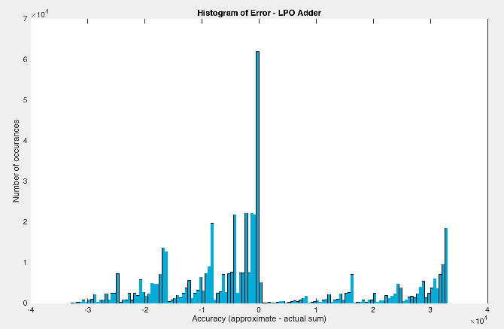
Adder Implementation
Plot shows 16 bits approximate (32 bit integer total)
LPO - low mean error per bit
Sum peaks at/near zero error

Slide 7
Multiplier Implementation
Simple PPG Multiplication
zeros
PP 0
PP 1
PP 2
…
VBL = 4
All partial products to the right of VBL are zero
Power/area reduced since number of adders reduced
Critical path lowered (operating frequency increases)

Slide 8
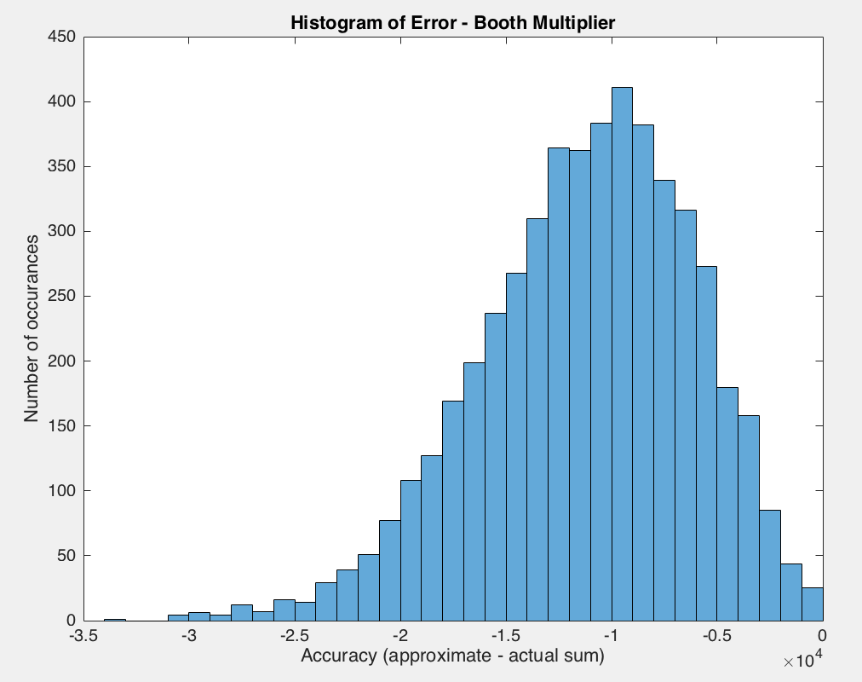
Multiplier Implementation
Normal distribution of error, VBL = 8
“Rounding” of error good for our application

Slide 9
Verilog Implementation
LPO adder:
Upper bits implemented using ‘+’
DC optimizes the upper accurate bits
Accurate adder implemented as well
Multiplier:
Variable VBL
Accurate simple PPG multiplier implemented
Setup:
Large constant clock chosen for adder/multiplier
Area obtained from ICC
Positive slack used to determine performance
Power obtained using PrimeTime

Slide 10
Caffe
Deep learning framework created by BVLC
I have no idea Emily halp. Mention Docker? idk

Slide 11




LeNet Architecture
Input Data
Conv 1
- ConvNet that classifies digits
Pooling 2
- Simple but relevant baseline architecture
Conv 2
- Gradient-Based Learning technique
- 91.7% accuracy
Pooling 2
Outputs probability that input is certain
digit
Fully Connected
Score
Out

Slide 12
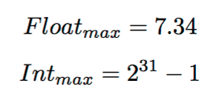



Floating Point to Integer Mapping
Constant factor k chosen to map from float to integer
Integer Mapping:
Float Mapping:

Slide 13

Error Introduction
Input Data
Conv 1
% Error
Pooling 2
Conv 2
Pooling 2
Fully Connected
Score
Out

