Slide 1
HEALTHDIARY: Dıet&fıtness applıcatıon
Elif Naz Erçin – 117200058
Ege Berk Yeşil - 115200075

Slide 2
INTRODUCTION
What did we research and pay attention to while working on this project?
- Similar applications and tools and technologies that we can probably use on this project.
What is our main goal?
- To guide people to be healthy and to add to the shortcomings of similar applications.

Slide 3
METHODOLOGY
The proposed application divided into two parts named front-end and back-end.

Slide 4
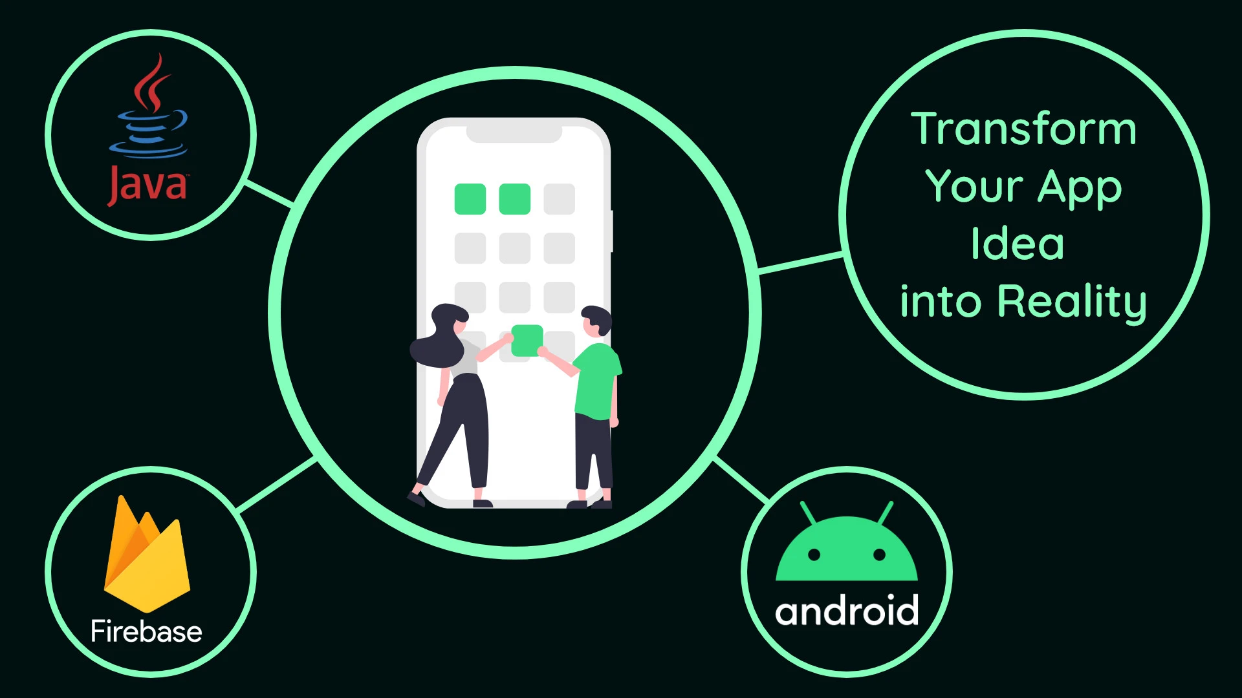
METHODOLOGY
Java has been on the rise in mobile application for a long time, it also brings powerful and useful application making. With the Android Studio, it offers an easier GUI construction and a responsive application.
An easy-to-use interface will be designed for front-end, where users can easily find everything they are looking for in the application.
This is how Java transformed to an Application:

Slide 5
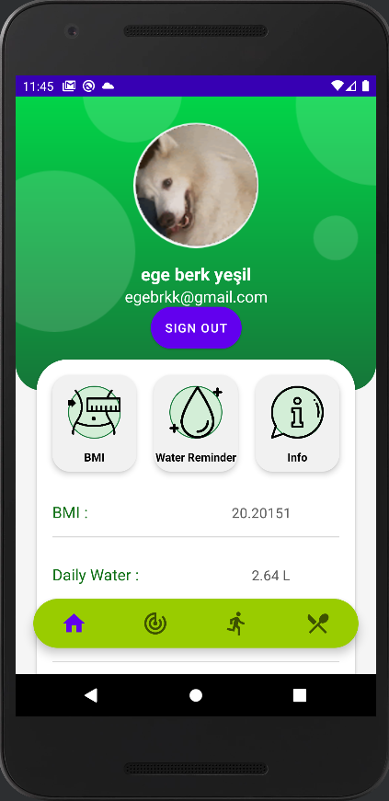
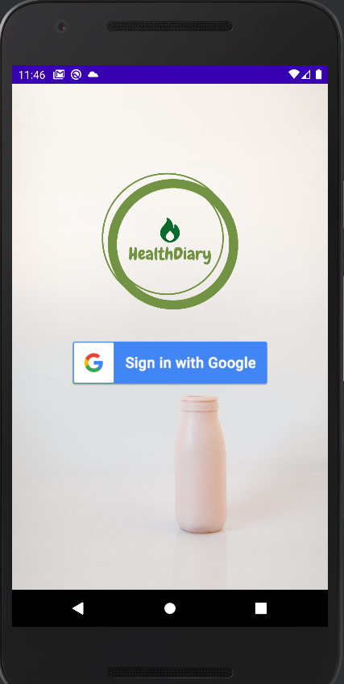
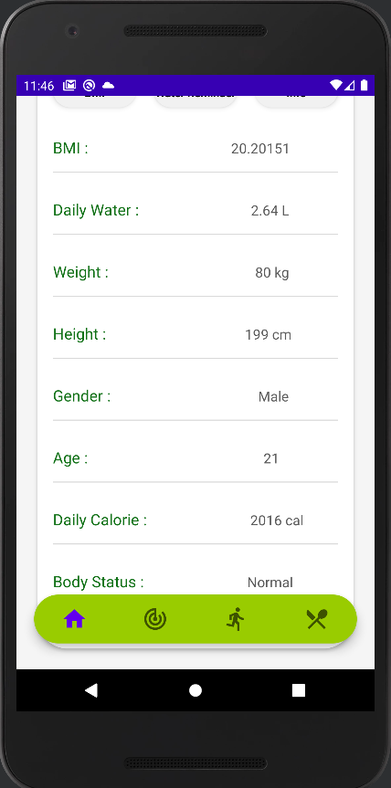
METHODOLOGY - FRONTEND
How login page and profile screen look like of application:

Slide 6
METHODOLOGY - API
After all the research was done, it was decided to use API Ninjas -- Nutrition API.
Returns a list of nutrition information extracted from given text. Nutrition data for each food item is scaled to 100g unless a quantity is specified within the query parameter

Slide 7
RELATED WORKS
MyFitnessPal
Lifesum
Great food database
Great input controls
Additional content are not very compelling
Can read the barcode
Good food database
Easy to use
Low price
Highly customizable
No community or personal coaching

Slide 8
RELATED WORKS
Noom
FitWell
Weak food database
Intertactive daily content
Interaction with other users
No free trial
Coaching could use improvement
Daily food content
Easy to use
Low price
Training videos for what user wants
No community
Excellent food database

Slide 9
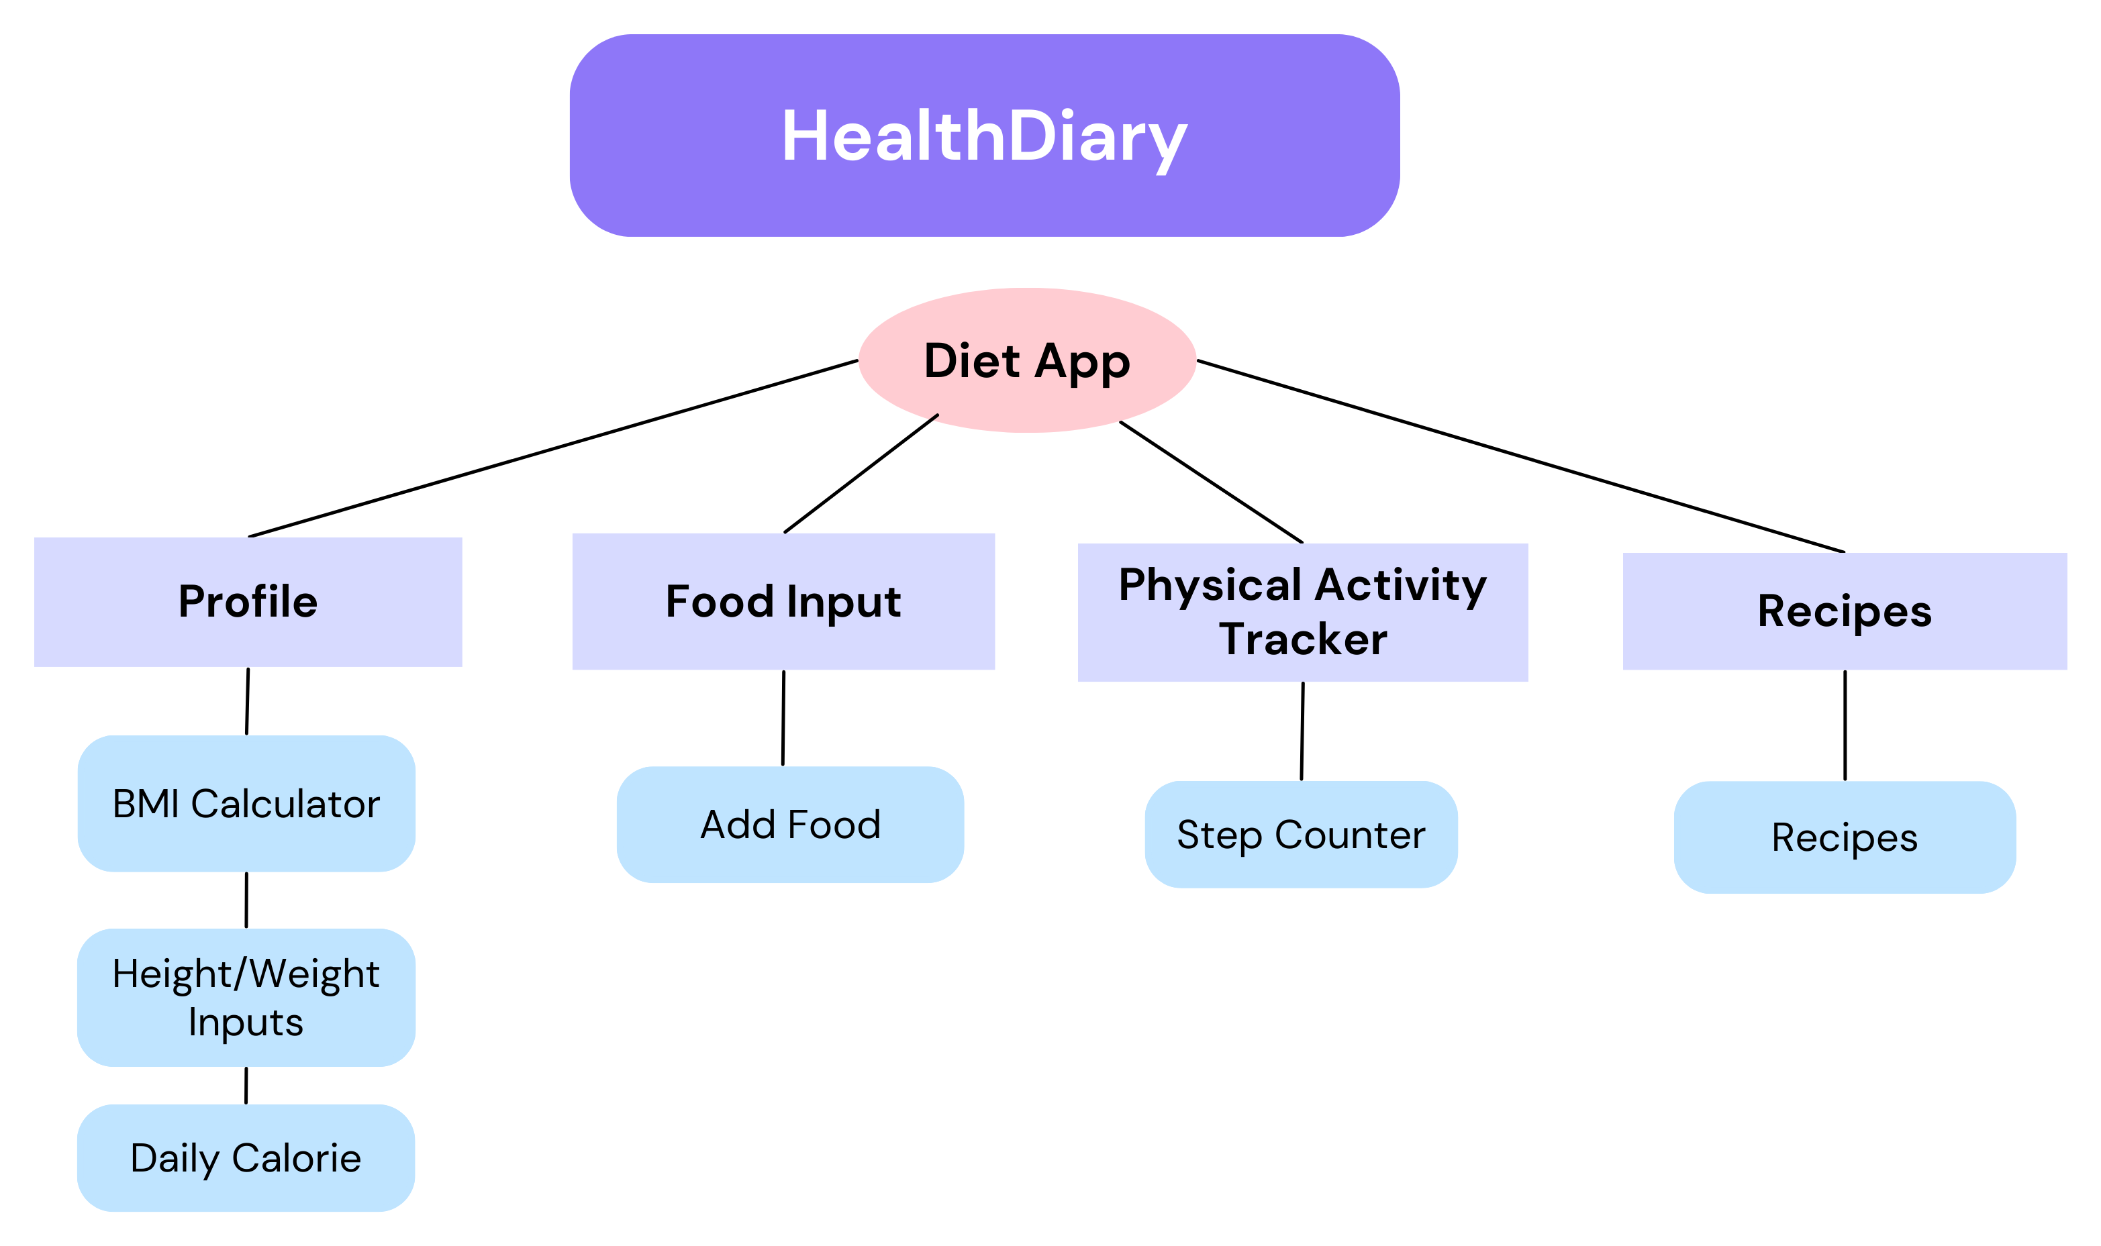
APPLICATION DESIGN

Slide 10
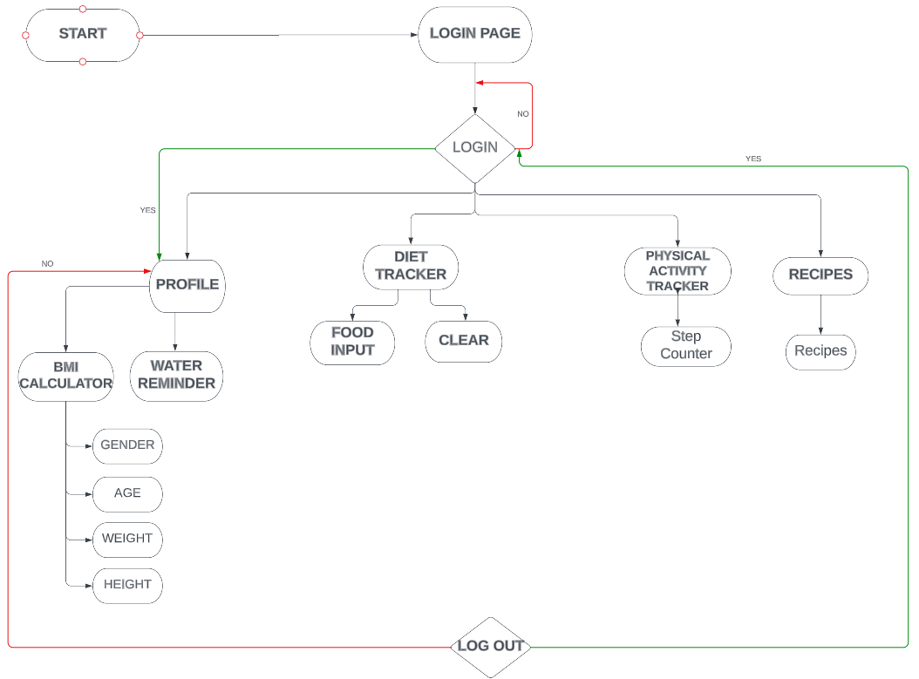
APPLICATION DESIGN
FLOW CHART FOR THE PROJECT

Slide 11
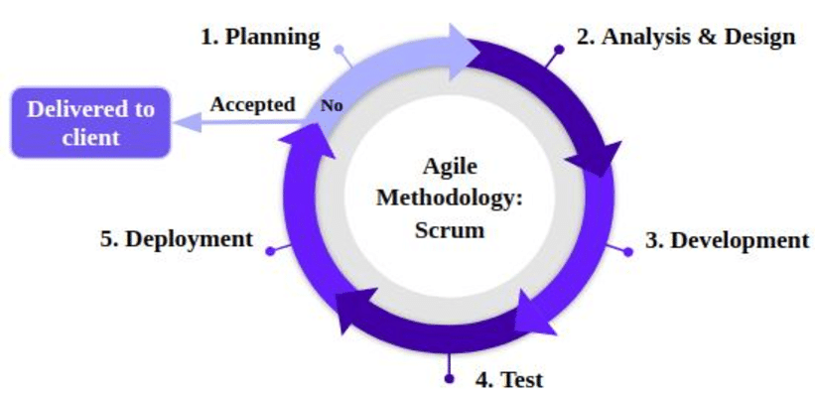
DESIGN METHODOLOGY
AGILE METHODOLOGY
- Agile is a software development methodology based on iterative development. It encourages transparency and accountability as well as self-organization of teams. Scrum is one of the Agile methodologies and a very productive one.

Slide 12



CONCLUSION and FUTURE WORK
As a result of this study, it is expected to benefit people to be healthy. Preventing the spread of fast-food culture and directing to healthy-life is one of the possible results of this practice.
Technologies to be used:
Java with Android Studio
API Ninjas
Future Work

Slide 13
THANK YOU FOR LISTENING

