Slide 1
Refactoring Legacy Code
Andreas Enbohm
@enbohm
2013-09-11

Slide 2




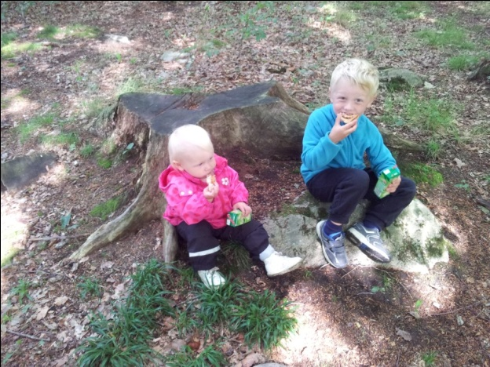
About Me

Slide 3


What is Legacy Code?

Slide 4
Legacy Code
Legacy Code is Simply Code Without Tests!
(do you write legacy code?)

Slide 5

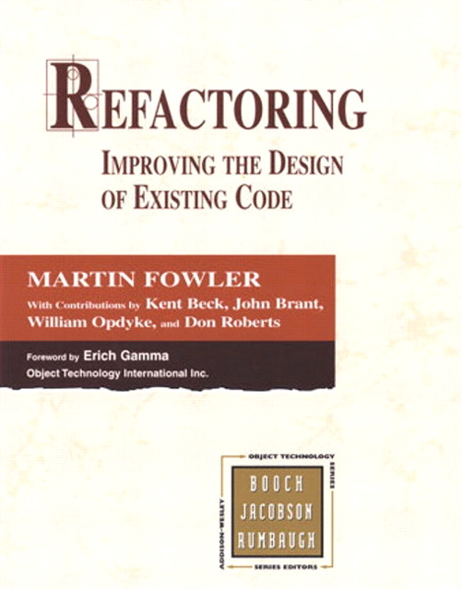
Refactoring
Sandro Mancuso http://craftedsw.blogspot.com

Slide 6
Refactoring Legacy Code
Have a clear goal - otherwise you could end up just moving around code and not making things any better
Specify, don’t verify - aim is not to test code, but to produce artifacts that describes its behaviour (characterization tests)

Slide 7
Business Component We Want to Change
TweetService.java – a service responsible for finding tweets by a specific user
Need to be logged in to see tweets by a particular user
Need to be friends to see someone else’s tweets

Slide 8
Tips
Use a code coverage tool
Commit often - enables you to commit improvements quickly - allows you to rollback if you make a mistake - remember, refactoring should be done in small steps!
Identify Seams - parts where you can modify behaviour without editing that place - use known dependency breaking techniques to create seams
Stay in the ’green-zone’ as long as possible

Slide 9
Tips (cont)
Start refactoring from deepest to shortest branch
if (…) {
boolean param…
if (param) {
if (getStuff()) {
…
}
}
} else {
…
}
Start testing from shortest to deepest branch

Slide 10



Q & A
http://www.slideshare.net/enbohm
@enbohm
https://github.com/enbohm

