Slide 1
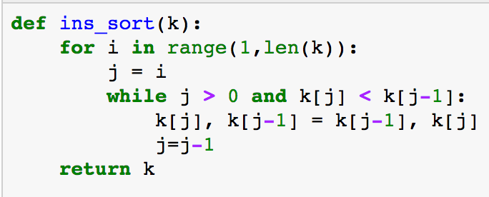
I = 1
J = 1
J-1 = 0
7 | 4 | 5 | 2 | 9 | 1

Slide 2
I = 1
K[j] = 4
K[j-1] = 7
Is 4 < 7? Yes
Swap them
J = 1
J-1 = 0
7 | 4 | 5 | 2 | 9 | 1

Slide 3
I = 1
K[j] = 7
K[j-1] = 4
j = j -1 = 0
j > 0? No, so we break out of the while loop
J = 1
J-1 = 0
4 | 7 | 5 | 2 | 9 | 1

Slide 4
Next Iteration: I = 2
J = 2
J-1 = 1
4 | 7 | 5 | 2 | 9 | 1

Slide 5
I = 2
K[j] = 5
K[j-1] = 7
Is 5 < 7? Yes
Swap them
J = 2
J-1 = 1
4 | 7 | 5 | 2 | 9 | 1

Slide 6
I = 2
K[j] = 7
K[j-1] = 4
j = j -1 = 1
j > 0? Yes, so we stay in the while loop
J = 2
J-1 = 1
4 | 5 | 7 | 2 | 9 | 1

Slide 7
I = 2
K[j] = 5
K[j-1] = 4
Is 5 < 4? No, do no swap
j = j-1 = 0
j > 0? Yes, so we stay in the while loop
J = 1
J-1 = 0
4 | 5 | 7 | 2 | 9 | 1

Slide 8
I = 3
K[j] = 2
K[j-1] = 7
Is 2 < 7? Yes, SWAP
j = j-1 = 0
j > 0? Yes, so we stay in the while loop
J = 3
J-1 = 2
4 | 5 | 7 | 2 | 9 | 1

Slide 9
I = 3
K[j] = 2
K[j-1] = 5
Is 2 < 5? Yes, SWAP
j = j-1 = 1
j > 0? Yes, so we stay in the while loop
J = 2
J-1 = 1
4 | 5 | 2 | 7 | 9 | 1

Slide 10
I = 3
K[j] = 2
K[j-1] = 4
Is 2 < 5? Yes, SWAP
j = j-1 = 0
j > 0? No, break out of the loop
J = 1
J-1 = 0
4 | 2 | 5 | 7 | 9 | 1

Slide 11
I = 4
K[j] = 9
K[j-1] = 7
Is 9 < 7? Nope, leave it alone
j = j-1 = 3
j > 0? Yes, so do we stay in the loop?
J = 4
J-1 = 3
4 | 2 | 5 | 7 | 9 | 1
Nope!
k[j] is not < k[j-1], so we move on to the next iteration

Slide 12
I = 5
K[j] = 1
K[j-1] = 9
Is 1 < 9? Yep, Swap them
j = j-1 = 4
j > 0? Yes, stay in the loop
J = 5
J-1 = 4
4 | 2 | 5 | 7 | 9 | 1
Nope!
k[j] is not < k[j-1], so we move on to the next iteration

