Slide 1
StarWars vs StarTrek the battle for Comic Con dominance
By Christopher Villafuerte

Slide 2
Goal. StarWars corporate (Disney) wants to have an overwhelming turnout of fans for the Comic Con 2021

Slide 3
How. To achieve this Disney is sending reward their fans on the subbredit StarWars, offering a secret $15 discount off ComicCon 2021 entry fee.

Slide 4
Problem: The promotion is only for participants on the StarWars subreddit, therefore corporate want to make sure that only StarWars fans receive this promotions. (and not Trekies)

Slide 5
Process is to create a model that yields a high accuracy and precision score in a binary classification between the subreddits StarWars and StarTrek?

Slide 6
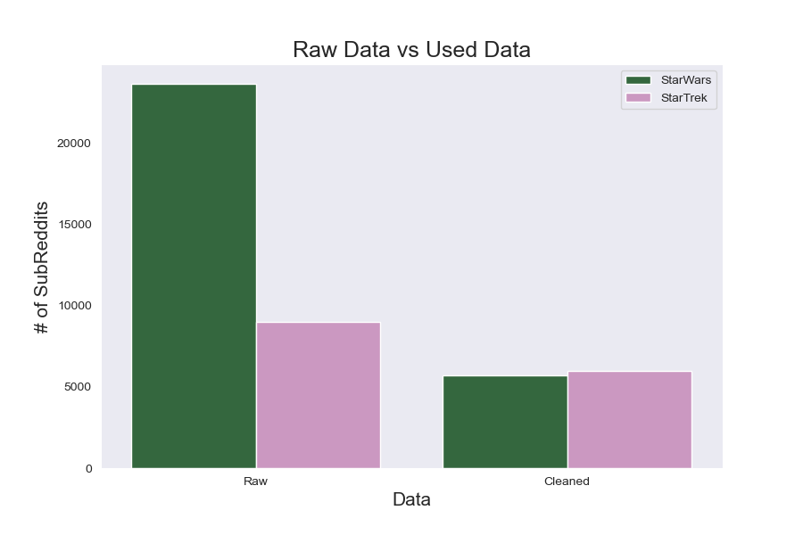
Data:
Notes:
23,700, StarWars subReddits and 9,000 Startrek subreddits.
5,712 Starwars subReddits and 6,000 startrek subReddits

Slide 7
BaseLine 51%

Slide 8
Models Naïve Bayes, Logistic Regression, Random Forest Adaboost classifier models

Slide 9
Paired with: TfidfVectorizer and CountVectorizer both with standard stop words.

Slide 10
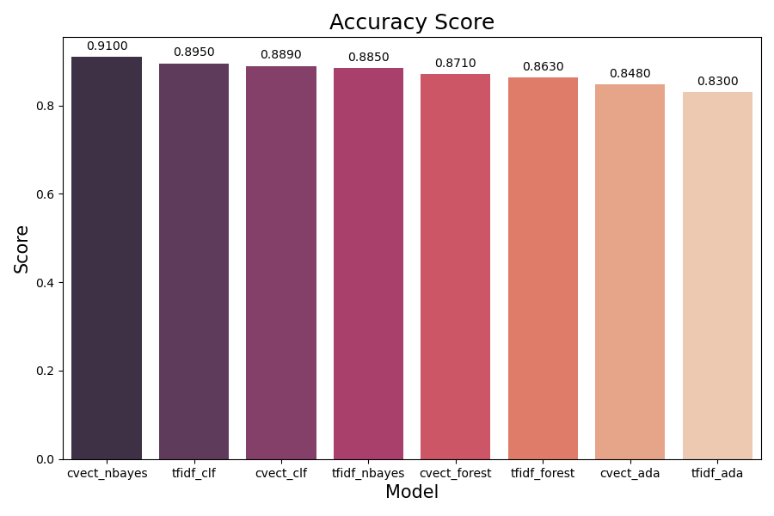
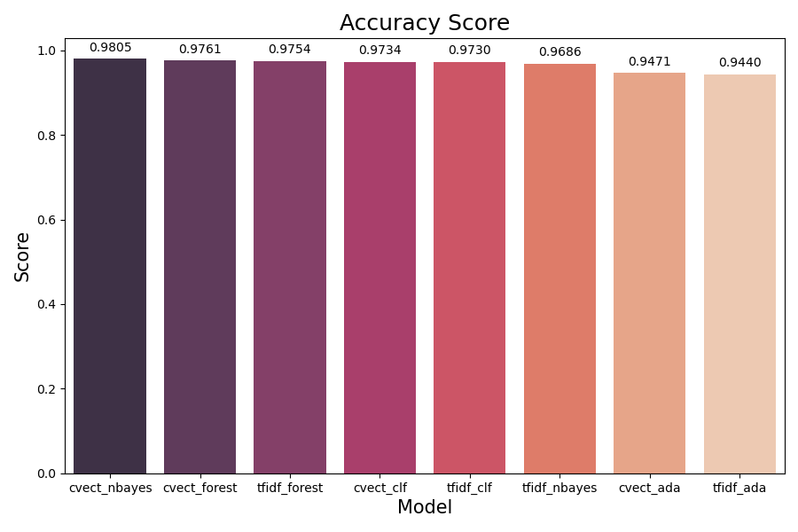
Accuracy Score

Slide 11
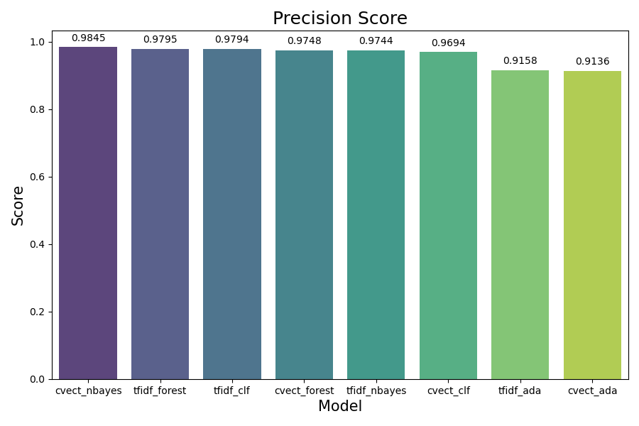
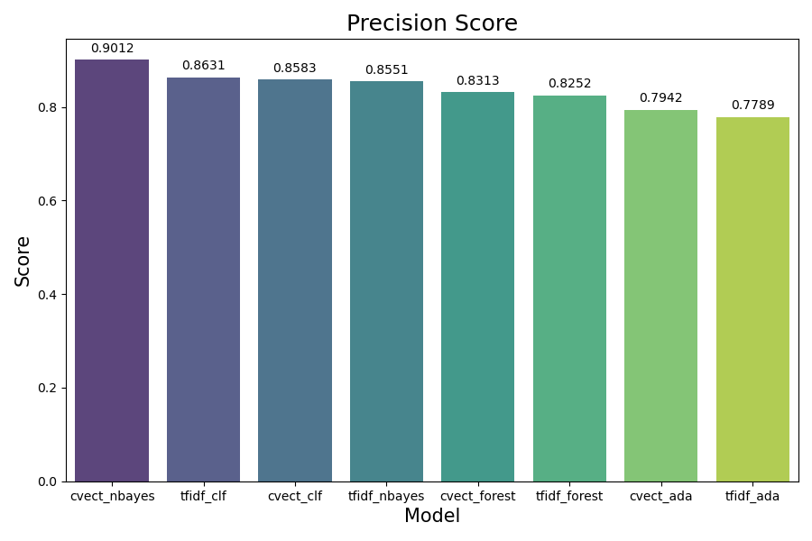
Precision Score

Slide 12
Final Model Naive Bayes & CountVectorizer

Slide 13
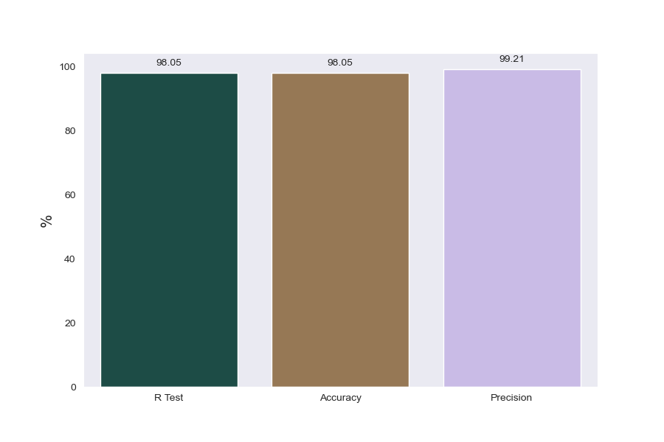
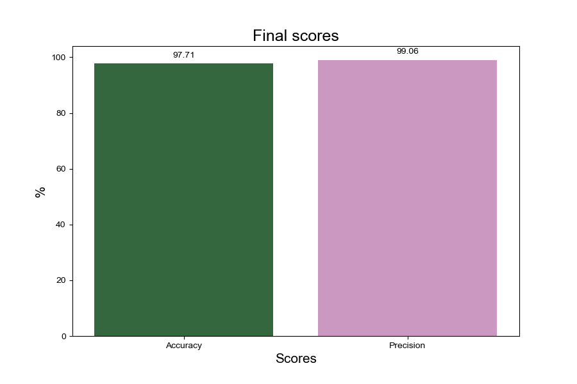
Final Scores
98.05
98.05
99.21
R Score
Accuracy
Precision

Slide 14
Tuning factors -Heavy data cleaning - Lemmatizing - Custom stop words (1-2) n-grams 5000 features

Slide 15
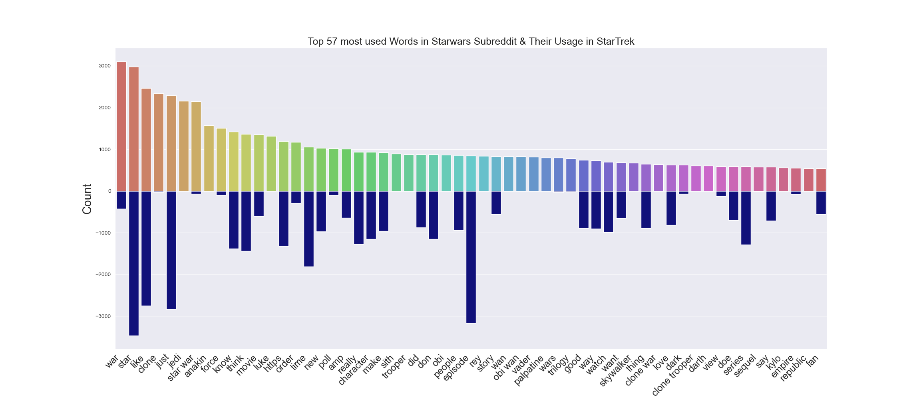
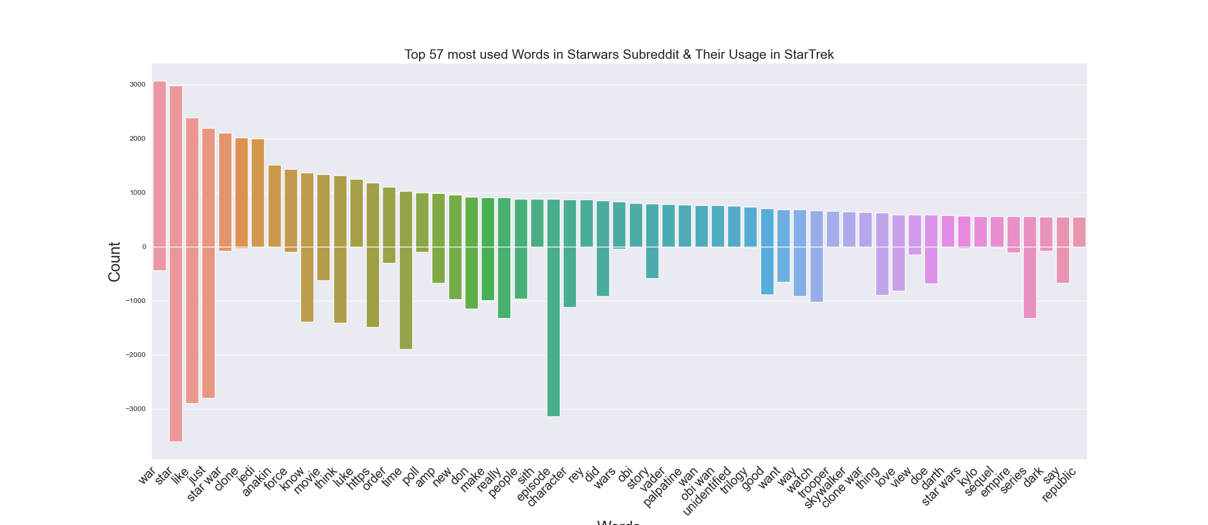
57 Most Used Words in Starwars subReddit
Words

Slide 16
With this model we can confidently infer the difference between StarWars and StarTrek Reddits

