Slide 2
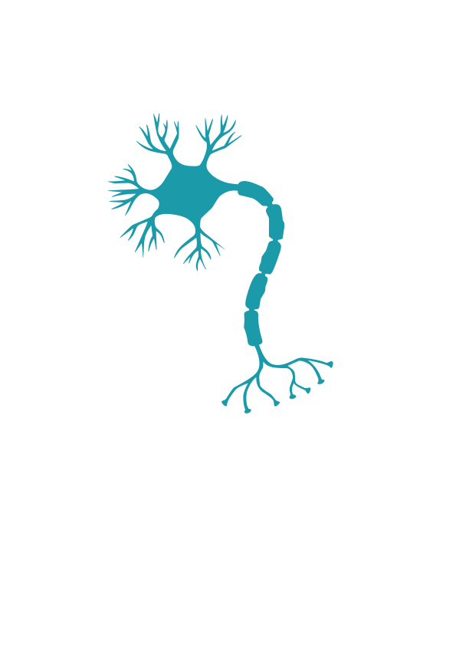
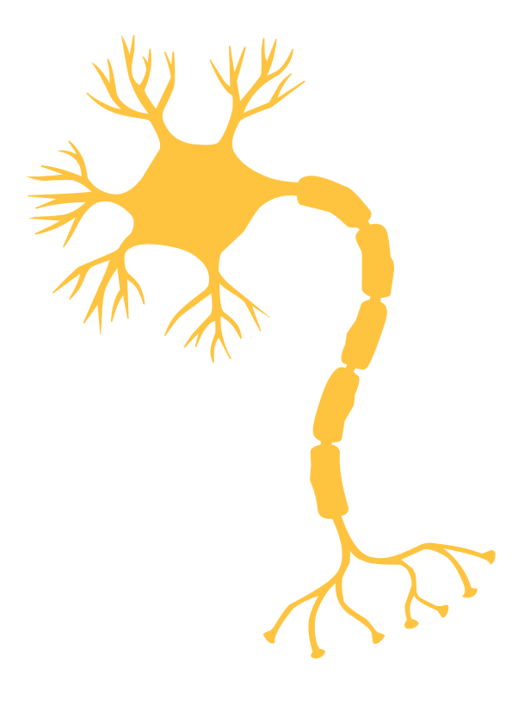

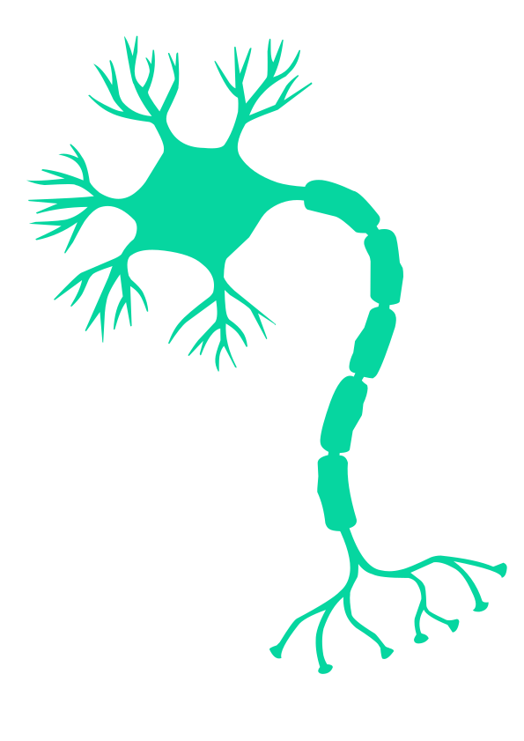
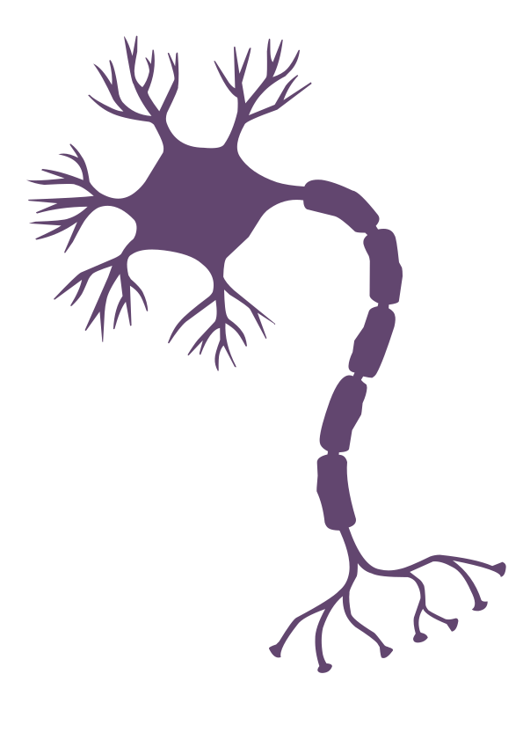
How do Neurons Learn?
NMDA-Synapses and Hebb Learning

Slide 3
Where are we?
Implementing NMDA channels in Brian2
STDP and Hebb Learning

Slide 4
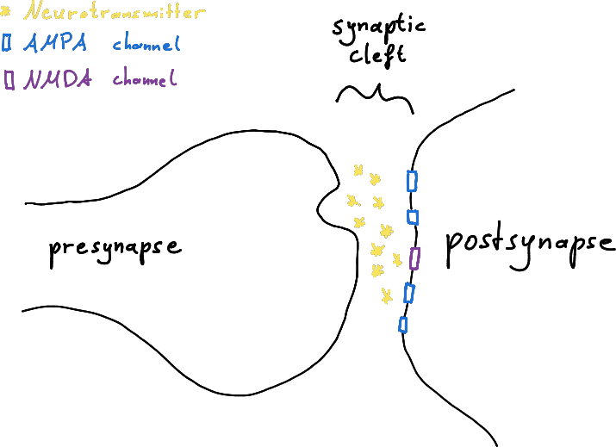
Where are we?

Slide 5
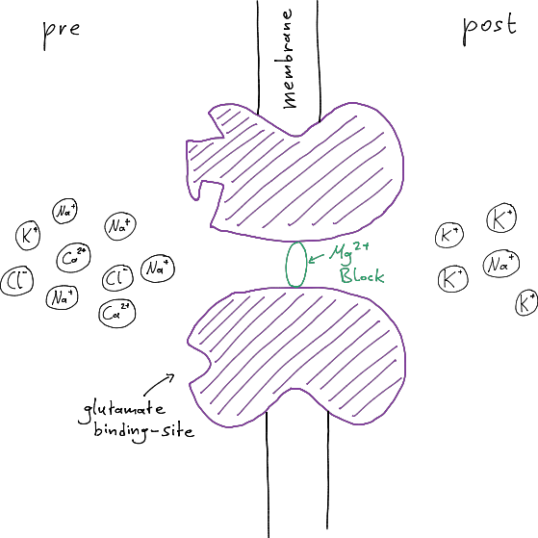
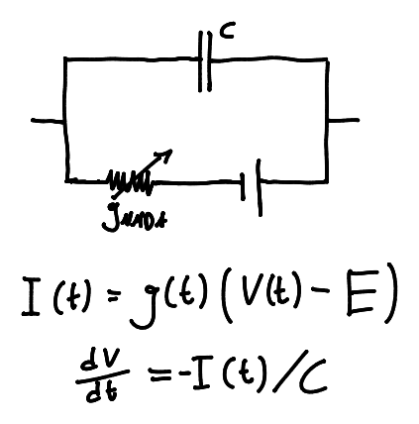
Where are we?

Slide 6
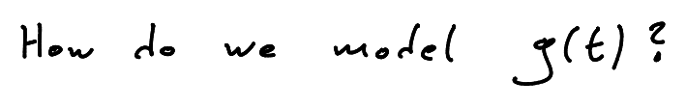
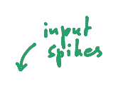
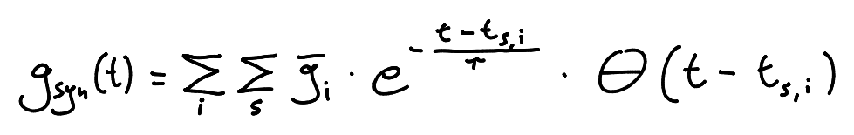
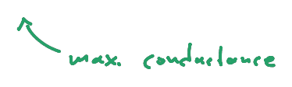
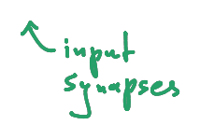
Where are we?

Slide 7
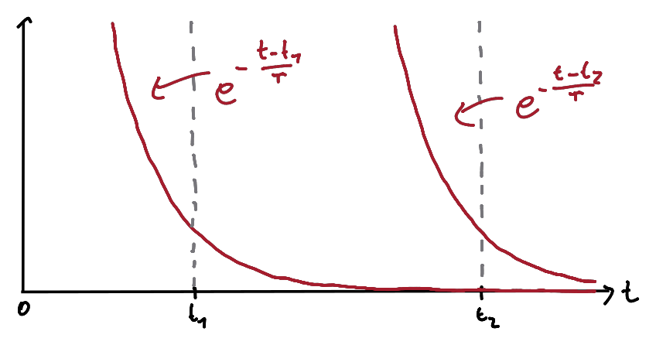
Where are we?

Slide 8
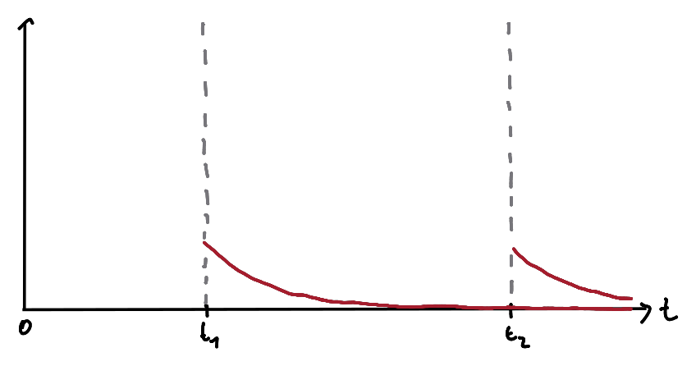
Where are we?

Slide 9
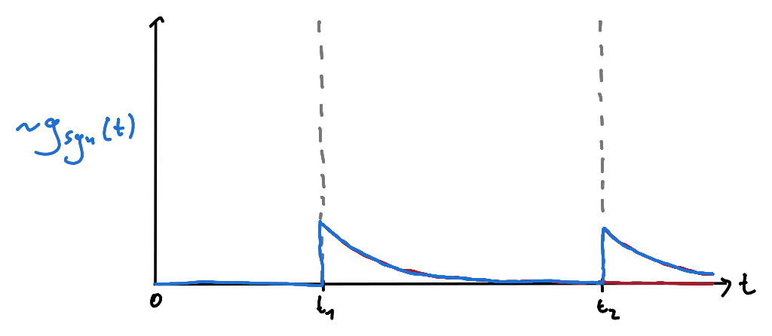
Where are we?

Slide 10
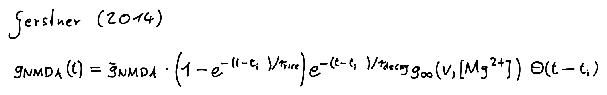

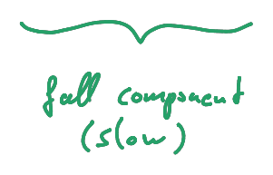


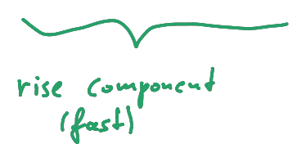
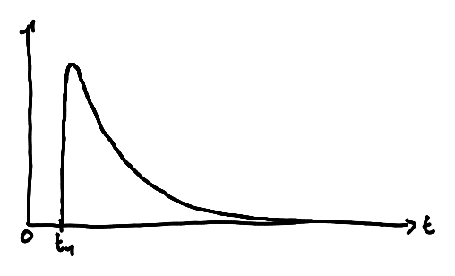
Where are we?

Slide 11
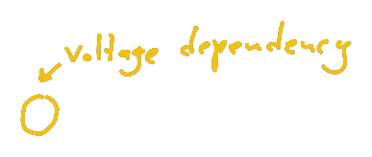
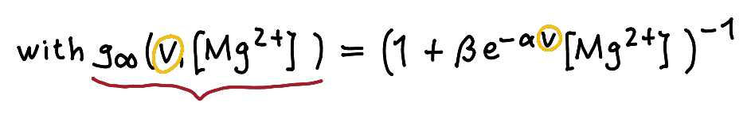
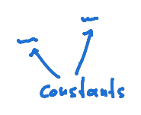
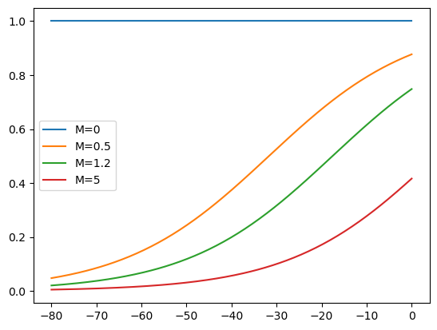
Where are we?

Slide 12
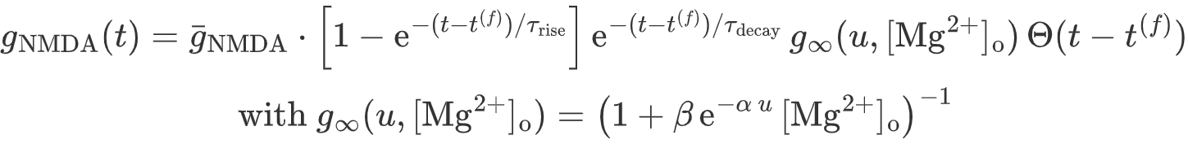
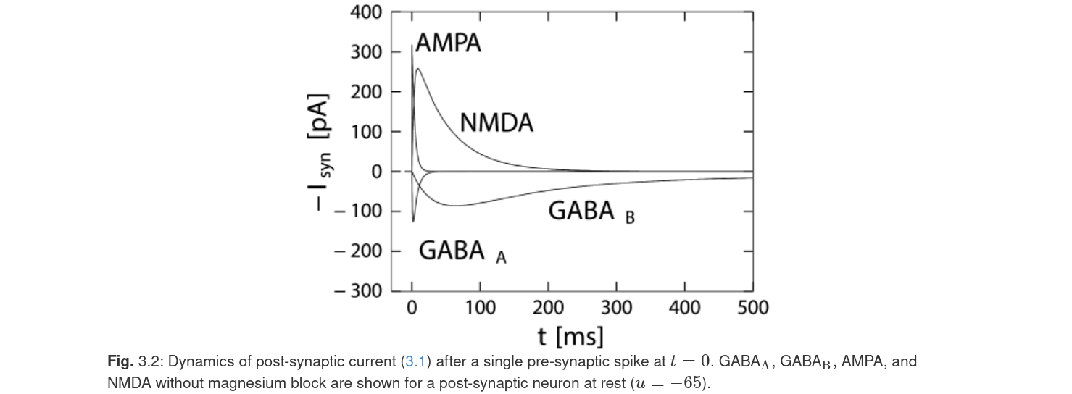
Where are we?

Slide 13
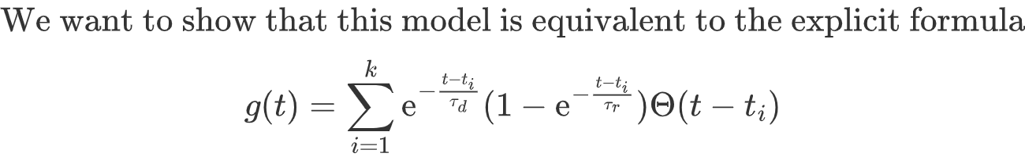
Implementing NMDA channels in Brian2
*C(u)

Slide 14
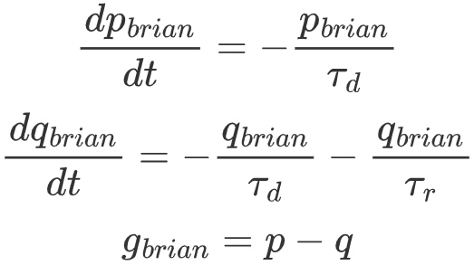
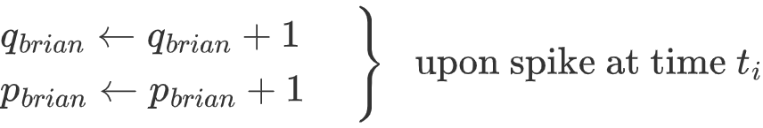
Implementing NMDA channels in Brian2

Slide 15
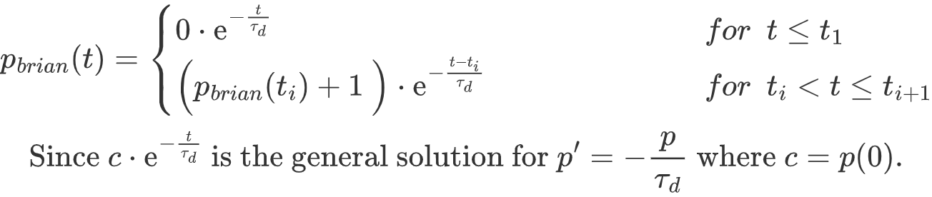
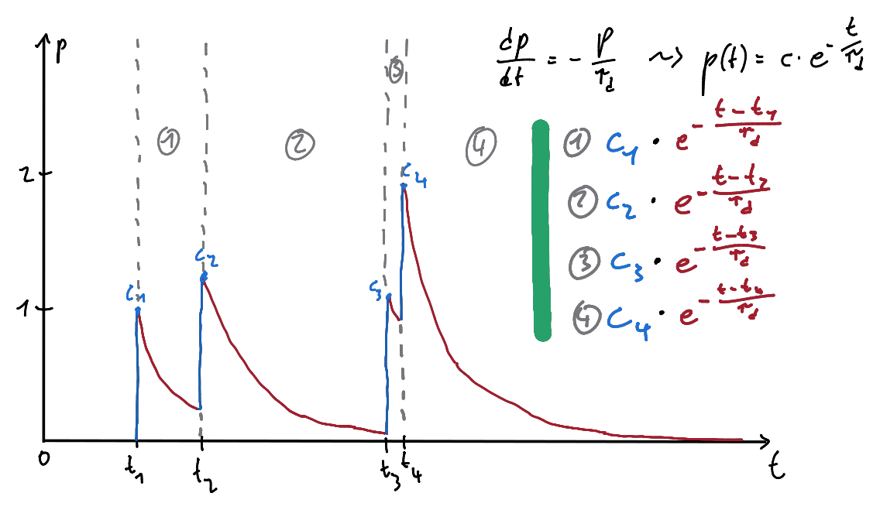
Implementing NMDA channels in Brian2

Slide 16
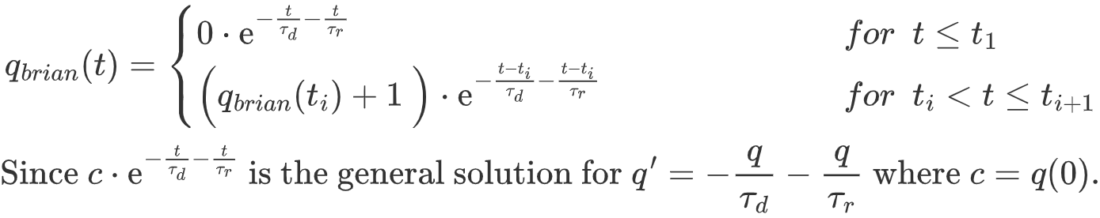
Implementing NMDA channels in Brian2

Slide 17
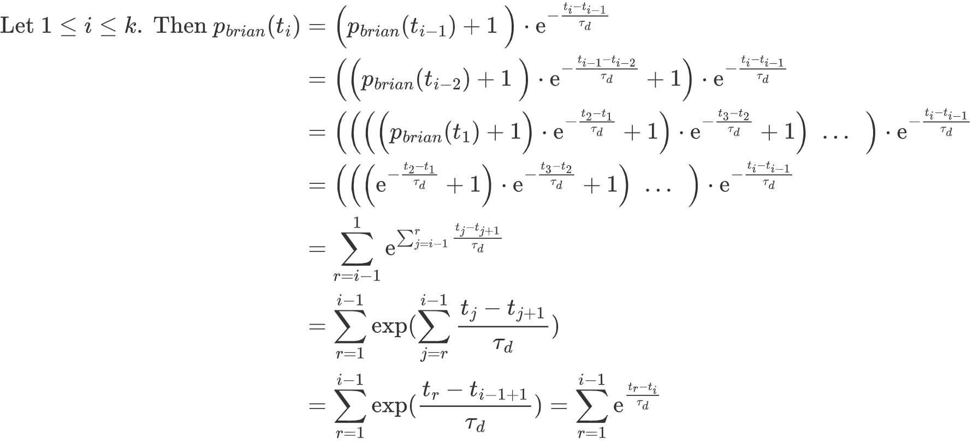
Implementing NMDA channels in Brian2

Slide 18
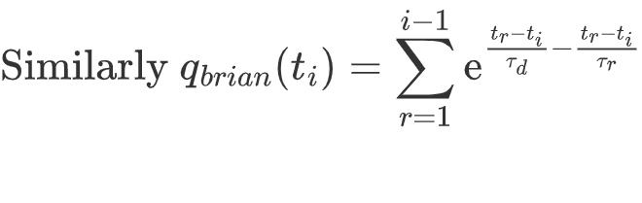
Implementing NMDA channels in Brian2

Slide 19
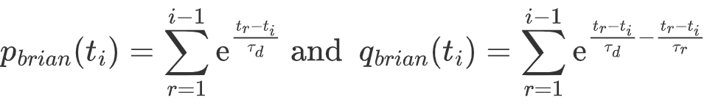
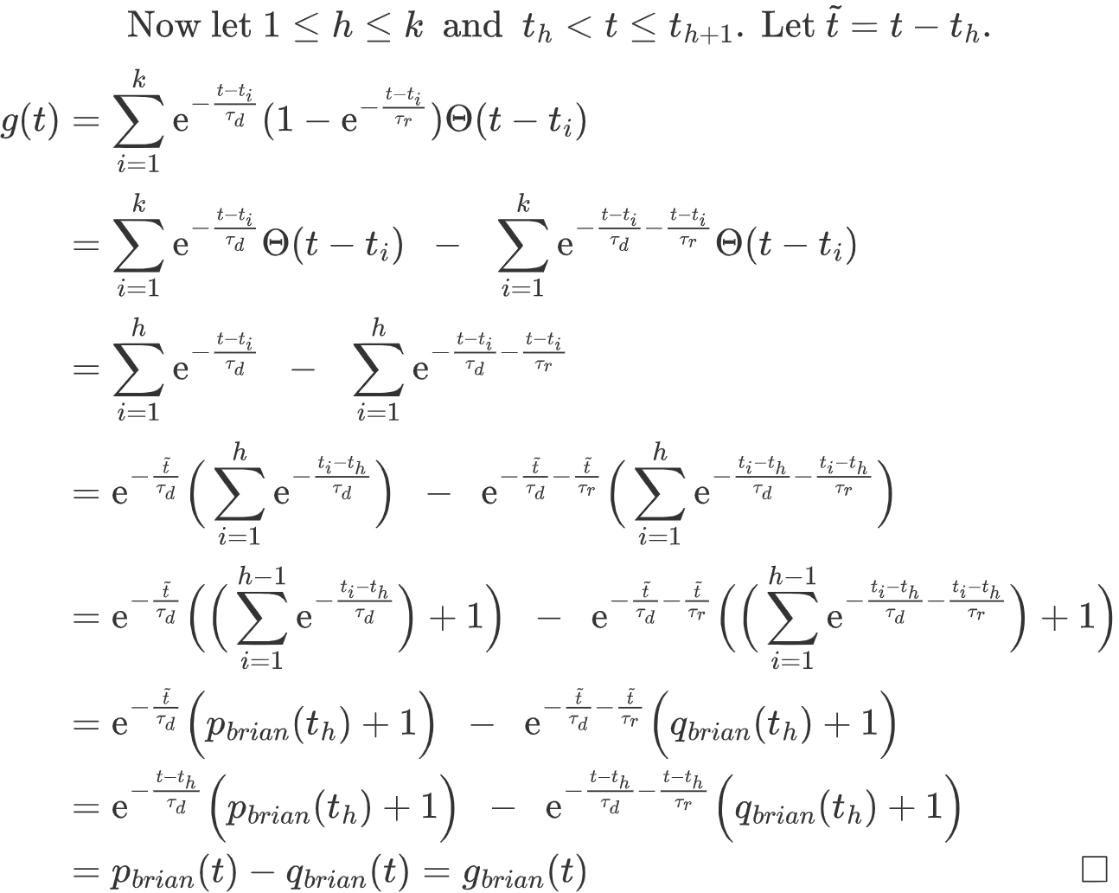
Implementing NMDA channels in Brian2

Slide 20
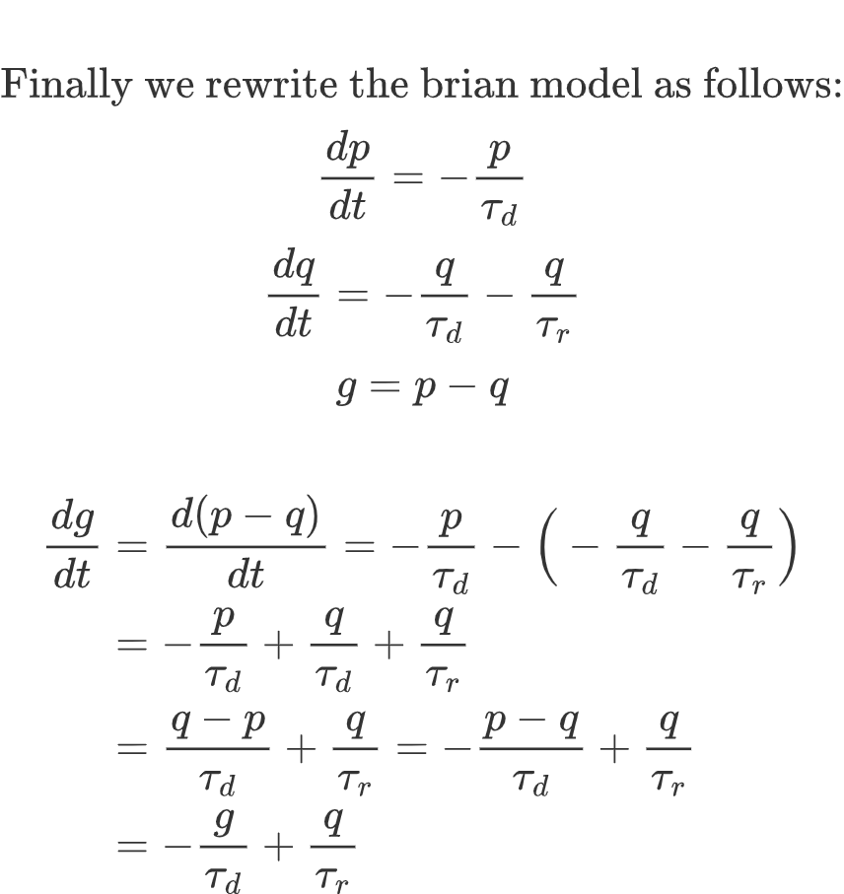
Implementing NMDA channels in Brian2

Slide 21
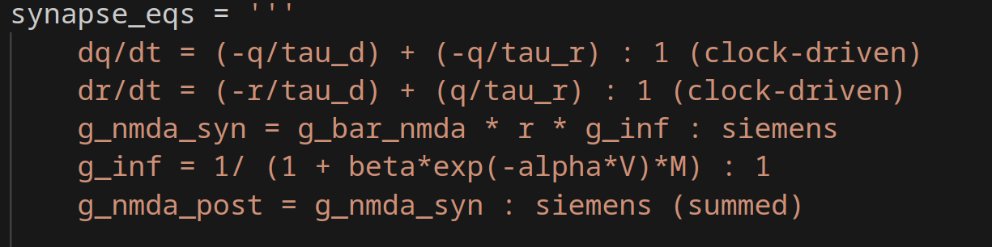
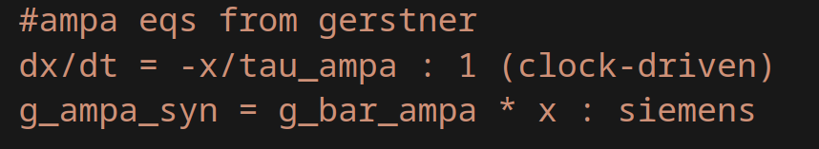
Implementing NMDA channels in Brian2

Slide 22
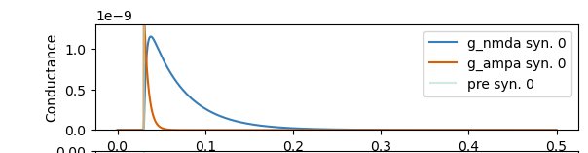
Implementing NMDA channels in Brian2

Slide 23
Break!

Slide 24
STDP and Hebb Learning

Slide 25
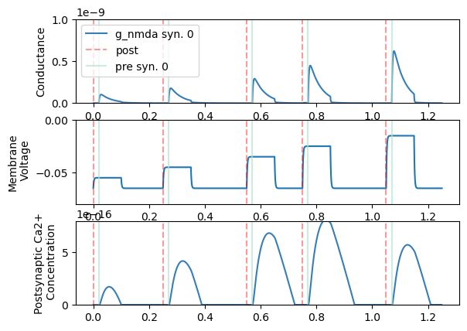
STDP and Hebb Learning

Slide 26
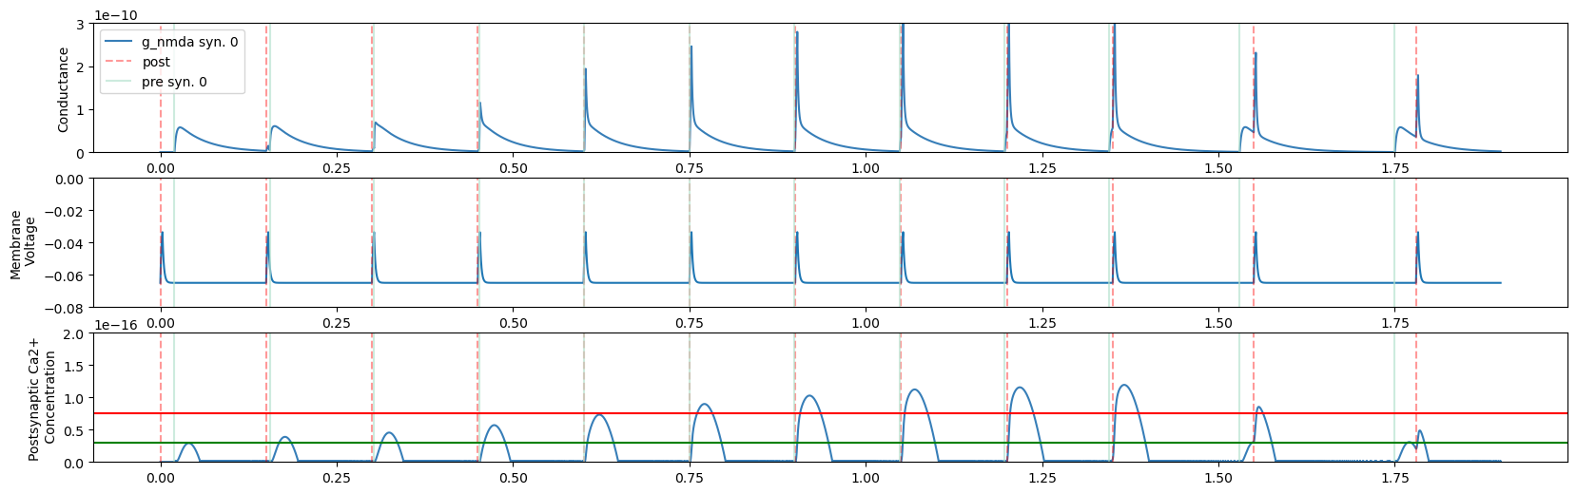
STDP and Hebb Learning

Slide 27
STDP and Hebb Learning
Calcium Hypothesis
- For an overview see [1]
- Lisman (1989) [2]
Ca2+ „activates“ CaMKII (autophosphoylation → activity independent of Ca2+). CaMKII affects functional properties of AMPA channels and their trafficking. [3]

Slide 28
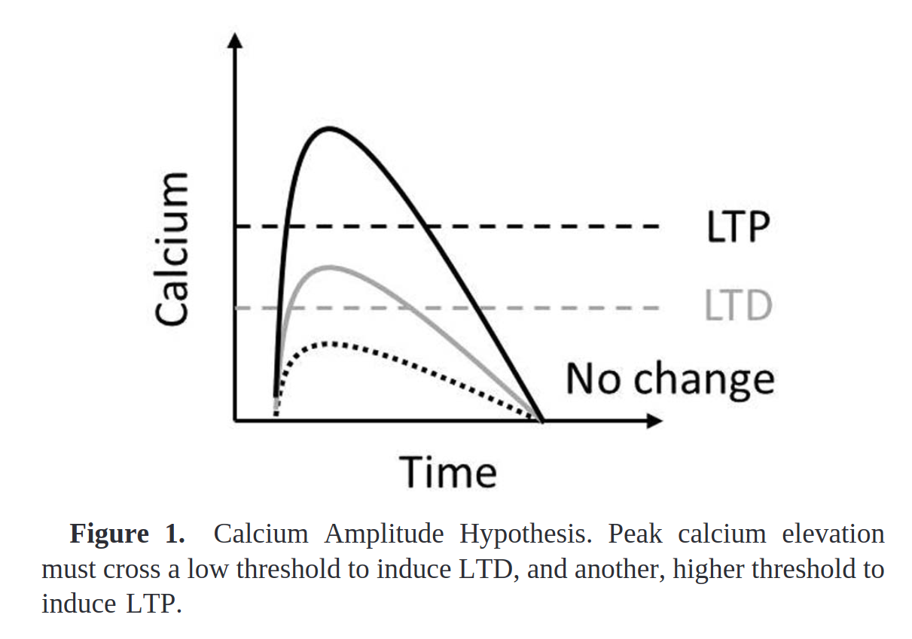
STDP and Hebb Learning

Slide 29
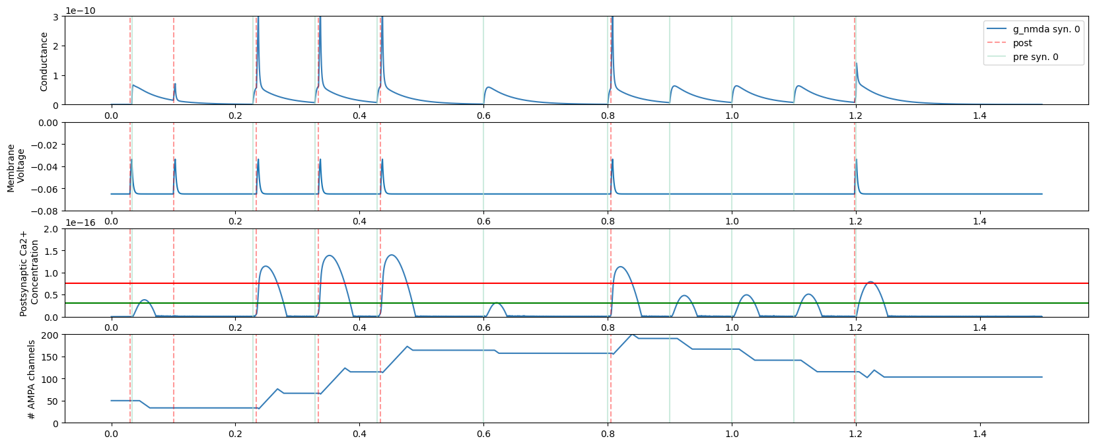
STDP and Hebb Learning

Slide 30
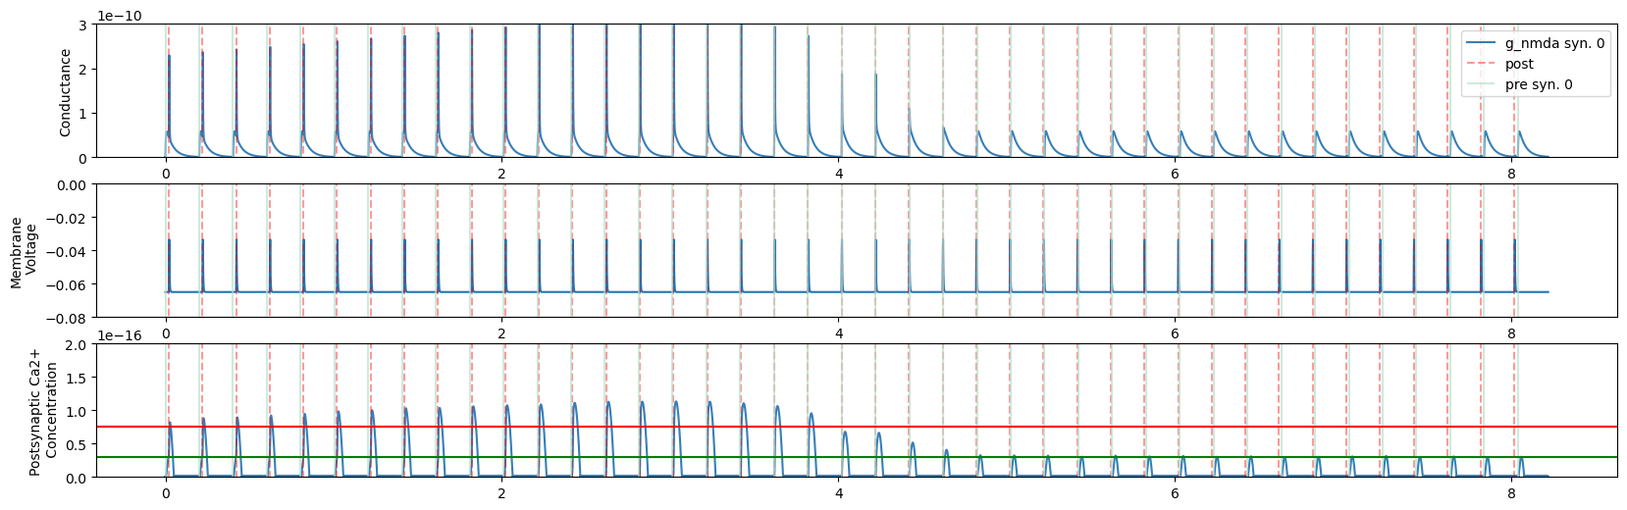
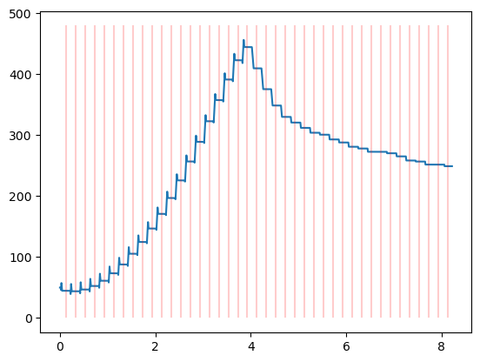
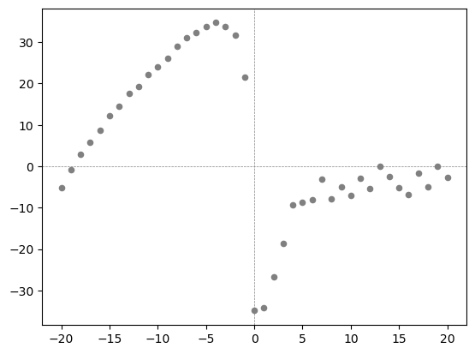
STDP and Hebb Learning

Slide 31
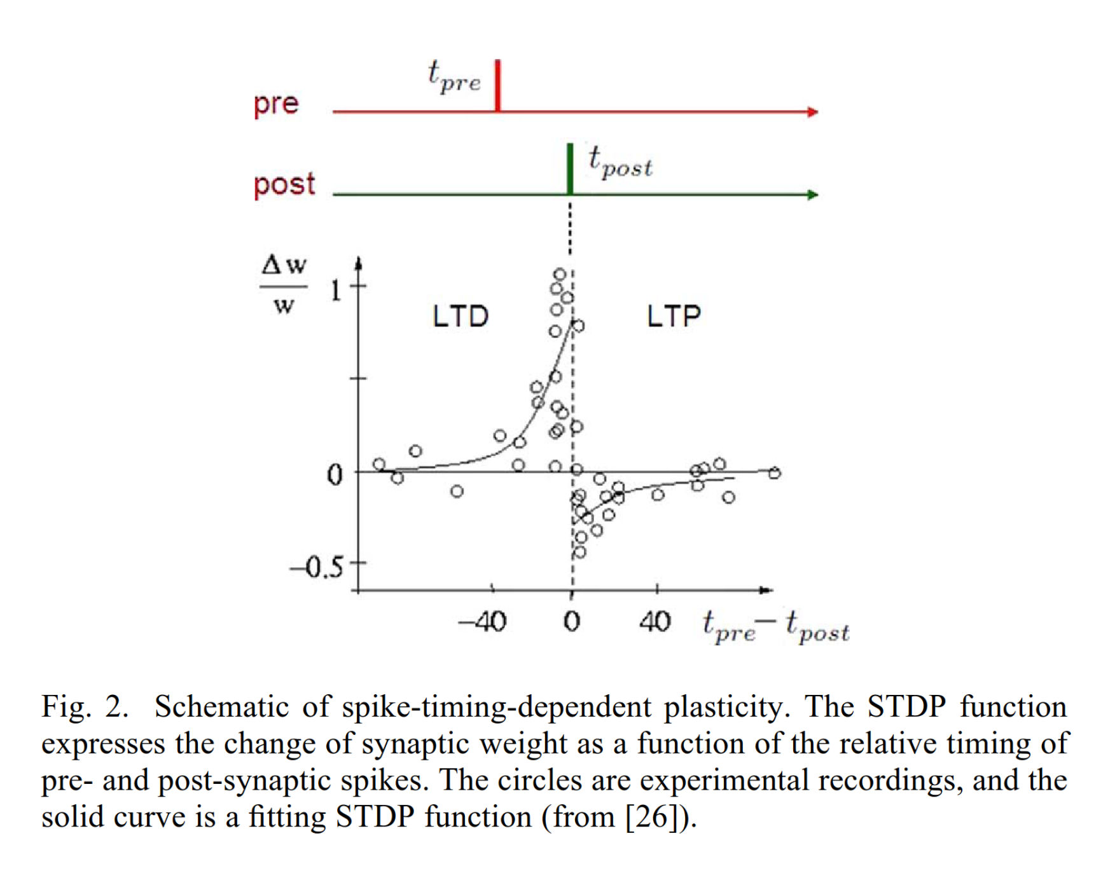
STDP and Hebb Learning

Slide 32
STDP and Hebb Learning
Hebb rule [4]:
„Neurons that fire together, wire together“
→ Synapses increase weight if synapse persistently takes part in firing the postsynaptic target neuron
→ Synapses decrease weight when presynaptic firing is independent of postsynaptic one
⟹ Mirrors classical conditioning at synaptic level

Slide 33
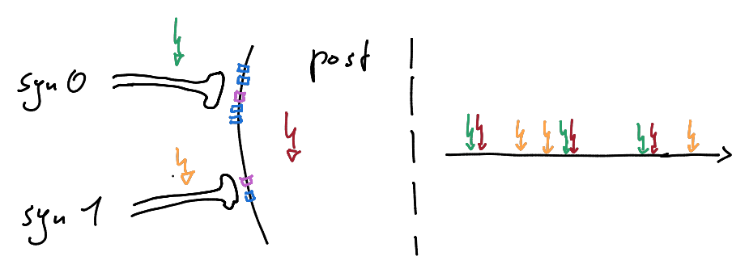
STDP and Hebb Learning

Slide 34
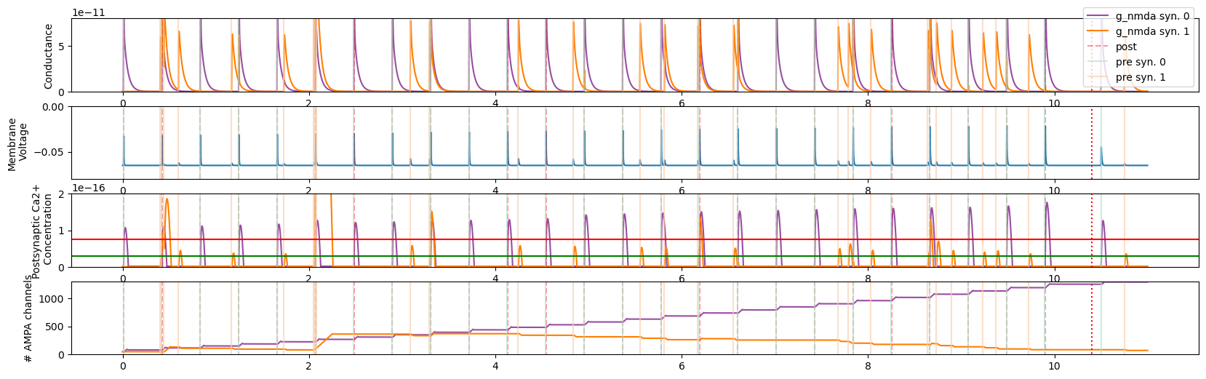
STDP and Hebb Learning

Slide 35
Sources
Evans, R. C., &amp; Blackwell, K. T. (2015a). Calcium: Amplitude, duration, or location? The Biological Bulletin, 228(1), 75–83. https://doi.org/10.1086/bblv228n1p75
Lisman, J. (1989). A mechanism for the Hebb and the anti-hebb processes underlying learning and memory. Proceedings of the National Academy of Sciences, 86(23), 9574–9578. https://doi.org/10.1073/pnas.86.23.9574
Lisman, J., Schulman, H., & Cline, H. (2002). The molecular basis of CaMKII function in synaptic and behavioural memory. Nature Reviews Neuroscience, 3(3), 175–190. https://doi.org/10.1038/nrn753
Gerstner, W., Kistler, W. M., Naud, R., & Paninski, L. (2016). 19.1 Hebb rule and experiments. In Neuronal dynamics from single neurons to networks and models of cognition. essay, Cambridge University Press.
Further Reading:
Gerstner, W., Kistler, W. M., Naud, R., & Paninski, L. (2014). Neuronal dynamics. https://doi.org/10.1017/cbo9781107447615
Koch, C. (1998). Biophysics of computation. In Oxford University Press eBooks. https://doi.org/10.1093/oso/9780195104912.001.0001
Wikimedia Foundation. (2023, September 14). Ca2+/calmodulin-dependent protein kinase II. Wikipedia. https://en.wikipedia.org/wiki/Ca2%2B/calmodulin-dependent_protein_kinase_II
Brian Authors. (2021). Converting from integrated form to odes. Converting from integrated form to ODEs - Brian 2 2.5.4 documentation. https://brian2.readthedocs.io/en/stable/user/converting_from_integrated_form.html
Thank you for listening!

Slide 36
Image Sources
Neurons on Title Page:
Mohammed_hassan. (n.d.). Nervenzelle, Neuron, Gehirn. Pixabay. Retrieved October 18, 2023, from https://pixabay.com/de/vectors/nervenzelle-neuron-gehirn-neuronen-3759541/.
Figure 3.2:
Gerstner, W., Kistler, W. M., Naud, R., & Paninski, L. (2016). 3.1 Synapses. In Neuronal dynamics from single neurons to networks and models of cognition. essay, Cambridge University Press.
Figure 1:
Evans, R. C., & Blackwell, K. T. (2015). Calcium: Amplitude, duration, or location? The Biological Bulletin, 228(1), 75–83. https://doi.org/10.1086/bblv228n1p75
Figure 2:
Cai, W., Ellinger, F., & Tetzlaff, R. (2015). Neuronal synapse as a memristor: Modeling pair- and triplet-based STDP rule. IEEE Transactions on Biomedical Circuits and Systems, 9(1), 87–95. https://doi.org/10.1109/tbcas.2014.2318012
Thank you for listening!

