Slide 1
Team 9 Presentation
By Val Hahn, Derek Vogel, and Ja’lon Clark

Slide 2
Overview
Processor Size and Composition
Components
Utilities
Testing Process
Demonstration

Slide 3
Processor Size
16-bit processor
Register files are limited to 16-bits
24-bit instruction size
Contains Opcode, Cond, S, Source, Destination, Immediate, and T
Works for D-type, S-type, J-type

Slide 4
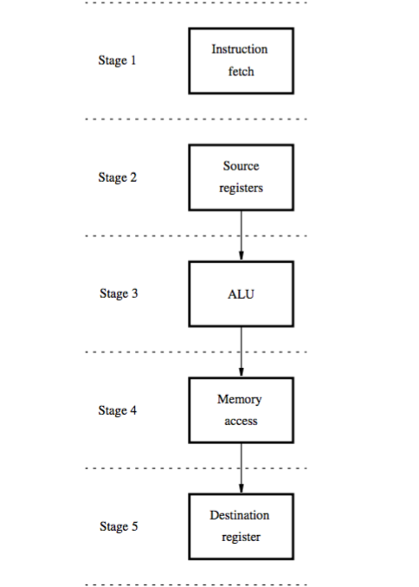
5 Stages of the Processor
Fetch
Decode
Executes
Memory
Write

Slide 5
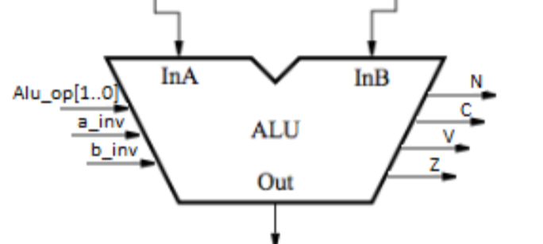
Components
ALU
Handles arithmetic of selected operations
Can operate ADD, SUB, AND, OR, and XOR

Slide 6
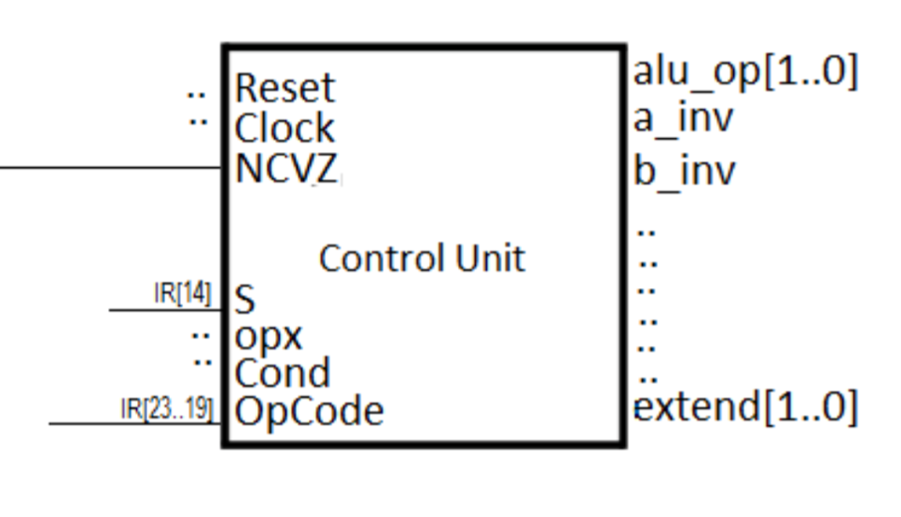
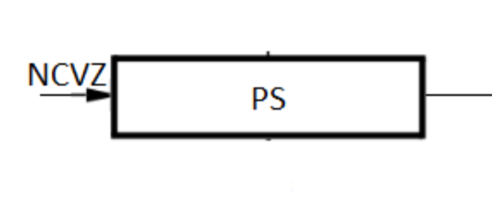
Components
Control Unit
Takes the instructions and sends the op-code to the ALU
Controls the path of processor and stages
Sets the condition flags
PS Register
Holds temporary conditional flags AFTER ALU operation
Won’t update unless told so

Slide 7
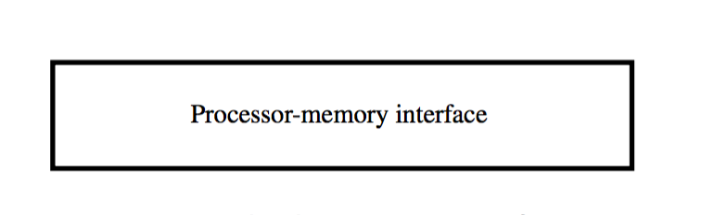
Components
Memory Interface
Stores and retrieves values in main memory
Accessed only by load and store instructions

Slide 8
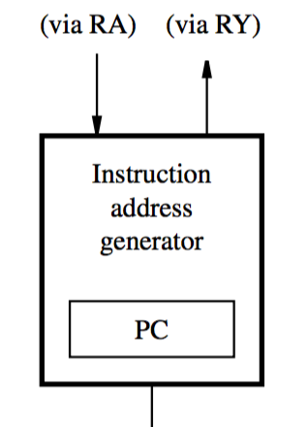
Components
Instruction Address Generator
Program Counter
Helps determine execution of instructions
Contains Adder
Assists with offsets and jumps

Slide 9
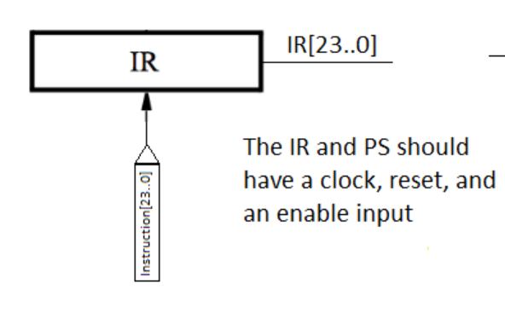
Components
Instruction Register
Directly stores instructions

Slide 10
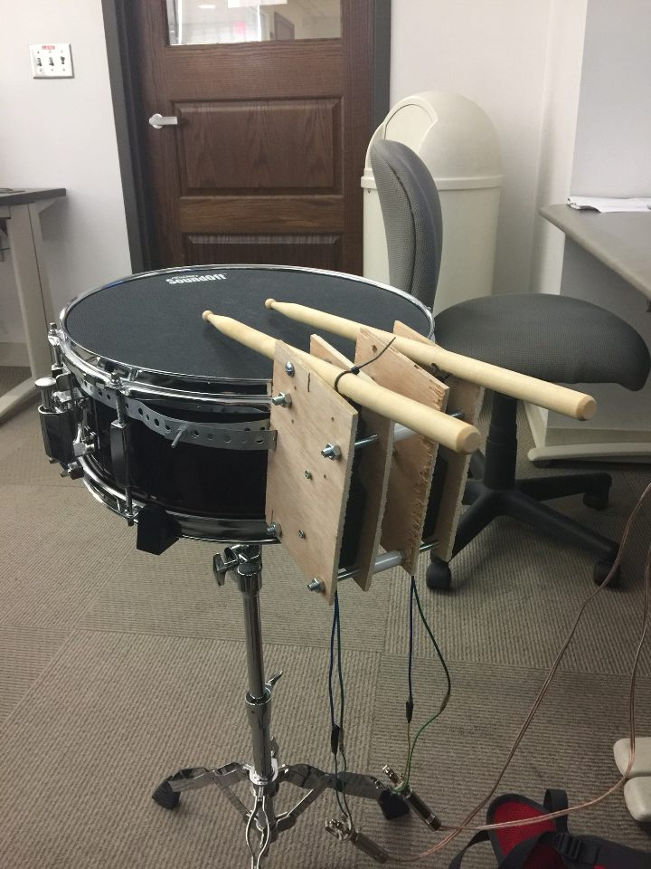
Components
IO Interface
Where IO devices are stored and loaded from
IO components include switches, push buttons, LEDs, and 7-segment display

Slide 11
Instructions
D-Type Instructions
S-Type Instructions
J-Type Instructions

Slide 12
D-Type Instructions
Add & Sub
Done in the ALU
Result value saved to register file
Sub inverts the number before computation to subtract
And, Or, Xor
Computes in the ALU to their specific logic gate
Load, Store & Compare
Deals with memory interface

Slide 13
S-Type Instructions
Inc & Dec
Adds/Subtract immediate value of 1
Jr (Jump replace)
Sets PC to destination register
Clr
Clears all bits of destination register to 0

Slide 14
J-Type Instructions
J
Jumps to relative address
Does not return anything
JL
Same as J, but returns address in RA

Slide 15
Speed
Base clock speed of 2000 ps per cycle
Works perfectly
Doubling speed to 1000 ps per cycle crashes

Slide 16

Testing
First tested Add, Sub, And, Or, and Xor
Load, Store, Branch, and were tested together
Used that to test IO components
Tested green LEDs, red LEDs, pushbuttons, switches, and drum kit.
Successfully works

Slide 17
LED Demonstration
vsim Team9_FinalProject view wave add wave Clock add wave RA add wave RB add wave RZ add wave RY add wave IR add wave BugAddress add wave BugDOut
add wave Bugmem_writeIO add wave Bugmem_writeMAIN add wave ZBug add wave LEDG force Clock 1 0, 0 1000 -repeat 2000 force NKEY 0001 0 run 400000

Slide 18
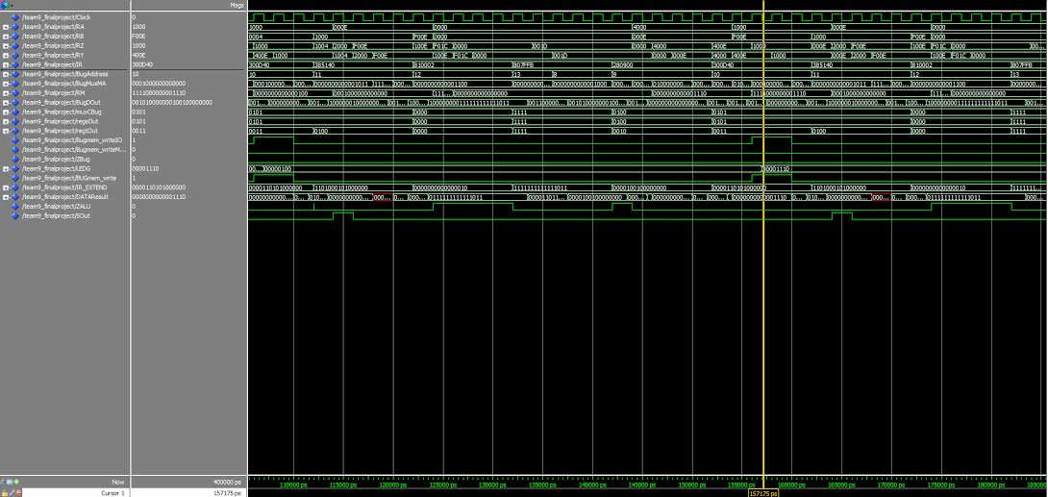
Demonstration

Slide 19
LED Demonstration
vsim Team9_FinalProject view wave add wave Clock add wave RA add wave RB add wave RZ add wave RY add wave IR add wave BugAddress add wave BugDOut
add wave Bugmem_writeIO add wave Bugmem_writeMAIN add wave ZBug add wave LEDG force Clock 1 0, 0 1000 -repeat 2000 force NKEY 0111 0 run 400000

Slide 20
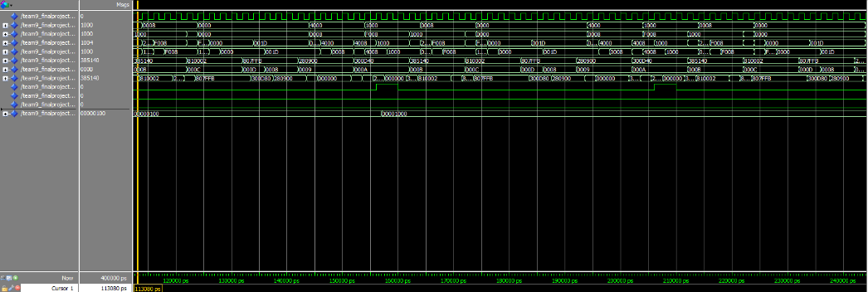
Demonstration

