Slide 1

Business Analytics Project – Kickstarter
To Help More Creators Achieve Their Goals

Slide 2
The Project Overview
Data
Web scraping
Pre-Processing
Merged data files
Feature Engineering
Predictors, Responses, And Training
Model Selection
Back Testing & Metrics Design
Regression Model
KNN
PCR & PLS
Decision Tree
Random Forest
XG - Boost
Category
Country
Backers
Final pledges
Funding status
Funding goal
Maximize the total gain on the platform
Four scenarios
Assumptions
Data repository
Extracted info from JSON Objects
Converted UNIX timestamp into normal format
Removed nulls, duplicates & text
Convert categorical into numerical
Transformed numbers into log (1+n)
Notes:
1. We found our major dataset on a data repository, and web scrapped additional info on Kickstarter. Then we merged what we got from different sources together as a 3 gigabytes data with 579,140 rows.
2. We extracted useful features from JSON Objects.
3. We converted UNIX timestamp into normal format
4. We converted categorical data into numerical data
5. We removed nulls, duplicates & text. After cleaning the data, we got 174,000 usable rows left .
6. Importantly, we transformed the pledged values into logarithms, to avoid heteroscedasticity (the non-constant variance in the residuals).
7. After feature engineering, we reached final 9 factors to be our predictors.
8. We subset our data into training, validation and testing, and run six regression machine learning models on the training set.
9. We select the best model based on MSE and our metrics, which we will dig into details in a short while.

Slide 3
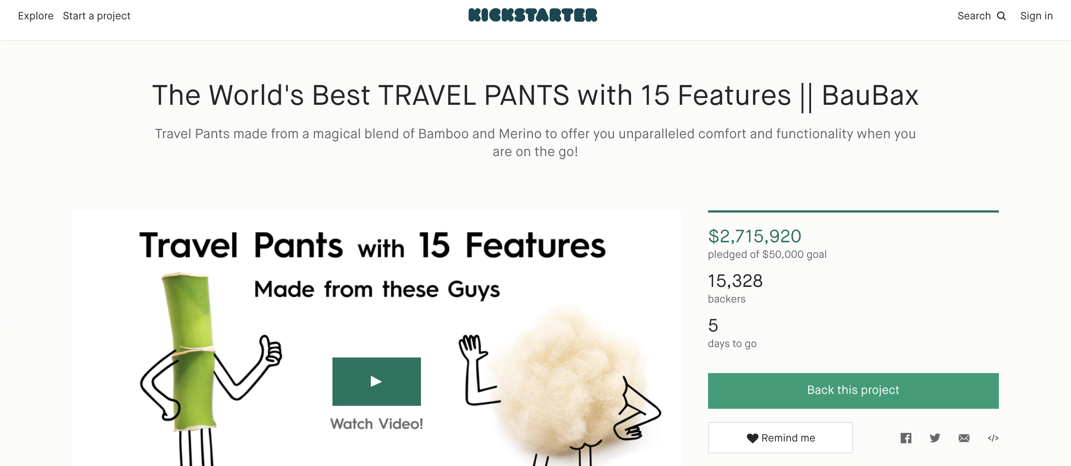
What is Kickstarter?
Notes:
Launched in the United States in 2009, Kickstarter is a global crowdfunding platform which helps creative projects to raise funding from backers. Project creators choose a deadline and a minimum funding goal. Projects must reach their funding goal, otherwise no money will be collected. People who back Kickstarter projects are offered tangible rewards such as custom editions and early releases of the projects as well as special experiences in exchange for their pledges.
Our data consists of the Webpage info

Slide 4
Low Success Rate Attracts Our Attention
7 out of 10 projects
failed to meet the goal
Notes:
Why are we interested in Kickstarter?

Slide 5
Success Rate Varies by Categories & Countries

Slide 6
New Metrics -- Assumptions
Assumption 1 : The model is built on the worst assumptions. We ignore all irrelevant gains.
Assumption 2 : Launchers are willing to follow our advise, and switch original goals into predicted values.
Notes:
We need metrics that can quantify the relationship between funding goal & final pledges
1: The model is built on the worst scenario, to simplify the process, also to generate a best result
2: who have their expected funding goal are willing to follow our advise, and switch their original goals into our predicted pledged value

Slide 7
New Metrics -- 4 Simplified Scenarios
Launcher's Goal > Actual Pledges
Launcher's Goal < Actual Pledges
Our Predication > Actual Pledges
Our Predication < Actual Pledges
Our Predication > Actual Pledges
Our Predication < Actual Pledges
No impact*
Funded(Gain)
Not Funded (Loss)*
Amount funded decreases (Loss)*
Scenario 1
Scenario 2
Scenario 3
Scenario 4

Slide 8
Models Selection & Back Testing
 | Linear Regression | KNN | PLS | Decision Tree | Random Forest | XG-Boost
MSE | 8.40 | 7.37 | 8.40 | 1.06 | 0.88 | 0.72
Net Profit | (14,800.64) | (14,845.45) | (14,773.43) | (48,004.30) | (35,326.32) | 33,166.81

Slide 9

Values We Can Generated
For project launchers: $50 M successful dollar increased, 17% success rate increased
For Kickstarter: $2.5 M revenue increased
For Financial Institutions: Approximately 21% potential target

Slide 10

Conclusion
MSE doesn’t always define the validity of a project.
XG – Boost performs the best for highest gains.
People are overestimating the goal value.
Gap between people’s expectation and actual pledges offers a promising profit room.
Notes:
MSE doesn’t always define the validity of a project. A modified gain function indicates what model/hyperparameters work best for us
In terms of models we tried, XG – Boost performs the best with lowest MSE and a correspondingly high gain value

