Slide 1
















CRIME ANALYSIS DASHBOARD
BY : ENDAH RAKHMAWATI

Slide 2

PROJECT OVERVIEW
Explore the world of crime data around Europe with me as we delve into intriguing insights and trends.
Dataset : https://bit.ly/4e6Ar9T

Slide 3





EXTRACT
1.
Get the data from database in SQL SERVER from connection and import all the dataset into excel without making sql statements. Click transform to clean it first in power query.
2.
W
O
R
K
F
L
O
W
TRANSFORM
Data collected from various sources can be messy, containing errors due to human mistakes, technical issues, or other factors. Data cleaning involves various methods and techniques to transform the data into a more accurate, consistent, and usable format.
LOAD
3.
The cleaned data can be calculated more in power pivot. We can add the required measures or sort by column which is also important. After that we can create data modeling so that the data can be processed into the pivot table.
4.
VISUALIZATION
Creating a dashboard from the pivot table that has been created and modifying the pivot chart to produce insightful information so that users can make decisions.

Slide 4
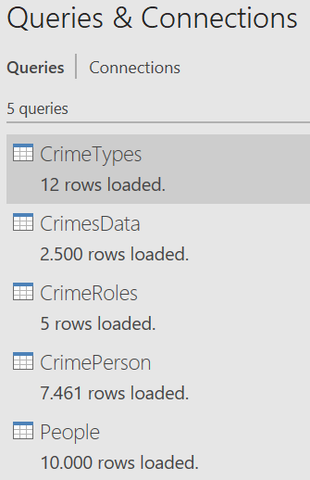
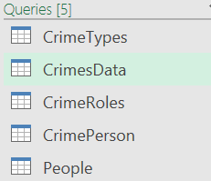
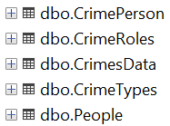

USING POWER QUERY
LOAD
TRANSFORM
EXTRACT

Slide 5
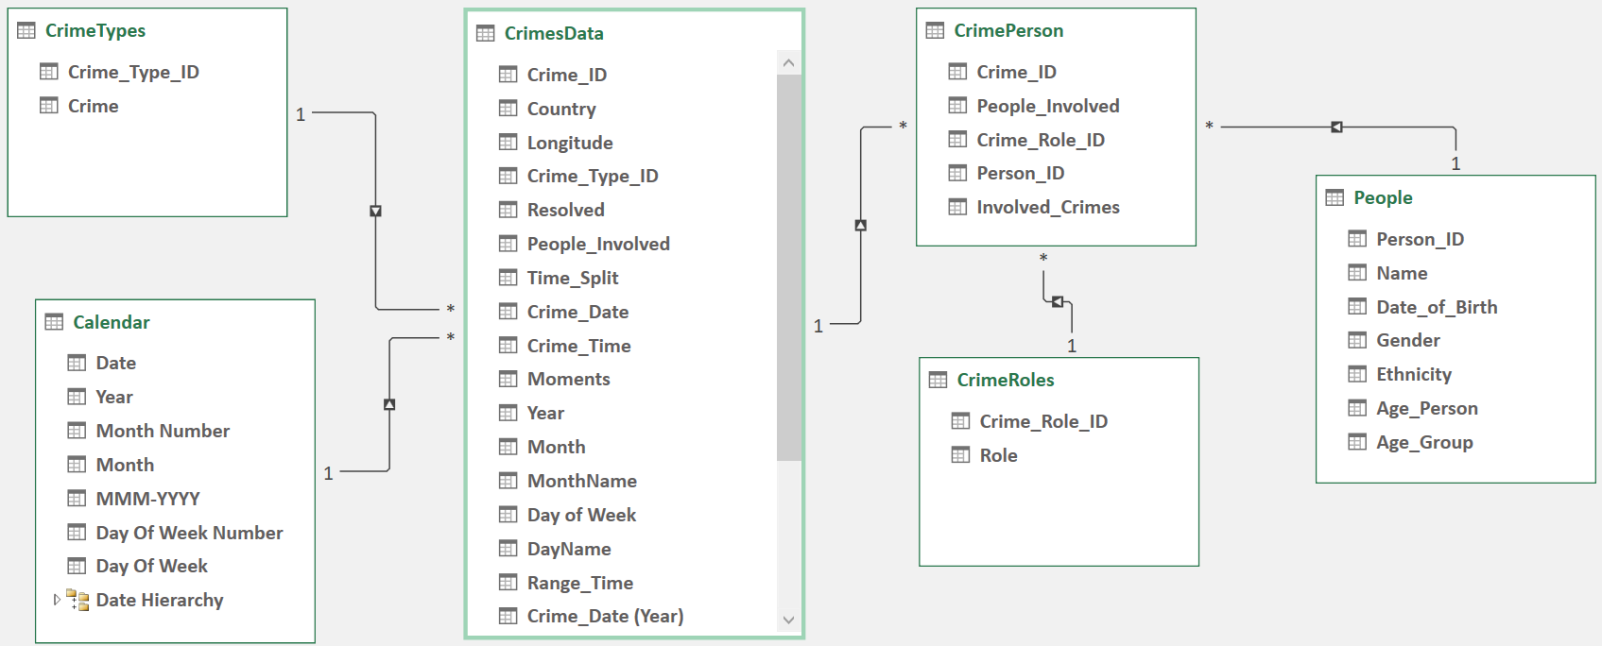
DATA MODELING USING POWER PIVOT

Slide 6
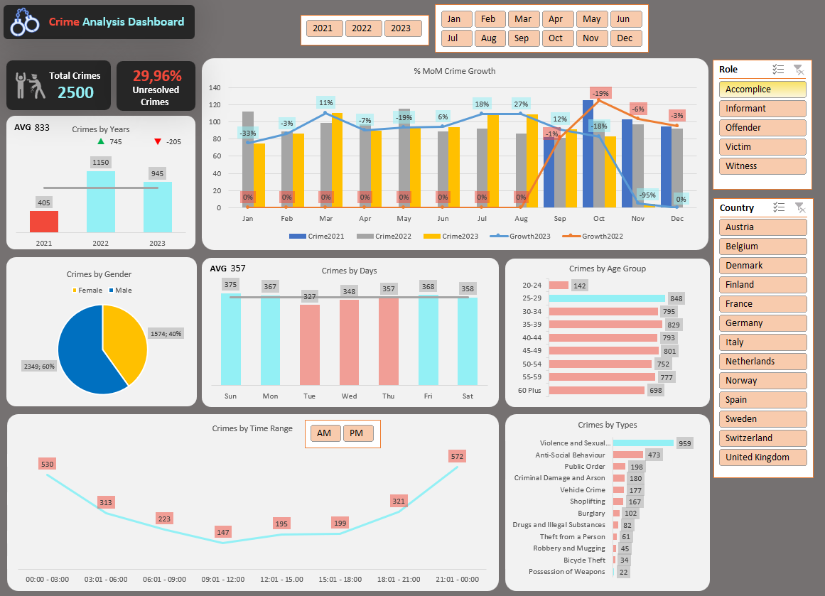
DASHBOARD

Slide 7


DASHBOARD OVERVIEW
Year-over-Year Crime
Month-over-Month Crime
Total Crimes
Dive into the overall count of reported crimes, providing a number view of the crime landscape by slicers.
Uncover the patterns and shifts in crime distribution as we analyze data across different years, revealing yearly changes and trends.
Uncover the patterns and shifts in crime distribution as we analyze months across different years, revealing months % differences and trends.
Crimes by Time Range
Crimes by Age Group
Crimes by Day
Take a closer look at crime occurrences within weekdays, shedding light on when crimes more likely to happen.
Take a closer look at crime occurrences within specific time intervals, shedding numbers when crimes are more likely to happen.
Take a closer look at crime incidents in a particular age group across all roles, shedding light on which groups are involved in a crime incident.

Slide 8
DASHBOARD OVERVIEW
Crimes by Gender
Crime Types
Unresolved Crimes
Dive into the overall count of reported crimes, involving gender in various roles.
Uncover of crime types distribution what crimes are more likely to happen as we analyze data in certain slicer.
Percentage of crimes incidents lacks resolution

Slide 9


INSIGHTS
THE HIGHEST TOTAL CRIME
DANGEROUS TIME
CRIME TYPE
INVOLVED PERSON
Time : In year 2022, month October, Sunday.
Place: Austria is the most criminal country in Europe.
In time range 21:00 - 00:00
Violence and Sexual Offences is the common occurs crime in Europe.
MALE in productive age group, almost in age 20-50 yo.

Slide 10


CONNECT WITH ME :
ENDAHEN12@GMAIL.COM
HTTPS://WWW.LINKEDIN.COM/IN/ENDAHRAKHMAWATI/

