Slide 1




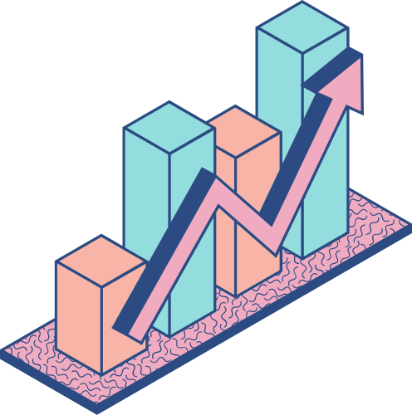



PYTHON FOR
DATA ANALYSIS
BY: ENDAH RAKHMAWATI

Slide 2

BACKGROUND
In business, each user has different characteristics. So we can take more targeted actions to increase sales, usage, or prevent them from leaving our product/platform (churned).
OBJECTIVE
This case study is to deepen EDA, create a rate of user retention, RFM segmentation, and analyze the market basket which can be used to evaluate and increase the productivity of the online retail business at a time.

Slide 3


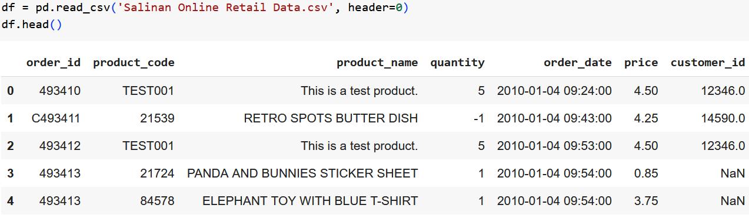
DATA SCOPE
The dataset is an online retail sales report that sells various products, both food and household needs in 2010.
Dataset link : https://bit.ly/47yJMFn

Slide 4
DATA CLEANING
1
2
3
4
5
REMOVING MISSING VALUES
CORRECTION FORMAT/TYPE OF DATA
ADDING COLUMNS
REMOVING OUTLIER
REMOVING DUPLICATION

Slide 5
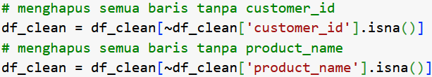
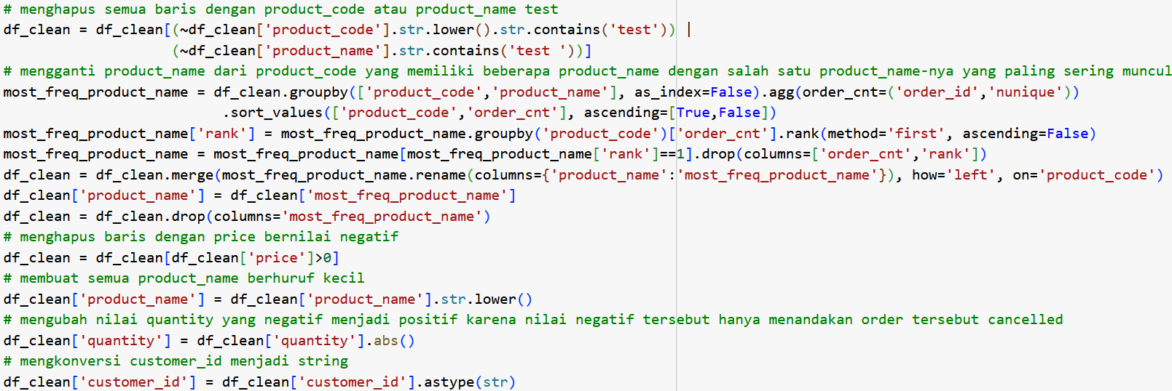
DATA CLEANING

Slide 6
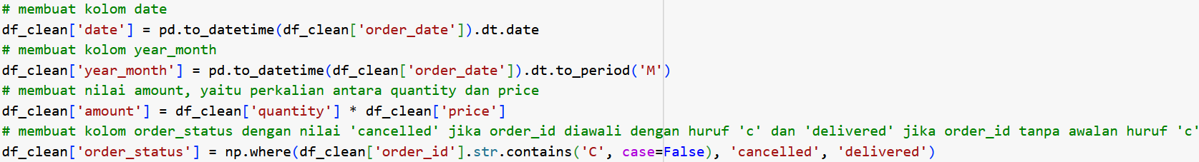
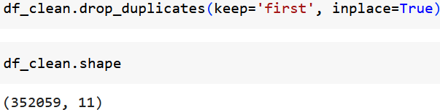
DATA CLEANING

Slide 7

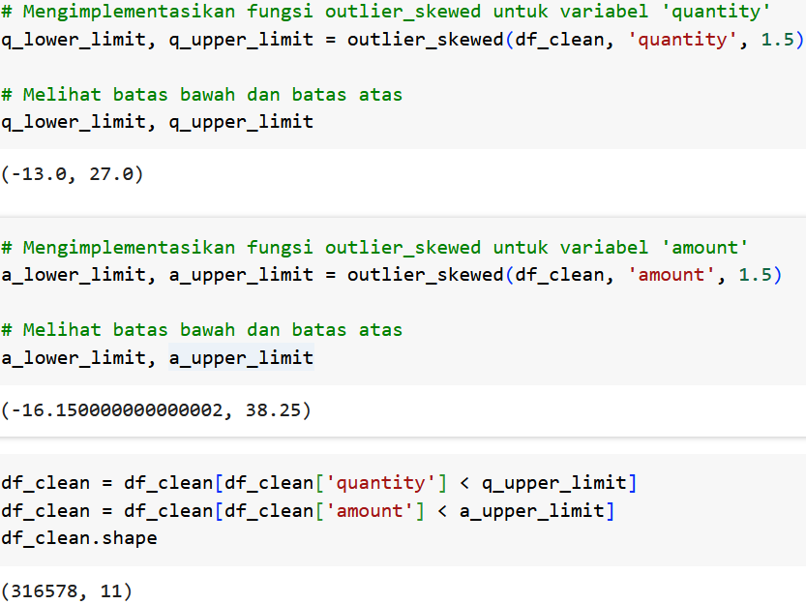
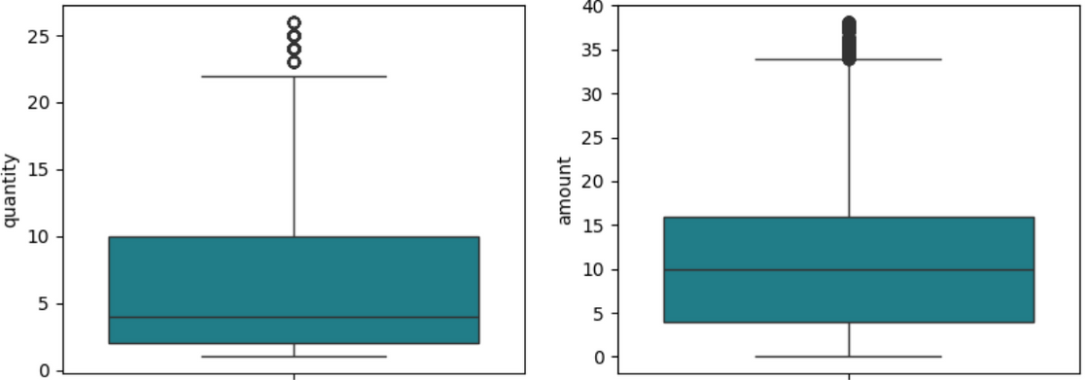
OUTLIER HANDLING
Dealing with outliers using the IQR Method. We will remove outliers in the quantity and amount columns, both of them have skewed distributions.
RESULT

Slide 8
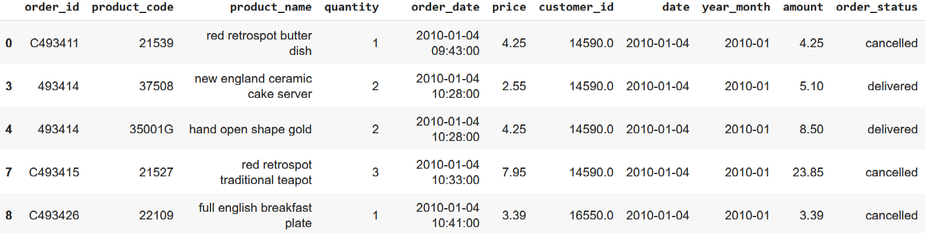
CLEANED DATA

Slide 9
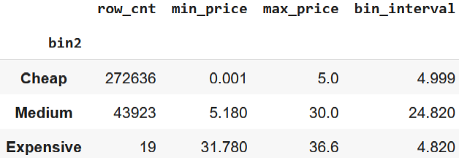
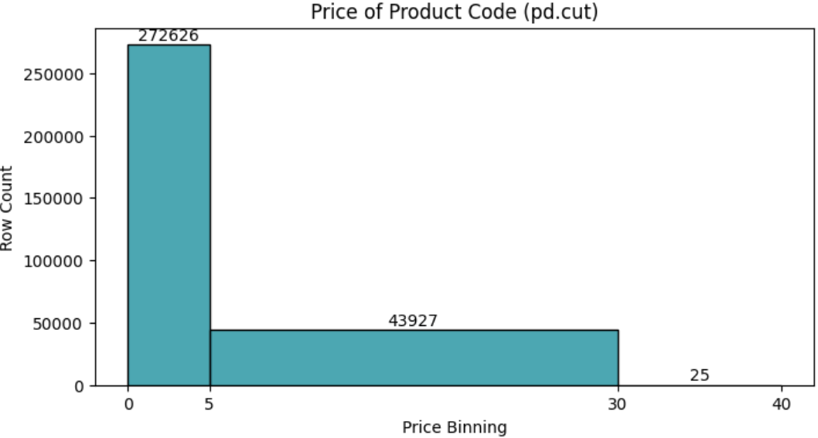

BINNING OF PRICES
Binning with the length of each bin boundary and label determined independently.

Slide 10
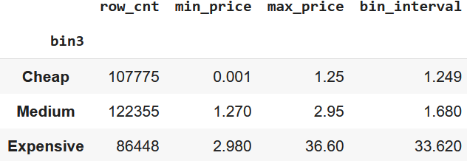
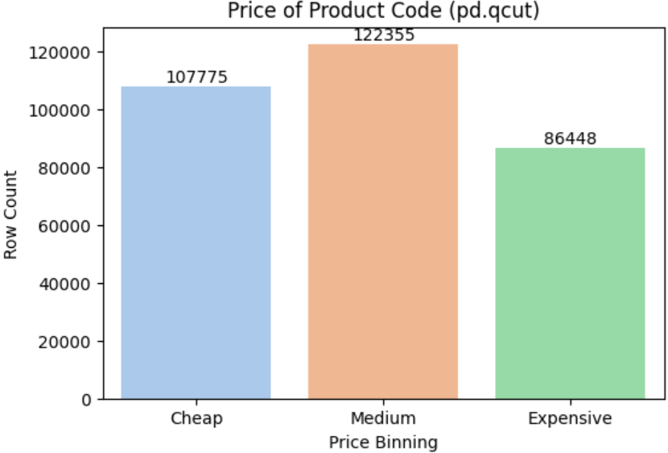
BINNING OF PRICES
Binning with a certain number of bins and the number of members in each bin is relatively the same.

Slide 11
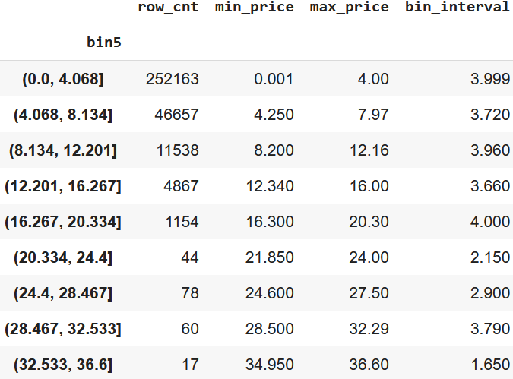
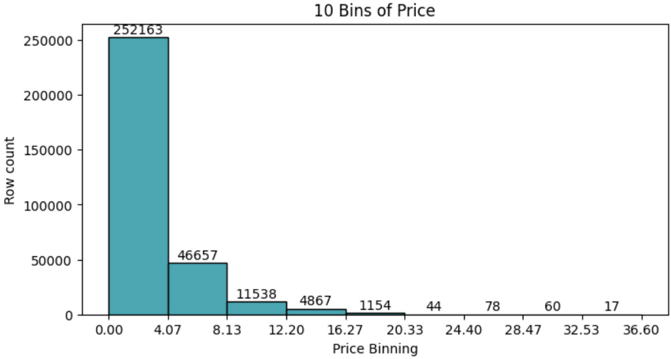
BINNING OF PRICES
Binning with a certain number of bins.

Slide 12
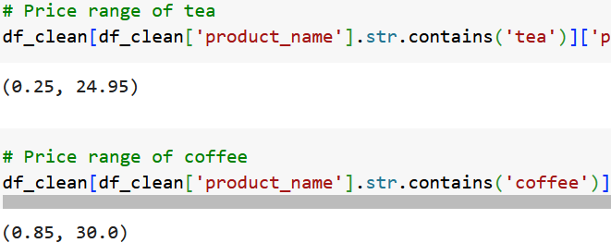


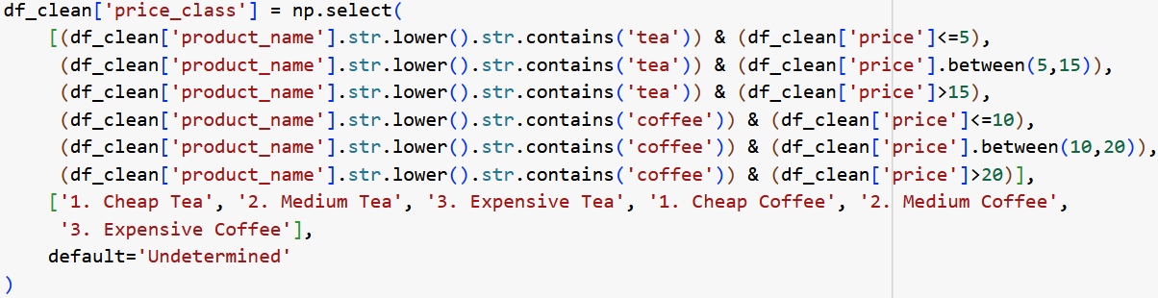
CASE STATEMENT
Price class of tea and coffee product only. The price range of coffee is higher than price range of tea.

Slide 13
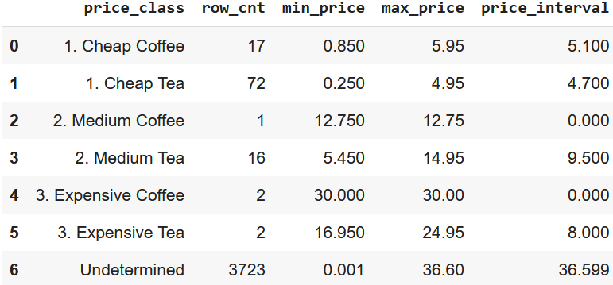
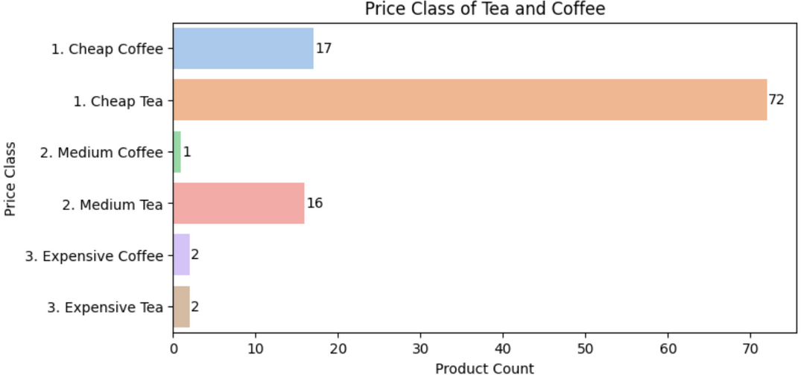
CASE STATEMENT
The highest number of product is cheap tea. There are 72 kinds of cheap tea.

Slide 14
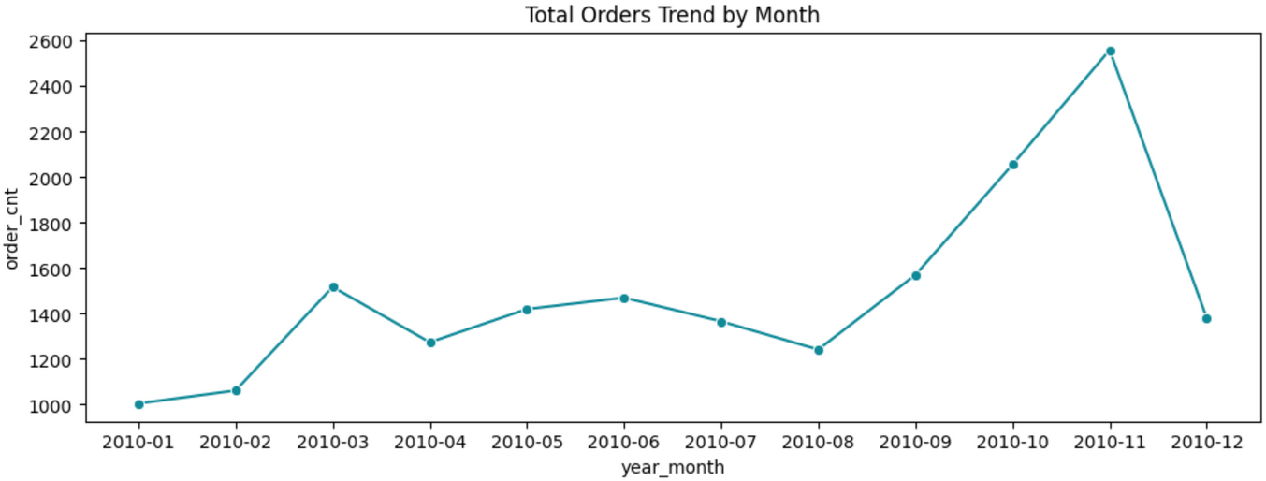
EXPLORATORY DATA ANALYSIS
ORDERS BY MONTHS
From August - November 2010 the total orders increase significantly.
The maximum order is in November 2010.

Slide 15
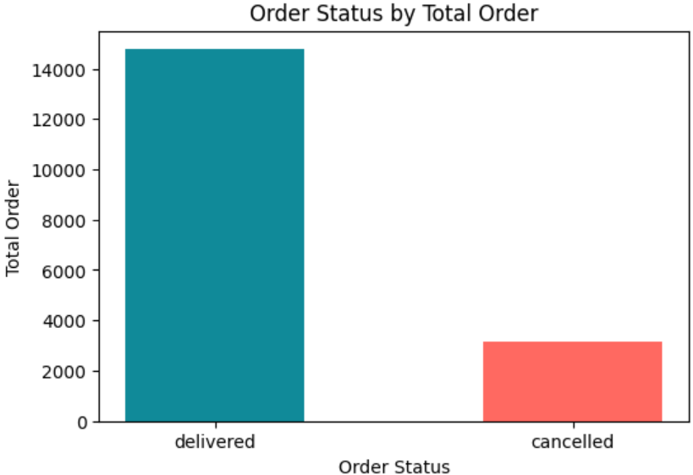
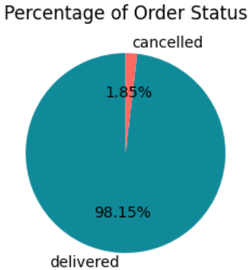
EXPLORATORY DATA ANALYSIS
ORDER STATUS DISTRIBUTION
98,15% of total orders are delivered, only 1,85% are cancelled.

Slide 16
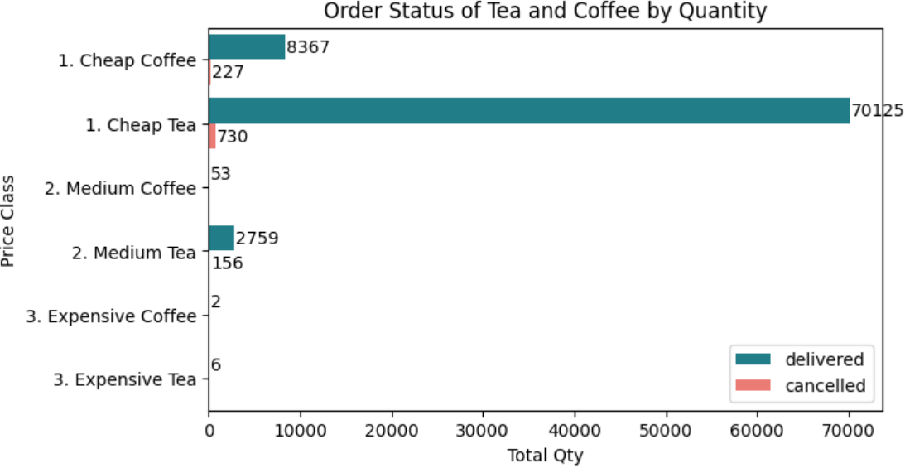
EXPLORATORY DATA ANALYSIS
ORDER STATUS BY QUANTITY
5,35% of medium tea quantity order are cancelled. The expensive tea and coffee are totally delivered. The best seller is cheap tea.

Slide 17
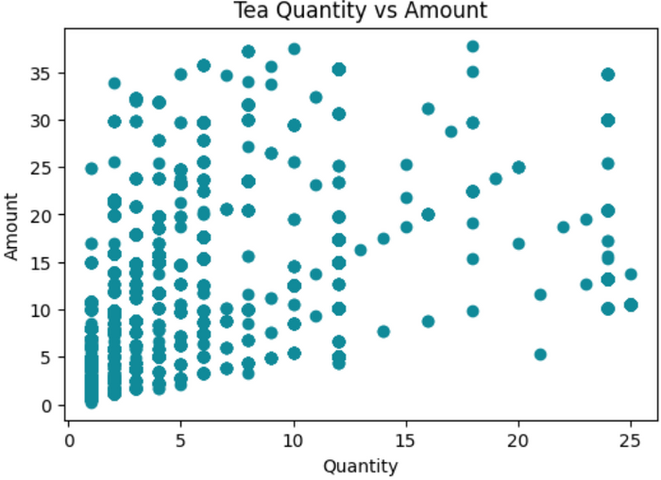
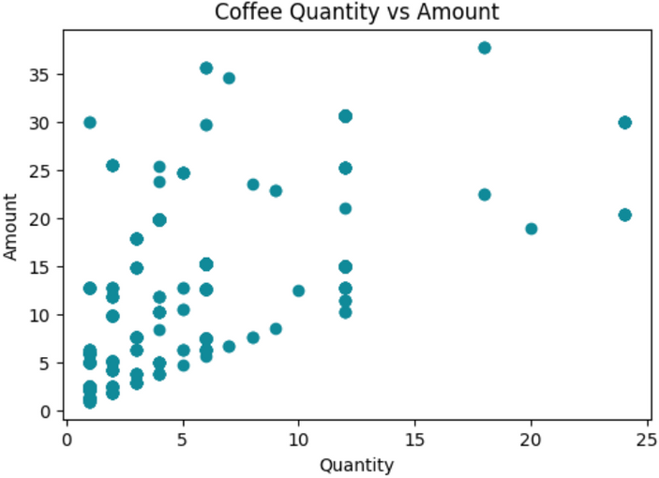
CORRELATION VARIABLES
The relationship between amount and quantity variables for tea and coffee product is weak. The higher order quantity does not necessarily mean the higher total amount.
Many buyers buy it in small quantities at varying prices.

Slide 18

USER RETENTION COHORT
User retention analysis is done to find out whether there is user behavior that returns to transact or use a product (retained). Having loyal users who continue to return to transact or use our products will generate profits for our business.
Cohort analysis allows us to see the level of user retention from various times at once so that we can analyze how consistently our users return to transact.

Slide 19
USER RETENTION COHORT
1
2
3
4
5
STEP
STEP
STEP
STEP
STEP
Aggregate transaction data into a summary of total transactions/orders for each user each month.
Create a column as a cohort of users, the first month of the transaction.
Calculate the distance between the transaction month and the first month of the transaction and add it to 1 which means the first month.
Pivot table with index in the form of cohort, column in the form of month interval, and value is the number of unique users (unique count of customer ID)
Count the number of users in each cohort (users who made their first transaction in that month) and divide all the values ​​in the pivot table by that value to get the retention rate.

Slide 20
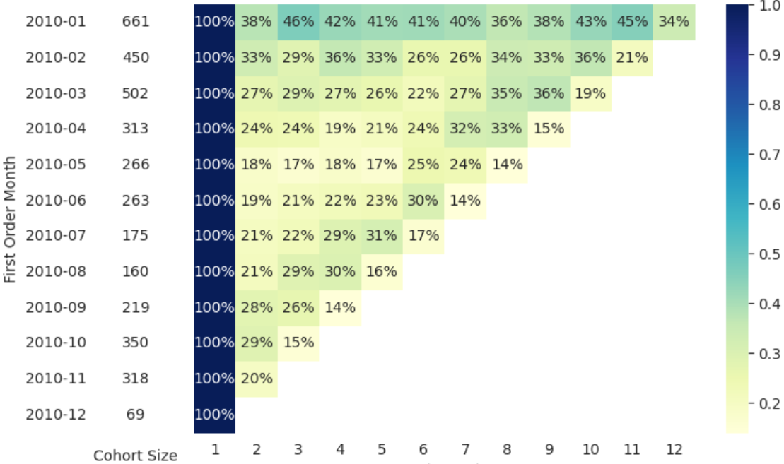
Display the pivot table that already contains the retention rate values ​​in the heatmap.

Slide 21

INSIGHTS
The most users first transacted in January 2010 (661 users). This user cohort also transacted the most in their 2nd month with a retention rate of 38% compared to other cohorts. In addition, this cohort was also the most loyal in transacting during the following months with a retention rate of -+40%.
Unfortunately, most users did not return to transact, as seen from the retention rate in many cohorts and other months of less than 50%. What is quite worrying is that the retention rate in December 2010 was the lowest for all user cohorts compared to previous months.

Slide 22
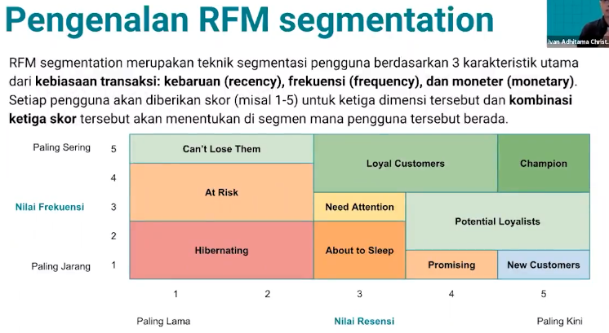

RFM (RECENCY, FREQUENCY, MONETARY) SEGMENTATION
RFM segmentation is a user segmentation technique based on 3 main characteristics of transaction habits: recency, frequency, and monetary. Each user will be given a score, for example (1-5) for the three dimensions and the combination of the three scores will determine which segment the user is in.

Slide 23
THE STEPS
1
2
3
4
5
6
STEP
STEP
STEP
STEP
STEP
STEP
Aggregate transaction data into a summary form of total transactions (orders), total order value (order value), last order date for each user.
Create a column for the number of days since the last order.
Create a binning of the number of days since the last order consisting of 5 bins with the boundaries being min, P20, P40, P60, P80, max and label 1 to 5 from the highest to the lowest bin as the recency score.
Create a binning of the number of days since the last order consisting of 5 bins with the qcut() function and label 1 to 5 from the highest to the lowest bin as the frequency score.
Create a binning of the total order value consisting of 5 bins with the limits being min, P20, P40, P60, P80, max and label 1 to 5 from the lowest to the highest bin as the monetary score.
Create segment name columns based on recency and frequency scores.

Slide 24
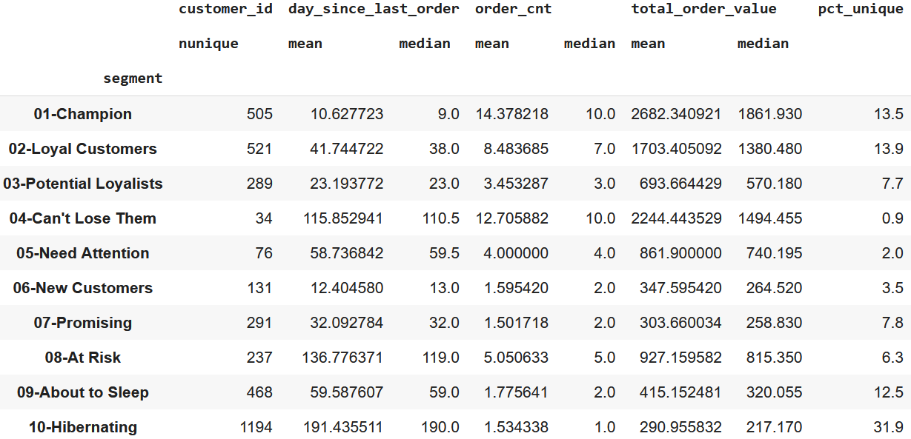
The summary display of RFM segmentation is in the form of the number of users, average and median of total orders, total order value, and number of days since the last order.

Slide 25
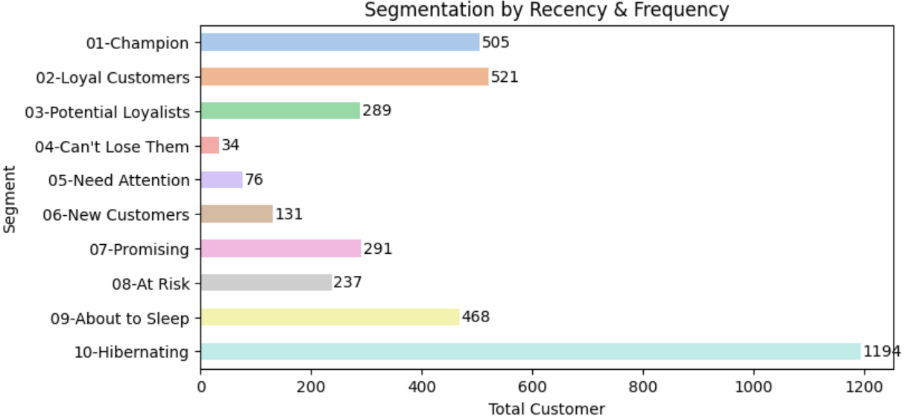
The chart of RFM segmentation based on Recency and Frequency orders by customers.

Slide 26
INSIGHTS
Most users are in the segments : Hibernating (1194 customers, 31.9%), Loyal Customers (521 customers), Champion (505 customers). Special programs that focus on the urgency of transactions for Loyal Customers can be created to make them transact again in the near future so they can move up to the Champion segment. Special programs that focus on the number of transactions for Potential Loyalists can be created to make them transact more often so they can move up to the Loyal Customers segment.
Special programs for Hibernating can be created to make them transact again even though they are not that often so they can move up to the New Customers or even Potential Loyalist segments.

Slide 27

MARKET BASKET ANALYSIS
MBA (Market Basket Analysis) is used to find associations of 2 or more products from a set of user transaction data. The main concept used in MBA is the calculation of the frequency of occurrence of products purchased together in a transaction/order. The output of market basket analysis can be used to cross-sell or up-sell to users/buyers in stores or platforms. Some examples of its application:
- arrange the placement of an item in a store.
- provide product recommendations in stores.
- pair/group several products as a bundle.

Slide 28
MARKET BASKET ANALYSIS
1
2
3
4
STEP
STEP
STEP
STEP
Aggregate unique product_name in pivot table named basket with index order_id, fill empty values ​​with number 0
Encode the basket data frame with True for all values ​​above 0 and False for all values ​​0.
Get order_id with more than 1 unique product.
Applying apriori algorithm.
Create a frequent itemset list (a collection of products that are frequently purchased).
Calculate the support, confidence, and lift values ​​for each possible product pair.

Slide 29
APRIORI ALGORITHM
Apriori algorithm is one of the algorithms used in market basket analysis. Using prior knowledge or previous knowledge about frequent itemsets. This algorithm is iterative starting from an itemset containing 1 item and so on and will eliminate itemsets that are not frequent (below minimum support).
Some terms used:
- k-itemset: a collection of items/products containing k items.
- support: the percentage of itemsets purchased over all transactions.
- minimum support: the minimum support limit desired as a frequent itemset criterion.

Slide 30
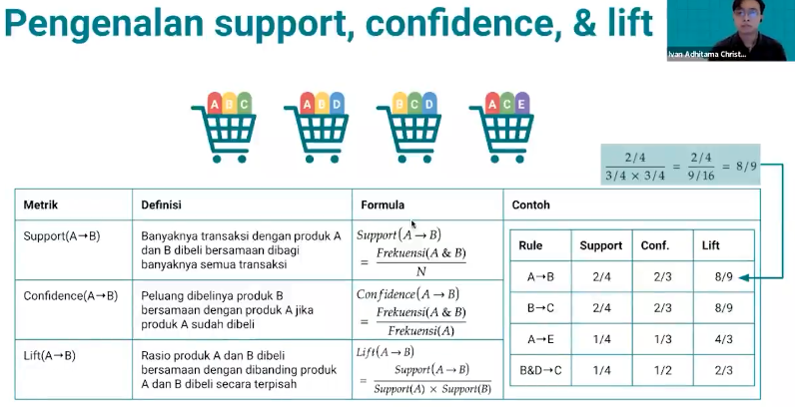
ABOUT SUPPORT, CONFIDENCE, AND LIFT

Slide 31

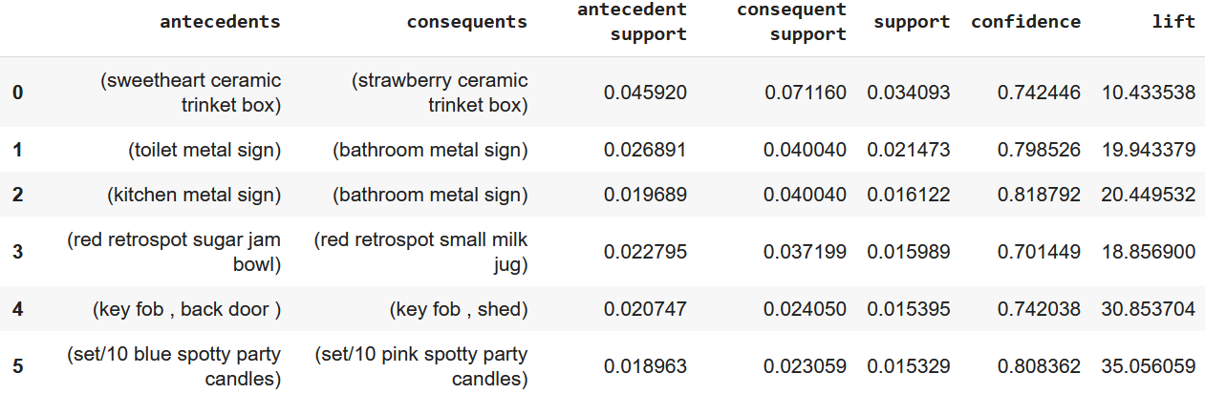
TOP 5 ITEMS IN THE BASKET

Slide 32
INSIGHTS
The sweetheart ceramic trinket box product was purchased in 4.5% of total transactions. When buyers have purchased the sweetheart ceramic trinket box, 74% of them also purchased the strawberry ceramic trinket box. There is a strong association between the sweetheart ceramic trinket box and the strawberry ceramic trinket box with the chance of both products being purchased together in 1 transaction 10 times greater than the chance of both products being purchased individually.
Based on this insight, the strawberry ceramic trinket box product can be placed near/next to the sweetheart ceramic trinket box or both products can be sold in a bundle.

Slide 33




CONNECT
WITH ME :
endahen12@gmail.com
https://www.linkedin.com/in/endahrakhmawati

