Slide 1


Case Study - E-Learning
Implementing SQL :
TechCorp
Student : Endah Rakhmawati

Slide 2


Case Study
Implementing SQL : TechCorp
TechCorp is an e-commerce company that focuses on selling electronic products such as laptops, smartphones and accessories. TechCorp also provides customer support services to assist customers with technical issues and questions regarding products sold.
As a Data Analyst at this company, you are assigned to analyze various data for financial reporting and business performance analysis.
Data Input for Tables : Download here
#RintisKarirImpian

Slide 3
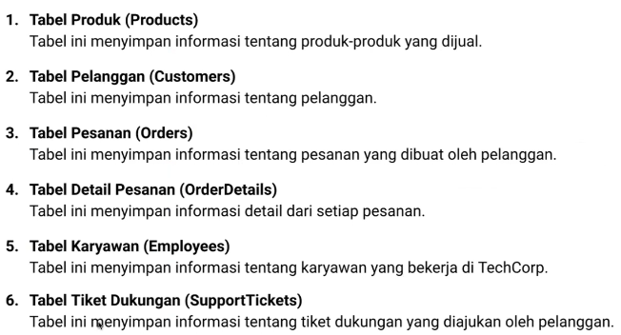
Case Study
Database Schema
#RintisKarirImpian

Slide 4

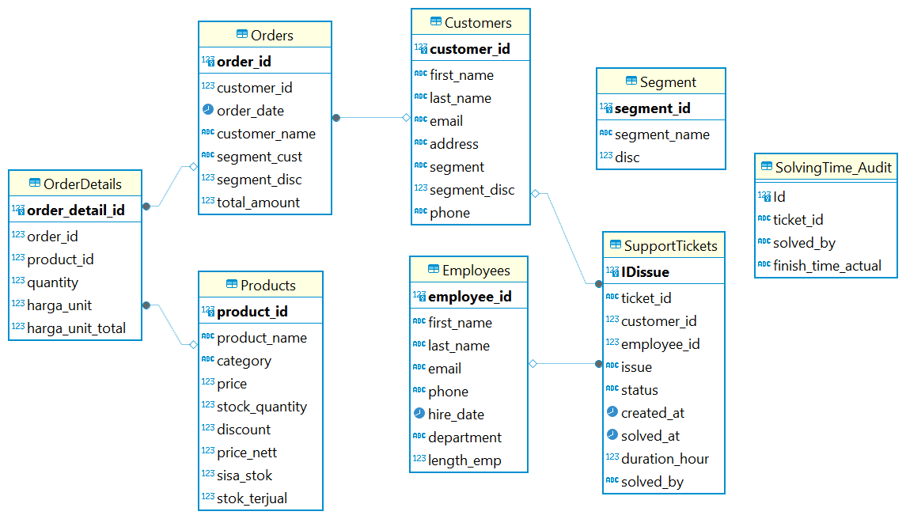
Case Study
Entity Relationship Diagram
#RintisKarirImpian

Slide 5
Case Study
DDL (Data Definition Language)
#RintisKarirImpian

Slide 6
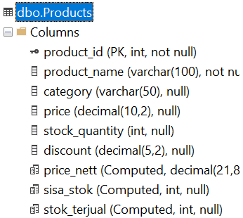
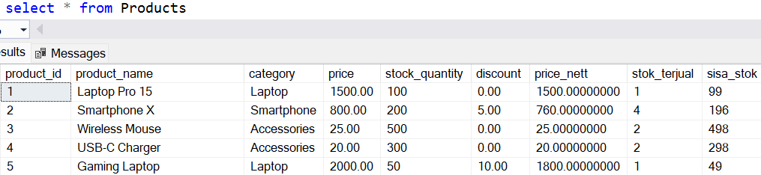
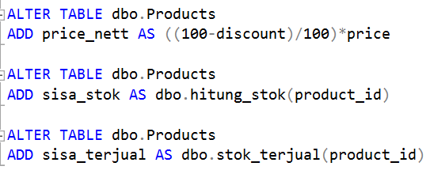
Products
Constraint
There isn't any.
Functions
hitung_stok : reduce the stock quantity with the quantity in the Orders table. If there isn’t any products in OrderDetails, sisa_stok remains intact.
stok_terjual : add up the quantity in the Orders table for each product_id.
#RintisKarirImpian

Slide 7
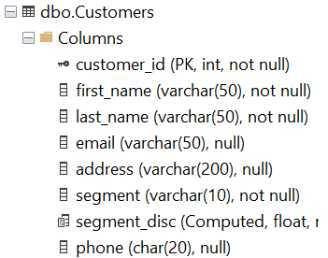
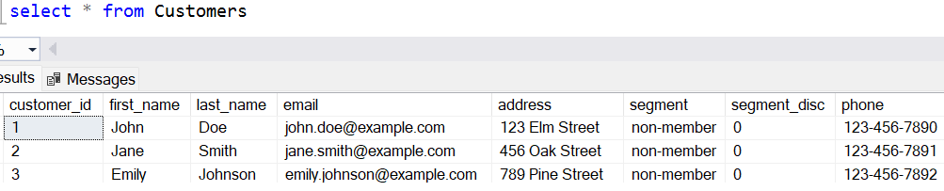
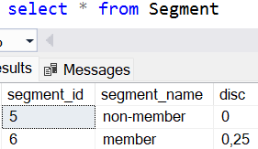
Customers
Constraint
#RintisKarirImpian

Slide 8

Customers
Functions
ListSegment : only if the segment parameter in the Customers table is the same as segment_name in the Segment table. If it is not appropriate/not available then customer data cannot be entered.
fn_segmentdisc : looking for the disc in the Segment table according to the segment parameters in the Customers table.
#RintisKarirImpian

Slide 9
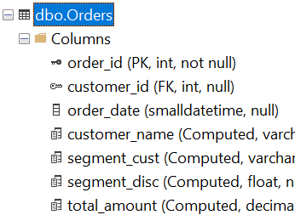
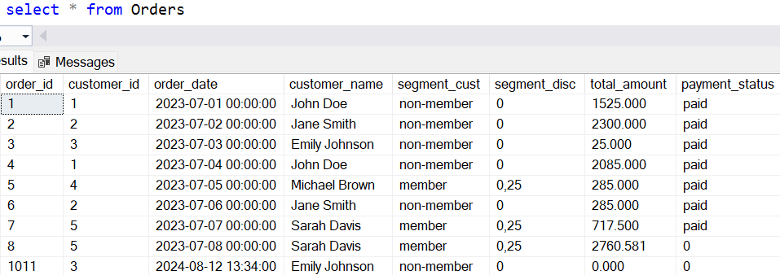
Orders
Constraint
#RintisKarirImpian

Slide 10
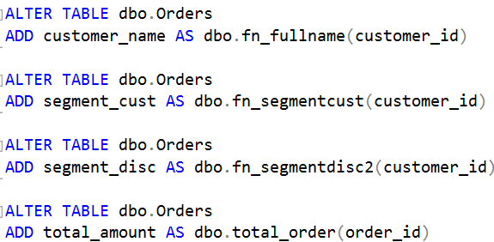
Orders
Functions
fn_fullname : combined first_name and last_name from the Customers table based on customer_id in Orders.
fn_segmentcust : get segment in the Customers table based on customer_id in Orders.
fn_segmentdisc2 : get segment_disc in the Customers table based on customer_id in Orders.
#RintisKarirImpian

Slide 11
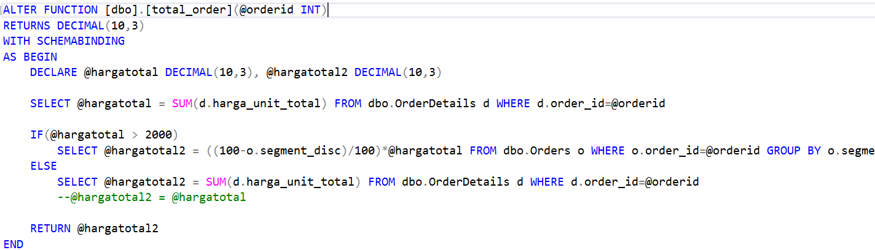
Orders
Functions
total_order : calculate the sum of all product prices for each order_id, if the amount is > 2000 dollars then you will get an additional discount from segment_disc, namely for the member segment which gets a 0.25% discount. If the total_amount is < 2000 dollars then you won't get the additional discount even though the segment is a member.
#RintisKarirImpian

Slide 12
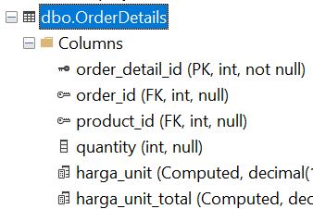
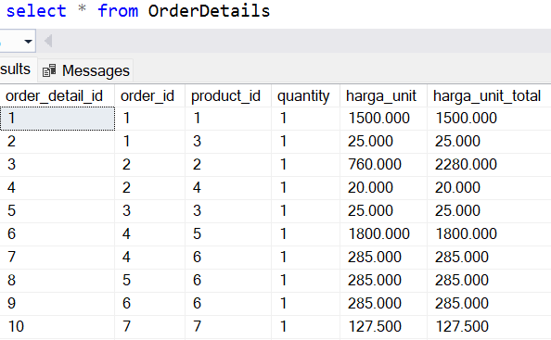

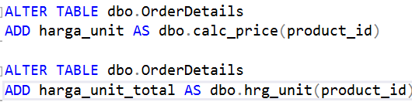
OrderDetails
Constraint
Functions
fn_ListOrderId : only if the order_id entered is unpaid, you can add or remove the product in OrderDetails.
calc_price : the unit price of the product is reduced by the disc for each product.
harga_unit_total : get the net unit price multiplied by the quantity ordered in the order details.
#RintisKarirImpian

Slide 13
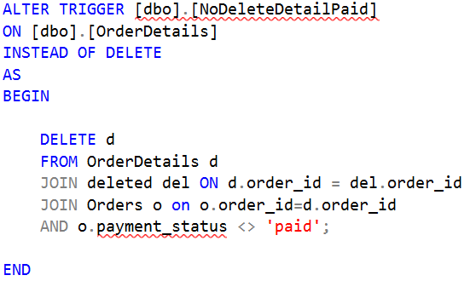
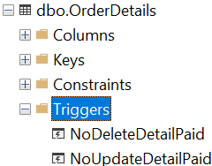
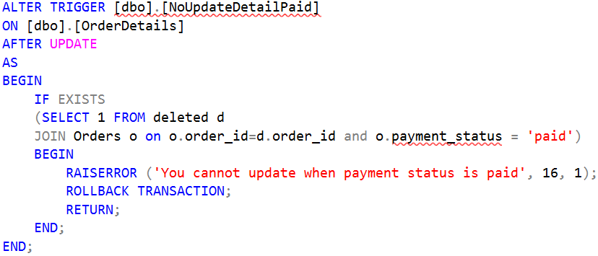
OrderDetails
Triggers
What order_id can be deleted are those whose payment_status has not been paid
What order_id can be updated are those whose payment_status has not been paid
#RintisKarirImpian

Slide 14
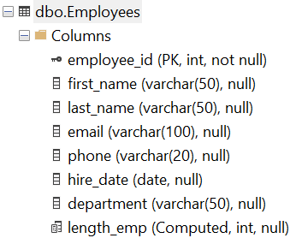
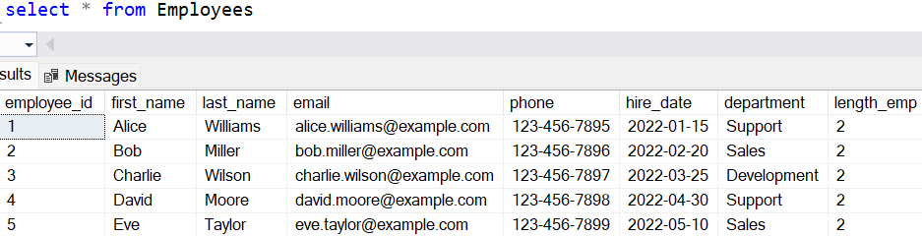
Employees
Computed column
Constraint
There isn't any.
#RintisKarirImpian

Slide 15
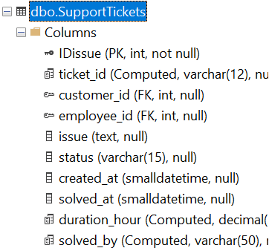
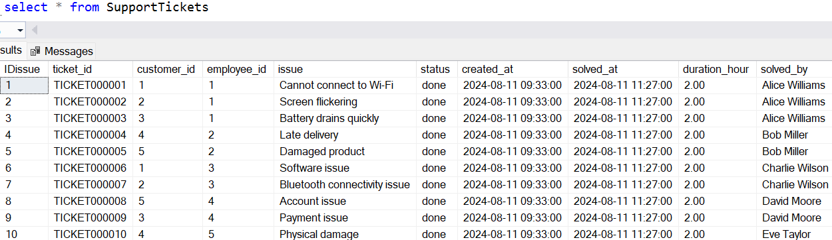

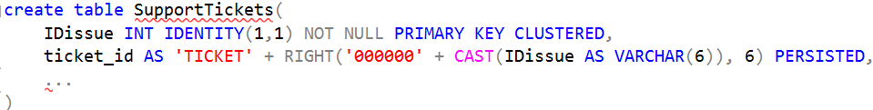
SupportTickets
Constraint
Format ticket_id
df_createat : when an issue is created, the default create_at is getdate().
df_status : when an issue is created, the default [status] is 'open'.
Computed column
#RintisKarirImpian

Slide 16

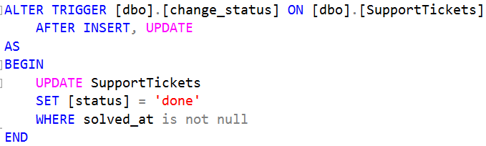

SupportTickets
Trigger [status]
Functions
empname : The combination of first_name and last_name taken from the Employees table is based on the employee_id in the SupportTickets table.
Only when solved_at is inputed the [status] change its value to 'done'.
#RintisKarirImpian

Slide 17
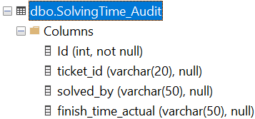
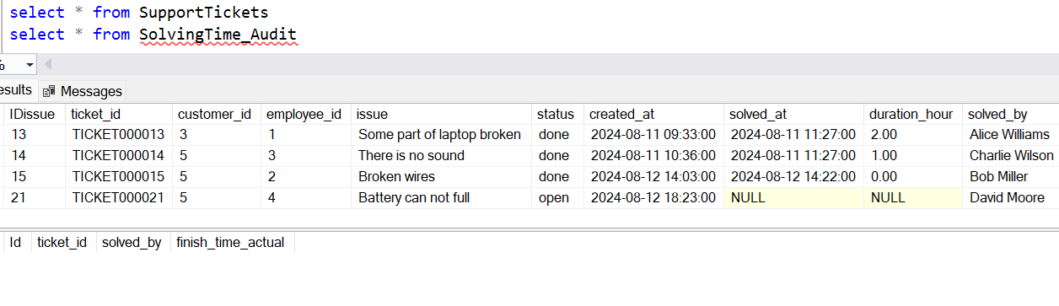
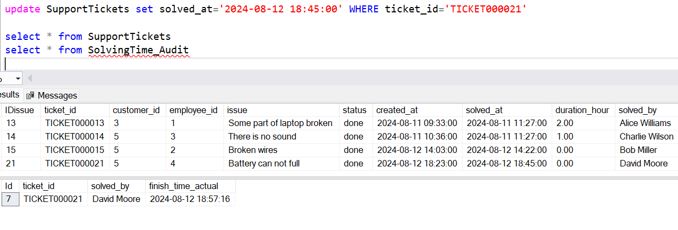
SolvingTime_Audit
Before input solved_at
After input solved_at
There is 12 minutes difference:
solved_at 18.45.00
finish_time_actual 18.57.16
#RintisKarirImpian

Slide 18
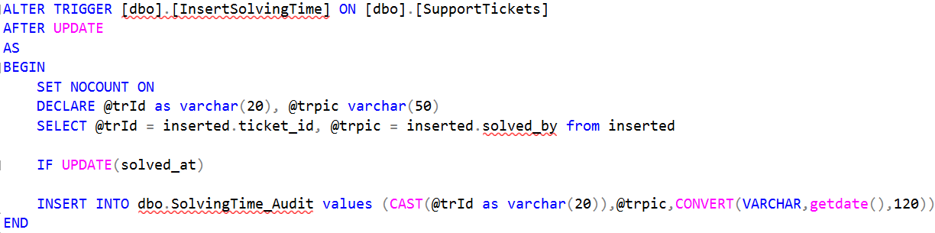
SolvingTime_Audit
Trigger InsertSolvingTime
After there is an update action on solved_at, it will automatically record the action in the SolvingTime_Audit table by giving the actual finish time value, namely getdate(). This way, the solved_at values ​​in the SupportTickets and SolvingTime_Audit tables can be audited to see if they are appropriate or if there are deviations.
#RintisKarirImpian

Slide 19
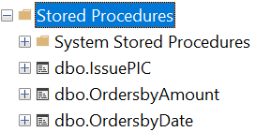
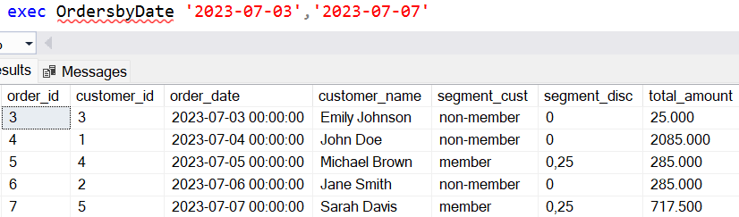
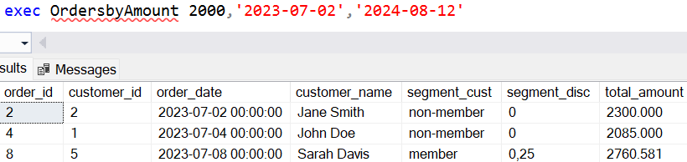
Stored Procedures
Displays all Orders in a certain period according to the entered date and end date.
Displays all Orders that have a total amount >= 2000 dollars in a certain period according to the entered start and end date.
#RintisKarirImpian

Slide 20
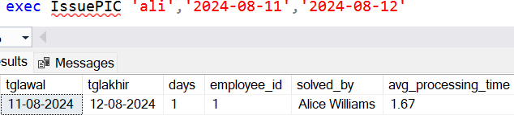
Stored Procedures
Displays the average processing time for issues that have been completed in the SupportTickets table searched for each employee name, namely solved_by in a certain period according to the entered start and end date.
#RintisKarirImpian

Slide 21
Case Study
DML (Data Manipulation Language)
#RintisKarirImpian

Slide 22
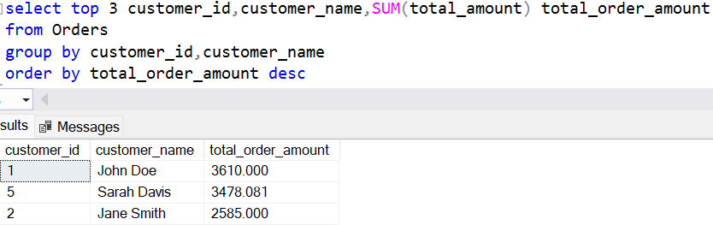
Query 1
1. Identifikasi 3 pelanggan teratas berdasarkan total nominal pesanan!
+
Lampirkan jawaban kamu disini
#RintisKarirImpian

Slide 23
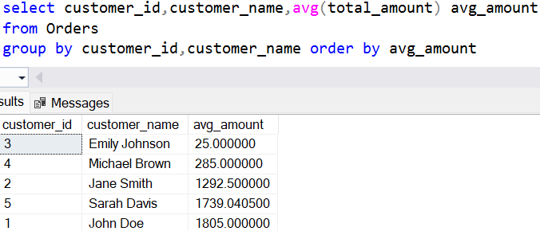
Query 2
2. Temukan rata-rata nominal pesanan untuk setiap pelanggan!
+
Lampirkan jawaban kamu disini
#RintisKarirImpian

Slide 24
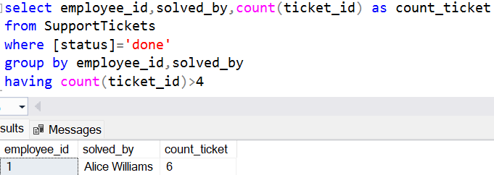
Query 3
3. Temukan semua karyawan yang telah menyelesaikan lebih dari 4 tiket support!
+
Lampirkan jawaban kamu disini
#RintisKarirImpian

Slide 25
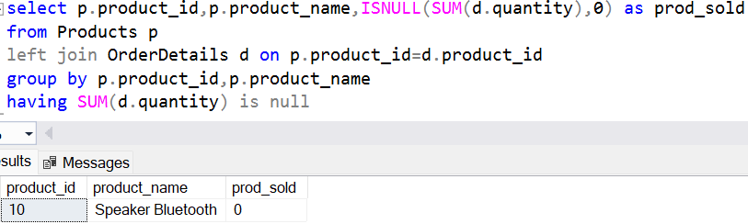
Query 4
4. Temukan semua produk yang belum pernah dipesan!
+
Lampirkan jawaban kamu disini
#RintisKarirImpian

Slide 26
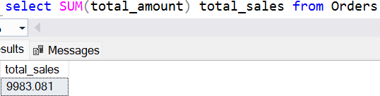
Query 5
5. Hitung total pendapatan yang dihasilkan dari penjualan produk!
+
Lampirkan jawaban kamu disini
#RintisKarirImpian

Slide 27
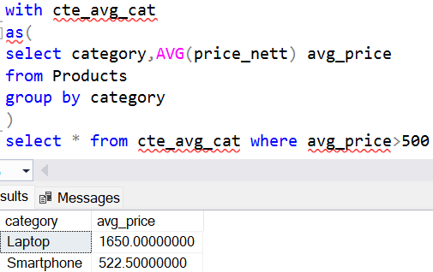
Query 6
6. Temukan harga rata-rata produk untuk setiap kategori dan temukan kategori dengan harga rata-rata lebih dari $500!
+
Lampirkan jawaban kamu disini
#RintisKarirImpian

Slide 28
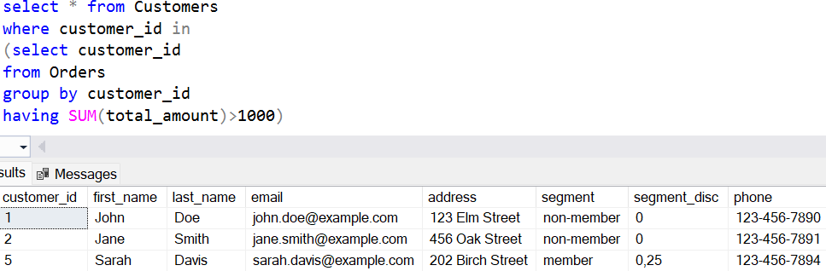
Query 7
7. Temukan pelanggan yang telah membuat setidaknya satu pesanan dengan total jumlah lebih dari $1000!
+
Lampirkan jawaban kamu disini
#RintisKarirImpian

Slide 29


Case Study - E-Learning
Connect with me :
endahen12@gmail.com
www.linkedin.com/in/endahrakhmawati

