Slide 1
Foundations of Vision and Language
Information Theory and Language Modeling
Sidharth Ranjan

Slide 2
Outline
Zipf’s law
Shannon’s approach to language
Entropy
Information-theoretic measures
Language Modeling
N-gram/Markov Models
Noisy-channel Model

Slide 3
How can we computationally represent the structure of language?

Slide 4
Language representation
Describe grammatical rules
  English sentences have subjects, verbs, objects, and so on.
Statistical structure of language
  How frequently do words occur?
  How predictable is one word from another?
  How much information does a word carry?
Do most words in a corpus occur with an average frequency?

Slide 5
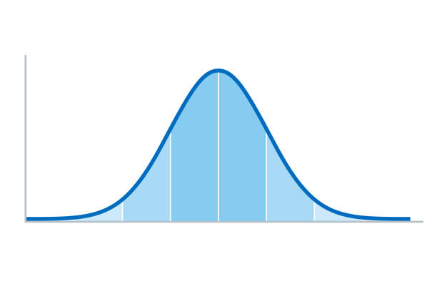
Many phenomena in the world follow a “normal distribution”
  Very few observations with extremely low values
  Many observations with average values
  Very few observations with extremely high values
Examples:
  Rolling three dice at a time
  Life expectancy of people in Finland
  Height of children in the same school year
Word frequencies are different!

Slide 6
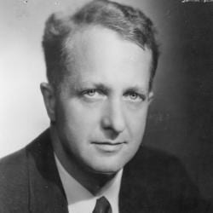
Zipf’s Law (1932)
Zipf’s law denotes a surprising regularity in the way word frequencies are structured
George Kingsley Zipf (1902-1950)
1912: French stenographer Jean-Baptiste Estoup notes word frequency regularity.
1932: Zipf introduces the concept in early studies.
1935: Zipf details the law in The Psycho-Biology of Language.
1949: Zipf applies the law to city sizes and behavior.

Slide 7
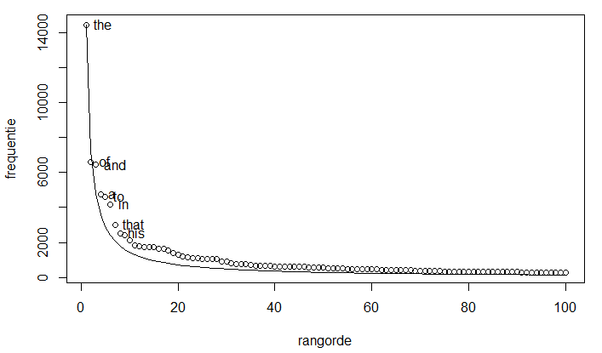

Slide 8
Zipf’s law
Some words are used very frequently
  Grammatical words: the, of, and, to, a, in, …
Many words are used very rarely
So language has a very uneven frequency distribution
Frequent words are short, rare words tend to be longer

Slide 9
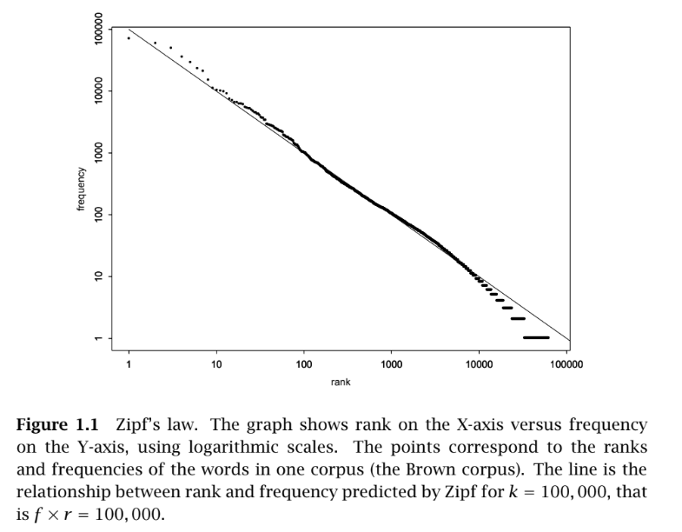

Slide 10
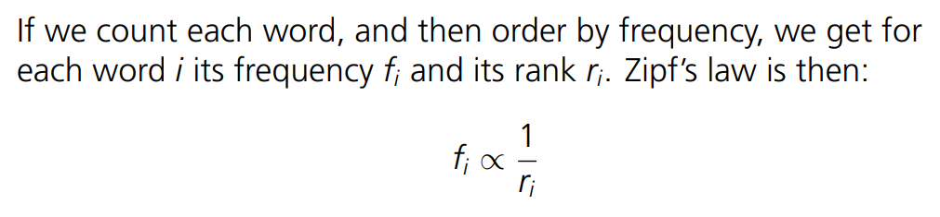
Zipf’s Law by George Kingsley Zipf
(1902-1950)
Did you know?
In every language, the most frequent word occurs twice as often as the second most frequent word.

Slide 11
Question
Should the 50th most common word occur with three times the frequency of the 150th most common word?

Slide 12
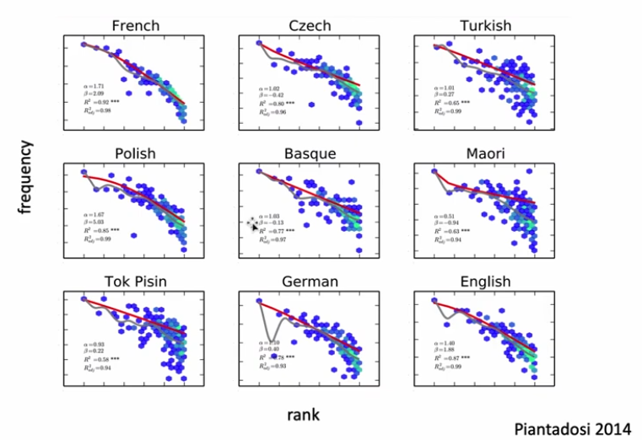
Zipf’s law across languages
Why should language have this particular statistical structure?

Slide 13
Why are words frequencies Zipfian?
The principle of least effort:
  If we have to use a word very often, it saves time and energy if that word is very short
Communication efficiency and robustness:
  Shorter words carry a higher risk of being misheard, so they do not carry a lot of information, but they convey this information efficiently
  Longer words carry more information and are more reliably identified, but at a higher processing cost
  Language appears to balance efficiency and robustness (trade-off)
    Efficiency: Minimizes the physical and cognitive effort required by the speaker to produce language
    Robustness: Ensures that listener can successfully reconstruct the intended meaning in presence of noise and distractions
Benefits:
  Zipf’s law helps us understand the statistical properties and the structure of language
  Guide us to design a better NLP systems

Slide 14

The Zipf Mystery

Slide 15
Insights
If language has such strong statistical regularities, can we actually quantify those regularities?
Can we measure:
  Predictability
  Uncertainty
  Information
  Redundancy
Claude Shannon & World war II
  Communication & Code breaking
  How can information be represented computationally?

Slide 16
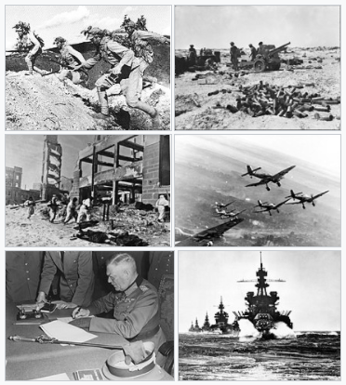
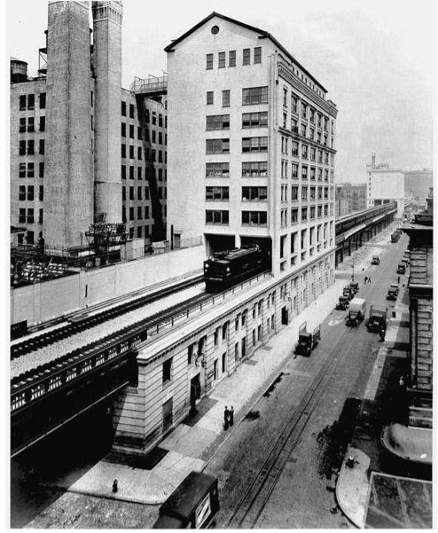
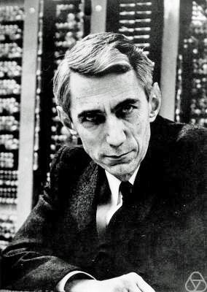
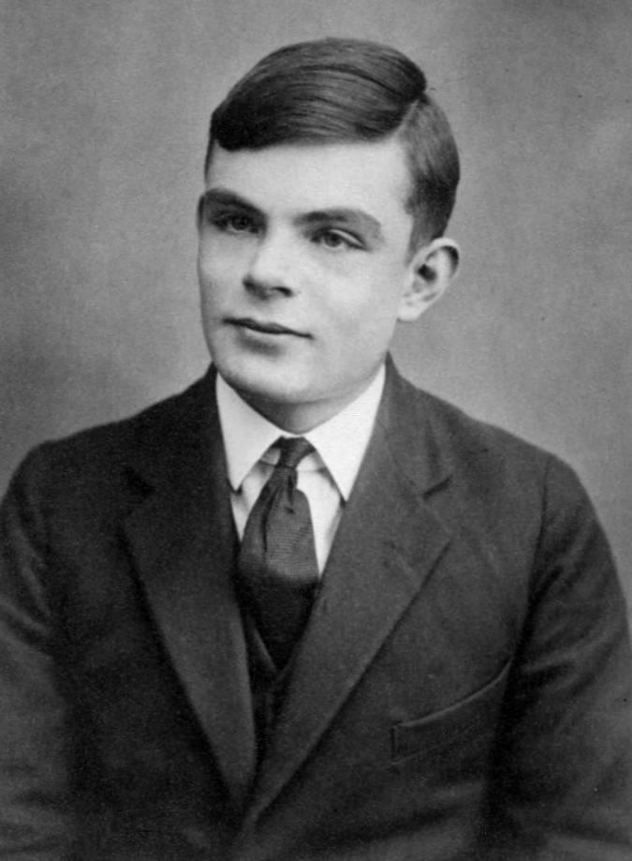
Word War II (1939-1945)
Bell Labs (1943)
Word War II
Bell Laboratory
CE Shannon
Alan Turing

Slide 17
Timeline
How can information and computation be represented formally?
Alan Turing
(23 June 1912 – 7 June 1954)
CE Shannon
(30 April 1916 – 24 Feb 2001)
1931-1934: Undergrad (King’s College, Cambridge)
[*Independently proved Central Limit Theorem]
1936-1938: PhD (Princeton University)
[Formulation of Turing Machine – Church-Turing thesis]
1932-36: Undergrad (EE/Maths: University of Michigan)
1936-37: Masters (MIT) [Founded Digital circuit design theory]
1940: PhD (MIT) [An Algebra for Theoretical Genetics]

Slide 18
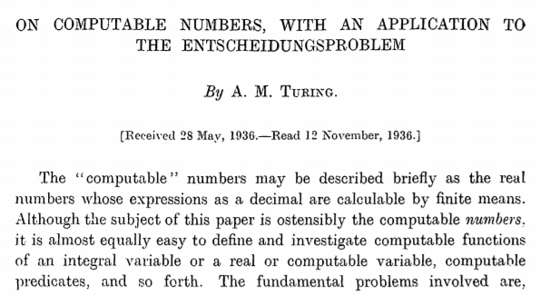
Code makers and Code breakers
Interests: Chess, Crossword puzzles, Typewriter
With the subject off the table:
  Turing showed one of his paper to Shannon!
CE Shannon
Alan Turing

Slide 19
Conversation…
Powers and limitations of an idealized computing machine…
Possibility of the machines learning to think…
Shannon: Why not feed “cultural things,” such as music, to an electronic brain?
Turing: “No, I’m not interested in developing a powerful brain. All I’m after is just a
mundane brain…”
Alert: It’s 1943… both the transistor and the electronic computer had yet to be born!
The common vision of Shannon and Turing :- LOGIC

Slide 20
Summary
Turing encoded instructions as numbers. He encoded decimal numbers as zeroes and ones...
Shannon made codes for switches and relays…
Game of symbols and mapping
  Mapping one set of objects onto another
  For example: logical operators and electric circuits; algebraic functions and machine instructions

Slide 21
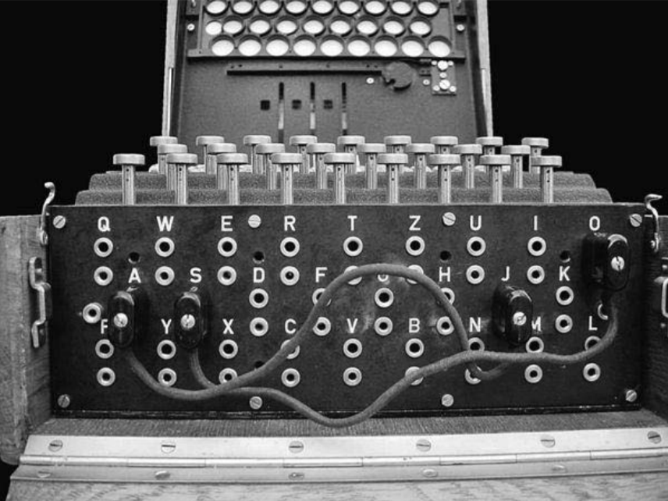
ENIGMA Machine
By the war’s end, ENIGMA deciphering thousands of military intercepts every day: processing information, that is, on a scale never before seen…
They indirectly talked about Turing’s notion about how to measure all this stuff…
The probability of some fact—a particular Enigma code setting, for example, or the location of a submarine. If I receive some evidence that rules out most of those locations, the uncertainty decreases
Turing cared about the data that changed the probability: a probability factor, something like the weight of evidence
Shannon has similar thoughts which inspired him to establish a theoretical foundation—A Mathematical Theory of Cryptography (1945)

Slide 22
Claude Shannon’s thoughts
A Mathematical Theory of Cryptography (1945). Declassified version (1949)
  A stream of data looks like junk!
  Goal—Find the real pattern
  Motivated him to understand the patterns of language (tangible and countable)
Patterns in language: Redundancy (an aid to understanding/recovering)
  Language is not random as it contains redundancy!

Slide 23
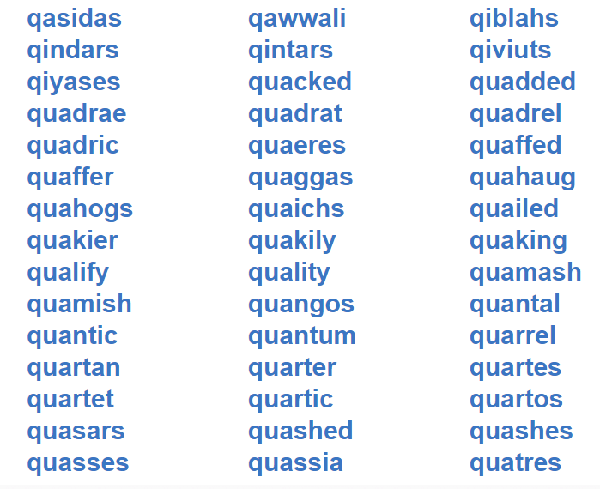
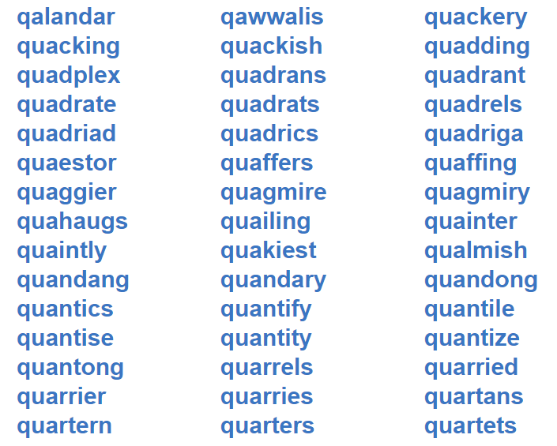
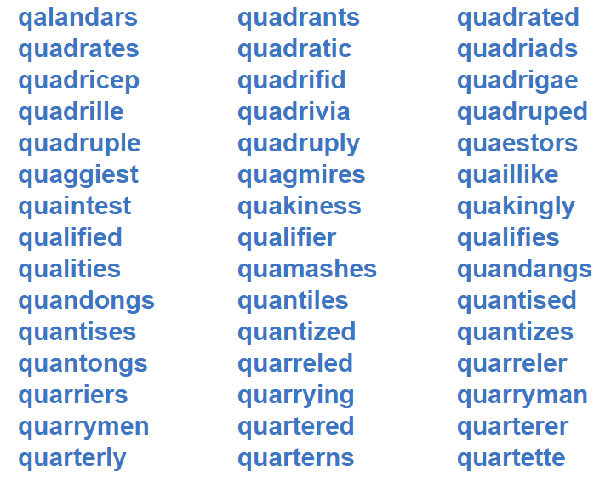
Patterns in language- Redundancy
Wherever the letter q appears, the u that follows is redundant
After q, a u are expected. There is no surprise. It contributes no information!
How much a text in the language can be reduced in length without losing any information?
Each event has a probability that depends on the state of the system and perhaps also on its previous history!

Slide 24
Shannon’s approach to language
Examined statistical structure in terms of how much of a message influences the probability of the next symbol
Language is a dynamic system whose future course is conditioned by its past history
To understand this better, he worked out the problem using English text!

Slide 25
Framework: Shannon’s n^{th} order approximation
Symbols: Alphabet of 27 characters, the letters plus a space between words
Generated strings of characters with the help of a table of random numbers
A, B, C, D, E, F, G, H, I, J, K, L, M, N, O, P, Q, R, S, T, U, V, W, X, Y, Z, ‘ ’
Make a sequence of 5 characters?

Slide 26
Zero-order approximation
Random characters, no structure or correlations
XFOML RXKHRJFFJUJ ZLPWCFWKCYJ
FFJEYVKCQSGHYD GPAAMKBZAACIBZLHJGD.

Slide 27
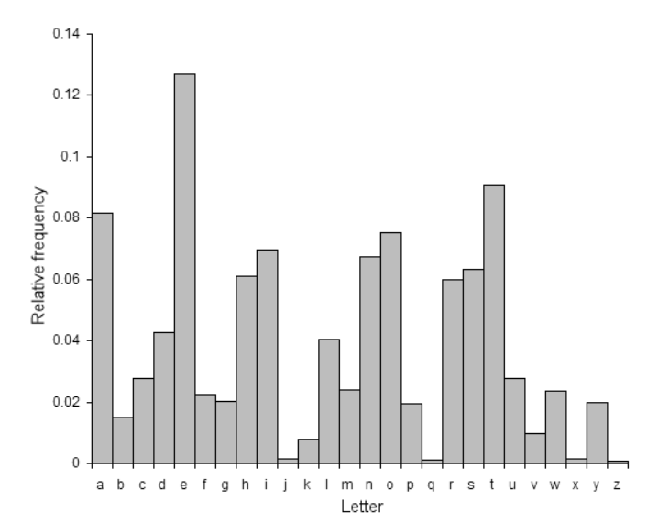
First-order approximation
Each character is independent of the rest, but the frequencies are those expected in English
More e’s and t’s, fewer z’s and j’s
OCRO HLI RGWR NIMILWIS EU LL NBNESEBYA
TH EEI ALHENHTTPA OOBTTVA NAH BRL
Inference: Word lengths look more realistic!
Link: https://mathcenter.oxford.emory.edu/site/math125/englishLetterFreqs/

Slide 28
Second-order approximation
Frequencies of each character match English and so also do the frequencies of each bigram, or letter pair
(After q, a u are expected…)
ON IE ANTSOUTINYS ARE T INCTORE ST BE S DEAMY ACHIN
D ILONASIVE TUCOOWE AT TEASONARE FUSO TIZIN ANDY
Occurrence
Engineering
Successfully
Understood
cc, rr, ll, ee, ss, or oo

Slide 29
Third-order approximation
Frequencies of each character match English and so also do the frequencies of each trigram, or letter triplet
IN NO IST LAT WHEY CRATICT FROURE BIRS GROCID
PONDENOME OF DEMONSTURES OF THE REPTAGIN IS
REGOACTIONA OF CRE

Slide 30
First-order word approximation
REPRESENTING AND SPEEDILY IS AN GOOD APT OR COME CAN
DIFFERENT NATURAL HERE HE THE A IN CAME THE TO
OF TO EXPERT GRAY COME TO FURNISHES THE LINE
MESSAGE HAD
BE THESE

Slide 31
Second-order word approximation
Pairs of words appear in the expected frequency, so we do not see
“a in” or “to of”
THE HEAD AND IN FRONTAL ATTACK ON AN ENGLISH WRITER THAT THE CHARACTER OF THIS POINT IS THEREFORE ANOTHER METHOD FOR THE LETTERS THAT THE TIME OF WHO EVER TOLD THE PROBLEM FOR AN UNEXPECTED
Inference: Sequences increasingly “look” like English

Slide 32
Summary: Shannon’s n^{th} order approximation
Thought: To represent a message as the outcome of a process that generated events with discrete probabilities
Intuition: “…more choices meant more uncertainty—more information”
Hypothesis: The ‘measure’ of information as the measure of ‘uncertainty’
  “…of how much ‘choice’ is involved in the selection of the event”
  “…of how uncertain we are of the outcome”

Slide 33

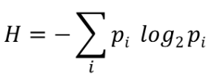
Shannon’s Entropy (1948)
Nyquist and Hartley’s formula:
(1928)
Measure information, choice, and uncertainty as a function of probabilities
Average logarithm of the improbability (unexpectedness) of the message
where p_{i} is the probability of each message; measure in bits (log base 2)

Slide 34
Activity: Quantifying predictability and redundancy
A
SMALL
OBLONG
READING
LAMP
ON
THE
D
Desk
Efficient communication system: To make the chance of error as small as you wish?
Message encoding: Whether removing redundancy to increase efficiency or adding redundancy to enable error correction (increase robustness)
Hypothesized the working over electrical communication devices – flip-flops
The Mathematical Theory of Communication (1949) by CE Shannon – The Noisy Channel Model
Context reduces uncertainty: Basic intuition behind language modeling!

Slide 35
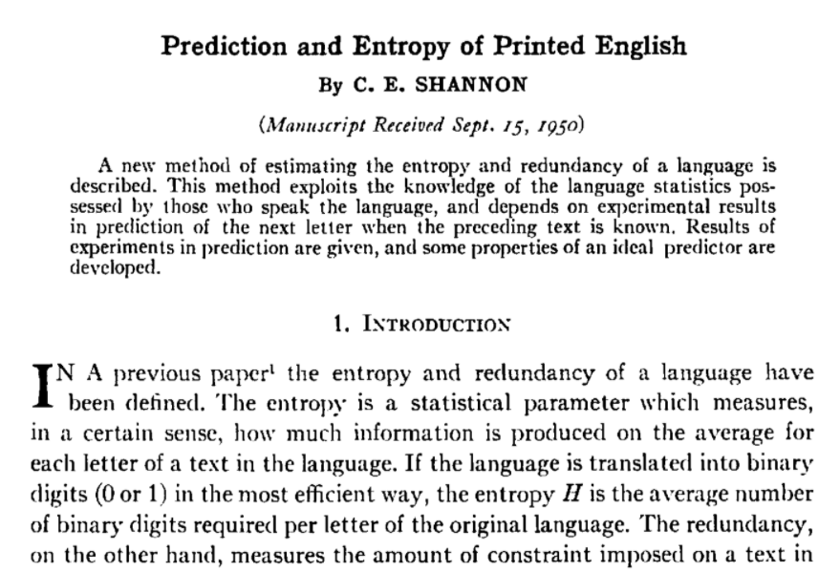
Quantifying predictability and redundancy
Shannon estimated that English (over eight letters) has a built-in redundancy of about 50 percent:
Each new character of a message conveys not 5 bits but only about 2.3

Slide 36
50% built-in redundancy in English
Hypothesis:
  To represent 26 unique options in binary code, you need 5 bits because 2⁴ = 16 (not enough) and 2⁵ = 32 (more than enough)
  If English was completely random then every single letter you typed would deliver a full 5 bits of brand-new information
Shannon’s Observation:
  Reading a sequence of English text longer than 8 letters, the actual information being delivered drops to about 2.3 bits per character
  Letters do not appear randomly but rather follow strict statistical patterns
    If you see the letters t-h-e-r-e-f-o-r-, your brain instantly fills in the e
    You can easily read a sentence with all the vowels removed: Ths sntnc s stll rdbl
    Spot a typo instantly – Error violates the expected statistical pattern of the language
Conclusion:
  The actual information content (2.3 bits) is roughly half of the raw capacity (5 bits), Shannon concluded that English has a 50% redundancy

Slide 37
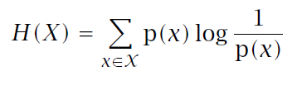
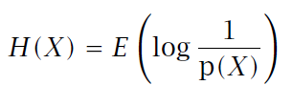
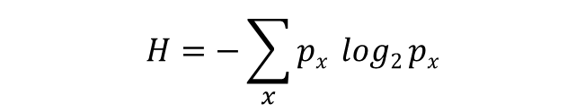
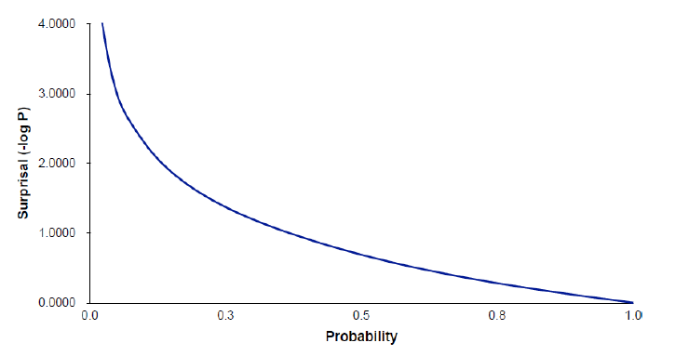
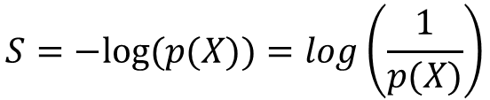
Entropy
Average uncertainty of a symbol or a random variable
Expected surprise (computed over probabilities)
Entropy does not truly represent the randomness in the sequence!
Only measures the relative difference in the frequencies of each symbol
Average length of the message needed to transmit an outcome efficiently!

Slide 38
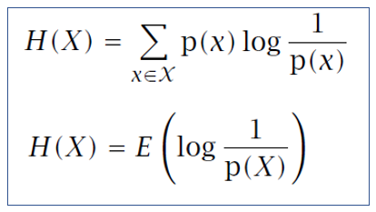
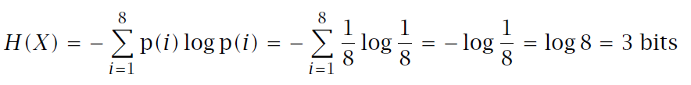

Question 1
Calculate the entropy of rolling an 8-sided die.
Entropy: Amount of information in a random variable X
P(X=1)=P(X=2) …. =P(X=8) = 1/8
The average length of the message needed to transmit an outcome of that variable
The most efficient way is to simply encode the result as a 3 digit binary message:

Slide 39
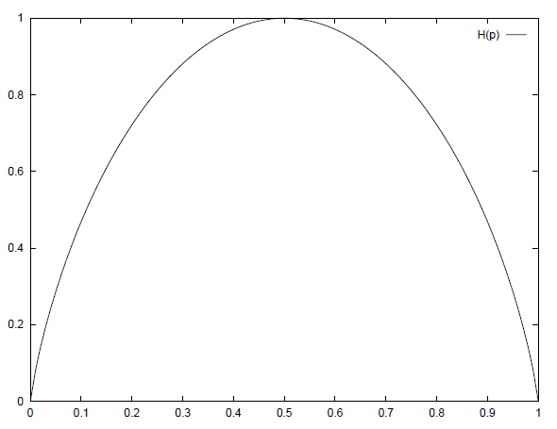
Question-2
H(X)
Calculate the entropy of tossing a fair coin.
P(X=H)=P(X=T) = 1/2
H(X) = 0.5 log₂2 + 0.5 log₂2
= log₂2 = 1 bit
Average length of the message needed to transmit an outcome of RV using the optimal code = 1
P(X = H)

Slide 40
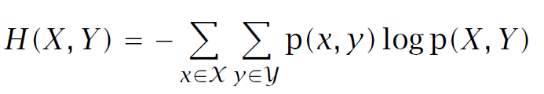
Joint entropy
The joint entropy of 2 random variable X, Y is the amount of the information needed on average to specify both their values

Slide 41
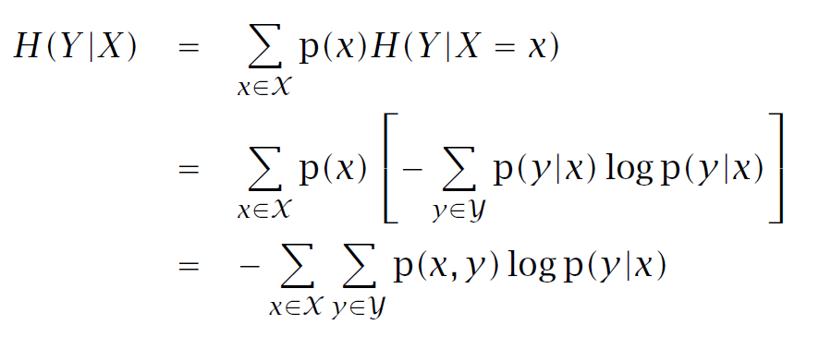
Conditional entropy
The conditional entropy H(Y|X) of a random variable Y given another X,
expresses how much extra information one still needs to supply on average
to communicate Y given that one knows X
So language modeling is fundamentally about conditional probability and therefore conditional uncertainty!

Slide 42

Example 1
X → Weather
Y → Whether I carry an umbrella
If I don't know the weather, there is some uncertainty about whether I carry an umbrella: H (Y)
But suppose I tell you that it’s raining then the uncertainty about Y changes. We will not use p(y) anymore but rather p(y|x)
Entropy of Y, once we know that X= x is: H (Y | X)

Slide 43
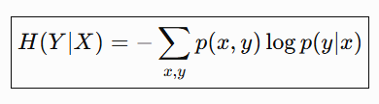

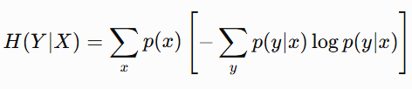


Contd…
X ∈ {Sunny, Rainy}
We need to calculate H(Y∣X=Sunny) & H(Y∣X=Rainy)
H(Y∣X) = p(x₁) H(Y|X=x₁) + p(x₂) H(Y|X=x₂)

Slide 44
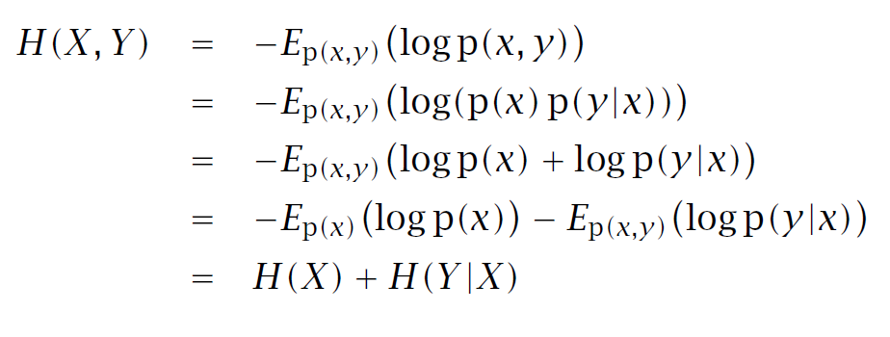
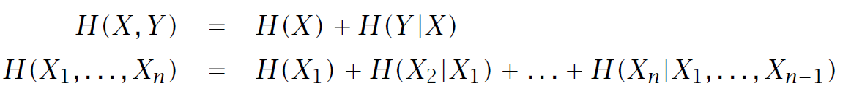
Chain Rule
The information required to specify X and Y is the information required to specify X, plus the additional information required to specify Y once X is known.

Slide 45



Mutual Information
I(X,Y) is the mutual information between X and Y
It is the reduction of uncertainty of one RV due to knowing about the other, or the amount of information one RV contains about the other

Slide 46
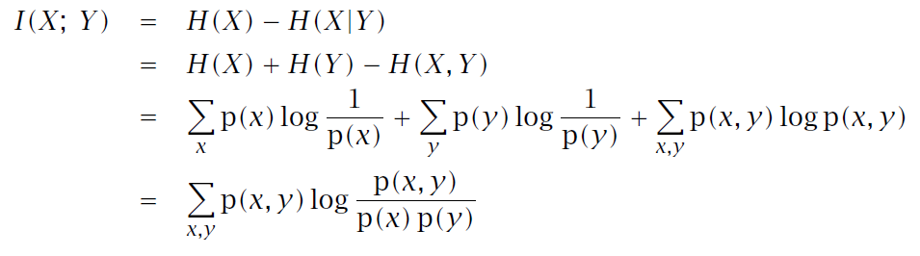
Mutual Information (Cont)
If X and Y are strongly related, knowing X tells us a lot about Y, and mutual information is high.
If knowing X tells us almost nothing about Y, mutual information is low.

Slide 47
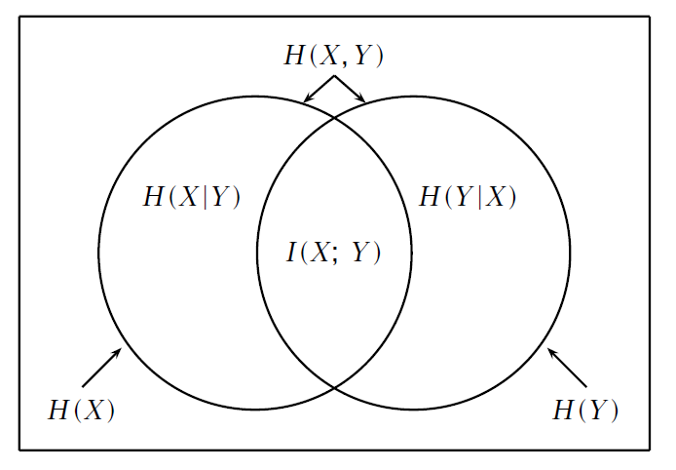

Mutual Information (Venn diagram)
So mutual information is literally the part of uncertainty that the two variables share!

Slide 48
Example 1
X → Whether a student studies
Y → Whether the student passes
If studying and passing are completely unrelated, then knowing Y doesn't reduce our uncertainty about X
  I (X; Y) ≈ 0
But suppose almost everyone who passes studied, and almost everyone who fails did not study. Then observing Y gives us substantial information about X
  I (X; Y) > 0

Slide 49
Example 2
X = the current word
Y = the preceding word
Consider the word sequence: New Delhi
So knowing that the first word is New substantially changes the probability of the next word being Delhi
P (Delhi | New) > P (Delhi)
Therefore, knowing New reduces our uncertainty about the next word
If the occurrence of one word changes the probability distribution of another word, the two words contain mutual information
Very useful for identifying word associations and collocations

Slide 50
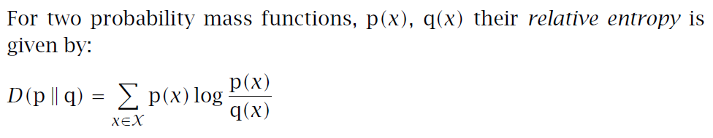
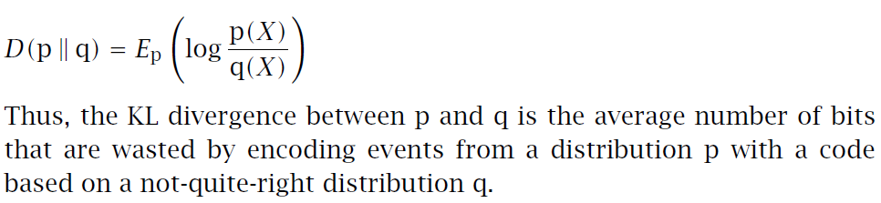
Relative entropy or Kullback-Leibler divergence

Slide 51
In-class Exercise
Q1: Briefly explain the concept of entropy and what does it say about a given symbol sequence?
Q2: For two random variables, X and Y, with given discrete probability distributions, p(x) and p(y), write the expression for mutual information, I(X; Y), in terms of p(x) and p(y), and prove that it is symmetric, i.e.
I(X; Y) = I(Y; X).

Slide 52
Summary
Entropy
Joint entropy
Conditional entropy
Chain rule
Mutual information
Relative entropy

Slide 53




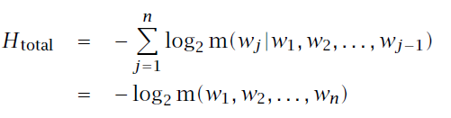
Entropy and natural language
m: language model is a probability distribution over sentences
Conditional entropy:
Pointwise conditional entropy:
where w = next word, h = history of words seen so far, m = language model
Total conditional entropy:
(Total Surprisal)
Measure of surprise on seeing the next word
Chain Rule

Slide 54

Perplexity
m: language model is a probability distribution over sentences
Ĥ = H_{total} / N = Average surprise (number of choices) per word
Perplexity: PP(w)
  Number of possible next words that can follow any word
  Lower perplexity better the language model i.e, model is making relatively confident predictions
  Predictability preference by LM over randomness

Slide 55

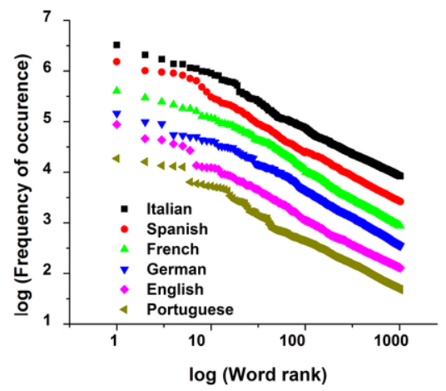
Open Questions?
How are we able to predict each other?
  As a result of structure of language, the freedom of language decreases as we look at longer and longer strings of words!
  Entropy decreases as order of Shannon’s approximation increases!
How structures are imposed on our speech patterns?
  Statistical properties of language
  We narrow down our repertoire to fit what we are exposed!
  (Zipf’s law)
Common in human and non-human communication systems!

Slide 56
Predicting sequences
He put the coffee …
If we would like to predict upcoming words in a sequence, we could assign a probability to each possible next word
I will be back soonish is likelier than I will be bassoon dish (ASR)
Models that assign probabilities to sequences of words are called language models (LMs)
https://web.stanford.edu/~jurafsky/slp3/3.pdf

Slide 57
Markov assumption
The most basic type of language model is the n-gram model
A sequence of N words (2-gram, 3-gram, 4-gram ..etc) is used to estimate the probability of the last word in the n-gram
Markov assumption: Probability of a word depends upon the (fairly recent, finite) previous words
N-grams directly model the probability of a sequence of observations

Slide 58
Unigram
S: He put the coffee on the table
P (S) = P(He) P(put) P(the) P(coffee) P(on) P(the) P(table)

Slide 59


Bigram Model
N-gram model is called a Markov model or Markov chain
S: He put the coffee on the table
P (S) = P(put | He) P(the | put) P(coffee | the) P(on | coffee) P(the | on) P(table | the)
Bigram probability of a word w_{n} given a previous word w_{n−1} = Count of the bigram C(w_{n−1}w_{n}) and normalize by the sum of all the bigrams that share the same first word w_{n−1} → Unigram count for word w_{n−1}

Slide 60
Trigram Model
S: He put the coffee on the table
P (S) = P(the | He put) P (coffee | put the) P (on | the coffee) P (the | coffee on) P (table | on the)
N-gram model is called a Markov model or Markov chain
P (coffee | put the) = c(put the coffee) / c(put the)
Use a document or corpus – grep “put the coffee”

Slide 61
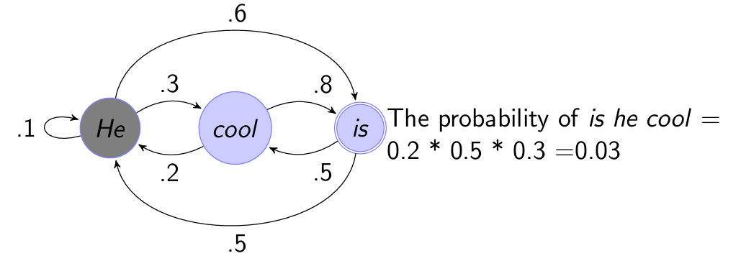
Markov chain
Markov chain for words showing states and transition probabilities
This is a type of weighted finite state machine
A start distribution π = [0.7, 0.1, 0.2] gives the probability of starting with
He, cool or is
Weighted finite-state system

Slide 62
Takeaways
Language is highly structured and therefore highly predictable
Probability gives us a way to quantify that predictability, and language models use this probability structure to predict linguistic sequences
How can we computationally represent the structure of language?
  We can represent linguistic structure probabilistically by modeling the probabilities of words and sequences of words given their context (probabilistic process)
  Can be computationally represented in the form of weighted finite-state machine as well (graph-based computational representation)

Slide 63
Language Modeling (In-Class Activity)
Adapted from Jurafsky & Martin 2015
Training data:
<s> I am Sam </s>
<s> Sam I am </s>
<s> Sam I like </s>
<s> Sam I do like </s>
<s> do I like Sam </s>
1. Using a bigram language model based on the above training data, which of the following sentences is better, i.e., gets a higher probability?
S: <s> Sam I do I like </s>
S: <s> Sam I am </s>
S: <s> Sam I do like linguistics </s>
2. Using a unigram language model based on the above training data, which of the following sentences is better, i.e., gets a higher probability?
S: <s> Sam I do I like </s>
S: <s> Sam I am </s>
S: <s> Sam I do like linguistics </s>

Slide 64
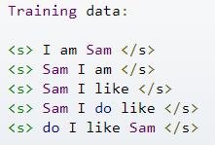


In-Class Activity
Create bigram and unigram language model on toy dataset and evaluate their performance on unseen test dataset.
How does your model perform in case of OOV words?
How does a smoothing play a role in fixing the issues in #2?
Repeat the exercise for a larger dataset – Brown corpus
  Some more problems

Slide 65
Methodology
Don’t train on the test corpus!
Use training set and test set
Language Model
Train data
Test data
Model Accuracy
Likelihood
Log likelihood
Perplexity

Slide 66
Evaluating n-gram models
Extrinsic evaluation
  Performance on a application oriented task
Intrinsic evaluation
  Measure quality independent of any application
  Perplexity (PP or PPL)

Slide 67


Model Accuracy
Likelihood: The probability of some observed data (the test set W_{test}), given the model M
Log likelihood:
  Likelihood uses very small numbers = underflow
  Taking the log resolves this problem

Slide 68

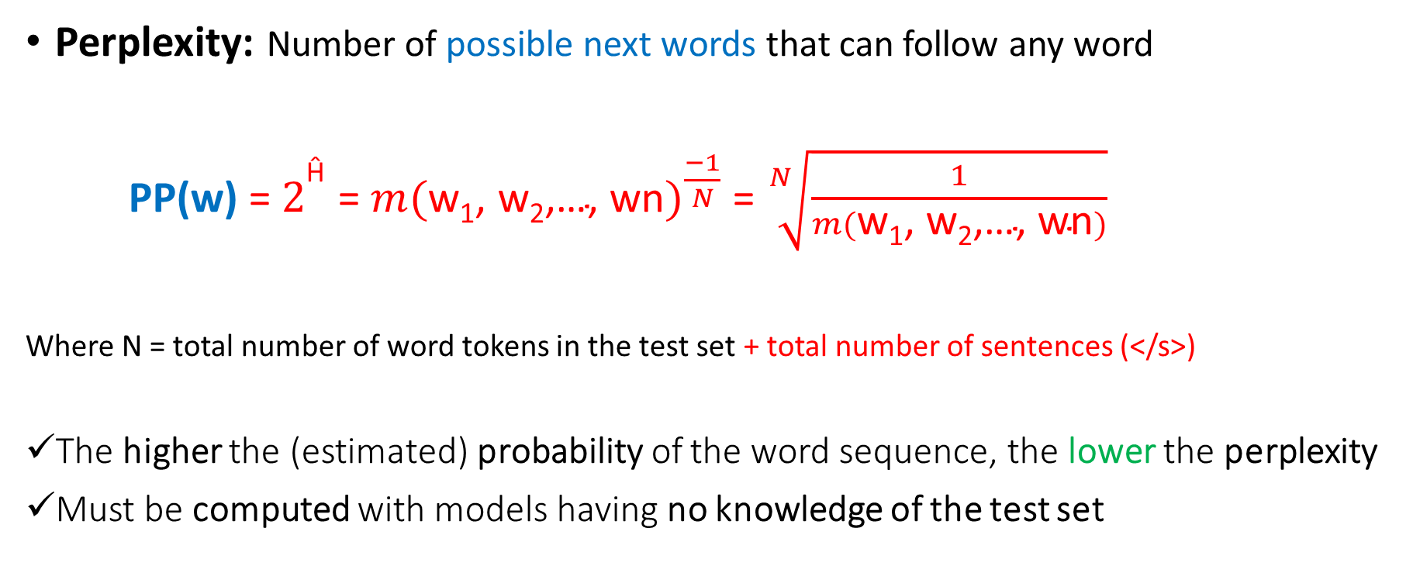
Model Accuracy
And the perplexity of two language models is only comparable if they use identical vocabularies

Slide 69
Model Performance
N-gram model performs well for test corpora that happen to be alike training corpus
  In real life, that’s not the case!
Goal -- Build a robust model that generalizes well
Problems of Zeros!

Slide 70
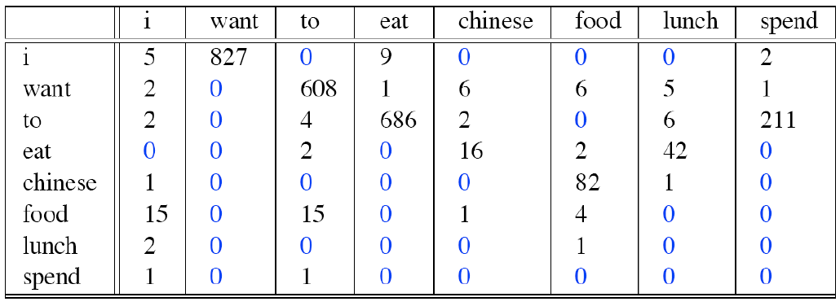
Problems of Zeros
Steal probability mass to generalize better!
Bigram counts from 9222 sentences from the Berkeley Restaurant Project (Refer Ch-3, SLP Book)

Slide 71
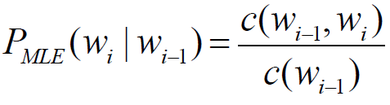
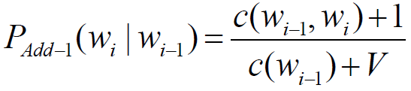


Out of vocabulary (OOV) and rare words
Smoothing methods: Ensures better performance
  Add-1 or Laplace smoothing
  Absolute discounting
  Good-Turing discounting
  Witten-Bell discounting
  Kneser-Ney smoothing
Various advance techniques have been developed to improve the language model performance
  Interpolation
  Backoff

Slide 72
N-gram hierarchy
If no examples of the trigram (w_{n-2}w_{n-1}w_{n} ) to compute P(w_{n}|w_{n-2}w_{n-1}) then estimate probability using bigram probability P(w_{n}|w_{n-1} )
If no examples of the bigram to compute P(w_{n}|w_{n-1}) then utilize unigram probability P(w_{n})

Slide 73
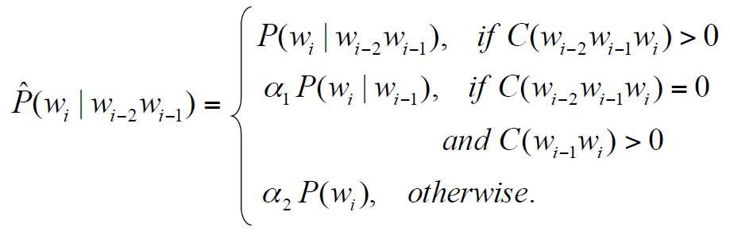
Backoff (Katz 1987)
Non-linear method -- Estimates for an n-gram is allowed to back off through progressively shorter histories

Slide 74

Problems with Backing-off
Let’s say – bigram (w₁w₂) is frequent but trigram (w₁w₂w₃) is rare
  Might represent a meaningful drop – “grammatical null”
  Not necessarily represent data sparsity or appearance by chance
One may not want to back-off

Slide 75
Simple linear interpolation
Construct a linear combination of the multiple probability estimates
where λ₁ + λ₂ + λ₃ = 1
Weighted average of unigram, bigram, and trigram probabilities
  Results in an another probability function
Utilizes different contextual histories as appropriated in n-gram lengths

Slide 76
Best approach
In Practice
Simple linear interpolation of n-grams
+
Smoothed probability for OOV words
(best smoothing technique)

Slide 77
Setting smoothing parameters (Hyperparameter tuning)
How to pick best value for λ?
Try many λ values & report the one that gets best results?
Language Model
Training
Test
Pick λ that gives the best result on this set (~10-20%)
Dev
Training
… and report results of that final model on test data
Use that λ to get the smoothed count

Slide 78
SRILM - The SRI Language Modeling Toolkit
For building and applying statistical language models (LMs), primarily for use in:
  Speech recognition
  Statistical tagging
  Segmentation
  Machine translation
SRILM consists of the following components:
  A set of C++ class libraries implementing language models, supporting data structures and miscellaneous utility functions
  A set of executable programs built on top of these libraries -- training LMs, testing, tagging or segmenting text, etc.
SRILM runs on UNIX and Windows platforms

Slide 79
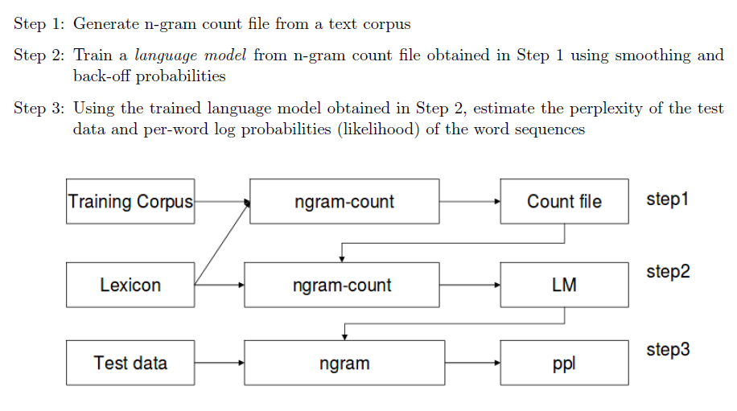
SRI Language Modeling

Slide 80
Components of SRILM training command
#Training
Executable binary = {ngram-count}
Train data (-text filename)
Specify value of order n in n-gram LM (-order)
  {Unigram (n=1), Bigram (n=2), Trigram (n=3)}
Specifying the name for language model (-lm)
Handling OOV words:
  UNK tag (-UNK)
  Smoothing arguments (-addsmooth #num)

Slide 81
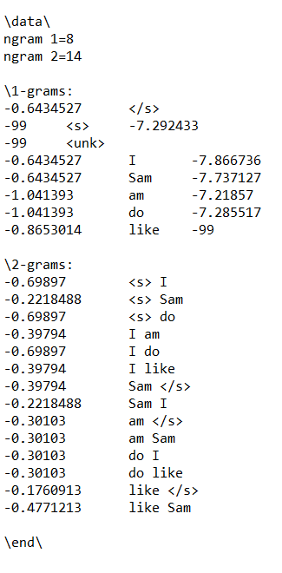
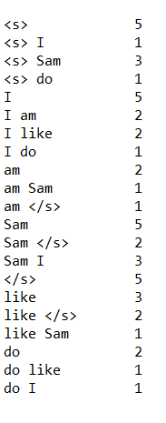
Format of N-gram count and lm file
n-gram
counts
Log of backoff weight (base 10)
Log probability (base 10)

Slide 82

Components of SRILM testing command
#Testing
Executable binary = {ngram}
Test data (filename)
Specifying the trained language model (-lm)
Arguments for estimating different metrics
  Perplexity (-ppl)
  Per word probability (-debug 2)

Slide 83
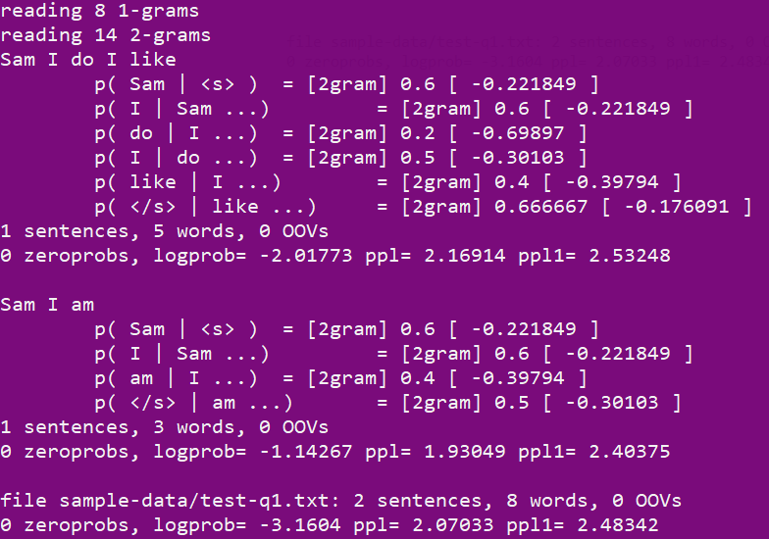

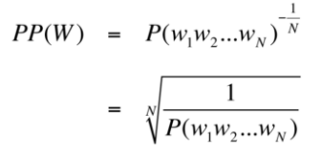
Format of testing results
Total probability (log base 10)
N = #words + #</s>
N = #words

Slide 84
SRILM Documentation
Know more –
Link: http://www.speech.sri.com/projects/srilm/manpages/

Slide 85
Instructions from In-Class Tutorial
Executable binary files – {ngram-count, ngram}
Dataset –
  Toy dataset
  Brown corpus {brown-train, brown-dev, brown-test}
Navigate your terminal to the working directory containing above files
Run SRILM commands from the In-Class tutorial

Slide 86
Let’s solve some problems…

Slide 87
Appendix

Slide 88
Shannon’s Noisy Channel Model
Aim: Optimize in terms of throughput and accuracy while communicating messages in the presence of noise in the channel
Duality between compression (achieved by removing all redundancy)
and transmission accuracy (achieved by adding controlled redundancy
so that the input can be recovered in the presence of noise)

Slide 89
Shannon’s Noisy Channel Model
Goal: To encode the message in such a way that it occupies minimal space while still containing enough redundancy to be able to detect and correct errors
W
X
Y
W*
Channel
p(y|x)
decoder
encoder
message
input to
channel
Attempt to
reconstruct
message based
on output
Output from
channel

Slide 90

Shannon’s Noisy Channel Model
Channel capacity: The rate at which one can transmit information through the channel with an arbitrary low probability of being unable to recover the input from the output
We reach a channel capacity if we manage to design an input code X whose distribution p(X) maximizes I (X;Y) between input and output

Slide 91




Linguistics and the Noisy Channel Model
In linguistic we can’t control the encoding phase. We want to decode the output to give the most likely input.
where p(i) is the language model and p(o|i) is the channel probability
Ex: Machine translation, Optical character recognition, Speech recognition
I
O
decoder
Noisy Channel
p(o|I)

