Slide 1
Foundations of Vision and Language
Introduction: Language
Sidharth Ranjan

Slide 2
Course Administration
Class timings: 6:00-7:30 PM on Friday and 2:30-4:00 PM on Saturday
Language Part of the course will be instructed in two parts
  Traditional Methods (8 lectures)
  Modern Methods (8 lectures)
Goal of the course is to introduce students to various methods in NLP/CL
  Focus of the first part of the course will be on morphological, lexical and syntactic analysis of natural language data
Class assumes that you have some linguistics background. Please ask questions in case you don’t know certain terms

Slide 3
Online Mode
Via Google Classroom: https://classroom.google.com/c/ODcxMzIxNjcwODIx
Hybrid classroom:
  Online class: https://meet.google.com/apr-cuoy-uti
  Offline class: CS101, CSE Building
Materials will be uploaded on Google Classroom
Lectures CANNOT be shared/copied/circulated - they are strictly for class reference only. Disciplinary action can be taken against you in case of violation

Slide 4
Pedagogy and Teaching Structure
Special focus on applications and practical knowledge
Alternate theory and practice sessions
Use of writing pad, presentation slides, and lab demo
We will do exercises in the class. Please bring laptops!

Slide 5
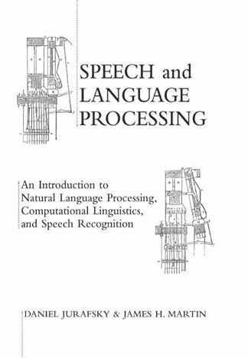
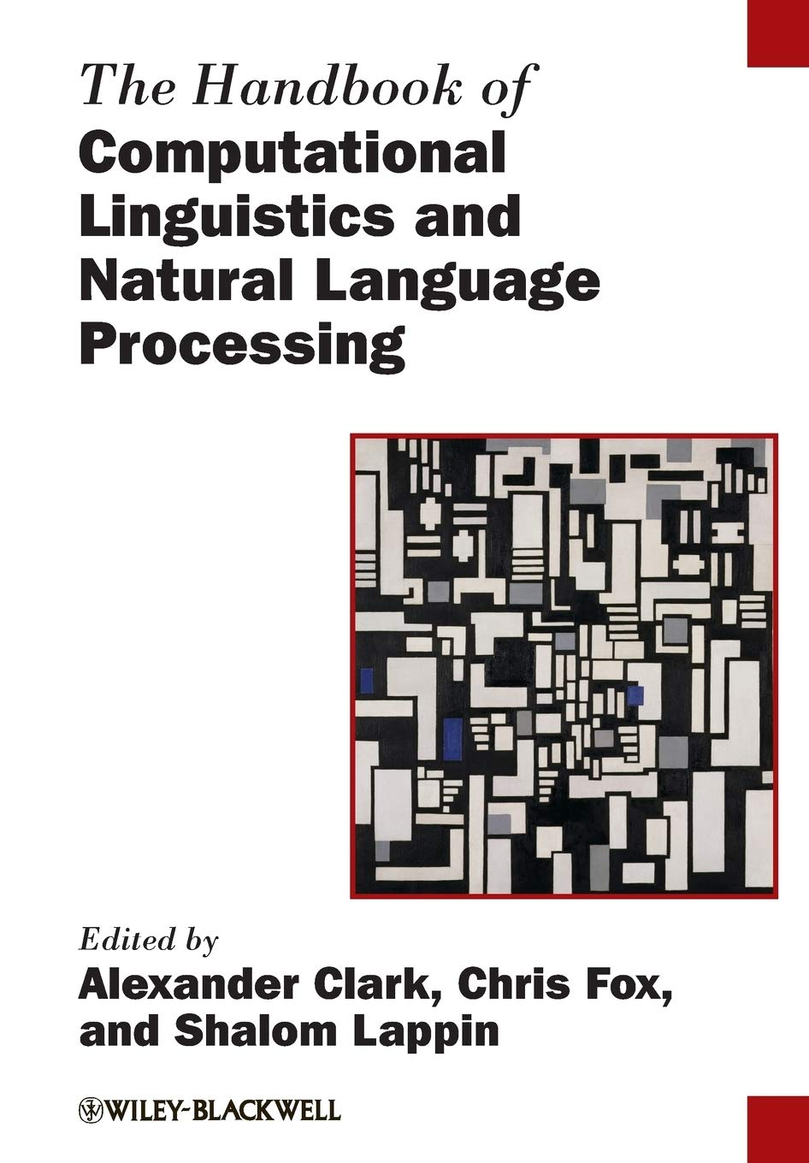
Books

Slide 6
Outlook
What is Language?
  What language does?
  Language as symbolic and interactive communication
Language Understanding and AI
  Early NLU systems
  Ambiguity and data-driven approaches
Computational modeling ←(vs)→ Linguistic understanding

Slide 7
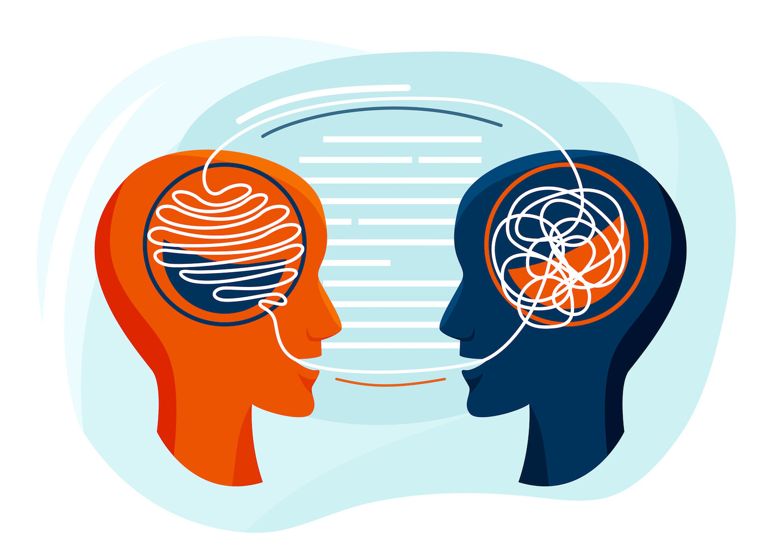
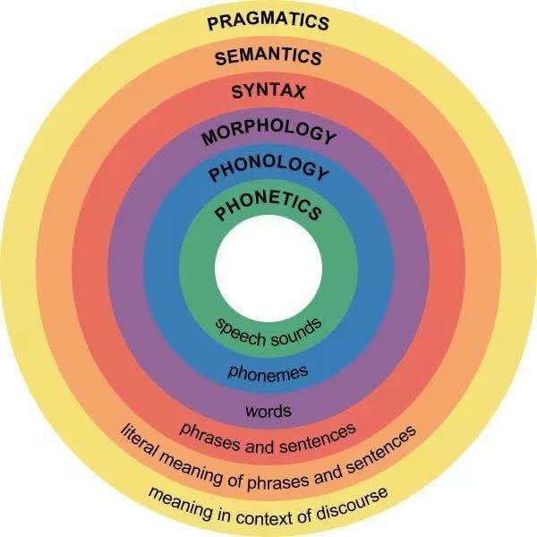
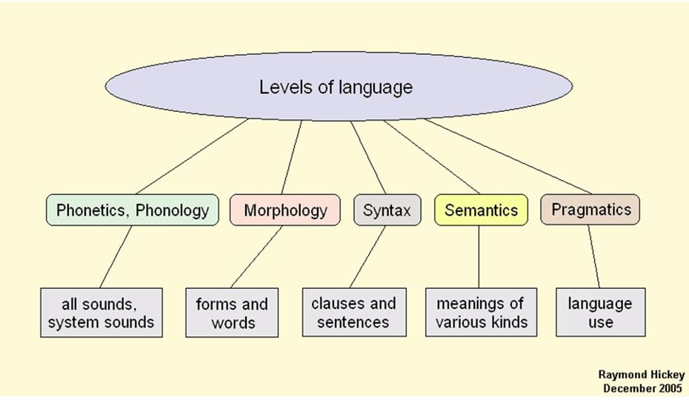
What is Language?
Language reflects patterns of thought – conceptualization
  Language offers window to mind (cognitive functions)
  Provides insights into the nature, structure and organization of ideas/thoughts
Study language in order to describe its systematicity, structure, and the functions, and how these functions are realized by the language system

Slide 8
Question
We aren't only asking:
How do I manipulate this string of words?
We can also ask:
What kind of cognitive or representational system could produce this behaviour?

Slide 9
What is language for?
We take language for granted, yet we rely upon it throughout our lives to perform a range of functions
  Shopping
  Talking to our best friends
  Talking on phone
  Expressing our opinions
  Arguing or insulting someone
  So on…
Other forms of behaviour that could be accomplished in the absence of language
  Telepathy?
  Browsing internet?
  Sending email?

Slide 10

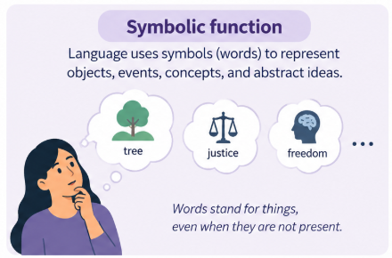
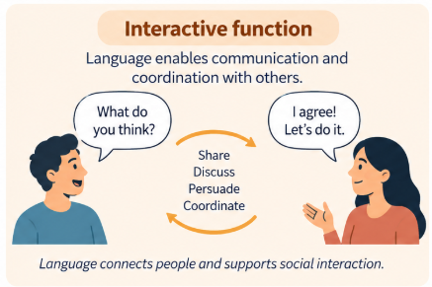
What is language for?
Language allows quick and effective expression
Provides well developed means for encoding and transmitting complex and subtle ideas
  Symbolic function
  Interactive function

Slide 11
Symbolic function
Language express itself using Symbols (‘bits of language’)
  Might be meaningful subparts of words (dis- as in distaste)
  Whole words (cat, run, tomorrow)
  Strings of words (He couldn’t write the entire musical piece)
Forms: Symbols consists of forms, which could be either spoken, written or signed, and form a pair with the conventional meaning (form-meaning)
Meaning: Conventional ideational or semantic content associated with the symbol
Language does not directly represent the external world; it represents our conceptualized experience (thoughts) of the world

Slide 12
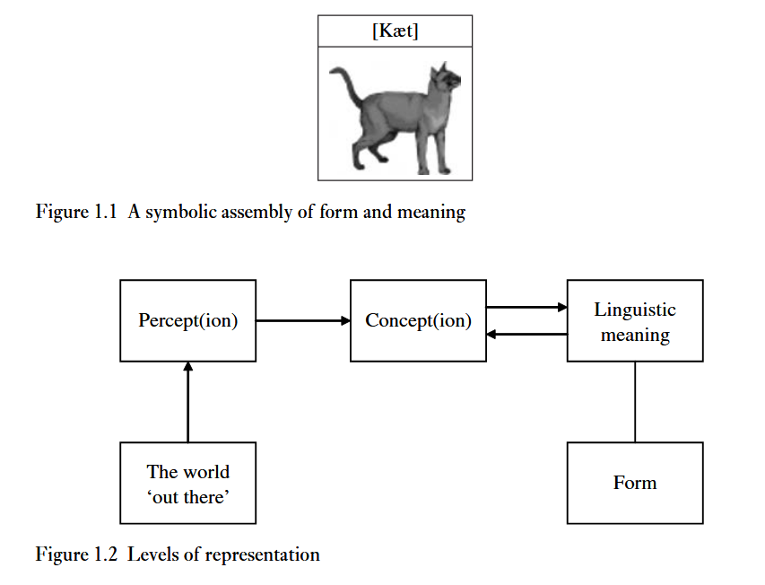
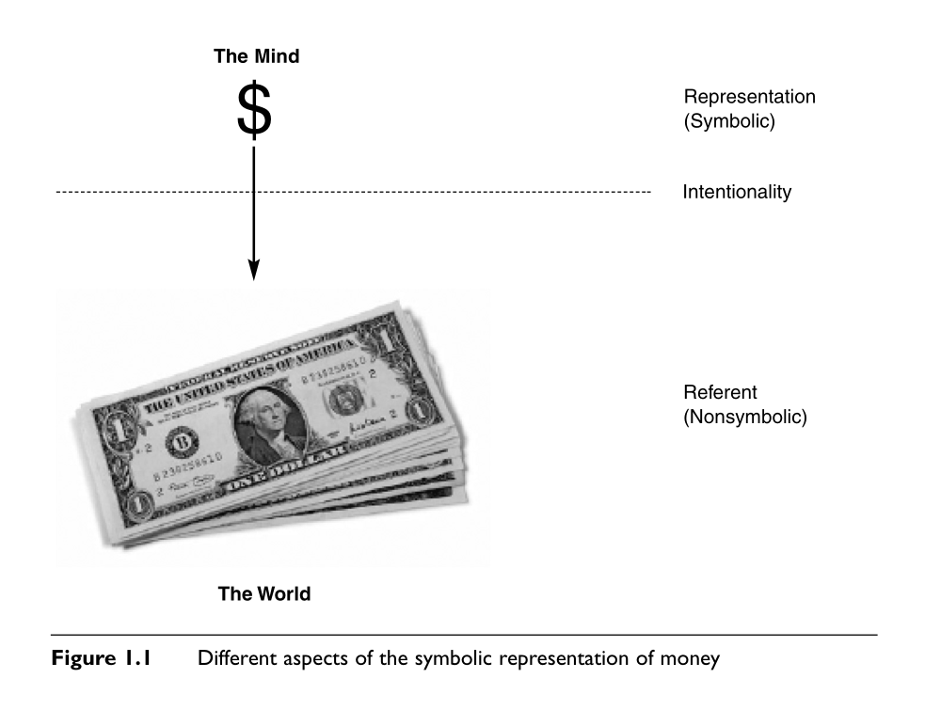
Symbolic function (Projected Reality)
The word cat is not the actual animal. It is a symbolic representation that allows us to mentally access the concept even when no cat is physically present.

Slide 13
Form-Meaning Pair
Image represents the meaning conventionally paired with the form pronounced in English as [kaet]
The meaning associated with a linguistic symbol is linked to a particular mental representation termed a concept
Concepts, in turn, is derived from percepts
  Consider a piece of fruit like a pear.
  Different parts of the brain perceive its shape, colour, texture, taste, smell and so on.
  Diverse range of perceptual information deriving from the world ‘out there’ is integrated into a single mental image (a representation available to consciousness), which gives rise to the concept of PEAR
Language does not transmit reality itself; it transmits symbols that allow us to reconstruct a conceptualized reality.

Slide 14
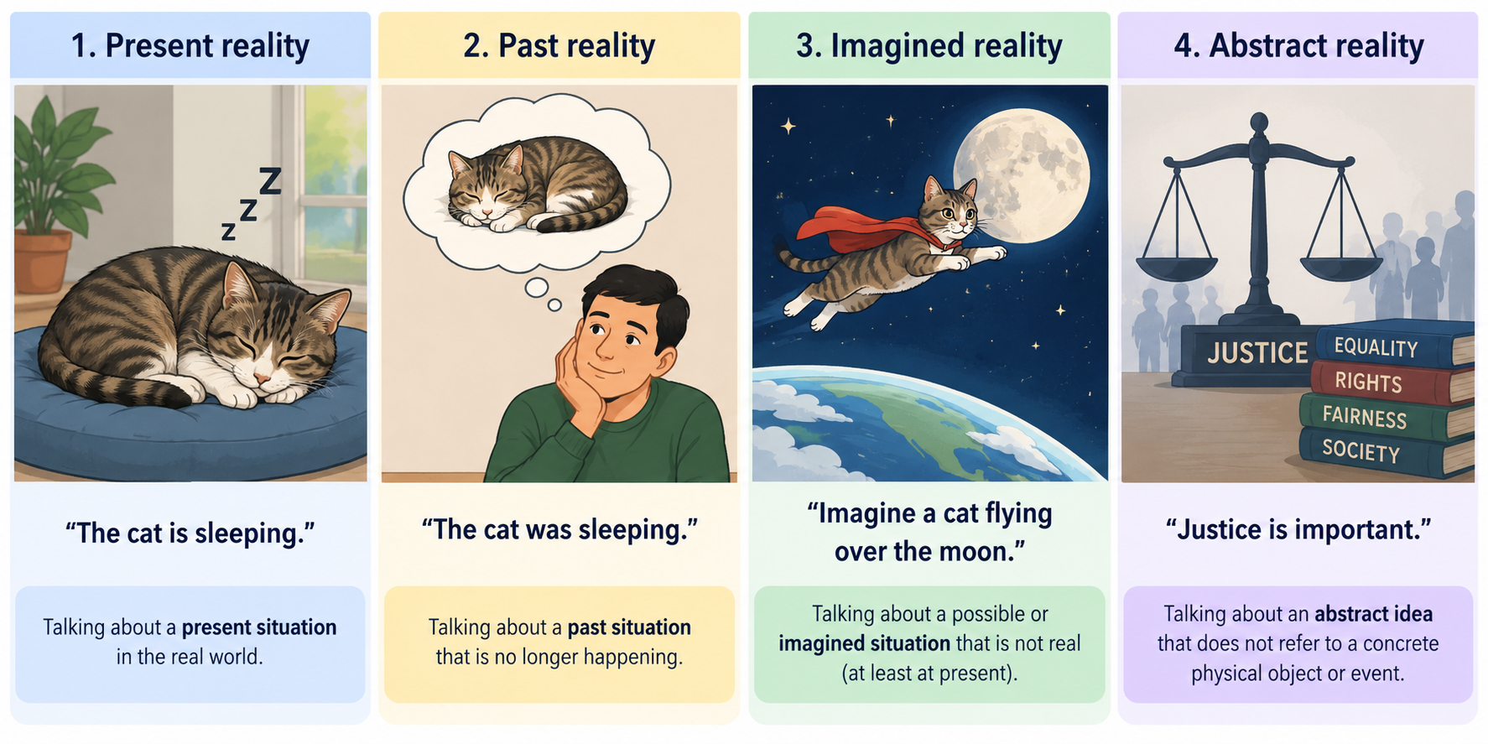
Examples

Slide 15
Examples (Contd…)
The cat jumped over the wall.

Slide 16
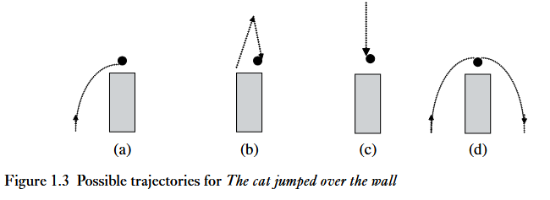
Examples (Contd…)
The cat jumped over the wall.
A range of interpretations: The behaviour described by jump has the potential to involve a variety of trajectory shapes

Slide 17
Examples (Contd…)
The cat jumped over the wall.
A range of interpretations: The behaviour described by jump has the potential to involve a variety of trajectory shapes
How much information does language actually specify, and how much does the listener have to infer?

Slide 18
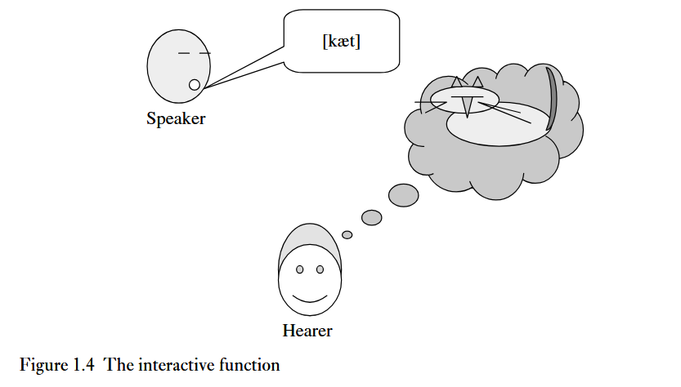
Interactive Function
We use language to get our ideas across i.e., to communicate
Thought
Linguistic representation
Rich conceptualization
Transmission
Signal
Linguistic representation
Decoding
Reconstructed thought

Slide 19

Piraha Language

Slide 20


Slide 21
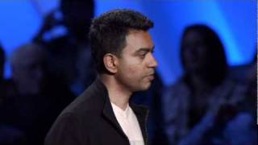
Birth of a Word

Slide 22
Natural Language Understanding
Natural language understanding is closely tied to the questions:
  Can machines understand language?
  Can machines think?
  Can machines carry out information-processing like the mind?
  Can we ‘reverse-engineer’ the cognitive processes such as language and perception?
This is where Computer vision, Natural language understanding, Artificial Intelligence come together!

Slide 23
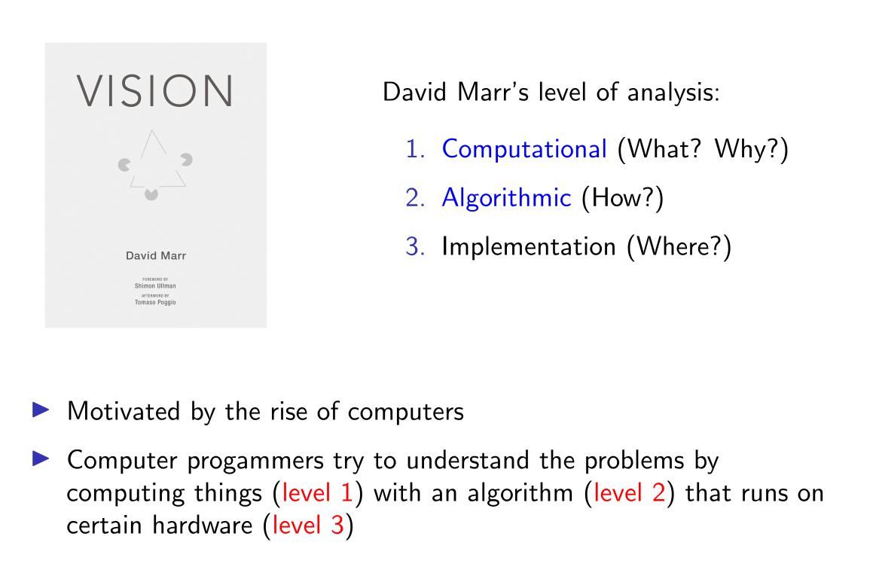
Tri-Level Hypothesis
Build a system that recognizes whether an image contains a cat
Build a system that parses a sentence
Build a system that makes a robot fly

Slide 24
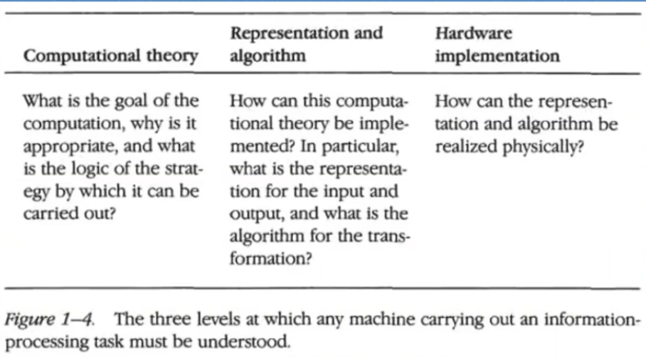
Tri-level hypothesis (Contd…)

Slide 25
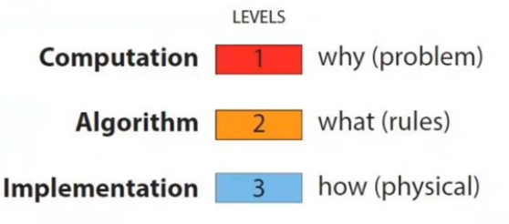
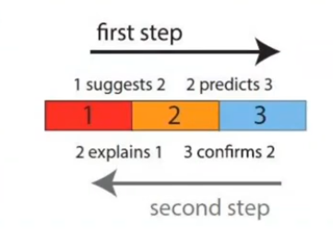
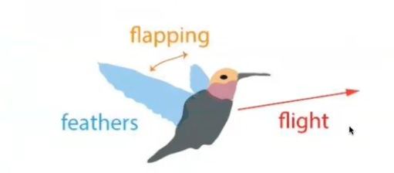
In-Class Activity: How to make a robot fly?

Slide 26
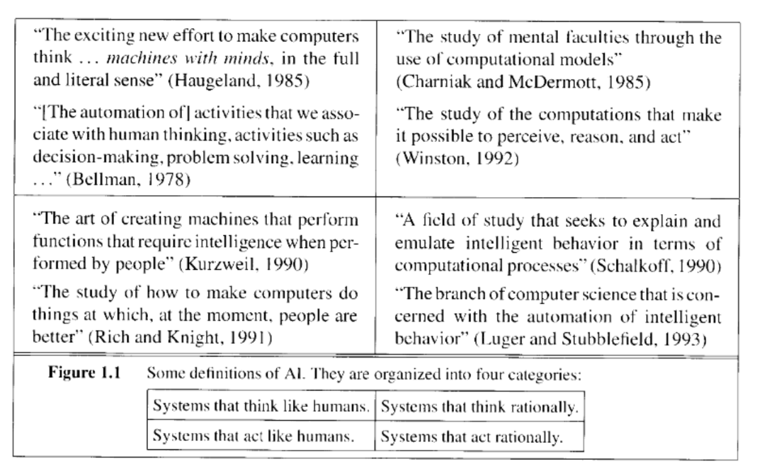
What is AI?

Slide 27
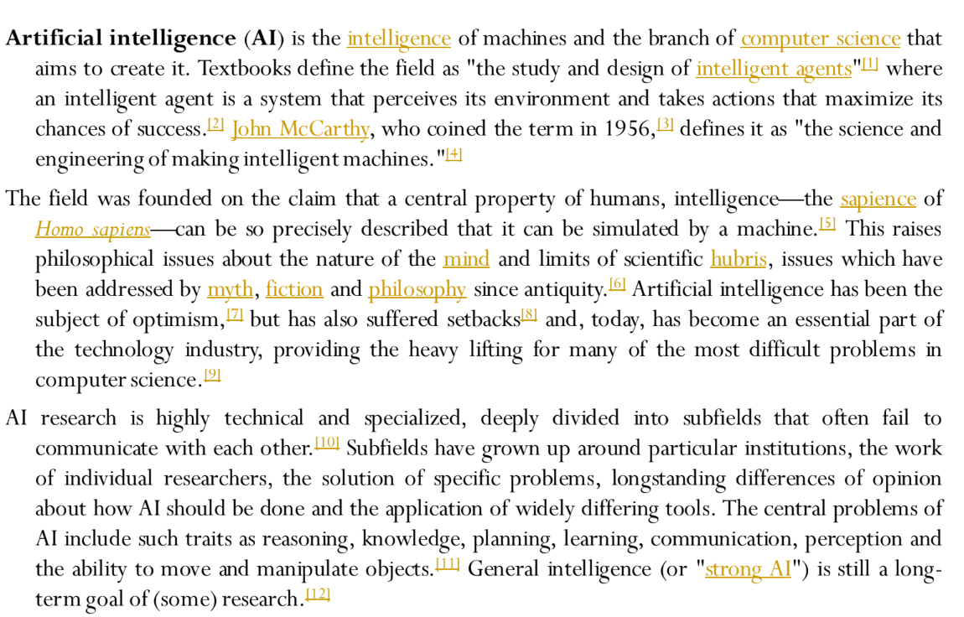
Wikipedia

Slide 28
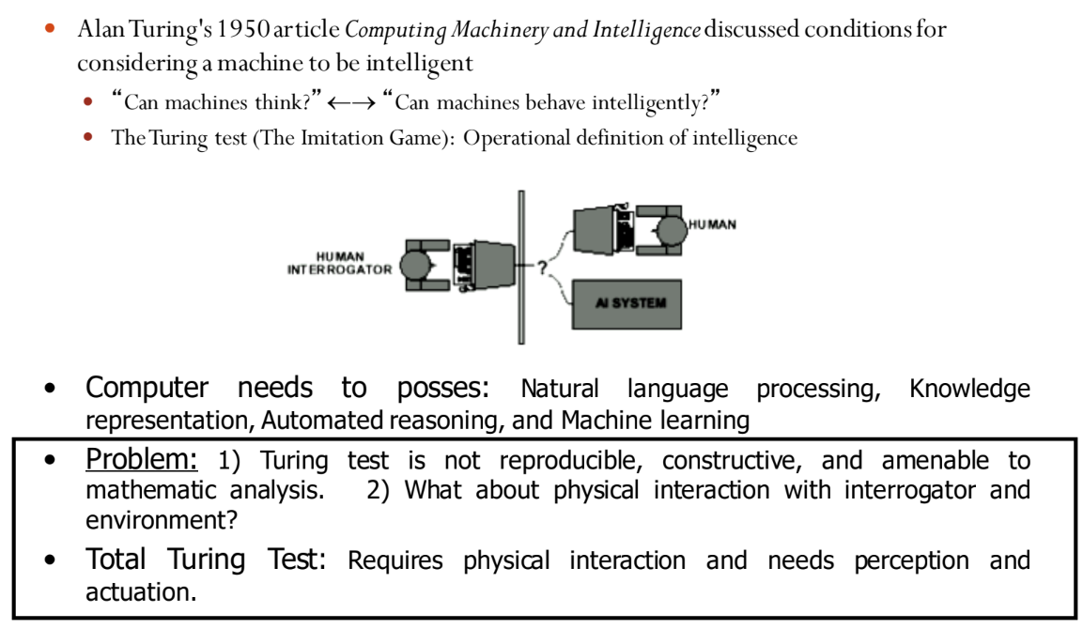
Acting Humanly: The Full Turing Test

Slide 29
Turing test: Key Ideas
Original Thought
  Can machine think?
Turing Test (Behavioural test/Imitation Game)
  Can machine communicate and behave like a human?
Total Turing test:
  Can the machine communicate, perceive, reason, and physically act like a human?
  The goal here is not just to be acting humanly through conversation but also humanly in the real word

Slide 30
What would a computer need to pass the Turing test?
Natural language processing: to communicate with examiner
Knowledge representation: to store and retrieve information provided before or during interrogation
Automated reasoning: to use the stored information to answer questions and to draw new conclusions
Machine learning: to adapt to new circumstances and to detect and extrapolate patterns
Vision: to recognize the examiner’s actions and various objects presented by the examiner
Motor control: to act upon objects as requested
Other senses: such as audition,smell,touch, etc.

Slide 31
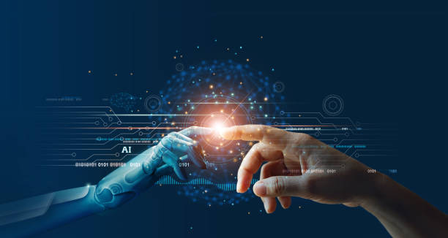
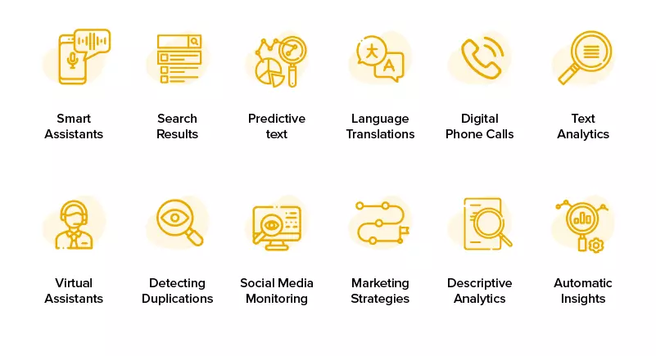

Natural Language Processing
NLP → Computational Systems that process human language for a wide range of applications…
Credits: @Google Images

Slide 32

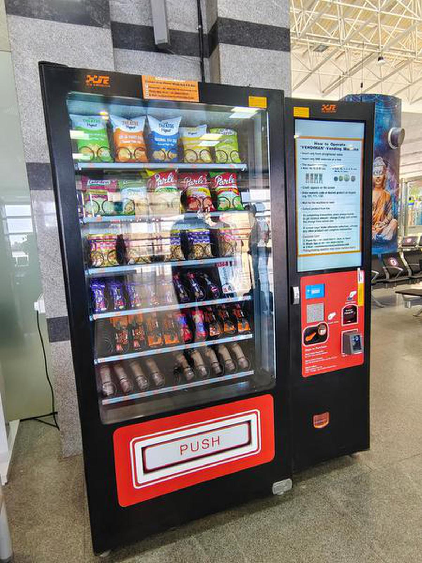
Vending Machine
Credits: @Google Images
How do we connect human communication with machine behaviour?

Slide 33
NLP/NLU/CL ?
NLP: Application oriented e.g. information retrieval, speech to text, sentiment analysis (end-user application)
  Language → Information
CL: Uncovering a part of an overall cognitive architecture; developing computational models of linguistic phenomena
  Language → Model
NLU: Shared end goal for both i.e., getting a system that meaningfully understands natural language
Linguistic description → Computational representation → Empirical evaluation

Slide 34
Build systems for Natural Language Understanding
Building a machine capable of language understanding was an attractive goal for practitioners of AI (Artificial Intelligence) in 70s
During this time, “computational linguistics”, “cognitive science” or “natural language processing” were not totally distinct
Build a machine capable of carrying out a conversation like a human being
If a machine can fool you into thinking it’s human, then would we reach our goal of natural language understanding?

Slide 35
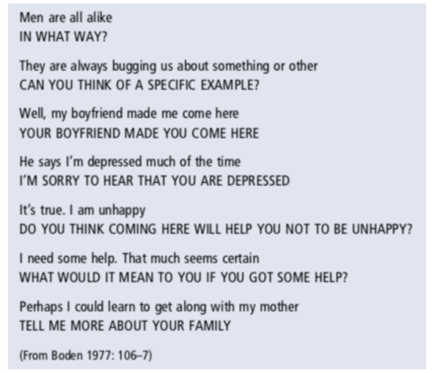
ELIZA: an early ‘chatbot’ (1966)
Developed by Joseph Weizenbaum (MIT)
ELIZA simulated as a psychotherapist
ELIZA’s responses (shown in caps) were based on pattern matching (rather than any real analysis)
Producing an appropriate-looking response is not necessarily the same as understanding!

Slide 36
SHRDLU
Terry Winograd built SHRDLU (1972) – More than a conversational agent
  used language to report on its environment
  to plan actions
  to reason about the implications of what is being said to it
Model how we understand our world via language
  Connects language with a representation of an environment
SHRDLU operates in a ‘micro-world’

Slide 37
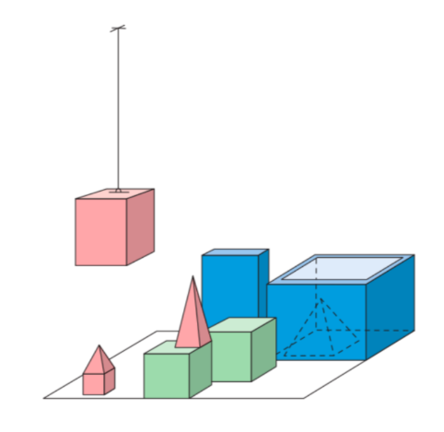
SHRDLU
Pick up a big, red block.
OK

Slide 38
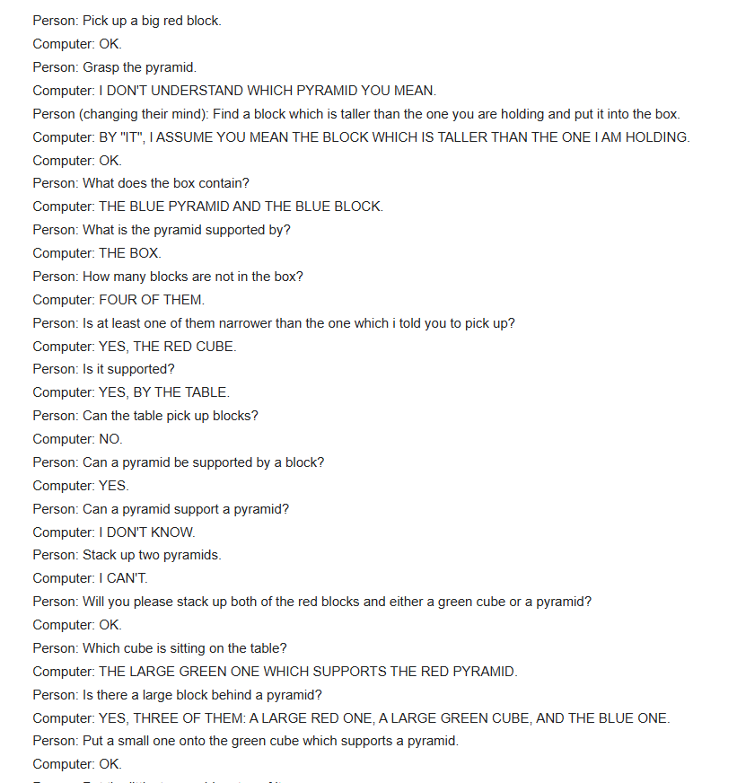
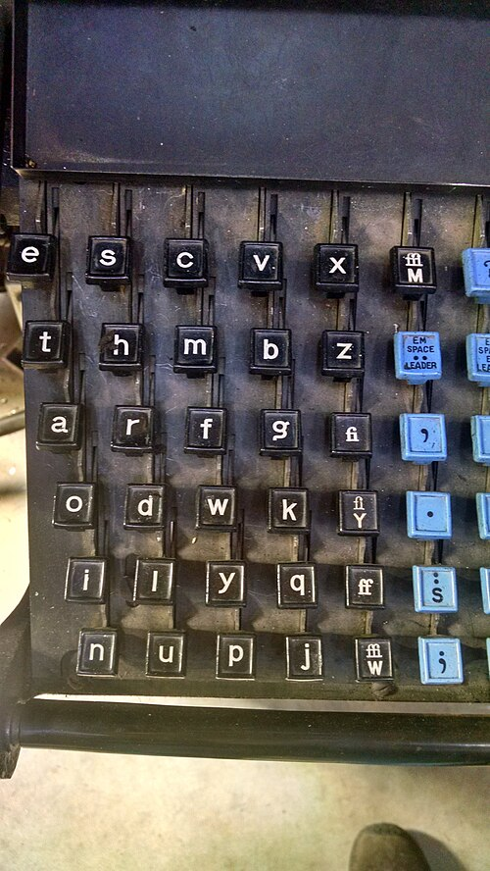
SHRDLU
https://en.wikipedia.org/wiki/Etaoin_shrdlu

Slide 39
SHRDLU
Domain specific understanding of language
Question-answering, executing commands in English
  First early parser of a English (based on a grammar)
  Putting together the component parts of a cognitive system in a model
  ‘Working proof’ of the idea of language as procedural/algorithmic
  Makes the simulation of "understanding" more convincing
“If language is understood as a body of knowledge, then SHRDLU gave us a model of how it could be represented in a cognitive system and how it could be integrated with other, more general forms of knowledge about the environment”

Slide 40
Building blocks of NLU
Datasets, usually text corpus (though these may be multi-modal)
  Sometimes these need to be collected/annotated/crowdsourced
  May be multilingual (e.g. Universal Dependencies)
  May be related to specific areas e.g. child language, learner’s corpora, eye-tracking
Formal/Computational processing
  Using symbolic (rule-based) grammars e.g. English Resource Grammar
  Using stochastic/ML algorithms
Validation by comparison with human performance
  ‘Performance’ metrics e.g. BLEU
  Cognitive metrics (may be harder to pin down)

Slide 41
A typical NLP/CL setup
Method:
  Use of corpora/text resources
  Rule-based (formal) grammars, quantitative methods, mathematical formalisms
  Metrics for evaluation
Identify a corpus/other relevant resource
Quantify certain hypotheses you may have about the task (e.g. adjectives help in sentiment analysis, subcategorization information in parsing)
Develop/learn a computational model based on these hypotheses
Validate the model based on internal and external metrics

Slide 42
Main Challenges
Ambiguity and language analysis
For example: At last, a computer that understands you like your mother.
~ McDonnell-Douglas ad, 1985
The computer understands you as well as your mother understands you.
The computer understands that you like your mother
The computer understands you as well as it understands your mother.

Slide 43
Main Challenges (Contd…)
At last, a computer that understands you like your mother.
Consider the speech recognition problem: how can we distinguish between this utterance, when spoken, and “... a computer that understands your lie cured mother”?
Word sense ambiguity problem: how do we know that here “mother” means “a female parent” or “a cask or vat used in vinegar-making”
Copy the local patient files to disk
is it the patients or the files that are local?

Slide 44
Is NLP a massive knowledge engineering project?
Inspired from Linguistics:
  Correlations (co-occurrences) found in language data are important sources of information
  You shall know a word by the company it keeps (~ linguist J. R. Firth 1957)
Claude Shannon’s Information Theory
  Shannon wasn’t concerned with what a message means. Instead, he focused on how surprising or uncertain the message is.
  The information content of a message depends on its probability, not its meaning
Language can be viewed from a data-driven, empirical perspective — and a data-driven perspective leads naturally to a computational perspective

Slide 45
Computational linguistics without linguistics?
Always been a trend, perhaps more so with deep learning and neural models
Ever-larger training sets, more powerful training techniques to yield impressive performance
Impossibly large datasets required, computational power
Divisions between ‘high’ and ‘low’ resource languages
Language models that only use linguistic form to predict the next word do not learn meaning/communicative intent (Bender and Koller, 2020)
Powerful models like BERT still insensitive to negation, event prediction based on roles (Ettinger, 2020)
How to learn from rare, but informative events?

Slide 46
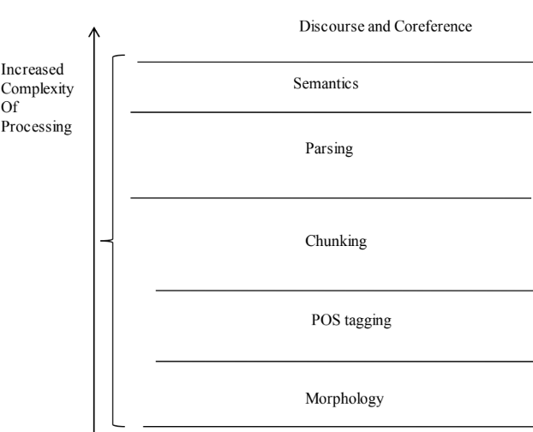
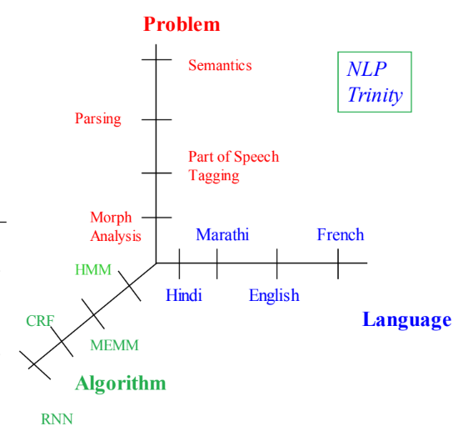
NLP Trinity

Slide 47
Closing Discussion
Q1: If a machine produces a completely appropriate response to a sentence, does that mean it understands the sentence?
Q2: What is the difference between processing language and understanding language?
Q3: If a model learns statistical patterns from enormous amounts of text, what exactly has it learned?

Slide 48

Today’s world

Slide 49
Next Class
How can we computationally represent the structure of language?

Slide 50
Reading and References
Lillian Lee’s ”I’m sorry Dave, I’m afraid I can’t do that”: Linguistics, Statistics, and Natural Language Processing circa 2001” (also in the form of a online talk)
Mark Steedman’s Romantics and Revolutionaries: What Theoretical and Computational Linguists need to know about each other (but were afraid to ask). in Linguistic Issues in Language Technology
E. Bender and A. Koller, Climbing towards NLU: On Meaning, Form and Understanding in the age of Data, ACL 2020
Allyson Ettinger, What BERT is Not: Lessons from a New Suite of Psycholinguistic Diagnostics for Language Models, TACL, Vol 8, 2020

