Slide 1

AZ Processor
SoC Design
From the book
《CPU自制入门》
（日）水頭一壽
（日）米澤遼
（日）藤田浴士
(译）赵谦
Ported to world’s cheapest FPGA by
（日）Ichi Yo Boi 陈恩得

Slide 2

System Overview
AZPR SoC consists of
ROM
CPU
GPIO
RAM
Headache
UART
Timer

Slide 3
Slides Overview
Part 1: RTL design:
CPU: pipeline, hazard mitigation, interrupt/exception handling
Generate RAM, ROM, PLL in Quartus
IO: GPIO, timer, UART
Bus protocol
ModelSim simulation that prints “Hello,world.”
Part 2: Hardware design:
FPGA pin assignment and circuit connection
Debugging using SignalTap Logic Analyzer
Part 3: Software design:
XMODEM protocol to transfer .bin to FPGA via UART
Hello world print demo
Kitchen timer demo

Slide 4
Part 1:
RTL Design

Slide 5
5-Stage Pipelined CPU Design Overview
if_stage
id_stage
ex_stage
mem_stage
wb_stage
CTRL
(check interrupt, exception, stall or flush the regs)
Program counter
Forwarding
Op code
Result from ALU or loaded from memory
ALU
IF/ID Reg
Decoder
ID/EX Reg
MEM/WB Reg
Instruction
EX/MEM Reg
GPR
& CR
Operands
Memory
write
Memory
Read
Bus
Optimized access, possible due to use of dual-port RAM
Competing for bus access
RAM
ROM
GPIO
Timer
UART

Slide 6
CPU: Hazards
Structural Hazard
IF and MEM stage share a dual-port RAM. May be problematic when accesing the same RAM address.
Concurrent read is OK.
Concurrent write doesn’t occur in AZPR because IF stage never write to the RAM, only read.
Concurrent read and write from/to RAM is possible but not handled in AZPR. Self-modifying code may not work properly.

Slide 7
CPU: Hazards
Data Hazard
An instruction may depend on the result of previous instruction which has not been written yet

Slide 8
Data Hazard
Scenario 1: ID stage needs GPR data not yet written by EX or MEM stage (RAW hazard)
time
GPR[3] = GPR[1] + GPR[1]
IF
ID
EX
MEM
WB
Forward GPR[3]
GPR[5] = GPR[3] + GPR[4]
IF
ID
EX
MEM
WB
Forward GPR[5]
Forward GPR[3]
GPR[6] = GPR[3] + GPR[5]
IF
ID
EX
MEM
WB

Slide 9
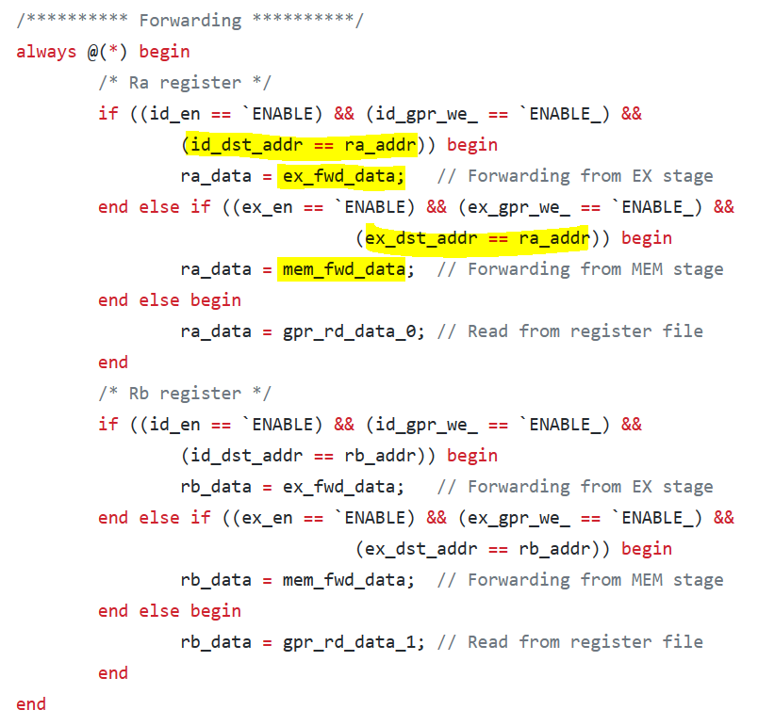
Data Hazard
Forwarding for sceneario 1 in RTL code:

Slide 10
Data Hazard
Scenario 2: ID stage needs memory data not yet loaded in MEM stage (load hazard)
time
GPR[3] = MEMORY[GPR[2]]
IF
ID
EX
MEM
WB
Cannot Forward GPR[3] like this
GPR[6] = GPR[3] + GPR[5]
IF
ID
EX
MEM
WB
Stall one cycle
(so that the second instruction remains in ID stage in next cycle)
Need to detect load hazard once decoded
At this time the first instruction is in ID/EX reg, while the second instruction is IF/ID reg
Then can
forward GPR[3]
GPR[6] = GPR[3] + GPR[5]
IF
ID
EX
MEM
WB

Slide 11
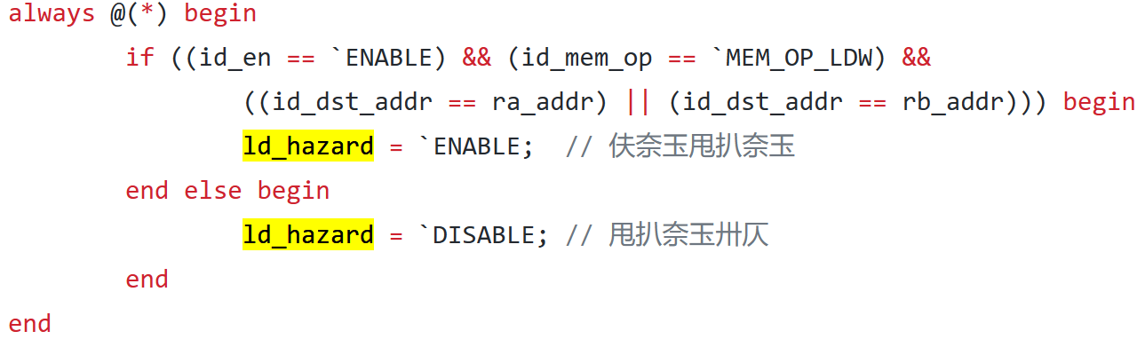
Load Hazard Detection
Fetched into IF/ID reg a load instruction and
ID/EX reg indicates the previous instruction will in later cycle writes to GPR needed by the load instruction aforementioned
Note:
if_insn is an output from IF/ID reg, being decoded in ID stage
id_dst_addr is an output from ID/EX reg, being executed in EX stage

Slide 12
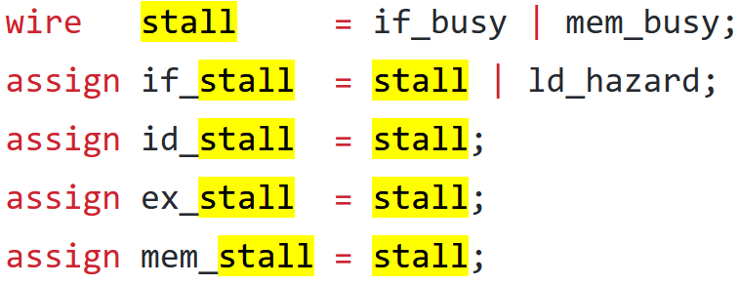
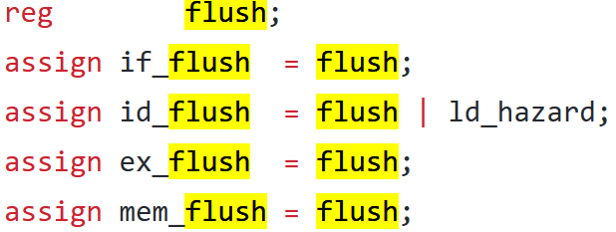
Pipeline: Stall
Maintain pipeline registers in the next cycle
Stall when IF or MEM stage is busy accessing bus
ld_hazard will cause if_stall (but no other stall), so that IF/ID reg won’t be updated, and the instruction in ID stage remain in ID stage for one more cycle, while other stages advance
As a side note, ld_hazard will also cause id_stall so that ID/EX won’t execute the ID stage instruction which is being stalled

Slide 13
Data Hazard
There are other data hazards, but in AZPR:
WAW hazard never happens because write always happen sequentially.
WAR hazard never happens because read always happen before write.

Slide 14
CPU: Hazards
Control Hazard
Affects instructions that cause program counter branching/jumping
e.g. branch, call, jmp, EXRT
AZPR uses branch delay slot
AZPR doesn’t use branch prediction

Slide 15
Branch Delay Slot
AZPR mandates software to slot in a dummy NOP instruction after each of the aforementioned instruction.
time
Branch/call/jmp/EXRT
IF
ID
EX
MEM
WB
Even though we can already pre-determine next instruction address in ID stage, the read address provided to synchronous RAM/ROM can’t be updated yet at least until next clock cycle (I said at least because there may be stall due to waiting for bus access), so this NOP instruction is still needed regardlessly.
Useless to fetch at this point,
Might as well just fetch a NOP
Intentional NOP
IF
ID
EX
MEM
WB
Already took in the next instruction at this edge, too late for ID stage to deduce the instruction that should’ve been taken and change what is being fetced in IF stage
Another instruction
(could be anywhere due to jumping)
IF
ID
EX
MEM
WB

Slide 16
CPU: Interrupt & Exception
Interrupt:
Hardware-induced, e.g. timer, UART
Exception:
Software-induced, e.g. overflow, trap, undefined instruction, misaligned memory access
Simplification: AZPR doesn’t have interrupt vector table, so only one handler can be registered, and is shared between interrupt and exception.

Slide 17

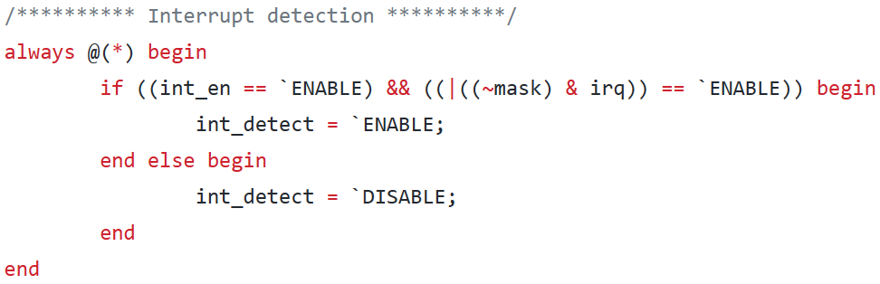
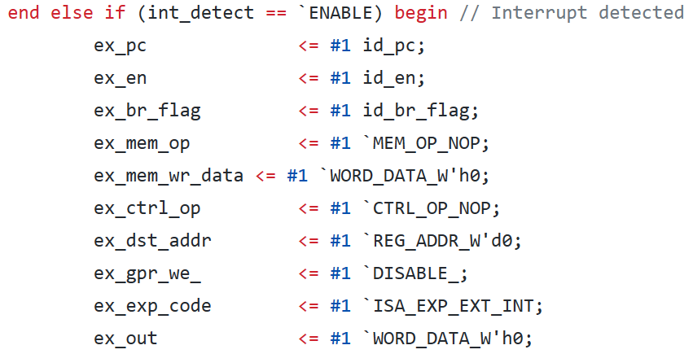
Interrupt
Checked in EX stage
Invalidate EX/MEM reg, set its exception code to ISA_EXP_EXT_INT, pass up to WB stage for CTRL to handle in the next cycle
pc in a pipeline register is by design pointing to the next instruction, e.g. in WB stage the mem_pc coming out of MEM/WB register is actually pointing to the next instruction, which is the instruction currently being processed in MEM stage. Thus, we introduce pre_pc to store the current instruction in WB stage. This way, when CTRL in WB stage see mem_exp_code is ISA_EXP_EXT_INT, the CTRL can conveniently use the pre_pc as epc (epc points to instruction that is interrupted). The same explanation applies for exception.
Explanation has to be tweaked a bit for the br_flag. mem_br_flag does indicate whether the current instruction is a branching instruction. We introduce br_flag to tell whether the instruction preceeding current instruction is a branching instruction. This way if br_flag is set, we know the instruction in WB stage is the NOP instruction used for branch delay slot.

Slide 18
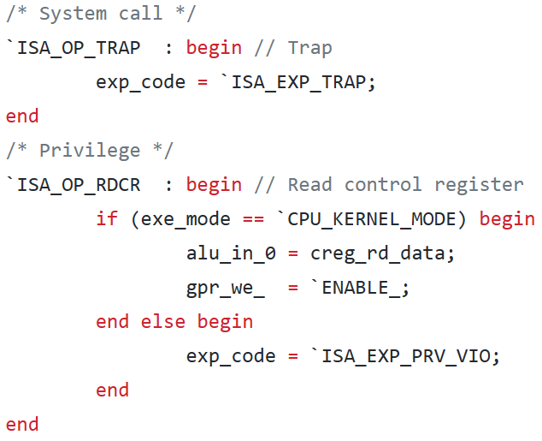
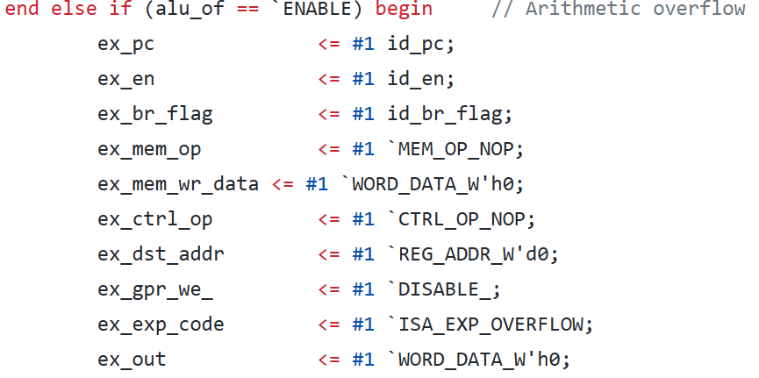
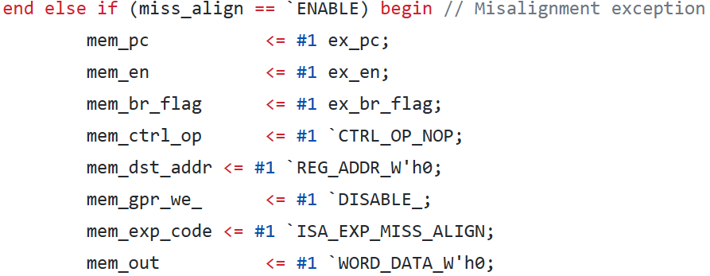
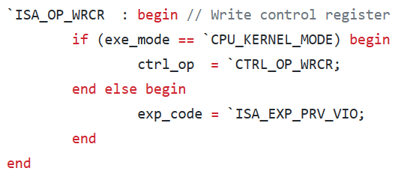
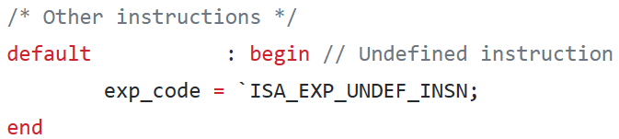
Exception
Checked in many stages:
ID stage: trap instruction, undefined instruction, accessing control register in user mode (privilege violation)
EX stage: arithmetic overflow
MEM stage: misaligned access to memory
Similar to interrupt, exp_code is set accordingly and will be passed to WB stage for CTRL to handle

Slide 19
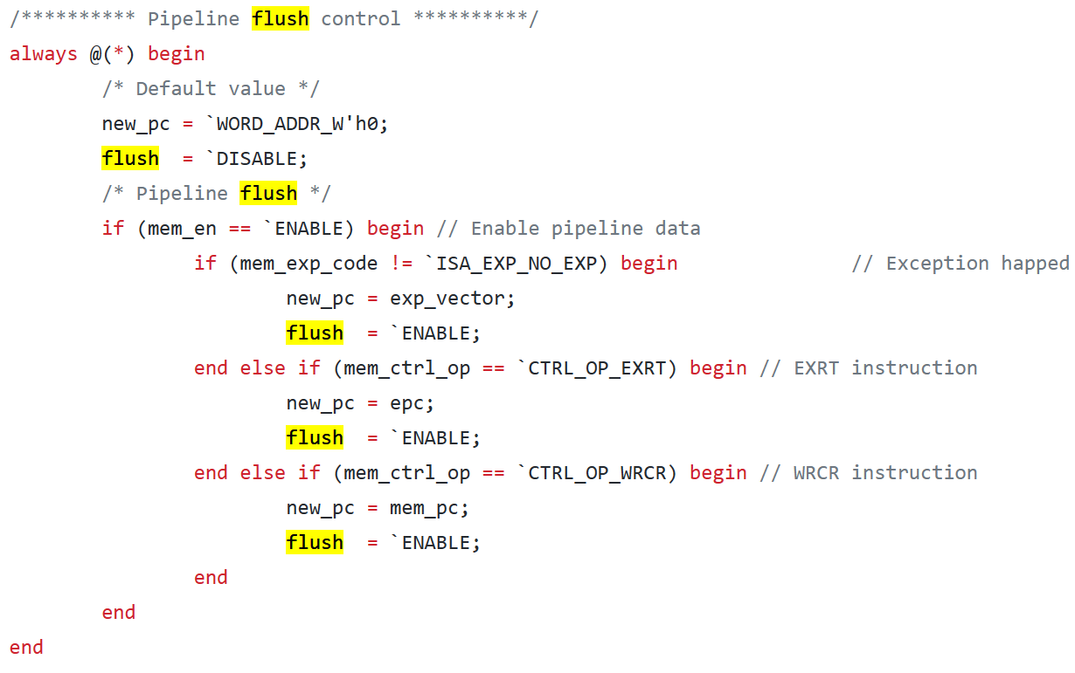
Pipeline: Flush
Invalidate pipeline registers, a new life begins by reinitialization
Flush when CPU is in a totally new state
Encountered exception (because later instructions are meaningless while current instruction already has exception) or
Return from exception (because of updated exe_mode from kernel mode to user mode) or
Write to control register (because later instructions in the pipeline may have started and was using old control register value)

Slide 20
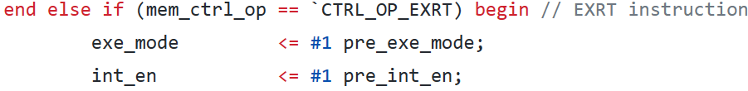
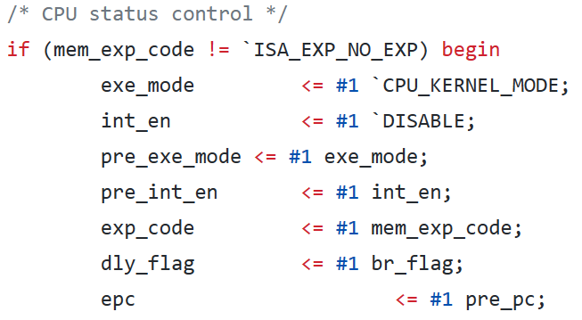
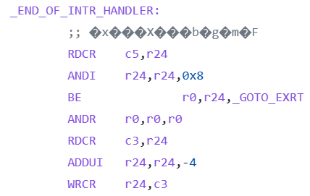
Interrupt/Exception Handling
Even though an interrupt/exception is detected in many stages, it reaches all the way to WB stage to be handled by CTRL.
Save branch flag into delay flag register, software interrupt handler can later check the delay flag (in control register C5) and see whether the instruction being interrupted was a branch delay slot or not (see slide regarding interrupt)
Set epc to pre_pc, because the pc in the pipeline register is by design pointing to the next pc, as discussed before
Save execution mode to be restored by EXRT, then switch to kernel mode
Save interrupt enable flag to be restored by EXRT, then disable interrupt, thus nested interrupt never happen
Check delay flag in software interrupt handler, if set, change the return address by subtracting 4 (1 instruction = 4 bytes)

Slide 21
Memory
RAM: Dual-port RAM, because both IF and MEM stage will use it.
ROM: Single-port ROM, becase only IF stage will read it.
No MMU and no cache

Slide 22
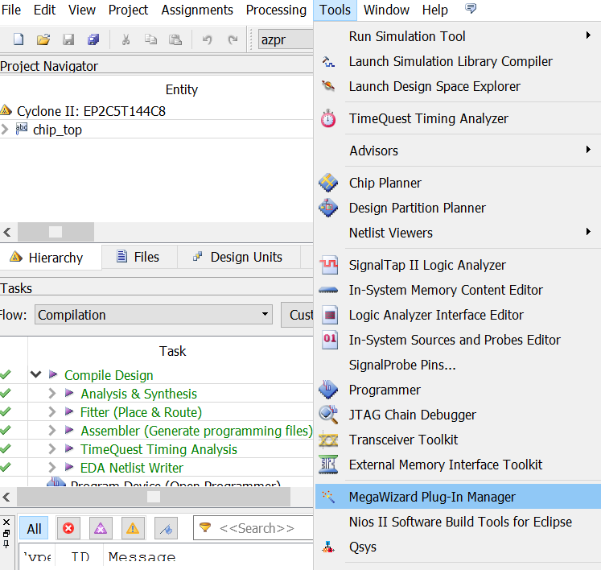
RAM
Use MegaWizard to generate

Slide 23
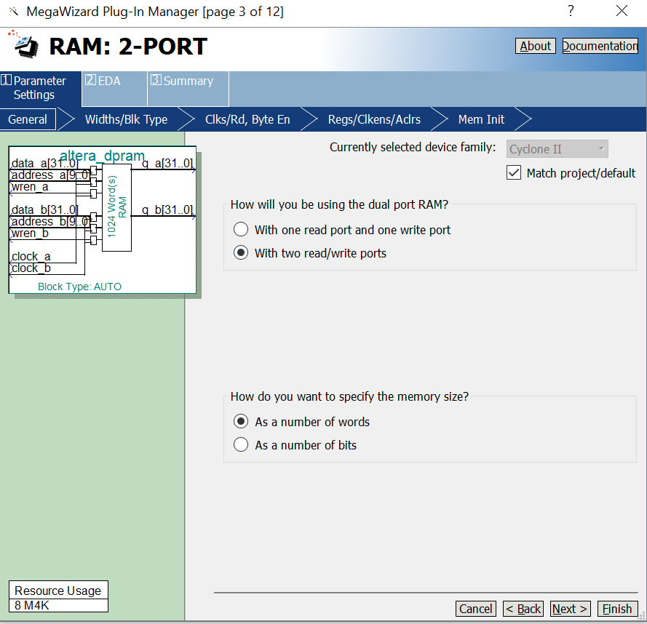
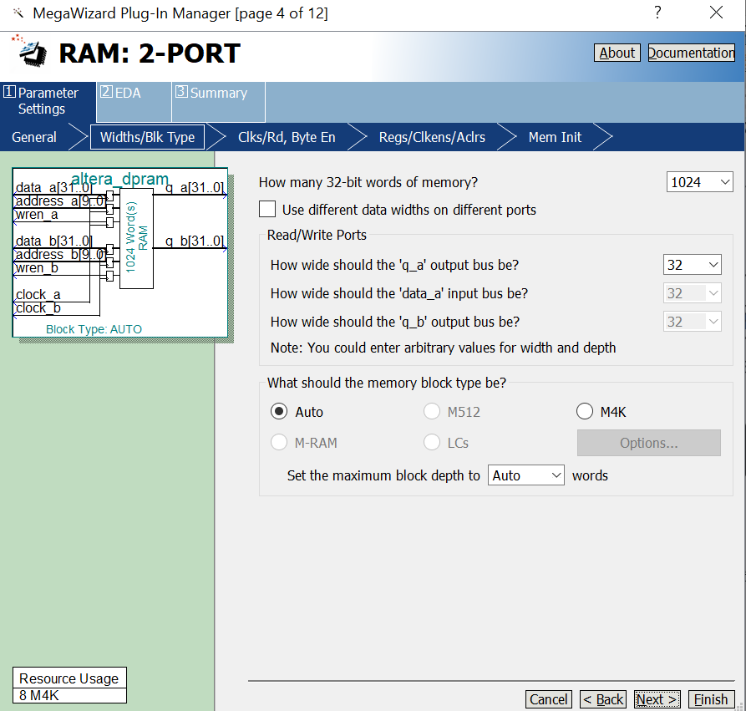
Intentionally shrinked to 1024 to fit in the cheap FPGA

Slide 24
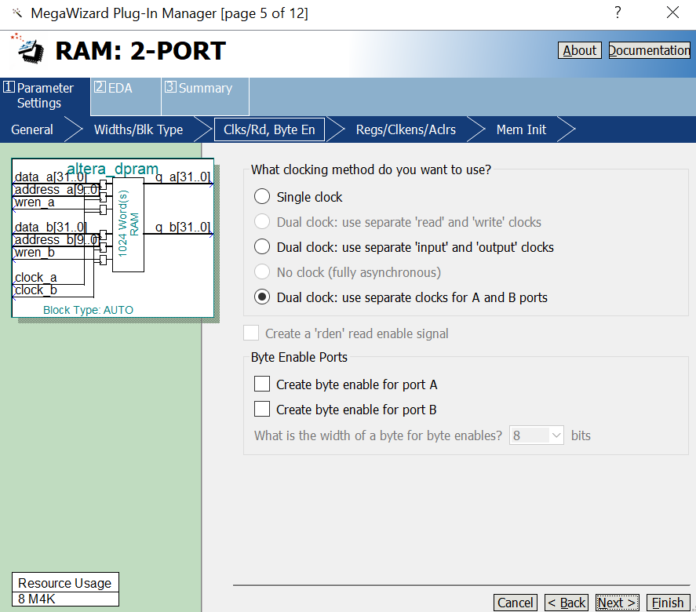
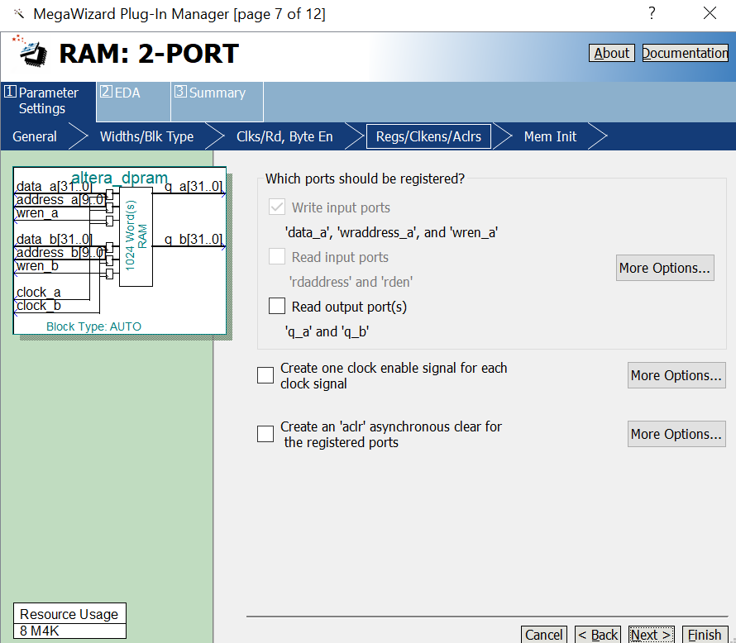

Slide 25
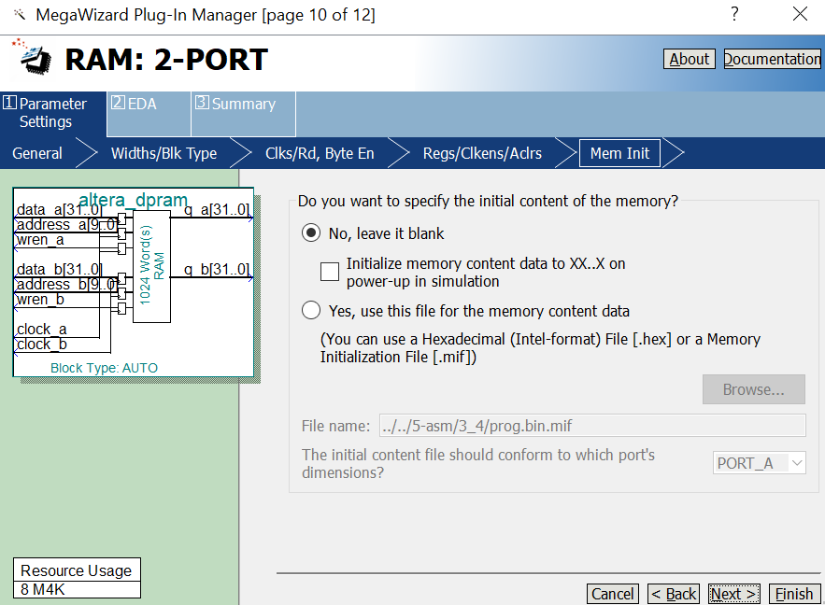
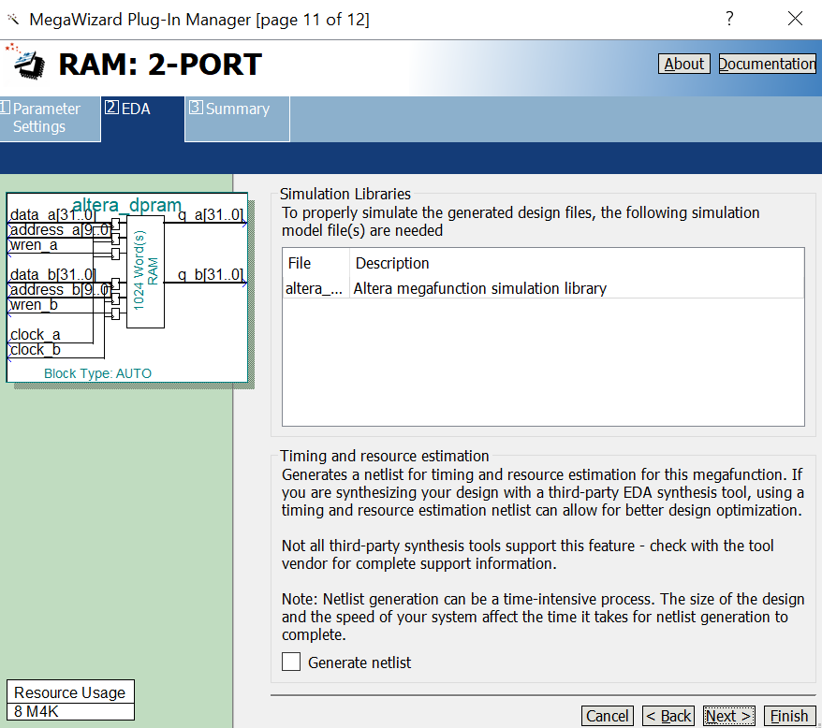

Slide 26
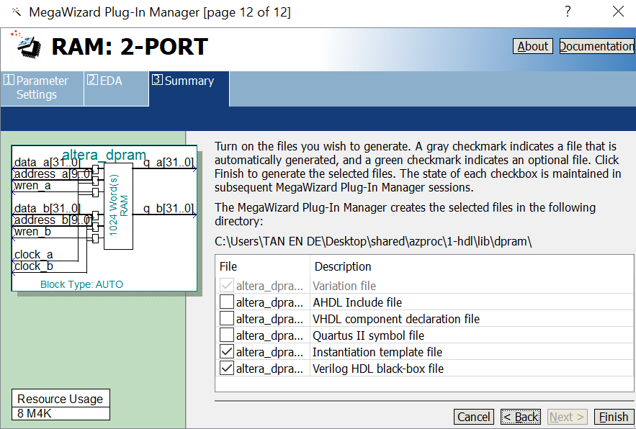

Slide 27
ROM
Embedding .bin in ROM using .mif
Assembler
azprasm.exe
azprbin2mif.py
Megawizard ROM
.asm
.bin
.mif

Slide 28
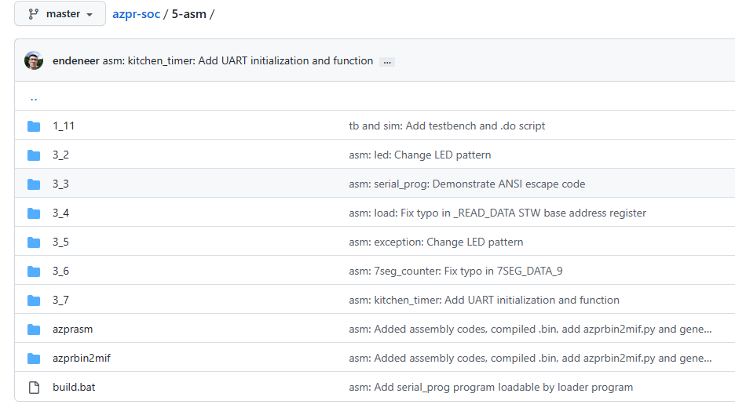

Slide 29
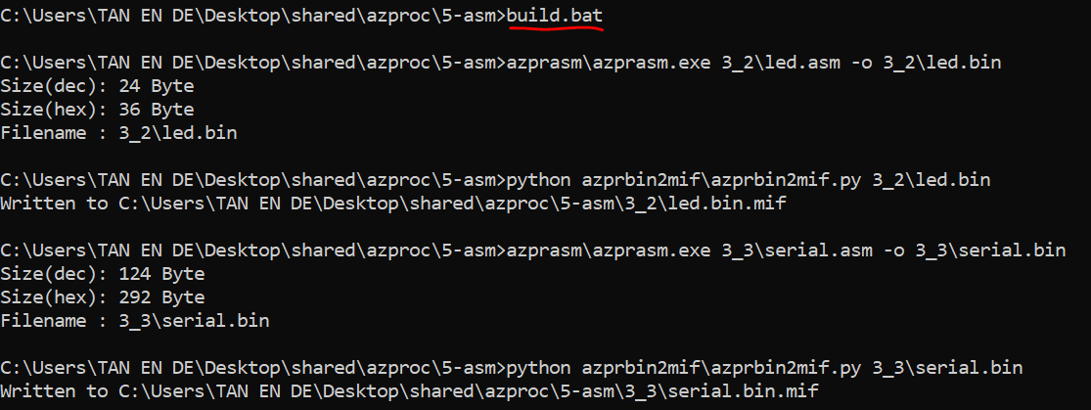

Slide 30
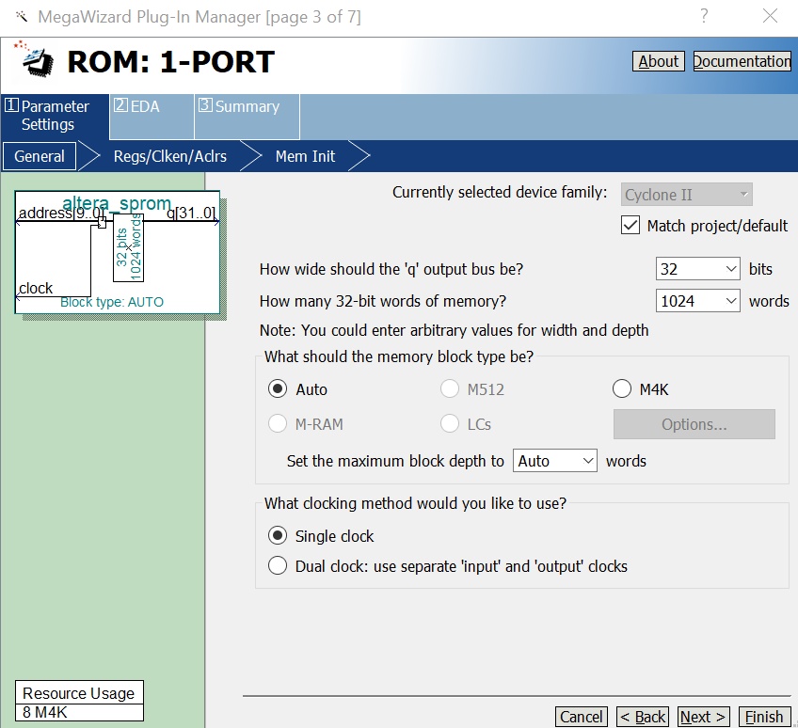
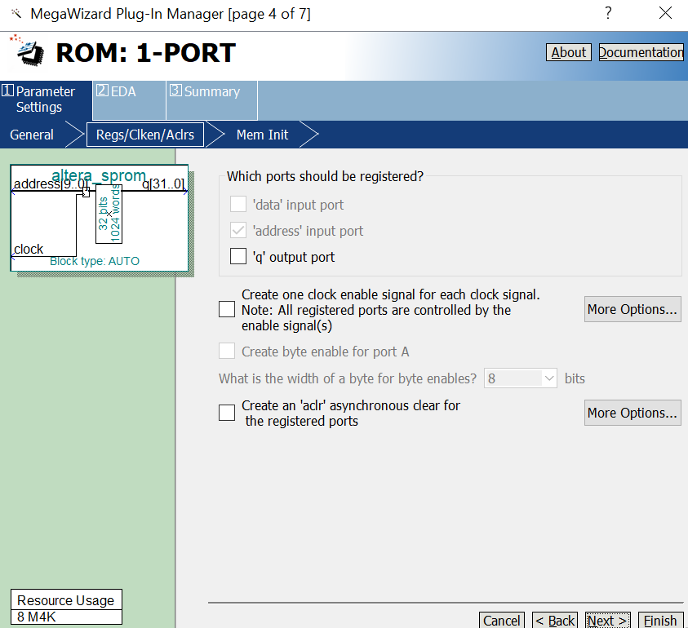
Intentionally shrinked to 1024 to fit in the cheap FPGA

Slide 31
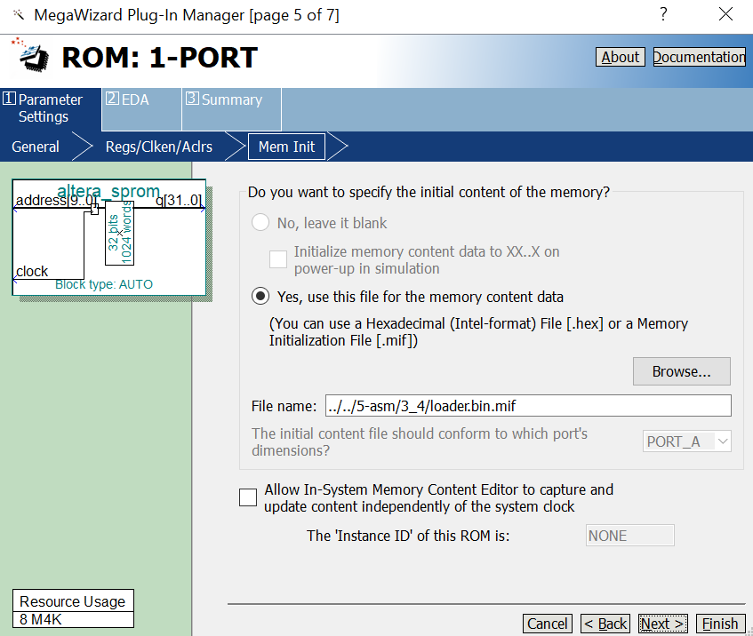

Slide 32
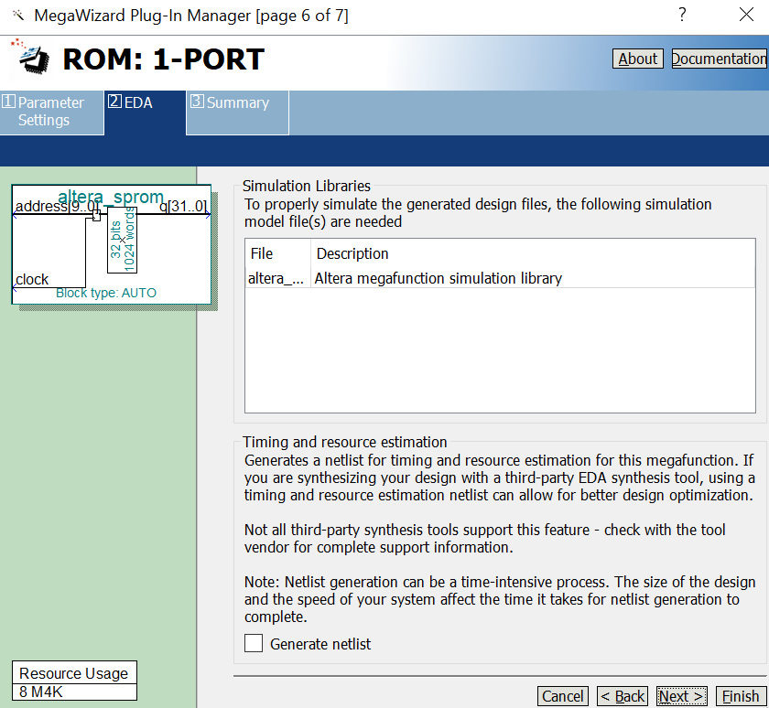
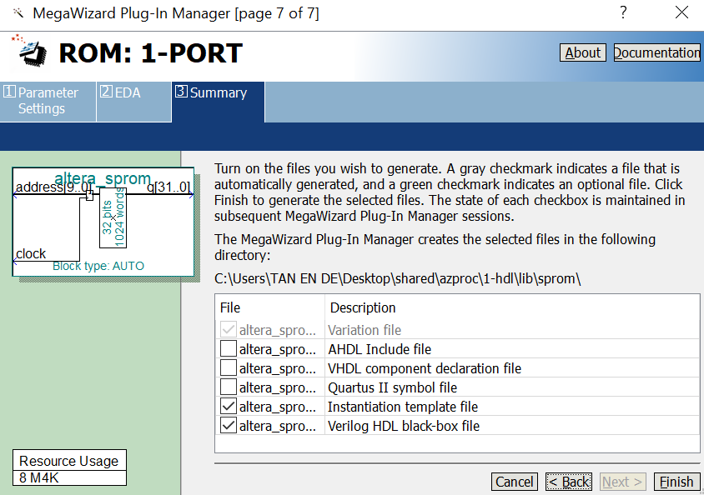

Slide 33
Clock & Reset
Use MegaWizard to generate PLL (Altera-equivalent of Xilinx’s DCM)
PLL has a locked signal to tell if the generated clock is ready or not. Use this signal to reset flip flops.
PLL is resetable via reset_sw input.

Slide 34
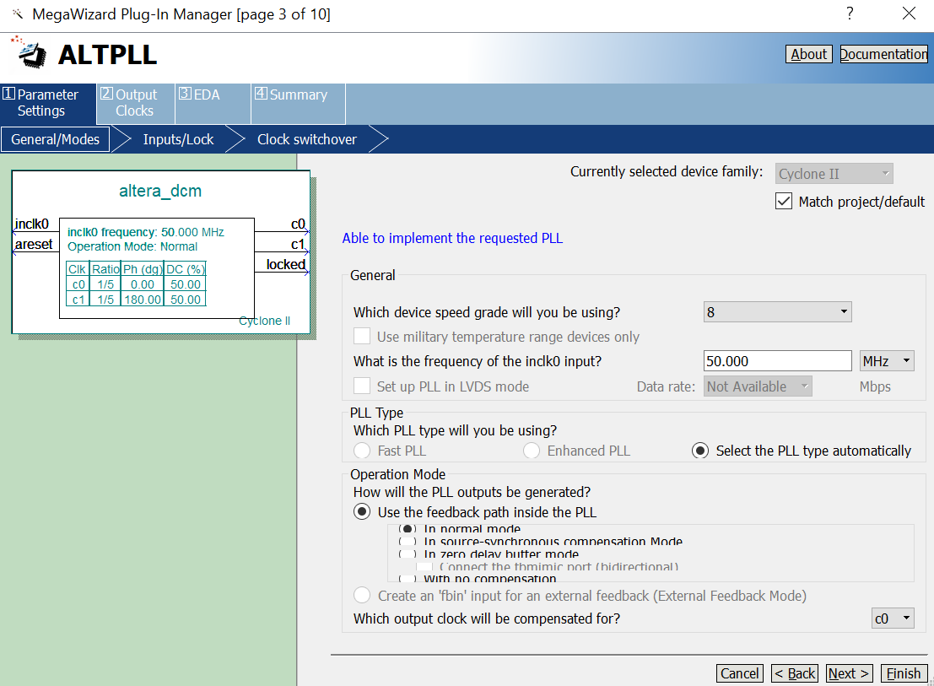

Slide 35
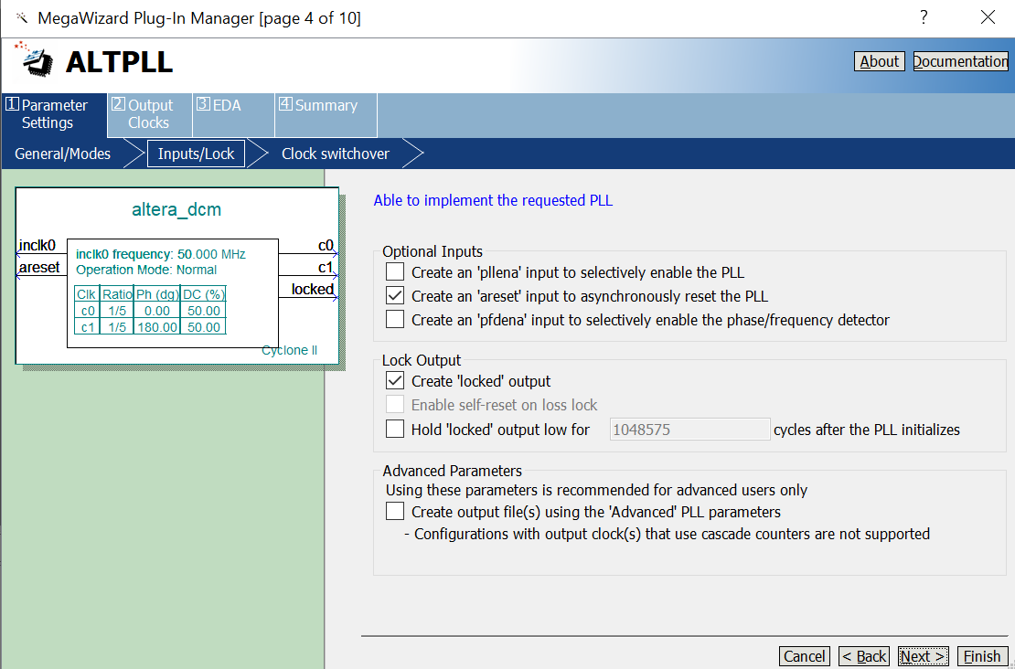

Slide 36
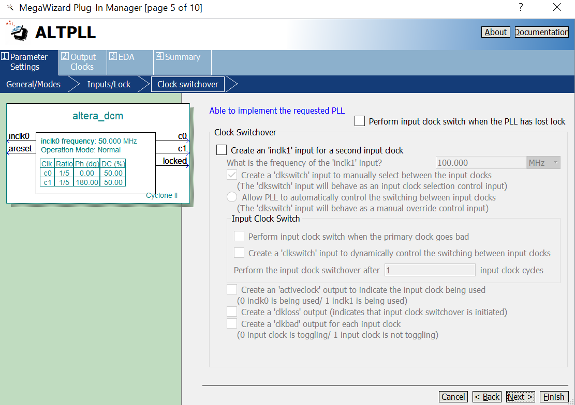

Slide 37
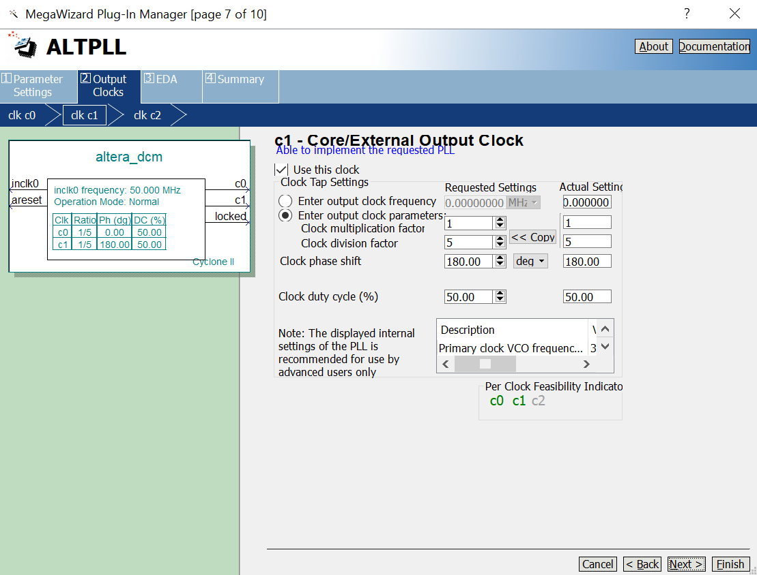
180 degree clock as a trick to read from RAM in the same cycle (address is provided in first half-cycle and data comes out in next half-cycle due to 180 degree clock), in effect, address and the corresponding instruction appears in the same cycle

Slide 38
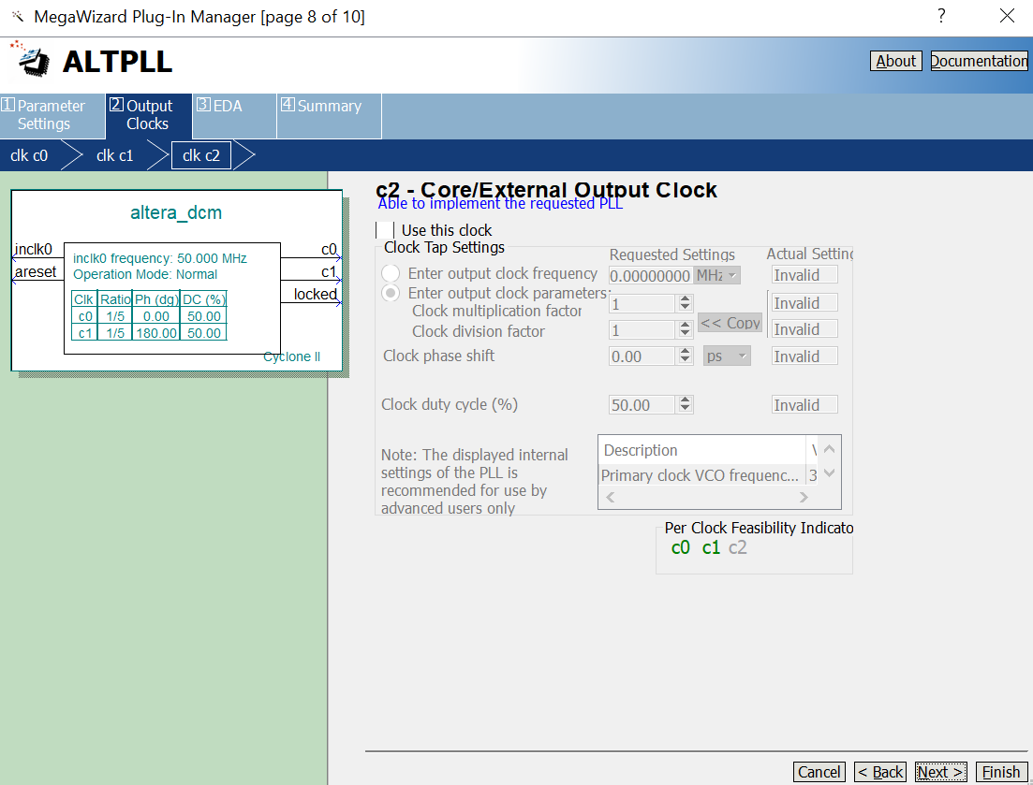
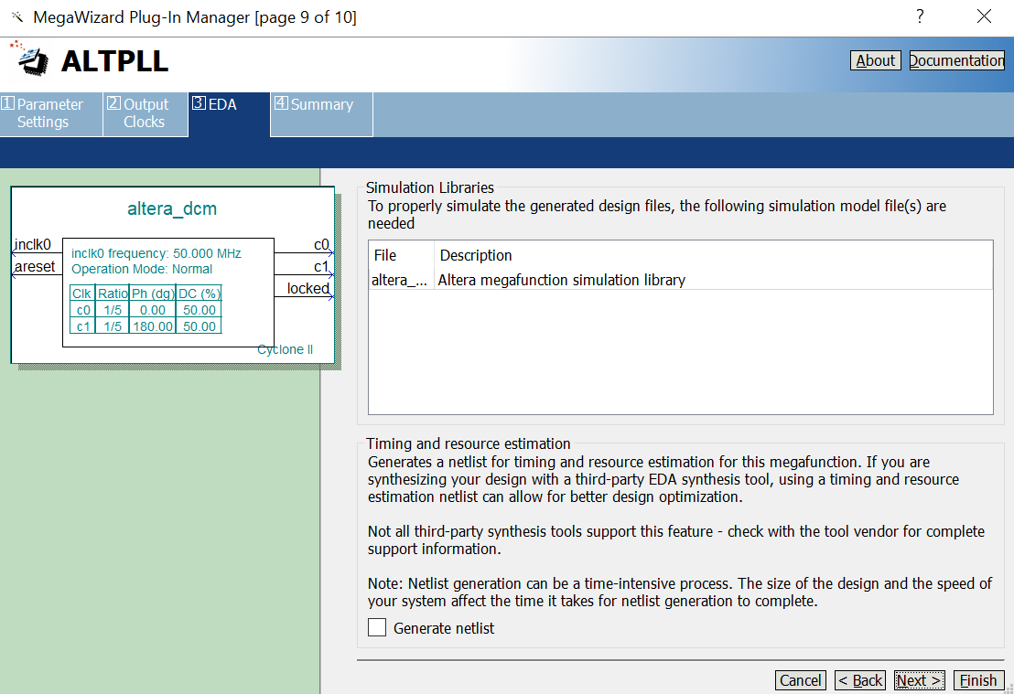
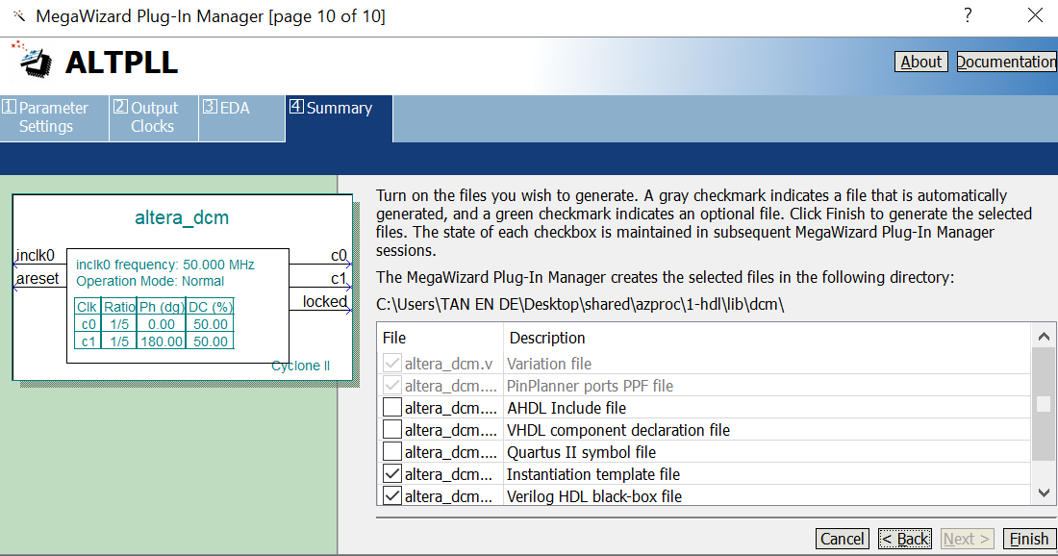

Slide 39
GPIO
3 types:
Input
Output
Bidirectional: Can be configured as input or output
Description | Offset | Access | Content
 |  |  | [31..0]
Input | 0x0 | R | INPUT_DATA
Output | 0x4 | R/W | OUTPUT_DATA
Bidirectional | 0x8 | R/W | INOUT_DATA
Direction | 0xc | R/W | INOUT_DIR

Slide 40
Timer
Up counter.
Generate interrupt once the counter value reaches a programmable threshold value.
Periodic mode and one-shot mode are available.
Description | Offset | Access | Content
 |  |  | [31..2] | 1 | 0
Control | 0x0 | R/W | Unused | Mode 1 = periodic 0 = one-shot | Start
Interrupt | 0x4 | R/W | Unused |  | INT
Threshold | 0x8 | R/W | EXPR_VAL
Counter value | 0xc | R/W | COUNTER

Slide 41
UART
No parity checking.
In AZPR, no hardware transmitter/receiver buffer is provided. Data needs to be transmitted/received by software one byte by one byte. Not a problem since UART baud rate is slow, i.e. 38400, while CPU is running at 10MHz.
Description | Offset | Access | Content
 |  |  | [31..8] | [7..4] | 3 | 2 | 1 | 0
Control | 0x0 | R/W | Unused |  | Transmit busy | Receive busy | Transmit INT | Receive INT
Data to transmit / received | 0x4 | R/W | Unused | DATA

Slide 42
Bus
Multiple slaves:
Each peripheral is a slave and is accessed as an MMIO device via the bus.
Bus address decoder determines which peripheral to access.
Limitation: In AZPR bus design, only 8 slaves can be used. May increase number of slaves at the expense of less usable memory range for each peripheral.
Slave index (3 MSB Bits) | Allocated bus address | MMIO
3'b000 | 0x0000_0000 ～ 0x1FFF_FFFF | ROM
3'b001 | 0x2000_0000 ～ 0x3FFF_FFFF | RAM
3'b010 | 0x4000_0000 ～ 0x5FFF_FFFF | Timer
3'b011 | 0x6000_0000 ～ 0x7FFF_FFFF | UART
3'b100 | 0x8000_0000 ～ 0x9FFF_FFFF | GPIO
3'b101 | 0xA000_0000 ～ 0xBFFF_FFFF | Unused
3'b110 | 0xC000_0000 ～ 0xDFFF_FFFF | Unused
3'b111 | 0xE000_0000 ～ 0xFFFF_FFF | Unused

Slide 43
Bus
Multiple masters:
IF and MEM stage may compete for bus access.
Solution: Bus arbiter.
Round-robbin algorithm.
Also, the master that is holding the bus must voluntarily release it for other master to use.

Slide 44

Bus Access Lifecycle
Master requests bus access.
Round-robbin bus arbiter grants the master the bus access.
Master provides address it wants to access.
Bus decoder set chip select signal to select proper slave based on the address.
Master set read/write operation along with the data to write in case of write operation.
Master uses address select pulse to tell slave to start processing.
Slave notices the chip select and the address select pulse
Thus, slave processes the operation accordingly, i.e. in RTL:
When operation is done, slave signals ready signal to tell the master.
Master now knows that the operation is done, take reading in case of read operation.
Master releases the bus access request.
Bus arbiter is now free to grant other master.

Slide 45
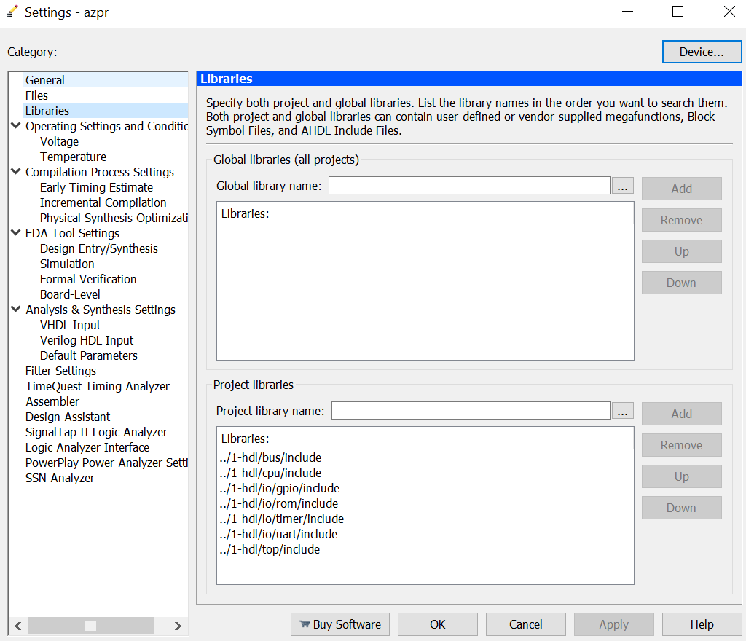
Include Header Files in Quartus

Slide 46
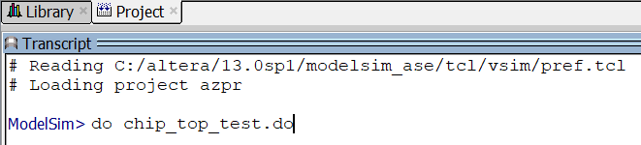
ModelSim Simulation
Firstly, create a new ModelSim project in the folder 3-sim and add all the .v files, including the .v files generated from Megawizard from 1-hdl 2-tb folder.
Do not have to include .h files.
Inside the 3-sim folder, I have provided a sample .do script to run the simulation for serial program that prints “Hello,World.”

Slide 47
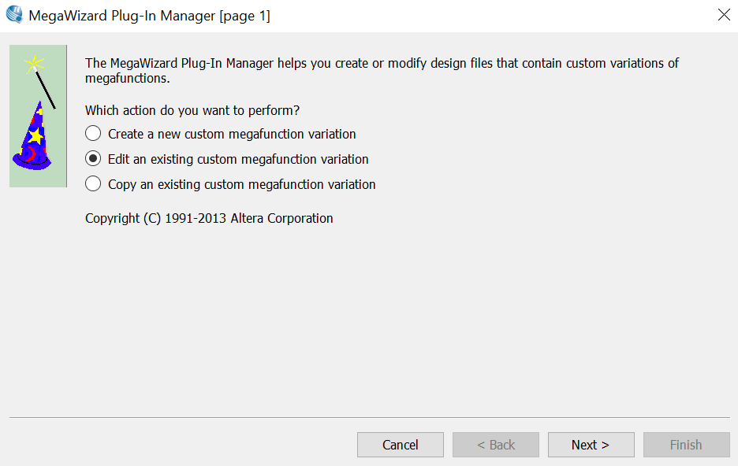
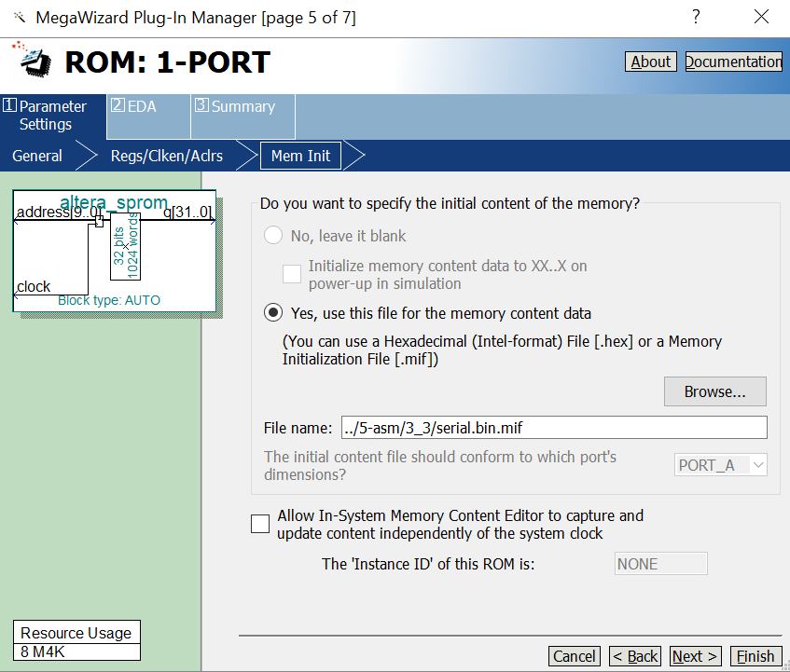
Before run the chip_top_test.do, change the .mif embedded in ROM first

Slide 48
ModelSim Simulation
Inside the 3-sim folder, I have provided a sample .do script to run the simulation for serial program that prints “Hello,World.”
See more explanation in next few slides

Slide 49
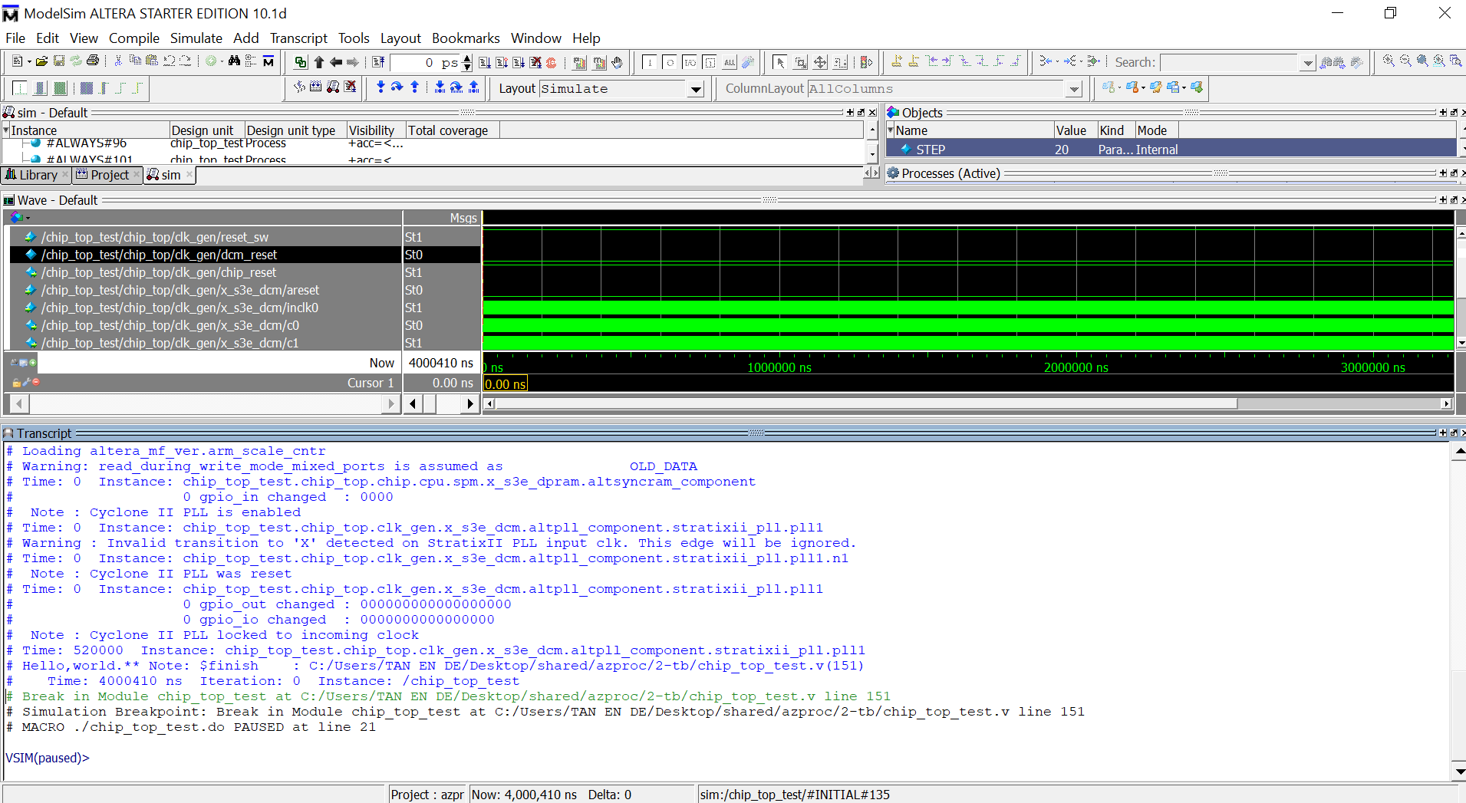

The simulation takes a while, then “Hello,world.” will be printed.
To quit simulation
quit -sim

Slide 50
Simulate MegaWizard Component in ModelSim
See the 3-sim/chip_top_test.do:
Need to include library when invoking vsim in ModelSim
work.name_of_testbench
vsim -onfinish stop -L altera_mf_ver -wlf chip_top_test.wlf -voptargs=+acc work.chip_top_test
Stop simulation when $finish; in testbench
Include altera_mf_ver (ver means verilog) library for simulating PLL/RAM/ROM
Save the wave log format as chip_top_test.wlf (see next slide)

Slide 51
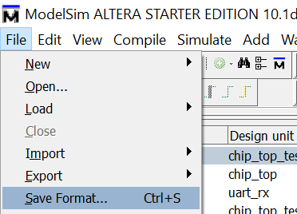
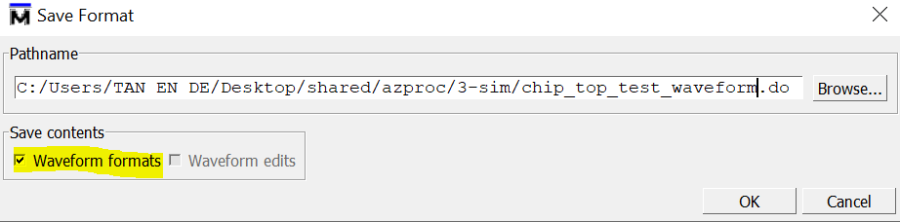
Save simulation waveform for view later without re-simulation
Method 1: Use -wlf when invoking ModelSim vsim
To construct the .wlf
vsim -onfinish stop -L altera_mf_ver -wlf chip_top_test.wlf -voptargs=+acc work.chip_top_test
Drag and drop instance into Wave window to inspect (the commands to add waveform will also be displayed in Transcript window, copy & paste them into chip_top_test.do file, or you can simply save the commands in chip_top_test_waveform.do as shown below, and then in the chip_top_test.do you can source the chip_top_test_waveform.do file to setup the Wave window)
run -all will then log into .wlf

Slide 52
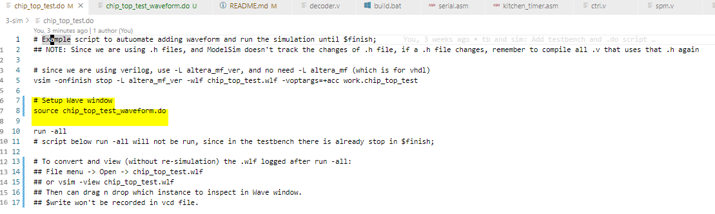
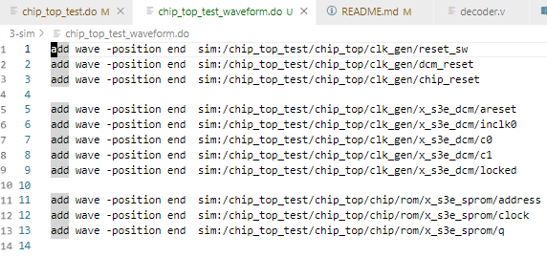

Slide 53
Save simulation waveform for view later without re-simulation
Method 2: Use $dumpvars in testbench (more tedious but more portable, e.g. to gtkwave)
$dumpfile(“chip_top_test.vcd”)
Capture by module: $dumpvars(0, chip_top.chip.rom)
Capture single signal: $dumpvars(0, chip_top.clk_gen.x_s3e_dcm.locked);
Need to manually convert to .wlf for viewing in ModelSim
vcd2wlf chip_top_test.vcd chip_top_test.wlf

Slide 54
To view .wlf
vsim -view chip_top_test.wlf
There will be nothing in the Wave window at this point. Need to drag n drop which instance to inspect in ModelSim’s Wave window.
To quit: dataset close chip_top_test
Extra note: It seems not possible to save $display, $monitor, $write, $strobe, etc. in .wlf or .vcd

Slide 55
Part 2:
Hardware Design

Slide 56
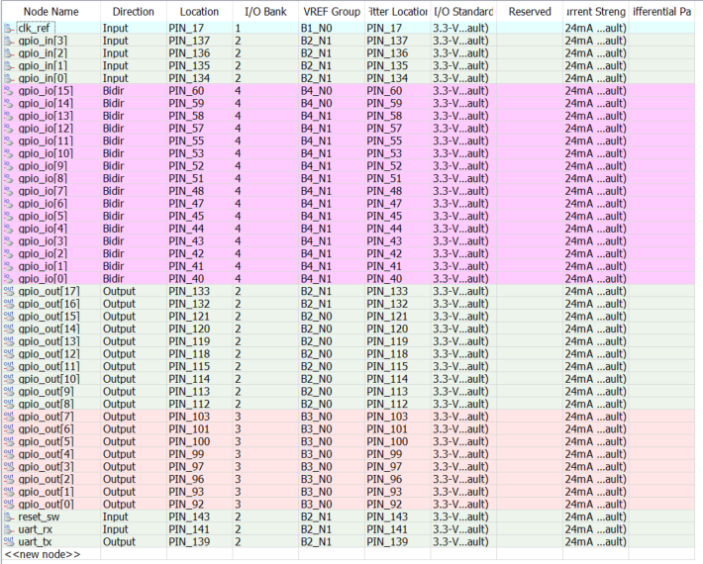
FPGA Pin Assignment

Slide 57
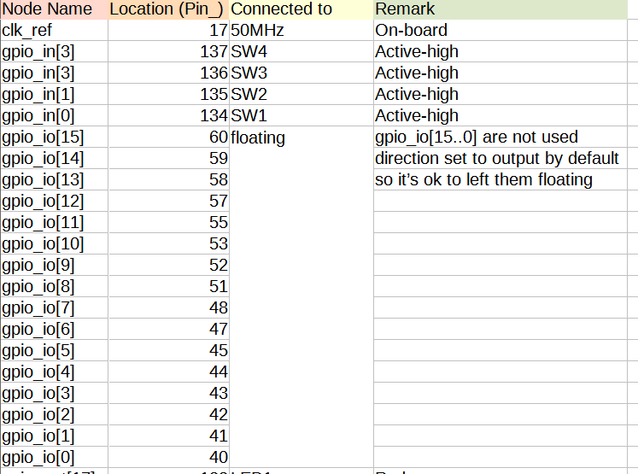
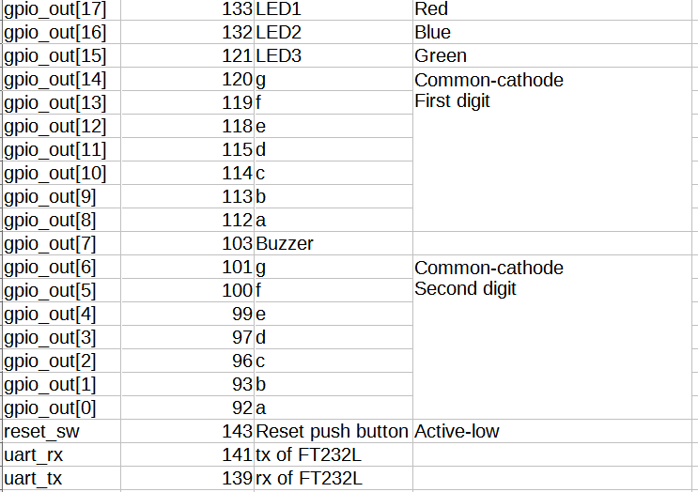

Slide 58
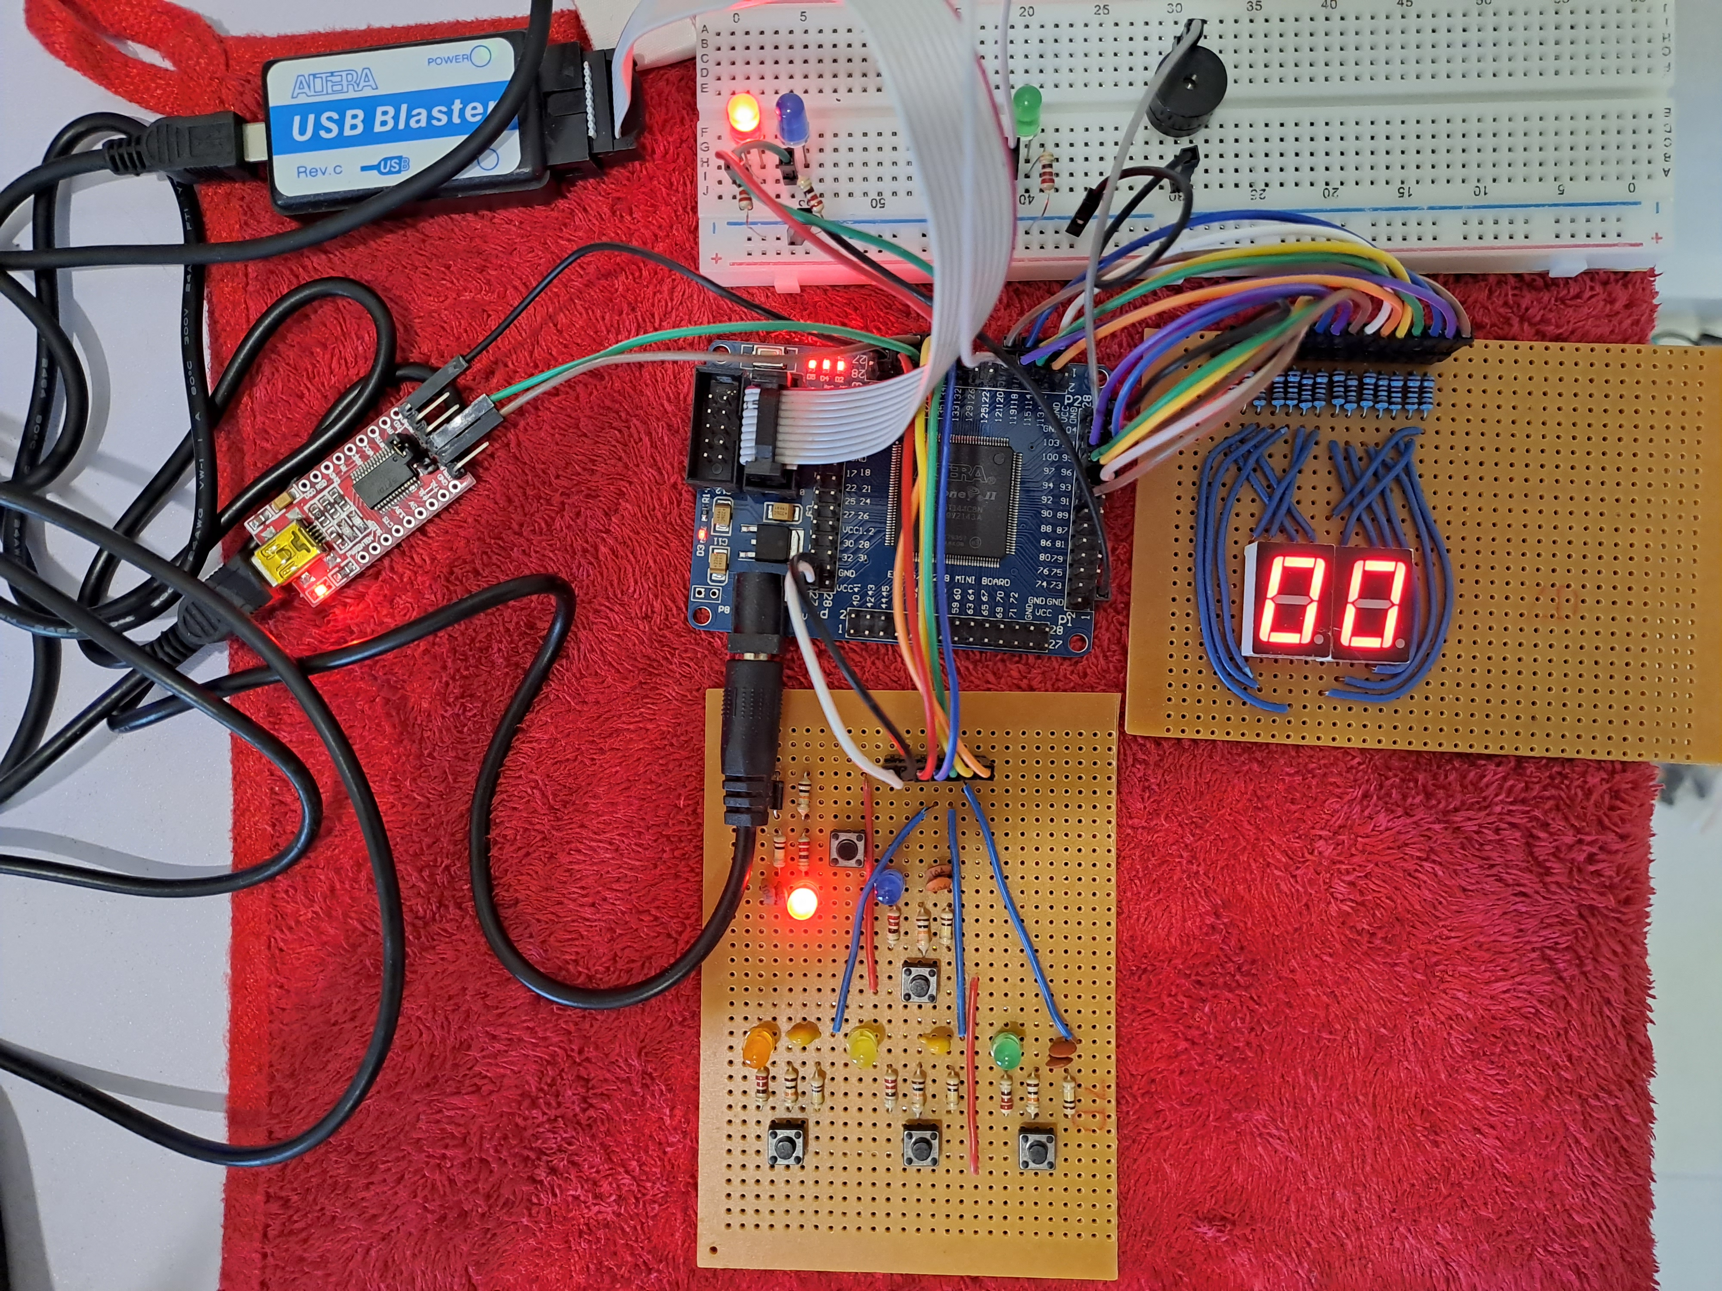
Output board:
gpio_out
USB Blaster
FPGA
FT232RL
Output board: gpio_out
Input board: gpio_in and reset_sw

Slide 59

gpio_in and reset_sw
Connected to FPGA via straight pin header
reset_sw
SW4
SW1
SW2
SW3

Slide 60

gpio_in and reset_sw
vcc
gnd
reset_sw
SW1
SW2
SW3
SW4
224
220Ω
LED
SWn
1N4007
red
10kΩ
10kΩ
100kΩ
Total 4 such active-high input for SW1-SW4 respecetively
220Ω
Active-low
power-on reset
100kΩ
reset_sw
224
= 22*10^(-12+4)
= 22nF

Slide 61

gpio_out connects to 7-segment displays, 3 LEDs, and 1 buzzer
LED1
LED2
LED3
Buzzer
Common-cathode
7-segment displays

Slide 62



gpio_out connects to 7-segment displays, 3 LEDs, and 1 buzzer
First digit: gpio_out[14..8]
Second digit: gpio_out[6..0]
Total 3 such LED for gpio_out[17..15]
gnd
a
A
B
C
D
E
F
G
A
B
C
D
E
F
G
220Ω
220Ω
220Ω
220Ω
220Ω
220Ω
220Ω
220Ω
220Ω
220Ω
220Ω
220Ω
220Ω
220Ω
220Ω
For buzzer, don’t need resistor
LED1-3
seven-segment display
(first digit)
seven-segment display
(second digit)

Slide 63


FT232RL connection
share ground between the module and the FPGA
choose 3.3V
GND
Computer’s
USB port
Mini-B
FT232RL
module
TX
uart_rx of FPGA
RX
uart_tx of FPGA
VCC not used

Slide 64

SignalTap Logic Analyzer
Real-time debug of what’s inside the FPGA design

Slide 65


Signal configuration
Since I’m using a cheap FPGA without much RAM, I can only use low sample depth value. Else error like this will occur:

Slide 66




Slide 67


Right-click, then will be able to choose the edge as trigger condition
Since we are interested in either of the rising edge, we should use OR in the trigger condition

Slide 68

To run SignalTap
Back to Quartus to recompile (shortcut is CTRL+L) and download .sof
May require setup & scan chain if not listed.
Run continuously

Slide 69


To disable SignalTap
Simply untick in Settings, then recompile.

Slide 70
Part 3:
Software Design

Slide 71
Program Loader
FPGA
Laptop
UART connection
XMODEM protocol
ROM embedded with
loader.bin.mif
Tera Term
Baud Rate: 38400
loader is a program such that when any of SW1-SW4 is pressed, then the program will get binary data using XMODEM protocol.
The data obtained will be stored into RAM.
Once done obtaining data, jump and execute at the RAM.
To get another binary, press the reset_sw button and repeat the steps above.

Slide 72
XMODEM
Packet format
each byte is transmitted as one UART transaction
SOH | BN | BNC | Data | CS
1 byte | 1 byte | 1 byte | 128 bytes | 1 byte
Actual things we write into RAM before jumping PC to RAM
SOH = Start Of Heading = 0x01
Two types of error-checking
BN = Block number
BNC = Binary complement of BN for initial error checking, such that BN + BNC = 0xFF
CS = Checksum = Sum of bytes in the packet modulo 256, for packet error checking

Slide 73
XMODEM
Sender
(Tera Term)
NAK
Receiver
(FPGA UART)
First packet
ACK
NAK = Negative Acknowledge = 0x15
ACK = Acknowledge = 0x06
EOT = End Of Transmission = 0x04
CAN = Cancel = 0x18
... ...
i-th packet with CS error
NAK
Resend i-th packet
ACK
... ...
EOT
ACK

Slide 74

Program Loader using XMODEM
Embed loader.bin.mif in ROM.
Compile & program the FPGA.
Open Tera Term. Set serial baud rate (speed) to 38400.

Slide 75


Slide 76


For hello world print demo
For kitchen timer demo

Slide 77
Program Loader using XMODEM
Tera Term is now ready to send, press any SW1-SW4.
Program is small, the send transfer will end in a blink of an eye.
Voila, the program nows jump to RAM and executing from RAM.

Slide 78
Demo
Demo 1: Print “Hello,world.”
Demo 2: Kitchen Timer

