Slide 1
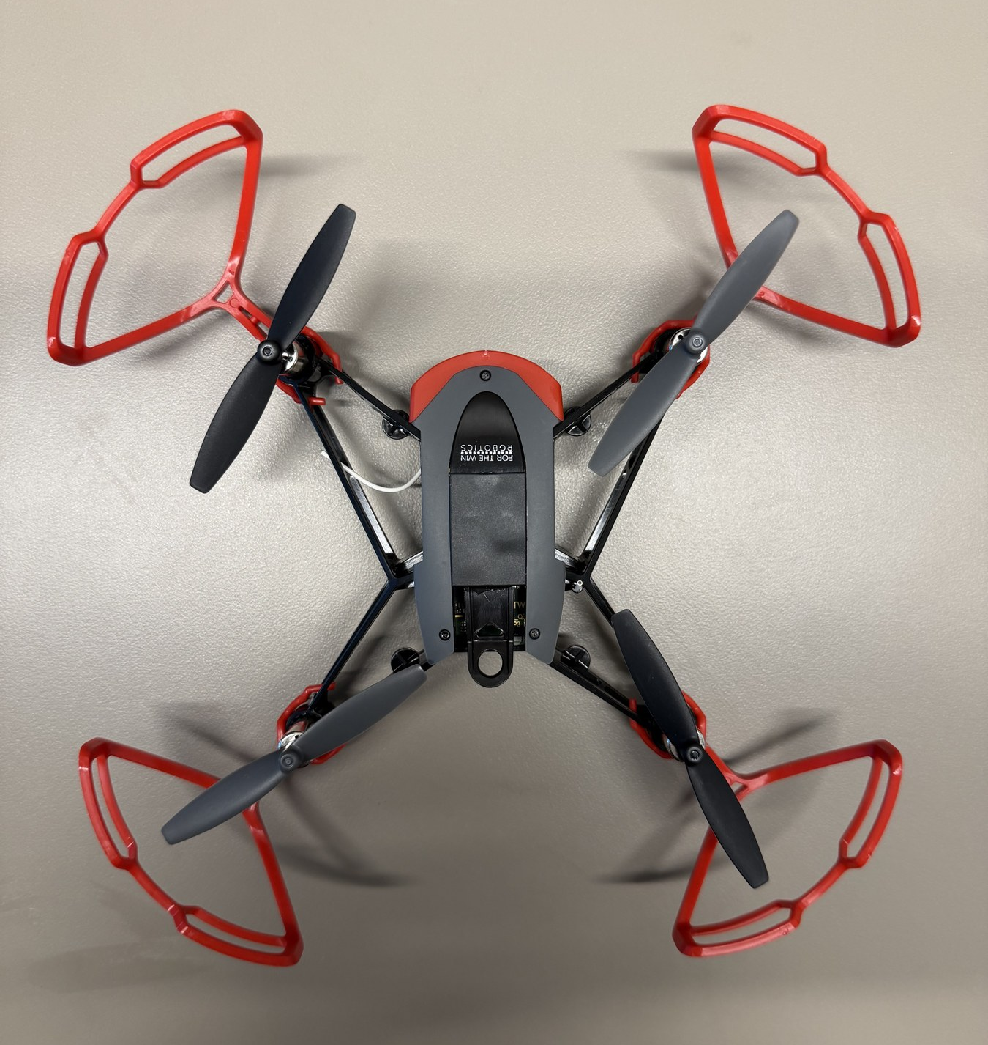

HOPPER INFORMATION SERIES
AERODYNAMICS
Quadrotor aerodynamics
From rotor thrust to translation, attitude, and the feedback loops that stabilize every command.
NED / FRD
6-DOF MODEL
CONTROL LOOPS
DECK 02 | AERODYNAMICS
Notes:
Introduce translation and rotation as one coupled rigid-body problem. The deck uses the paper’s North-East-Down inertial frame and Forward-Right-Down body frame throughout.
[Sources]
- User-supplied high-resolution photograph: drone_photos/IMG_4479.jpeg
- Elsberry, Dawkins, and Whitcomb, ral_main.pdf, §III-A p.2.
[/Sources]

Slide 2
AERODYNAMICS / 02
COORDINATE CONVENTION
Signs only make sense after the frames are declared
INERTIAL FRAME · NED
BODY FRAME · FRD
a₁ · north
b₁ · forward
×
a₂ · east
b₂ · right
b₃ · down
a₃ · down
ξₐ and vₐ are inertial-frame vectors.
Positive z points down.
Rₐᵦ maps body-frame vectors into the inertial frame.
ZYX EULER ANGLES
BODY → INERTIAL ROTATION
WRC | HOPPER STUDIO | INFORMATION SERIES
2 / 8
Notes:
The paper defines the inertial frame as North-East-Down and the body frame as Forward-Right-Down. R_ab maps body coordinates into inertial coordinates. Euler angles are ZYX roll, pitch, and yaw.
[Sources]
- Elsberry, Dawkins, and Whitcomb, ral_main.pdf, §III-A p.2, Fig. 1 and equations (5), (11)–(13).
[/Sources]

Slide 3
AERODYNAMICS / 03
ROTOR MODEL
Rotor speed creates thrust; collective thrust sets height
QUASI-STEADY ROTOR THRUST LAW
POSITIVE TOTAL-THRUST MAGNITUDE
A TRUE FIRST-ORDER MOTOR MODEL
Hover is an attitude-qualified condition
• Level hover: F_T = mg.
• Tilted hover: F_T cos φ₁ cos φ₂ = mg.
• For one-way rotors, uᵢ = ωᵢ²; the square law is static, not a motor time response.
Students command direction, time, and power; the controller allocates motor commands.
WRC | HOPPER STUDIO | INFORMATION SERIES
3 / 8
Notes:
The paper uses u_i = omega_i |omega_i|. For normal one-direction rotor operation this becomes omega_i squared. Distinguish the quasi-steady square law from an actual first-order motor lag.
[Sources]
- Elsberry, Dawkins, and Whitcomb, ral_main.pdf, §III-A p.2, equations (3)–(10).
[/Sources]

Slide 4
AERODYNAMICS / 04
TRANSLATION
Tilting the body redirects thrust horizontally
SIDE VIEW · ZERO YAW
FORWARD ACCELERATION · φ₃ = 0
thrust −F_T b₃
forward +a₁
VERTICAL ACCELERATION · z POSITIVE DOWN
gravity +mg a₃
Nose-down pitch is φ₂ < 0 in this NED/FRD convention.
Tilt reduces the vertical thrust component, so altitude hold needs more F_T.
WRC | HOPPER STUDIO | INFORMATION SERIES
4 / 8
Notes:
At zero yaw, a nose-down pitch has phi_2 less than zero and produces positive forward acceleration. Both inertial z and body b_3 point down. Keeping altitude while tilted requires additional total thrust.
[Sources]
- Elsberry, Dawkins, and Whitcomb, ral_main.pdf, §III-A p.2, equations (3), (12), and (13).
[/Sources]

Slide 5
AERODYNAMICS / 05
ROTOR ALLOCATION
Differential rotor forces create roll, pitch, and yaw moments
PAPER ROTOR NUMBERING
SIGN PATTERN
3
b₁ · forward
1
1
2
3
4
F_T
+
+
+
+
−τz
+τz
τ_x
−
+
+
−
+τz
−τz
b₂ right
τ_y
+
−
+
−
2
4
τ_z
+
+
−
−
Differential moments are added to the collective command.
THRUST / TORQUE ALLOCATION
WRC | HOPPER STUDIO | INFORMATION SERIES
5 / 8
Notes:
Rotor 1 is front-right, 2 rear-left, 3 front-left, and 4 rear-right in the attached paper. Roll and pitch come from thrust moments. Yaw comes from reaction/drag torque; increase one yaw-torque pair and decrease the other while approximately preserving total thrust.
[Sources]
- Elsberry, Dawkins, and Whitcomb, ral_main.pdf, §III-A p.2, Fig. 1, Table I, and equations (6)–(10).
[/Sources]

Slide 6
AERODYNAMICS / 06
RIGID-BODY MODEL
The paper’s full 6-DOF model
POSITION KINEMATICS
ATTITUDE KINEMATICS
TRANSLATIONAL DYNAMICS
ROTATIONAL DYNAMICS
vₐ: inertial velocity · ω_b = [p,q,r]ᵀ: body rate · I_m: inertia · τ = T u: applied torque
WRC | HOPPER STUDIO | INFORMATION SERIES
6 / 8
Notes:
These are the paper’s equations (1) through (4), with the translational force written using the positive total-thrust magnitude F_T. The gyroscopic cross product is part of the exact rotational dynamics; alpha equals I inverse tau is only a low-rate approximation.
[Sources]
- Elsberry, Dawkins, and Whitcomb, ral_main.pdf, §III-A p.2, equations (1)–(13).
[/Sources]

Slide 7
AERODYNAMICS / 07
COMMAND TO MOTORS
Timed motion is stabilized—but not position-controlled
SAFE TIMED MOTION · PROGRAM.JS
1 await drone.takeOff();
2 try {
3 await drone.fly("forward", 2, 15);
4 await drone.wait(1);
5 } finally {
6 await drone.land();
7 }
Motion / velocity
Attitude
Body rate
Mixer + motors
outer loop
φ₁, φ₂, φ₃
p, q, r
4 ESC commands
STATE ESTIMATOR
gyro + accelerometer + available aiding
What the timed command does—and does not do
COMMAND CONTRACT
await drone.fly(direction, seconds = 0, power = 0)
The aircraft stabilizes attitude and rate while the command runs. Without external position feedback, duration × power does not guarantee an exact final displacement.
direction — up / down / left / right / forward / backward
seconds — number ≥ 0 s; default 0
power — −100…100%; default 0
returns — Promise<void>; waits for stabilization
WRC | HOPPER STUDIO | INFORMATION SERIES
7 / 8
Notes:
The student's timed displacement is open-loop with respect to final position. The onboard flight controller still closes fast attitude and body-rate loops. The state estimator fuses the gyroscope, accelerometer, and any available aiding; an IMU alone does not provide absolute yaw.
[Sources]
- Hopper Studio flight API: local_site/lib/drone.ts.
- Elsberry, Dawkins, and Whitcomb, ral_main.pdf, controller context in §III-B.
[/Sources]

Slide 8
AERODYNAMICS / 08
MODEL BOUNDARY
Paper and simulator conventions are different
ATTACHED PAPER · PHYSICAL MODEL
SIMULATOR · CLASSROOM APPROXIMATION
• Inertial NED: z is positive down.
• Body FRD: b₁ forward, b₂ right, b₃ down.
• Full translational and rotational coupling.
• Rotor allocation and gyroscopic cross-product term retained.
• Altitude z is positive up.
• Positive stored pitch means nose-down / forward.
• Horizontal acceleration uses g tan(tilt).
• Attitude and vertical response are simplified and damped.
SIMULATOR POWER → TILT MAPPING
3.42°
10°
AT 15% POWER
AT 59.5% POWER
Use the paper for signs and dynamics; use simulation.ts to predict the classroom simulator.
WRC | HOPPER STUDIO | INFORMATION SERIES
8 / 8
Notes:
Do not interpret the simulator as the paper's NED plant. It deliberately uses positive-up altitude, a positive nose-down pitch display, a power-to-tilt mapping, g tan(tilt) horizontal acceleration, and simplified response dynamics. Fifteen-percent power maps to about 3.42 degrees; about 59.5 percent maps to 10 degrees.
[Sources]
- Elsberry, Dawkins, and Whitcomb, ral_main.pdf, §III-A p.2 equations (1)–(13), Fig. 1, Table I; §III-B p.3 equations (21)–(29).
- Hopper Studio simulator: local_site/lib/simulation.ts, powerToTiltDegrees and step dynamics.
[/Sources]

