Slide 1
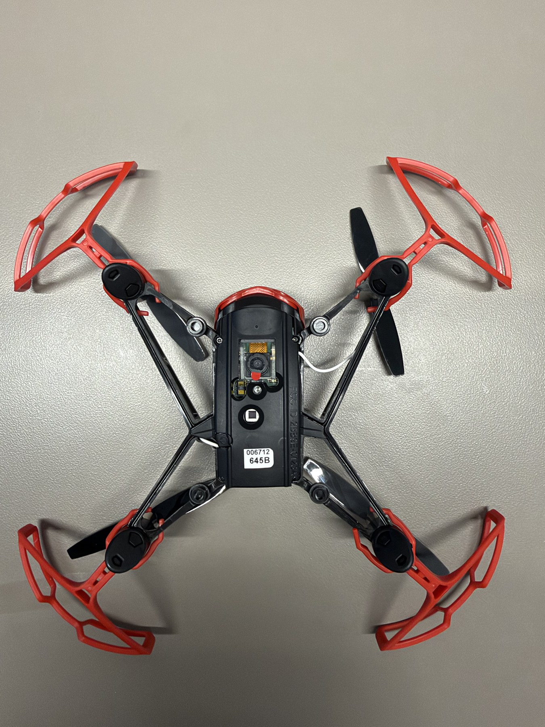

HOPPER INFORMATION SERIES
SENSOR SUITE
Hopper sensor suite
How an indoor quadrotor measures motion, sees the room, and stays stable without GPS.
NO GPS
INDOOR SENSING
SENSOR FUSION
DECK 01 | SENSOR SUITE
Notes:
Introduce the real Hopper and separate visible external sensors from internal flight electronics.
[Sources]
- User-supplied high-resolution photograph: drone_photos/IMG_4476.jpeg
[/Sources]

Slide 2
SENSOR SUITE / 02
REAL HARDWARE
External sensors see the room; internal sensors track motion
INSIDE THE BODY
FORWARD RGB CAMERA
• IMU: accelerometers + gyroscopes.
• Barometer: air-pressure change.
• Magnetometer: heading cue.
• Temperature sensing and the flight controller support compensation and fusion.
• Supplies the Wi-Fi video stream used by Hopper Studio vision.
• It is not part of the Bluetooth flight-control link.
DOWNWARD SENSING MODULE
• Optical flow estimates motion over the floor.
• Time-of-flight range provides a short-range floor-distance cue.
NO GPS / GNSS
Visible hardware
No latitude/longitude, global waypoint position, or GPS-derived speed.
The exposed underside makes the camera and downward sensor cluster easy to inspect.
WRC | HOPPER STUDIO | INFORMATION SERIES
2 / 7
Notes:
The low-resolution sensor-map reference is intentionally not used. The new layout uses the authentic high-resolution underside photograph and distinguishes visible modules from internal sensors. Exact internal component placement is not inferred from the photograph.
[Sources]
- User-supplied high-resolution photograph: drone_photos/IMG_4476.jpeg
- Existing Hopper sensor lesson: local_site/scripts/generate-information-pdfs.py
[/Sources]

Slide 3
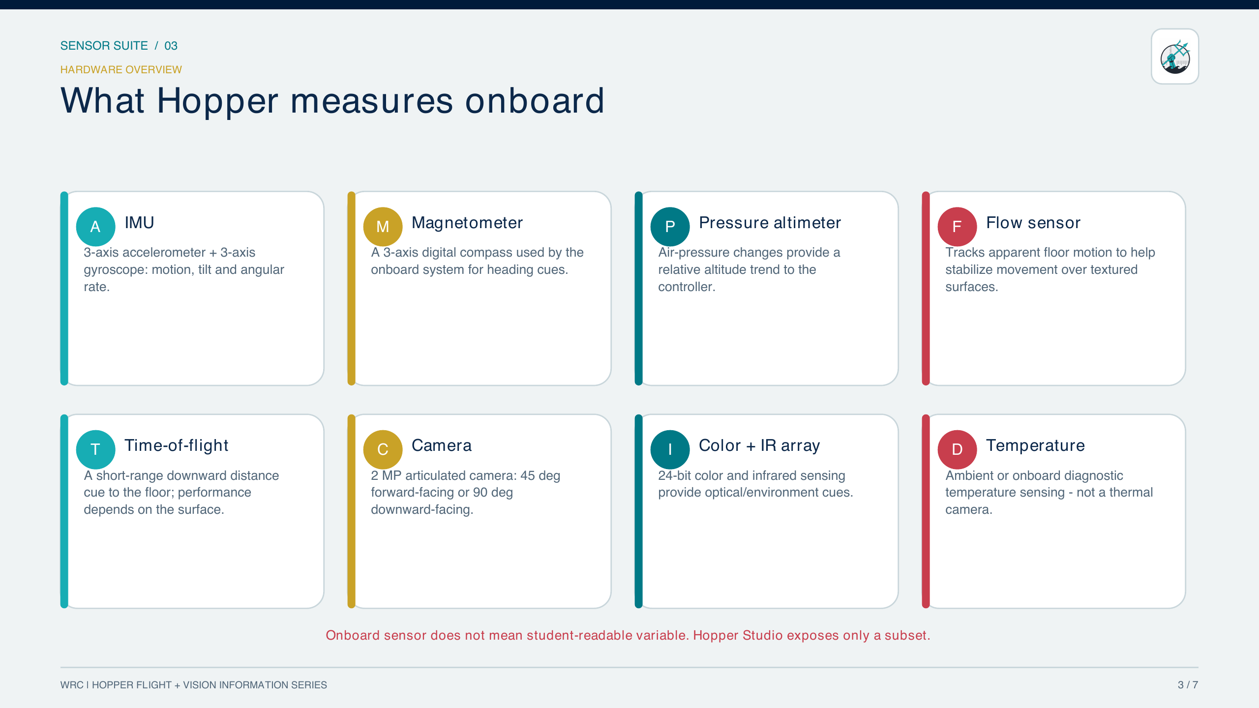
SENSOR SUITE / 03
3 / 7
Notes:
Existing sensor-suite lesson content.
[Sources]
- Hopper Studio project README and sensor lesson.
[/Sources]

Slide 4
SENSOR SUITE / 04
FROM MEASUREMENT TO MOTOR
Sensor fusion closes the control loop
1
Mission
2
Controller
3
Motors
4
Aircraft
Blocks or JavaScript request a motion.
Target thrust and attitude are calculated.
Four rotor speeds create force and torque.
The body moves through the room.
ONBOARD SENSOR FUSION
STATE ESTIMATE
Fused attitude, rates,
height trend, and motion
IMU
FLOW
TOF
BARO
MAG
The controller corrects motor commands from one fused state estimate—not from any single raw sensor.
WRC | HOPPER STUDIO | INFORMATION SERIES
4 / 7
Notes:
The onboard controller combines inertial, optical-flow, range, pressure, and magnetic cues into an estimated state. The state estimate—not any one raw sensor—feeds the controller, which continually updates the motor command.
[Sources]
- Hopper Studio project README and sensor lesson.
[/Sources]

Slide 5
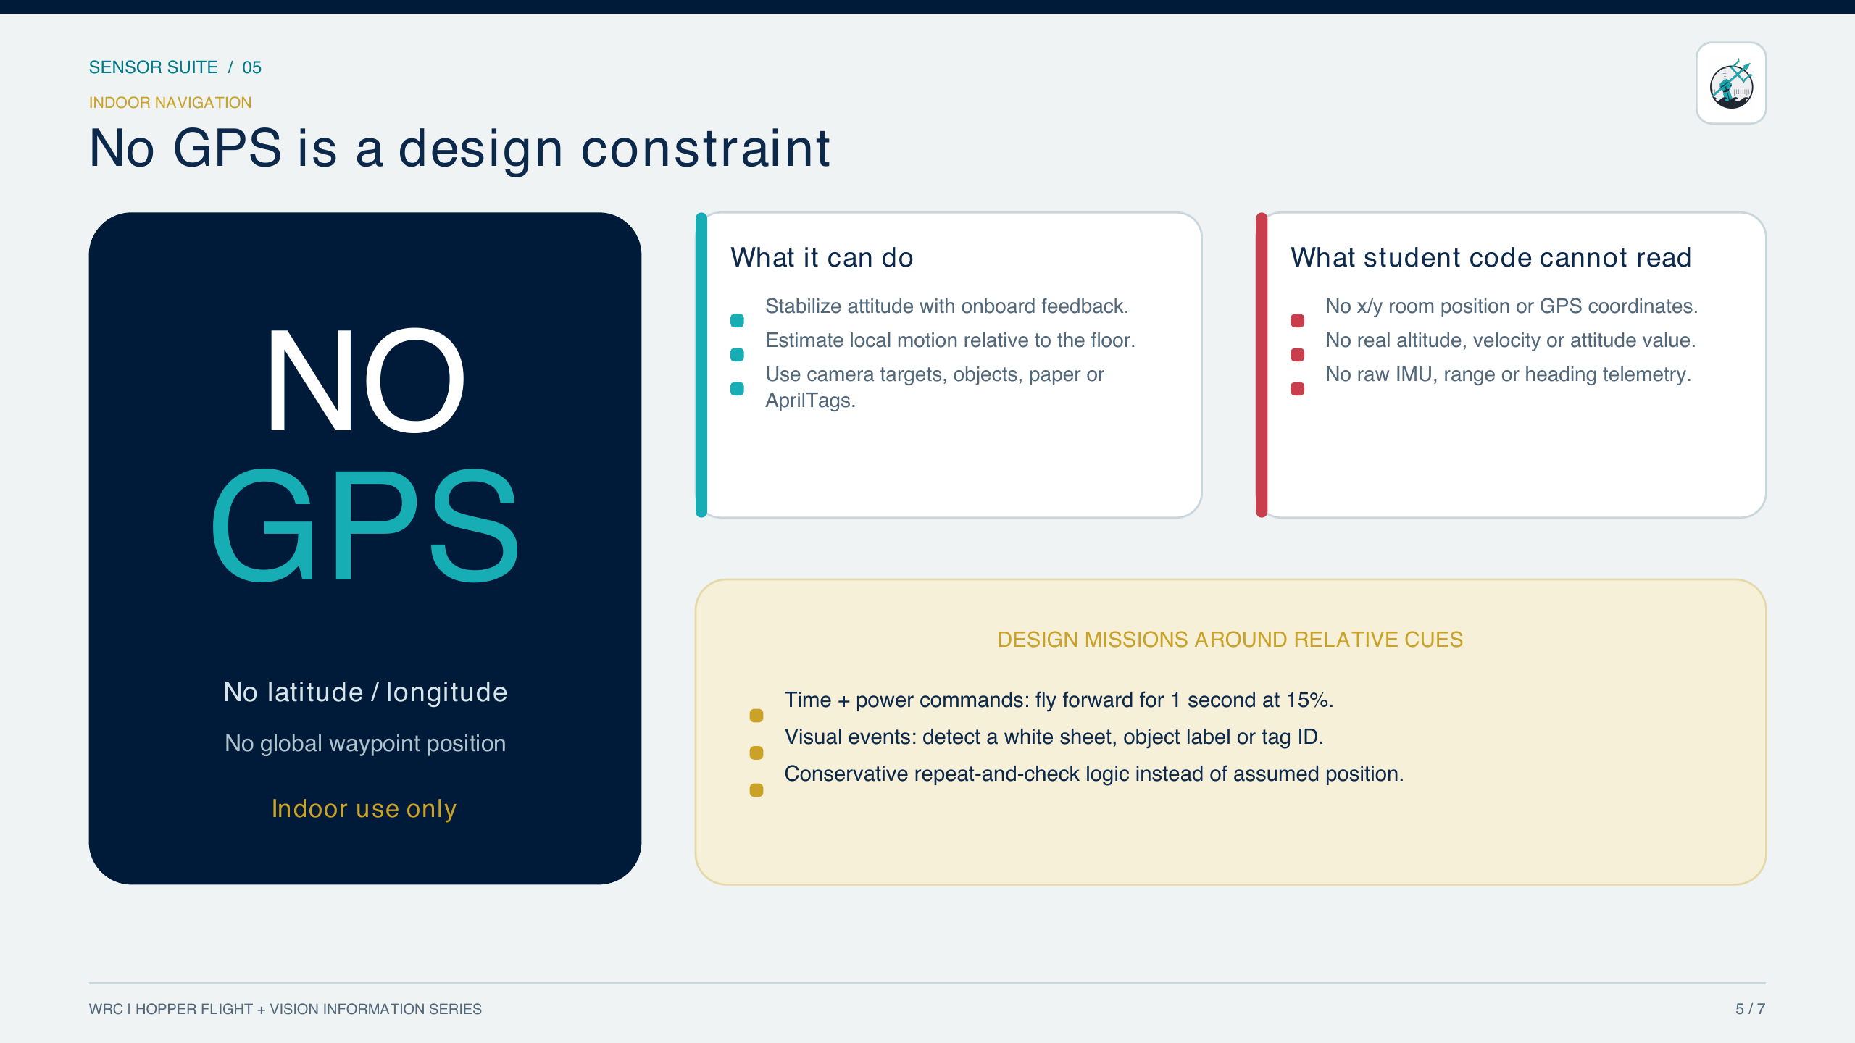
SENSOR SUITE / 05
5 / 7
Notes:
Existing sensor-suite lesson content.
[Sources]
- Hopper Studio project README and sensor lesson.
[/Sources]

Slide 6
SENSOR SUITE / 06
HOPPER STUDIO
Camera and communication are separate paths
01
02
03
04
FLIGHT PATH
Program
Bluetooth
Flight controller
Motors
Flight command or state request.
Low-rate command and telemetry link.
Closes the fast onboard control loops.
Produce thrust and torque.
Independent links: Bluetooth may be connected while camera pixels are unavailable.
01
02
03
04
CAMERA PATH
Camera
Wi-Fi / HTTP
Canvas
Vision
Video from 192.168.2.1.
Separate image-data path.
Hopper Studio reads fresh pixels.
Threshold, COCO, custom model, or AprilTag.
WRC | HOPPER STUDIO | INFORMATION SERIES
6 / 7
Notes:
Bluetooth controls flight and reports limited state. Wi-Fi/HTTP transports the camera stream. The paths are independent, so a green Bluetooth connection does not prove that browser-readable pixels are available.
[Sources]
- Hopper Studio implementation: local_site/lib/drone.ts
- Hopper Studio implementation: local_site/lib/vision.ts
- Hopper Studio camera proxy: local_site/desktop/server.mjs and app/api/camera/route.ts
[/Sources]

Slide 7
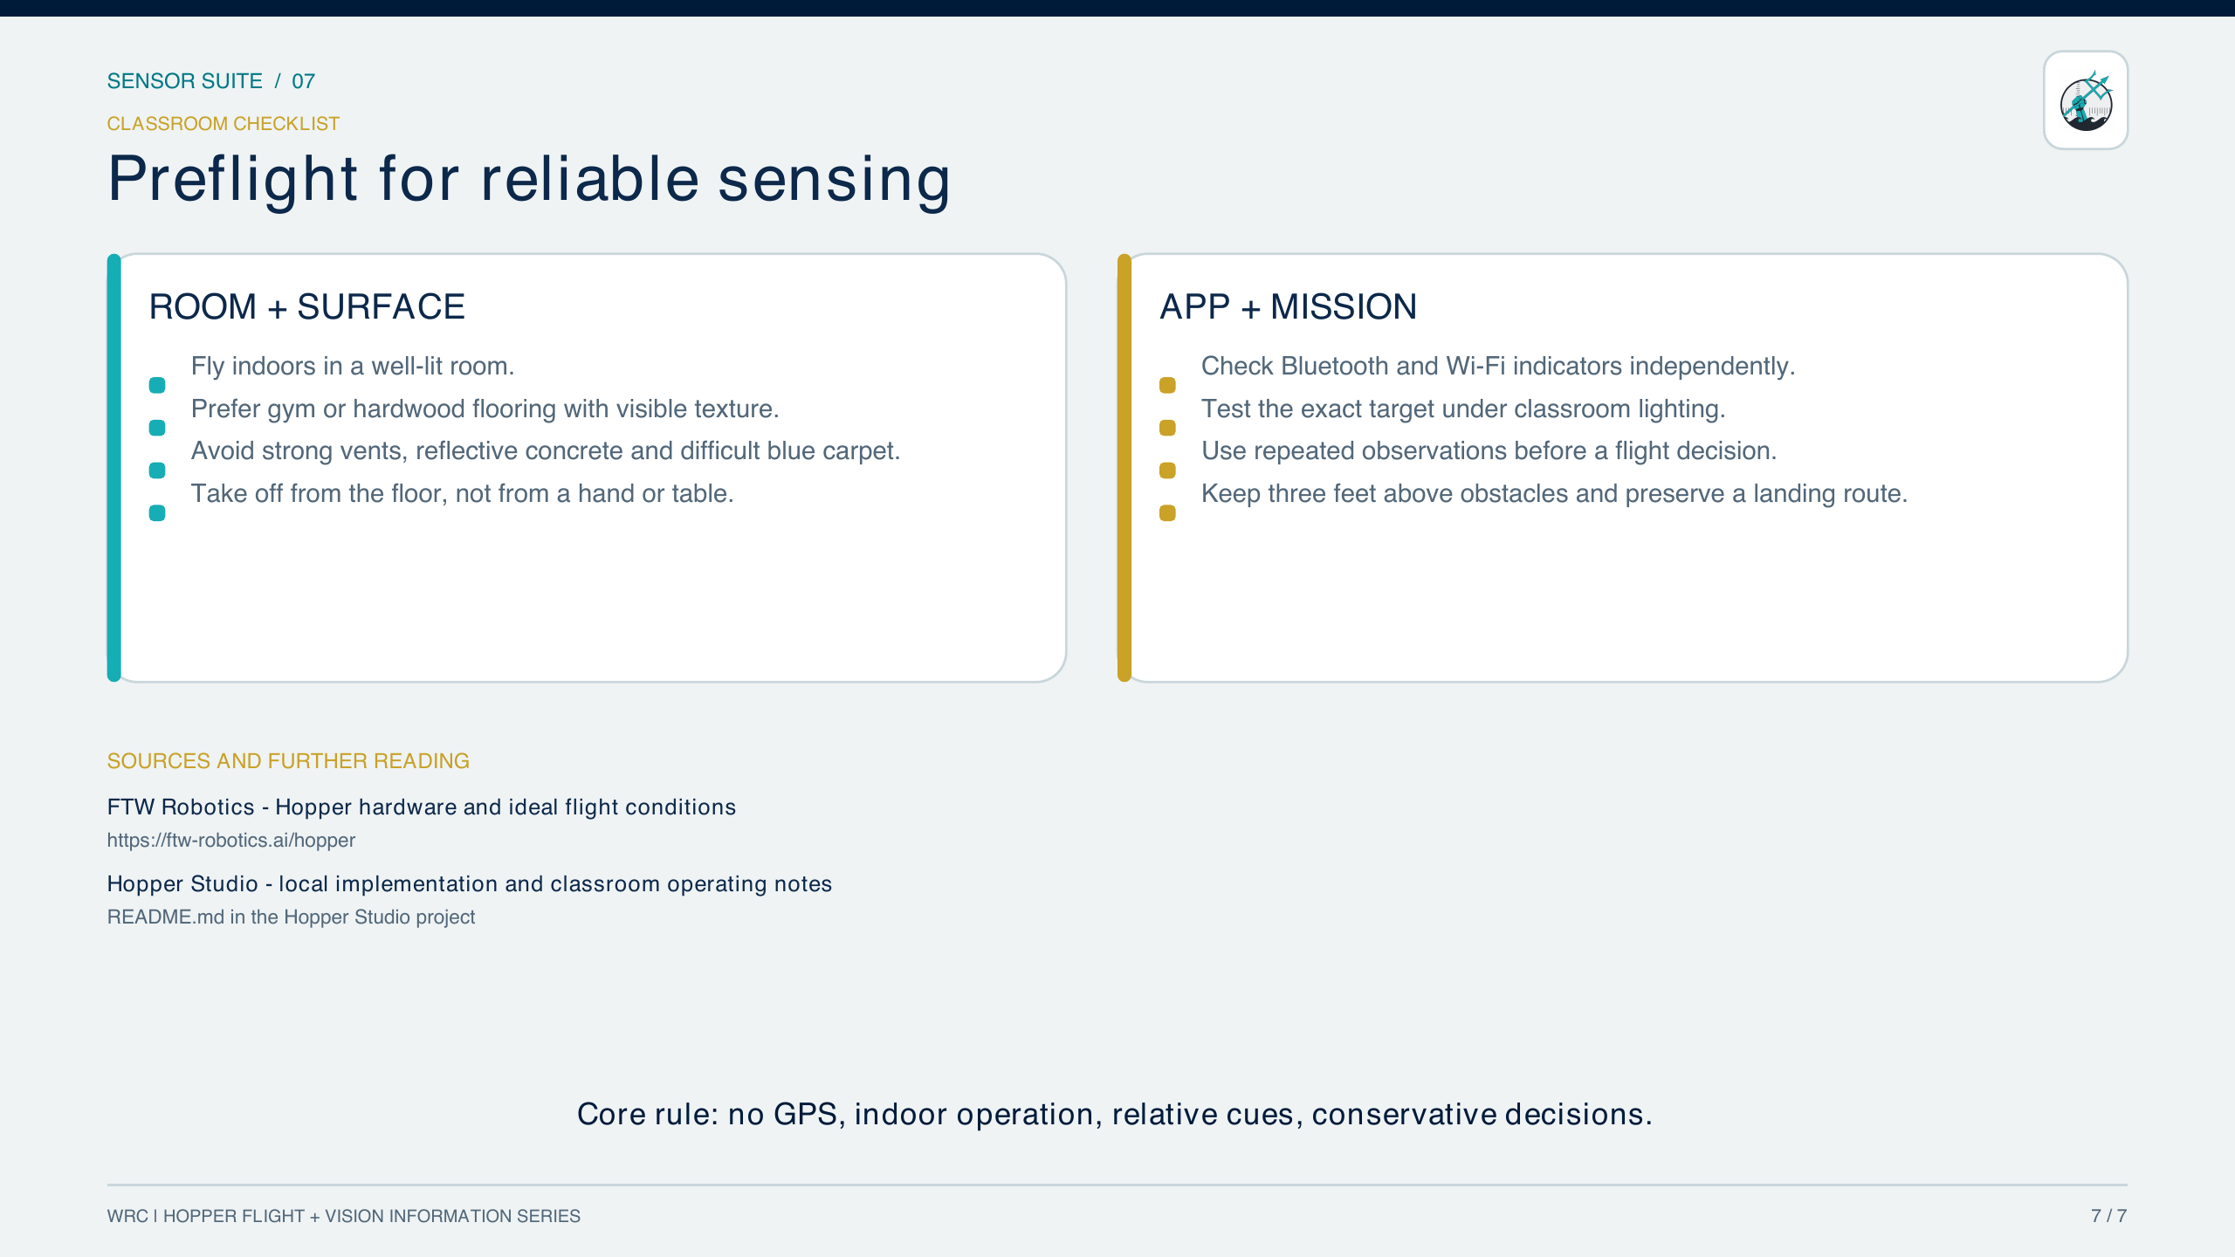
SENSOR SUITE / 07
7 / 7
Notes:
Existing sensor-suite preflight checklist.
[Sources]
- Hopper Studio project README and sensor lesson.
[/Sources]

