Slide 1
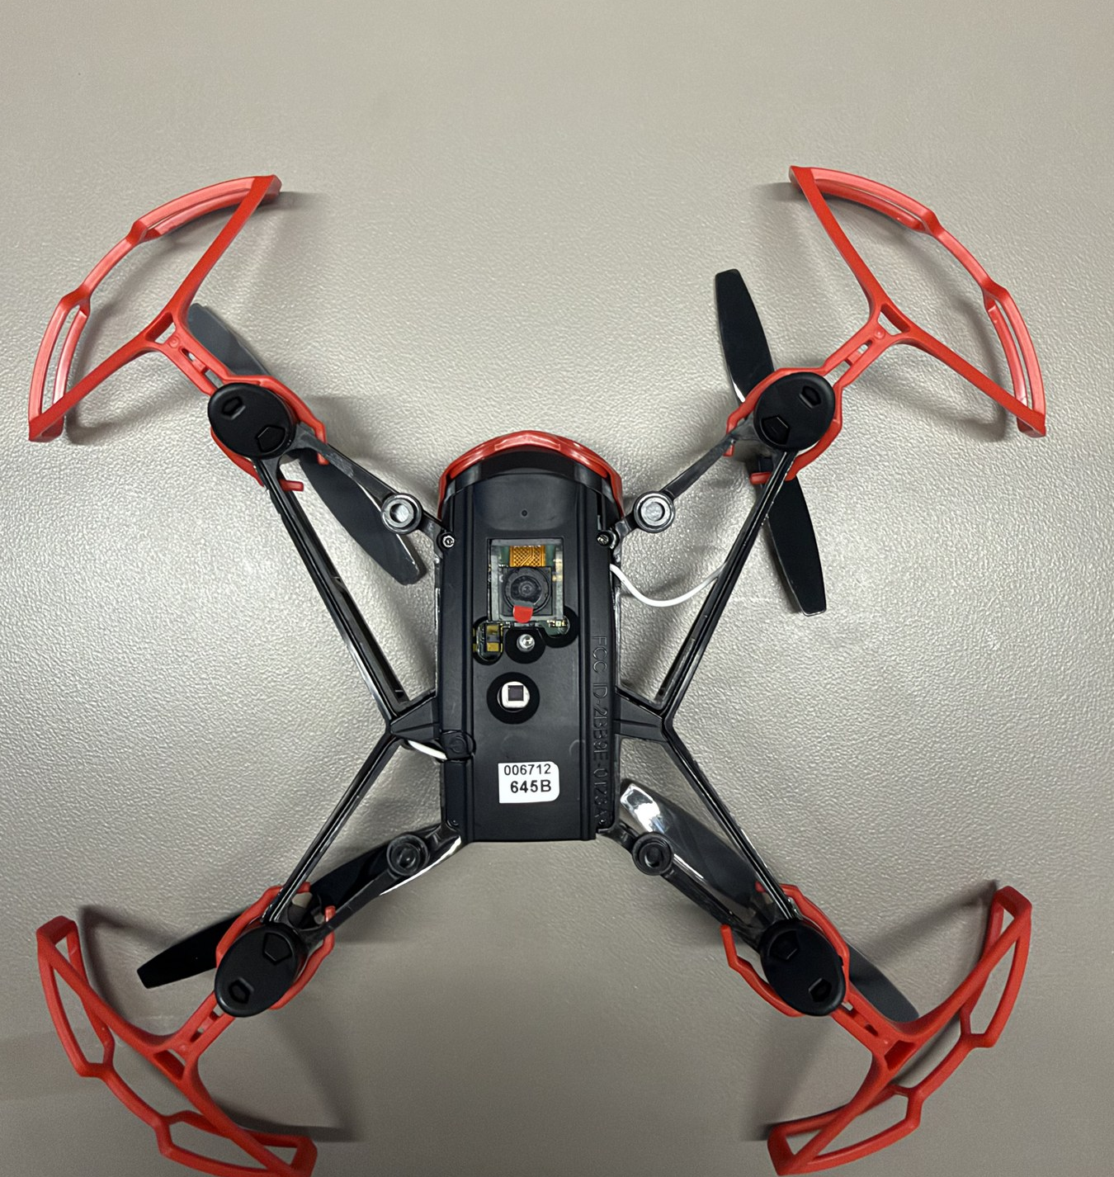

HOPPER INFORMATION SERIES
THRESHOLDING
Thresholding with Hopper
Turn camera brightness into an explainable binary measurement—and test it safely in a real room.
PIXELS
BINARY MASKS
SAFE DECISIONS
DECK 05 | THRESHOLDING
Notes:
Introduce thresholding as a deterministic image rule, not a learned model. The authentic camera hardware anchors the image-processing lesson in the actual aircraft.
[Sources]
- User-supplied high-resolution photograph: drone_photos/IMG_4476.jpeg
- Hopper Studio threshold implementation: local_site/lib/vision.ts.
[/Sources]

Slide 2
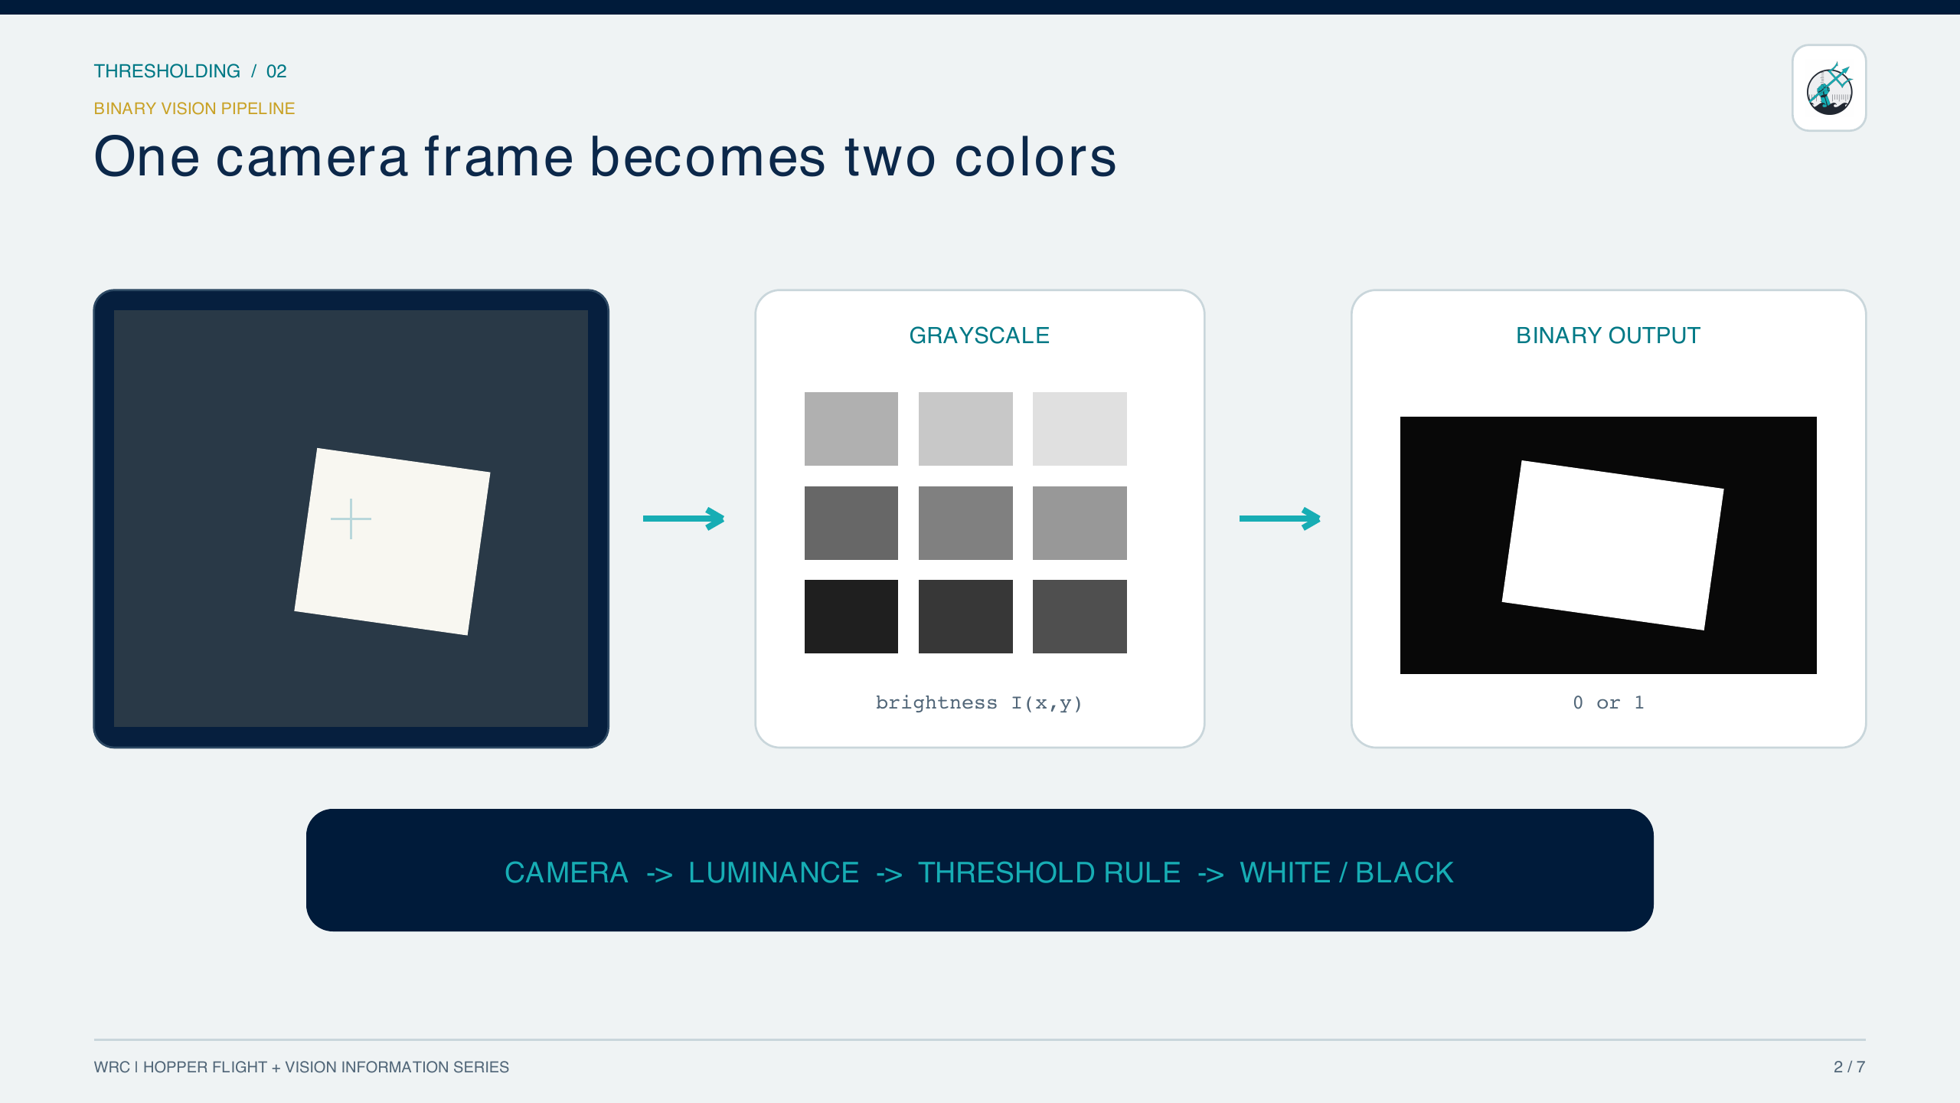
THRESHOLDING / 02
2 / 7
Notes:
Existing thresholding lesson content.
[Sources]
- Hopper Studio project source and locally generated lesson materials.
[/Sources]

Slide 3
THRESHOLDING / 03
BINARY DECISION
One threshold turns a grayscale frame into a mask
1 · CONVERT COLOR TO LUMINANCE
3 · MEASURE WHITE COVERAGE
2 · APPLY THE SLIDER THRESHOLD
How to read it
• T is the 0–100 slider value; 2.55T maps it to an 8-bit intensity.
• B = 1 means white in the binary mask; B = 0 means black.
• Invert swaps the classes: Bᵢₙᵥ = 1 − B.
Thresholding uses a rule you can inspect—not a learned neural network.
WRC | HOPPER STUDIO | INFORMATION SERIES
3 / 7
Notes:
Equations are typeset from LaTeX. The luminance formula is the standard Rec. 709 weighting used here to explain grayscale conversion; the app’s implementation should remain the operational reference.
[Sources]
- https://docs.opencv.org/4.x/d7/d4d/tutorial_py_thresholding.html
- Hopper Studio implementation: local_site/lib/vision.ts
[/Sources]

Slide 4
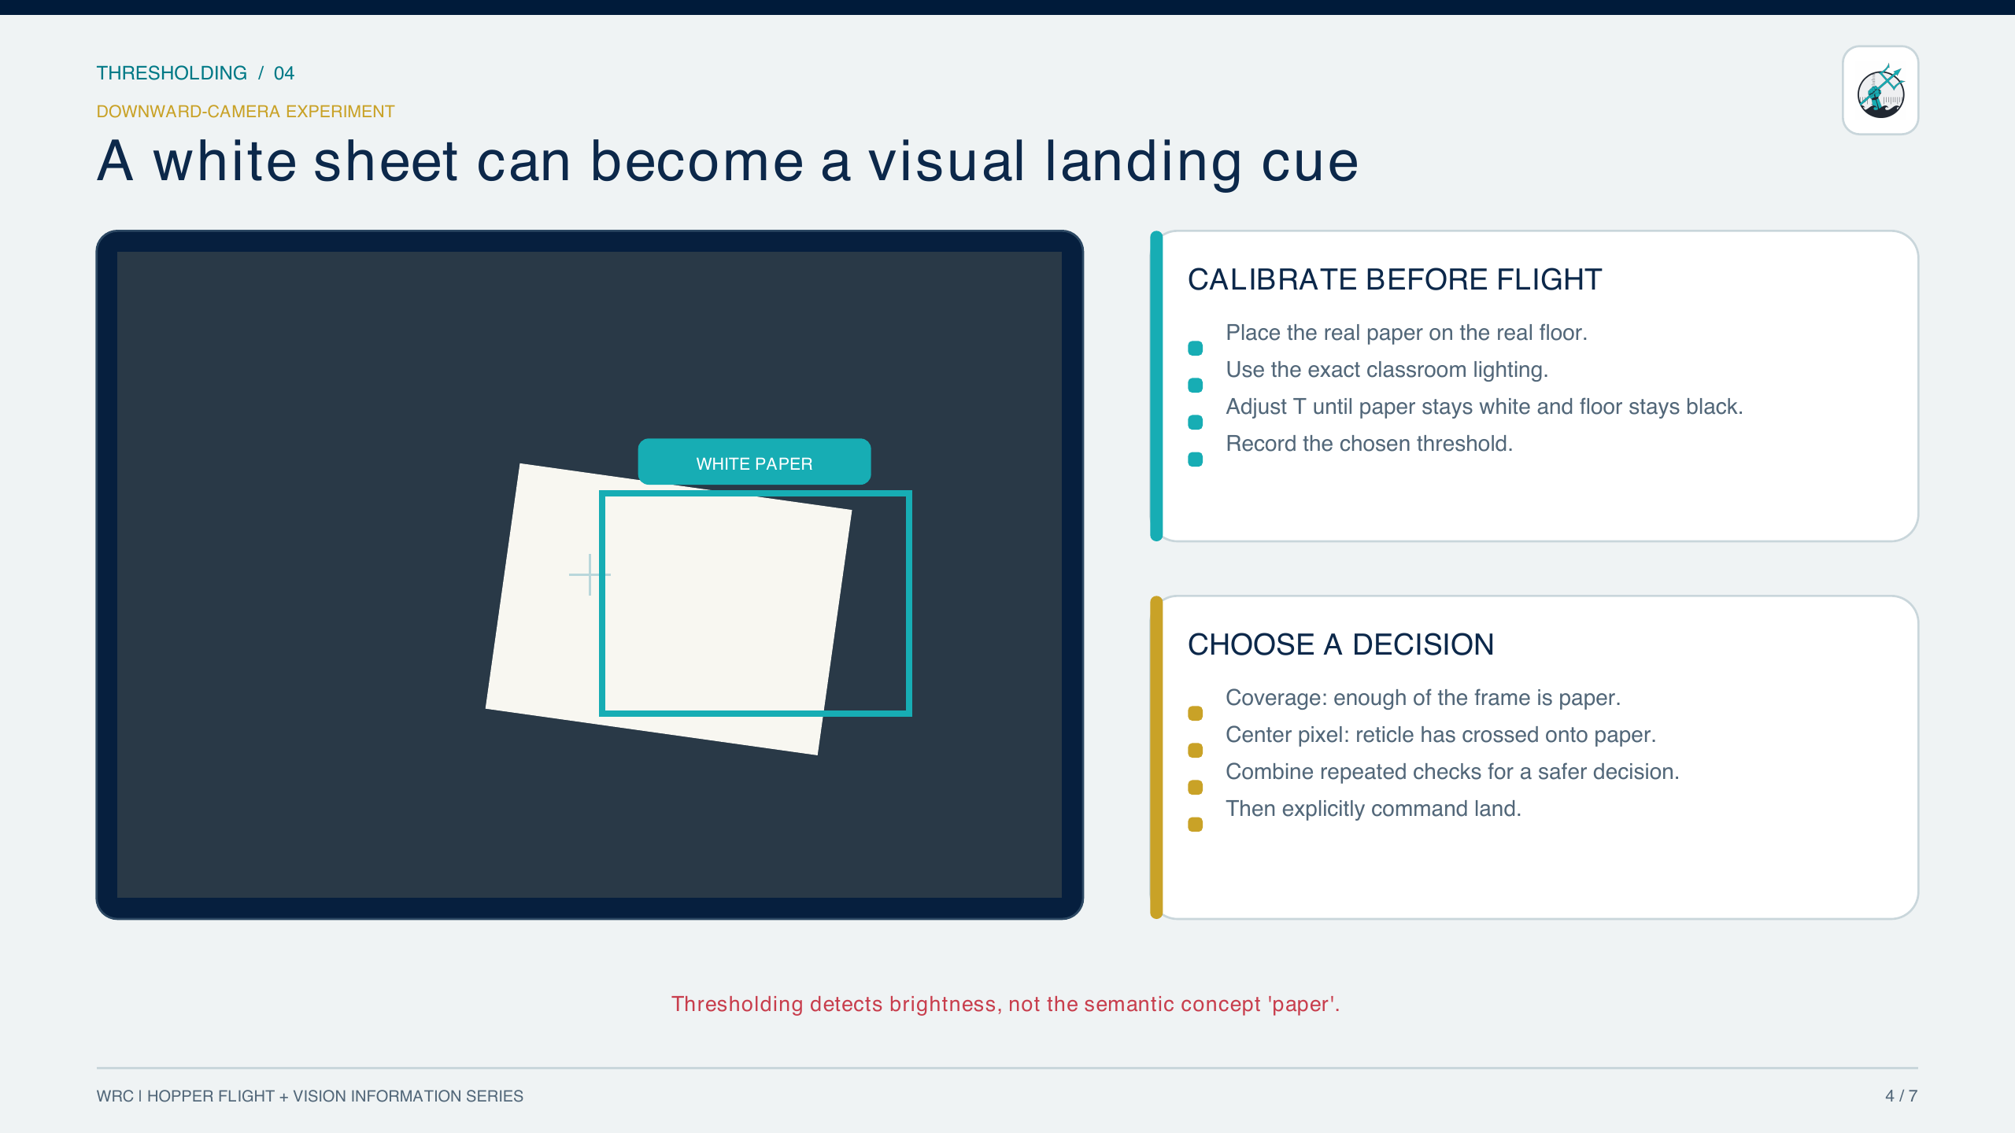
THRESHOLDING / 04
4 / 7
Notes:
Existing thresholding lesson content.
[Sources]
- Hopper Studio project source and locally generated lesson materials.
[/Sources]

Slide 5
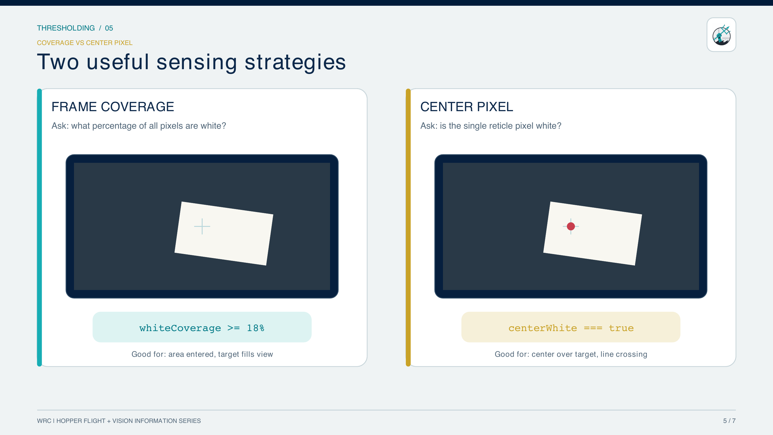
THRESHOLDING / 05
5 / 7
Notes:
Existing thresholding lesson content.
[Sources]
- Hopper Studio project source and locally generated lesson materials.
[/Sources]

Slide 6
THRESHOLDING / 06
MISSION CODE
Require two consistent scans—then land safely
BOUNDED TWO-HIT CHECK · PROGRAM.JS
VISION METHOD
1 await drone.takeOff();
2 let consecutiveHits = 0;
3
4 try {
5 for (let attempt = 0; attempt < 8; attempt += 1) {
6 const seen = await vision.seesBinary("white", 60, false, 18);
7 consecutiveHits = seen ? consecutiveHits + 1 : 0;
8
9 if (consecutiveHits === 2) {
10 await drone.hover();
11 break;
12 }
13 await drone.wait(0.35);
14 }
15 } finally {
16 await drone.land();
17 }
await vision.seesBinary(color, threshold, invert, minimumCoverage)
color — "white" | "black"
threshold — 0…100 brightness%; default 60
invert — boolean; default false
minimumCoverage — 0…100 frame%; default 10
returns — Promise<boolean> after a fresh scan
throws — if camera pixels cannot be captured
WHY THIS PATTERN IS SAFER
• Two hits reduce single-frame triggers.
• Eight attempts bound the search.
• finally lands on success, timeout, or error.
• break stops the loop after success.
WRC | HOPPER STUDIO | INFORMATION SERIES
6 / 7
Notes:
The code now matches the lesson claim: it requires two consecutive observations, limits the number of scans, exits immediately after success, and guarantees an explicit landing in finally. seesBinary performs a fresh threshold scan and returns a Promise<boolean>.
[Sources]
- Hopper Studio implementation: local_site/lib/vision.ts, scanThreshold and seesBinary.
- Hopper Studio flight API: local_site/lib/drone.ts.
[/Sources]

Slide 7
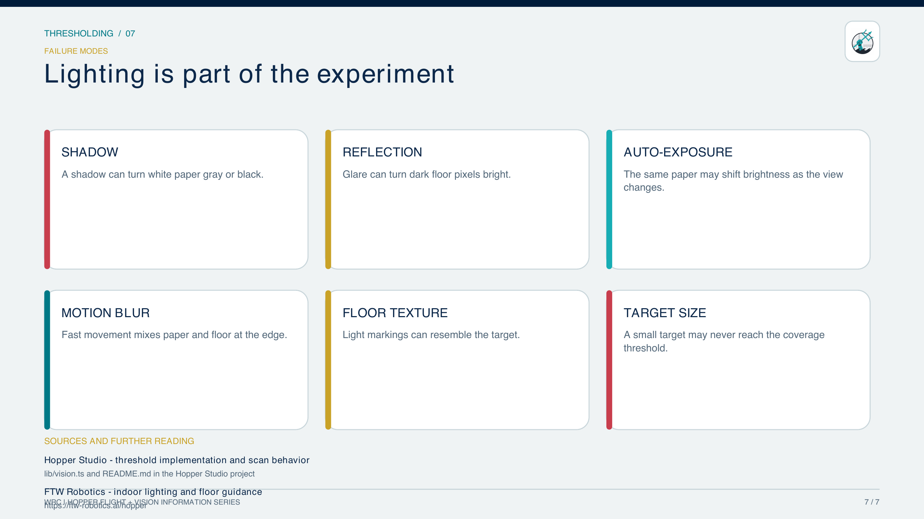
THRESHOLDING / 07
SOURCES
Hopper Studio lib/vision.ts · FTW Robotics indoor-flight guidance
WRC | HOPPER STUDIO | INFORMATION SERIES
7 / 7
Notes:
Lighting, reflection, blur, floor texture, and target size are experimental variables.
[Sources]
- Hopper Studio implementation: local_site/lib/vision.ts
- https://ftw-robotics.ai/hopper
[/Sources]

