Slide 1
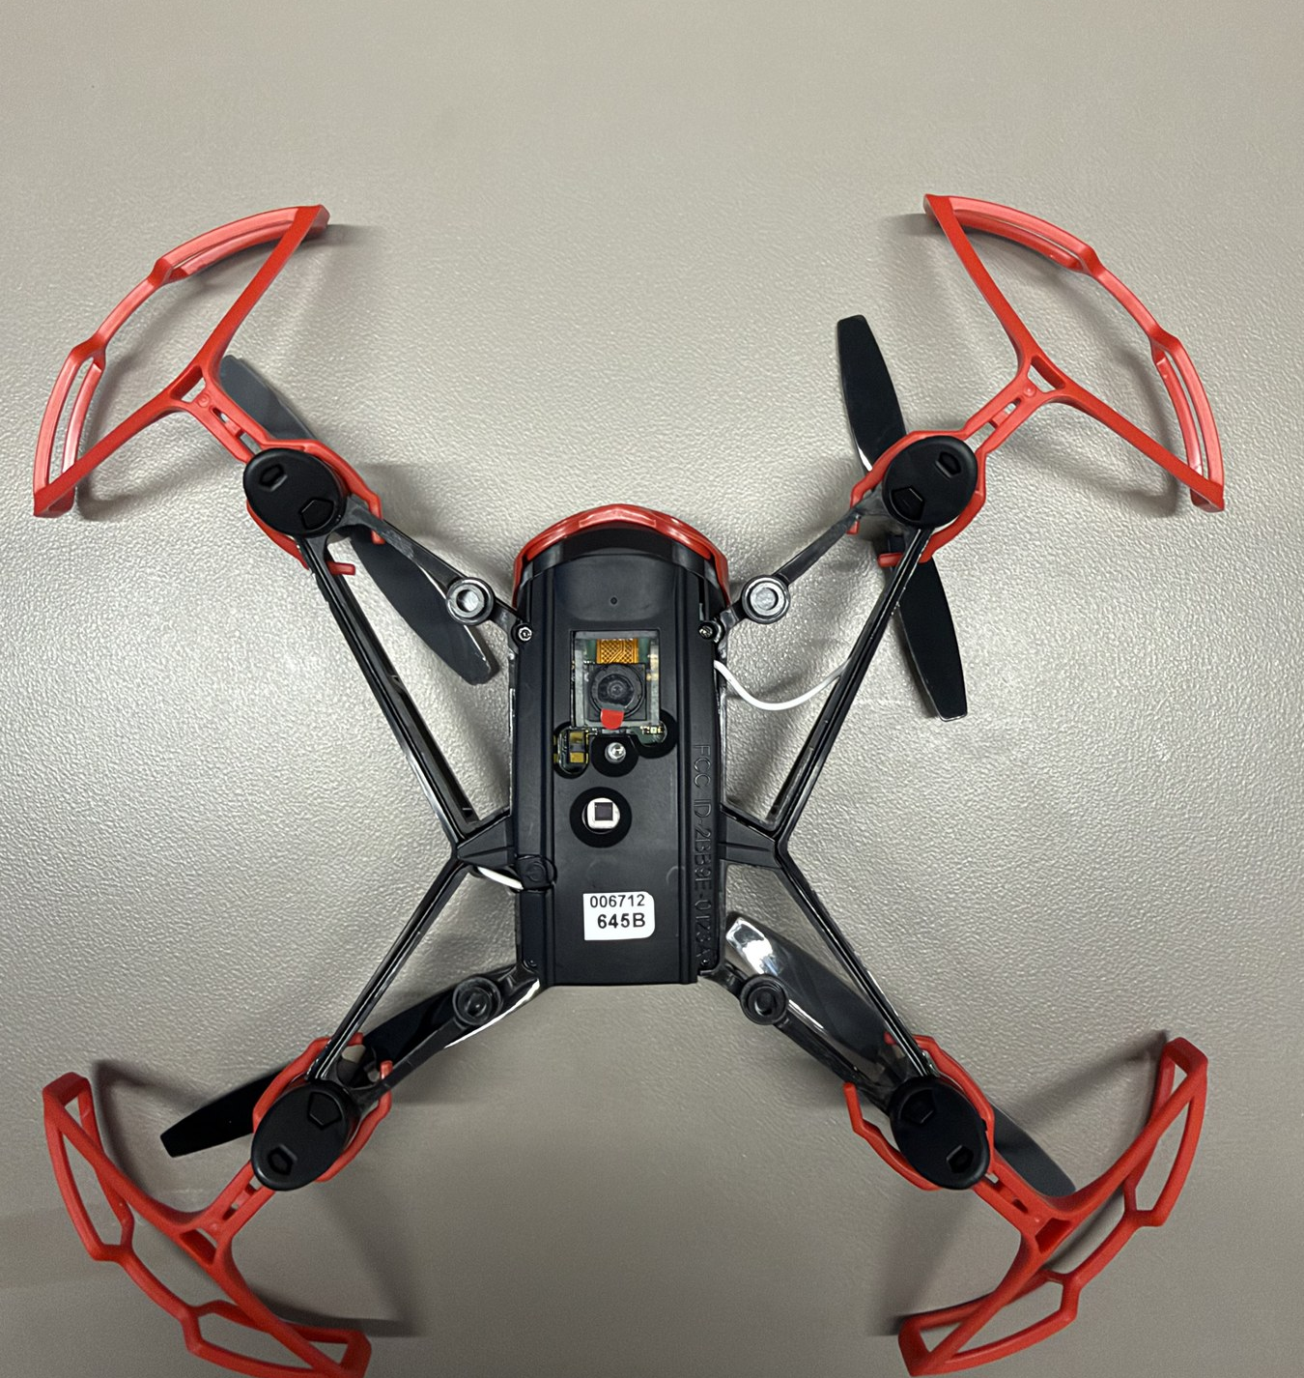

HOPPER INFORMATION SERIES
OBJECT DETECTION
Object detection and COCO
How Hopper Studio turns camera pixels into labeled boxes with a host-side neural network.
COCO-SSD
MOBILENETV2
BOUNDING BOXES
DECK 06 | OBJECT DETECTION
Notes:
The real-camera detector runs in Hopper Studio on the browser or desktop host. It is not an onboard neural network in the quadrotor flight controller.
[Sources]
- User-supplied high-resolution photograph: drone_photos/IMG_4476.jpeg
- https://cocodataset.org/
- Hopper Studio implementation: local_site/lib/vision.ts.
[/Sources]

Slide 2
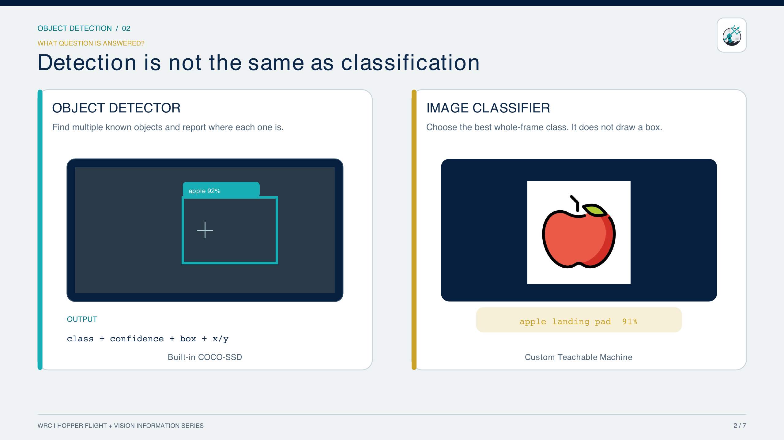
OBJECT DETECTION / 02
2 / 8
Notes:
Detection localizes objects; classification labels the overall frame.
[Sources]
- https://github.com/tensorflow/tfjs-models/tree/master/coco-ssd
[/Sources]

Slide 3
OBJECT DETECTION / 03
TRAINING DATA
COCO: common objects pictured in real context
330K
>200K
1.5M
80
IMAGES
LABELED IMAGES
OBJECT INSTANCES
OBJECT CATEGORIES
Why “in context” matters
What COCO does not guarantee
• Scenes contain multiple objects, clutter, overlap, and non-iconic viewpoints.
• Annotations include bounding boxes and segmentation masks—not only image labels.
• The 80 detector classes cover everyday categories such as person, car, truck, stop sign, chair, laptop, bottle, and sports ball.
• A class outside the 80-label vocabulary cannot be named.
• A familiar class may still be missed when it is tiny, blurred, occluded, or viewed unlike the training data.
• A confidence score is a model score—not certainty.
Dataset scale creates breadth; classroom testing reveals the limits.
WRC | HOPPER STUDIO | INFORMATION SERIES
3 / 8
Notes:
COCO is a large-scale dataset for detection, segmentation, keypoints, and captioning. Use the official figures shown on the dataset home page.
[Sources]
- https://cocodataset.org/
- https://cocodataset.org/workshop/coco-lvis-eccv-2020.html
[/Sources]

Slide 4
OBJECT DETECTION / 04
DEFAULT NEURAL NETWORK
Inside the shipped COCO-SSD detector
HOST-SIDE · NOT ONBOARD THE QUAD
CAMERA PIXELS
SSDLITE MOBILENETV2 300
SIX FEATURE MAPS
BOX + CLASS HEADS
INTERNAL TENSOR · 300×300×3
19×19×576
3 anchors/cell
1,917
10×10×1280
6 anchors/cell
CANDIDATE ANCHORS
5×5×512
6 anchors/cell
3×3×256
6 anchors/cell
Each anchor predicts
Canvas capture
≤ 420 px wide
[1, H, W, 3] RGB
2×2×256
6 anchors/cell
4 box offsets + 91 logits
1×1×128
6 anchors/cell
JavaScript NMS → ≤10 boxes
80 named COCO classes
Depthwise + inverted-residual
convolutional feature extractor
300×300×3
4,500,927
1,917
0.55
NO MODEL
INTERNAL INPUT TENSOR
COEFFICIENTS / 18.03 MB
ANCHORS ACROSS 6 MAPS
DEFAULT SCORE THRESHOLD
SIMULATOR: SYNTHETIC BOXES
WRC | HOPPER STUDIO | INFORMATION SERIES
4 / 8
Notes:
This is the shipped default detector: TensorFlow.js COCO-SSD 2.2.3 with the lite_mobilenet_v2 base, accurately described as SSDLite MobileNetV2 300. Hopper Studio captures an aspect-preserving canvas no wider than 420 pixels. The frozen graph accepts [1,H,W,3], resizes the full image to [1,300,300,3], normalizes to approximately minus one through one, and produces six prediction maps. The model contains 4,500,927 stored inference coefficients: 2,869,184 in the feature extractor and 1,631,743 in the heads. Weight shards total 18,034,528 bytes. The simulator supplies synthetic detections instead of running this graph.
[Sources]
- Hopper Studio implementation: local_site/lib/vision.ts
- Shipped graph: local_site/public/models/coco-ssd/model.json.
- Installed implementation: local_site/node_modules/@tensorflow-models/coco-ssd/dist/coco-ssd.node.js.
- Local dependency declaration: local_site/package.json.
[/Sources]

Slide 5
OBJECT DETECTION / 05
DECISION THRESHOLD
Confidence controls which boxes become actionable
If the threshold is…
person · 0.73
• 0.50 → this box is returned.
• 0.75 → this box is filtered out.
• Lower thresholds show more candidates and more false alarms.
• Higher thresholds show fewer, stronger candidates and more misses.
x = 304
y = 250
w = 210
h = 162
Coordinate rule
• Bounding boxes use [x, y, width, height].
• Hopper Studio stores the box center as a signed percentage from frame center.
Tune confidence on the exact room, target size, camera angle, and lighting.
WRC | HOPPER STUDIO | INFORMATION SERIES
5 / 8
Notes:
Demonstrate how the minimum-confidence slider changes returned boxes. A threshold is an operating-point choice, not a change to the model weights.
[Sources]
- https://github.com/tensorflow/tfjs-models/tree/master/coco-ssd
- Hopper Studio implementation: local_site/lib/vision.ts and components/HopperStudio.tsx
[/Sources]

Slide 6
OBJECT DETECTION / 06
MISSION CODE
Use fresh detections and document every argument
FRESH DETECTION DECISION · PROGRAM.JS
OBJECT DETECTOR
1 await drone.takeOff();
2 try {
3 const detections = await vision.detectObjects(0.65);
4 const person = detections.find(
5 (item) => item.class === "person",
6 );
7
8 if (person && person.centerX > 10) {
9 await drone.fly("right", 0.4, 12);
10 }
11 } finally {
12 await drone.land();
13 }
await vision.detectObjects(minimumConfidence, announceScan)
minimumConfidence — 0…1 score; default 0.55
announceScan — boolean; default true
returns — Promise<VisionDetection[]>; at most 10 boxes
fields — class, score, bbox, frame size, centerX/centerY
throws — if local model or camera pixels are unavailable
note — simulator returns synthetic detections
FLIGHT COMMAND USED ABOVE
await drone.fly(direction, seconds, power)
direction — "right" here; six direction strings are accepted
seconds — number ≥ 0; example 0.4 s
power — −100…100%; example 12
returns — Promise<void>; await before landing
WRC | HOPPER STUDIO | INFORMATION SERIES
6 / 8
Notes:
detectObjects performs a fresh scan and returns the complete detection array. This avoids the ambiguity of objectCoordinate, which is synchronous, reads the last saved coordinate, and returns zero both for a centered target and for missing/stale state. The example explicitly lands in finally.
[Sources]
- Hopper Studio implementation: local_site/lib/vision.ts, detectObjects and objectCoordinate.
- Hopper Studio flight API: local_site/lib/drone.ts, fly and land.
[/Sources]

Slide 7
OBJECT DETECTION / 07
MODEL CHOICE
Built-in detector or custom classifier?
BUILT-IN COCO-SSD DETECTOR
CUSTOM TEACHABLE MACHINE CLASSIFIER
• Finds multiple objects and draws a box around each.
• Returns one of 80 fixed COCO labels.
• No training required; useful for people, vehicles, stop signs, laptops, and more.
• Choose this when location or multiple objects matter.
• You choose mission-specific labels: red flag, blue flag, safe pad, obstacle.
• Fast transfer learning with your own classroom examples.
• Returns probabilities for the whole frame—not bounding boxes.
• Choose this when the frame’s dominant class answers the mission question.
Need custom labels AND boxes?
That is a custom object detector: collect box-annotated images and train a detection architecture. Hopper Studio’s Teachable Machine path is classification.
WRC | HOPPER STUDIO | INFORMATION SERIES
7 / 8
Notes:
Keep detection and classification vocabulary precise. The custom-label advantage is real, but Teachable Machine’s standard image project in this workflow labels the full frame.
[Sources]
- https://github.com/tensorflow/tfjs-models/tree/master/coco-ssd
- https://codelabs.developers.google.com/tensorflowjs-transfer-learning-teachable-machine
[/Sources]

Slide 8
OBJECT DETECTION / 08
EXPERIMENT DESIGN
Treat every detection as a measurement with limits
MAKE COCO EASIER
KNOWN FAILURE MODES
• Use a real label from the 80-class list.
• Choose large, well-separated objects.
• Test distance, rotation, clutter, and background.
• Keep confidence aligned with false-positive and miss costs.
• Small or partly hidden objects.
• Motion blur and low light.
• Unusual viewpoints and look-alike classes.
• A target that simply is not in COCO’s vocabulary.
Recommended sources
COCO dataset · TensorFlow.js COCO-SSD · SSD paper · MobileNetV2 paper · Hopper Studio source
SCAN → FILTER → LOCATE → DECIDE
WRC | HOPPER STUDIO | INFORMATION SERIES
8 / 8
Notes:
Close by asking students to name one false-positive cost and one missed-detection cost for their mission.
[Sources]
- https://cocodataset.org/
- https://github.com/tensorflow/tfjs-models/tree/master/coco-ssd
- https://arxiv.org/abs/1512.02325
- https://arxiv.org/abs/1801.04381
- Hopper Studio implementation: local_site/lib/vision.ts
[/Sources]

