Slide 1
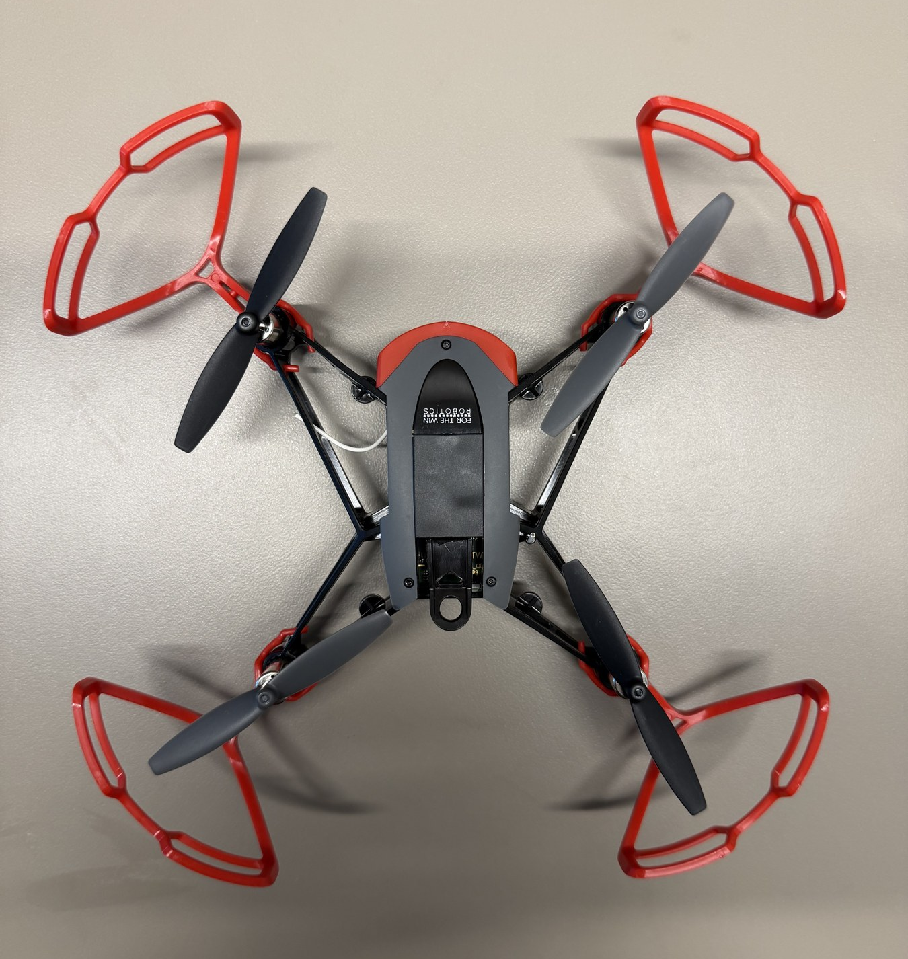

HOPPER INFORMATION SERIES
TEACHABLE MACHINE
Teachable Machine models
Build mission-specific whole-frame labels, export the browser model, and validate it honestly.
224×224 RGB
TRANSFER LEARNING
CUSTOM LABELS
DECK 07 | TEACHABLE MACHINE
Notes:
Teachable Machine models are custom, host-side classifiers. They are distinct from Hopper Studio's built-in COCO-SSD detector and do not run on the flight controller.
[Sources]
- User-supplied high-resolution photograph: drone_photos/IMG_4479.jpeg
- https://teachablemachine.withgoogle.com/
[/Sources]

Slide 2
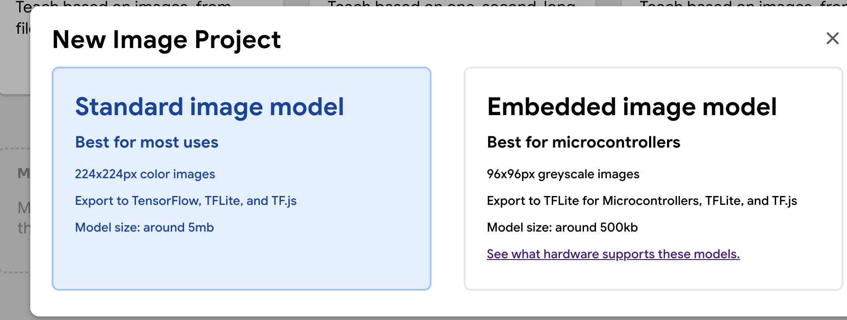
TEACHABLE MACHINE / 02
START THE PROJECT
Choose a standard image model
For Hopper Studio
• Select Image Project.
• Choose Standard image model.
• Export TensorFlow.js files after training.
• Keep model.json, weights.bin, and metadata.json together.
Use Standard image model: 224×224 color input and TensorFlow.js export. The embedded option targets microcontrollers.
WRC | HOPPER STUDIO | INFORMATION SERIES
2 / 10
Notes:
Use the student-supplied screenshot to point to the Standard image model choice.
[Sources]
- User-supplied screenshot: drone_photos/image.png
- https://teachablemachine.withgoogle.com/
[/Sources]

Slide 3
TEACHABLE MACHINE / 03
CLASS DESIGN
Custom labels are the advantage—“other” is the guardrail
RED FLAG
BLUE FLAG
SAFE PAD
OTHER / BACKGROUND
Red fabric, multiple angles
Blue fabric, multiple distances
Target pad under flight lighting
Floor, walls, people, blur, empty room
Why the “other” class matters
• A classifier must distribute probability across the labels it knows.
• Without negative/background examples, an irrelevant frame can be forced into a mission label.
• Make “other” diverse: empty views, different floors, students, walls, shadows, motion blur, and anything you do not want to trigger.
Choose labels that answer one mission question—and collect the world outside those labels.
WRC | HOPPER STUDIO | INFORMATION SERIES
3 / 10
Notes:
Explain why a negative/other label changes the set of available outputs. It does not make the model omniscient; it gives the model an explicit bucket for training examples that should not trigger mission actions.
[Sources]
- https://codelabs.developers.google.com/tensorflowjs-transfer-learning-teachable-machine
[/Sources]

Slide 4
TEACHABLE MACHINE / 04
CUSTOM NEURAL NETWORK
Custom model: pixels → features → class scores
HOST-SIDE CLASSIFIER · NOT AN ONBOARD FLIGHT MODEL
INPUT TENSOR
PRETRAINED MOBILENET FEATURE EXTRACTOR
CUSTOM CLASSIFIER HEAD
red flag
81%
blue flag
5%
safe pad
3%
[1, 224, 224, 3]
RGB · square crop/resize
one current frame
K classes
other
11%
Transfer learning reuses visual features instead of training every layer from scratch.
Exact layer shapes and coefficient count depend on the exported model and number of classes—inspect model.json.
WRC | HOPPER STUDIO | INFORMATION SERIES
4 / 10
Notes:
The standard image project uses 224-by-224 color inputs and transfer learning. A pretrained MobileNet-family feature extractor feeds a custom classification head with one probability per student label. The exact exported architecture, weights, and parameter count can vary by Teachable Machine version and number of classes, so model.json is authoritative. This is whole-frame classification: no bounding boxes or x/y coordinates.
[Sources]
- https://codelabs.developers.google.com/tensorflowjs-transfer-learning-teachable-machine
- https://github.com/googlecreativelab/teachablemachine-community/tree/master/libraries/image
[/Sources]

Slide 5
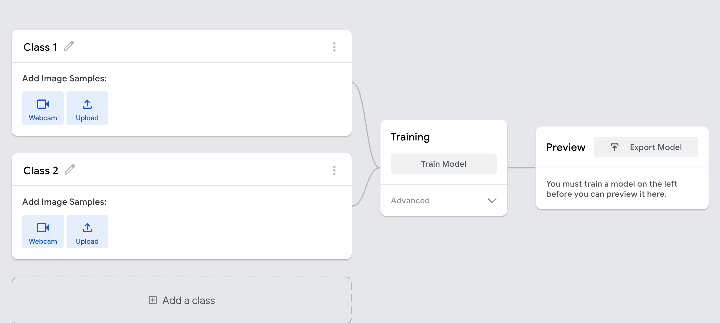
TEACHABLE MACHINE / 05
COLLECT, TRAIN, PREVIEW
Use the training screen as an experiment dashboard
1 · COLLECT BALANCED CLASSES
2 · TRAIN
3 · PREVIEW UNSEEN VIEWS
WRC | HOPPER STUDIO | INFORMATION SERIES
5 / 10
Notes:
Use the screenshot to point out the class panels, Train Model control, and Preview output. Hold out validation examples; a high training score alone is not evidence of field reliability.
[Sources]
- User-supplied screenshot: drone_photos/image copy.png
- https://teachablemachine.withgoogle.com/
[/Sources]

Slide 6
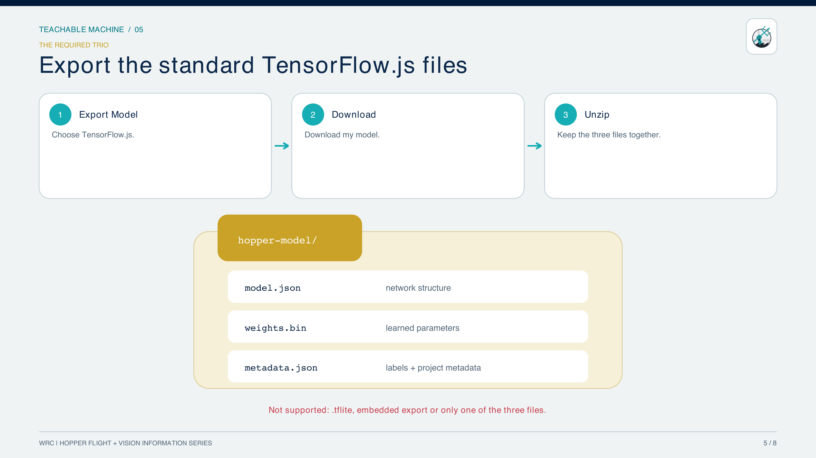
TEACHABLE MACHINE / 06
6 / 10
Notes:
Export model.json, weights.bin, and metadata.json together.
[Sources]
- https://github.com/googlecreativelab/teachablemachine-community/tree/master/libraries/image
[/Sources]

Slide 7
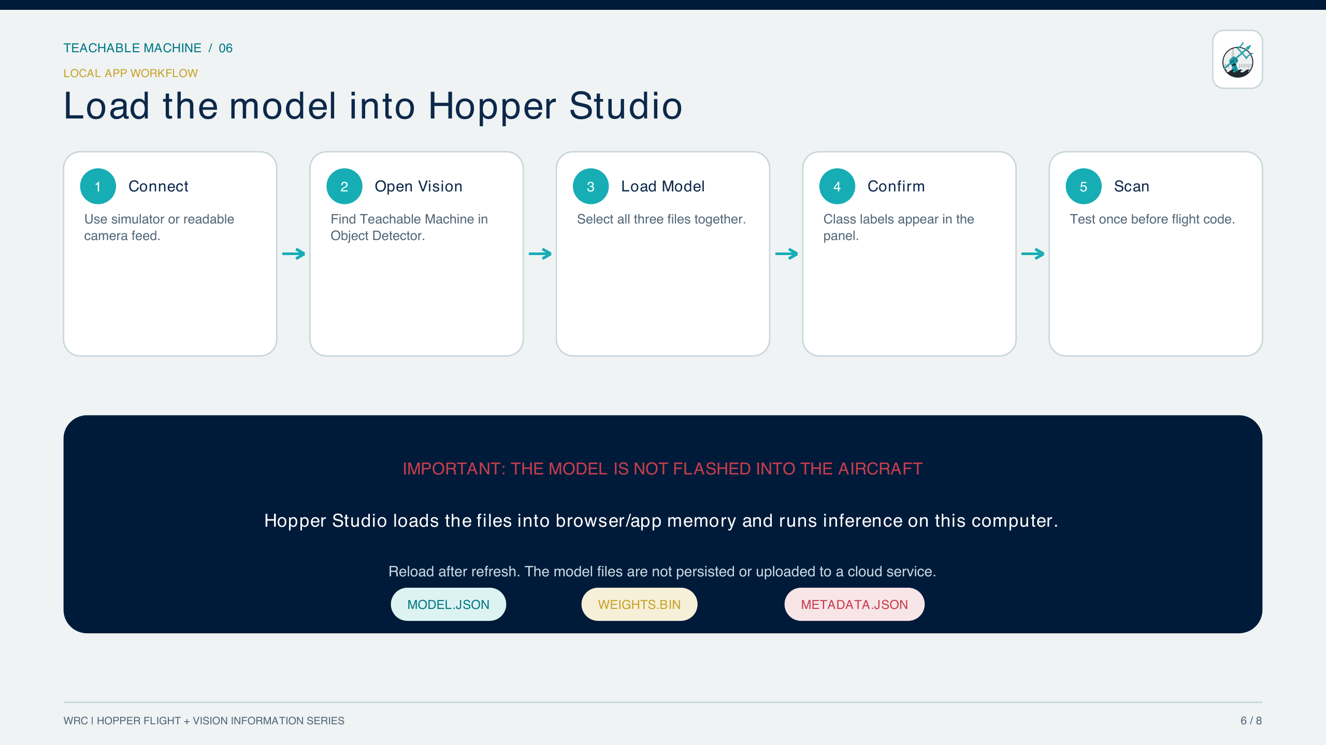
TEACHABLE MACHINE / 07
7 / 10
Notes:
Load the exported TensorFlow.js files into Hopper Studio.
[Sources]
- Hopper Studio implementation: local_site/lib/vision.ts and components/HopperStudio.tsx
[/Sources]

Slide 8
TEACHABLE MACHINE / 08
MISSION CODE
Ask for one label, one threshold, and one safe outcome
CUSTOM LABEL DECISION · PROGRAM.JS
CUSTOM CLASSIFIER
1 await drone.takeOff();
2 try {
3 const redFlag = await vision.seesCustomLabel(
4 "red flag",
5 0.80,
6 );
7
8 if (redFlag) {
9 await drone.fly("forward", 1, 12);
10 }
11 } finally {
12 await drone.land();
13 }
await vision.seesCustomLabel(label, minimumConfidence)
label — string; must match an exported class name
minimumConfidence — 0…1 score; default 0.75
returns — Promise<boolean> after a fresh whole-frame prediction
throws — if the 3 model files are not loaded or pixels are blocked
scope — one class decision; no box or x/y coordinate
FLIGHT COMMAND USED ABOVE
await drone.fly(direction, seconds, power)
direction — required direction string; example forward
seconds — duration ≥ 0; example 1 second
power — signed percentage clamped to −100…100; example 12
returns — Promise<void>; await before landing or another command
WRC | HOPPER STUDIO | INFORMATION SERIES
8 / 10
Notes:
seesCustomLabel performs a fresh classification and compares one named class to a minimum-confidence threshold. The code explicitly lands in finally. The custom model must already be loaded from model.json, weights.bin, and metadata.json in Vision Testing.
[Sources]
- Hopper Studio implementation: local_site/lib/vision.ts, loadCustomModel, classifyCustomModel, and seesCustomLabel.
- Hopper Studio flight API: local_site/lib/drone.ts.
[/Sources]

Slide 9
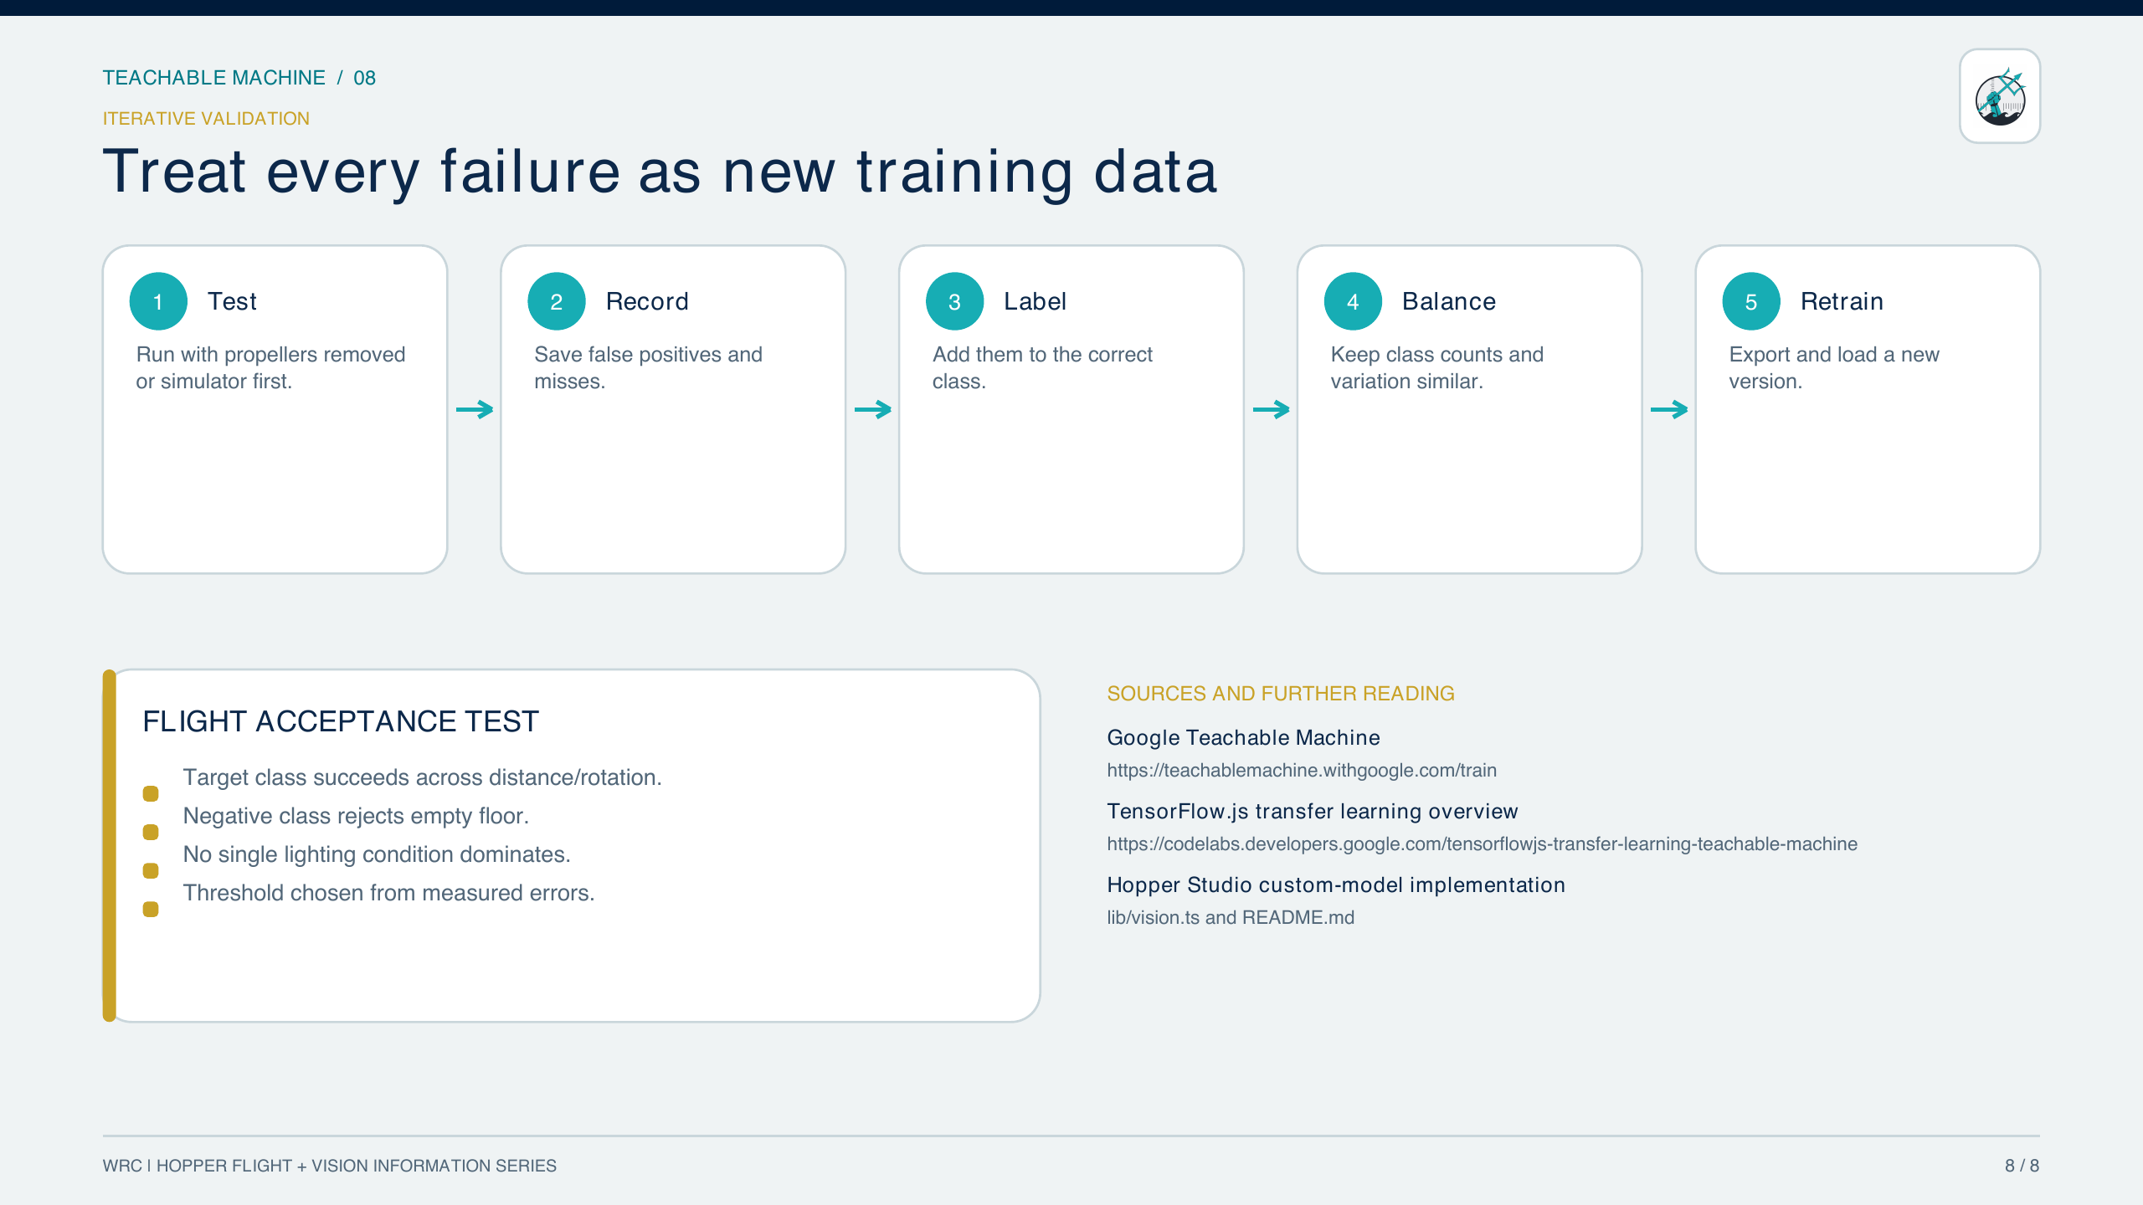
TEACHABLE MACHINE / 09
9 / 10
Notes:
Treat failures as new training data and retrain.
[Sources]
- https://codelabs.developers.google.com/tensorflowjs-transfer-learning-teachable-machine
[/Sources]

Slide 10
TEACHABLE MACHINE / 10
ACCEPTANCE TEST
A custom model is only ready after an honest field test
PASS CRITERIA
IF IT FAILS
• Correct label across expected distance, angle, and light.
• Low false-trigger rate on the “other” class.
• Stable predictions during short motion blur and camera changes.
• Works on held-out examples that were never used in training.
• Record the failure view.
• Label it correctly—often as other/background.
• Rebalance classes so one does not dominate.
• Retrain, export all three files, and repeat the same test.
Custom labels are powerful because they match your mission. The cost is owning the data, the negative class, and the validation.
WRC | HOPPER STUDIO | INFORMATION SERIES
10 / 10
Notes:
Close with an acceptance-test mindset. The model should be evaluated on unseen, mission-realistic imagery, including the ‘other’ class.
[Sources]
- https://codelabs.developers.google.com/tensorflowjs-transfer-learning-teachable-machine
- https://teachablemachine.withgoogle.com/
[/Sources]

