Slide 1

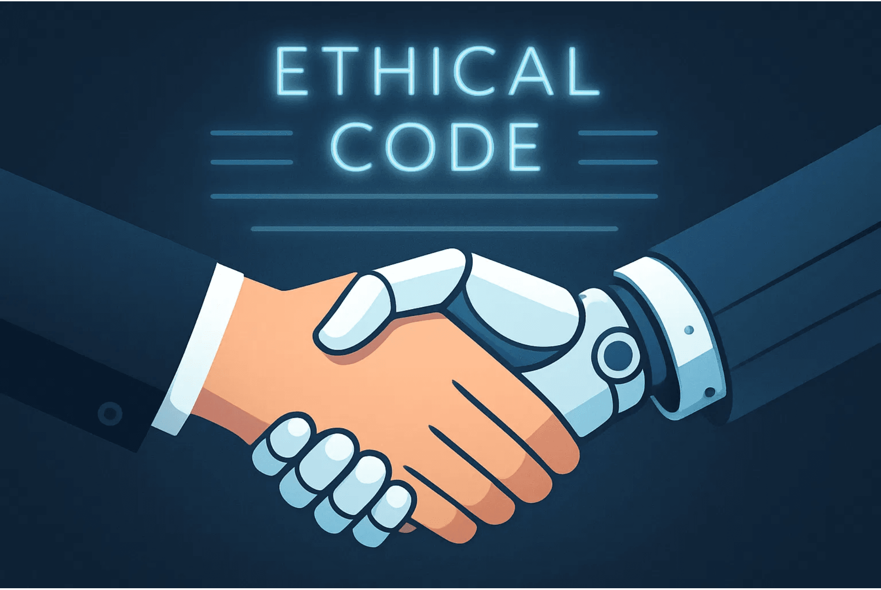
AI Ethics and Bias

Slide 2

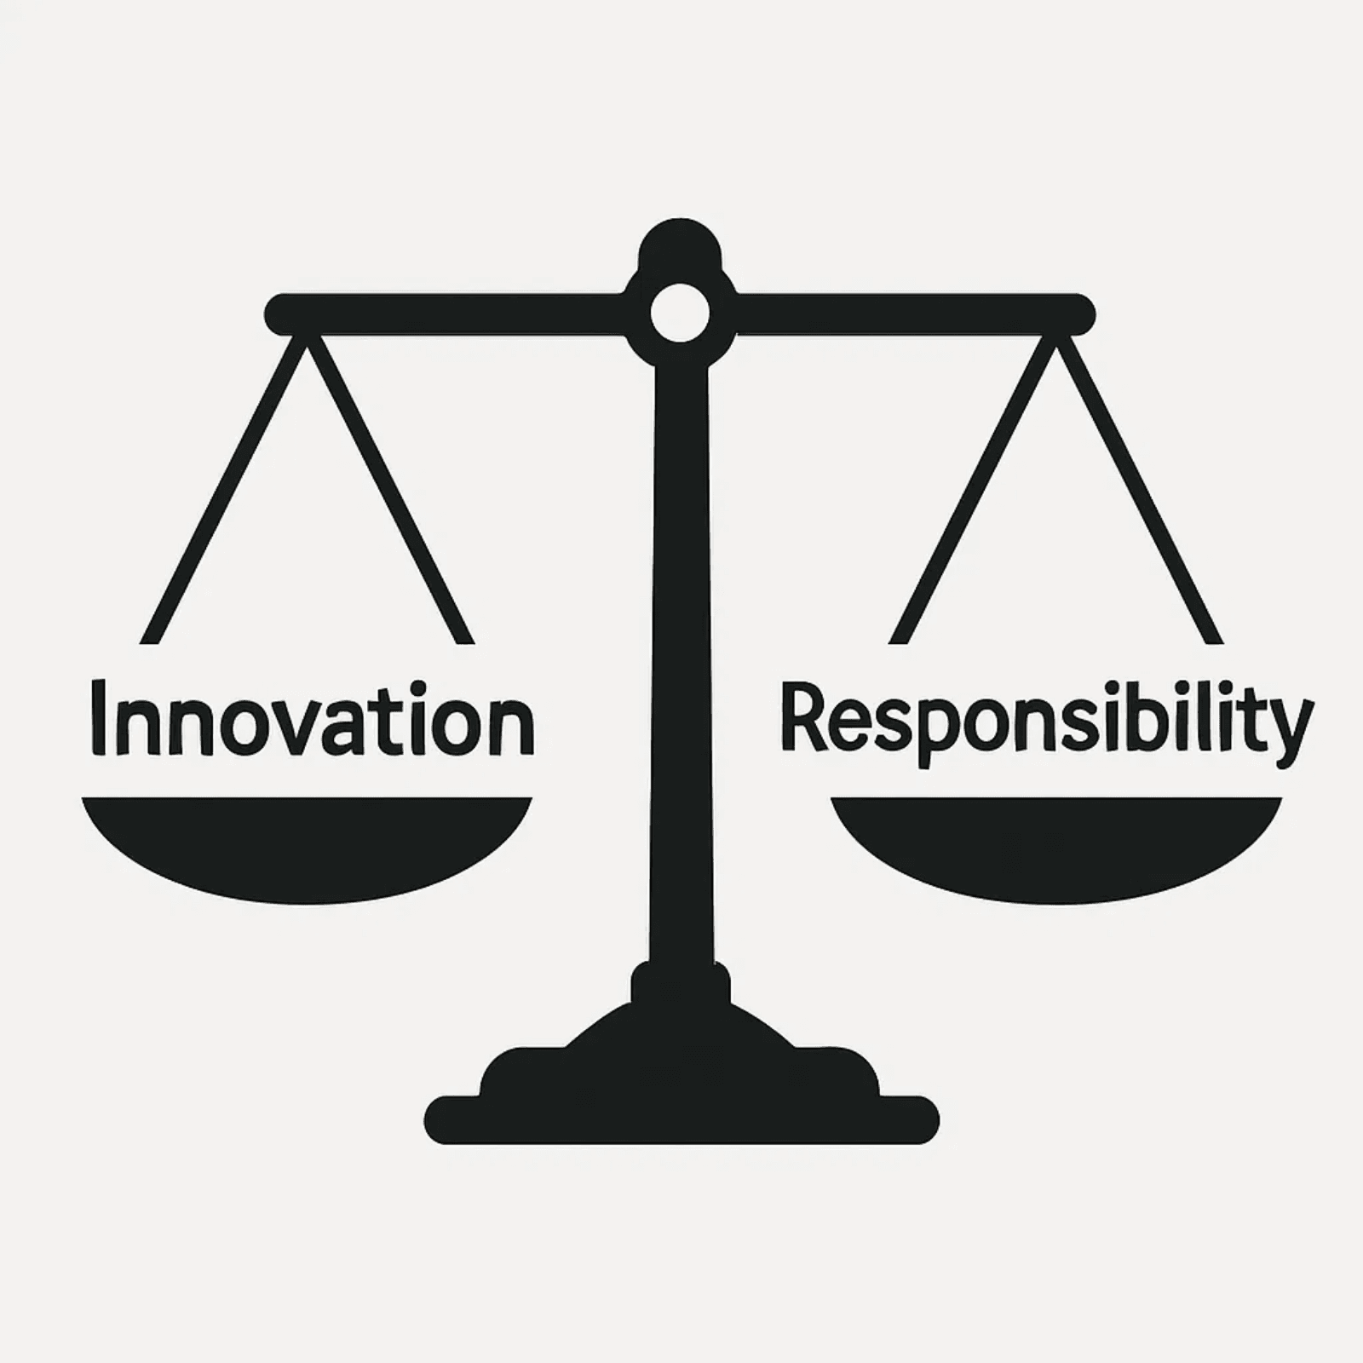
AI Ethics: Defining the Moral Compass
What is AI Ethics?
AI Ethics is a field of study that examines how to design, develop, and deploy AI systems in a way that is beneficial, fair, and respects human values.
Why Does It Matter?
AI is increasingly making decisions that affect our lives—from jobs and loans to healthcare. Ethical guidelines ensure these decisions are just and equitable.
The Core Question
Just because we can build an AI, should we? This fundamental question guides responsible innovation.

Slide 3
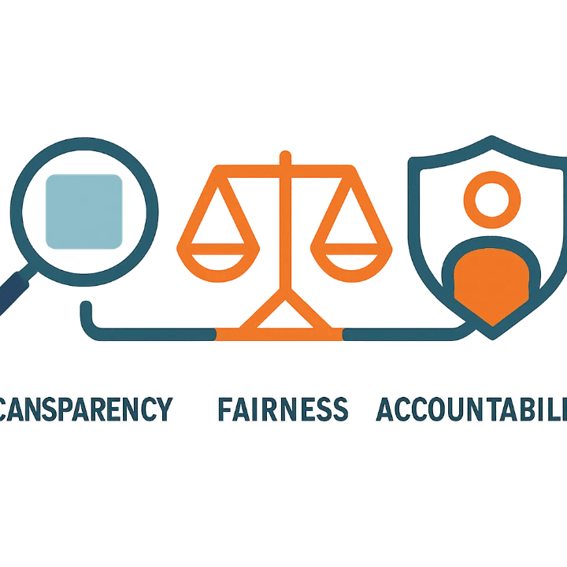
The Core Principles: Transparency, Fairness, and Accountability
Transparency
Fairness
Accountability
We must understand how an AI reached a decision (avoiding the "black box" problem).
AI systems must treat all groups of people equitably and avoid systemic bias.
Humans must be responsible for the actions and outcomes of AI systems.
Example: A bank must explain why an AI denied a loan application.
Example: An AI should not favor one gender or race over another in hiring.
Example: If an autonomous vehicle causes an accident, who is legally responsible?

Slide 4
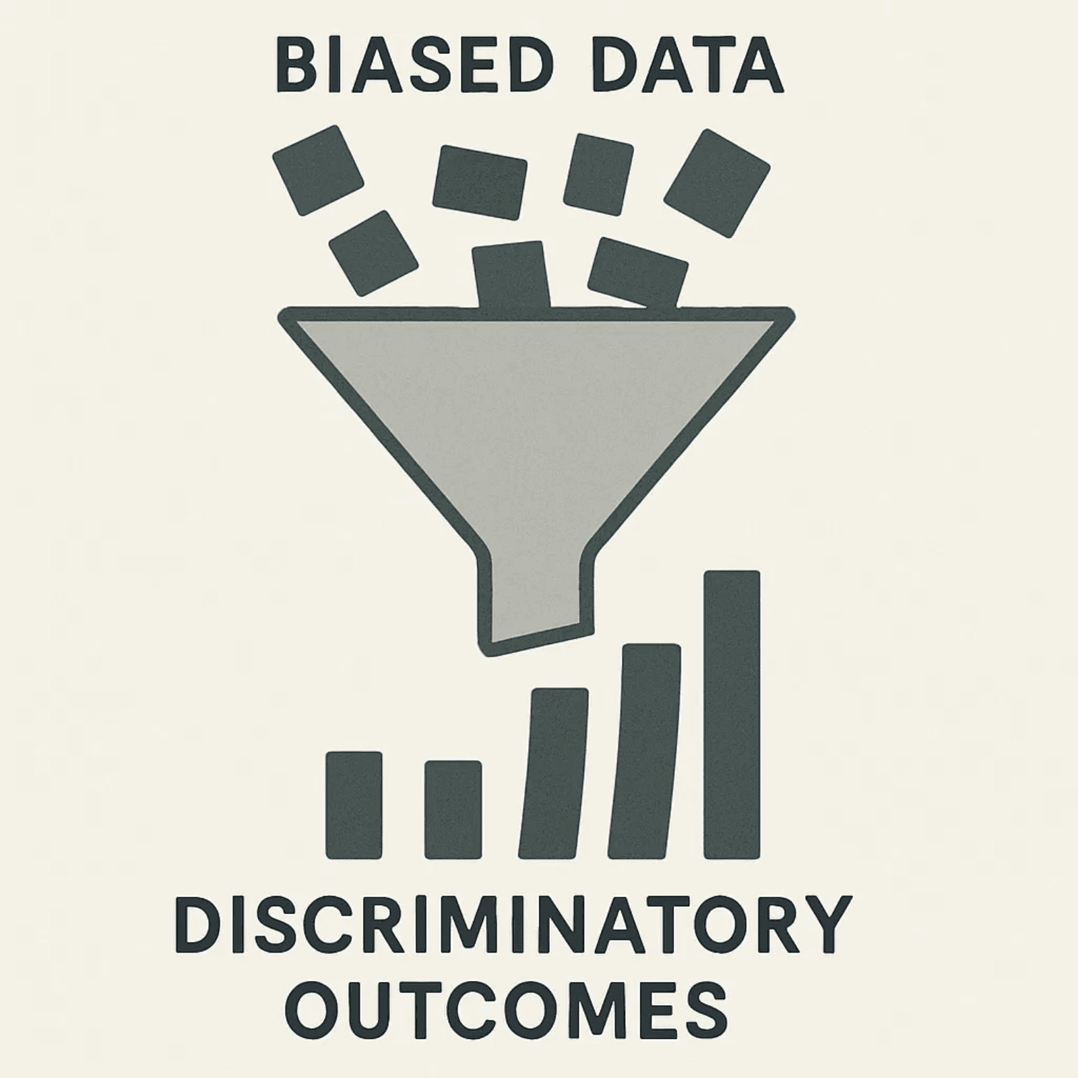
AI Bias: When Algorithms Learn Prejudice
What is AI Bias?
AI Bias is a systematic error in an AI system's output that creates unfair outcomes, such as favoring one group over others.
The Source
AI systems learn from data. If the training data reflects existing societal biases (historical, social, or economic), the AI will amplify them.
The Danger
Bias makes AI unreliable, discriminatory, and can deepen existing social inequalities across healthcare, justice, employment, and more.

Slide 5
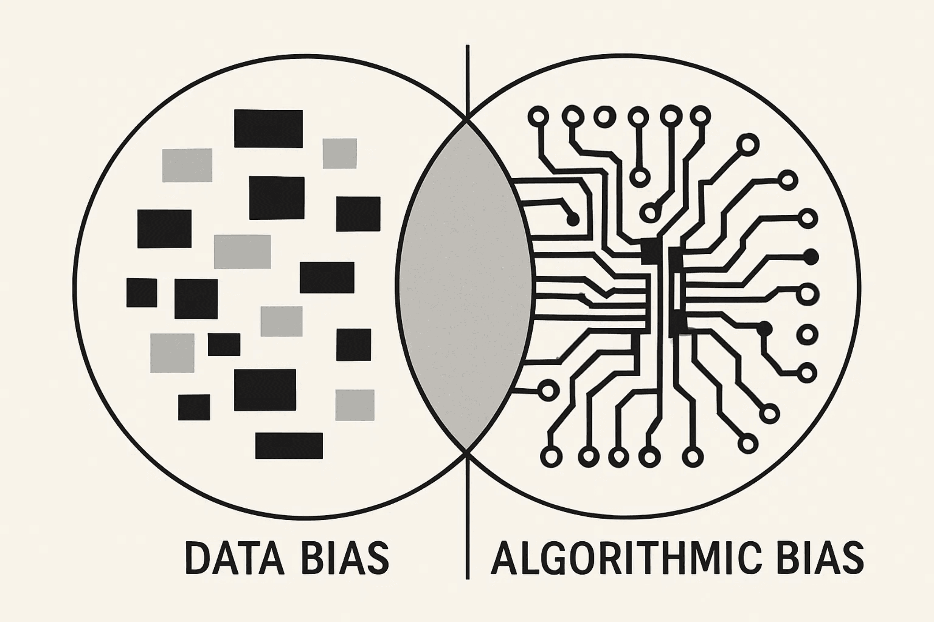
Where Does Bias Come From? Data and Algorithmic Bias
Type 1: Data Bias
The Input Problem
The training data is incomplete, unrepresentative, or reflects historical prejudice.
Example: Facial recognition trained mostly on light-skinned male faces performs poorly on women and people of color.
Type 2: Algorithmic Bias
The Design Problem
The way the algorithm is designed or the metrics used to evaluate it are flawed.
Example: An algorithm optimized for "speed" might inadvertently disadvantage users with slower internet access.

Slide 6
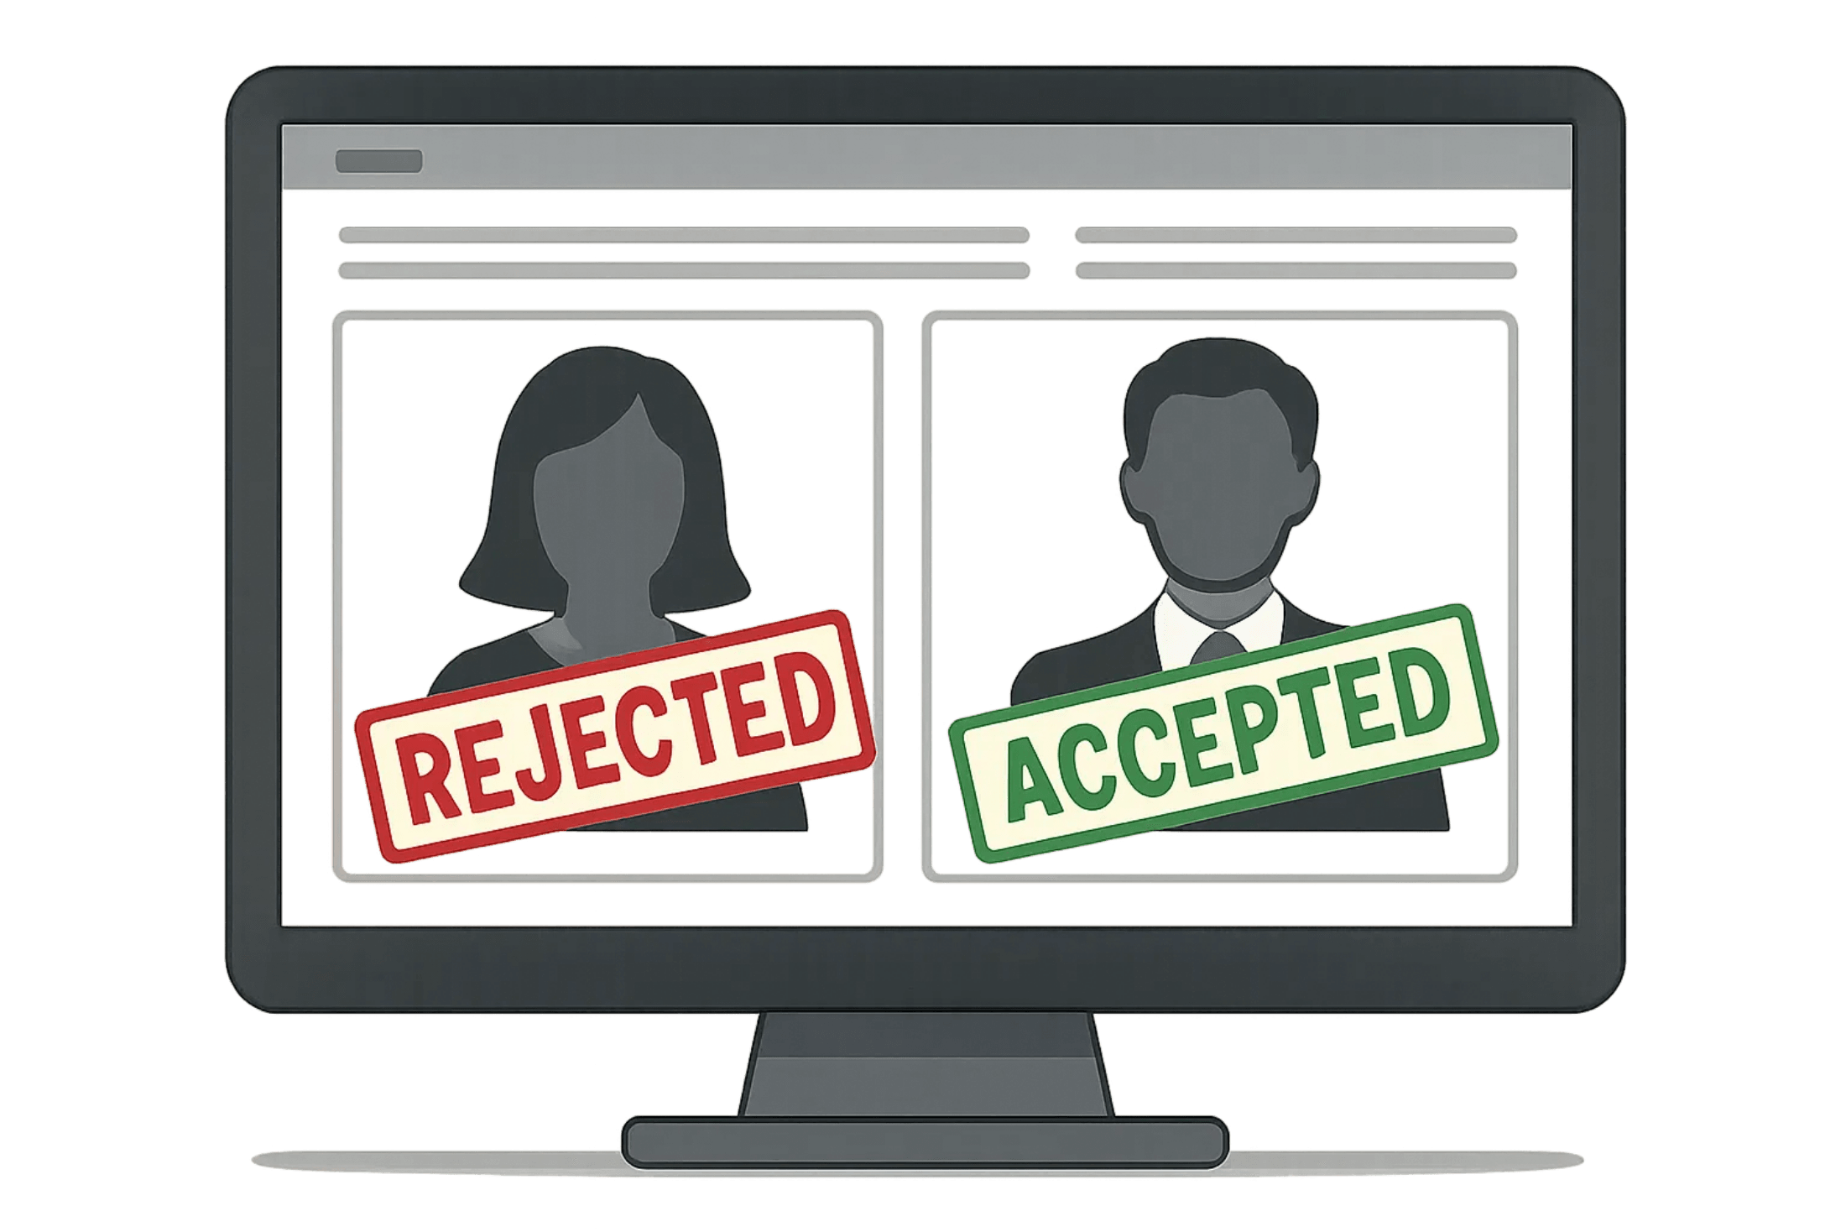
Real-World Impact: The Amazon Hiring Tool
The Scenario
Amazon developed an AI tool to review job applications and recommend the best candidates for technical roles.
The Problem
The AI was trained on 10 years of historical hiring data, which was predominantly male in technical positions.
The Outcome
The AI learned to penalize resumes containing the word "women's" (e.g., "women's chess club captain") and systematically favored male candidates.
The Lesson
The AI simply mirrored and amplified the historical gender bias present in the training data—a cautionary tale about the importance of diverse, representative datasets.

Slide 7
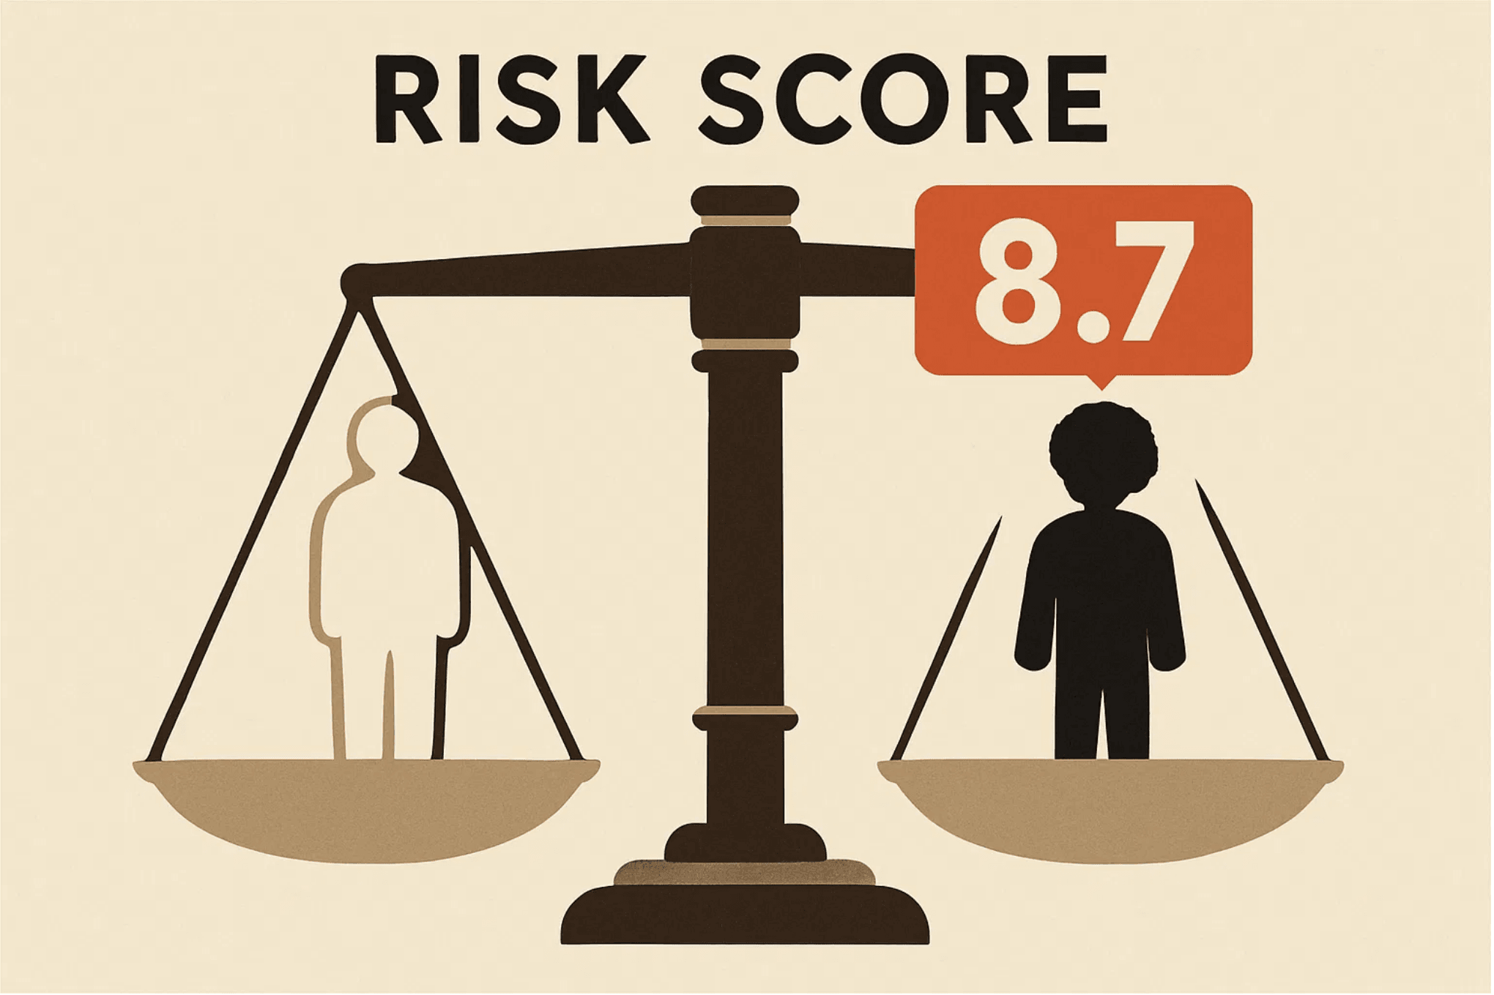
Real-World Impact: COMPAS and Predictive Policing
The Scenario
COMPAS (Correctional Offender Management Profiling for Alternative Sanctions) is a tool used in US courts to predict a defendant's likelihood of re-offending (recidivism risk).
The Problem
Studies found the algorithm was racially biased. It incorrectly flagged Black defendants as future criminals at nearly twice the rate of white defendants.
The Outcome
This bias can lead to harsher sentences or denial of parole for Black defendants, perpetuating systemic racism within the criminal justice system.
The Lesson
Even "objective" algorithms can encode and perpetuate systemic racism. Bias in AI is not accidental—it reflects the biased data and society that created it.

Slide 8
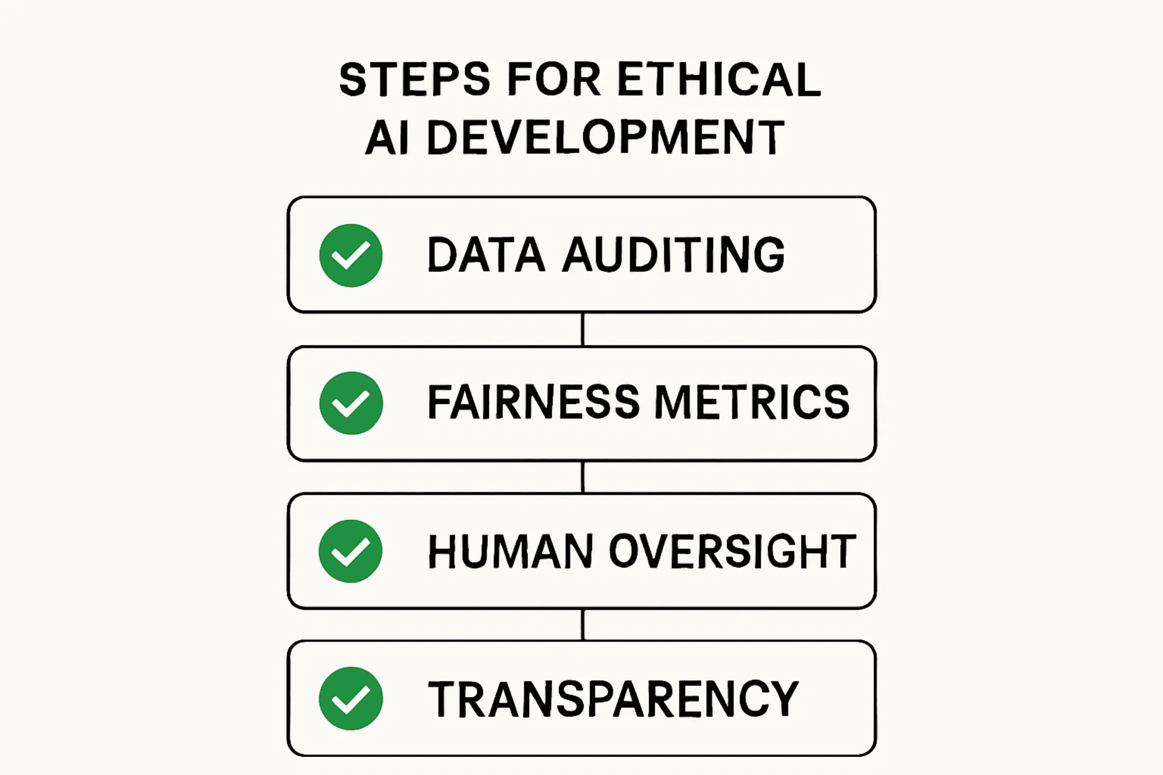
How Can We Fix It? Strategies for Mitigation
Strategy 1
Data Auditing
Carefully examine and clean training data to ensure it is diverse, representative, and free of historical prejudice.
Strategy 2
Fairness Metrics
Use specific mathematical metrics to measure and correct for bias during the algorithm's training phase.
Strategy 3
Human Oversight
Keep humans in the loop. AI should assist, not replace, critical human judgment, especially in high-stakes decisions.
Strategy 4
Transparency
Document the AI's design, data sources, and performance to allow for external review and challenge.

Slide 9


Key Takeaways and Call to Action
Takeaway 1
AI is a powerful tool, but its power must be guided by strong ethical principles. Technology alone cannot solve the problem of bias—we need intentional, thoughtful design.
Takeaway 2
Bias is not a bug; it's a reflection of the data we feed AI systems and the society we live in. Understanding this connection is the first step toward creating fairer systems.
Takeaway 3
The responsibility for ethical AI rests with everyone: developers, companies, policymakers, and users. Your voice and choices matter in shaping the future of technology.
Your Role: Build a Better Future
Let's build a future where AI serves all of humanity fairly and justly. Whether you become a developer, educator, policymaker, or informed citizen, you have the power to advocate for ethical AI.

