Slide 1
NoSQL Database — BCSE406L · Review 2
Real-Time Collaborative Whiteboard
An append-only document model in MongoDB, with Redis for ordering, presence and cross-instance event fanout
80,019
7
9
3
stroke documents in the
seeded database
purpose-built indexes,
every plan measured
aggregation pipelines,
live in the application
collections: rooms,
strokes, snapshots
Devesh Atul Mahajan (23BCE0801) · Prakrit Bahl (23BCE0826) · Lakshya Diwani (23BCE0811)
Batch NS02 · B.Tech CSE · Guide: Dr. D. Vivek

Slide 2
AGENDA
What this deck argues, and where
Rubric criterion | Marks | Argued by | Slides
System design | 6 | Append-only model, two-store split, ordering, fanout | 3 – 6
Database implementation | 8 | Collections, flexible schema, CRUD, deletion, indexes | 7 – 12
Query quality | 6 | Measured index plans, nine pipelines, join cost | 13 – 17
Prototype / demo | 5 | Running system, cross-instance sync, live analytics | 18 – 20
Documentation & progress | 5 | Deviations, limitations, plan for Review 3 | 21 – 22
Everything shown is measured against a running system.
The numbers in this deck come from docs/measurements.json, produced by a script that queries the live application. No figure here was typed by hand.

Slide 3
SYSTEM DESIGN
One decision shapes everything else
The canvas is never stored as a picture
It is an ordered, append-only stream of stroke documents. What a user sees is derived state, rebuilt by replaying that stream.
Why that makes it a NoSQL project
Four tools produce genuinely different documents in one collection. Undo becomes a flag, so history survives. Ordering cannot come from a clock.
Replay, not snapshots of truth. A snapshot is only a cache; the log remains the system of record.
Undo is a soft delete. active: false retains the stroke, so redo and analytics still see it.
Order comes from Redis INCR. Atomic across every instance, so replay is total and reproducible.
Previews are never persisted. One stroke writes exactly one document, however many frames it took to draw.
Sections 1 and 2 of the report

Slide 4
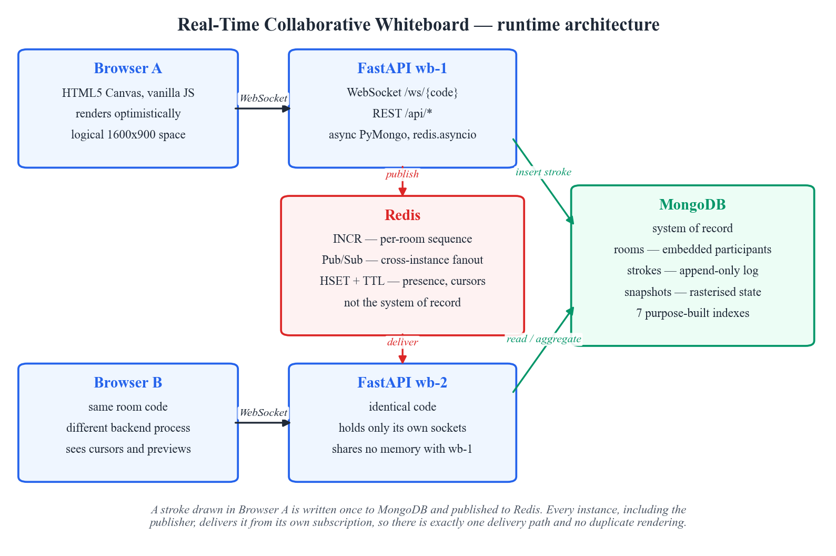
SYSTEM DESIGN
Runtime architecture
Two FastAPI processes, sharing no memory. This is deliberate.
A single process could broadcast from a dictionary and would never exercise the fanout layer at all.
MongoDB is the only durable state: rooms, the stroke log, snapshots.
Redis is the bus and the counter — drawn between the instances because that is its role.
Both drivers are async. A blocking call in a WebSocket handler would stall every other user on that process.
Demonstrated live: two browsers, two processes, one board

Slide 5
SYSTEM DESIGN
Why two data stores, and what breaks
 | MongoDB | Redis
Holds | Rooms, stroke log, snapshots | Counters, Pub/Sub, presence
Durability | System of record | Disposable cache
If it restarts | Boards are gone — this is the data that matters | Cursors vanish, presence rebuilds, counter realigns from Mongo. No drawing lost.
Why not the other one | Cannot give an atomic cross-process counter cheaply | Cannot be trusted with the only copy of a board
The division is by durability requirement, not convenience.
A cursor position that is stale within 16 ms is write amplification for no benefit, so it expires by TTL in Redis and is never written to disk.
Section 2.3 of the report

Slide 6
SYSTEM DESIGN
Ordering: the subtlest part of the design
Candidate | Verdict | Why
Client timestamp | Rejected | Participants' clocks disagree, sometimes by seconds
ObjectId timestamp | Rejected | One-second granularity: two strokes 40 ms apart order arbitrarily
Redis INCR per room | Chosen | Atomic across every instance, so the order is total and reproducible
app/repositories/strokes.py
Why it matters: replay only rebuilds the right picture in the right order.
seq = await r().incr(f"room:{room_id}:seq")
# Redis is a cache, not the record, so a restart must not
# collide: realign upward from the highest persisted seq.
highest = await db()[STROKES].find_one(
{"roomId": room_id}, sort=[("seq", -1)], projection={"seq": 1})
Failure mode avoided: an intermittent mis-ordering that is very easy to miss in testing.
Second reason for Redis. Ordering, not just fanout, is why it is in the stack.
Section 2.4 of the report

Slide 7
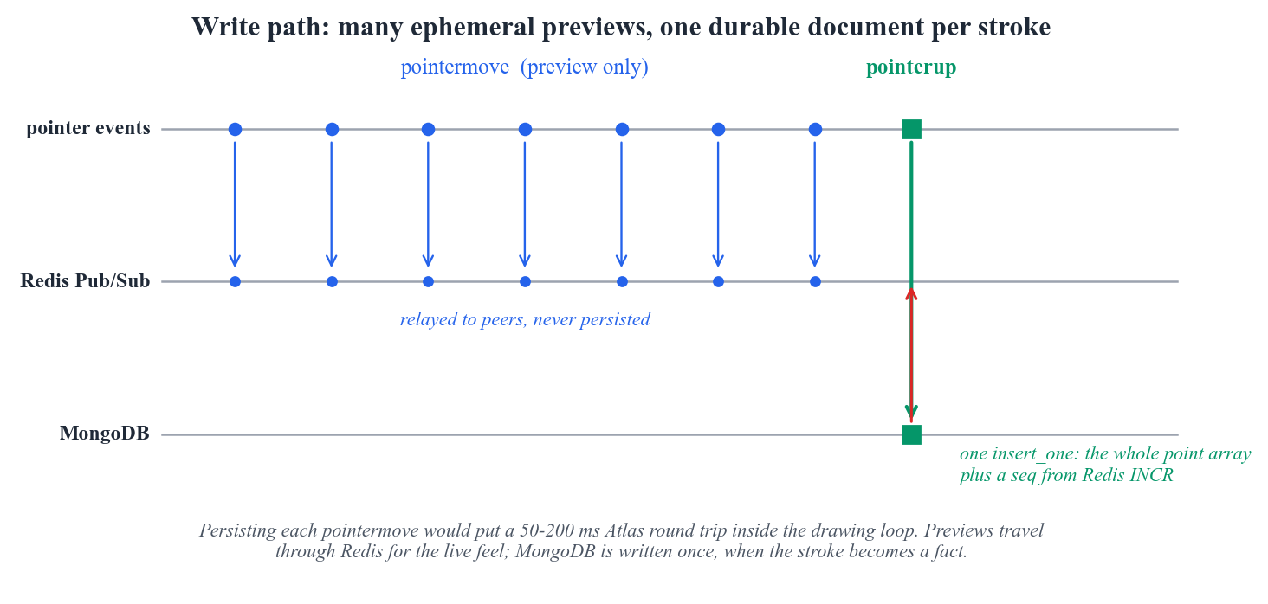
SYSTEM DESIGN
The write path, and the duplicate-stroke trap
Exactly one delivery path
The obvious version is wrong. Send to local clients and also publish to Redis, and the publisher — which is subscribed — renders the stroke twice.
Invisible on an opaque pen. Obvious with a transparent stroke or an eraser, and easily misread as a rendering bug.
So handlers never write to their own sockets. Every instance, publisher included, delivers from its subscription.
The author is excluded by an id carried inside the published message, so it works whichever instance holds that socket.
Section 2.7 of the report

Slide 8
DATABASE IMPLEMENTATION
Three collections, measured
Collection | Holds | Documents | Data | Indexes
rooms | One document per board, participants embedded | 8 | 0.00 MB | 0.11 MB
strokes | The append-only log, one document per stroke | 80,019 | 120.3 MB | 9.8 MB
snapshots | Rasterised canvas at a known sequence number | 5 | 13.8 MB | 0.04 MB
1,576 B
8
2 → 3
average stroke document — the basis of the
capacity estimate
rooms, one of them deliberately large
for the measurements
collections: snapshots was added
after measuring join cost
Review 1 proposed two collections. Measurement added the third.
A full replay of the largest room transfers 66 MB, so snapshotting moved from 'optional' to part of the normal join path.
Section 3.1 of the report

Slide 9
DATABASE IMPLEMENTATION
Flexible schema, shown rather than claimed
Three documents from the same collection, written by the same code path. No migration, no nullable columns standing in for absent fields.
pen — carries points
rect — no points at all
text — text and font
{
"tool": "pen",
"seq": 1,
"points": [
{"x": 323.7, "y": 294.2},
{"x": 325.9, "y": 293.9},
... 145 more ...
],
"pointCount": 148,
"style": {"width": 6.4},
"active": true
}
{
"tool": "rect",
"seq": 14,
"geometry": {
"x": 798.1, "y": 159.3,
"w": 417.5, "h": -191.1
},
"bbox": {"minX": 798.1, ...},
"style": {"width": 8.3},
"active": true
}
{
"tool": "text",
"seq": 21,
"text": "stroke log =",
"font": "600 34px Inter",
"geometry": {
"x": 452.0, "y": 118.0
},
"style": {"color": "#e8ecf4"},
"active": true
}
Adding a polygon tool tomorrow needs a model and a renderer — no migration. Existing documents are untouched and replay keeps working, because readers only look at the fields relevant to each tool.
Sections 3.3 and 3.7 of the report

Slide 10
DATABASE IMPLEMENTATION
Embed or reference, and the Redis key space
The governing question is whether the child is bounded
Redis is a database here too, so its keys are documented
Relationship | Strategy | Why
Room → participants | Embedded | Bounded, small, read with the room
Room → strokes | Referenced | Unbounded — 42,672 in one room
Room → snapshots | Referenced | Large binaries, pruned separately
Key | Type | Lifetime
room:{id}:seq | Counter | Persistent, realigned on join
wb:room:{CODE} | Pub/Sub | Transient, never stored
room:{CODE}:presence | Hash | Expires after 2 min of silence
No amount of tuning makes an unbounded embedded array safe.
At 1,576 bytes per stroke, the largest room alone would be far past the 16 MB document limit. Referencing also lets one stroke be undone or restyled without rewriting the room.
Sections 3.5 and 3.6 of the report

Slide 11
DATABASE IMPLEMENTATION
The full CRUD surface, over REST and WebSocket
An append-only log has no natural update or delete. These were designed in, not bolted on — and every one is reachable in Postman.
 | Endpoints | What it does
C | POST /api/rooms · POST /api/rooms/{code}/strokes | Room with a unique code; one stroke document
R | GET /api/rooms · /rooms/{code}/strokes?afterSeq= · /strokes/{id} | List, full replay, incremental tail, single document
U | PATCH /api/rooms/{code} · PATCH /api/strokes/{id} · POST /strokes/{id}/move | Rename; restyle nested fields; $inc nested geometry
D | POST /rooms/{code}/undo | redo | compact · DELETE /strokes/{id} · DELETE /rooms/{code} | Soft delete, hard delete, and cascade
A stroke created over REST appears on an open board immediately, because the endpoint publishes to Redis — a far better demonstration than a refresh.
Verified by script, not by assertion. A run walks every operation including the concurrent-undo race and reports pass or fail.
Section 4 of the report

Slide 12
DATABASE IMPLEMENTATION
Three deletion semantics, and the one real race
Semantics | Retains data | Used for
Soft delete | Yes, fully | Undo and redo
Compaction | No | Reclaiming finished boards
Cascade delete | No | Removing a board entirely
undo_last — one atomic claim
# Scoped to the user: a room-wide undo would let one
# person retract another's work.
# Atomic: find-then-update in two calls lets two
# simultaneous undos claim the same stroke.
doc = await db()[STROKES].find_one_and_update(
{"roomId": rid, "userId": uid, "active": True},
{"$set": {"active": False, "undoneAt": now}},
sort=[("seq", -1)],
return_document=ReturnDocument.AFTER,
)
MongoDB has no ON DELETE CASCADE.
Deleting a room without its strokes would silently orphan tens of thousands of documents no query returns and no user can reach. Referential integrity is the application's job, and the endpoint reports what it removed.
The second request no longer matches active: true on that document and moves to the next one. This is also the query the dedicated undo index exists for.
Sections 4.5 and 4.6 of the report

Slide 13
QUERY QUALITY
Seven indexes, each for a named query
Index | Key | The query it exists for
ix_room_code | {code: 1} | Every join is a lookup by short room code; unique prevents duplicate codes.
ix_room_activity | {lastActivityAt: -1} | Powers the 'recent rooms' list without scanning the whole collection.
ix_stroke_replay | {roomId: 1, seq: 1} | The hot path: replay a room's strokes in order. Covers range queries on seq for incremen
ix_stroke_undo | {roomId: 1, userId: 1, active: 1, seq: -1} | Per-user undo claims the newest active stroke belonging to that user. Descending seq let
ix_stroke_tool | {roomId: 1, tool: 1} | Supports the tool-distribution aggregation without a collection scan.
ix_stroke_time | {roomId: 1, createdAt: 1} | Supports the time-bucketed activity aggregation ($dateTrunc grouping).
ix_snapshot_latest | {roomId: 1, upToSeq: -1} | Fetches the newest snapshot for a room in a single index seek.
None was added speculatively.
Indexes cost storage and slow every write. These total 9.8 MB against 120 MB of data (8% overhead). The largest single index is _id, which no query in this application ever uses.
Section 5.1 of the report

Slide 14
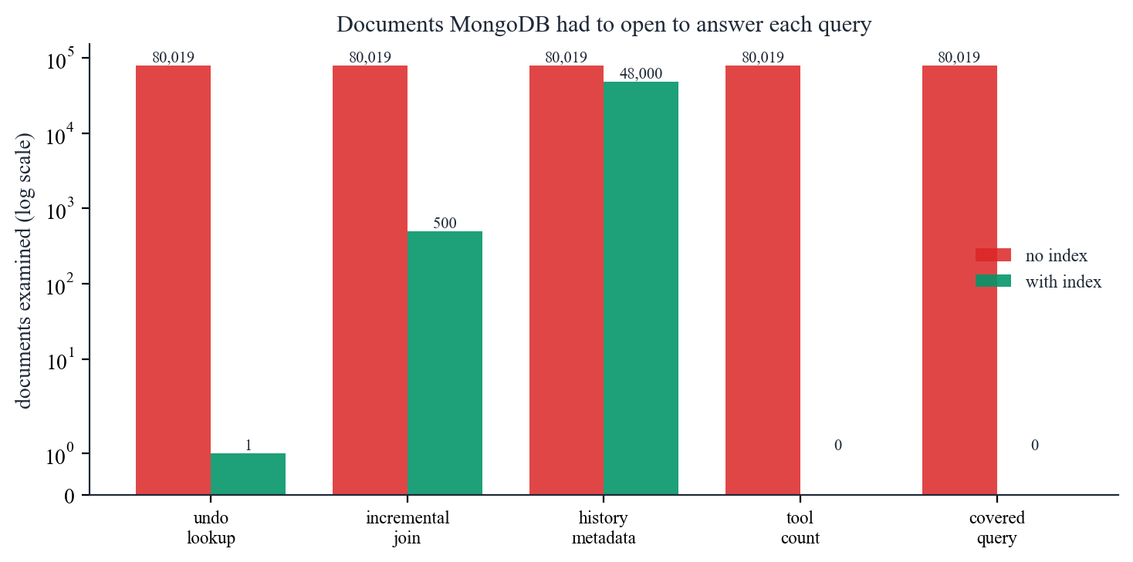
QUERY QUALITY
Indexes: measured, not asserted
Query | Without index | With index | Gain
undo lookup | COLLSCAN · 80,019 | IXSCAN · 1 | 23.2x
incremental join | COLLSCAN · 80,019 | IXSCAN · 500 | 3.7x
history metadata | COLLSCAN · 80,019 | IXSCAN · 48,000 | 1.1x
tool count | COLLSCAN · 80,019 | COUNT_SCAN · 0 | 4.8x
covered query | COLLSCAN · 80,019 | IXSCAN · 0 | 1.7x
The method
Drop the indexes, run each real query five times keeping the best, capture explain in executionStats mode, rebuild, repeat.
Two queries reach zero documents examined: the count wins a COUNT_SCAN that tallies index keys, and the covered query is answered entirely from the index.
Documents MongoDB had to open, log scale. Planner output, so it is reproducible.
Section 5.3 of the report

Slide 15
QUERY QUALITY
Where the index barely helps
history metadata: 305 ms without → 274 ms with (1.1x)
It still opens 48,000 documents. This result is reported rather than omitted.
The query is not selective. It returns tens of thousands of documents, so the index lets the server skip almost nothing.
Index then fetch is random access; scanning the collection in storage order is sequential. When a query touches most of a collection, the sequential scan wins.
MongoDB's own planner would often choose the scan. The optimiser agreeing with the measurement is the point.
The general rule: an index pays off in proportion to how much of the collection it lets the server skip. A query that skips nothing gains nothing.
Timings are also cache-warm: the whole collection fits in the WiredTiger cache here, which flatters the unindexed case. On Atlas M0 the gap would be wider, so these speed-ups are a conservative floor.
Section 5.4 of the report

Slide 16
QUERY QUALITY
Nine pipelines, each answering a real question
Pipeline | Question it answers | Stages | Time
Contribution breakdown by user | Who drew how much in this room, and how often did they und | $match, $group, $project, $sort | 351 ms
Tool usage mix | Which tools dominate, and how complex is a typical stroke | $match, $group, $project, $sort | 166 ms
Drawing activity over time | How did drawing intensity vary minute by minute? | $match, $group, $project, $sort, $limit | 159 ms
Stroke complexity distribution | Are strokes mostly short taps or long freehand curves? | $match, $bucket, $project | 238 ms
Colour palette in use | Which colours carry the most ink on the active canvas? | $match, $group, $project, $sort, $limit | 188 ms
Content bounding box | What canvas region actually contains drawing? | $match, $group, $project | 191 ms
Room leaderboard (joined) | Across all rooms, which are the busiest? | $match, $lookup, $set, $project, $sort, $limit | 354 ms
Single-request dashboard | Can the whole analytics panel load in one query? | $match, $facet | 420 ms
Storage footprint by tool | How many bytes does each kind of stroke document cost? | $match, $set, $group, $project, $sort | 219 ms
Not decorative: every one is reachable from the analytics panel in the running application, which displays the pipeline next to its own output.
Section 6 of the report

Slide 17
QUERY QUALITY
Two pipelines worth arguing about
$lookup with a sub-pipeline
$facet — four summaries, one pass
{"$lookup": {
"from": "strokes",
"localField": "_id",
"foreignField": "roomId",
"as": "agg",
"pipeline": [
{"$match": {"active": true}},
{"$group": {"_id": null,
"total": {"$sum": 1},
"people": {"$addToSet": "$userId"}}}
]}}
{"$facet": {
"byTool": [{"$group": ...}, {"$sort": ...}],
"byUser": [{"$group": ...}, {"$limit": 5}],
"perMinute": [{"$group": {"_id":
{"$dateTrunc": ...}}}],
"bounds": [{"$group": {"_id": null,
"minX": {"$min": "$bbox.minX"}}}]
}}
The sub-pipeline aggregates inside the join, so tens of thousands of strokes are never materialised into the room document. Without it, the array would exceed 16 MB and the query would fail.
The panel needs four summaries at once. Four queries would mean four round trips and four passes over the same documents; $facet evaluates all four over one $match, so the panel loads from a single request.
Section 6 of the report

Slide 18
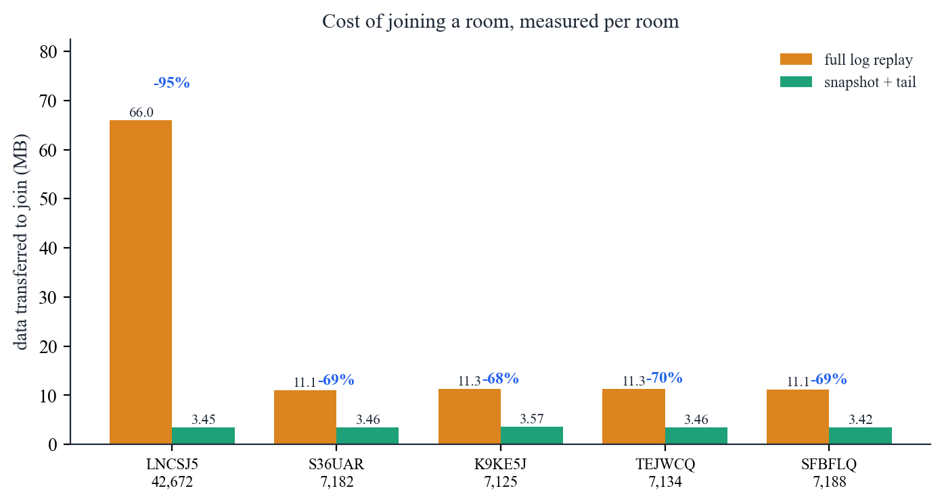
QUERY QUALITY
Measurement changed the design
66 MB
to join the 42,672-stroke room by full replay
3.45 MB
with a snapshot plus only the newer strokes
95%
less data transferred; the board opens in about half a second
Review 1 called snapshotting optional. The measurement settled it.
Serialising a full replay took seconds, not milliseconds. The snapshot is a cache of derived state — the log still holds the truth, so undo and analytics are unaffected. Below a few hundred strokes the image costs more than the strokes, so small rooms are skipped.
Section 7.2 of the report

Slide 19
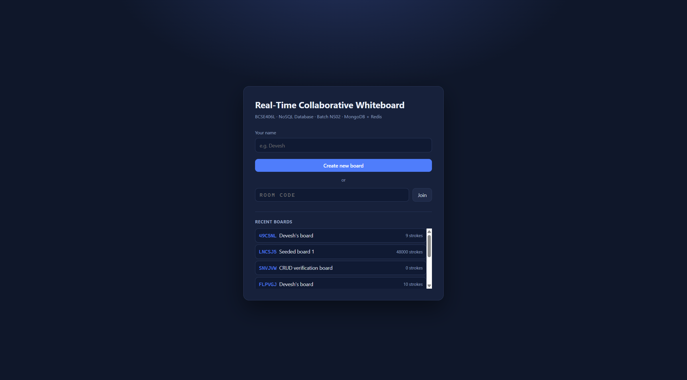
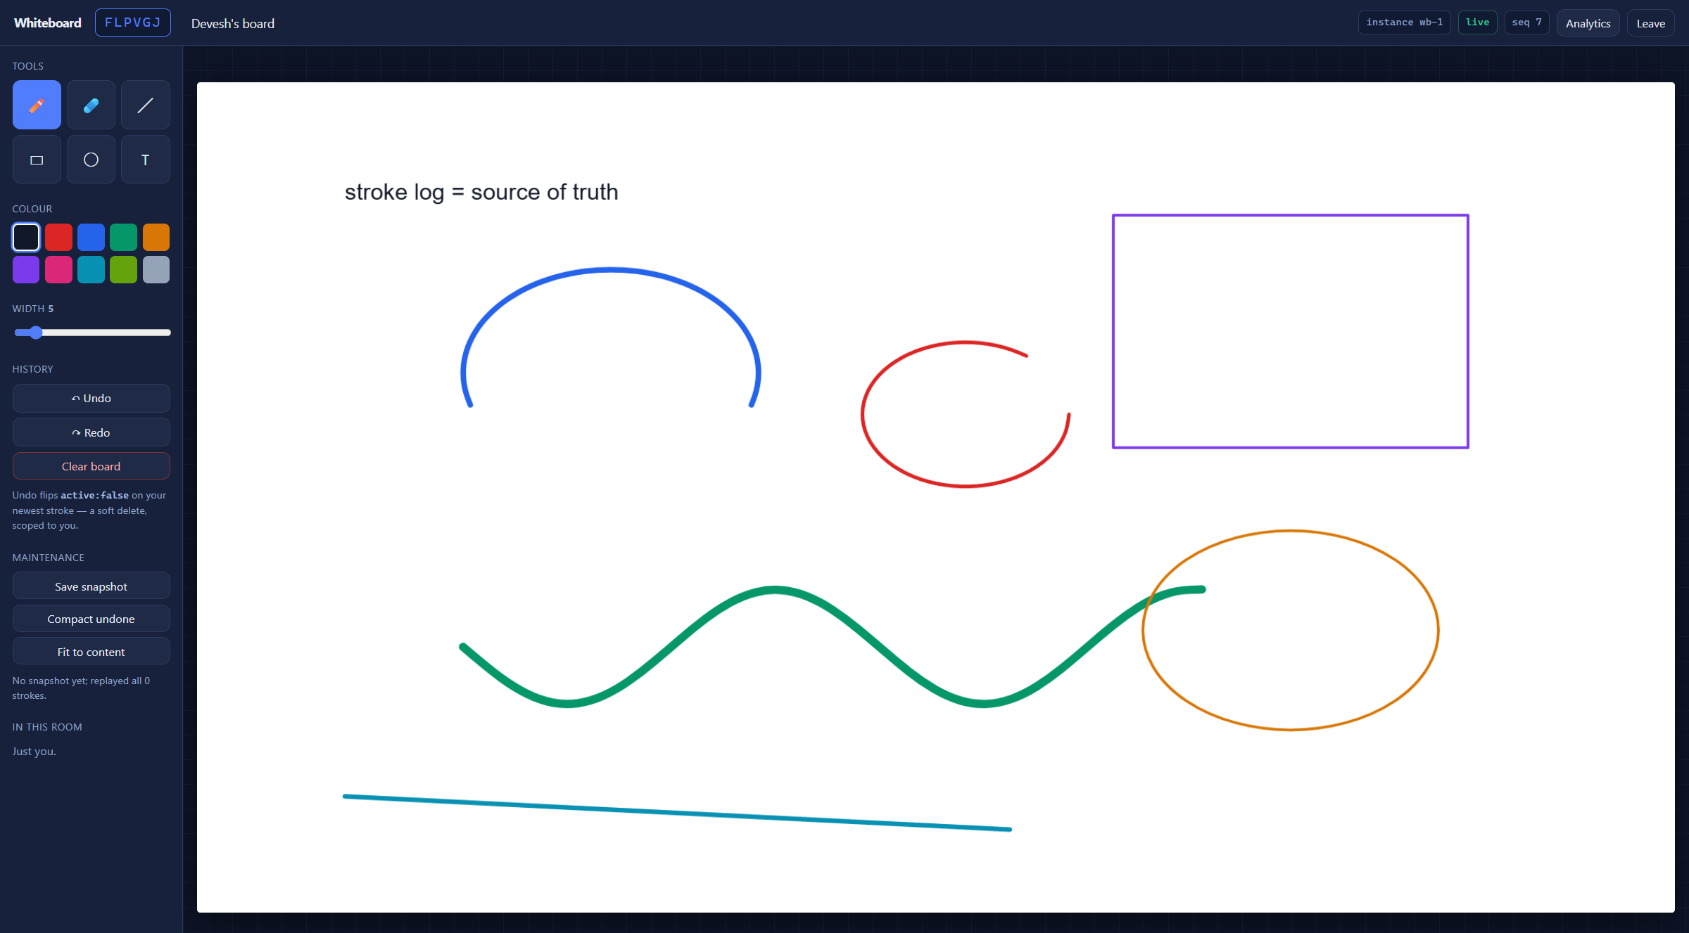
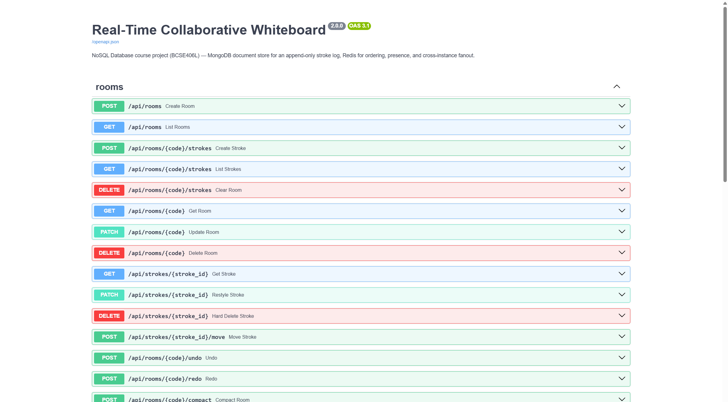
PROTOTYPE / DEMO
The running prototype
Lobby — boards listed by last activity, served by ix_room_activity
Six tools on one board; every mark is a separate document
The CRUD surface, exercised in Postman
Section 8 of the report

Slide 20
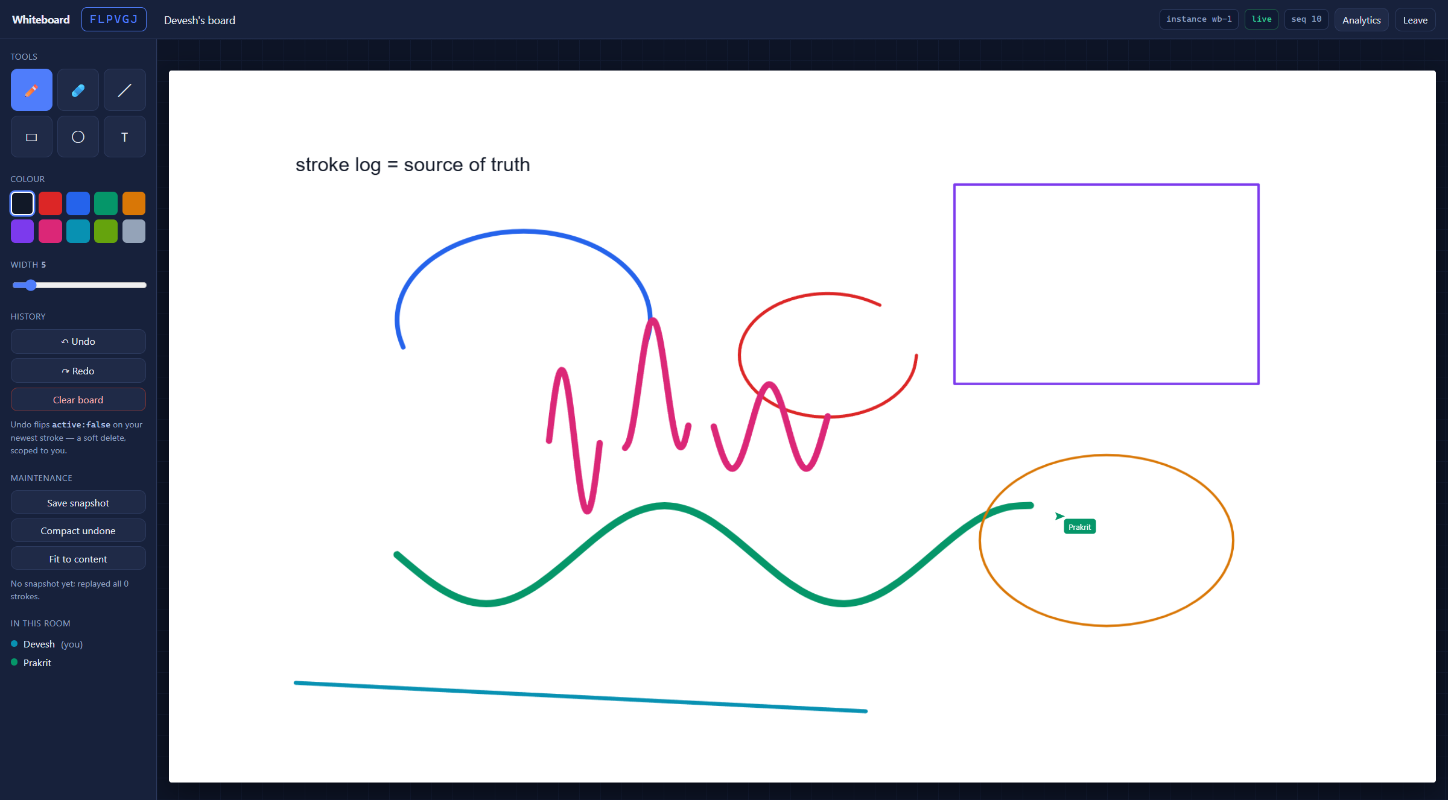
PROTOTYPE / DEMO
The result that matters most
Two processes, one board
This window is on wb-1, shown in the badge at the top right.
The pink strokes and the labelled cursor belong to a user connected to wb-2 — a separate OS process sharing no memory with this one.
Both arrived through Redis Pub/Sub. This is the claim the architecture makes, and it is the thing a single process could never demonstrate.
Live in the demo: two browsers, two ports, one room code

Slide 21
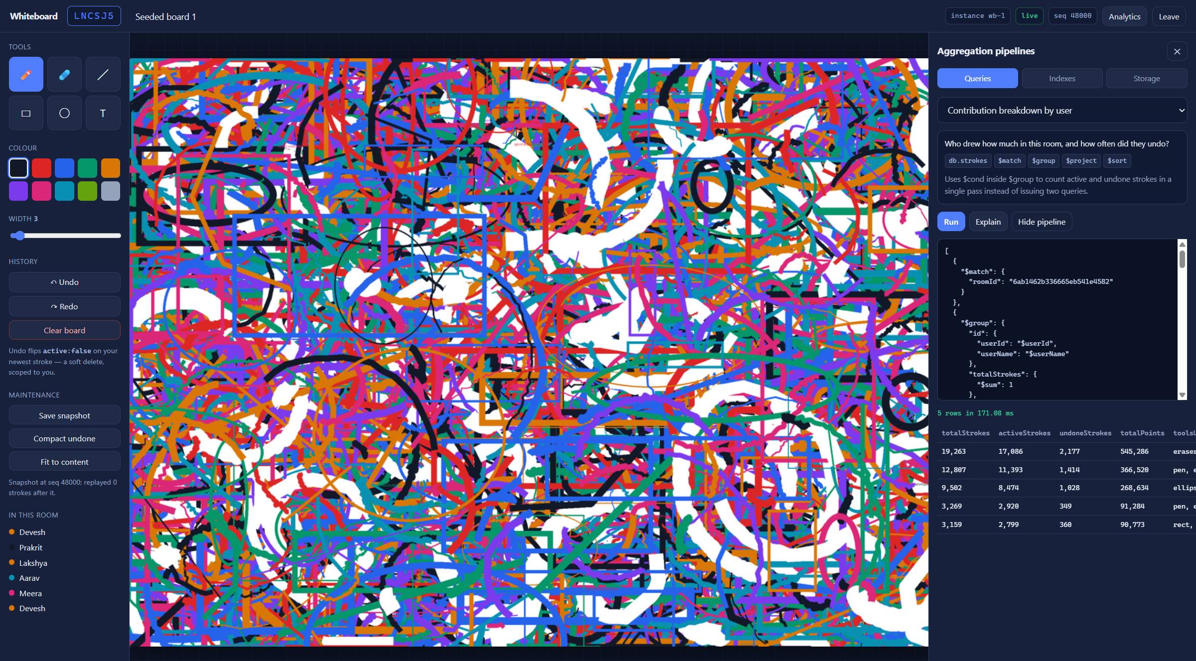
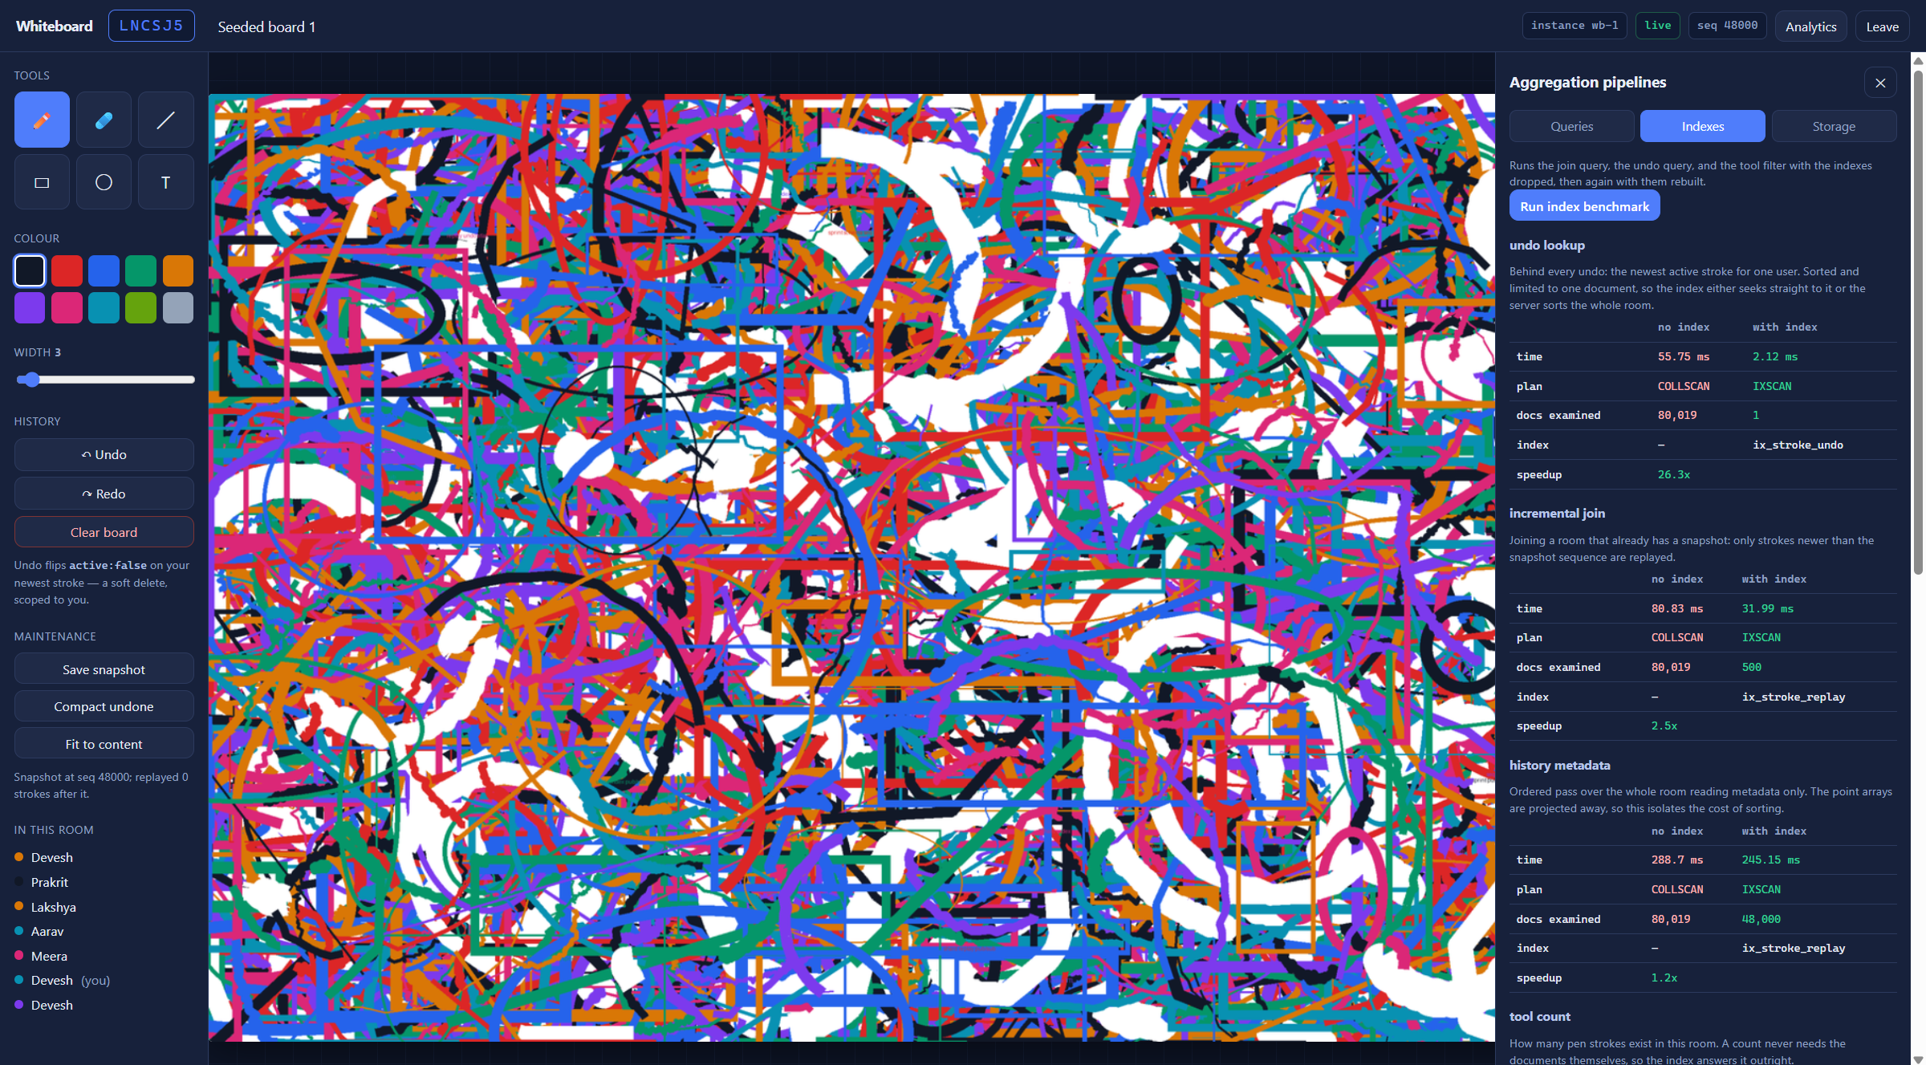
PROTOTYPE / DEMO
Database work, visible in the application
The analytics panel shows each pipeline next to its own output and the server-side execution time.
The index benchmark, run from the interface: plan, documents examined and time, with indexes dropped then rebuilt.
Aggregation and indexing are not shell transcripts pasted into a report — they are features of the product, which is why they can be demonstrated live.
Demonstrated live: pick a pipeline, run it, read the plan

Slide 22
DOCUMENTATION & PROGRESS
Progress, and four honest deviations
Completed since Review 1
Deviations from the Review 1 sheet
Application built — backend, transport, canvas client, six tools, presence.
Review 1 said | Review 2 does
Two collections | Three — join cost forced snapshots
Snapshotting optional | Implemented, client and server side
Atlas free tier | Local Docker; Atlas by configuration
Postman for testing | Postman plus a scripted run, which can express the undo race
Three collections with several document shapes in one log.
Full CRUD over REST and WebSocket, plus a cascading delete.
Seven indexes with plans captured through explain.
Nine pipelines surfaced in the product, not just a shell.
80,019 documents generated to a realistic shape.
Cross-instance sync demonstrated on two processes.
Section 9 of the report — 25-page document submitted alongside this deck

Slide 23
DOCUMENTATION & PROGRESS
Limitations we are not hiding, and what comes next
Known limitations
Plan for Review 3
No authentication. Identity is a display name in browser storage, so per-user undo trusts the client.
Deploy to Atlas M0 and re-measure; a constrained cache should widen the index advantage.
Preview fanout grows with the square of participants in a room.
Add a TTL index to expire abandoned rooms — a NoSQL feature not yet exercised.
Dense snapshots approach the size where GridFS would be right; the headroom is measured, not generous.
Try change streams as a second, database-driven notification path, and compare it with Redis.
No conflict resolution for concurrent edits to one stroke — last write wins. This is exactly where a CRDT would be needed, and it is not claimed.
Move snapshots to GridFS and compare WebP against PNG.
Add draggable objects, which would make a CRDT layer necessary rather than ornamental.
Timings are cache-warm, which understates the index benefit.
Load-test the fanout to find where one instance saturates.
Sections 9.3 and 9.4 of the report

Slide 24
LIVE DEMONSTRATION
What we will show in the demo
1
Create a board, draw with all six tools
Each mark becomes one document; watch the stroke count rise.
2
Open the same board in a second browser on port 8002
A different process. Strokes and cursors cross through Redis Pub/Sub.
3
Undo and redo from both windows
Soft delete, scoped per user, claimed atomically.
4
Exercise CRUD in Postman against the live board
A REST insert appears on the canvas without a refresh; cascade delete reports its counts.
5
Run pipelines from the analytics panel
Pipeline and output side by side, with server-side timings.
6
Run the index benchmark, then open the 42k-stroke board
COLLSCAN against IXSCAN, then a snapshot join in about half a second.
Thank you. · Devesh Atul Mahajan (23BCE0801) · Prakrit Bahl (23BCE0826) · Lakshya Diwani (23BCE0811)

