Slide 1



TEAM POLİWAG
Spotify Analysis
201180760 - Ender Güz
201180761 - Abdussamet Yaşar
201180763 - Gizem Değirmencioğlu
Notes:
<a href="https://www.freepik.com/free-photo/lifestyle-summer-holidays-technology-concept-carefree-happy-handsome-man-close-eyes-feeling-pleased-listening-favorite-song-wireless-headphones-feel-satisfaction-perfect-sound_17118229.htm#query=hearing%20music&position=5&from_view=search">Image by benzoix</a> on Freepik

Slide 2



Team Poliwag
What We Have Done
What We Have Done
Spotify is one of the most popular song streaming platforms today, and millions of people listen to it every day. Thanks to this platform, some people spend time listening to songs, while others earn money by sharing songs.
Heat Map
Popular Genres
So, what are the factors that increase streams on Spotify?
Words Frequency
Duration of Songs
Top Streams
Meta-Model
Initial Results
The duration?
The genre?
The energy?
What should a song have to be popular?
Final Model
Notes:
Photo by Frank Septillion on Unsplash

Slide 3
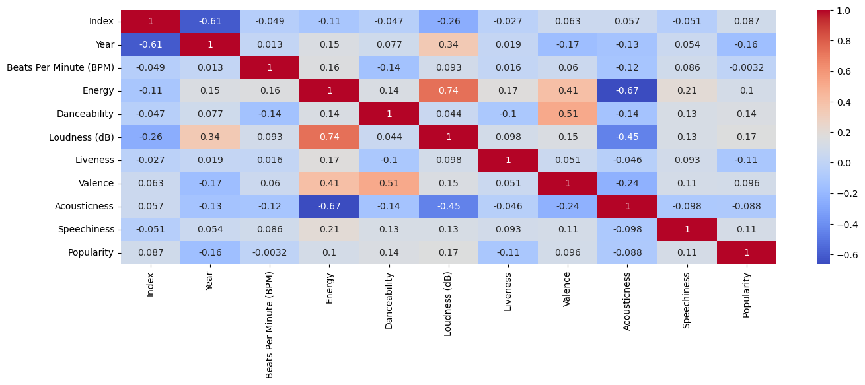
Team Poliwag
Heat Map
What We Have Done
Heat Map
Because of the intersection square of Speechiness and Popularity is above 0, it can be said that there is a slight linear relationship.
Popular Genres
Words Frequency
Duration of Songs
Top Streams
Because of the intersection square of BMP and Popularity is very close to 0, it can be said that there is no relationship between them.
Meta-Model
Initial Results
Final Model
Notes:
Photo by Frank Septillion on Unsplash
Photo by Joshua Fuller on Unsplash

Slide 4



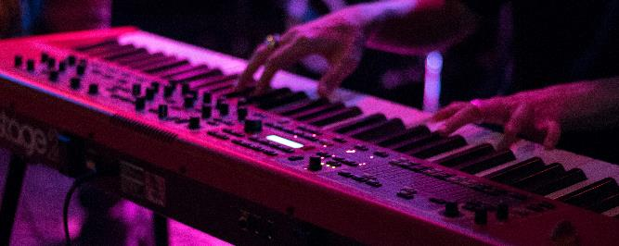


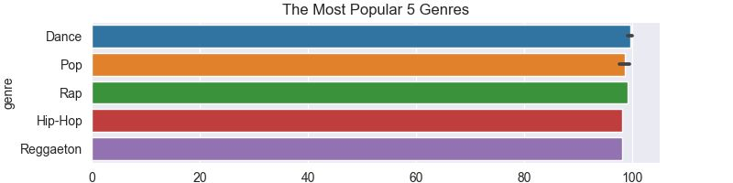
Team Poliwag
Most Popular Genres
What We Have Done
Heat Map
Pop
Hip-Hop
Popular Genres
Words Frequency
Pop
Duration of Songs
Dance
Rap
Top Streams
Meta-Model
Initial Results
Final Model
Notes:
Photo by freestocks on Unsplash
Photo by Martin Hexeberg on Unsplash
Photo by Alexander Popov on Unsplash
Photo by Matthias Wagner on Unsplash

Slide 5
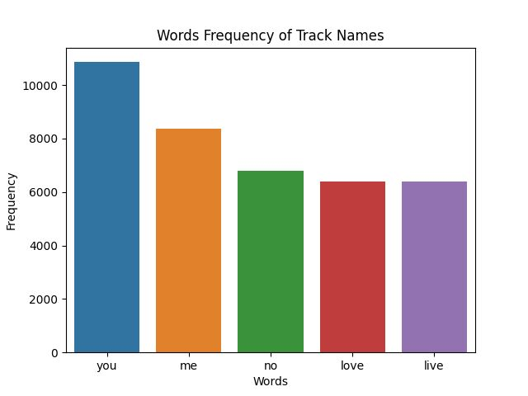
Team Poliwag
Words Frequency In Track Names
What We Have Done
Heat Map
Popular
Words
Popular Genres
Words Frequency
When we look at the graph we see that most common word to appear on a title is “you”.
Duration of Songs
Top Streams
Meta-Model
Initial Results
Final Model
Notes:
Photo by melanie van leeuwen on Unsplash
Photo by te nguyen on Unsplash
Photo by claudia raya on Unsplash
Photo by soundtrap on Unsplash

Slide 6
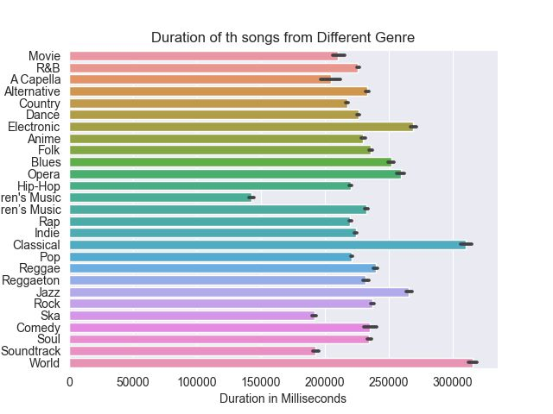
Team Poliwag
Duration of Songs From Genres
What We Have Done
Heat Map
Popular Genres
Words Frequency
Duration of Songs
Top Streams
Meta-Model
Initial Results
Final Model
Notes:
Photo by stefano pollio on Unsplash
Photo by jonathan chng on Unsplash
Photo by patrick tomasso on Unsplash
Photo by leo wieling on Unsplash
Photo by israel palacio on Unsplash

Slide 7
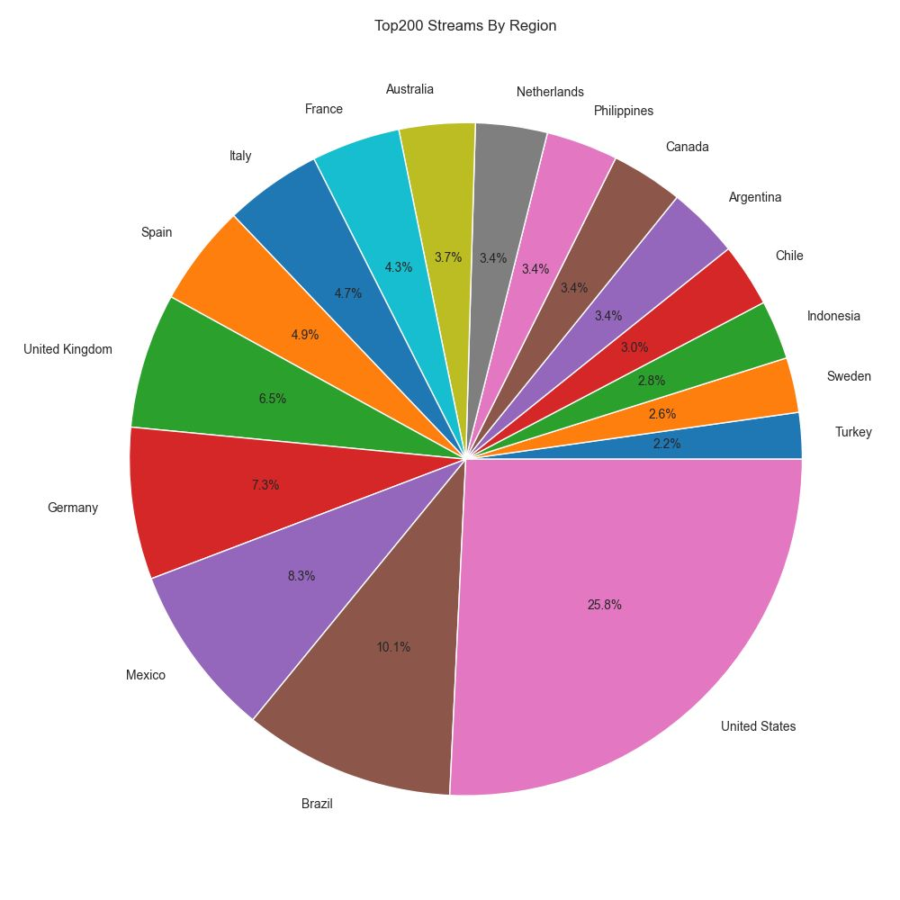
Team Poliwag
Top Streams by Region
What We Have Done
US
Brazil
Mexico
Germany
UK
Heat Map
Popular Genres
Words Frequency
Duration of Songs
Top Streams
Meta-Model
Initial Results
Final Model
Notes:
Photo by Marcela Laskoski on Unsplash
Photo by Marius Masalar on Unsplash
Photo by Luuk Wouters on Unsplash

Slide 8
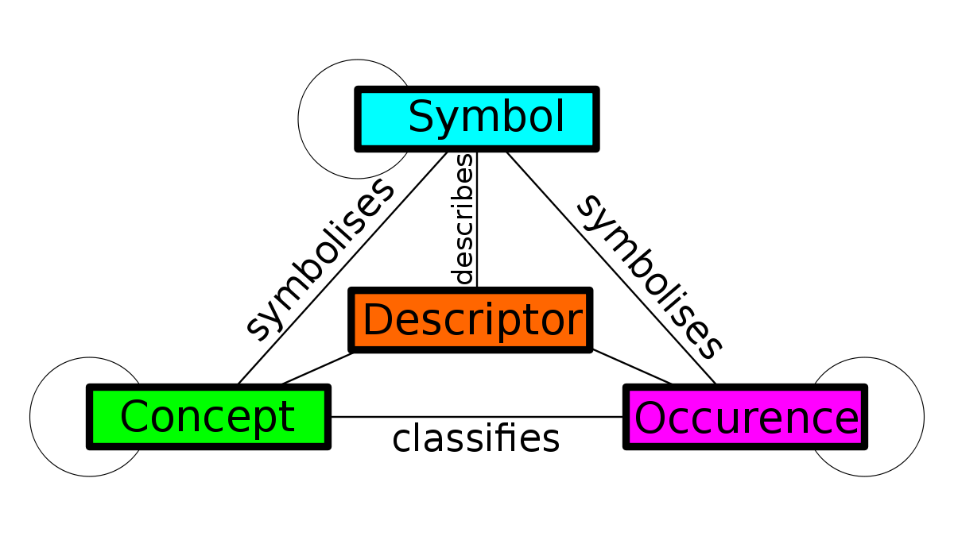
Team Poliwag
Meta-Model
What We Have Done
Heat Map
Popular Genres
Words Frequency
Duration of Songs
Top Streams
Meta-Model
A meta-model is a machine learning model that is trained to make predictions based on the outputs of other models. In other words, it takes the predictions of other models as input and uses them to make even more accurate predictions.
Initial Results
Final Model
Notes:
Photo by Te NGuyen on Unsplash
Photo by Dark Rider on Unsplash
Photo by Mike Giles on Unsplash

Slide 9

Team Poliwag
Initial Results
What We Have Done
Heat Map
Popular Genres
In our first attempt we tried to directly calculate the popularity of the songs according to their attributes with regression and results were not so great.
Words Frequency
Duration of Songs
Top Streams
Meta-Model
Initial Results
Final Model

Slide 10


Team Poliwag
Final Model
What We Have Done
After some thinking we decide to not directly predict the popularity value instead we decided to predict if the song would have a popularity over 74.
Heat Map
Popular Genres
Words Frequency
We chose 74 because the average popularity of the top 100 songs in our data set was 75.
Duration of Songs
Top Streams
And the accuracy was much better.
Meta-Model
Initial Results
Final Model

Slide 11

Thank You For Listening Us

