Slide 1
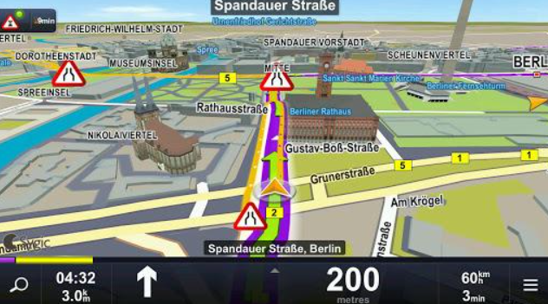


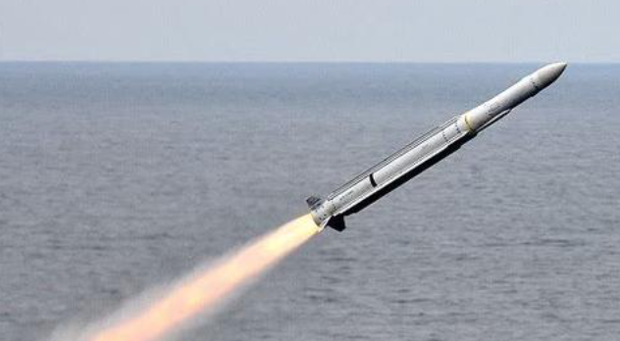
Navigation
Digital City
Measurement of Altitude
Missile Guidance

Slide 2
Positioning
Outdoor Positioning
Indoor Positioning
GPS
LBS
Wi-Fi Fingerprint
PDR

Slide 3

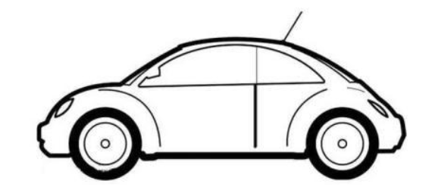

Slide 4
0.1 0.2 0.1
0.7 0.1 0.1
0.1 0.3 0.1
0.8 0.4 0.1
0.3 0.4 0.5

Slide 5
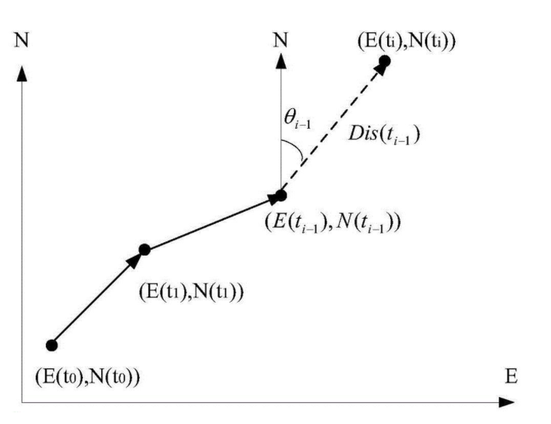

Slide 6
GPS Positioning Module
Position
Wi-Fi Fingerprint Positioning module
Position
LSTM
Position
PDR Positioning module
Position

Slide 7
Buildings
4
Open Space
2
3
1
Basement
5

