Slide 1

Exploring the Solar System: A Fascinating Journey
A Stunning View of the Solar System

Slide 2
The Marvels of the Universe
01

Slide 3
02
Enter title

Slide 4

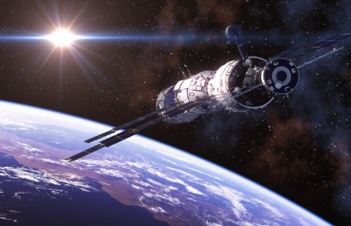
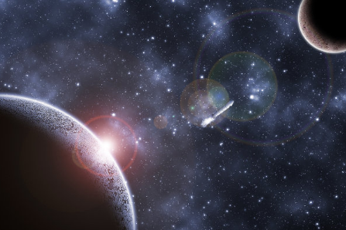
Enter title
Enter title
Click here to add content of the text Click here to add content of the text Click here to add content of the text

Slide 5




Enter title
Enter subtitle
Enter subtitle
Enter subtitle
Enter subtitle
Click here to add content of the text.Click here to add content of the text.
Click here to add content of the text.Click here to add content of the text
Click here to add content of the text.Click here to add content of the text
Click here to add content of the text.Click here to add content of the text

Slide 6
04
Enter title

Slide 7
THANKS

