Slide 1
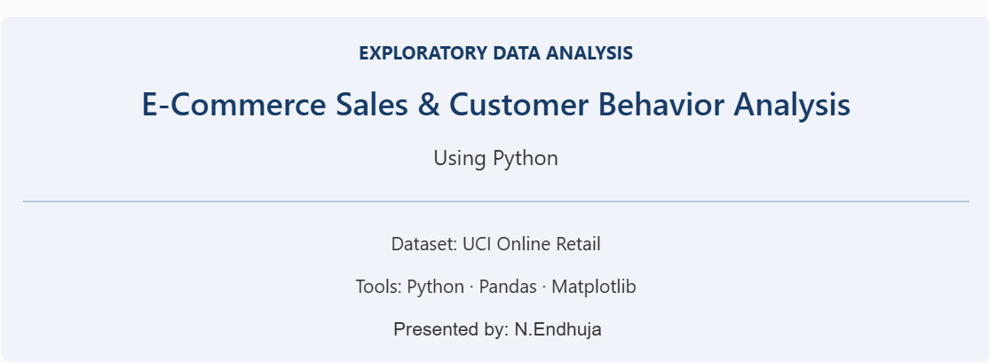

Slide 2
Project Overview
Objective
Analyze e-commerce transaction data to understand sales performance and customer purchasing behavior.
Key Objectives
Analyze sales trends and revenue
Identify popular products and markets
Understand customer behavior
Segment customers using RFM analysis

Slide 3
Dataset & Methodology
Dataset Information
• UCI Online Retail
• Online transactions
• Product and customer data
Analysis Workflow
1. Data cleaning
2. Exploratory analysis
3. Sales and customer analysis
4. RFM segmentation

Slide 4
Key Findings
£10.67M Total Revenue | 4,338 Unique Customers
Nov 2011 Highest-Revenue Month | United Kingdom Top Country by Revenue

Slide 5
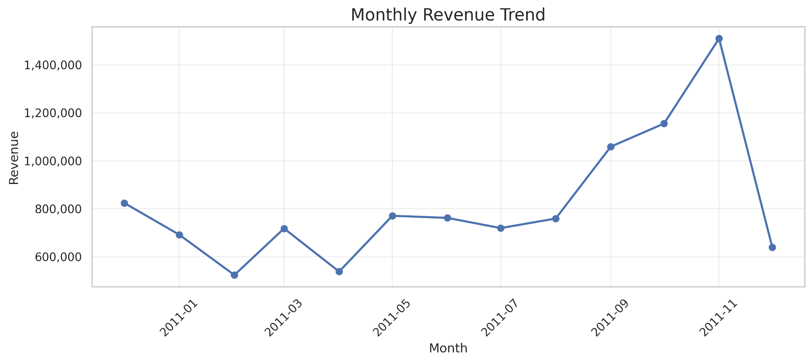
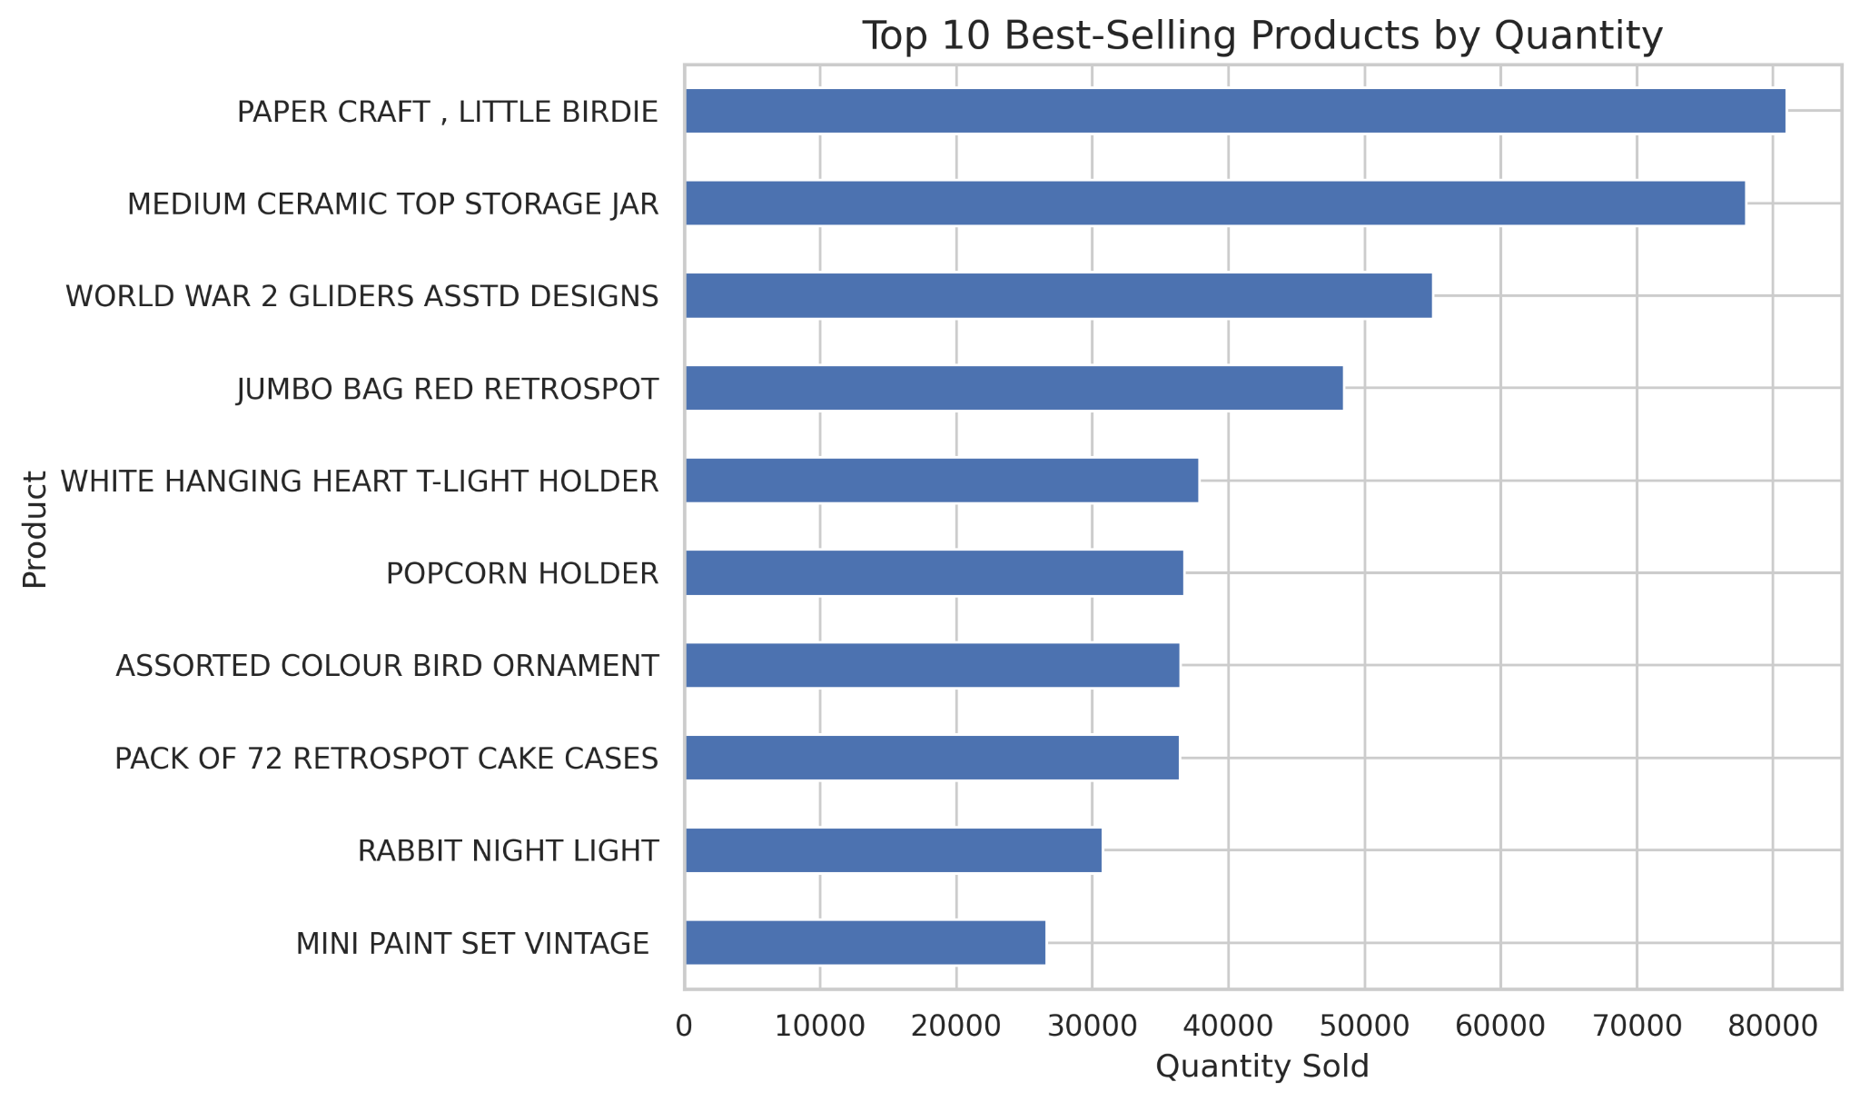
Sales Analysis
November 2011 Revenue £1,509,496.33

Slide 6
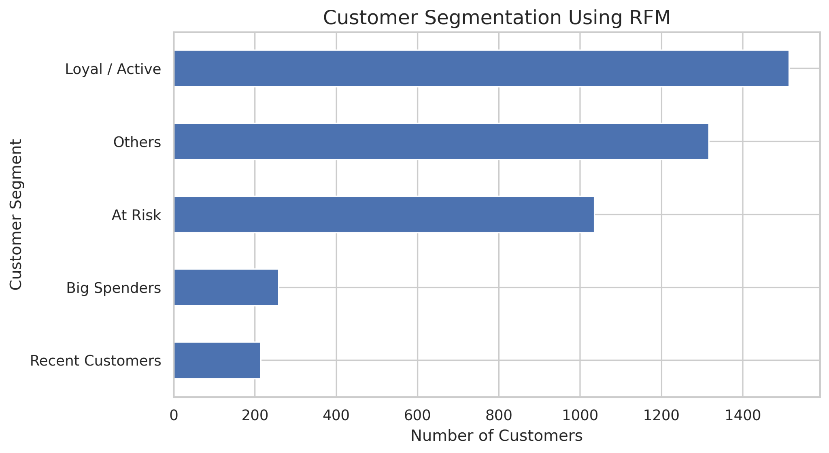
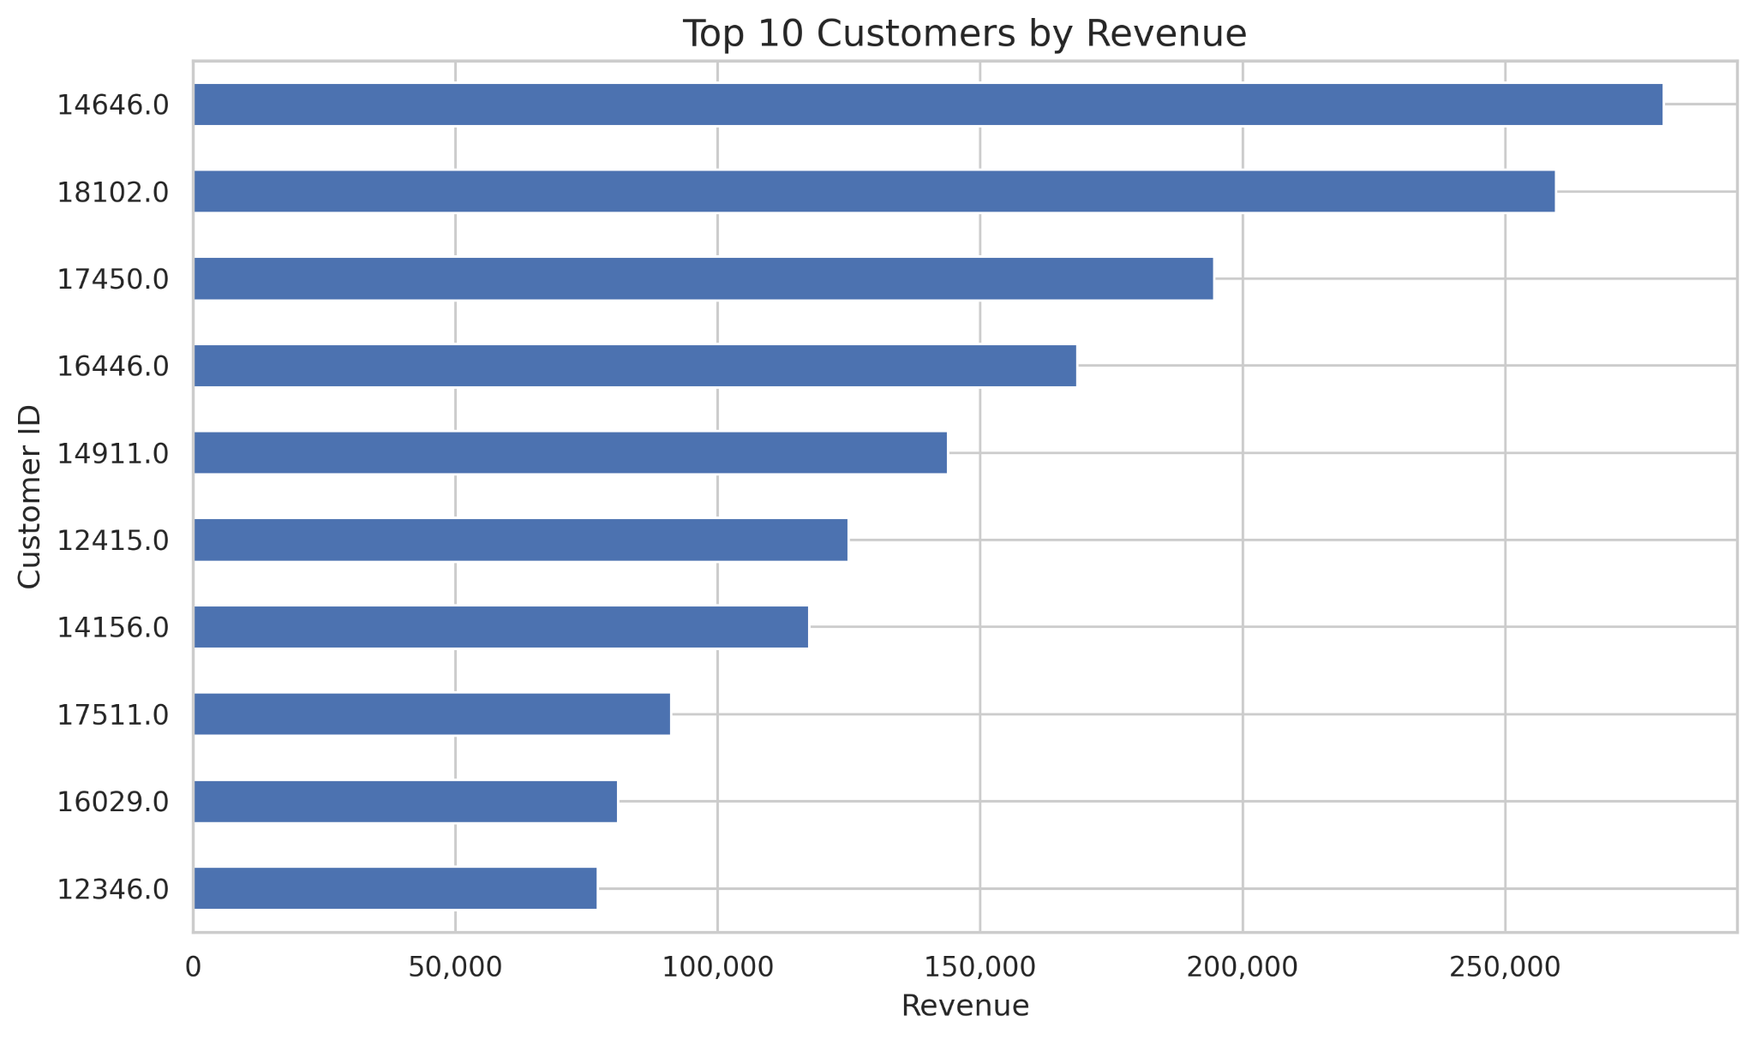
Customer Analysis & RFM Segmentation
Customer Analysis
Identified the top 10 customers by revenue.
Examined customer purchasing contributions.
Used RFM analysis to segment customers.
Recency
Frequency
Monetary
Business Value: Helps businesses plan customer retention and targeted marketing campaigns.

Slide 7
Business Recommendations
1. Inventory Planning
Maintain sufficient stock of popular products to help meet customer demand.
2. Seasonal Planning
Prepare inventory and promotions ahead of peak sales periods, such as November.
3. Customer Loyalty
Use loyalty rewards and personalized offers to encourage repeat purchases
4. Customer Retention
Use RFM segments to identify customers who may benefit from re-engagement campaigns

Slide 8
