Slide 1
Climate Change Belief Analysis
Presented by : SWAT Analytics Company
March 2022

Slide 2
Who are we
SWAT Analytics Consultancy is a team of young individuals with vast experience in data science. The team members have consistently provided reliable support services and consultancy to a wide variety of corporates in the capacity of a business partner or consultant. We endeavor to offer business solutions ethically and build long-term relationships with our clients.
Who is working on the current task?
Emmanuel Okoro
Jacqueline Wang’ombe
Jack Kamire
Titus Olang
Winfred Mutinda

Slide 3
Project Outline
Introduction
1
2
Problem Statement
3
Data
4
Explanatory Data Analysis
5
Data Engineering
Modeling
6

Slide 4

Introduction
1
Introduction
Have you notice any of the following occurrences:-
1. Hotter Temperatures
2. More Severe Storms
3. Increased drought
4. Changes in rainfall patterns
What could be causing this:-
Climate Change:- a change in the pattern of weather, and related changes in oceans, land surfaces and ice sheets, occurring over time scales of decades or longer
Key drivers of climate change:-
Greenhouse gases
Aerosol emissions
Land use change

Slide 5
Problem Statement
The problem:-
In an effort to reduce their carbon footprint, our clients are offering products/services that are environmentally friendly and sustainable. However, they are not sure whether climate change is a real threat or not?
The solution:-
Our team has been tasked to conduct a tweet sentiment analysis by creating a classifier model that predicts whether a tweet is pro-climate change or not.

Slide 6
Data
Twitter climate change data:
Tweet Id: Unique value
Message: Independent variable
Sentiment: Target variable
Categories:
2 News: the tweet links to factual news about climate change.
1 Pro: the tweet supports the belief of man-made climate change.
0 Neutral: the tweet neither supports nor refutes the belief of man-made climate change.
-1 Anti: the tweet does not believe in man-made climate change.

Slide 7


Explanatory Data Analysis (EDA)
What is Exploratory Data Analysis?
Exploratory data analysis (EDA) is the process of analysing and investigating data sets and summarizing their main characteristics.
Importance of EDA
It aids in determining how best to manipulate data to get the required answers, trends, patterns, and relationships as well as getting insights into the dataset.

Slide 8
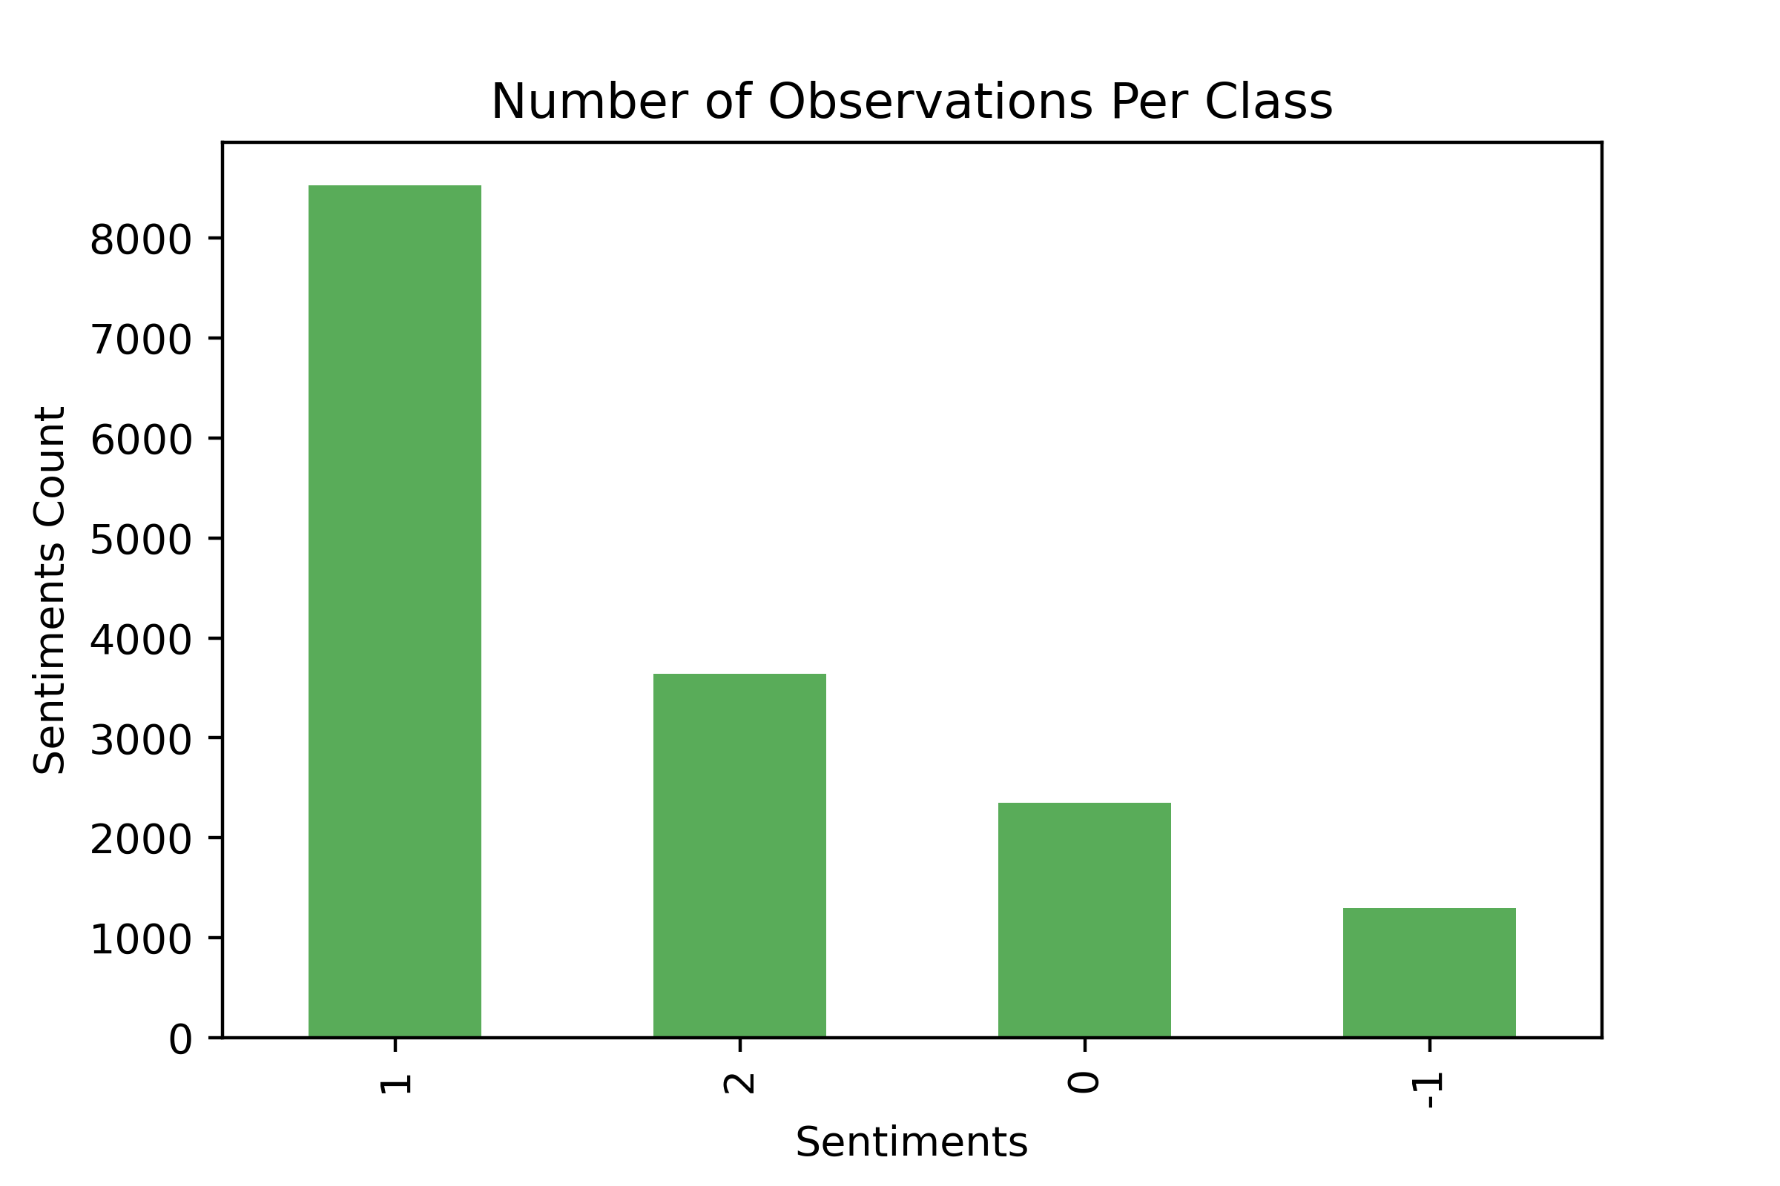
Explanatory Data Analysis (EDA)
Class Imbalance:
Class imbalance is where the number of examples in the training dataset for each class label is not balanced.

Slide 9
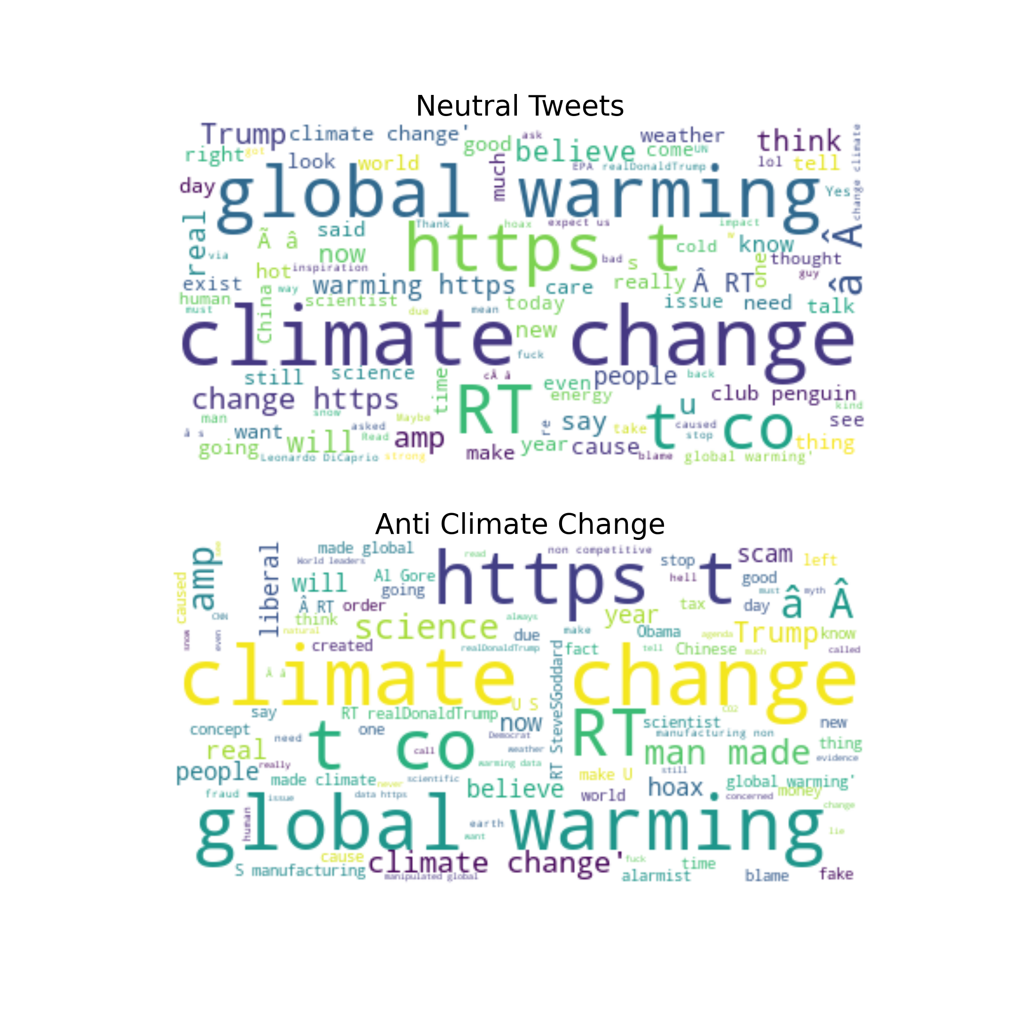
EDA
Data visualization for our categories using Word Cloud.

Slide 10
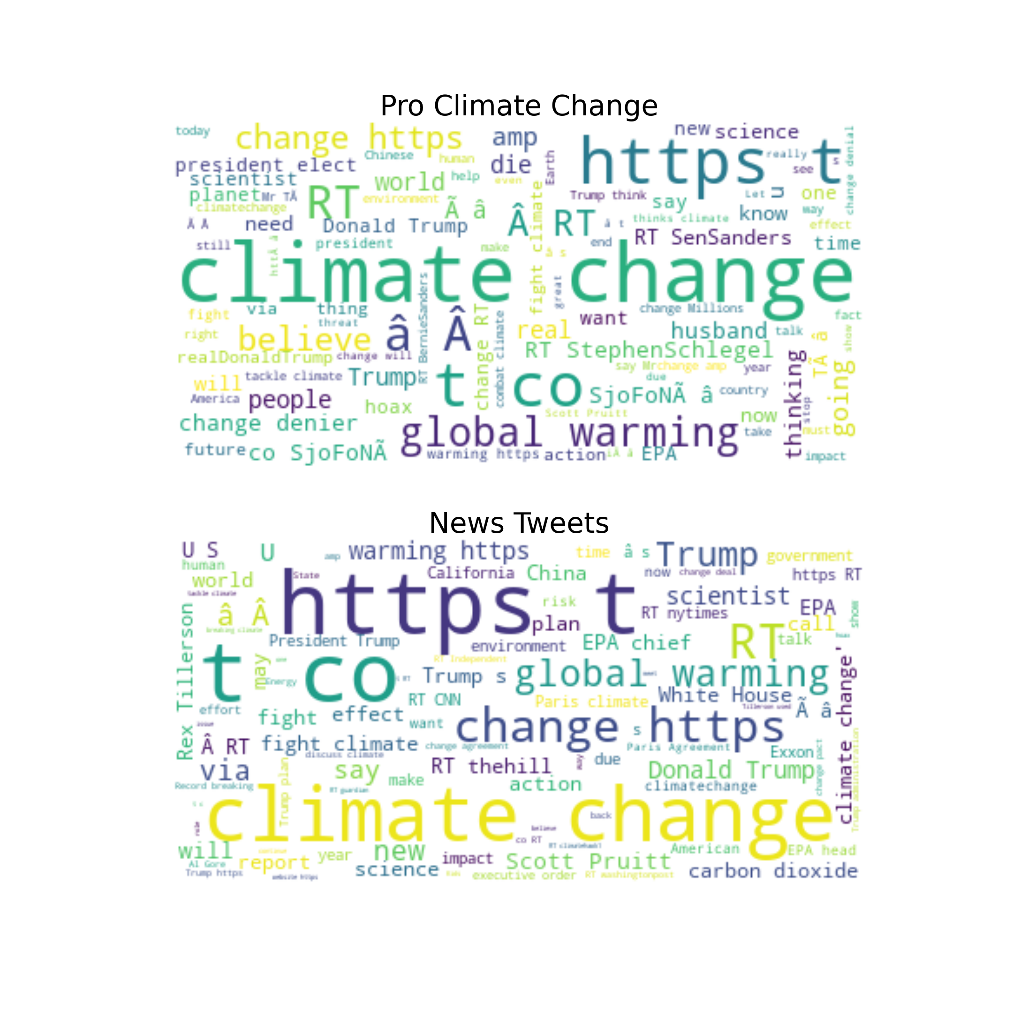
EDA
Data visualization for our categories using Word Cloud.

Slide 11
Data Engineering
Removing Noise: Remove Web-urls, Words starting with # and @, Making all text lowercase and punctuation. Tokenization: Splitting up a larger body of text into smaller lines, words or even creating words for a non-English language Stemming: Process of reducing inflection in words to their root forms such as mapping a group of words to the same stem even if the stem itself is not a valid word in the language Lemmatization: Process of grouping together the different inflected forms of a word so they can be analyzed as a single item. Removing stopwords: Stopwords are the English words which does not add much meaning to a sentence Bag of words Method to extract features from text documents Resampling : Downsampling the majority class and Upsampling the minority class

Slide 12
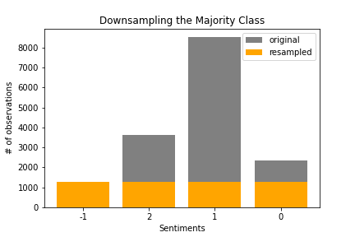
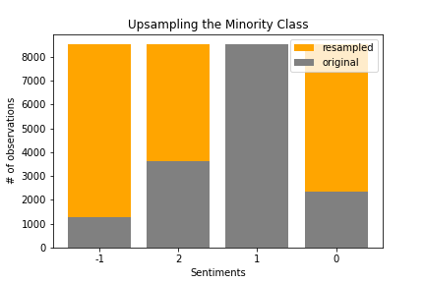
Data Engineering

Slide 13
Modeling
The following classification models were used:
Logistic regression

Slide 14
Model Performance
F1_Score :
It is the harmonic mean between precision and recall and it measures a test’s accuracy by telling you how many instances it classifies correctly.

