Slide 1
Code4z DBM-Db2 Schema Mgmt.
Workshop

Slide 2
Disclaimer
Certain information in this presentation may outline Broadcom’s general product direction. This presentation shall not serve to (i) affect the rights and/or obligations of Broadcom or its licensees under any existing or future license agreement or services agreement relating to any Broadcom software product; or (ii) amend any product documentation or specifications for any Broadcom software product. This presentation is based on current information and resource allocations as of March 25, 2025, and is subject to change or withdrawal by Broadcom at any time without notice. The development, release and timing of any features or functionality described in this presentation remain at Broadcom’s sole discretion.
Notwithstanding anything in this presentation to the contrary, upon the general availability of any future Broadcom product release referenced in this presentation, Broadcom may make such release available to new licensees in the form of a regularly scheduled major product release. Such release may be made available to licensees of the product who are active subscribers to Broadcom maintenance and support, on a when and if-available basis. The information in this presentation is not deemed to be incorporated into any contract.
Broadcom may use any feedback provided by you related to a Broadcom product or this presentation for any Broadcom business purposes (including but not limited to, preparation, reproduction, and distribution of derivative works based upon such feedback), without any obligation to you including consent or payment.
Copyright © 2025 Broadcom. All rights reserved. The term “Broadcom” refers to Broadcom Inc. and/or it’s subsidiaries. Broadcom, the pulse logo, Connecting everything, CA Technologies and the CA Technologies logo are among the trademarks of Broadcom.
THIS PRESENTATION IS FOR YOUR INFORMATIONAL PURPOSES ONLY. Broadcom assumes no responsibility for the accuracy or completeness of the information. TO THE EXTENT PERMITTED BY APPLICABLE LAW, BROADCOM PROVIDES THIS DOCUMENT “AS IS” WITHOUT WARRANTY OF ANY KIND, INCLUDING, WITHOUT LIMITATION, ANY IMPLIED WARRANTIES OF MERCHANTABILITY, FITNESS FOR A PARTICULAR PURPOSE, OR NONINFRINGEMENT. In no event will Broadcom be liable for any loss or damage, direct or indirect, in connection with this presentation, including, without limitation, lost profits, lost investment, business interruption, goodwill, or lost data, even if Broadcom is expressly advised in advance of the possibility of such damages.

Slide 3
Agenda
Workshop
Database Management for Db2 z/OS Extension Overview
Workshop Use Case
Let’s Get to Work
Access DBM-Db2 extension
Provision objects – Copy Objects
Explorer and Context commands
Add a column – Generate DDL
Add a column – Check DDL Syntax
Add a column – Deploy DDL
Wrap up

Slide 4
Code4z DBM-Db2 Schema Mgmt

Slide 5
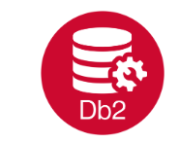
Database Management for Db2 z/OS Extension Overview
Broadcom Database Management for Db2 z/OS extension (DBM-Db2 extension) lets database administrators and application developers interact with Db2 for z/OS from Zowe Explorer. Administrators and developers can use the DBM-Db2 extension to manage the schema of Db2 objects.

Slide 6
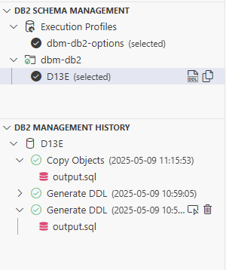
Code4z DBM-Db2 extension features
Db2 Schema Management View
Generate DDL - Guides you through the process of generating DDL statements for a selected Db2 object and its dependencies.
Copy Objects - Guides you through the process of copying objects and their data using easy-to-follow menus.
Note: Behavior of the Generate DDL and Copy Objects operations can be customized using Execution Profiles.
Db2 Management History View - Shows completed DBM-Db2 operations, including execution details, input files, and output files.
To save a file to a custom location, right-click it and select Save As.
Status Bar - Shows the selected Db2 subsystem, active execution profile, and any operation in progress.
Click a subsystem name or profile to navigate to the related profile selection in the Db2 Schema Management view.

Slide 7
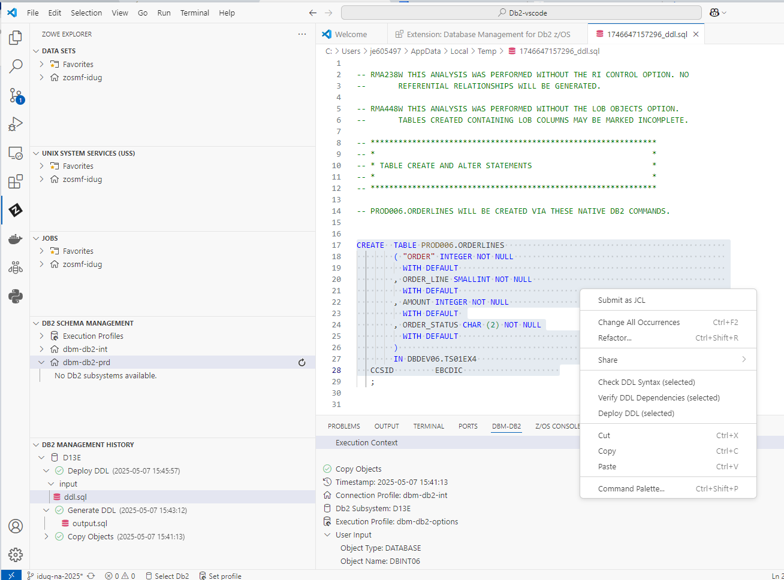
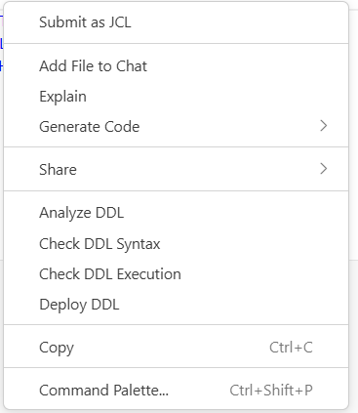
DBM-Db2 extension features
Context commands are available for execution against an SQL file listed in Explorer or opened in the Editor:
Analyze DDL - Analyzes the SQL DDL file and displays an analysis view that groups DROP, CREATE, and ALTER statements by Db2 object type.
Check DDL Syntax - Checks if the DDL syntax is valid.
Check DDL Execution - Verifies that the primary objects to be created do not exist on the target Db2 and that all required related objects exist on the target Db2 or in the DDL.
Deploy DDL - Applies DDL schema changes from the input file to objects on a target Db2.
Note: Behavior of the Deploy DDL can be customized using Execution Profiles.

Slide 8
Code4z DBM-Db2 Schema Mgmt
Workshop Use Case

Slide 9


A very common use case
Michelle
New z developer
Developer needs to implement a new function
Requires a program change
Adding a new column to an existing table
Test code against new version of the table
Using Code4z DBM-Db2 Schema Mgmt. from your Zowe Explorer session.
Provision an object with data from the integration environment to development environment.
Copy Objects
Add a column to table in development environment
Generate DDL | Check DDL Syntax
Deploy object change
Deploy DDL
Roger
Traditional DBA

Slide 10
The use case step by step (ProvisionObjects)
D13E (“development subsystem”)
D13E (“integration subsystem”)
YOUR_DEV_DB
YOUR_INT_DB
Clone object
Db2 | Database name | Table name | Purpose
D13E | YOUR_DEV_DB | YOUR_TABLE | Developer version of ORDERLINES
D13E | YOUR_INT_DB | YOUR_TABLE | Current integration test version of ORDERLINES

Slide 11
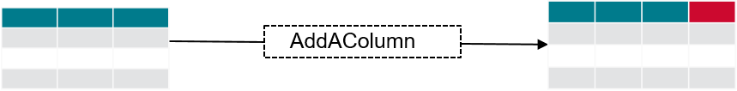
The use case step by step (AddAColumn & Test)
D13E (“development”)
YOUR_DEV_DB
Db2 | Database name | Table name | Purpose
D13E | YOUR_DEV_DB | YOUR_TABLE | Developer version of ORDERLINES

Slide 12
The use case step by step (Deploy object change)
D13E (“development subsystem”)
YOUR_DEV_DB
Deploy new schema
Db2 | Database name | Table name | Purpose
D13E | YOUR_DEV_DB | YOUR_TABLE | Developer version of ORDERLINES

Slide 13
Code4z DBM-Db2 Schema Mgmt
Let’s Get to Work

Slide 14

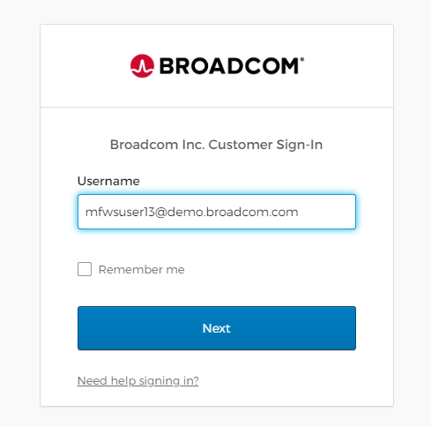
Login to your personal Workspace
1
Login to your personal Workspace:
Enter url https://sn.ws.broadcom.com in the browser
Enter your Username SN_USER@demo.broadcom.com
Click Next
2
3

Slide 15
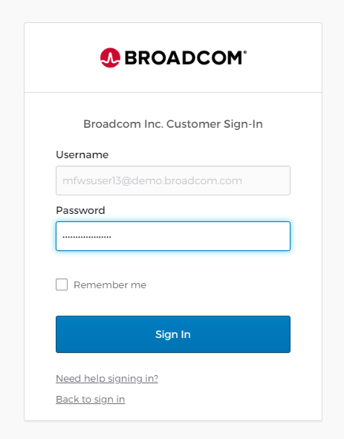
Login to your personal Workspace
Login to your personal Workspace:
Enter Password provided for DevOps workshop
Click Sign In
SN_USER@demo.Broadcom.com
1
2

Slide 16
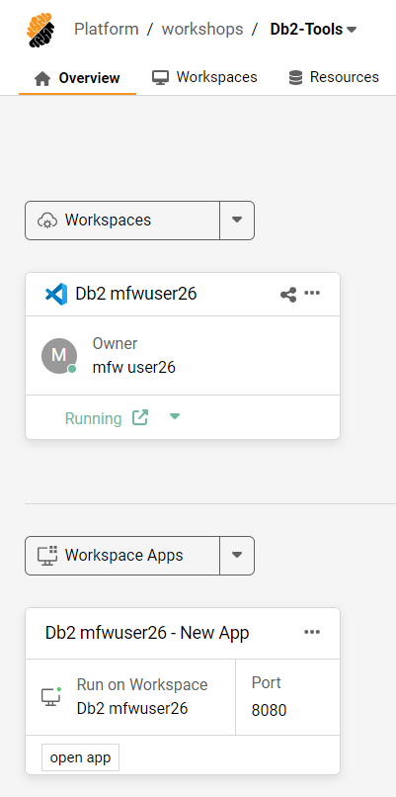
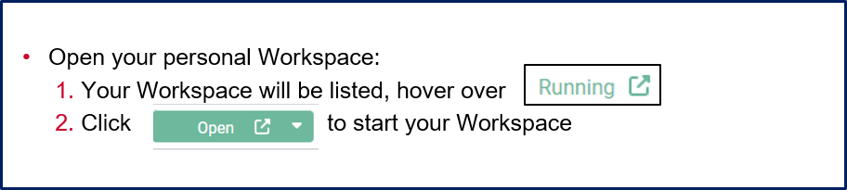
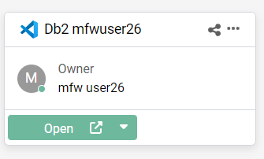
Open your personal Workspace
Ensure your project is Db2-Tools
Db2 SN_USER
Db2 SN_USER
SN_USER
Db2 SN_USER
1
Db2 SN_USER
SN_USER
Db2 SN_USER
2

Slide 17
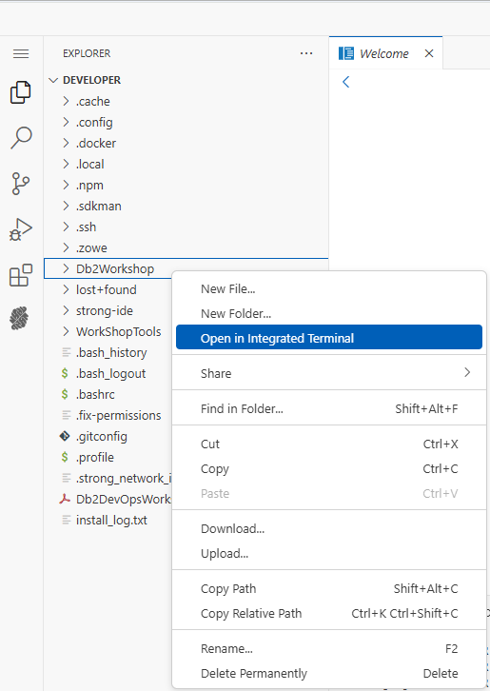
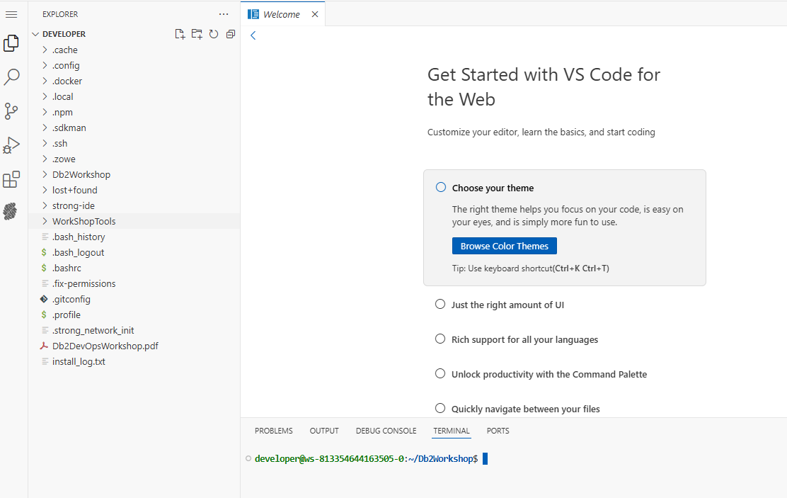
Open new Terminal and set home directory
Open new Terminal:
Right mouse click Db2Workshop folder, then select Open in integrated Terminal.
A new Terminal will open positioned in the /Db2Workshop directory
1
2

Slide 18
Code4z DBM-Db2 Schema Mgmt
Access DBM-Db2 extension

Slide 19
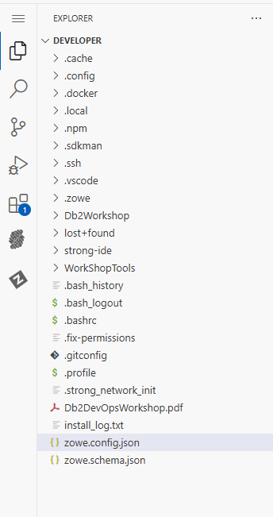
Access DBM-Db2 extension
Access DBM-Db2 extension:
Left mouse click
1

Slide 20
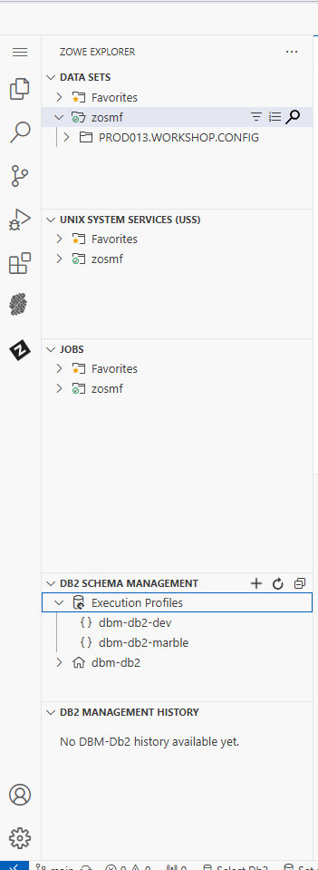
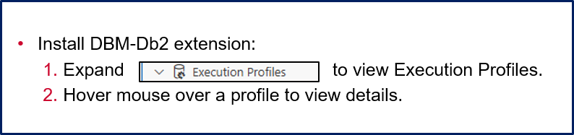
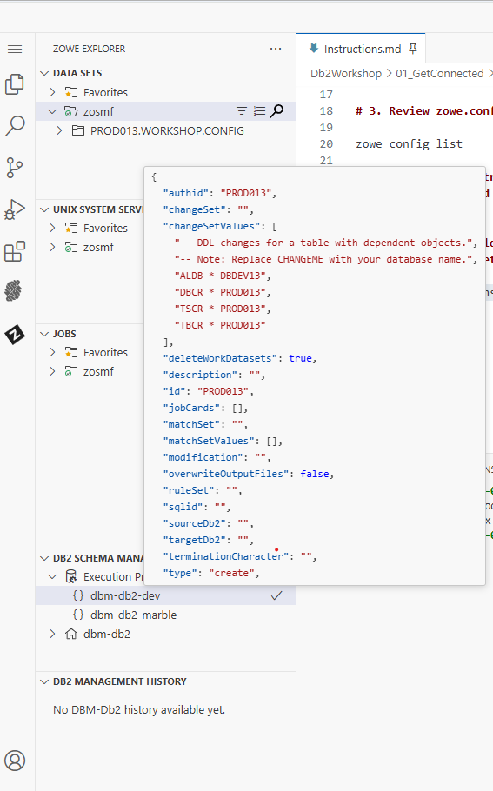

Access DBM-Db2 extension cont.
Access DBM-Db2 extension:
“MAINFRAME_USER”,
YOUR_DEV_DB",
MAINFRAME_USER”,
MAINFRAME_USER”,
2
MAINFRAME_USER”,
1
“MAINFRAME_USER”,
Select or Edit Profile

Slide 21
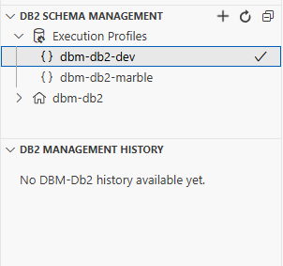
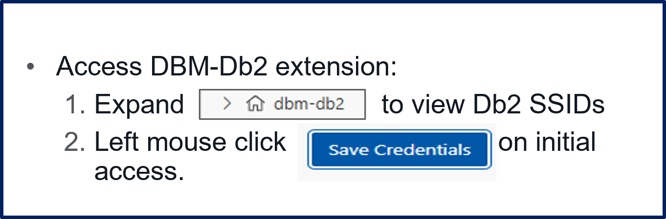
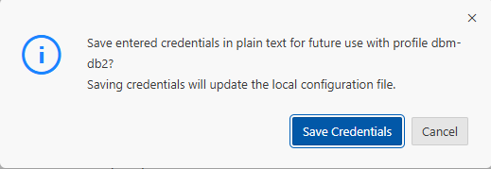
Access DBM-Db2 extension cont.
1
2

Slide 22
Code4z DBM-Db2 Schema Mgmt
Provision objects – Copy Objects

Slide 23
Create development environment
Create user database, tablespace and table in development environment
1: Use dbm-db-dev Execution Profile, ChangeSetValues are based on your MAINFRAME_USER Id.
<ChangeSetValues> <from> <to>
Example:
ALDB YOUR_INT_DB YOUR_DEV_DB
DBCR * MAINFRAME_USER
TSCR * MAINFRAME_USER
TBCR * MAINFRAME_USER
Use workshop userid for object name changes. For example:
Userid – MAINFRAME_USER
Database – YOUR_DEV_DB
Tablespace Creator – MAINFRAME_USER
Table Creator – MAINFRAME_USER

Slide 24
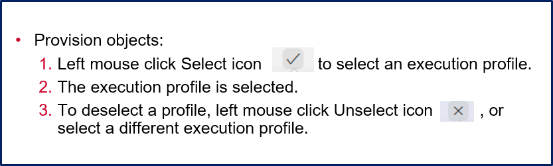
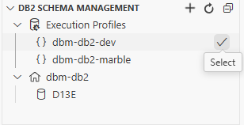
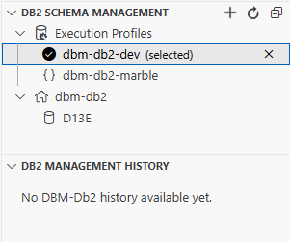
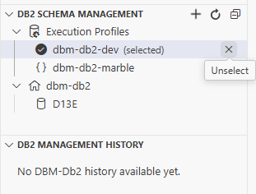
Create development environment Select dbm-db2-dev Execution Profile
1
2
3

Slide 25
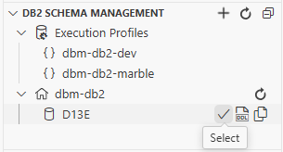
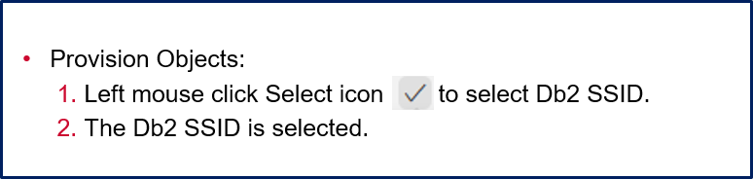
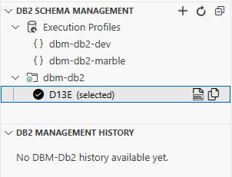
Create development environment Select dbm-db2 D13E Db2 SSID
1
2

Slide 26
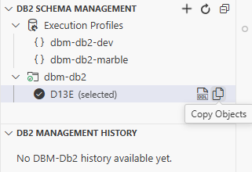
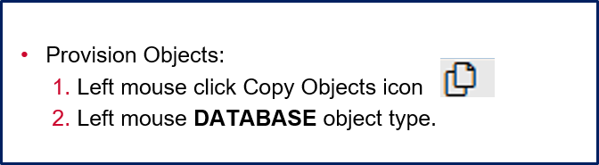
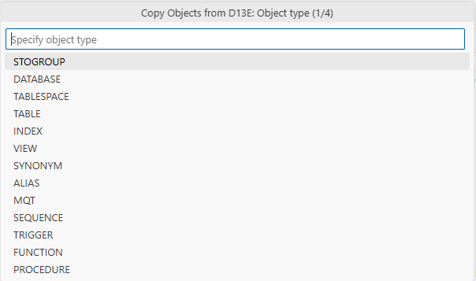
Create development environment Copy Objects – Select Object Type
1
2

Slide 27
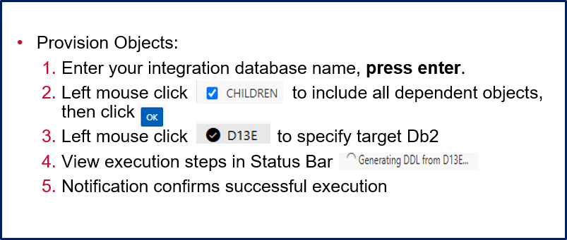
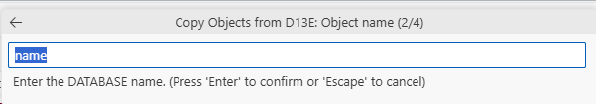
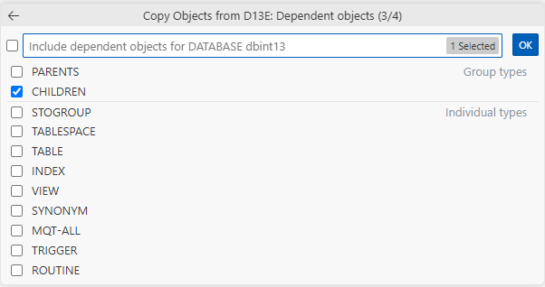


Create development environment Copy Objects
YOUR_INT_DB
1
YOUR_INT_DB
2
Generating DDL from D13E…
Verify DDL on D13E…
4
Unloading data from D13E…
Loading data to D13E…
5
3

Slide 28
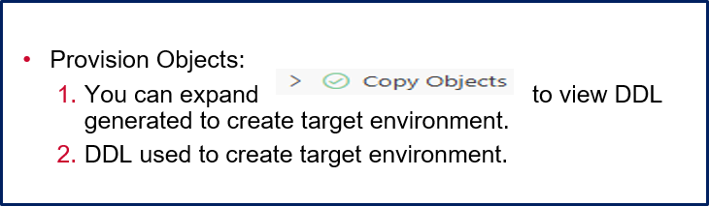
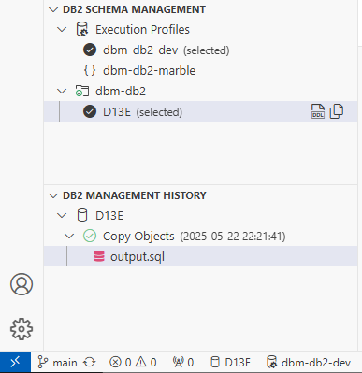
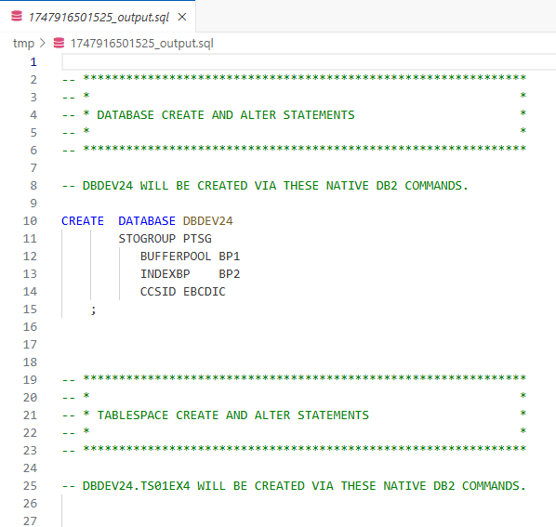
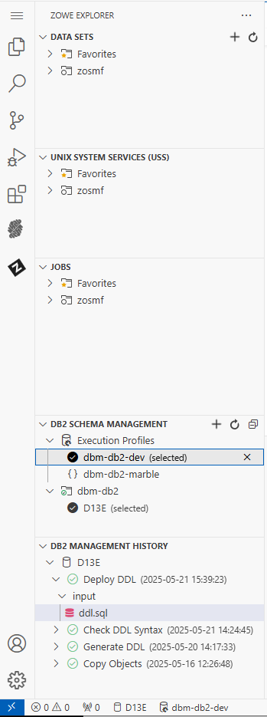
Create development environment Copy Objects
2
1
YOUR_DEV_DB

Slide 29
Code4z DBM-Db2 Schema Mgmt
Explorer and Context commands

Slide 30
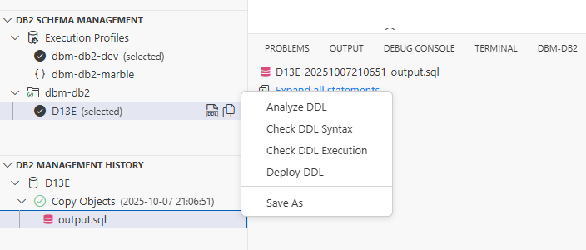
Explorer and Context commands
This section describes the Explorer and Context commands available for execution against a SQL file listed in the Explorer or opened in the Editor.
EDITOR (for *.sql files)
Commands: Analyze DDL, Check DDL Syntax, Check DDL Execution, Deploy DDL
FILE EXPLORER (for *.sql files)
Commands: Analyze DDL, Check DDL Syntax, Check DDL Execution, Deploy DDL

Slide 31
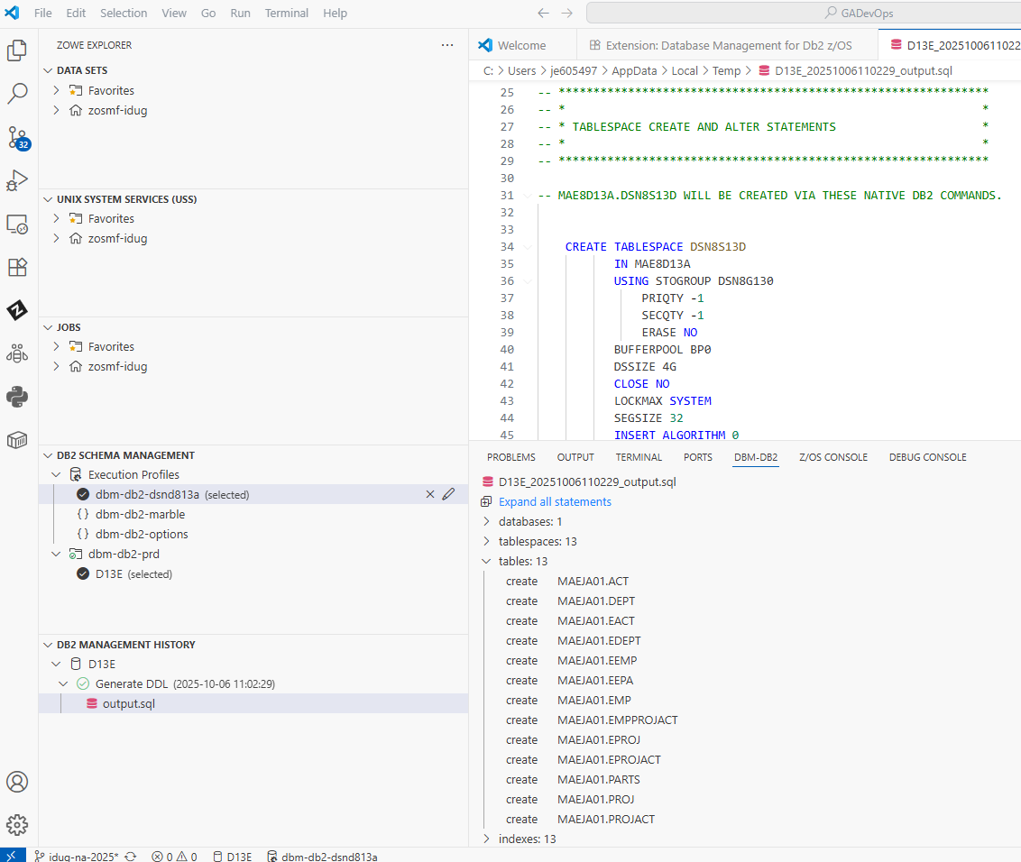
Explorer and Context commands
This section describes the Explorer and Context commands available for execution against a SQL file listed in the Explorer or opened in the Editor.
Analyze DDL command navigation:
Will generate an index of the Db2 objects contained in the *.sql file.
Analyze DDL is executed automatically when a *.sql file is created by dbm-db2 extension command, i.e., Generate DDL
You can also execute Analyze DDL via a left mouse click for the *.sql file.

Slide 32
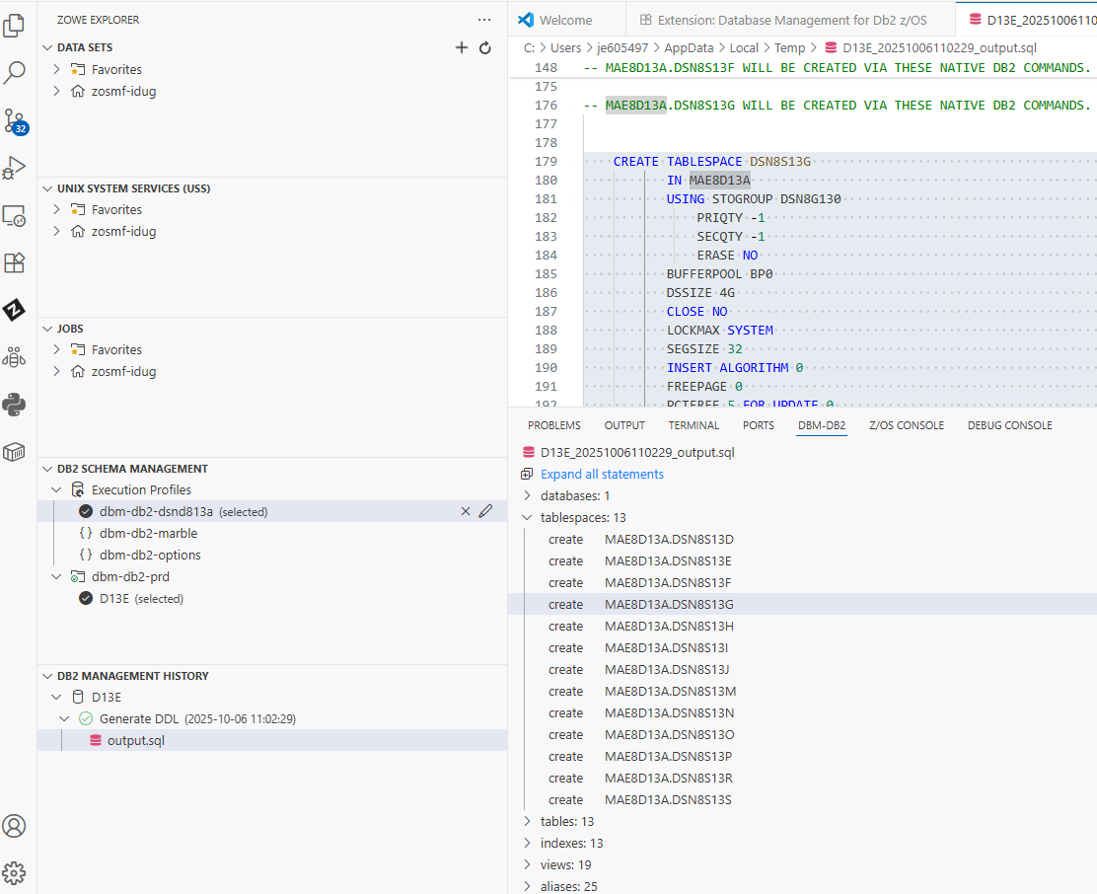
Explorer and Context commands
This section describes the Explorer and Context commands available for execution against a SQL file listed in the Explorer or opened in the Editor.
Analyze DDL command navigation:
Left mouse click an object will position and select that object in the *.sql file.
To select multiple objects use ctrl-click, or shift-click.
Selection by object type is also available.
1
1

Slide 33
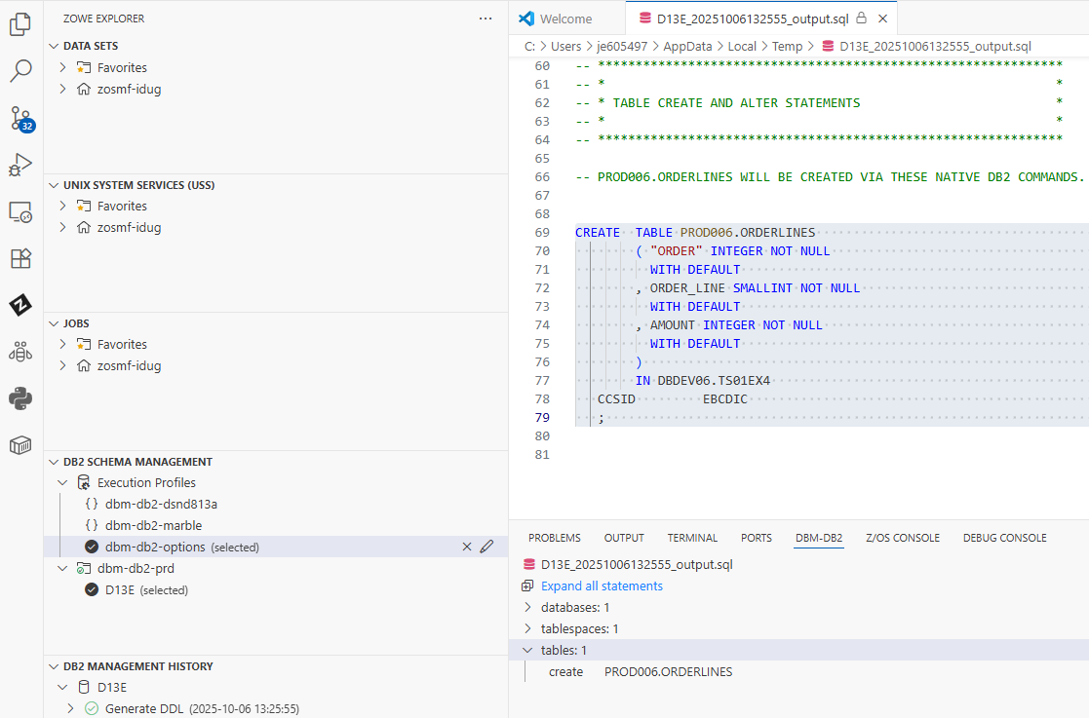
Explorer and Context commands
Updating and saving a *.sql file.
Updating and saving a*.sql file:
When a *.sql file is generated by a dbm-db2 extension command, i.e., Generate DDL. It is opened in read-only mode.

Slide 34
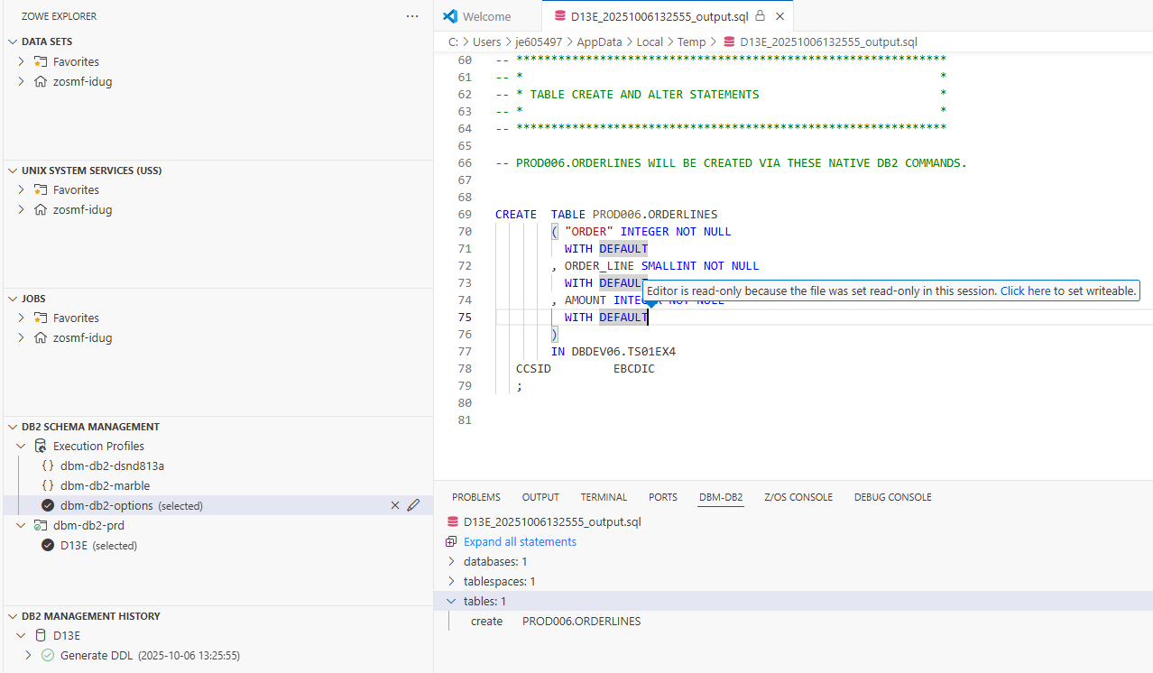
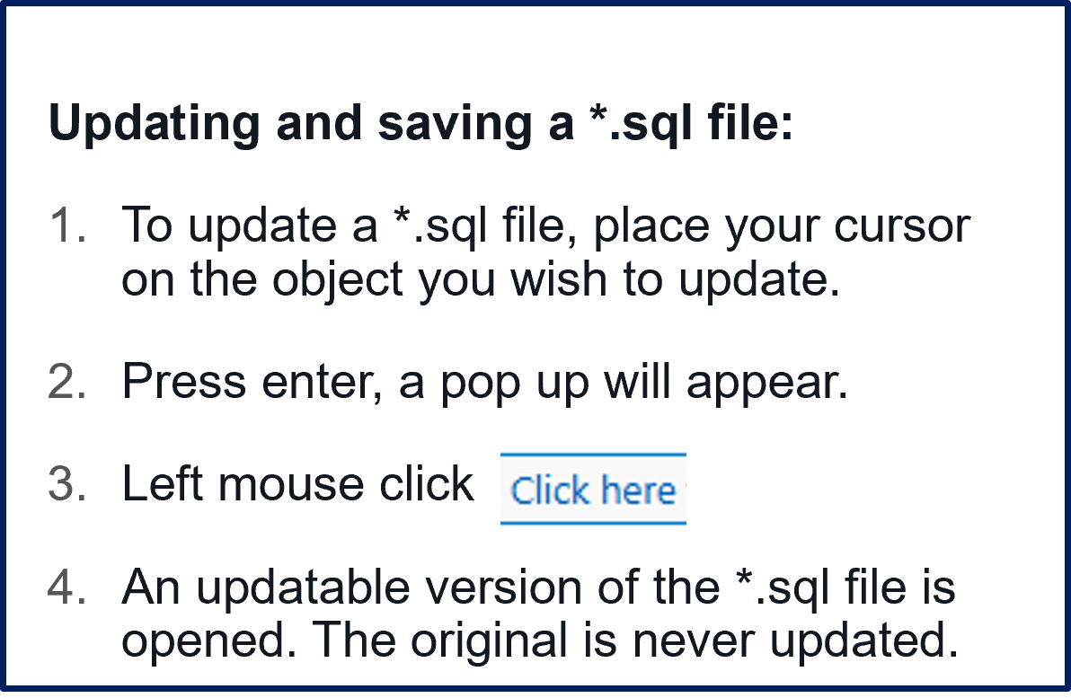
Explorer and Context commands
Updating and saving a *.sql file.

Slide 35
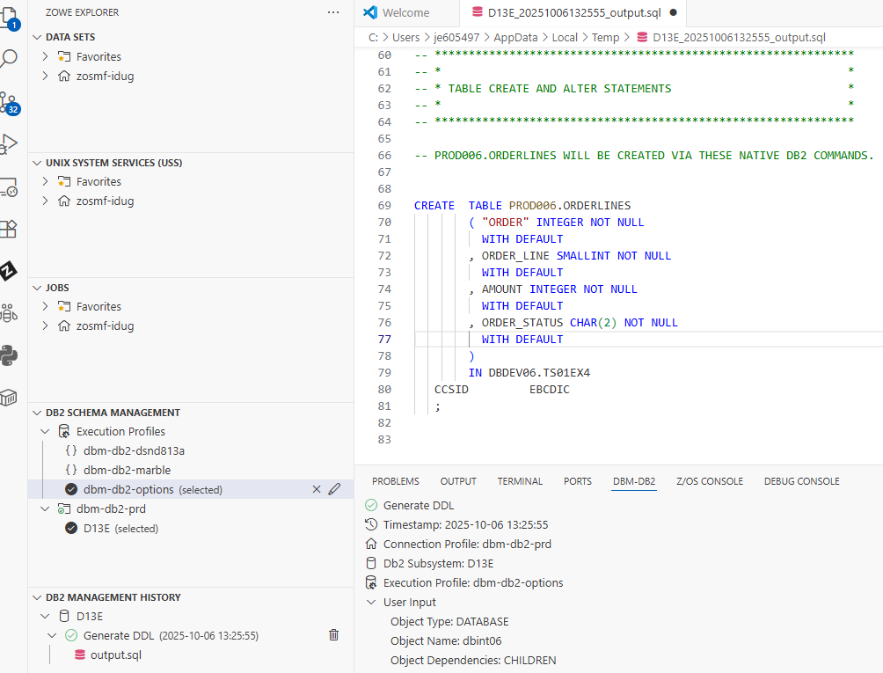
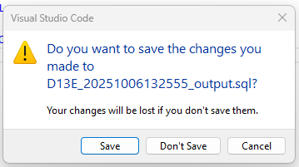
Explorer and Context commands
Updating and saving a *.sql file.
1
Updating and saving a *.sql file:
An updatable version of the *.sql file is opened. The original is never updated.
Make you changes then save.
2

Slide 36
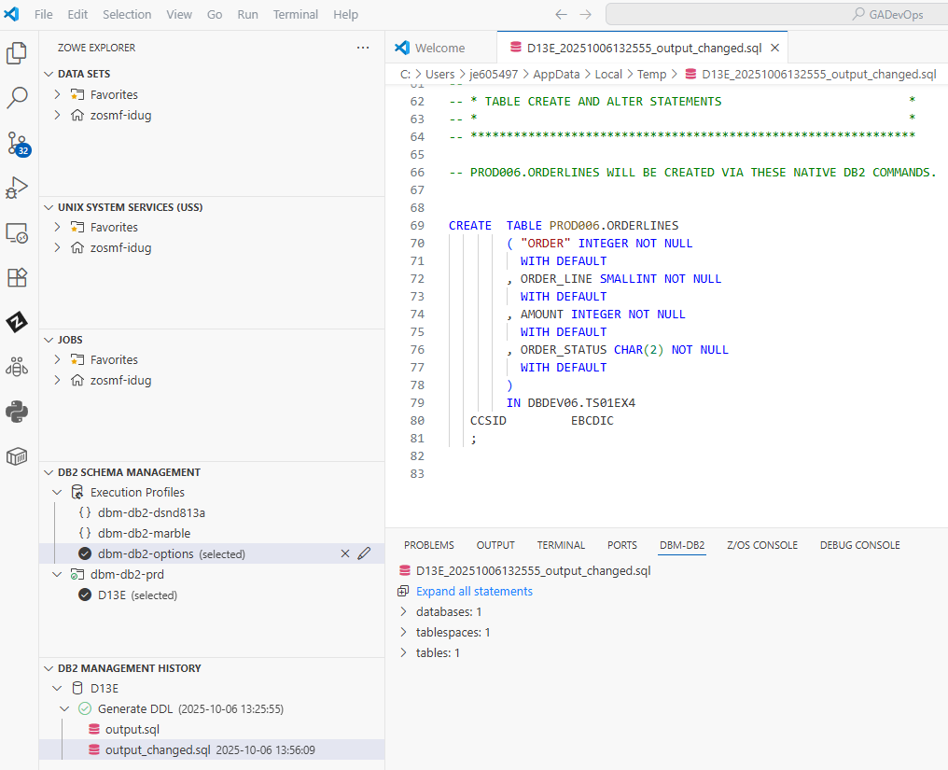
Explorer and Context commands
Updating and saving a *.sql file.
Updating and saving a *.sql file:
A changed copy is created in DB2 MANAGEMENT HISTORY, reflects the changes data and time in description.

Slide 37
Code4z DBM-Db2 Schema Mgmt
Add a column – Generate DDL

Slide 38
Add a column to table YOUR_TABLE
Add a new column to table YOUR_TABLE, check DDL syntax and Deploy DDL of the table change.
CREATE TABLE YOUR_TABLE
( "ORDER" INTEGER NOT NULL
WITH DEFAULT
, ORDER_LINE SMALLINT NOT NULL
WITH DEFAULT
, AMOUNT INTEGER NOT NULL
WITH DEFAULT
, ORDER_STATUS CHAR (2) NOT NULL
WITH DEFAULT
)
IN YOUR_DEV_DB.TSO1EX4
CCSID EBCDIC
;
Add new column to table YOUR_TABLE

Slide 39
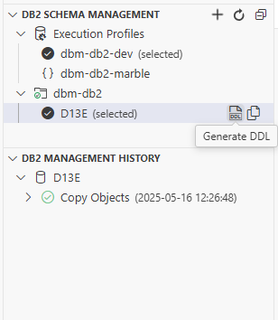
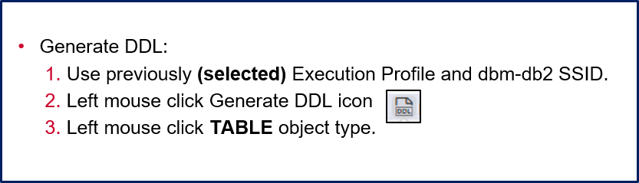
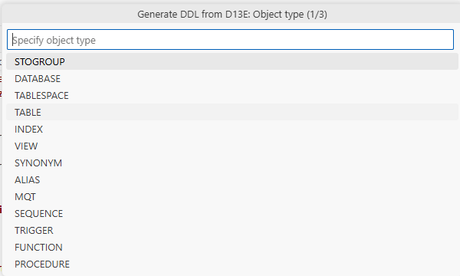
Add a column to table YOUR_TABLE: Generate DDL
Generate DDL for table YOUR_TABLE to add a new column.
1
2
3

Slide 40
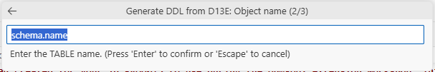
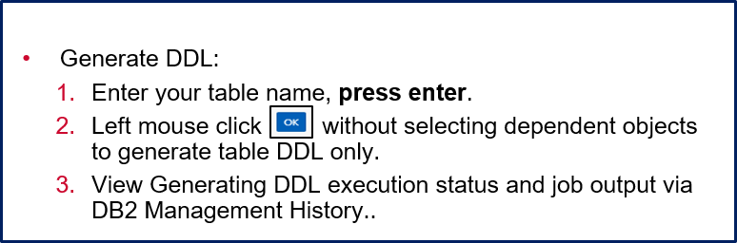


Add a column to table YOUR_TABLE: Generate DDL
Generate DDL for table YOUR_TABLE to add a new column.
YOUR_TABLE
1
YOUR_TABLE
2
YOUR_TABLE
Generating DDL from D13E…
3

Slide 41


Add a column to table YOUR_TABLE: Add Column
Generate updatable copy of output.sql file as described in the previous section to add a new column and save .
1
2
3

Slide 42
Code4z DBM-Db2 Schema Mgmt
Add a column – Check DDL Syntax

Slide 43


Add a column to table YOUR_TABLE: Check DDL Syntax - option 1
1
2

Slide 44



Add a column to table YOUR_TABLE: Check DDL Syntax – or option 2
3
1

Slide 45
Code4z DBM-Db2 Schema Mgmt
Add a column – Deploy DDL

Slide 46


Add a column to table YOUR_TABLE: Deploy DDL - or
Implement change for table YOUR_TABLE to add a new column.
1
2

Slide 47



Add a column to table YOUR_TABLE: Deploy DDL
Implement change for table YOUR_TABLE to add a new column.
2
1
3

Slide 48



Add a column to table YOUR_TABLE: Deploy DDL
Implement change for table YOUR_TABLE to add a new column.
The workshop environment is a container
in Strongnetwork, this has caused the
report links not to work. To view the impact reports expand Deploy DDL and click a report to open. The next slide demonstrates normal behavior.
Deploy DDL operation paused

Slide 49
Add a column to table YOUR_TABLE: Deploy DDL
Implement change for table YOUR_TABLE to add a new column.
2
Deploy DDL operation paused

Slide 50



Add a column to table YOUR_TABLE: Deploy DDL
Deploy DDL:
Deploy DDL operation is paused s you can review the following reports.
impact.json – provides details how objects are changed.
summary.txt – provides ICL format of object change.
compare.txt – batch processor script
Impact.json
Compare.txt
Summary.txt

Slide 51


Add a column to table YOUR_TABLE: Deploy DDL
Implement change for table YOUR_TABLE to add a new column.
1

Slide 52

Add a column to table YOUR_TABLE: Deploy DDL
Implement change for table YOUR_TABLE to add a new column.
Deploy DDL:
Completion displayed
1

Slide 53
Thank You
Email Address:
jim.endler@broadcom.com

