Slide 1
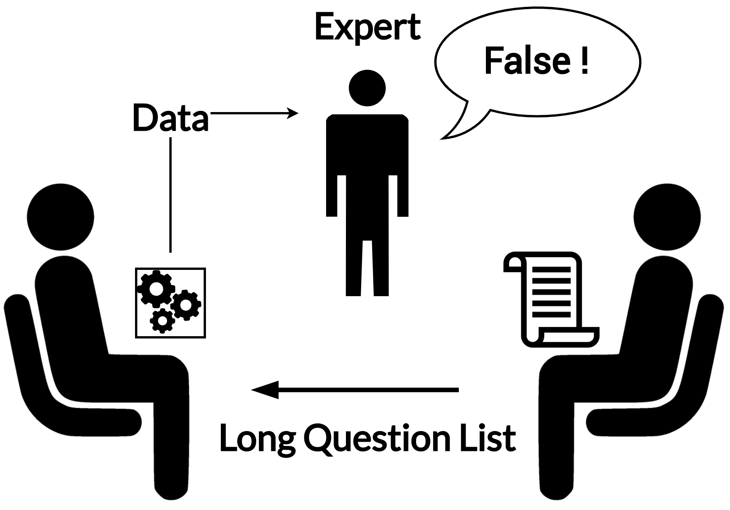
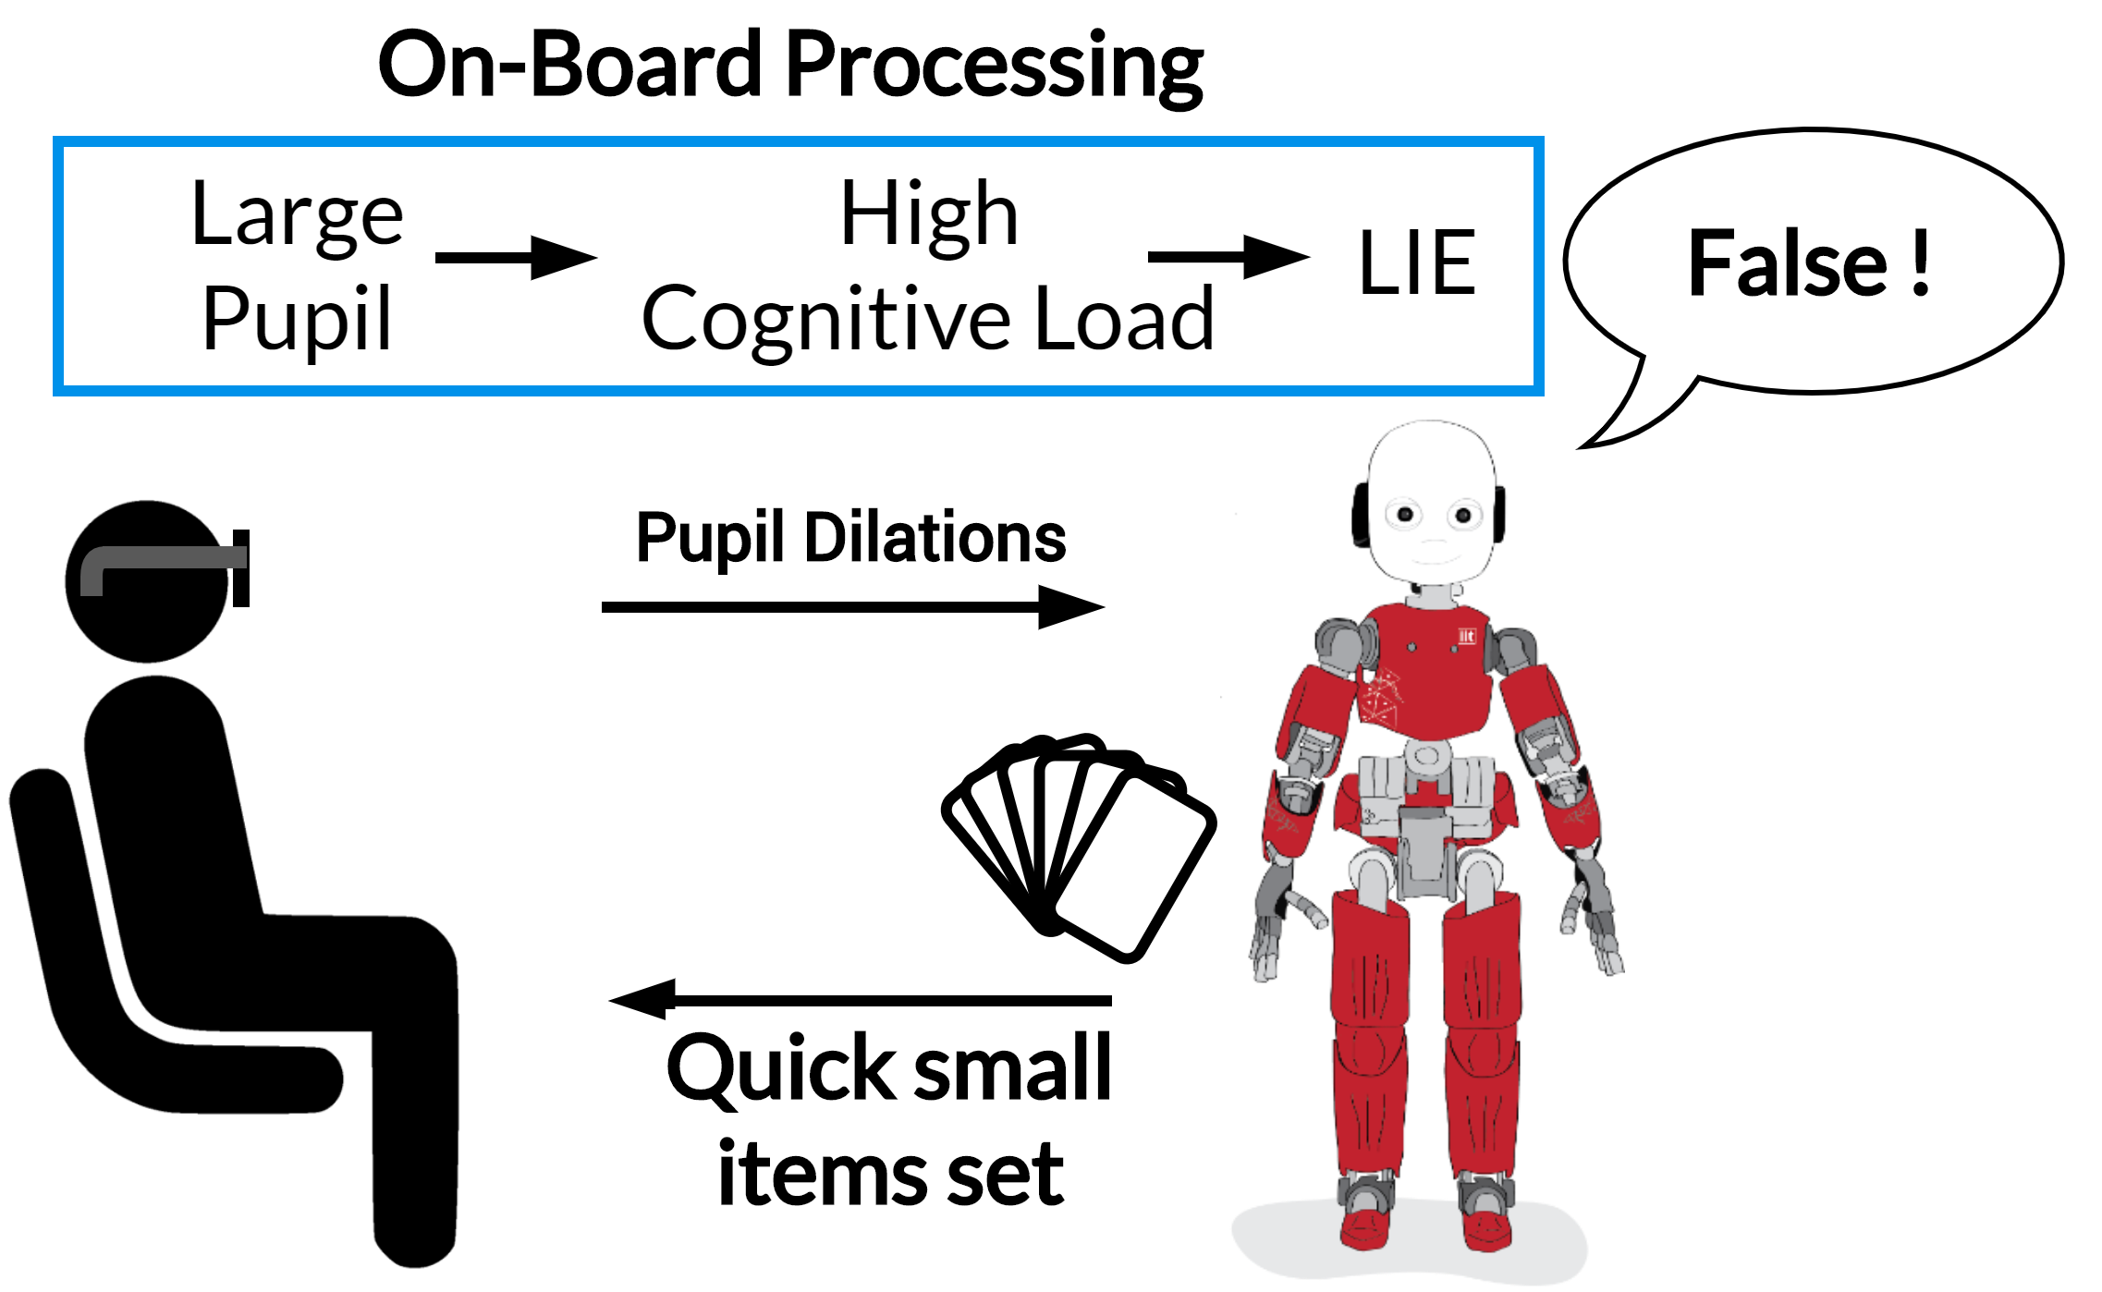
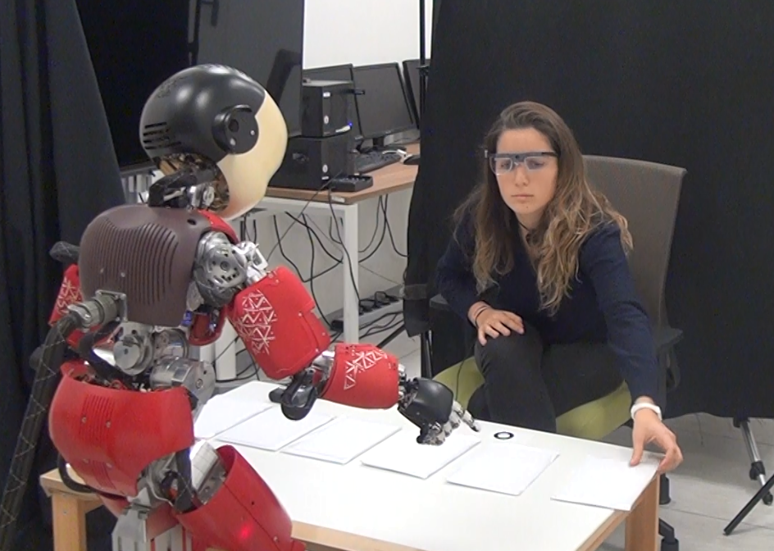
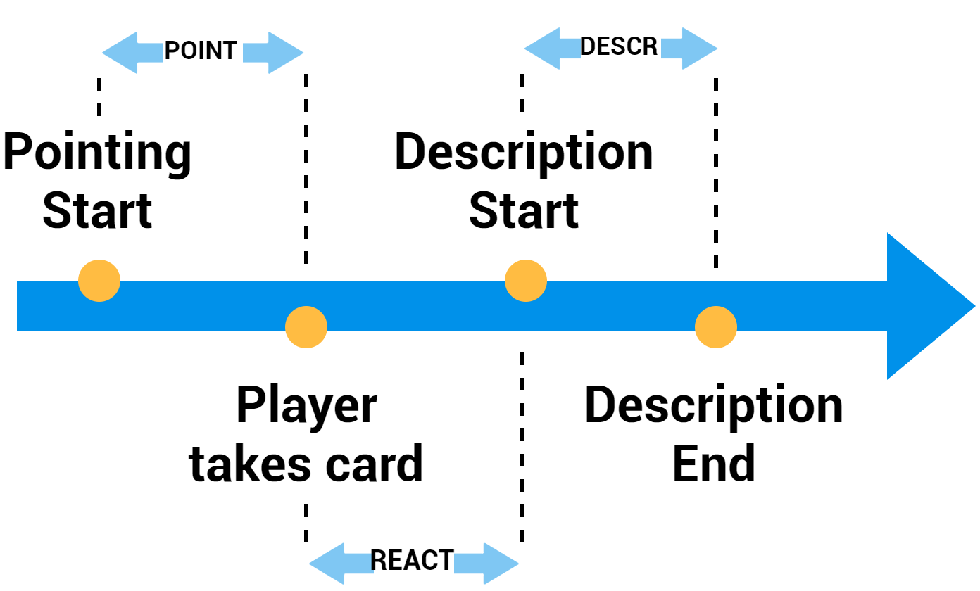
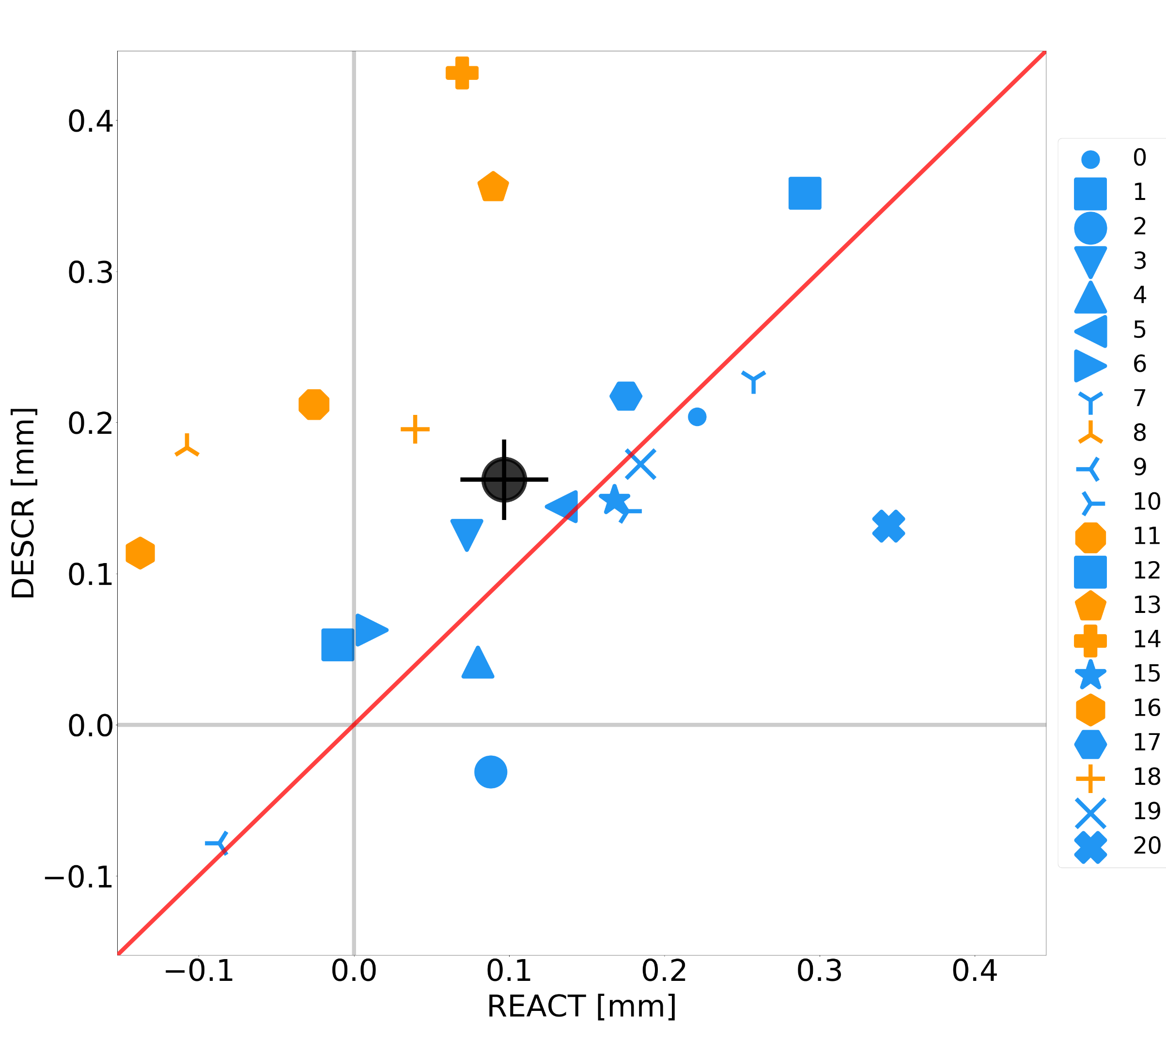
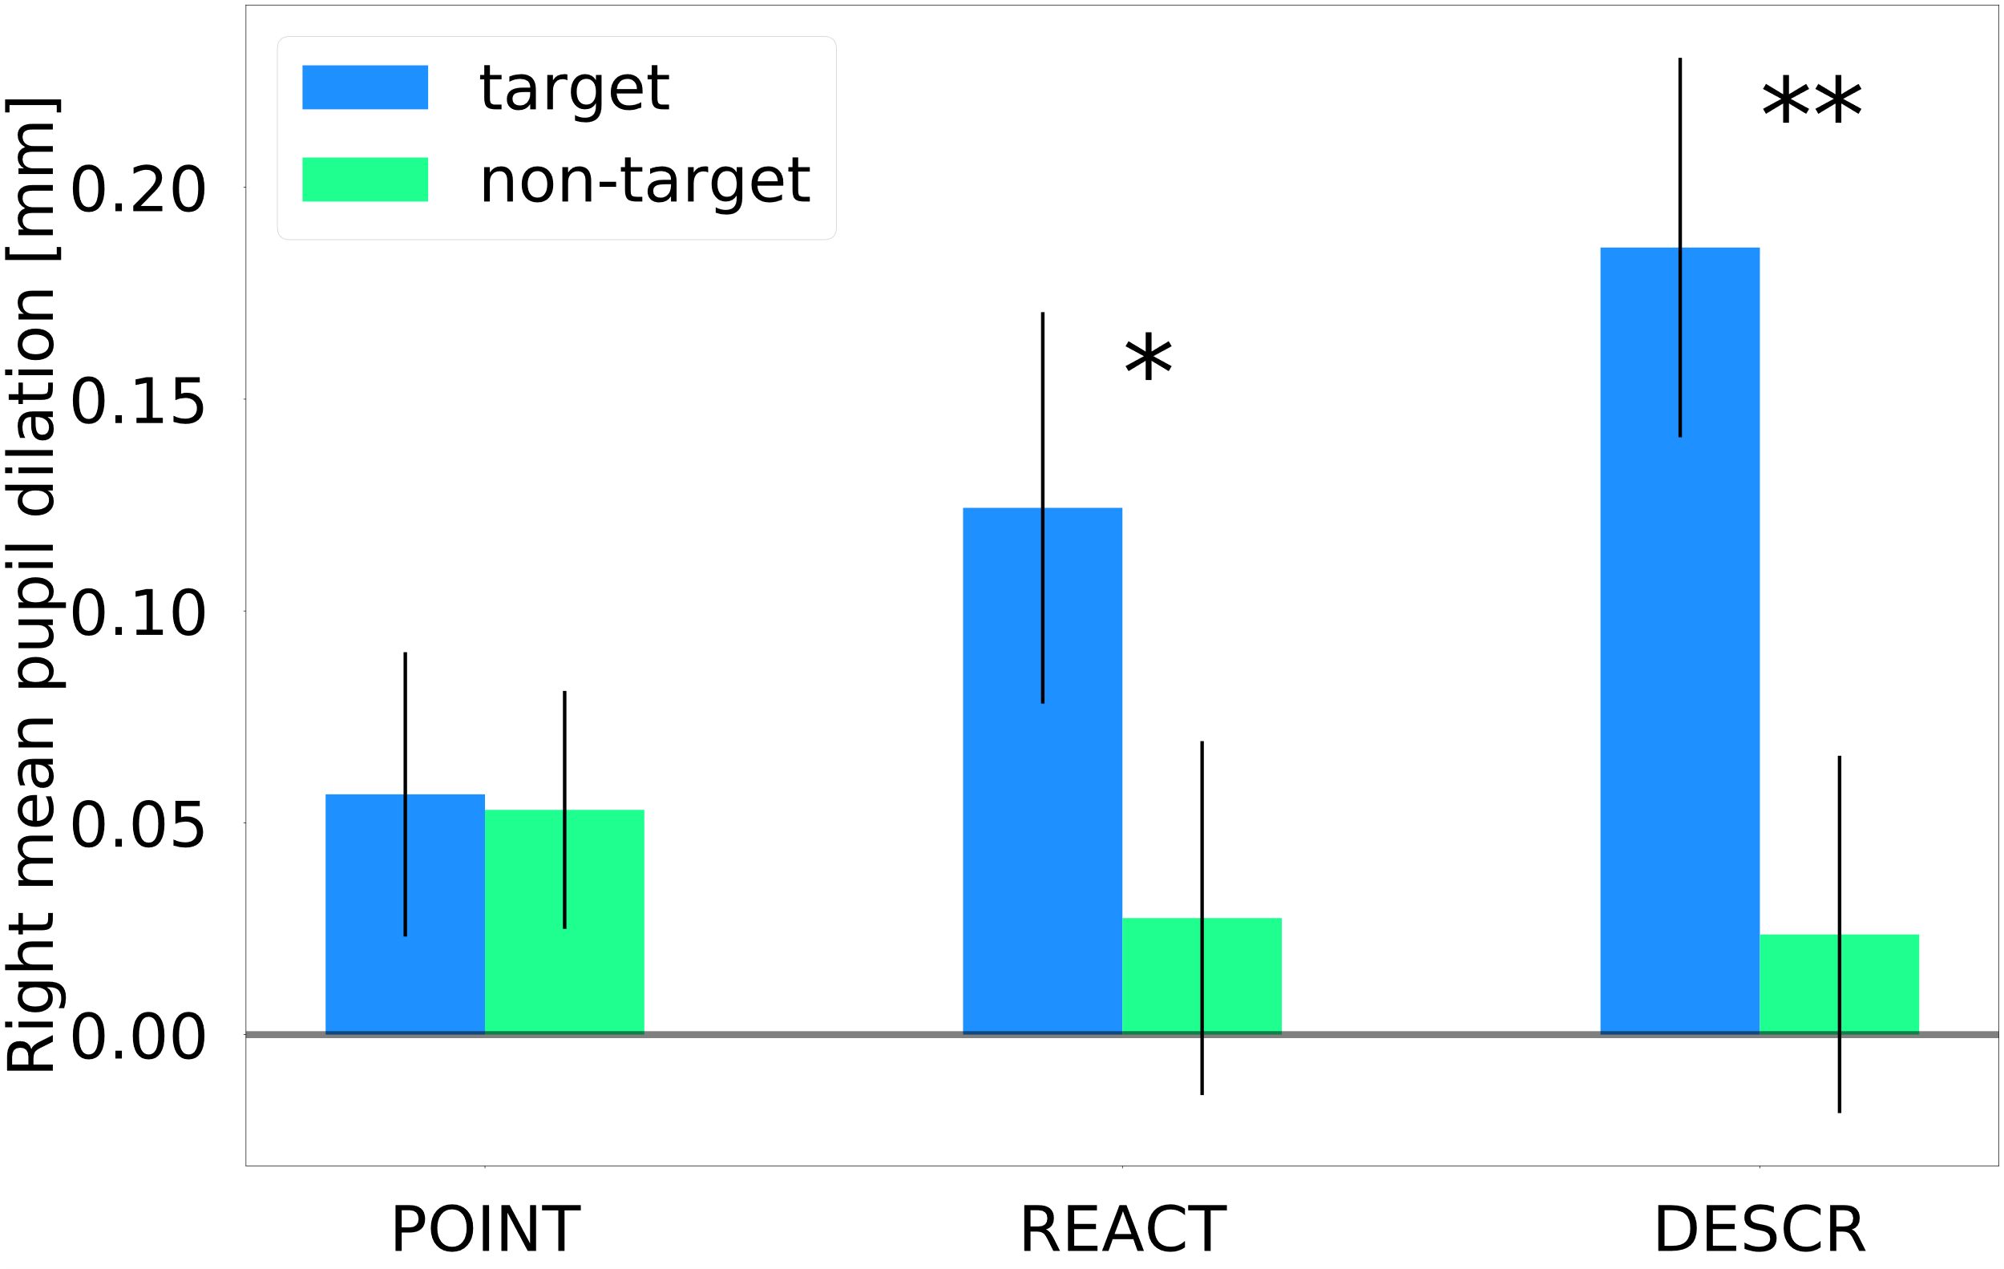





ICub detects your lies during a quick and entertaining Magic Trick
Your Eyes Never Lie: A Robot Magician Can Tell if You Are Lying
Pasquali D., Aroyo A. M., Gonzalez-Billandon J., Rea F., Sandini G., Sciutti A,
INTRO
Detecting lies in a real-world scenario is an important skill for a humanoid robot that acts in fields where is important to preserve an informal and pleasant interaction. However, lie detection is usually performed in highly controlled settings comparable to interrogatories.
MATERIALS
Tobii Pro Glasses 2 (to record pupil dilations at 100 Hz)
Six playing cards with a figure over a white background
iCub robotic platform (controlled via Wizard of Oz)
PARTICIPANTS
N = 28 participants – all Italians, 9 males and 17 females, average age of 24 years old (SD=5) – 7 removed due to Tobii malfunctions
BEFORE THE EXPERIMENT
The Player draws out and memorize a card (target card)
EXPERIMENT
The player shuffles the cards and put them covered on the table
iCub points each card. The player describes it
Target Card “Creative and Deceitful description”
Other Cards “Describe what you see”
TRADITIONAL SCENARIO
TRADITIONAL SCENARIO
DATA ANALYSIS
Mean pupil dilation posthoc computed during POINT, REACT and DESCR intervals for each card
RESULTS
DISCUSSION
It’s possible to detect lies in a quick Human-Robot Interaction.
Need to wear a Tobii Pro Glasses 2 eye tracker
The heuristic function is effective only if the presence of a fake description is a priori known between a finite set of items
The normalization makes the random forest effective only among the observations of the same individual
RANDOM FOREST CLASSIFIER
126 datapoints x 13 features
Normalization per subject
SMOTE to balance the dataset
F1 = 83.3%, AUCROC = 89.6 (SD=0.7)
HEURISTIC FUNCTION
Max Mean Pupil Dilation = Target Card
Accuracy = 75%
FUTURE WORKS
Autonomously detect lies in real-time
Enlarge the dataset
Take a picture to download the full paper

Slide 2
ICub detects your lies during a quick and entertaining Magic Trick
Your Eyes Never Lie: A Robot Magician Can Tell if You Are Lying
Pasquali D., Aroyo A. M., Gonzalez-Billandon J., Rea F., Sandini G., Sciutti A,
INTRO
Detecting lies in a real-world scenario is an important skill for a humanoid robot that acts in fields where is important to preserve an informal and pleasant interaction. However, lie detection is usually performed in highly controlled settings comparable to interrogatories.
MATERIALS
Tobii Pro Glasses 2 (to record pupil dilations at 100 Hz)
Six playing cards with a figure over a white background
iCub robotic platform (controlled via Wizard of Oz)
PARTICIPANTS
N = 28 participants – all Italians, 9 males and 17 females, average age of 24 years old (SD=5) – 7 removed due to Tobii malfunctions
BEFORE THE EXPERIMENT
The Player draws out and memorize a card (target card)
EXPERIMENT
The player shuffles the cards and put them covered on the table
iCub points each card. The player describes it
Target Card “Creative and Deceitful description”
Other Cards “Describe what you see”
TRADITIONAL SCENARIO
TRADITIONAL SCENARIO
DATA ANALYSIS
Mean pupil dilation posthoc computed during POINT, REACT and DESCR intervals for each card
RESULTS
DISCUSSION
It’s possible to detect lies in a quick Human-Robot Interaction.
Need to wear a Tobii Pro Glasses 2 eye tracker
The heuristic function is effective only if the presence of a fake description is a priori known between a finite set of items
The normalization makes the random forest effective only among the observations of the same individual
RANDOM FOREST CLASSIFIER
126 datapoints x 13 features
Normalization per subject
SMOTE to balance the dataset
F1 = 83.3%, AUCROC = 89.6 (SD=0.7)
HEURISTIC FUNCTION
Max Mean Pupil Dilation = Target Card
Accuracy = 75%
FUTURE WORKS
Autonomously detect lies in real-time
Enlarge the dataset
Take a picture to download the full paper

