Slide 1

Gerrit for Libreoffice
Björn Michaelsen
Robert Einsle
David Ostrovsky

Slide 2
Gerrit: Motivation

Slide 3

http://upload.wikimedia.org/wikipedia/commons/7/71/US_Navy_100627-N-5319A-218_Sailors_and_Marines_leap_from_the_well_deck_of_the_amphibious_transport_dock_ship_USS_New_Orleans_%28LPD_18%29_after_participating_in_the_Crossing_the_Line_ceremony.jpg By US Navy and thus public domain

Slide 4

Does it hurt?
Duplication of work
Frustration
Scaring away newcomers
Makes some kinds of work very hard or painful for everyone

Slide 5

http://upload.wikimedia.org/wikipedia/commons/d/d3/Broken_window_large.jpg CC-BY-SA3 by Tomas Castelazo

Slide 6

http://upload.wikimedia.org/wikipedia/commons/1/18/US_Navy_091212-N-3404S-106_Navy_defensive_end_Jabaree_Tuani_%28%5E98%29_and_nose_guard_Chase_Burge_%28%5E93%29_stop_Army_slot_back_Patrick_Mealy_%28%5E5%29_during_the_first_quarter_of_the_110th_Army-Navy_college_football_game.jpg By US Navy and thus public domain

Slide 7
Tinderboxes are Lemmings
Tinderboxes have different speeds.
Tinderboxes know nothing of each other.
Tinderboxes cant communicate or coordinate.
The slowest and rarest tinderboxes (Windows) are the most valueable.

Slide 8
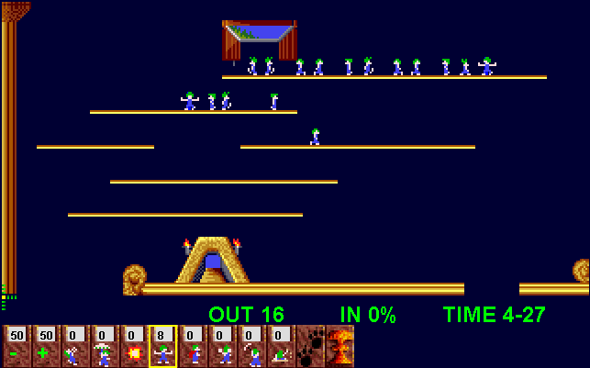
Tinderboxes are Lemmings

Slide 9
LO's CI Infrastructure and gerrit

Slide 10
Decentralized CI Infrastructure (without gerrit) 2/3
Tinderbox_1
Tinderbox_2
Web page
Tinderbox Master
Repository
Tinderbox_...
Tinderbox_n

Slide 11
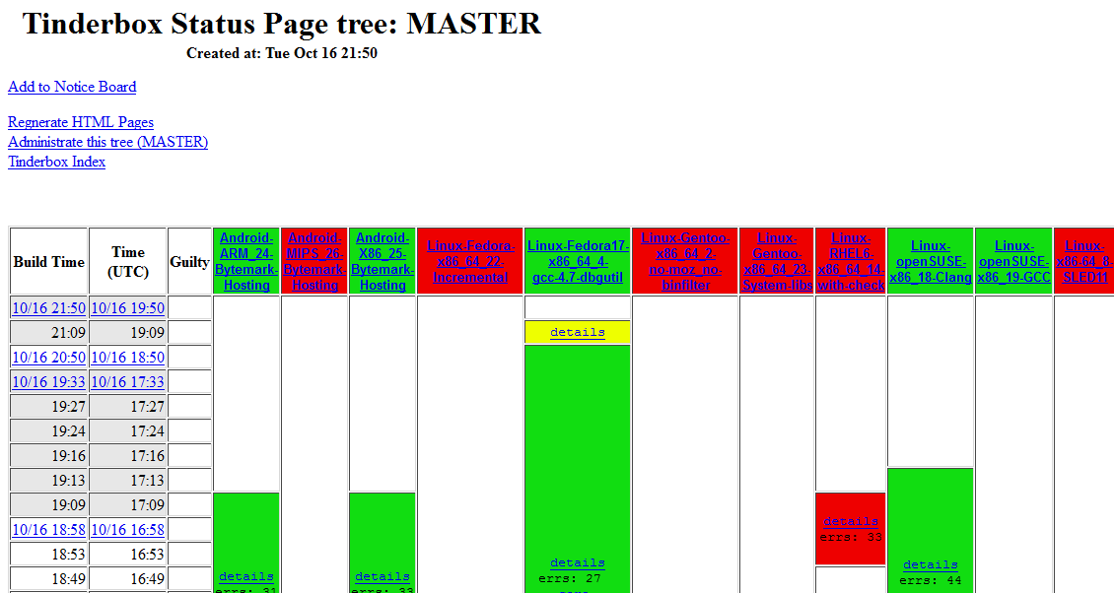
Decentralized CI Infrastructure (without gerrit) 3/3

Slide 12
Decentralized CI Infrastructure with gerrit 1/3
Some kind of queue manager is needed to distribute checks jobs between tinderboxes
One patch set must be checked only once for each platform and configuration
Tinbuild2 must be teached to talk to queue manager
Results from all tinderboxes are gathered and combined result is reported back to gerrit
A patch set is approved only when all check jobs were successful.

Slide 13
Decentralized CI Infrastructure with gerrit 3/3
Reusing existing infrastructure
Tinbuild2 teached to talk to queue manager
Different strategies for gerrit patch verfication vs. master check
  Prefer gerrit verification
  Prefer master check
Tinderbox_1
Tinderbox_2
Web page
Tinderbox Master
Repository
Tinderbox_...
Tinderbox_n
gerrit
Queue manager

Slide 14
Queue manager's feature set
Consumption gerrit-stream events
Communication API/protocol for tinderboxen
Job Scheduler
Build log publication and visualization
Internal pipeline visualization
Documentation
Nice to have: Gerrit web ui extension
    check job results are reported in own table on change page in gerrit
    during review process specific configuration can be selected to be checked, i. e. with-java if java stack was changed in change context

Slide 15
Gerrit Plugin Architecture
Since upcoming gerrit 2.5 plugin architecture is introduced
What can a gerrit plugin extend?
  New ssh commands under plugin's own namespace
  New plugin web pages under plugin's own namespace
  Extend database
  Highly experimental and not in upcoming release 2.5: web ui extension of core pages (GWT and javascript plugin types)
Dog fooding: Replication is a gerrit plugin now and not a core feature
ssh gerrit plugin-name-1.0 some-really-cool-command --foo --bar baz
https://review.gerrit.net/plugins/plugin-name-1.0/page.html

Slide 16
Gerrit-buildbot: queue manager as gerrit plugin 1/6
Tinderbox_1
Gerrit
Tinderbox_2
Tinderbox_...
buildbot-plugin
Tinderbox_n

Slide 17
Gerrit-buildbot: queue manager as gerrit plugin 2/6
Consumption gerrit stream events
  Trivially as gerrit plugin: just a callback
Communication API/protocol (for tinbuild2 and other clients)
  Gerrit ssh command:
Job Scheduler
  Internally job queue is maintained and can be polled per ssh command:
Result reporting and build log publication per ssh:
ssh logerrit buildbot-1.0 show-queue –project core
ssh logerrit buildbot-1.0 get-task --project core --platform linux
cat log | ssh logerrit buildbot-1.0 report --ticket 4711 --failed

Slide 18
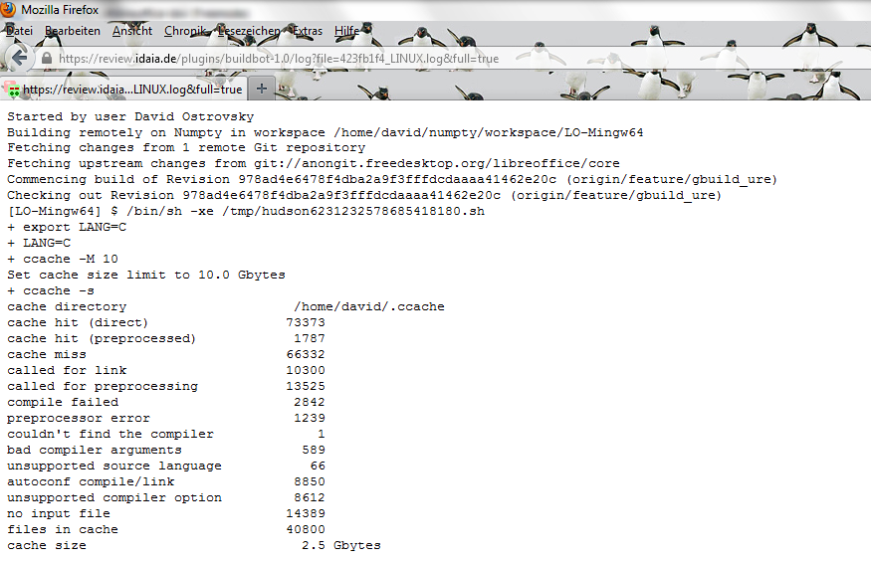
Gerrit-buildbot: queue manager as gerrit plugin 3/6
Build log visualization: web page extension

Slide 19
Gerrit-buildbot: queue manager as gerrit plugin 4/6
Documentation: per ssh
ssh logerrit buildbot-1.0 report --help
buildbot-1.0 report [--] [--failed (-f)] [--help (-h)] [--log (-l) -|LOG] [--succeed (-s)] --ticket (-t) TICKET
-- : end of options
--failed (-f) : specify this option if job failed
--help (-h) : display this help text
--log (-l) -|LOG : url of the job log page or - for standard input
--succeed (-s) : specify this option if job was successfull
--ticket (-t) TICKET : ticket of the job

Slide 20
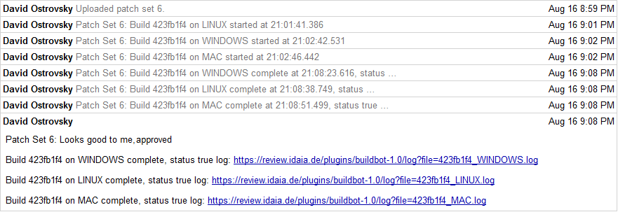
Gerrit-buildbot: queue manager as gerrit plugin 6/6
Result are presented in gerrit's comment table
Nice to have: Implement CI verification status table on gerrit's change page (once web ui plugin can extend core pages)
  Don't mix human's review and CI's verification outcome

Slide 21
??? Questions ???

