Slide 1
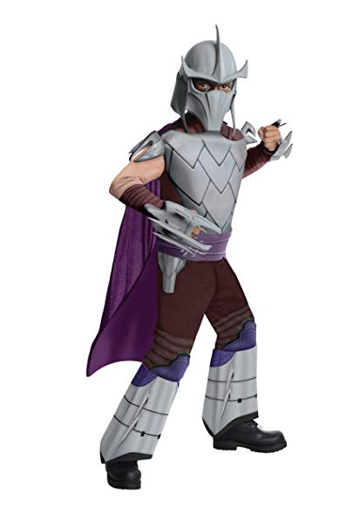
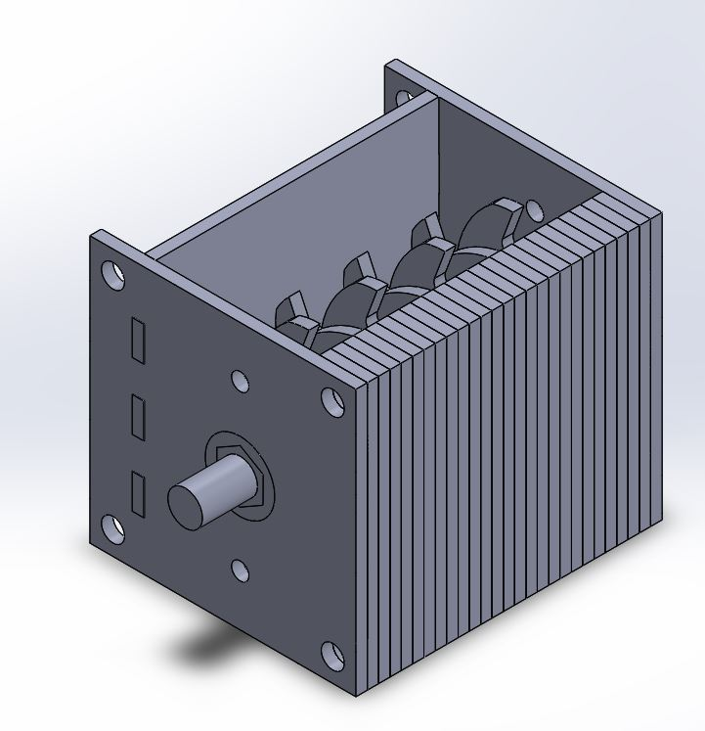
Transfer Student Mutant Ninja 9/2/2019

Slide 2
2-Week Sprint Recap
Goals
Develop a problem statement
List objectives and constraints
List of potential metrics with units
Design a black box
Accomplishments
Defined Problem statement, considered design limitations and some potential overall general designs
Shortfalls
Primary is cost and prioritizing what needs to be purchases first
In relation, considering the motor vs. ‘manpower’ comparison and which is best for this application
Reflections
Start thinking about different cutter designs
Develop equations and calculations to roughly evaluate forces involved

Slide 3
Next 2-Week Sprint Scope
Milestone Oriented Tasks
Begin general design considerations based on limitations
Continue with machine design specific equations depending on overall design
Verifiable Outcomes
Do research on what works and consider cost when working into our general design
Other Team Inputs Required
Individual brainstorming of ideas
Upcoming Milestones & Critical-Path
Rough design and general drawing packet

Slide 4
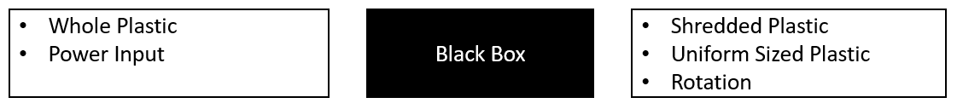
Project Progress Reflection
6z6
Statement: Build a device that takes in raw recyclable plastic products and outputs shredded plastic
Specifications:
3-5mm particle size
120v AC @ 10amps
10-80 ft/lbs of mechanical input
1’x1’x3’ of volume
$240 max cost
6 people x 8 hr/week x 12 week = 576 hours
Black Box:

