Slide 2


Object Oriented Programming Kotlin und Go im Vergleich
Konzepte der Programmiersprachen
Julia Ihrenberger
07.01.26
Source: https://go.googlesource.com/website/+/refs/heads/master/_content/doc/gopher/modelsheet.jpg
https://kotlinlang.org/docs/kotlin-brand-assets.html#kotlin-logo

Slide 3
Content
Kotlin Refresher
Packages
Class Code Structure
Chess Excursion
Chessboard Representation: Bitboards
Implementation
Code Flow
Code Structure
Bitboard Usage
Addendum
Source: https://kotlinlang.org/docs/basic-syntax.html

Slide 4
Refresh: Packages and Classes
package packageName import otherPackage.* open class InheritableClass(
val Immutable: DataType,
var Mutable: DataType = DefaultValue){
//Code Block
}
similar structure to Go with packages
Kotlin values Immutability over all else, so classes and function need to be marked as open for inherit and override
Source: https://kotlinlang.org/docs/basic-syntax.html

Slide 5
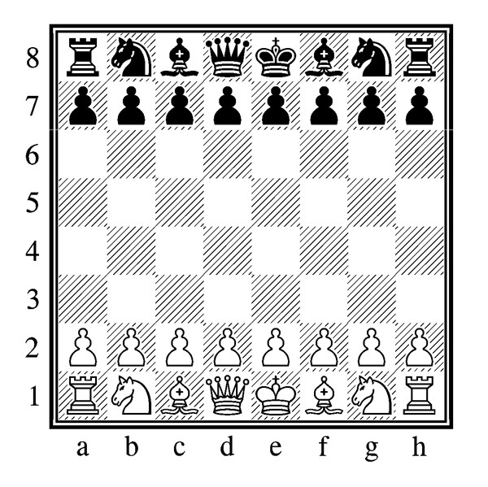
Excursion: Chess Rules
King: one step in each direction
Queen: omni-directional
Bishop: omni-diagonal
Knight: jumps in L shape
Rook: cardinal
Pawn: >:c
Extras:
En Passant Capture
Castling
Pawn Promotion
Source: https://computerchess.com/Schach-lernen/Schachregeln-einfach-erklaert/

Slide 6
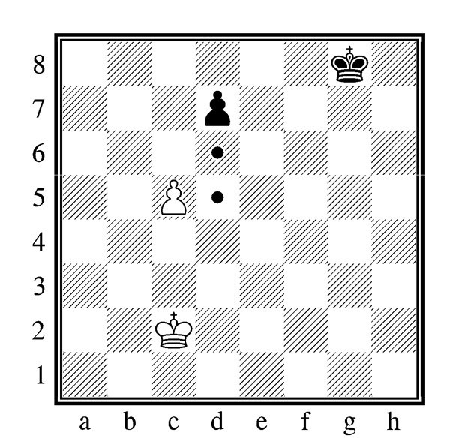
Excursion: Chess Rules
En Passant Capture:
captures enemy pawn during double step
Source: https://computerchess.com/Schach-lernen/Schachregeln-einfach-erklaert/

Slide 7
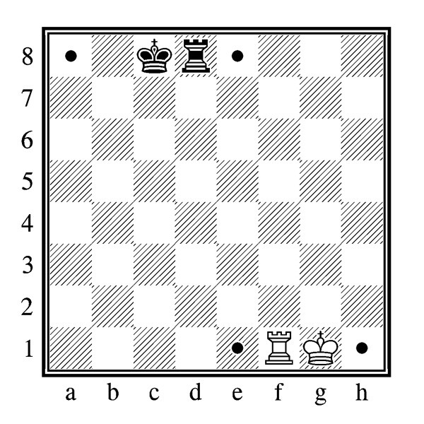
Excursion: Chess Rules
Castling:
if the involved Rook and King have not moved, then they can execute a Castle maneuver, semi-swapping places
Source: https://computerchess.com/Schach-lernen/Schachregeln-einfach-erklaert/

Slide 8
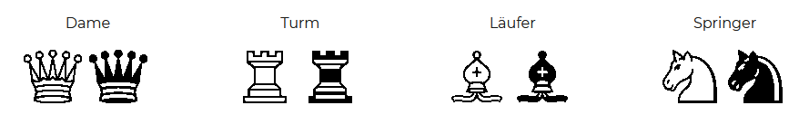
Excursion: Chess Rules
Pawn Promotion:
if a pawn reaches the other edge of the board, it gets promoted to another piece (all expect King)
Source: https://computerchess.com/Schach-lernen/Schachregeln-einfach-erklaert/

Slide 9
How to represent the Chessboard?

Slide 10
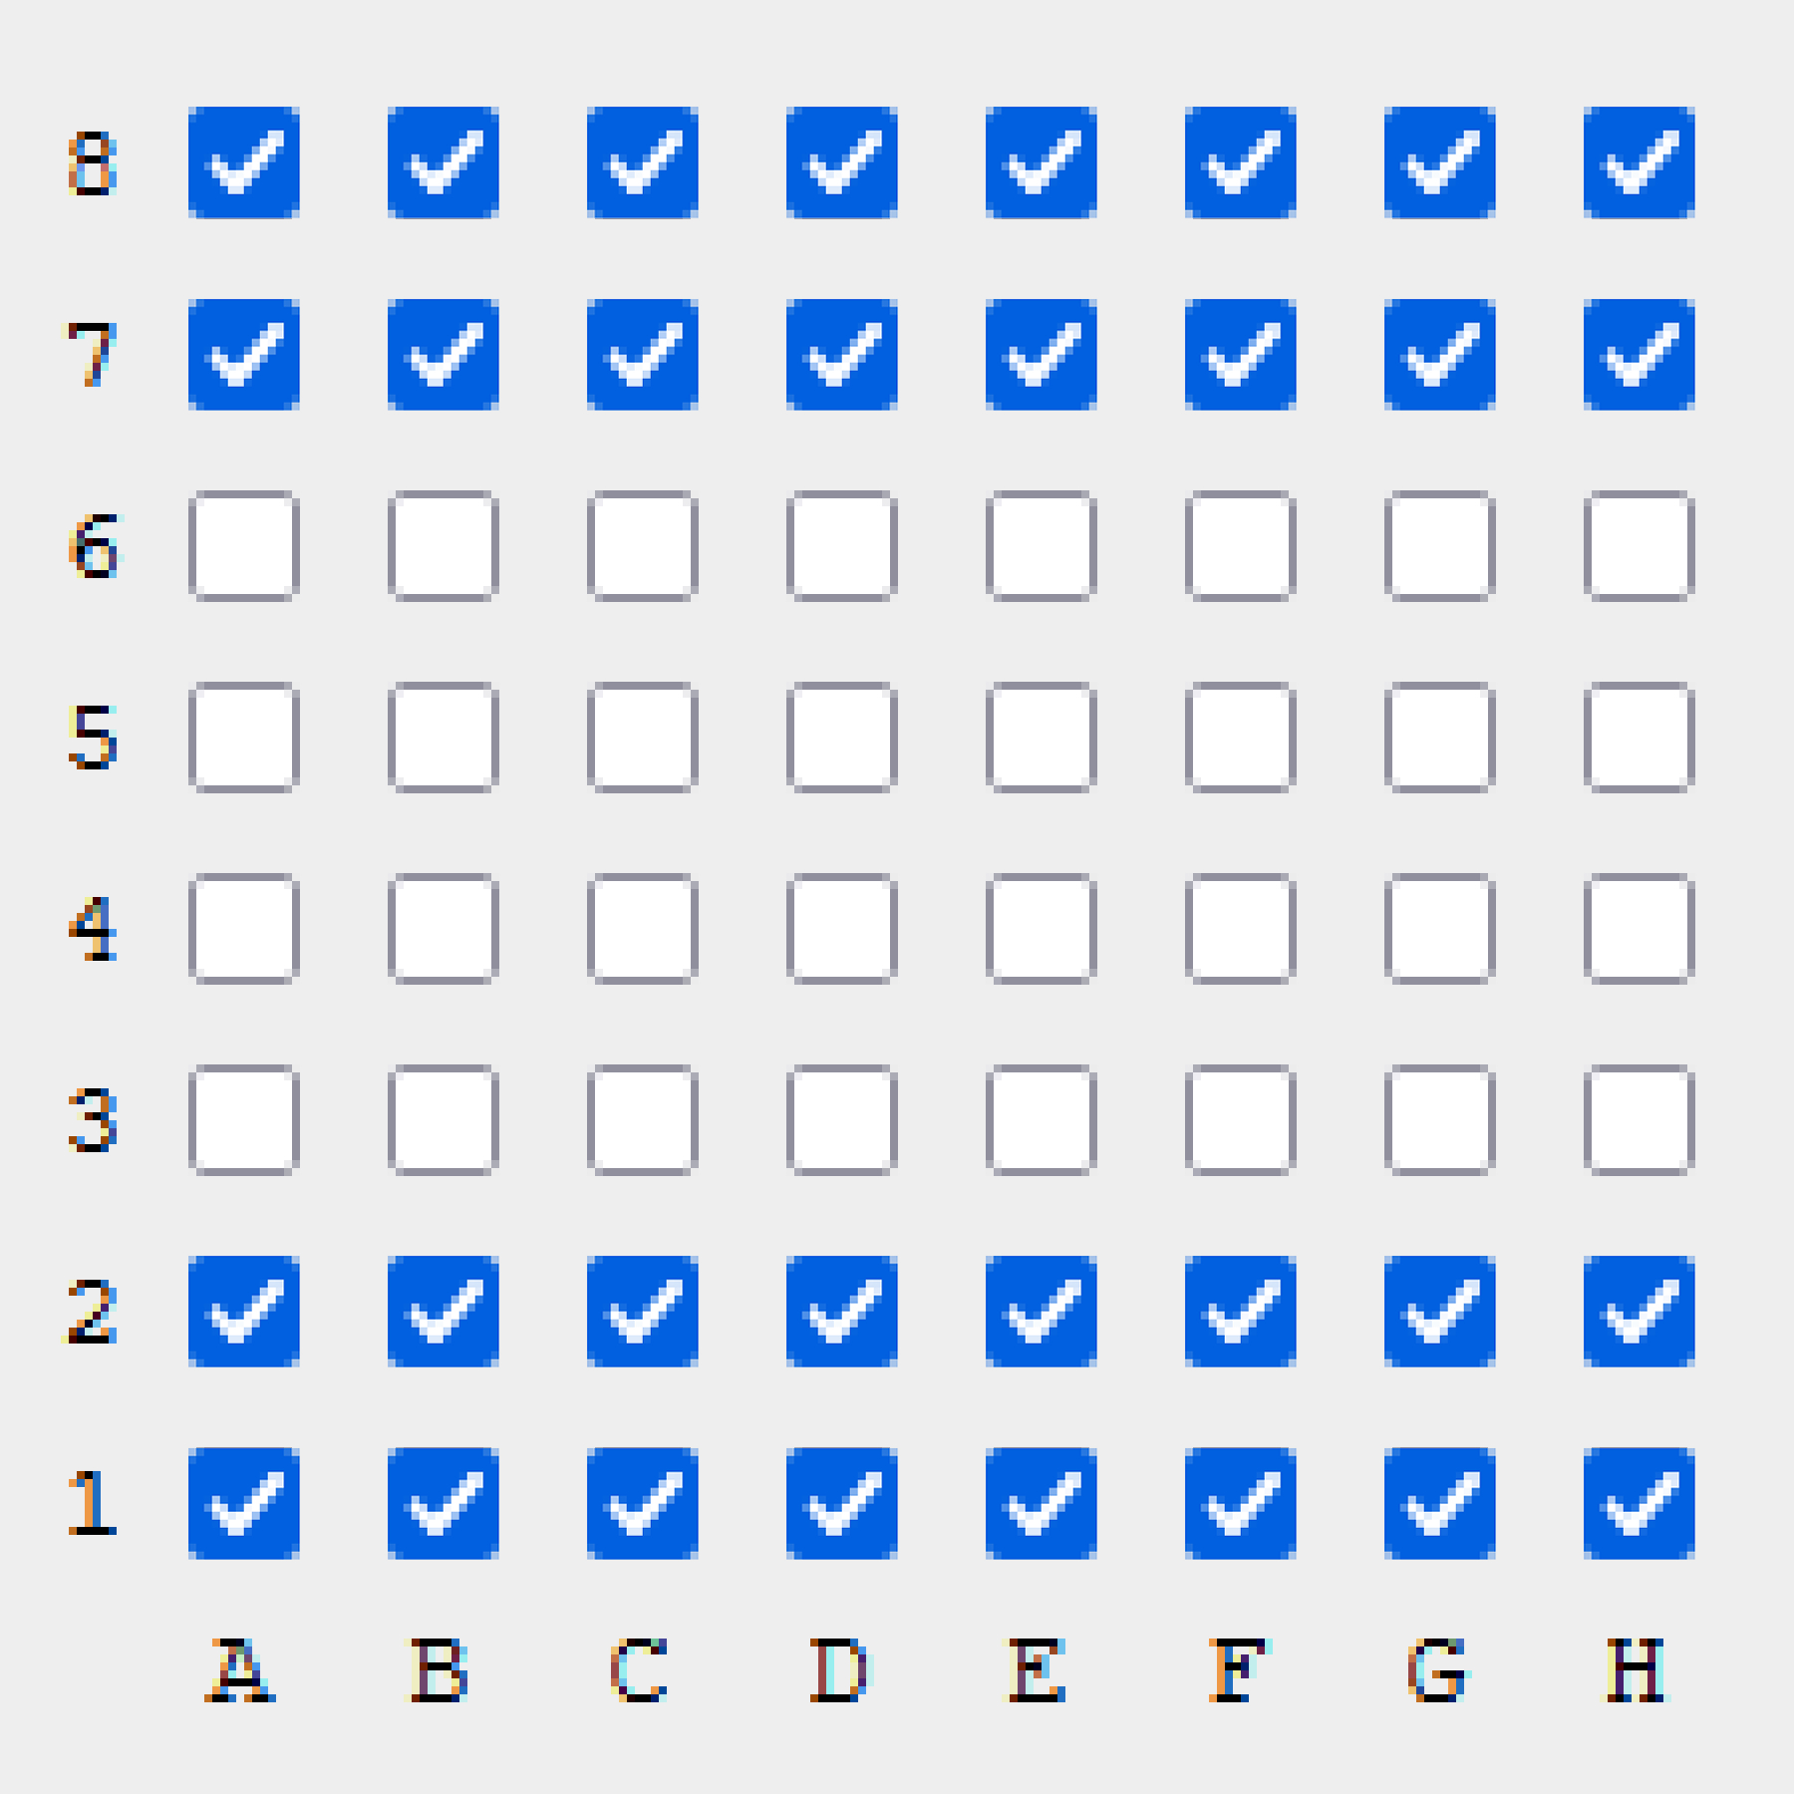
Bit Boards
1 | 1 | 1 | 1 | 1 | 1 | 1 | 1
1 | 1 | 1 | 1 | 1 | 1 | 1 | 1
0 | 0 | 0 | 0 | 0 | 0 | 0 | 0
0 | 0 | 0 | 0 | 0 | 0 | 0 | 0
0 | 0 | 0 | 0 | 0 | 0 | 0 | 0
0 | 0 | 0 | 0 | 0 | 0 | 0 | 0
1 | 1 | 1 | 1 | 1 | 1 | 1 | 1
1 | 1 | 1 | 1 | 1 | 1 | 1 | 1
chessboard representation via 64 bits (one for each square)
faster and easier computation via bit operations (optimized for chess AI implementation)
each chess piece type gets its own bit board in each color
meaning a bit board solution consists of 12 bit boards
hex: ffff00000000ffff
all bitboard presentations made with https://gekomad.github.io/Cinnamon/BitboardCalculator/
Notes:
klassische herangehensweise: arrays
aber ganze disziplin (in hinsicht auf Schach Kis) und nutzung von bitboards

Slide 11
Bit Boards: Indices
00 | 01 | 02 | 03 | 04 | 05 | 06 | 07
08 | 09 | 10 | 11 | 12 | 13 | 14 | 15
16 | 17 | 18 | 19 | 20 | 21 | 22 | 23
24 | 25 | 26 | 27 | 28 | 29 | 30 | 31
32 | 33 | 34 | 35 | 36 | 37 | 38 | 39
40 | 41 | 42 | 43 | 44 | 45 | 46 | 47
48 | 49 | 50 | 51 | 52 | 53 | 54 | 55
56 | 57 | 58 | 59 | 60 | 61 | 62 | 63
flipped in the rendering to have view from White Player’s perspective
Source: https://gekomad.github.io/Cinnamon/BitboardCalculator/

Slide 12
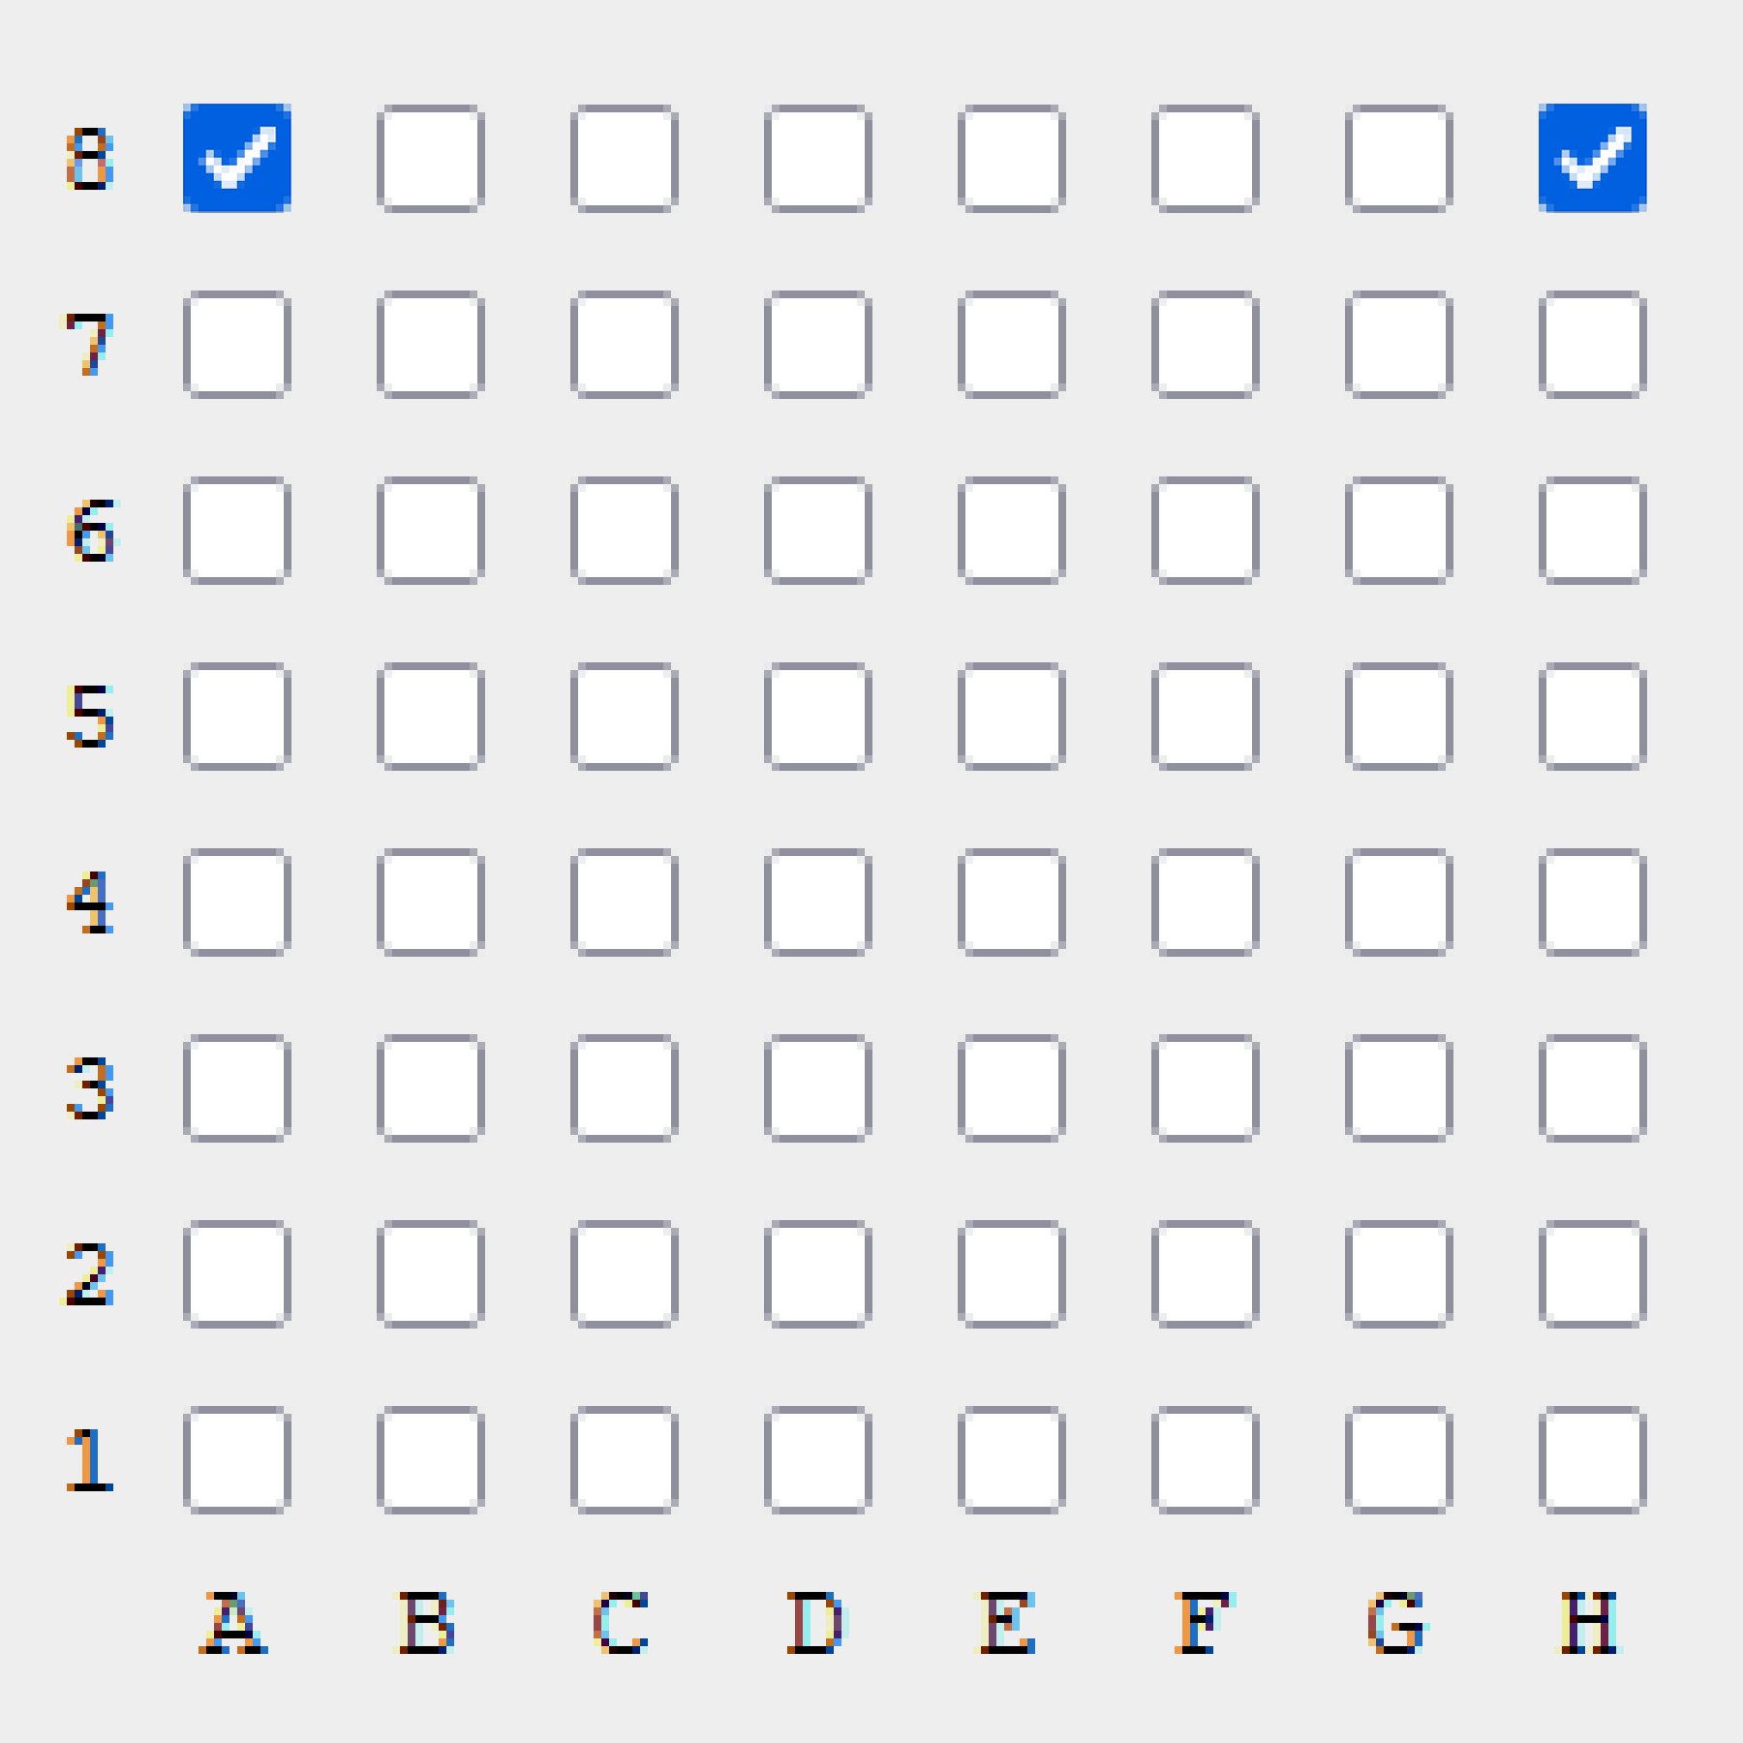
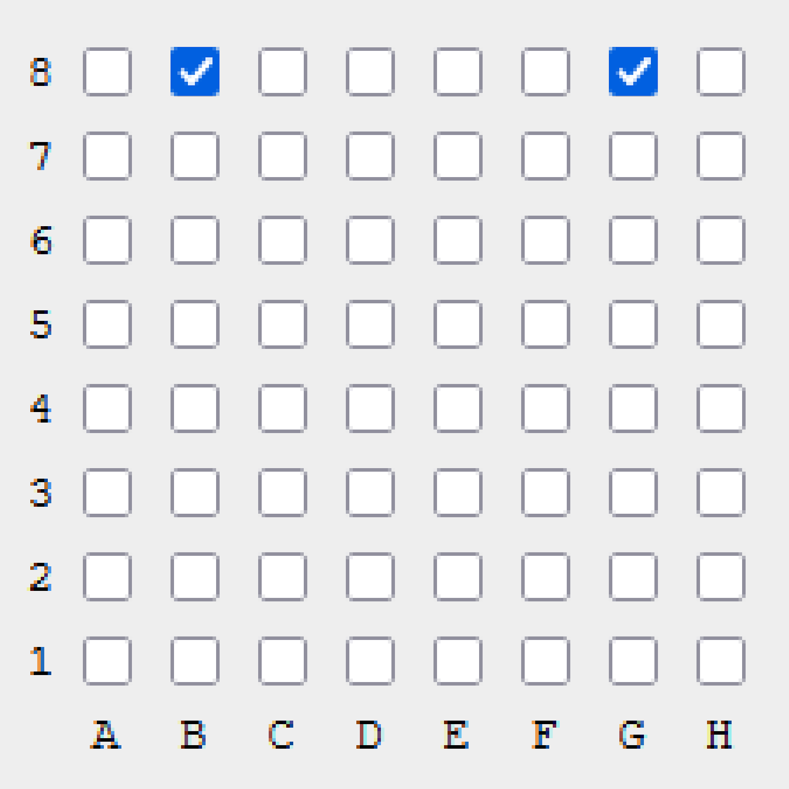
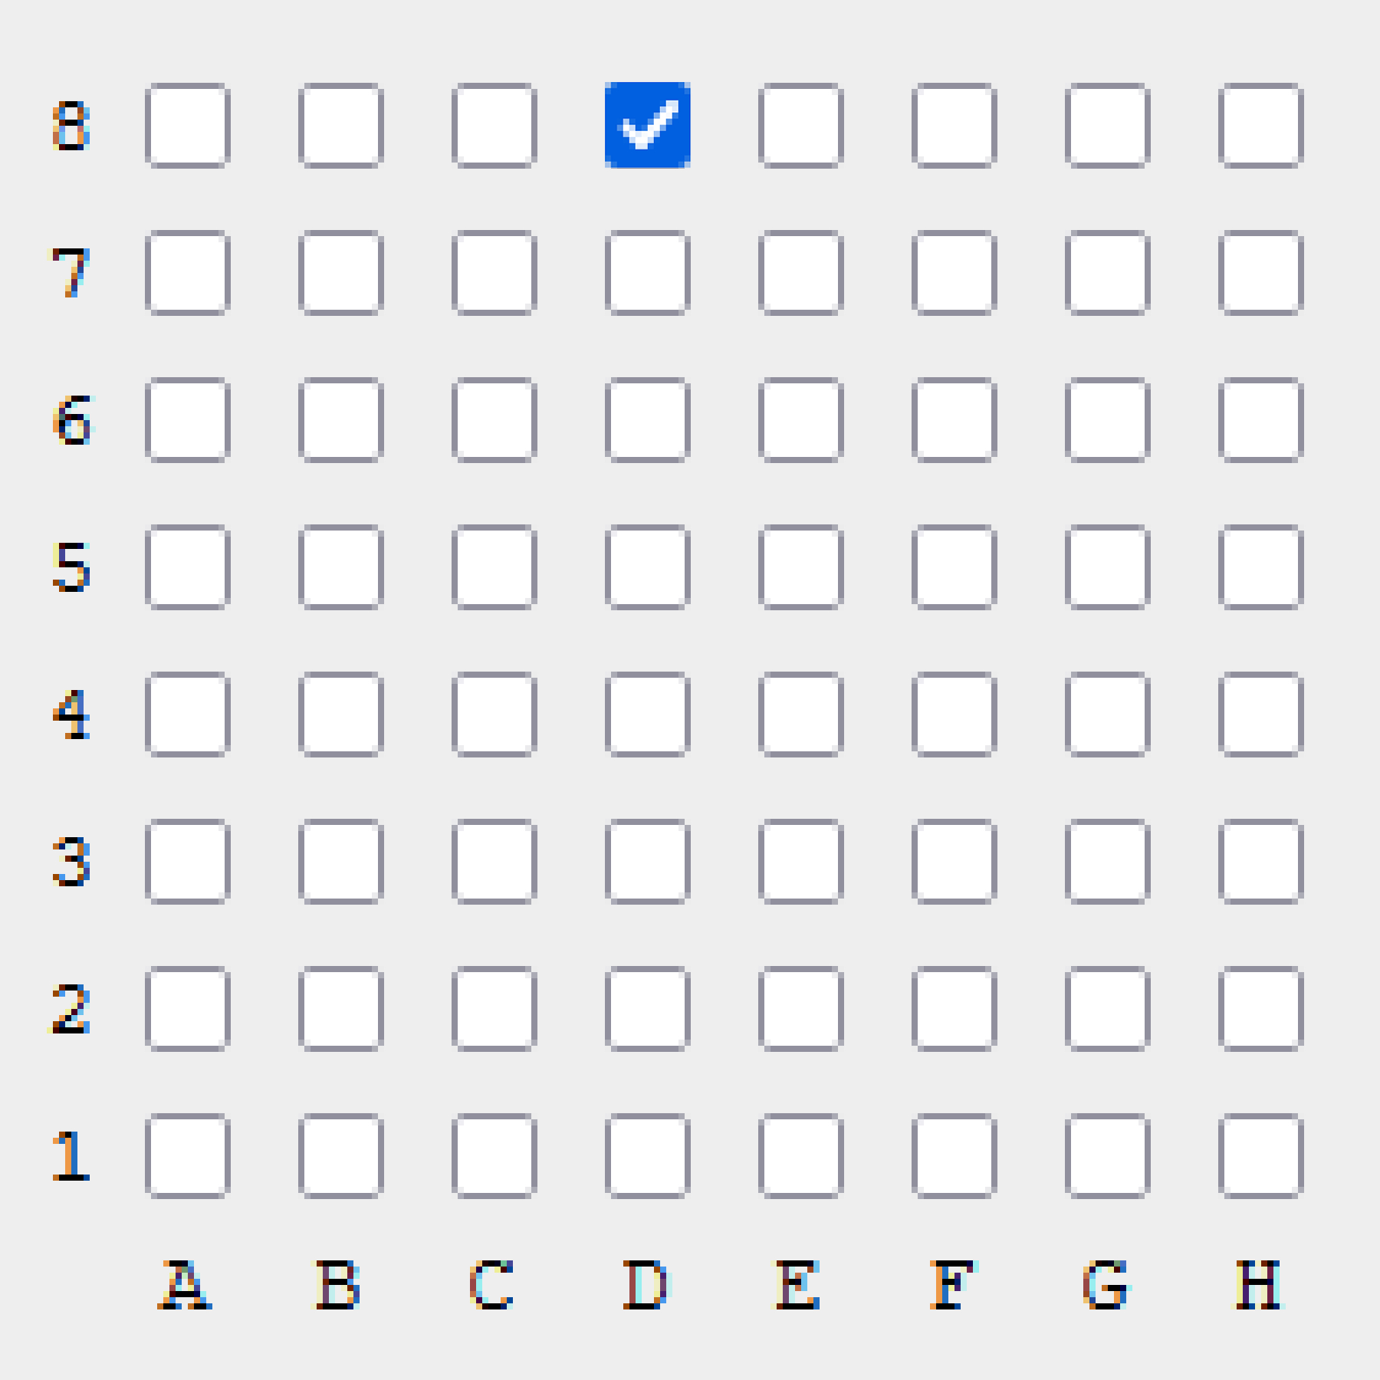



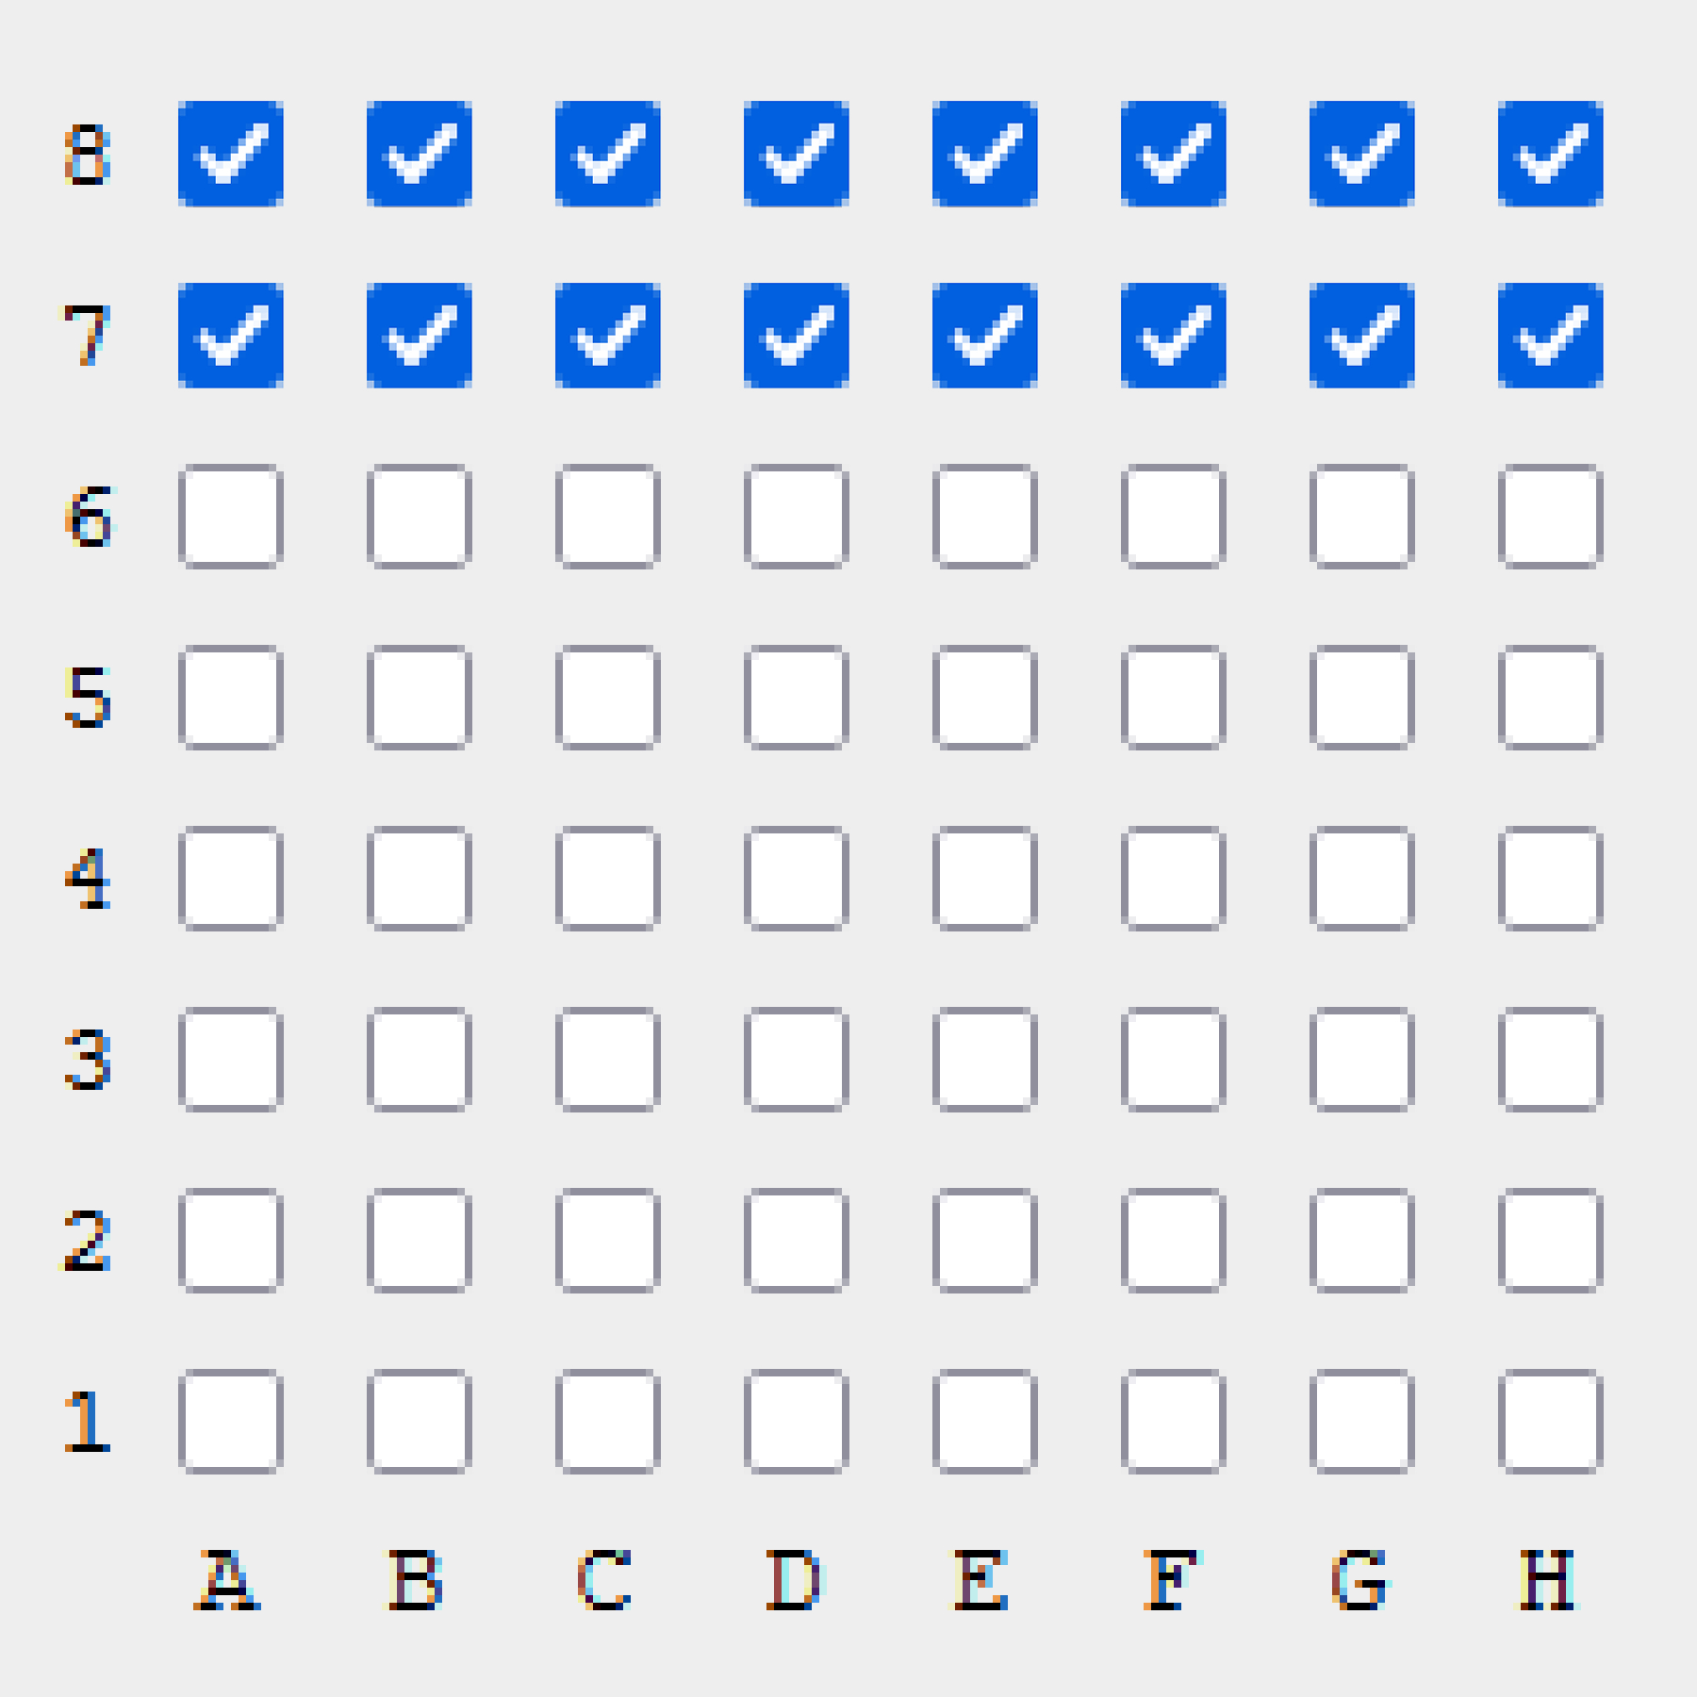
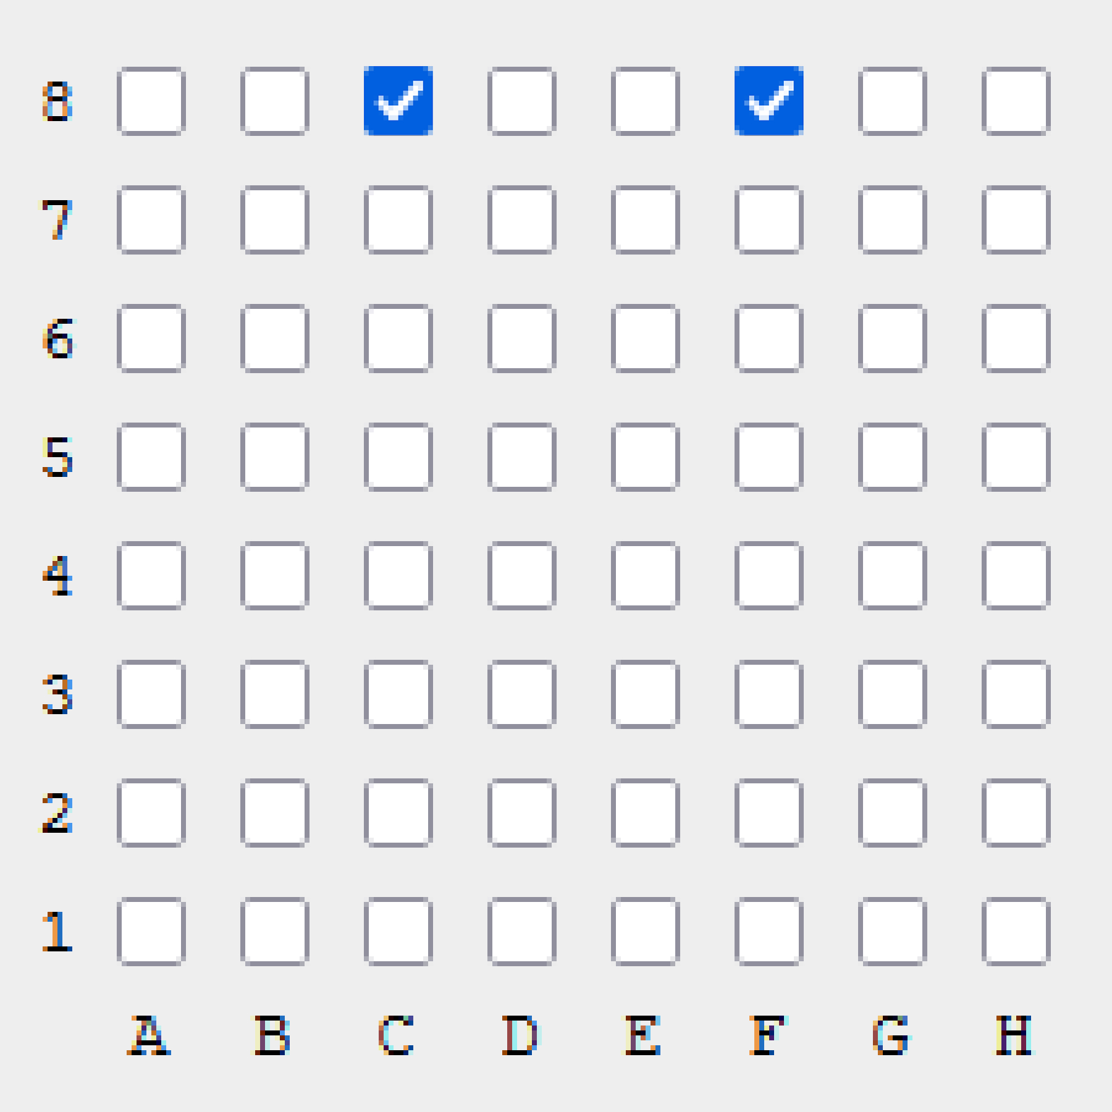
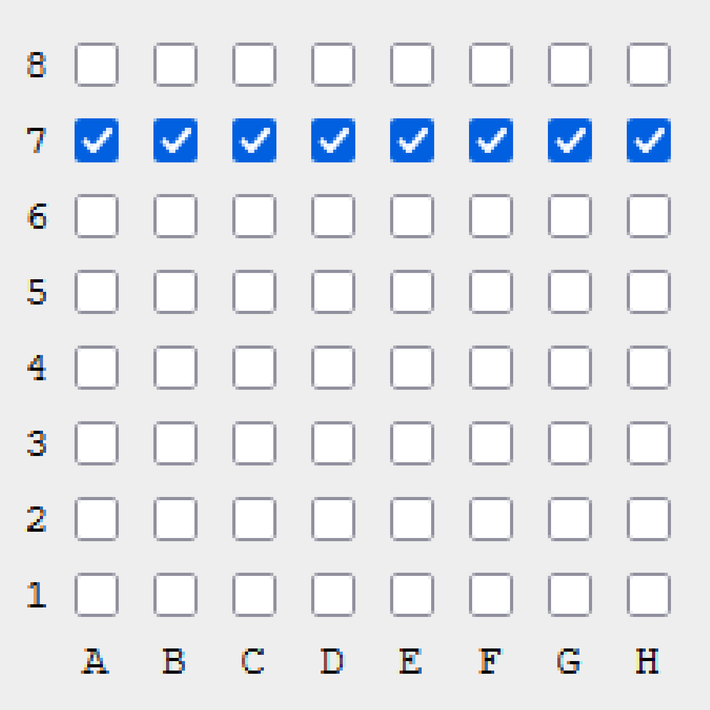
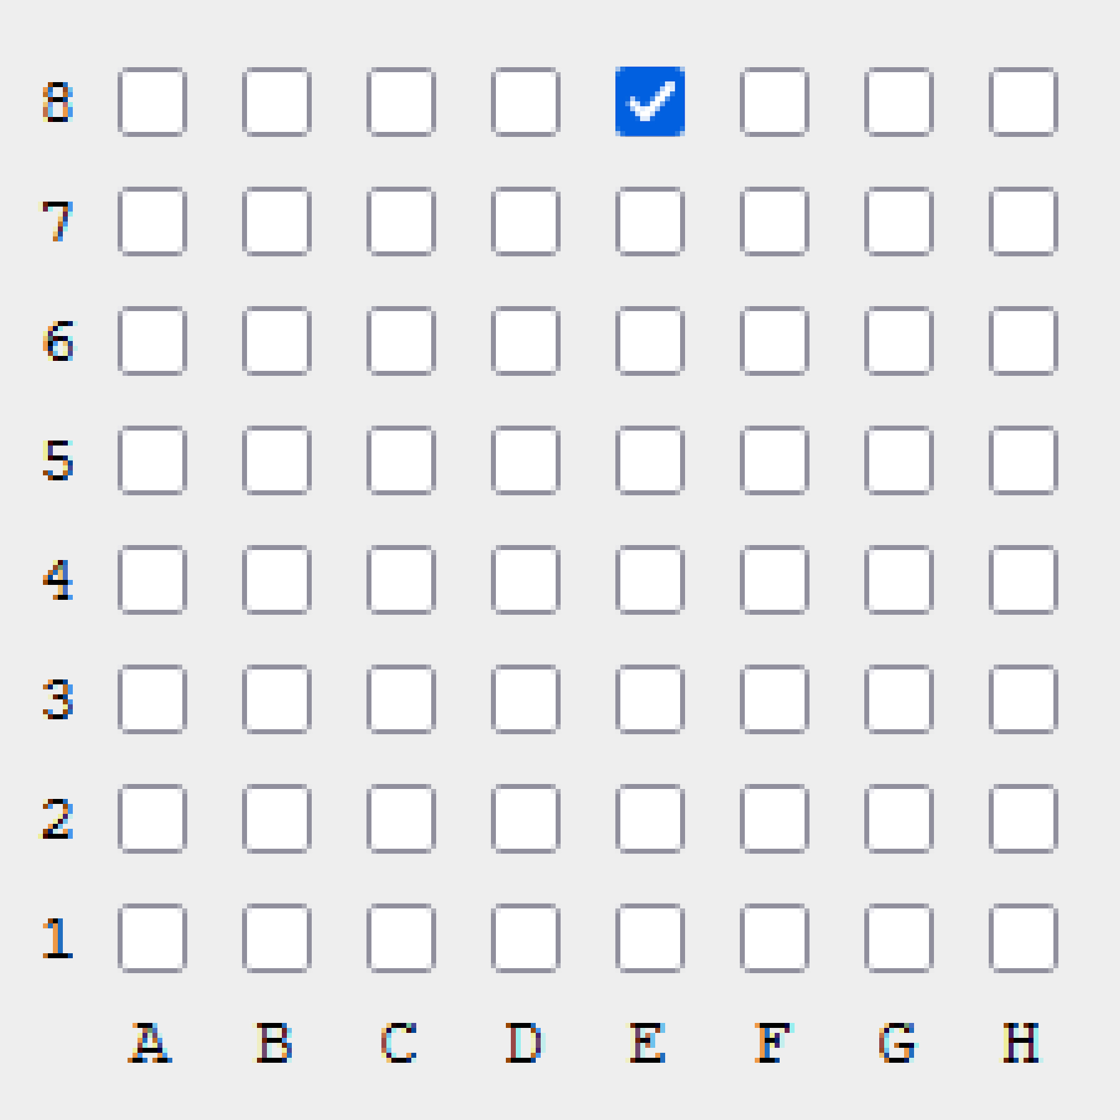



Bit Boards: Chess Pieces
0x81
0x42
0x10
0x24
0xFF00
0x8
Source: https://staging.svgrepo.com/collection/chess-vectors/
https://gekomad.github.io/Cinnamon/BitboardCalculator/

Slide 13
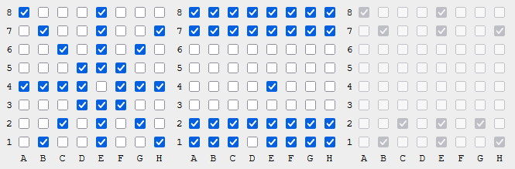
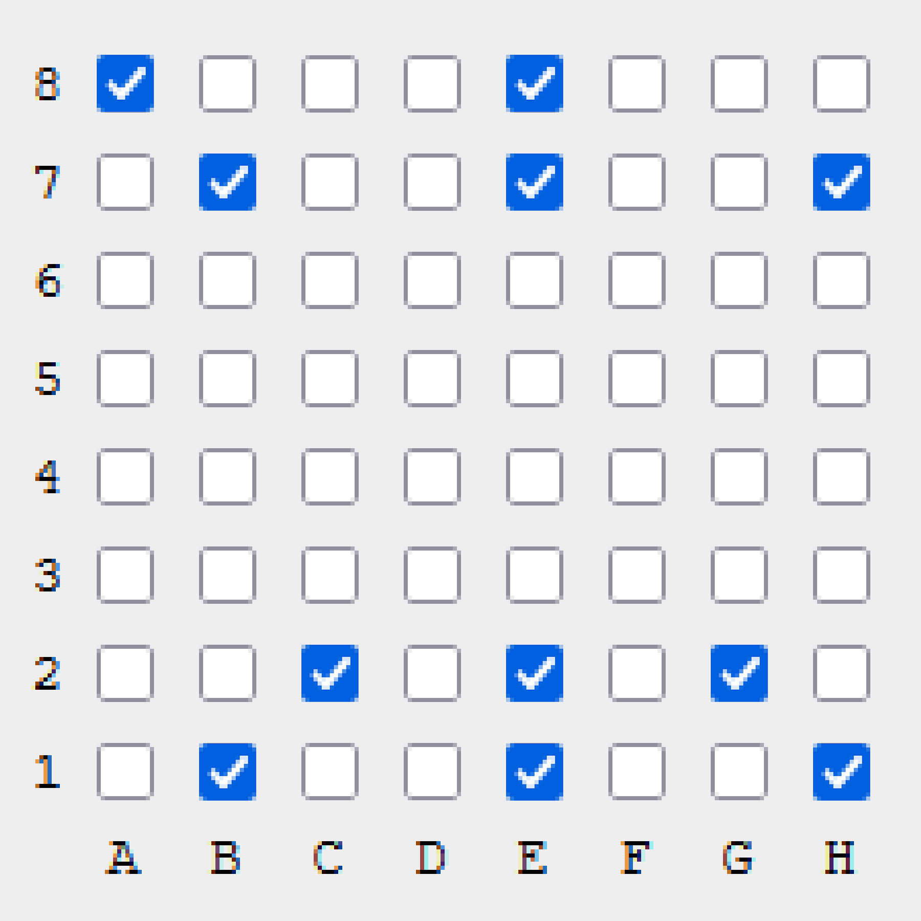
Bit Boards Calculations
Example:
WQueen on E4
AND
operation
result: all possible attacks on all other pieces

Slide 14
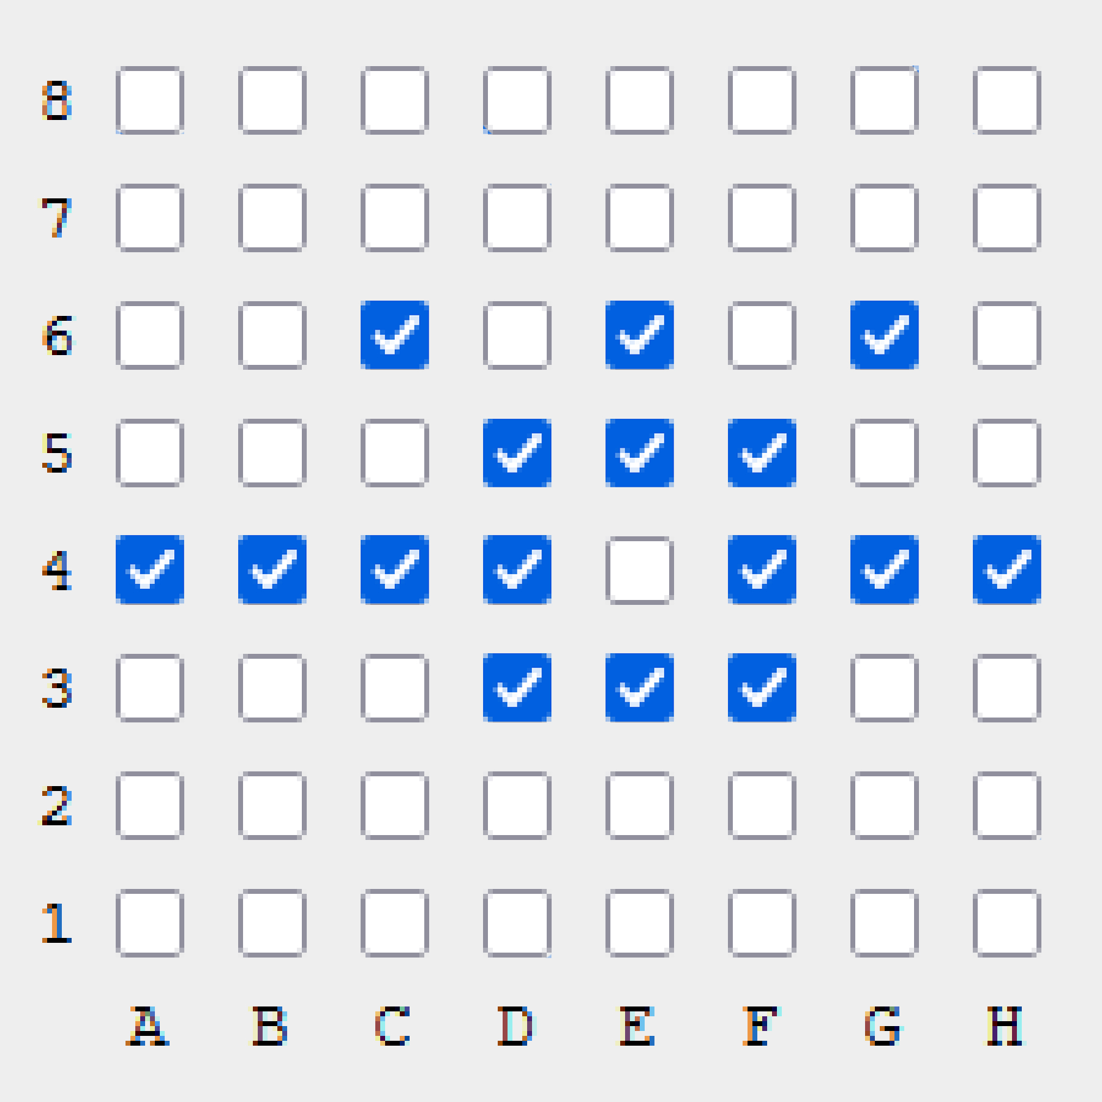
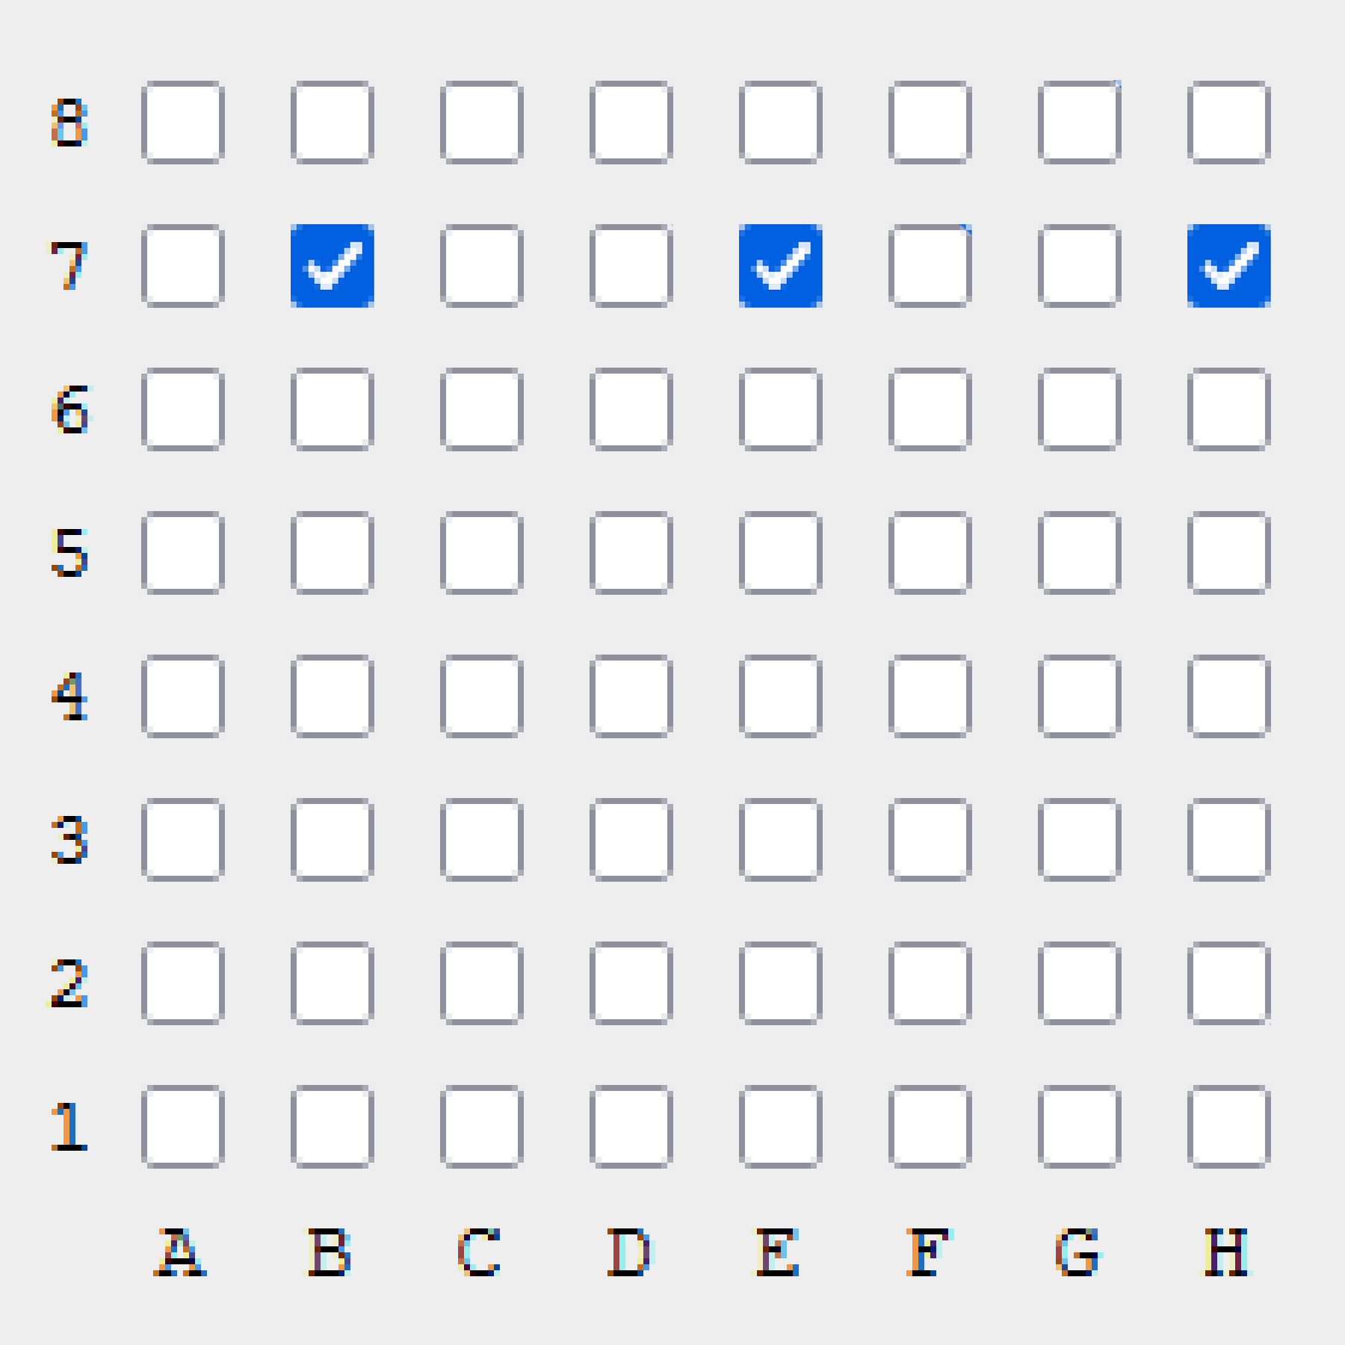
Bit Boards Calculations
Filtered Movement
Filtered Attack

Slide 15
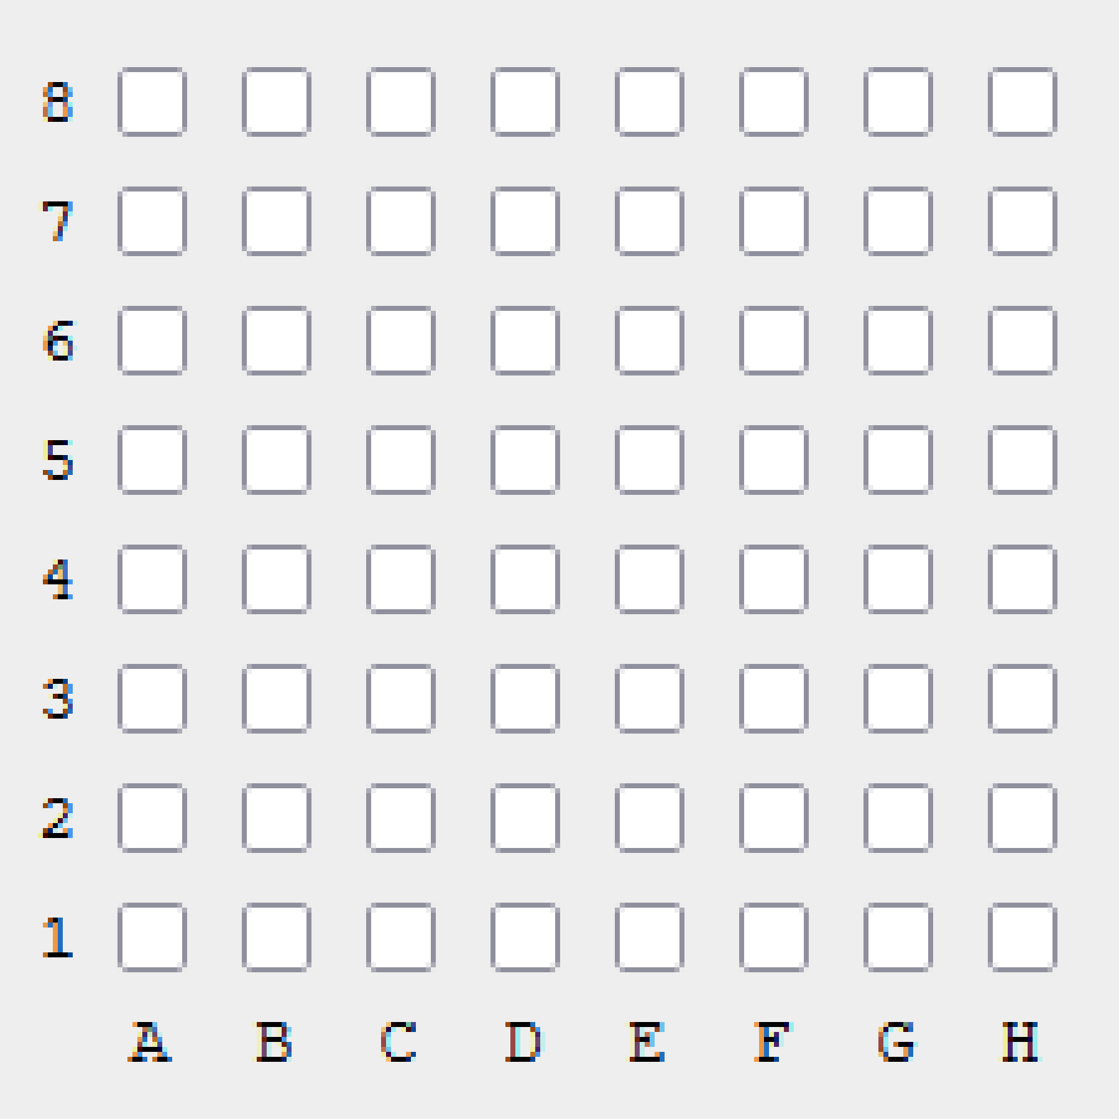
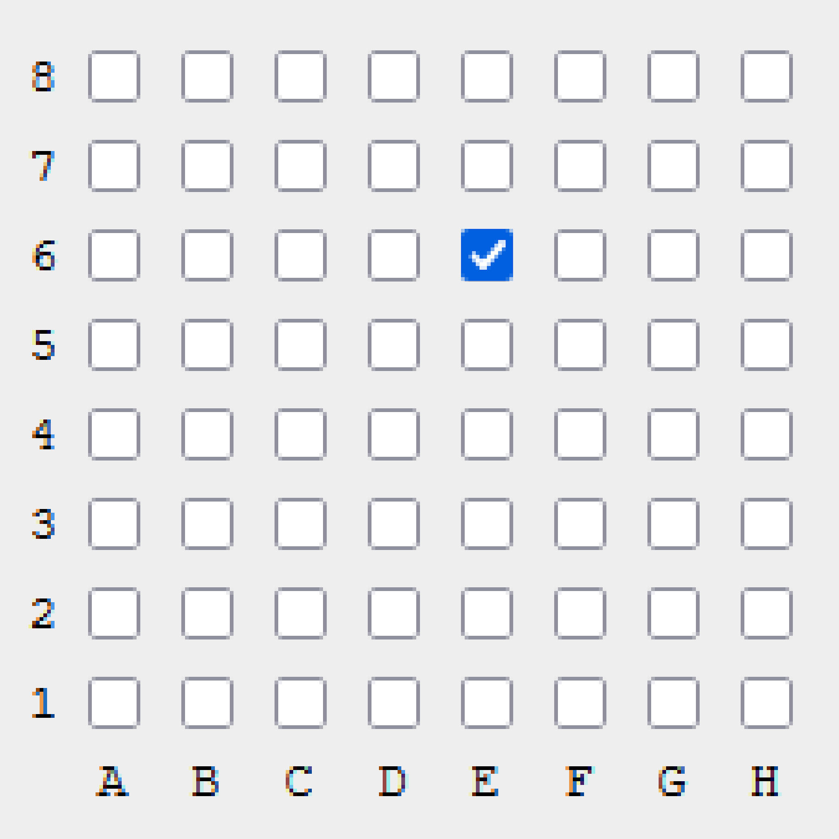
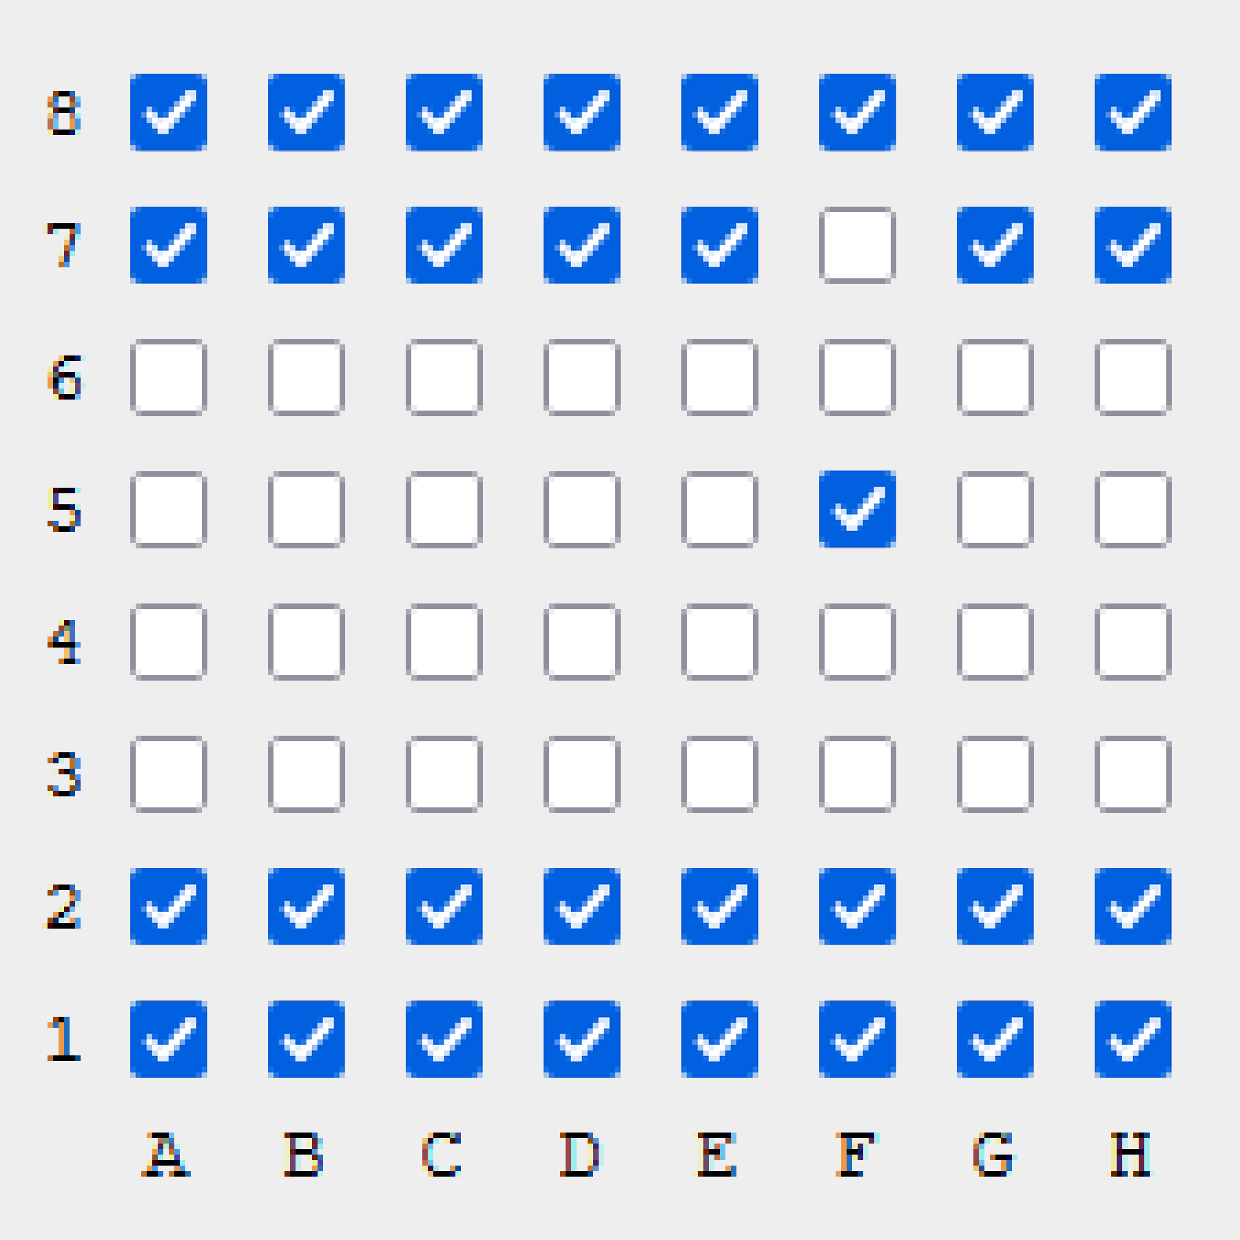
Not True Bitboards
FlipBit(board, index)
not a proper bitboard implementation
more like an amalgamation of both bitboards and normal array handling
has the added speedboost and simplicity from bit operations
helper functions:
FlipBit()
SwapBit()
20
SwapBit(board, index, index)
13, 29

Slide 16
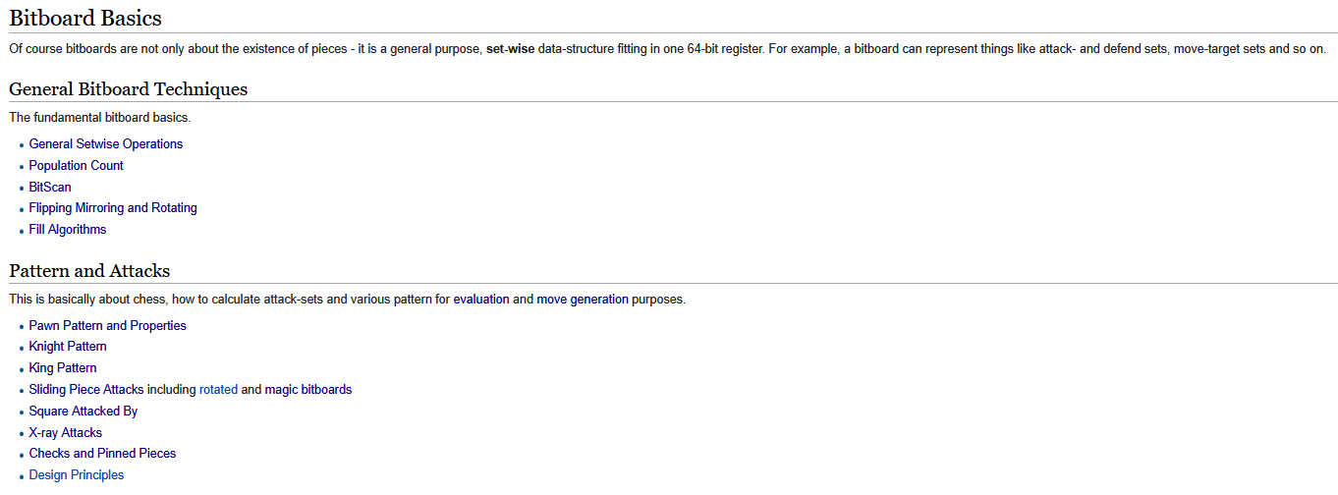
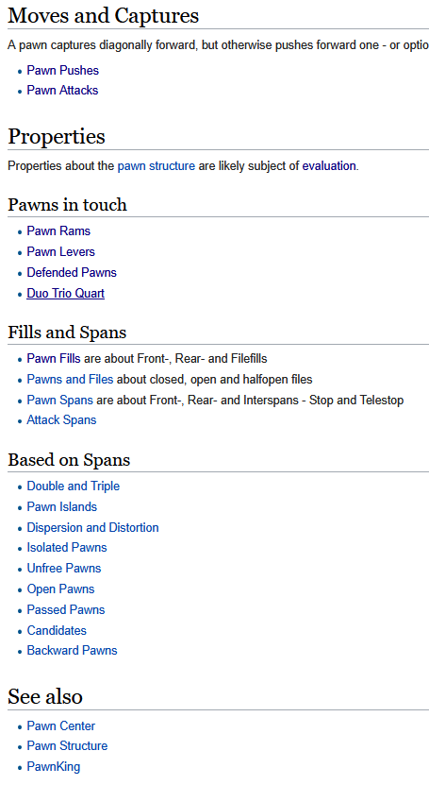

A deep deep rabbit hole to fall into...
Source: https://www.chessprogramming.org/Bitboards
I wonder if I can do it though…
(spoilers: eh)
Source: https://healeycodes.com/visualizing-chess-bitboards

Slide 17
Implementation

Slide 18




Not Most Ideal Comparison
used copy paste to see how easy it was to do a one-to-one implementation of the same code architecture
problems (will expand on later): not fully used Go’s potential, circular dependencies

Slide 19
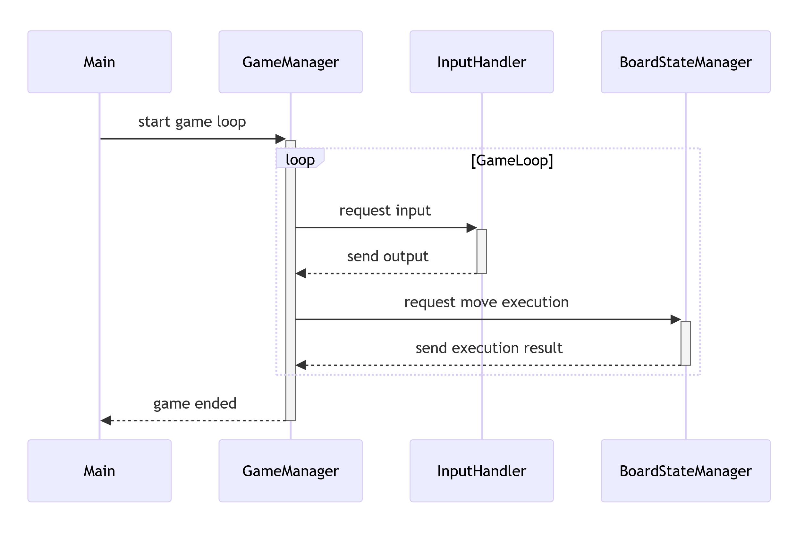
Chess Engine Flow

Slide 20
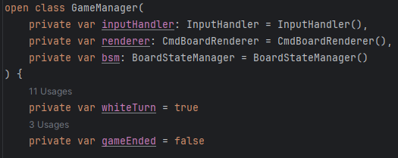
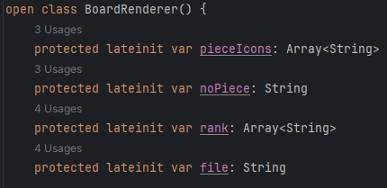
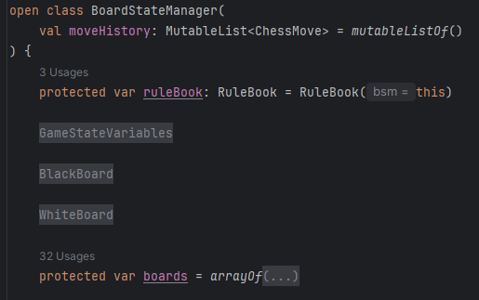
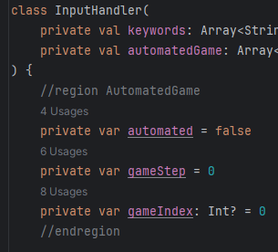
Kotlin

Slide 21
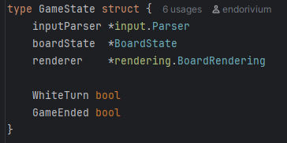
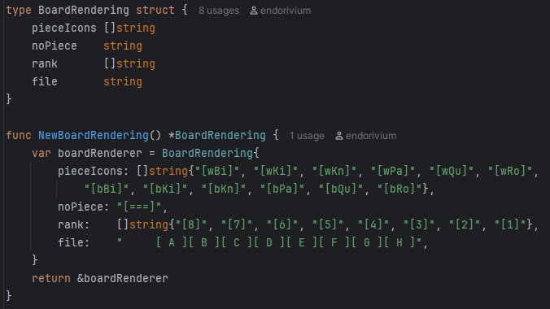
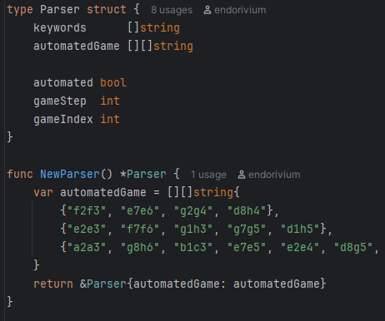
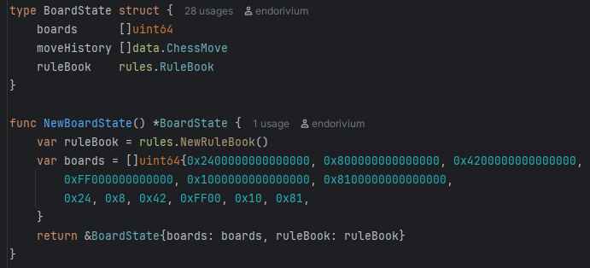
Go

Slide 22
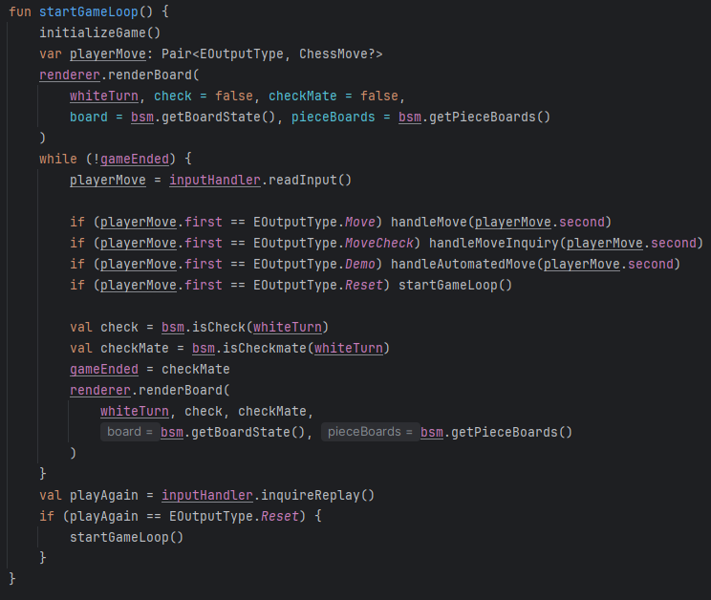
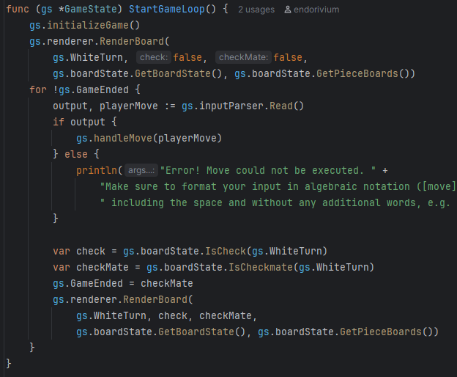
StartGameLoop()
Kotlin
Go

Slide 23
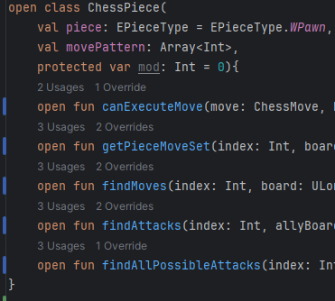

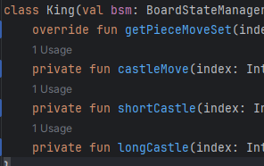
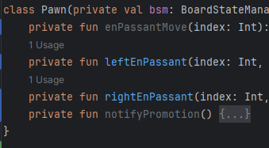
Kotlin: Code Structure
ChessPiece as default/ base implementation
assumes the default piece is white and can move indefinitely according to its movePattern
SingleStep only moves one step in any given direction (according to movePattern)
King implements Castling
Pawn implements En Passant and Promotion

Slide 24
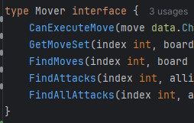
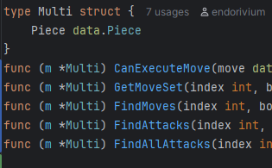
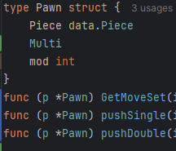
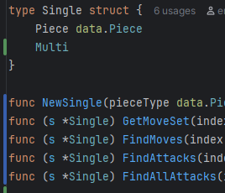
Go: Code Structure
Mover as interface to allow polymorphism
Multi is equivalent to ChessPiece
Single is the same as SingleStep
No Castling, En Passant or Promotion because of time and strange circular dependencies

Slide 25
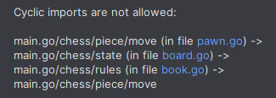
Thoughts
initially confusing but ultimately not that difficult to do a one-to-one implementation
however, could not get Pawn and King implementations to work
needed: reference to board state manager
but introduced circular dependency
could not fix it in time

Slide 26
Addendum
(Annoyances/ Improvements)

Slide 27
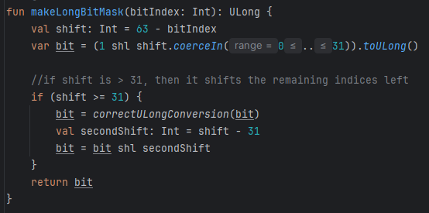
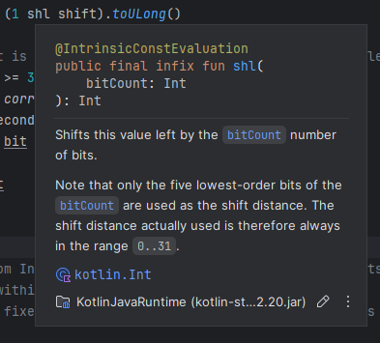
Kotlin Bit Operations
thought I had to compensate for language deficit and wrote own function (time waste)
inferred data type ruined bit operation in Kotlin
did not catch it in time
did not happen in Go

Slide 28
Go Packages
package usage in Go is annoying (take a shot every time gs is references here)
need to reference package usage via name clashes with local variable and parameter naming, can even lead to strange errors in the code

Slide 29

Kotlin Function Naming
Autogenerated getters and setters are named Get<VariableName>() and Set<VariableName>(), accidentally creating functions with the same name leads to errors
also: renaming those with F2 also renames all VariableName instances
these two are the same to Kotlin:

Slide 30
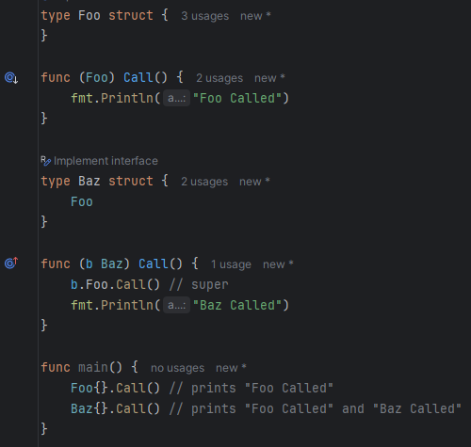
Method Overriding in Go
function overriding (or at least a mimicry of it) is actually possible in Go
override is even marked in Goland
but: will raise error if there is ambiguity due to composition (struct has both Baz and Foo and then calls Call())
Source: https://medium.com/random-go-tips/method-overriding-680cfd51ce40

Slide 31
Conclusion
Go encourages composition and interface usage for modular and easily testable code
but: annoying to use due to package references
strange architectures to circumvent limitations and achieve OOP concepts (and enums)
test files are forced to be in same folder as class
Kotlin has good structures that help with code clarity (e.g. range comparison, for loop) and testing is fairly easy
but: primary constructor strangely separates class members if lateinit is needed and has
immutability makes inheritance and testing a chore

Slide 32
Sources
BitBoard Calculator by gekomad
Bitboards by ChessProgramming Wiki
Kotlin Unit Testing guide by Kacper Wojciechowski
Making a Chess Engine in Zig by John Murray
Visualizing Chess Bitboards by Andrew Healey
What is Bitmasking? by GeeksforGeeks

