Slide 1
Fighting Boredom in Recommender Systems with Linear Reinforcement Learning
Tiandi Ye 2020.07.31

Slide 2
Contents
Introduction
Problem Formulation
Model Validation on Real Data
Linear Upper-Confidence bound for Reinforcement Learning
Experiments
Conclusion

Slide 3
Introduction
Existence of an Optimal Fixed Strategy
matrix factorization
multi-armed bandit (MAB)
A/B testing
Boredom Effect
movie recommendation problem
meal taste

Slide 4
Related Work
Once an arm is pulled, its reward decreases due to loss of interest and never increases again.
Rewards continuously decrease whether the arm is selected or not.
MDP-based RS, next item reward depends on previously k selected items without any underlying model assumption. Without considering exploration-exploitation trade-off and directly solving an estimated MDP leads to linear regret.
Two possible states sensitization and boredom.

Slide 5
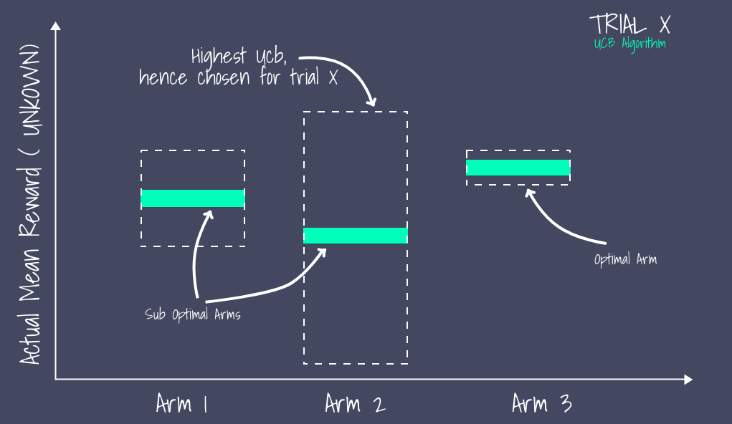
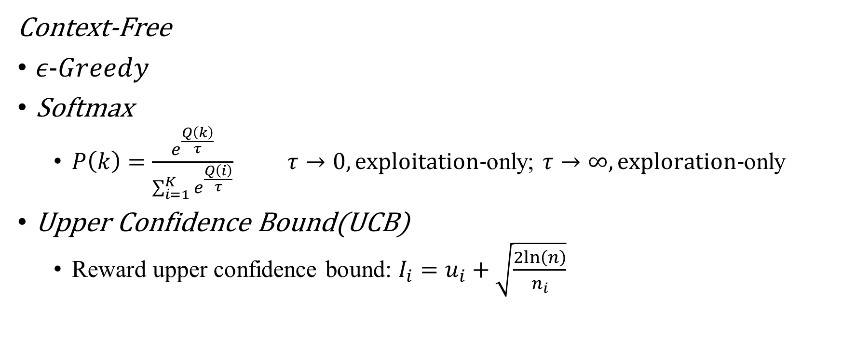
Multi-Armed Bandit(MAB)
Context-Free
$ε−Greedy$
Softmax
$P\left(k\right)=\frac{e^{\frac{Q\left(k\right)}{τ}}}{\sum_{i=1}^{K}{e^{\frac{Q\left(i\right)}{τ}}}}$ $τ→0, exploitation−$only; $τ→∞, exploration−$only
Upper Confidence Bound(UCB)
Reward upper confidence bound: $I_{i}=u_{i}+\sqrt{\frac{2ln⁡\left(n\right)}{n_{i}}}$

Slide 6
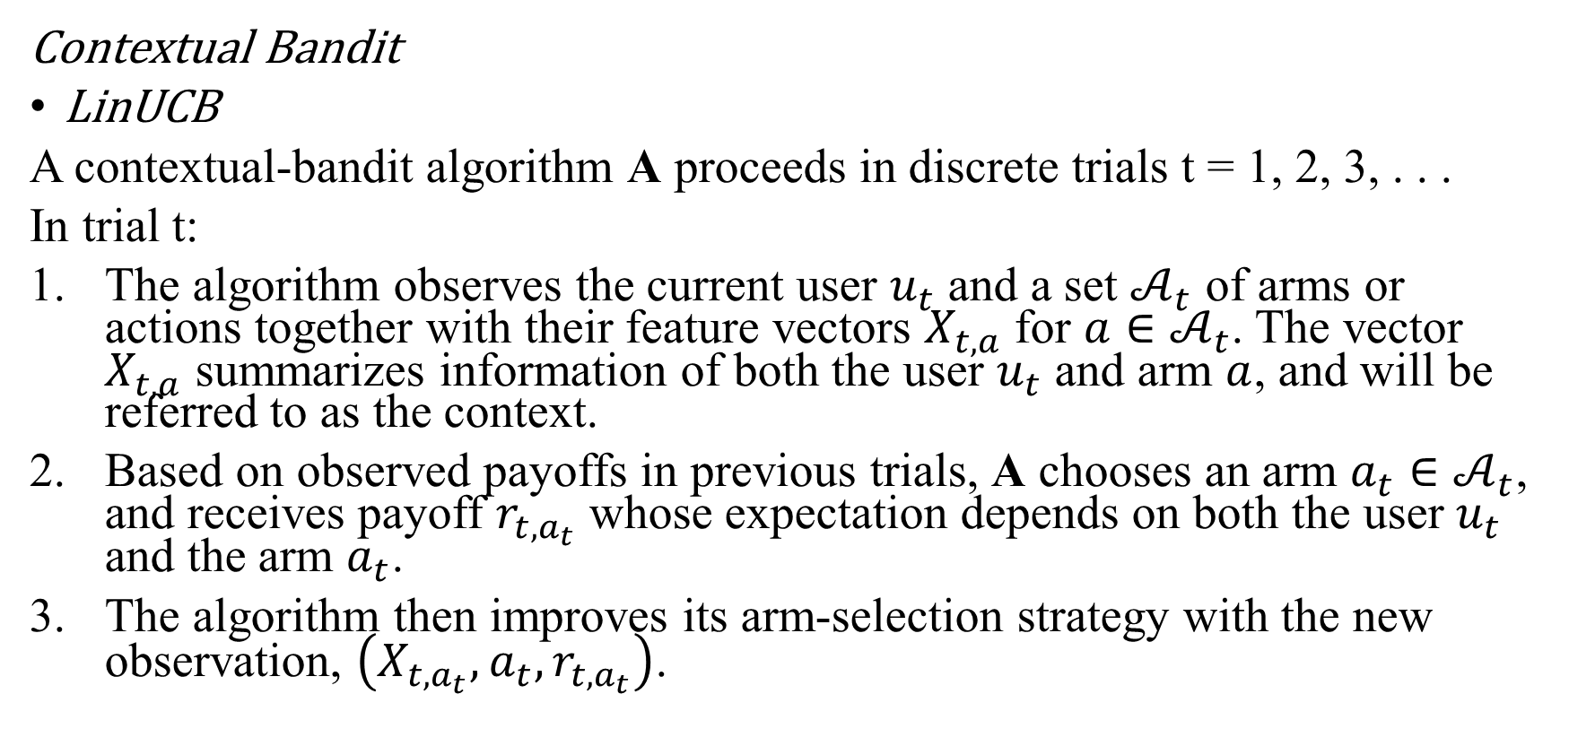
Multi-Armed Bandit(MAB)
Contextual Bandit
LinUCB
A contextual-bandit algorithm A proceeds in discrete trials t = 1, 2, 3, . . .
In trial t:
The algorithm observes the current user $u_{t}$ and a set $𝒜_{t}$ of arms or actions together with their feature vectors $X_{t,a}$ for $a∈𝒜_{t}$. The vector $X_{t,a}$ summarizes information of both the user $u_{t}$ and arm $a$, and will be referred to as the context.
Based on observed payoffs in previous trials, A chooses an arm $a_{t}∈𝒜_{t}$, and receives payoff $r_{t,a_{t}}$ whose expectation depends on both the user $u_{t}$ and the arm $a_{t}$.
The algorithm then improves its arm-selection strategy with the new observation, $\left(X_{t,a_{t}},a_{t},r_{t,a_{t}}\right)$.

Slide 7
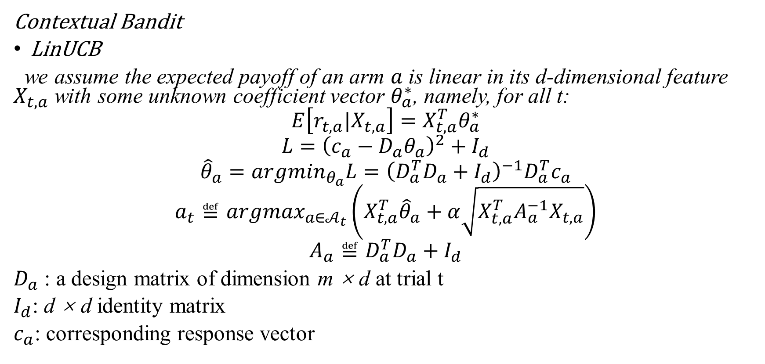
Multi-Armed Bandit(MAB)
Contextual Bandit
LinUCB
we assume the expected payoff of an arm $a$ is linear in its d-dimensional feature $X_{t,a}$ with some unknown coefficient vector $θ_{a}^{∗}$, namely, for all t:
$$E\left[r_{t,a}|X_{t,a}\right]=X_{t,a}^{T}θ_{a}^{∗}$$
$$L={\left(c_{a}−D_{a}θ_{a}\right)}^{2}+I_{d}$$
$${\hat{θ}}_{a}={{argmin}_{θ_{a}}L=\left({D_{a}^{T}D}_{a}+I_{d}\right)}^{−1}D_{a}^{T}c_{a}$$
$$a_{t}≝{argmax}_{a∈𝒜_{t}}\left(X_{t,a}^{T}{\hat{θ}}_{a}+α\sqrt{X_{t,a}^{T}A_{a}^{−1}X_{t,a}}\right)$$
$$A_{a}≝D_{a}^{T}D_{a}+I_{d}$$
$D_{a}$ : a design matrix of dimension m × d at trial t
$I_{d}$: d × d identity matrix
$c_{a}$: corresponding response vector

Slide 8
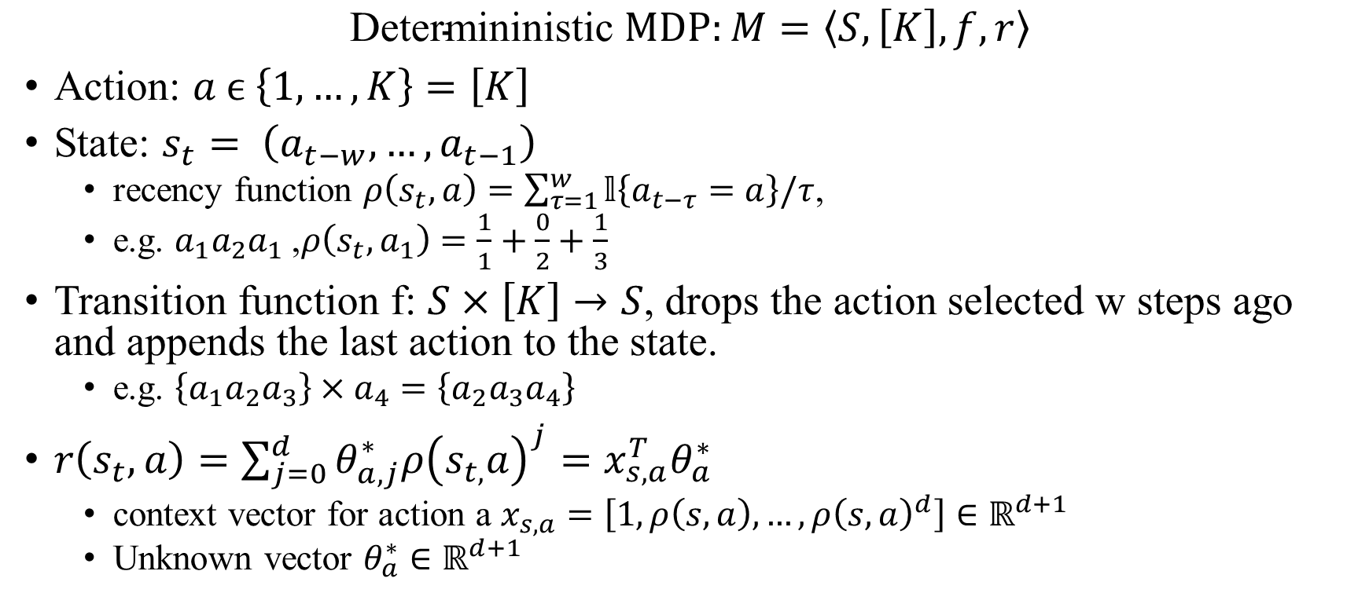
Problem Formulation
$$\text{D}\text{etermininistic} MDP:M=\left\langle S, \left[K\right], f, r\right\rangle$$
Action: $a ϵ \left\{1, …, K\right\}=\left[K\right]$
State: $s_{t}= \left(a_{t−w}, …, a_{t−1}\right)$
recency function $ρ\left(s_{t},a\right)=\sum_{τ=1}^{w}{𝕝\left\{a_{t−τ}=a\right\}/τ}$,
e.g. $a_{1}a_{2}a_{1}$ ,$ρ\left(s_{t},a_{1}\right)=\frac{1}{1}+\frac{0}{2}+\frac{1}{3}$
Transition function f: $S×\left[K\right]→S$, drops the action selected w steps ago and appends the last action to the state.
e.g. $\left\{a_{1}a_{2}a_{3}\right\}×a_{4}=\left\{a_{2}a_{3}a_{4}\right\}$
$r\left(s_{t},a\right)=\sum_{j=0}^{d}{θ_{a,j}^{∗}ρ{\left(s_{t,}a\right)}^{j}}=x_{s,a}^{T}θ_{a}^{∗}$
context vector for action a $x_{s,a}=\left[1, ρ\left(s,a\right), …, {ρ\left(s,a\right)}^{d}\right]∈ℝ^{d+1}$
Unknown vector $θ_{a}^{∗}∈ℝ^{d+1}$

Slide 9


Value Iteration ($θ_{a}^{∗} were known$)
$u_{i+1}\left(s\right)=\max_{aε\left[K\right]}\left[r\left(s,a\right)+u_{i}\left(f\left(s,a\right)\right)\right]$
regret: $∆\left(T\right)=Tη^{∗}−\sum_{t=1}^{T}{r\left(s_{t},a_{t}\right)}$

Slide 10
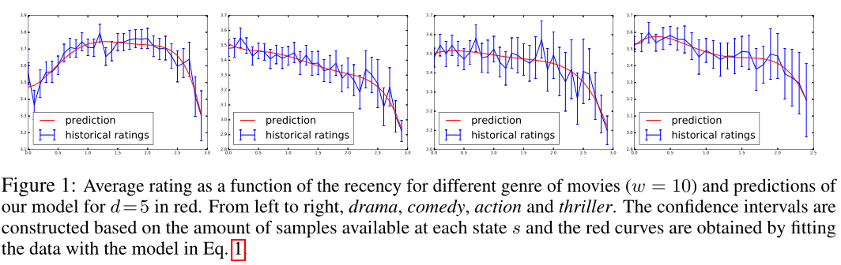
Model Validation on Real Data(movielens-100k)
drama
comedy
action
thriller
$${(drama, r}_{1}),\left(comedy,r_{2}\right),\left(comedy,r_{3}\right),\left(thcomedy,r_{4}\right),\left(action,r_{5}\right),\left(comedy,r_{6}\right)$$

Slide 11
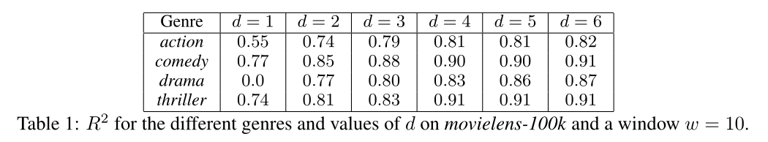
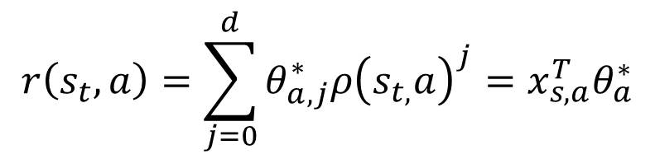
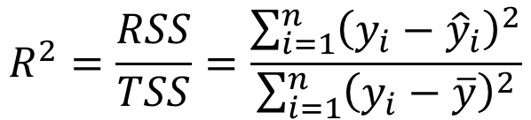
Model Validation on Real Data
$$r\left(s_{t},a\right)=\sum_{j=0}^{d}{θ_{a,j}^{∗}ρ{\left(s_{t,}a\right)}^{j}}=x_{s,a}^{T}θ_{a}^{∗}$$
$$R^{2}=\frac{RSS}{TSS}=\frac{\sum_{i=1}^{n}{{\left(y_{i}−{\hat{y}}_{i}\right)}^{2}}}{\sum_{i=1}^{n}{{\left(y_{i}−\overline{y}\right)}^{2}}}$$

Slide 12
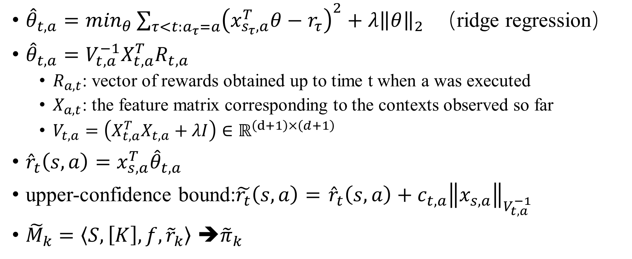
LinUCRL Linear Upper-Confidence bound for Reinforcement Learning
${\hat{θ}}_{t,a}=\min_{θ}\sum_{τ<t:a_{τ}=a}{{\left(x_{s_{τ},a}^{T}θ−r_{τ}\right)}^{2}+λ{\left\|θ\right\|}_{2}}$ （ridge regression）
${\hat{θ}}_{t,a}=V_{t,a}^{−1}X_{t,a}^{T}R_{t,a}$
$R_{a,t}$: vector of rewards obtained up to time t when a was executed
$X_{a,t}$: the feature matrix corresponding to the contexts observed so far
$V_{t,a}=\left(X_{t,a}^{T}X_{t,a}+λI\right)∈ℝ^{\left(d+1\right)×\left(d+1\right)}$
${\hat{r}}_{t}\left(s,a\right)=x_{s,a}^{T}{\hat{θ}}_{t,a}$
upper-confidence bound:$\tilde{r_{t}}\left(s,a\right)=$ ${\hat{r}}_{t}\left(s,a\right)+c_{t,a}{\left\|x_{s,a}\right\|}_{V_{t,a}^{−1}}$
${\tilde{M}}_{k}=\left\langle S,\left[K\right],f,{\tilde{r}}_{k}\right\rangle$ ➔${\tilde{π}}_{k}$

Slide 13
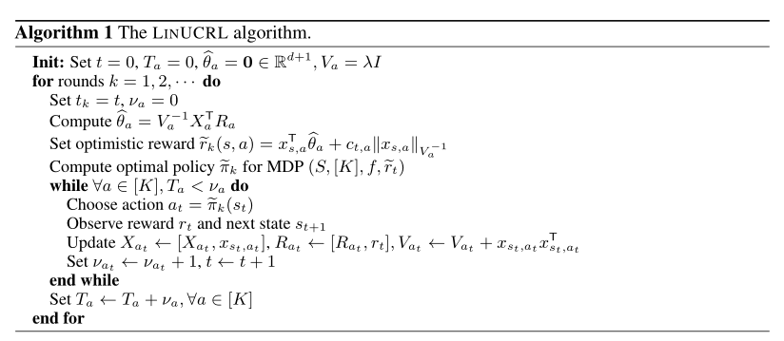
Algorithm

Slide 14

LinUCRL
Computational complexity：
LinUCRL
$u_{i+1}\left(s\right)=\max_{aε\left[K\right]}\left[r\left(s,a\right)+u_{i}\left(f\left(s,a\right)\right)\right]$
$O\left(dSK\right)$
UCRL
$u_{i+1}\left(s\right)=\max_{aε𝒜}\left\{{\tilde{r}}_{k}\left(s,a\right)+\max_{p\left(·\right)ε𝒫\left(s,a\right)}\left\{\sum_{s^{′}εS}{p\left(s^{′}\right)·u_{i}\left(s^{′}\right)}\right\}\right\}$
$O\left(S^{2}K\right)$

Slide 15

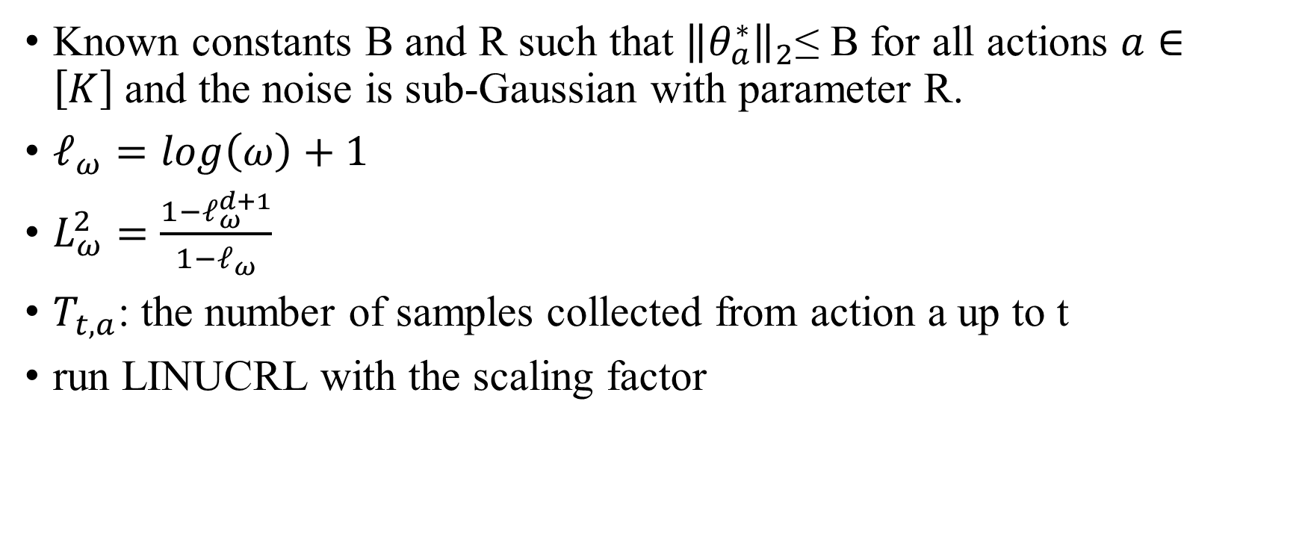
Theoretical Analysis
Known constants B and R such that ${\left\|θ_{a}^{∗}\right\|}_{2}$≤ B for all actions $a∈\left[K\right]$and the noise is sub-Gaussian with parameter R.
$ℓ_{ω}=log\left(ω\right)+1$
$L_{ω}^{2}=\frac{1−ℓ_{ω}^{d+1}}{1−ℓ_{ω}}$
$T_{t,a}$: the number of samples collected from action a up to t
run LINUCRL with the scaling factor

Slide 16
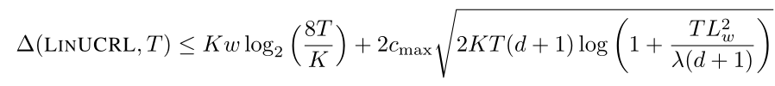

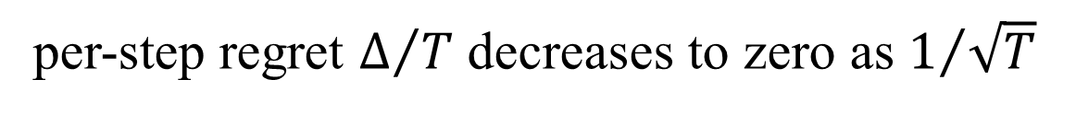
Theoretical Analysis.
Cumulative regret
$$c_{max}=\max_{t,a}c_{t,a}$$
per-step regret $Δ/T$ decreases to zero as $1/{\sqrt{T}}$

Slide 17
Experiments
Toy experiment
Movielens
Real-world data from A/B testing

Slide 18
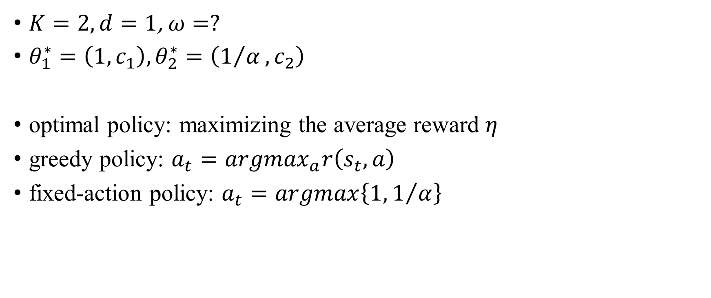
Toy experiment
$K=2,d=1$,$ω=?$
$θ_{1}^{∗}=\left(1,c_{1}\right),θ_{2}^{∗}=\left(1/α,c_{2}\right)$
optimal policy: maximizing the average reward $η$
greedy policy: $a_{t}={argmax}_{a}r\left(s_{t},a\right)$
fixed-action policy: $a_{t}=argmax\left\{1,1/α\right\}$

Slide 19
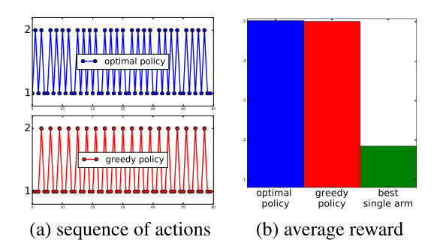
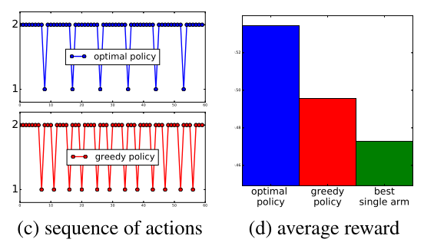
$c_{1}=0.3≈c_{2}=0.4,α=1.5$(limited boredom effect)
Difference is very narrow.
$c_{1}=2≫c_{2}=0.01,α=2$.0(strong boredom effect)
Greedy policy: 66% for action 1
Optimal policy: 57% for action 1

Slide 20
Movielens-100k
userId::movieId::rating::timestamp
100,000 ratings (1-5) from 943 users on 1682 movies
Each user has rated at least 20 movies.
Ratings are made on a 5-star scale, with half-star increments (0.5 stars - 5.0 stars).
K = 10 actions corresponding to different genres of movies
d = 5
w = 5
Notes:
MovieLens数据集包含多个用户对多部电影的评级数据，也包括电影元数据信息和用户属性信息。

Slide 21
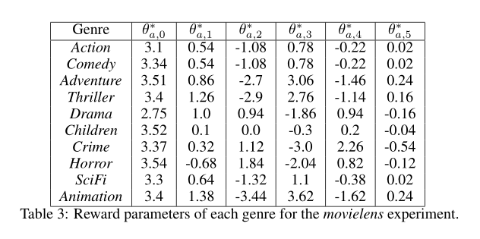
Resulting Parameters
a constant strategy would always pull the comedy genre since it is the one with the highest “static” reward

Slide 22
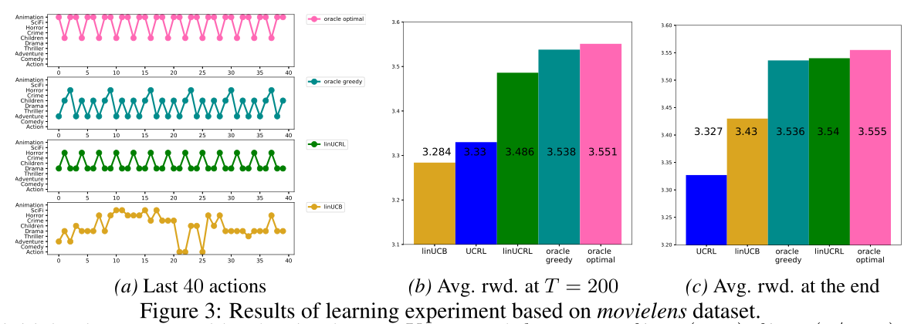
Results
Despite the fact that UCRL targets this better performance, the learning process is very slow as the
number of states is too large.

Slide 23
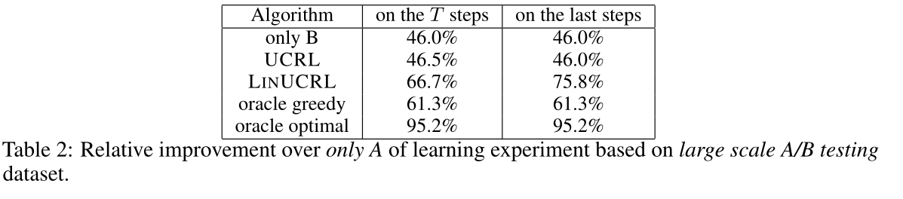
Large scale A/B testing dataset
350M tuples (user id, timestamp, version, click)
Don’t impose any linear assumption on the simulator.

Slide 24
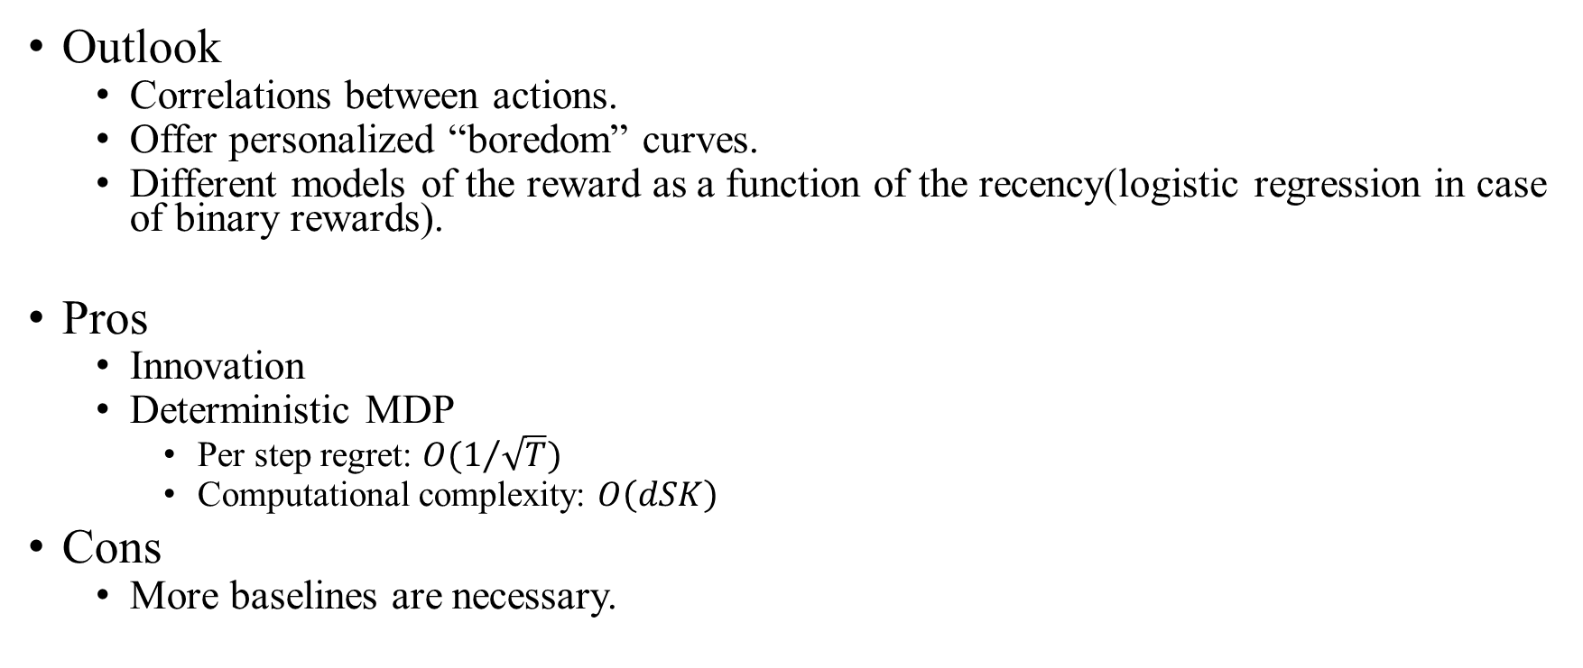
Conclusion
Outlook
Correlations between actions.
Offer personalized “boredom” curves.
Different models of the reward as a function of the recency(logistic regression in case of binary rewards).
Pros
Innovation
Deterministic MDP
Per step regret: ${O(1}/{\sqrt{T})}$
Computational complexity: $O\left(dSK\right)$
Cons
More baselines are necessary.

Slide 25
Thanks for listening.

