Slide 1
Data Management for Data Science
Lecture 14: Sampling
Prof. Asoc. Endri Raço

Slide 2
Statistical Inference
Statistical inference: The process of making guesses about the truth from sample data.
Sample statistics
Truth (not observable)
Sample (observation)
*hat notation ^ is often used to indicate “estitmate”
Population parameters
Make guesses about the whole population

Slide 3
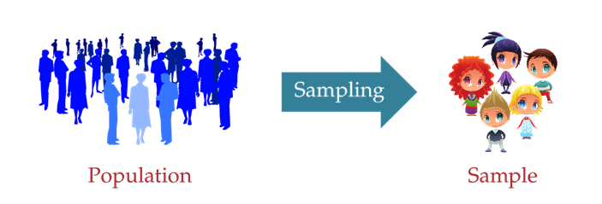
Introduction
Probability sampling
Non-probability sampling

Slide 4
Probability sampling
We use randomization to select elements from our population
Examples
Simple Random Sampling
Stratified sampling
Systematic sampling
Cluster sampling
Multi-stage sampling

Slide 5
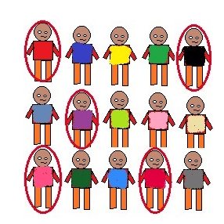
Random sampling
Random selection of 20 students from class of 50 student. Each student has equal chance of getting selected. Here probability of selection is 1/50

Slide 6
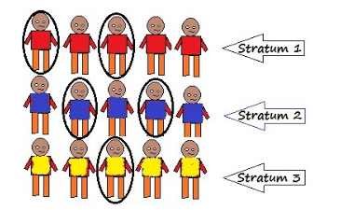
Stratified sampling
Divide the elements of the population into small subgroups (strata) based on the similarity in such a way that the elements within the group are homogeneous and heterogeneous among the other subgroups formed. And then the elements are randomly selected from each of these strata.

Slide 7
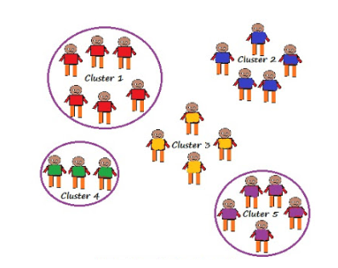
Single Stage Cluster sampling
Our entire population is divided into clusters or sections and then the clusters are randomly selected.

Slide 8
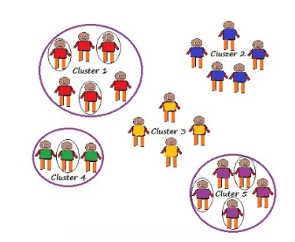
Two Stage Cluster sampling
First we randomly select clusters and then from those selected clusters we randomly select elements for sampling

Slide 9
Non-Probability sampling
We use randomization to select elements from our population
Examples
Convenience sampling
Quota sampling
Snowball sampling

Slide 10
Convenience sampling
The samples are selected based on the availability. This method is used when the availability of sample is rare and also costly. So based on the convenience samples are selected.
For example: Researchers prefer this during the initial stages of survey research, as it’s quick and easy to deliver results.

Slide 11
Quota sampling
This type of sampling depends of some pre-set standard. It selects the representative sample from the population. Proportion of characteristics/ trait in sample should be same as population. Elements are selected until exact proportions of certain types of data is obtained or sufficient data in different categories is collected.
For example: If our population has 45% females and 55% males then our sample should reflect the same percentage of males and females.

Slide 12
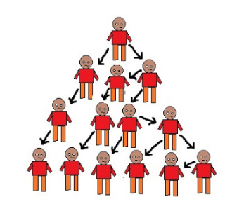
Snowball sampling
This technique is used in the situations where the population is completely unknown and rare. We will take the help from the first element which we select for the population and use that element to recommend other elements who will fit the description of the sample needed.

