Slide 1
Data Management for Data Science
Lecture 20: Optimization/Gradient Descent
Prof. Asoc. Endri Raço

Slide 2
Today
Optimization
Gradient Descent

Slide 3
What is Optimization?
Find the minimum or maximum of an objective function given a set of constraints:

Slide 4
Why Do We Care?
Linear Classification Maximum Likelihood
K-Means

Slide 5
Prefer Convex Problems
Local (non global) minima and maxima:

Slide 6
Convex Functions and Sets

Slide 7
Important Convex Functions

Slide 8
Convex Optimization Problem

Slide 9
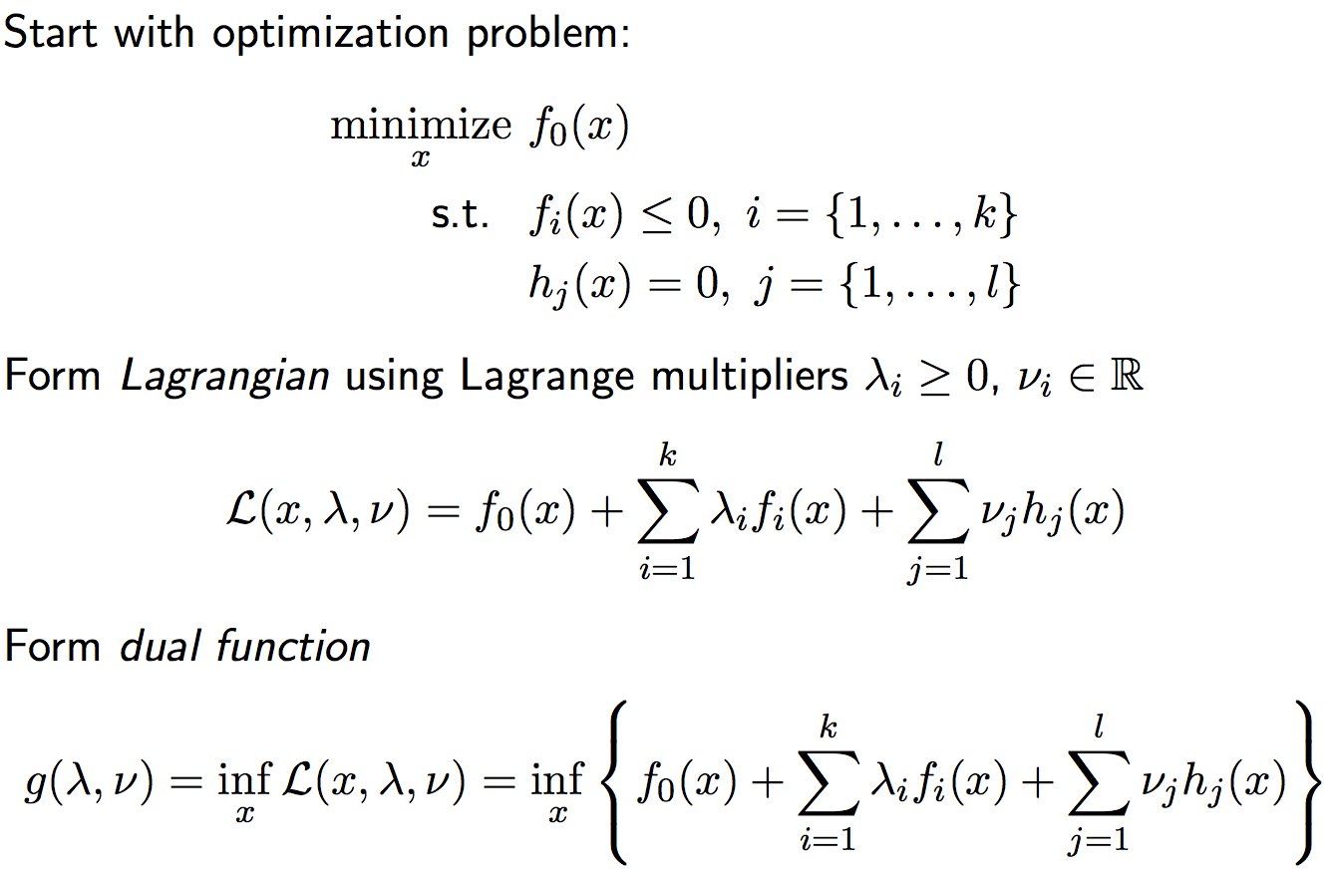
Lagrangian Dual

Slide 10
First Order Methods:
Gradient Descent
Newton’s Method
Introduction to Convex Optimization for Machine Learning, John Duchi, UC Berkeley, Tutorial, 2009
Subgradient Descent
Introduction to Convex Optimization for Machine Learning, John Duchi, UC Berkeley, Tutorial, 2009
Stochastic Gradient Descent
Stochastic Optimization for Machine Learning, Nathan Srebro and Ambuj Tewari, presented at ICML'10
Trust Regions
Trust Region Newton method for large-scale logistic regression, C.-J. Lin, R. C. Weng, and S. S. Keerthi, Journal of Machine Learning Research, 2008
Dual Coordinate Descent
Dual Coordinate Descent Methods for logistic regression and maximum entropy models, H.-F. Yu, F.-L. Huang, and C.-J. Lin, . Machine Learning Journal, 2011
Linear Classification
Recent Advances of Large-scale linear classification, G.-X. Yuan, C.-H. Ho, and C.-J. Lin. Proceedings of the IEEE, 100(2012)

Slide 11
First Order Methods:
Gradient Descent
Newton’s Method
Introduction to Convex Optimization for Machine Learning, John Duchi, UC Berkeley, Tutorial, 2009
Subgradient Descent
Introduction to Convex Optimization for Machine Learning, John Duchi, UC Berkeley, Tutorial, 2009
Stochastic Gradient Descent
Stochastic Optimization for Machine Learning, Nathan Srebro and Ambuj Tewari, presented at ICML'10
Trust Regions
Trust Region Newton method for large-scale logistic regression, C.-J. Lin, R. C. Weng, and S. S. Keerthi, Journal of Machine Learning Research, 2008
Dual Coordinate Descent
Dual Coordinate Descent Methods for logistic regression and maximum entropy models, H.-F. Yu, F.-L. Huang, and C.-J. Lin, . Machine Learning Journal, 2011
Linear Classification
Recent Advances of Large-scale linear classification, G.-X. Yuan, C.-H. Ho, and C.-J. Lin. Proceedings of the IEEE, 100(2012)

Slide 12
Gradient Descent

Slide 13
Single Step Illustration

Slide 14
Full Gradient Descent Illustration
Notes:
Elipses are level curves (function is quadratic). If we start on ---- line –gradient goes towards minimum (middle), if not, bounce back and forth

Slide 15
First Order Methods:
Gradient Descent
Newton’s Method
Introduction to Convex Optimization for Machine Learning, John Duchi, UC Berkeley, Tutorial, 2009
Subgradient Descent
Introduction to Convex Optimization for Machine Learning, John Duchi, UC Berkeley, Tutorial, 2009
Stochastic Gradient Descent
Stochastic Optimization for Machine Learning, Nathan Srebro and Ambuj Tewari, presented at ICML'10
Trust Regions
Trust Region Newton method for large-scale logistic regression, C.-J. Lin, R. C. Weng, and S. S. Keerthi, Journal of Machine Learning Research, 2008
Dual Coordinate Descent
Dual Coordinate Descent Methods for logistic regression and maximum entropy models, H.-F. Yu, F.-L. Huang, and C.-J. Lin, . Machine Learning Journal, 2011
Linear Classification
Recent Advances of Large-scale linear classification, G.-X. Yuan, C.-H. Ho, and C.-J. Lin. Proceedings of the IEEE, 100(2012)

Slide 16
First Order Methods:
Gradient Descent
Newton’s Method
Introduction to Convex Optimization for Machine Learning, John Duchi, UC Berkeley, Tutorial, 2009
Subgradient Descent
Introduction to Convex Optimization for Machine Learning, John Duchi, UC Berkeley, Tutorial, 2009
Stochastic Gradient Descent
Stochastic Optimization for Machine Learning, Nathan Srebro and Ambuj Tewari, presented at ICML'10
Trust Regions
Trust Region Newton method for large-scale logistic regression, C.-J. Lin, R. C. Weng, and S. S. Keerthi, Journal of Machine Learning Research, 2008
Dual Coordinate Descent
Dual Coordinate Descent Methods for logistic regression and maximum entropy models, H.-F. Yu, F.-L. Huang, and C.-J. Lin, . Machine Learning Journal, 2011
Linear Classification
Recent Advances of Large-scale linear classification, G.-X. Yuan, C.-H. Ho, and C.-J. Lin. Proceedings of the IEEE, 100(2012)

Slide 17
Newton’s Method
Inverse Hessian
Gradient
Notes:
Need Hessian to be invertible --- positive definite

Slide 18
Newton’s Method Picture

Slide 19
First Order Methods:
Gradient Descent
Newton’s Method
Introduction to Convex Optimization for Machine Learning, John Duchi, UC Berkeley, Tutorial, 2009
Subgradient Descent
Introduction to Convex Optimization for Machine Learning, John Duchi, UC Berkeley, Tutorial, 2009
Stochastic Gradient Descent
Stochastic Optimization for Machine Learning, Nathan Srebro and Ambuj Tewari, presented at ICML'10
Trust Regions
Trust Region Newton method for large-scale logistic regression, C.-J. Lin, R. C. Weng, and S. S. Keerthi, Journal of Machine Learning Research, 2008
Dual Coordinate Descent
Dual Coordinate Descent Methods for logistic regression and maximum entropy models, H.-F. Yu, F.-L. Huang, and C.-J. Lin, . Machine Learning Journal, 2011
Linear Classification
Recent Advances of Large-scale linear classification, G.-X. Yuan, C.-H. Ho, and C.-J. Lin. Proceedings of the IEEE, 100(2012)

Slide 20
First Order Methods:
Gradient Descent
Newton’s Method
Introduction to Convex Optimization for Machine Learning, John Duchi, UC Berkeley, Tutorial, 2009
Subgradient Descent
Introduction to Convex Optimization for Machine Learning, John Duchi, UC Berkeley, Tutorial, 2009
Stochastic Gradient Descent
Stochastic Optimization for Machine Learning, Nathan Srebro and Ambuj Tewari, presented at ICML'10
Trust Regions
Trust Region Newton method for large-scale logistic regression, C.-J. Lin, R. C. Weng, and S. S. Keerthi, Journal of Machine Learning Research, 2008
Dual Coordinate Descent
Dual Coordinate Descent Methods for logistic regression and maximum entropy models, H.-F. Yu, F.-L. Huang, and C.-J. Lin, . Machine Learning Journal, 2011
Linear Classification
Recent Advances of Large-scale linear classification, G.-X. Yuan, C.-H. Ho, and C.-J. Lin. Proceedings of the IEEE, 100(2012)

Slide 21
Subgradient Descent Motivation

Slide 22
Subgradient Descent – Algorithm

Slide 23
First Order Methods:
Gradient Descent
Newton’s Method
Introduction to Convex Optimization for Machine Learning, John Duchi, UC Berkeley, Tutorial, 2009
Subgradient Descent
Introduction to Convex Optimization for Machine Learning, John Duchi, UC Berkeley, Tutorial, 2009
Stochastic Gradient Descent
Stochastic Optimization for Machine Learning, Nathan Srebro and Ambuj Tewari, presented at ICML'10
Trust Regions
Trust Region Newton method for large-scale logistic regression, C.-J. Lin, R. C. Weng, and S. S. Keerthi, Journal of Machine Learning Research, 2008
Dual Coordinate Descent
Dual Coordinate Descent Methods for logistic regression and maximum entropy models, H.-F. Yu, F.-L. Huang, and C.-J. Lin, . Machine Learning Journal, 2011
Linear Classification
Recent Advances of Large-scale linear classification, G.-X. Yuan, C.-H. Ho, and C.-J. Lin. Proceedings of the IEEE, 100(2012)

Slide 24
First Order Methods:
Gradient Descent
Newton’s Method
Introduction to Convex Optimization for Machine Learning, John Duchi, UC Berkeley, Tutorial, 2009
Subgradient Descent
Introduction to Convex Optimization for Machine Learning, John Duchi, UC Berkeley, Tutorial, 2009
Stochastic Gradient Descent
Stochastic Optimization for Machine Learning, Nathan Srebro and Ambuj Tewari, presented at ICML'10
Trust Regions
Trust Region Newton method for large-scale logistic regression, C.-J. Lin, R. C. Weng, and S. S. Keerthi, Journal of Machine Learning Research, 2008
Dual Coordinate Descent
Dual Coordinate Descent Methods for logistic regression and maximum entropy models, H.-F. Yu, F.-L. Huang, and C.-J. Lin, . Machine Learning Journal, 2011
Linear Classification
Recent Advances of Large-scale linear classification, G.-X. Yuan, C.-H. Ho, and C.-J. Lin. Proceedings of the IEEE, 100(2012)
Notes:
A brief introduction to Stochastic gradient descent

Slide 25
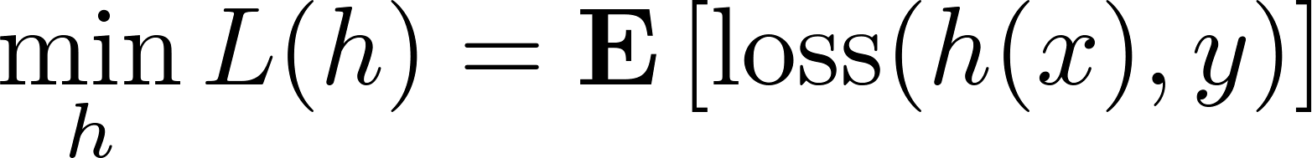
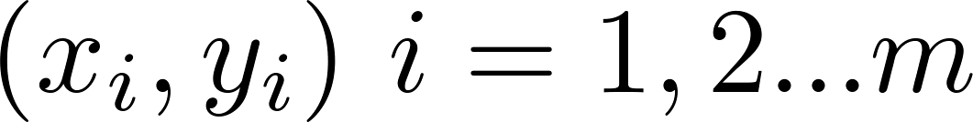
Online learning and optimization
Goal of machine learning :
Minimize expected loss
given samples
This is Stochastic Optimization
Assume loss function is convex

Slide 26
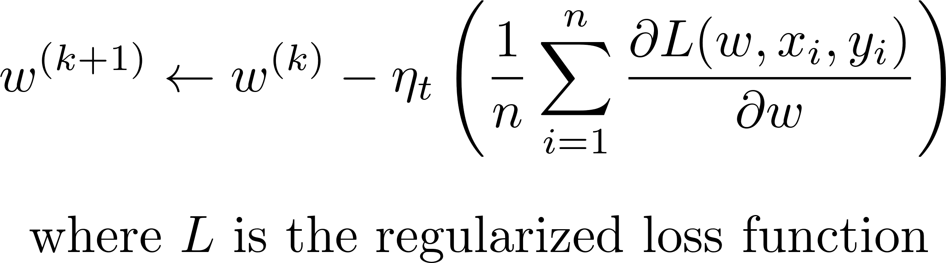
Batch (sub)gradient descent for ML
Process all examples together in each step
Entire training set examined at each step
Very slow when n is very large

Slide 27

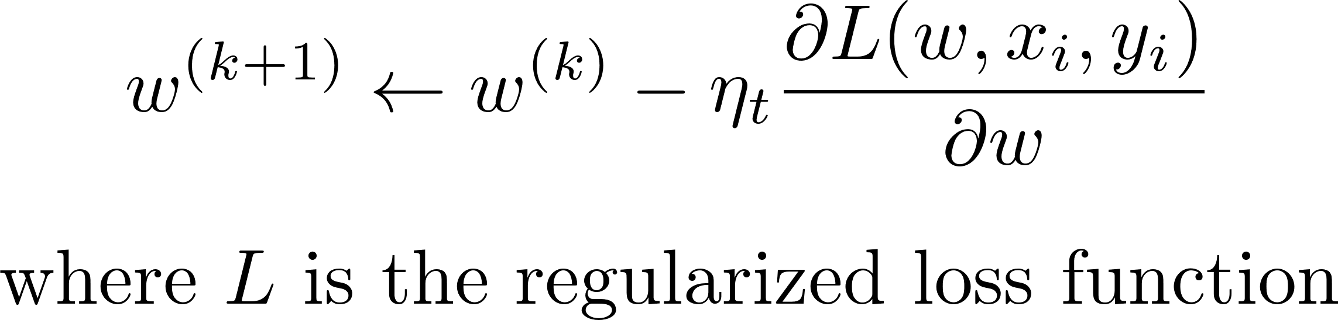
Stochastic (sub)gradient descent
“Optimize” one example at a time
Choose examples randomly (or reorder and choose in order)
Learning representative of example distribution

Slide 28
Stochastic (sub)gradient descent
Equivalent to online learning (the weight vector w changes with every example)
Convergence guaranteed for convex functions (to local minimum)

Slide 29
Hybrid!
Stochastic – 1 example per iteration
Batch – All the examples!
Sample Average Approximation (SAA):
Sample m examples at each step and perform SGD on them
Allows for parallelization, but choice of m based on heuristics

Slide 30

SGD - Issues
Convergence very sensitive to learning rate
( ) (oscillations near solution due to probabilistic nature of sampling)
Might need to decrease with time to ensure the algorithm converges eventually
Basically – SGD good for machine learning with large data sets!

Slide 31
First Order Methods:
Gradient Descent
Newton’s Method
Introduction to Convex Optimization for Machine Learning, John Duchi, UC Berkeley, Tutorial, 2009
Subgradient Descent
Introduction to Convex Optimization for Machine Learning, John Duchi, UC Berkeley, Tutorial, 2009
Stochastic Gradient Descent
Stochastic Optimization for Machine Learning, Nathan Srebro and Ambuj Tewari, presented at ICML'10
Trust Regions
Trust Region Newton method for large-scale logistic regression, C.-J. Lin, R. C. Weng, and S. S. Keerthi, Journal of Machine Learning Research, 2008
Dual Coordinate Descent
Dual Coordinate Descent Methods for logistic regression and maximum entropy models, H.-F. Yu, F.-L. Huang, and C.-J. Lin, . Machine Learning Journal, 2011
Linear Classification
Recent Advances of Large-scale linear classification, G.-X. Yuan, C.-H. Ho, and C.-J. Lin. Proceedings of the IEEE, 100(2012)

Slide 32
Statistical Learning Crash Course
Staggering amount of machine learning/stats can be written as:
N (number of y_{i}’s, data) typically in the billions
Ex: Classification, Recommendation, Deep Learning.
De facto iteration to solve large-scale problems: SGD.
Billions of tiny iterations
Select one term, j, and estimate gradient.

Slide 33
Parallel SGD (Centralized)
Centralized parameter updates guarantee convergence
Parameter Server is a bottleneck
Parameter Server: w = w - αΔw
Δw
w
Model
Workers
Data Shards

Slide 34
Parallel SGD (HogWild! - asynchronous)
Data Systems Perspective of SGD
Insane conflicts: Billions of tiny jobs
(~100 instructions), RW conflicts on x
Multiple workers need to communicate!
HogWild!: For sparse convex models (e.g., logistic regression) run without locks; SGD still converges (answer is statistically correct)

